Slide 1
Software Carpentry @ Uiowa!

Slide 2
Instructors
Adina Howe
Jory Schossau
Chris, Fan, Ryan
Notes:
Welcome to SWC bootcamp! First of all, I’d like to thank Chris for organizing this bootcamp. SWC is a really novel organization. We are made up exclusively of volunteer instructors and volunteer organizers. When I joined, there were about 6 instructors. Now, I think there are more than 2 dozen on the website. We have bootcamps all over the United States as well as internationally including Europe, South America, and Asia. My name is Adina and I took this course about 5 years ago after graduating with my PhD from the environmental engr dept here at the Uiowa. This course was the beginning of a huge research shift for me…and learning to work with big data…and now enabling to do the jobs I’m employed at today. But its not just me teaching you guys…I’m here with Jory (my coinstructor) and Fan and Ryan (volunteer helpers) for this course.

Slide 3
What do scientists care about?
Correctness
Reproducibility
Efficiency
Notes:
Our goal today is to help you use your computers more effectively to do better science. In general, no matter what kind of scientists you are, if you are doing data analysis, you are concerned about three main issues.

Slide 4
What do scientists actually care about?
Efficiency
Correctness
Reproducibility and provenance
Notes:
Of these three, the biggest gain that we can help you with is how to be efficient with your data analysis. And actually, in being efficient, you will find that you are able to do more data analysis faster and thus improve the accuracy and reproducibilty of your science.

Slide 5
Our concern
Effects of science is more reliant on computational inference
The development of sophisticated computational pipelines
Quality and accuracy
Notes:
As we become more reliant on computational inference, does more of our science become wrong?
“Big Data” increasingly requires sophisticated computational pipelines…
We know that simple computational errors have gone undetected for many years
a sign error => retraction of 3 Science, 1 Nature, 1 PNAS
Rejection of grants, publications!
http://boscoh.com/protein/a-sign-a-flipped-structure-and-a-scientific-flameout-of-epic-proportions

Slide 6
Our central thesis
With only a little bit of training and effort,
Computational scientists can become more efficient and effective at getting their work done,
while considerably improving correctness and reproducibility of their code.

Slide 7
What are our goals?
Notes:
We want to enable you to be able to do better computational data analysis…allowing you to be more efficient, accurate, and produce reproducible results.

Slide 8
Notes:
We’re going to spend the next two days previewing some of the tools that will enable you to do this more efficiently and effectively.

Slide 9
Notes:
All together, these tools are going to allow you to be more organized, do more analysis without needing someone to write program for you, automate tasks, and overall, give you a good idea of what good practices using computation for your science might look like.

Slide 10
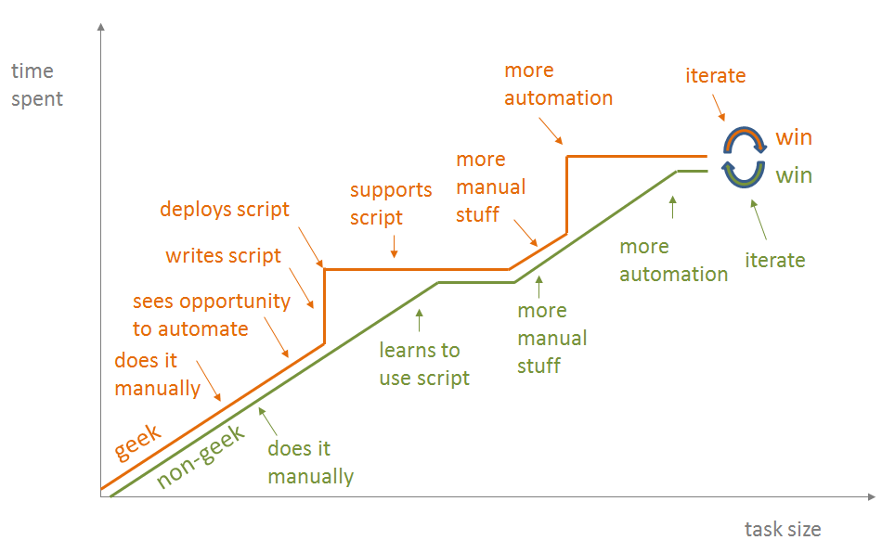
Automation
Notes:
All tasks that involve data manipulation can be done manually. You are here in this course because you feel like there is something wrong with that, there are some tasks that you can start automating and maybe some that you’ve already started automating that will save you time and allow you to do more with less time. You’re likely in the green line where you do a lot of manual stuff but have seen the win that comes out of either thinking about or doing stuff automatically. Our goal here today is to push you towards the orange line, where you can use tools to see opportunities to automate more tasks and also be able to execute those automations.

Slide 11
A preview of what’s to come…
Skills will vary and this is a build-up process
You will not learn everything you need to know in a two day workshop
We are a launchpad
Tips for success: Team up, ask questions, ask for help, stay positive, give feedback

Slide 12
Administrivia
Asking for help
Using the Web site(s)
Sticky notes: ok? Not ok?
Minute cards: at the end of every session, write down
One thing you learned
One thing you are confused about

