Slide 1
Git & Github Tutorial

Slide 2

Why do I need version control?
Reproducible research
Fast and efficient research

Slide 3
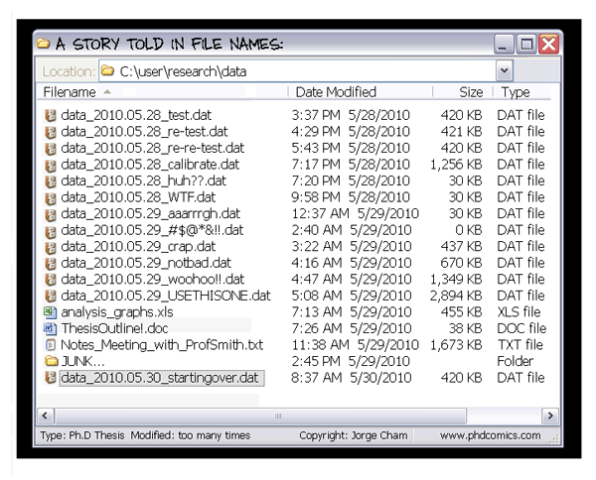
Is this your directory?
Jorge Cham, PhD comics

Slide 4
Version Control
Version control system:
keeps all the historical versions for easy tracking.
benefits team collaboration.
improves our efficiency.
can be used as a data center, which makes build automation possible.

Slide 5
Setting Up Git

Slide 6
Creating a project
Initializing a new project::
$ git init
Initializing from an existing project::
$ git clone https://github.com/adina/upenn-wise-git

Slide 7
Configuring Git
Locally: only the git repository you are working on will be affected:
$ git config [options]
User-wide: the user's default configuration will be modified in ~/.git/config:
$ git config --global [options]
Globally: system-wide configuration: all users are going to be affected::
$ git config --system [options]

Slide 8
Configuring Git
Your identity:
$ git config --global user.name "Your Name Comes Here”
$ git config --global user.email you@yourdomain.com
Setting your editor::
$ git config --global core.editor emacs
Checking your settings::
$ git config --list

Slide 9
Exercise
Clone the repository: https://github.com/adina/upenn-wise-git
Configure your git environment:
git config user.name "Your Name Comes Here"
git config user.email you@yourdomain.example.com
git config color.ui auto
Check your configuration settings by using
git config --list

Slide 10
Saving snapshots / versions

Slide 11
A few commands
git add: adds a file to the snapshot we want to take::
$ git add README
git commit: save all the files we added to the snapshots::
$ git commit -m "My commit message"
git status: show the status of the files of the repository
$ git log: show commit log

Slide 12
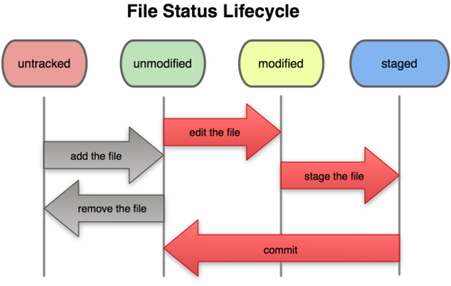
File stages
Tracked files: files that were in the last snapshots.
Untracked files: all the other files
Tracked files can be in 3 different states:
unmodified
modified
staged

Slide 13
Exercise
Create a new file AUTHORS and add it.
Check what the status of your repository is, by using git status.
Save the state of your repository with git commit
Now edit the AUTHORS file, and check the status of the repository.
Add this file and commit it.
Type git log in the repository. What do you see?

Slide 14
Removing and Deleting Files (under version control)
git rm: Removes files from the working tree::
git rm FILENAME
git mv: Move or rename a file or a directory::
git mv FILENAME TARGET

Slide 15
Exercise
Rename the file AUTHORS to CONTRIBUTORS using git mv
Now delete this file (don't forget to commit your changes).
Use git log to see the history of the repository.

Slide 16
Undo’s
git reset HEAD: unstages filename::
$ git reset HEAD filename
$ git reset --soft HEAD^: uncommits the last commit
git checkout: unmodifies an unstaged file
$ git checkout -- filename1 filename2

Slide 17
Exercise (1 / 2)
Create a TODO file, and add it to the staging area.
Remove this file from the staging area.
Create a python script, e.g., called power.py with the following code in it:
def power(x):
return x ** 2
Add this to the staging area and commit it.

Slide 18
Exercise (2/2)
Now edit it again, and add the following function to the bottom of the file:
def square_root(x):
return np.sqrt(x)
Use git checkout to remove the changes you've made to this file. You can check what you have done using git status.

Slide 19
Branching

Slide 20
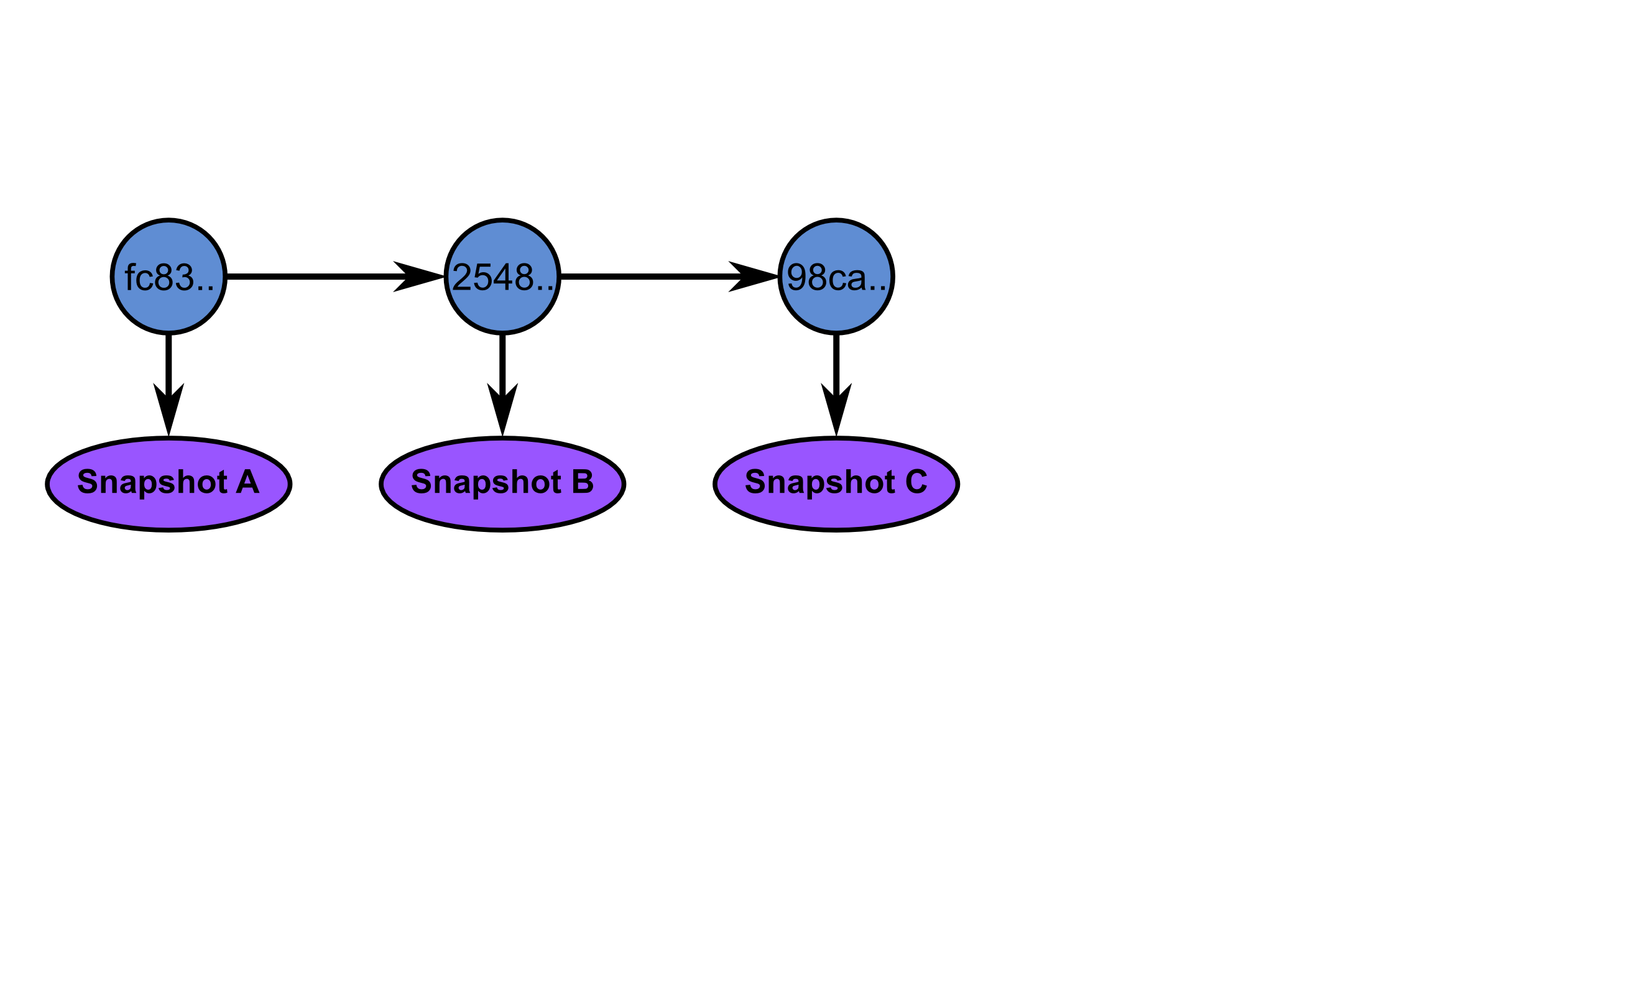
Commits are repository snapshots

Slide 21
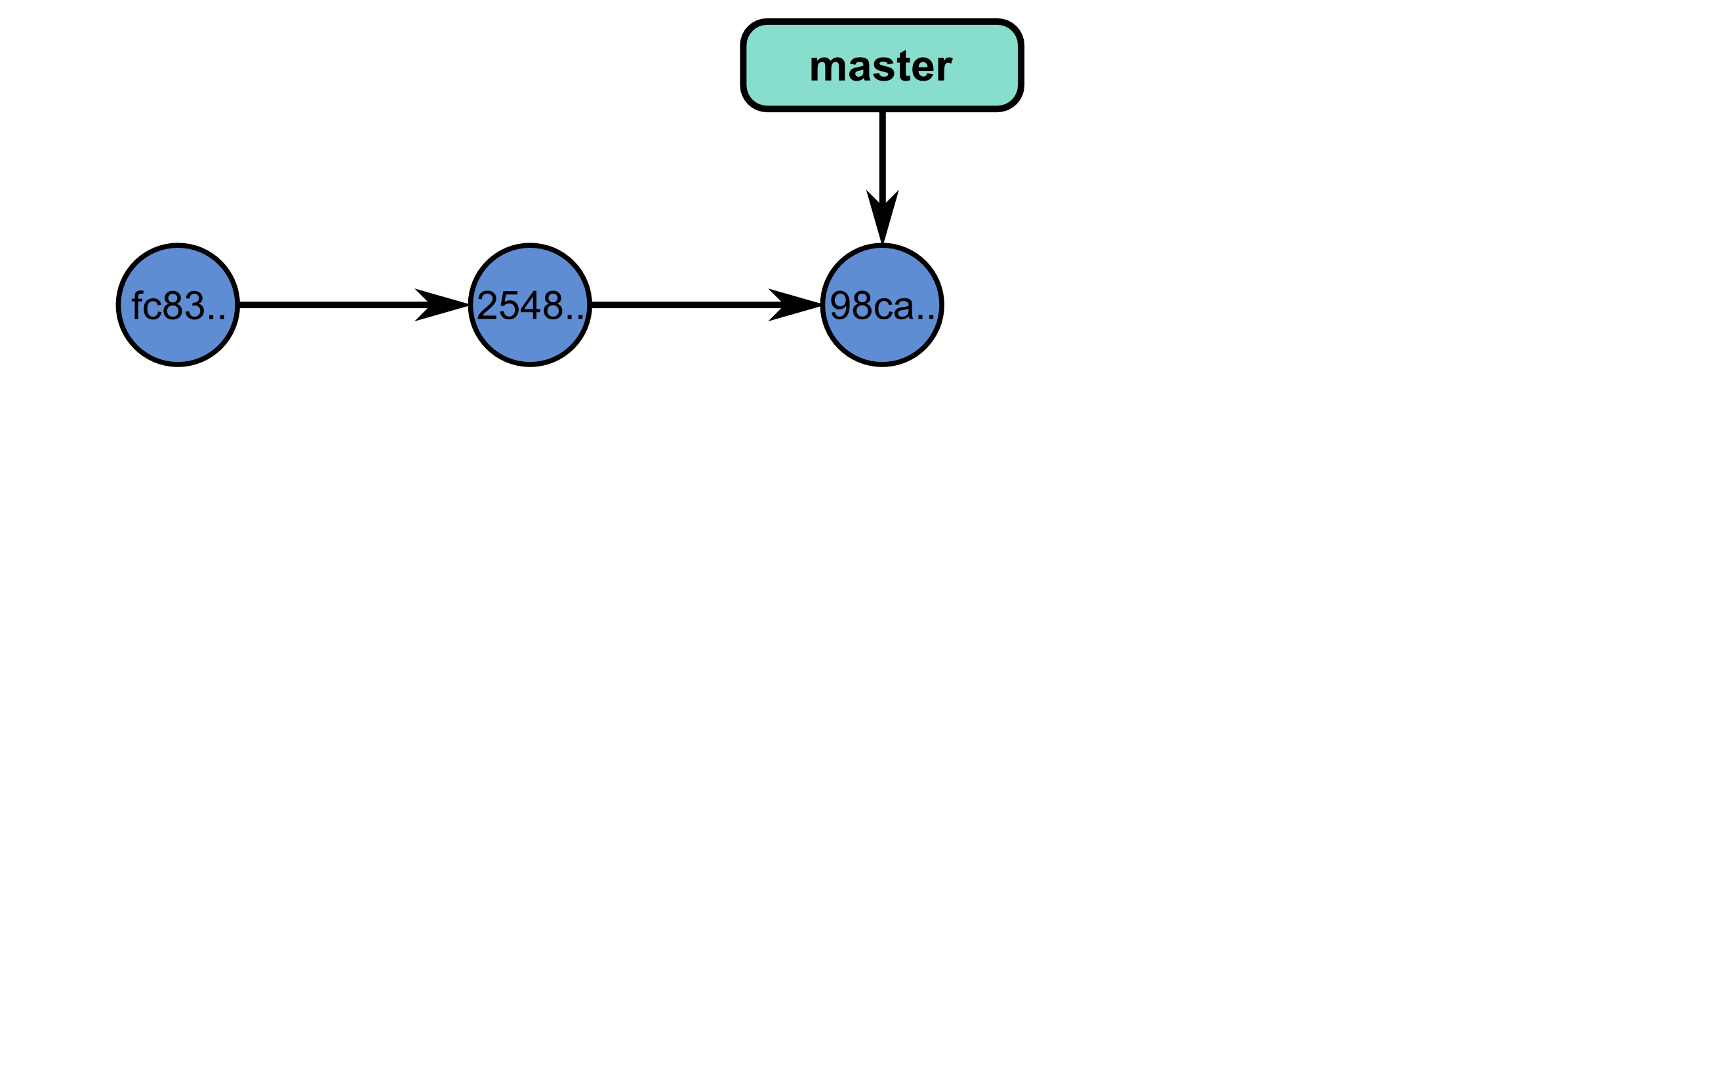
A branch is a pointer to a commit.

Slide 22
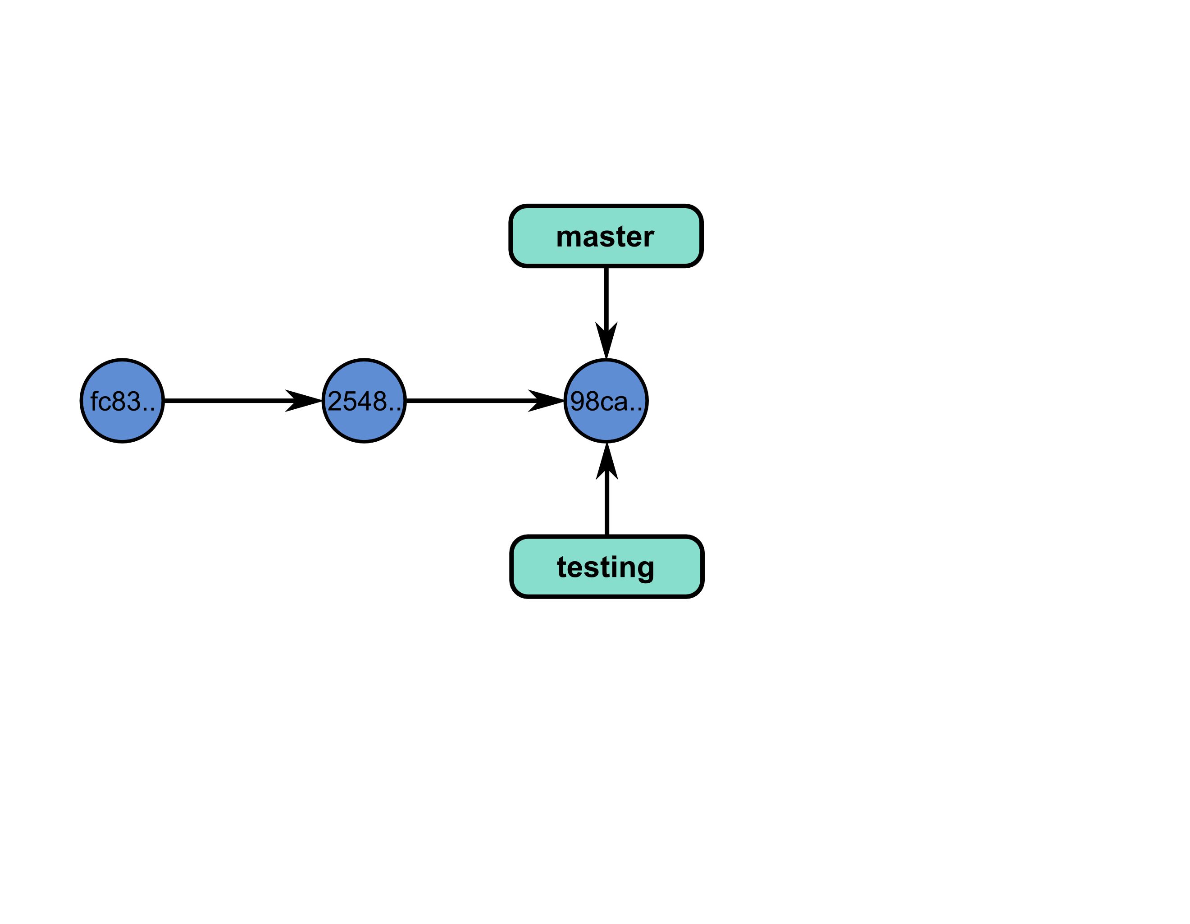
So you can have multiple branches.

Slide 23
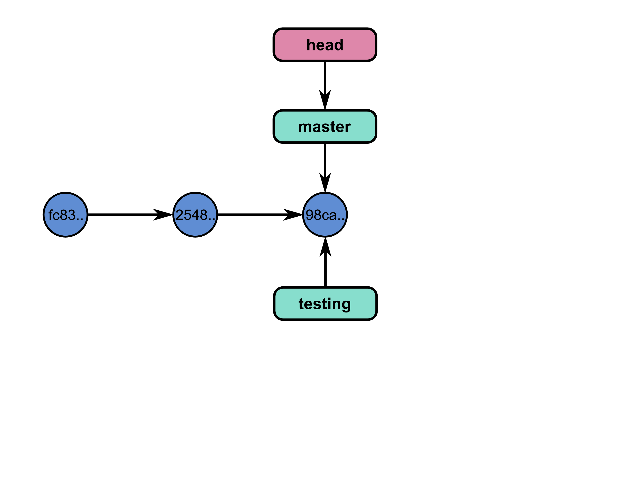
What branch are you on?

Slide 24
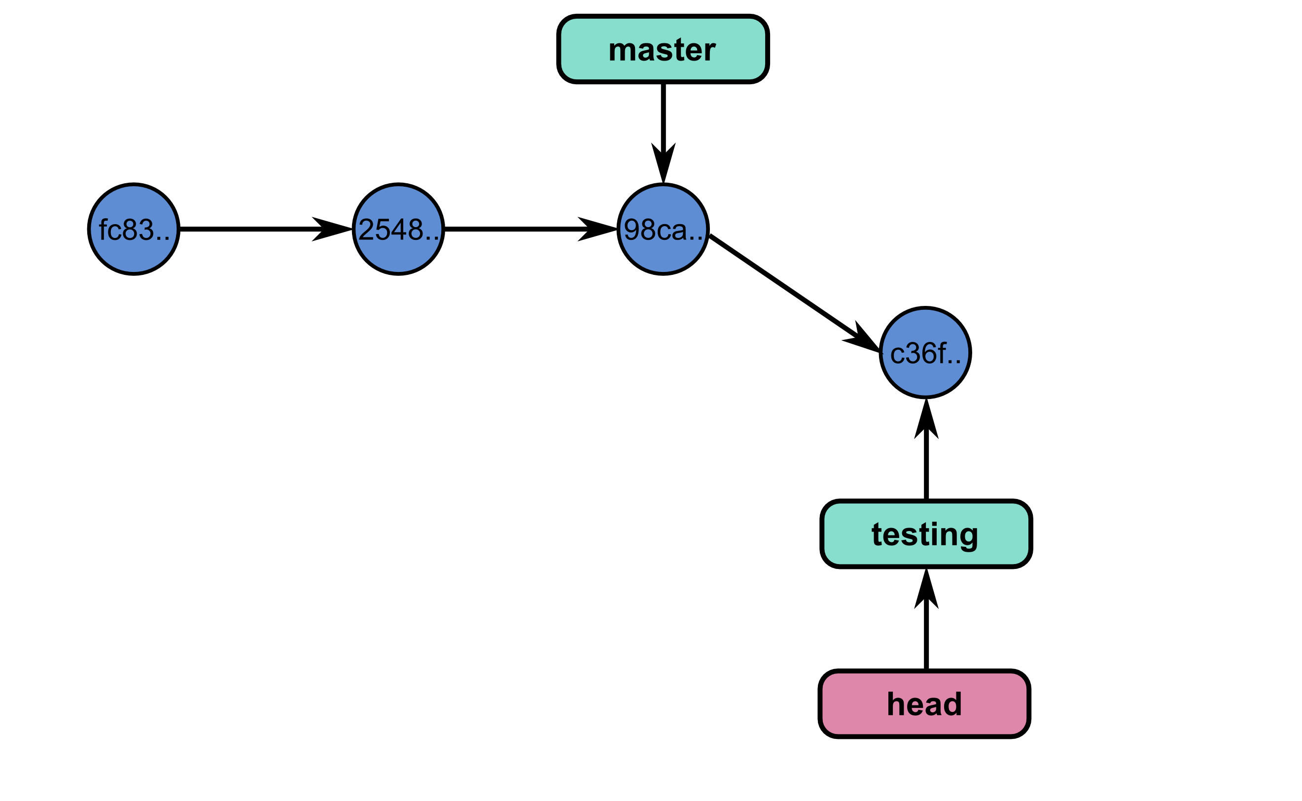
So you can commit on that branch.

Slide 25
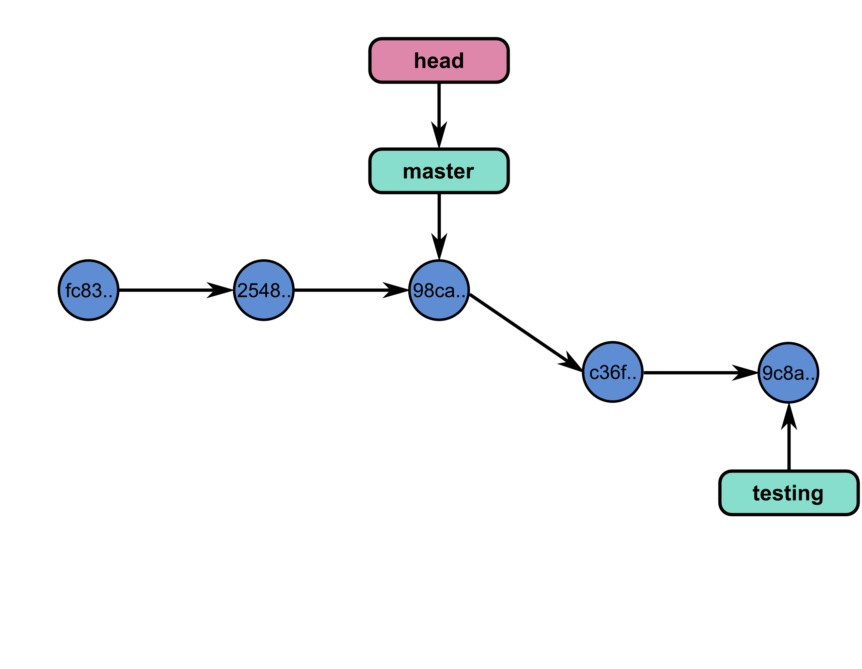
And even one more time.

Slide 26
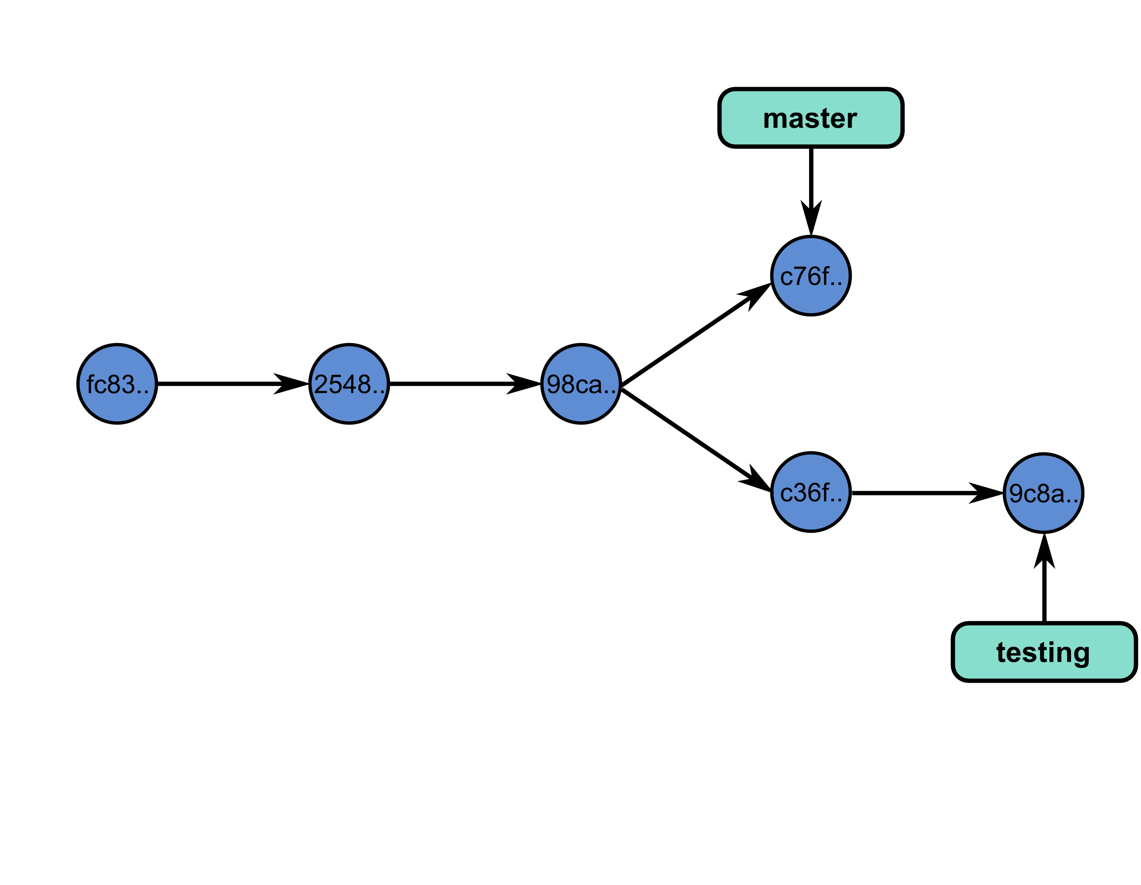
But sometimes the code diverges…

Slide 27
Commands
git branch: manages branches
git branch: lists the branches of the local repository
git branch [branch_name]: creates a branch
git branch -d [branch_name]: deletes a branch
git checkout: moves to a branch:
git checkout [branch_name]: moves to a branch
git checkout -b [branch_name]: creates and moves to the branch branch_name

Slide 28
Exercise
Create a new branch development, using git branch development.
Switch to that branch.
Check in which branch you are using git branch.
Create a python script that prints the first 10 integers, and commit it.
Look at the history of your repository.
Switch to the branch master, and look again at the history. What do you see?

Slide 29
Merging

Slide 30
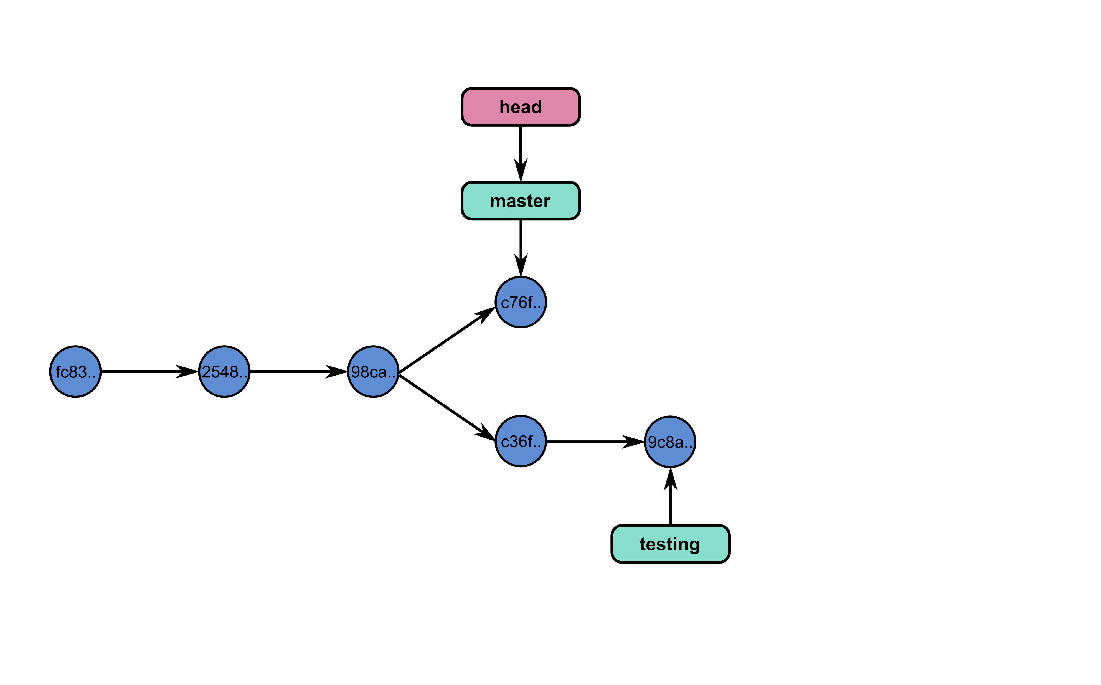
A Tale of Two Branches

Slide 31
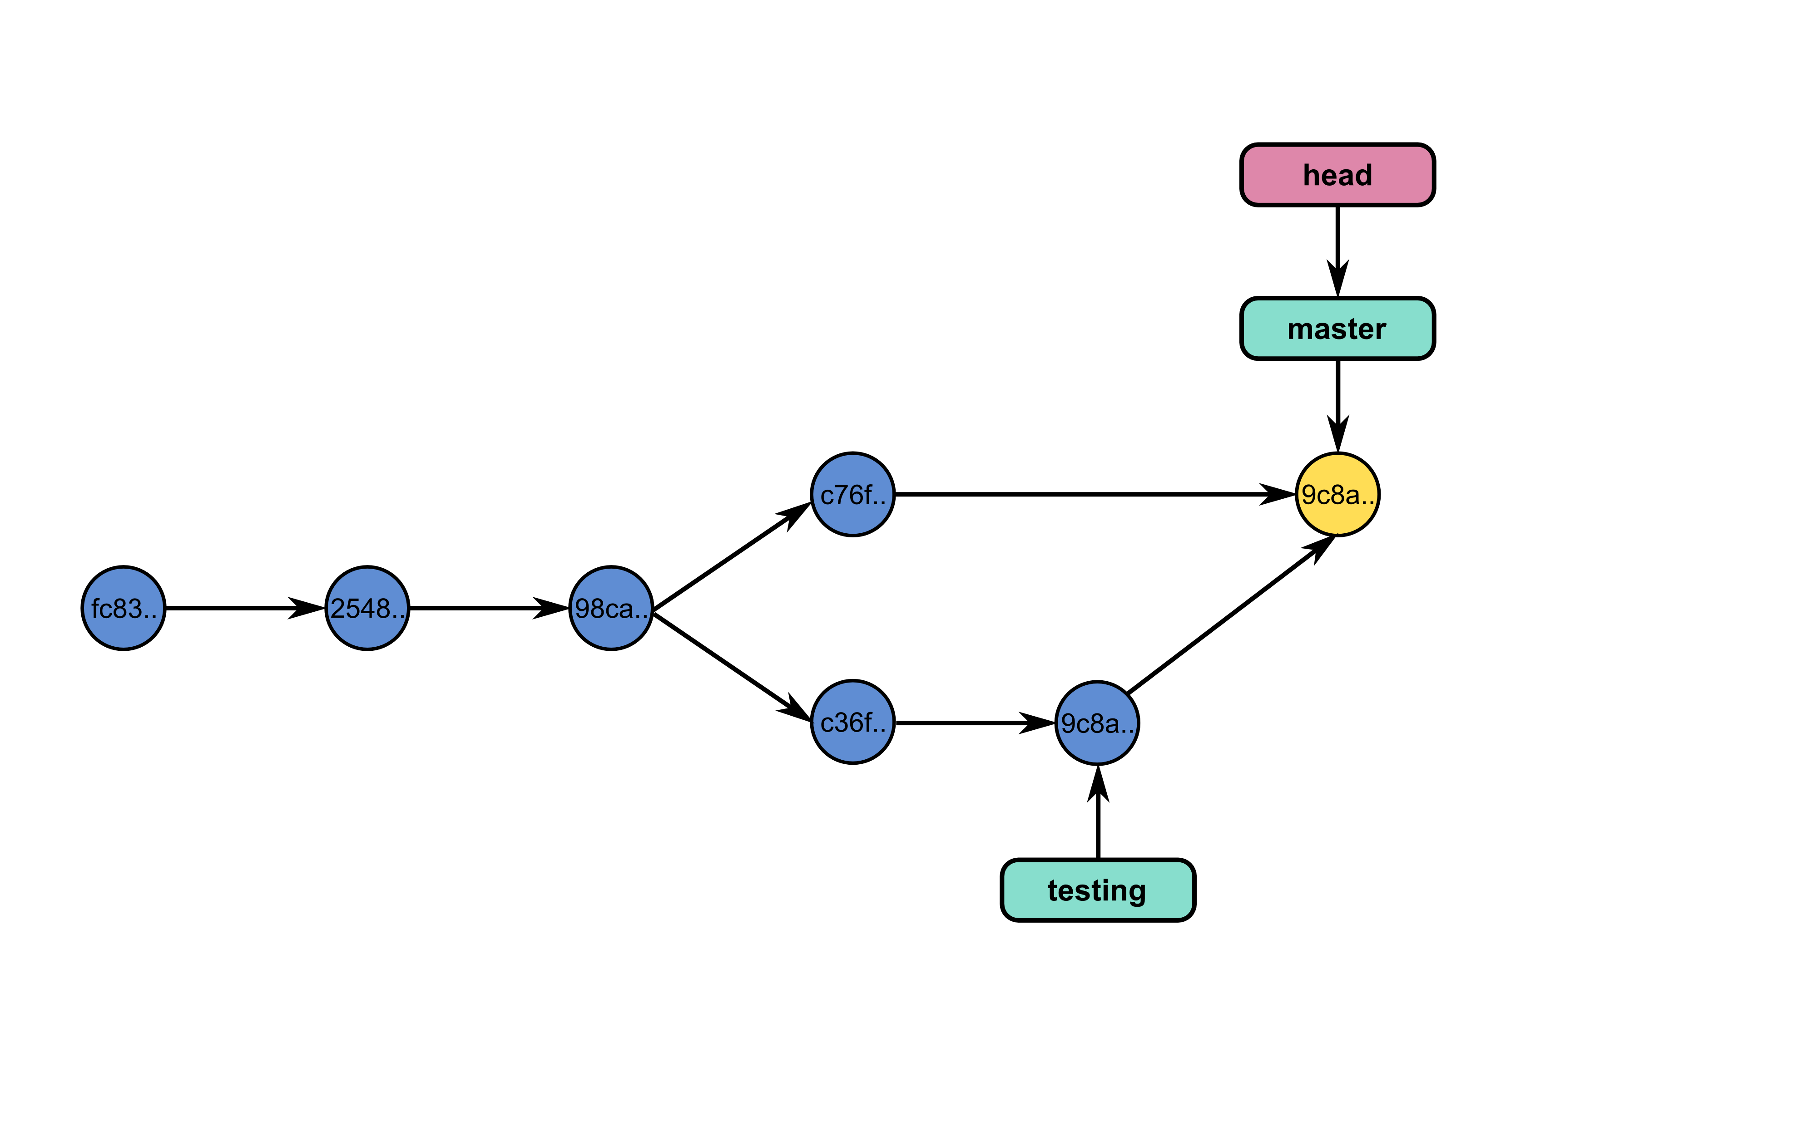
Let’s merge these branches.

Slide 32
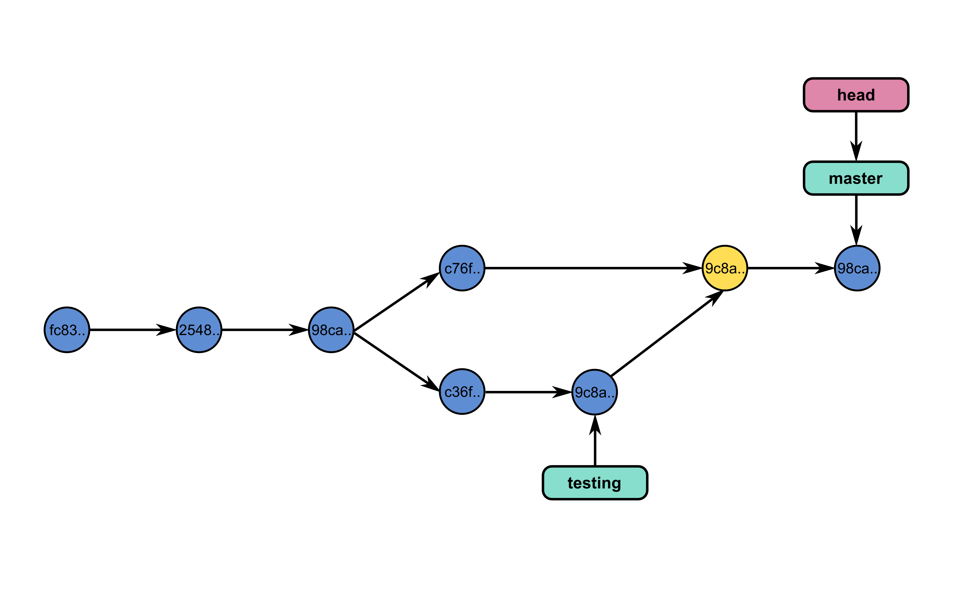
And continue working…

Slide 33
Commands
git merge - join developments history together
git merge [branch_name]: merges [branch_name] onto current branch

Slide 34
Dealing with conflicts
When a conflict emerges, you must manually edit the files:
<<<<<<< HEAD:calc.py
print 'the average is', sum(x) / float(len(x))
print 'sumsqdiffs is', sum(diffs)
=======
avg = sum(x) / float(len(x))
sumsqdiffs = sum(diffs) / float(len(x))
print 'average is', avg, 'and sumsqdiffs is', sumsqdiffs
>>>>>>> edgier:calc.py

Slide 35
Undo a MERGE or PULL
git reset --hard HEAD: if you tried to pull or merge, and it resulted in a lot of conflicts you don't want to deal with.
git reset --hard ORIG_HEAD : you merged a branch which resulted in a fast forward, and you want to cancel it.

Slide 36
Exercise
Try deleting branch development using git branch -d development. What do you see ?
Merge the changes of branch development in master.
Try to delete the branch development once again.

Slide 37
Working with a server (or GitHub)

Slide 38
Remote repositories
Remote repositories are versions of your project that are hosted on the Internet or network somewhere.
git remote lists the remote servers you have configured. Tip: For more verbosity, add -v option.
git remote add name url: adds the url as a remote
git remote rm name: remove the remote name

Slide 39


Slide 40
Updating a repository
git fetch [remote-name]: fetches the branches on the remote. The branches from that remote are then accessible locally in [remote-name/branch-name]
git push [remote-name] [branch-name]: pushed [branch-name] onto remote [branch-name]
git merge [branch-name]: merges [branch-name] into the current branch

Slide 41
Exercise - Partnered
Create a github project (Do not make a README file)
Add the url of the project as a remote called origin.
Push your changes to github: git push origin master
Check on github that you have indeed pushed your changes.
Create a branch on your local repo. Make a change by adding a title or new line. Add & commit & push. (git push origin branchname)
Check out the changes on github.
Merge changes on your master branch.

