Slide 1
Practical Bioinformatics Community structure measures for meta-genomics
István Albert
Bioinformatics Consulting Center Penn State

Slide 2
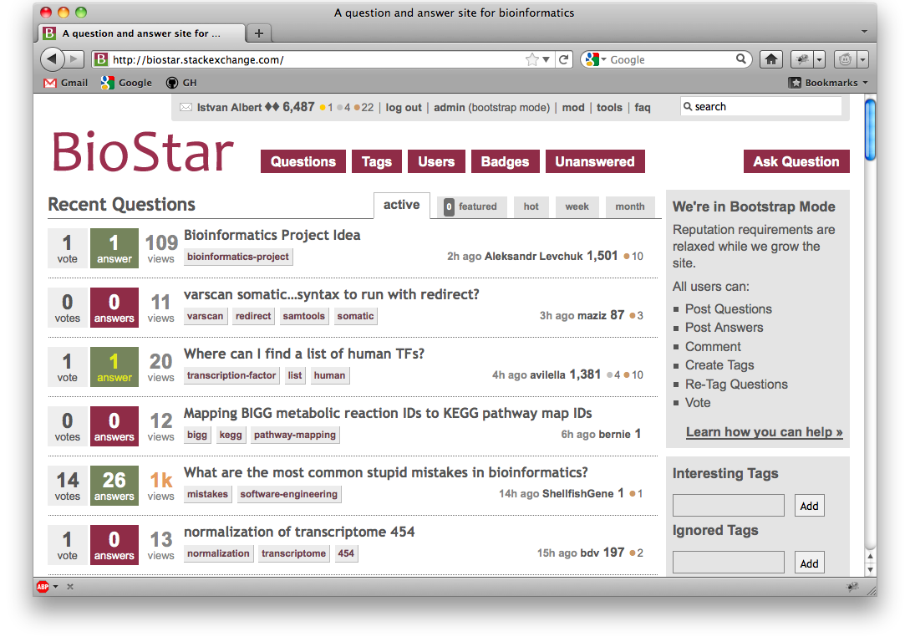
BioStar: http://www.biostars.org
Question and Answer site for Bioinformatics

Slide 3
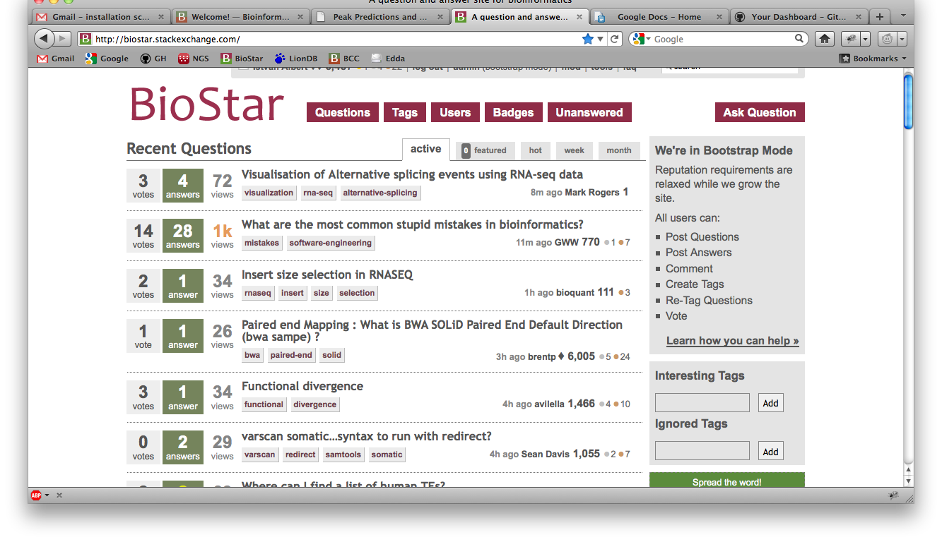

Slide 4
Holistic data analysis
Try to lay out all steps first – worry about parameter settings later – knowing what the data looks like
Too much planning is actually detrimental
So is fretting about the details
Start with the end result → I’d like to have my data laid out as a …

Slide 5


Slide 6
Topic: metagenomics
the majority of microbial biodiversity cannot be captured by cultivation based methods
metagenomics = the study of genetic materials recovered from environmental samples

Slide 7
Increased complexity
We’re interested in the bacterial species (memberships) present in the colonies
Also interested in the relative abundances between these species
We need to detect changes → we need to compare two bacterial communities

Slide 8
16S ribosomal protein
highly conserved between different species of bacteria and archaea
whereas the rest of genetic content varies greatly across species
16S RNA can be used for taxonomical classification

Slide 9
Two widely used approaches
Classifying sequences:
by their similarity to reference sequences (phylotyping)
by their similarity to other sequences in the sample (operations taxonomic units → OTU)

Slide 10
Taxonomy
Placing a bacteria into a taxonomy is difficult
Several competing groups – each maintain a separate taxonomical database
Three widely used curated taxonomy outlines that contain significant conflicts with each other

Slide 11
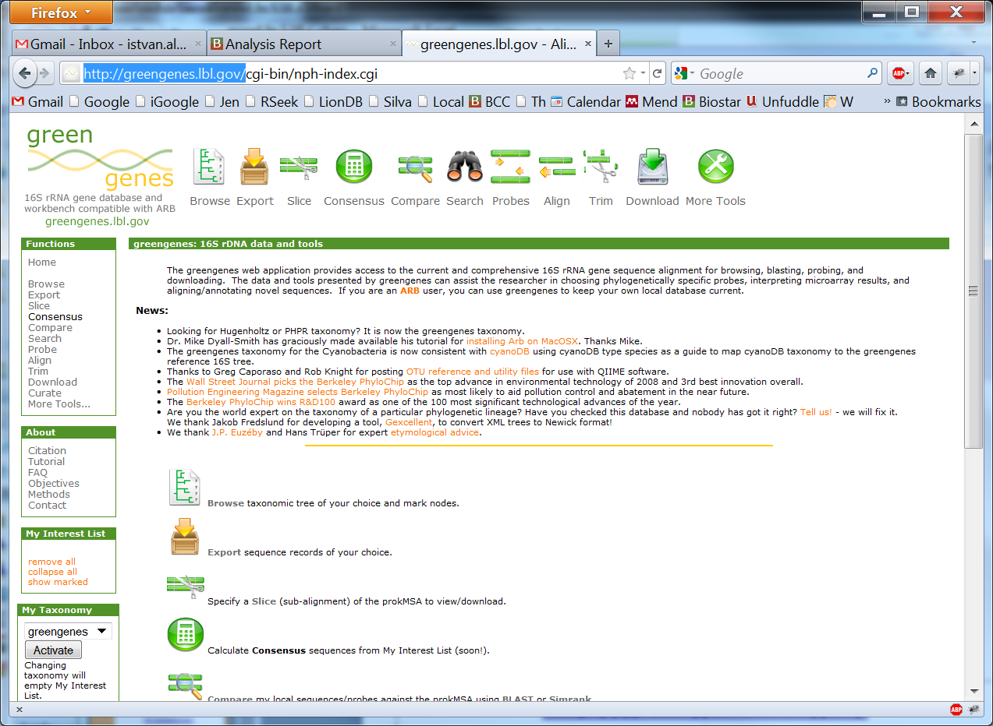
Greengenes
http://greengenes.lbl.gov/

Slide 12
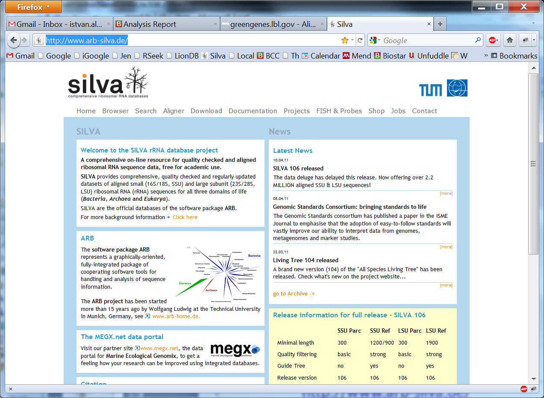
SILVA
http://www.arb-silva.de/

Slide 13
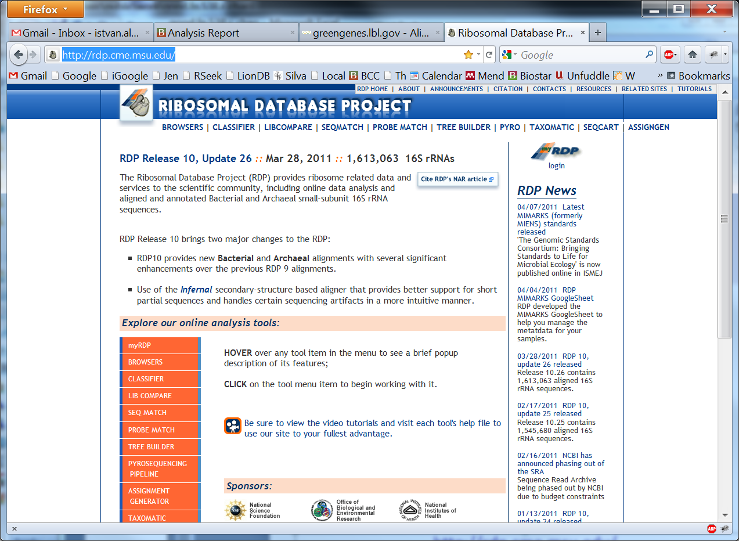
RDP
http://rdp.cme.msu.edu/

Slide 14
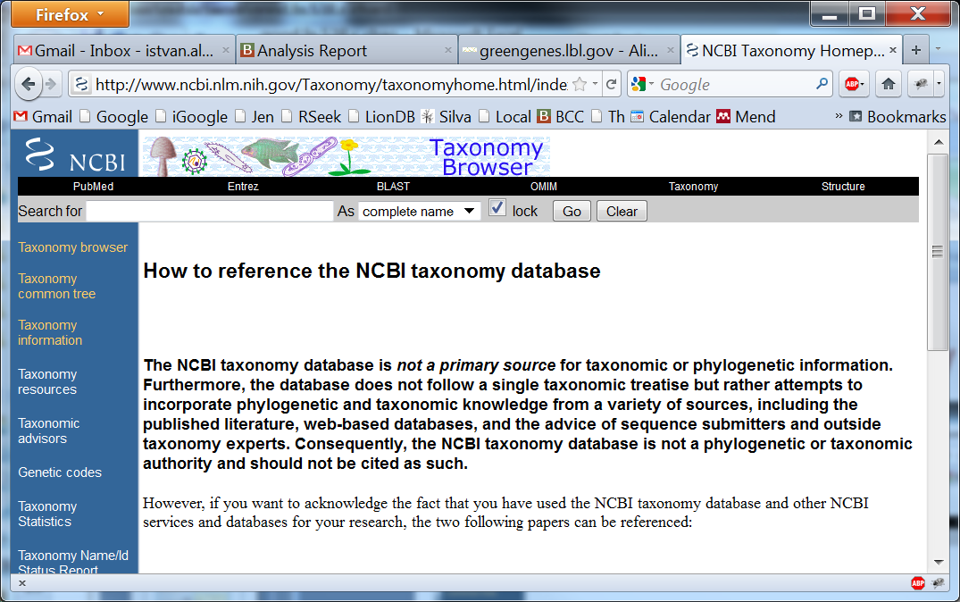
NCBI taxonomy

Slide 15
One common phylotyping workflow
Run the blast aligners with the reads against the NCBI bacterial database (can be very time consuming)
Use MEGAN – Metagenome Analyzer to process the results

Slide 16
For 16S RNA there is faster way
Align against a hand curated, prealigned representative selection (NAST algorithm).
This needs far fewer resources

Slide 17
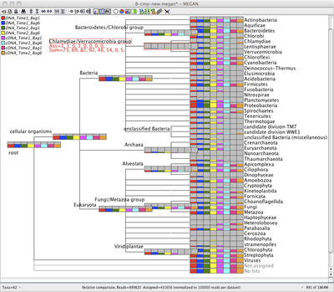
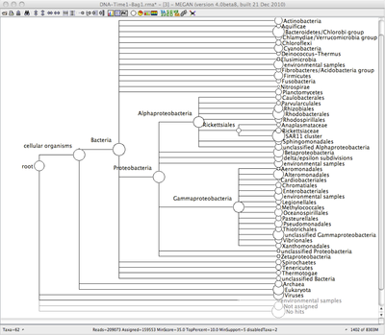
MEGAN
http://ab.inf.uni-tuebingen.de/software/megan/
Graphical user interface – nice visualizations

Slide 18
Pitfalls in phyloytping approaches
The advantage of a phylotype based methods is that it places a label onto each sequence
Yet the same species may have very different phenotypes
Same phenotypes may actually belong to different lineages
Nonetheless overall it works well for taxonomical classification

Slide 19
OTU based approaches
Clustering based – sequences are clustered by their similarity (must be conserved regions 16S RNA)
We (YOU) choose a percent similarity level that can range from 0 → 100% at which to merge sequences

Slide 20
Pitfalls of OTU based approaches
No consistent method for converting between the thresholds used to define OTUs and taxonomic levels
The distances within a taxonomic group are not evenly distributed
Clustering is computationally intensive

Slide 21
The methods are slowly merging
Phylotyping software get more OTU based functionality
OTU based software get more phylotyping functionality

Slide 22
The mothur package
Primarily OTU based but it has phylotyping functionality built in
http://www.mothur.org/
Exceedingly well documented
with binaries for every platform
download it for your computer

Slide 23
Comparing bacterial communities: A and B
We always have an incomplete sample of a large community
What is the overlap between A and B
Is B a subset of A?
If membership of A and B are identical are their abundances the same?
What if A was sampled at a higher ratio than B

Slide 24
OTU based calculators for single communities
Each calculator gives us a small window into one particular property of the dataset
Community richness
Community evenness
Community diversity
OTU number extrapolation

Slide 25
OTU based calculators for multiple communities
Shared community richness
Similarity in community membership
Similarity in community structure

Slide 26

Community richness – alpha diversity
Chao estimator
Based on what we see how many microbes are really there
Many other estimators: ACE, jackknife etc

Slide 27

Community diversity – dominance
Berger-Parker index
largest abundance / total number of individuals
Many other estimators: Simpson, Shannon etc

Slide 28
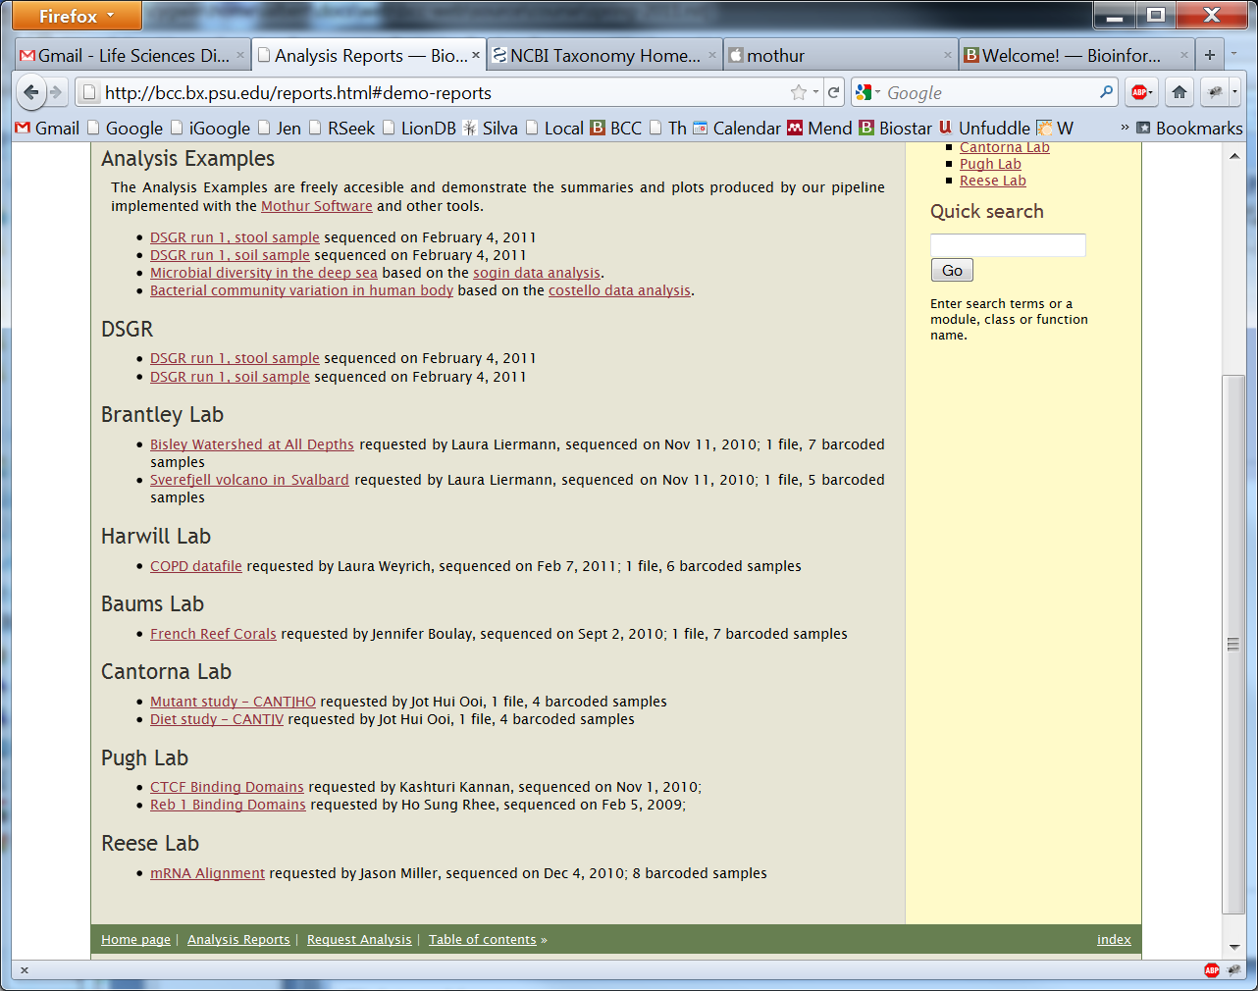
http://bcc.bx.psu.edu/ → Analysis Examples

Slide 29
Running through an example
Requirements:
Use the datasets in day7/meta
The mothur software is installed in: day7/meta/mothur
Run it as: ./mothur
If you are having trouble accessing it copy the mothur executable next to the data

Slide 30
Example dataset
From the paper:
"Microbial diversity in the deep sea and the underexplored 'rare biosphere‘”, PNAS, 2006
The first to use pyrosequencing technology to sequence 16S rRNA gene tags.

Slide 31
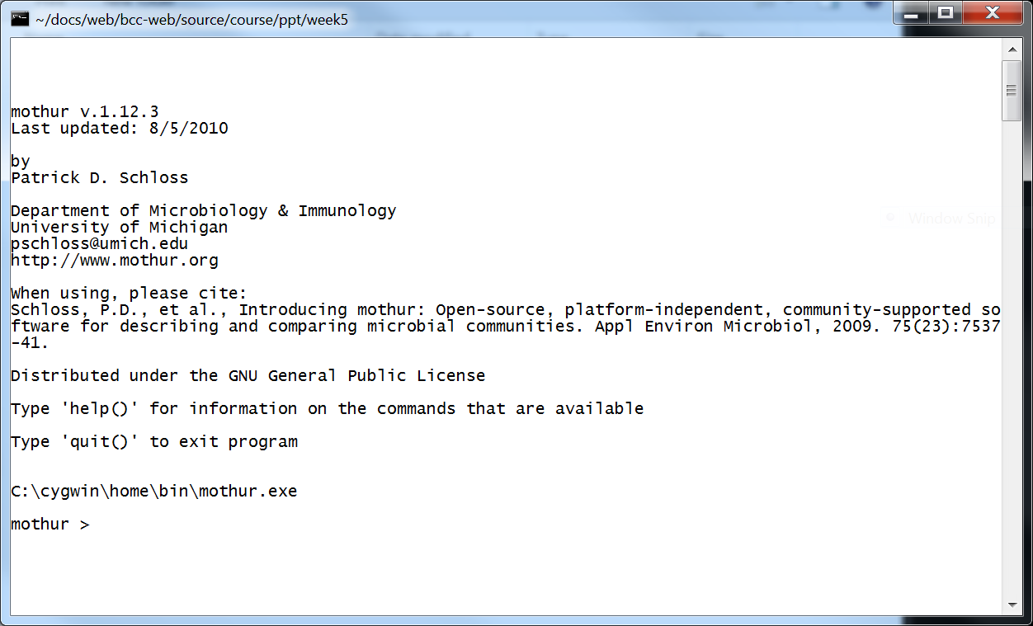
mothur command line (a bit like R)
You can type commands into mothur even better create a text file with commands and run those commands with mothur

Slide 32
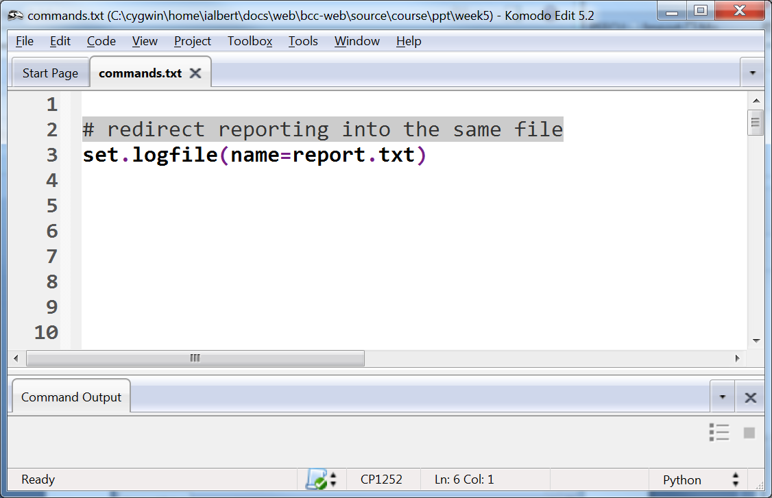
All commands generate a log that you can look at later. This command redirects the log in to a know file. Note the command structure.

Slide 33
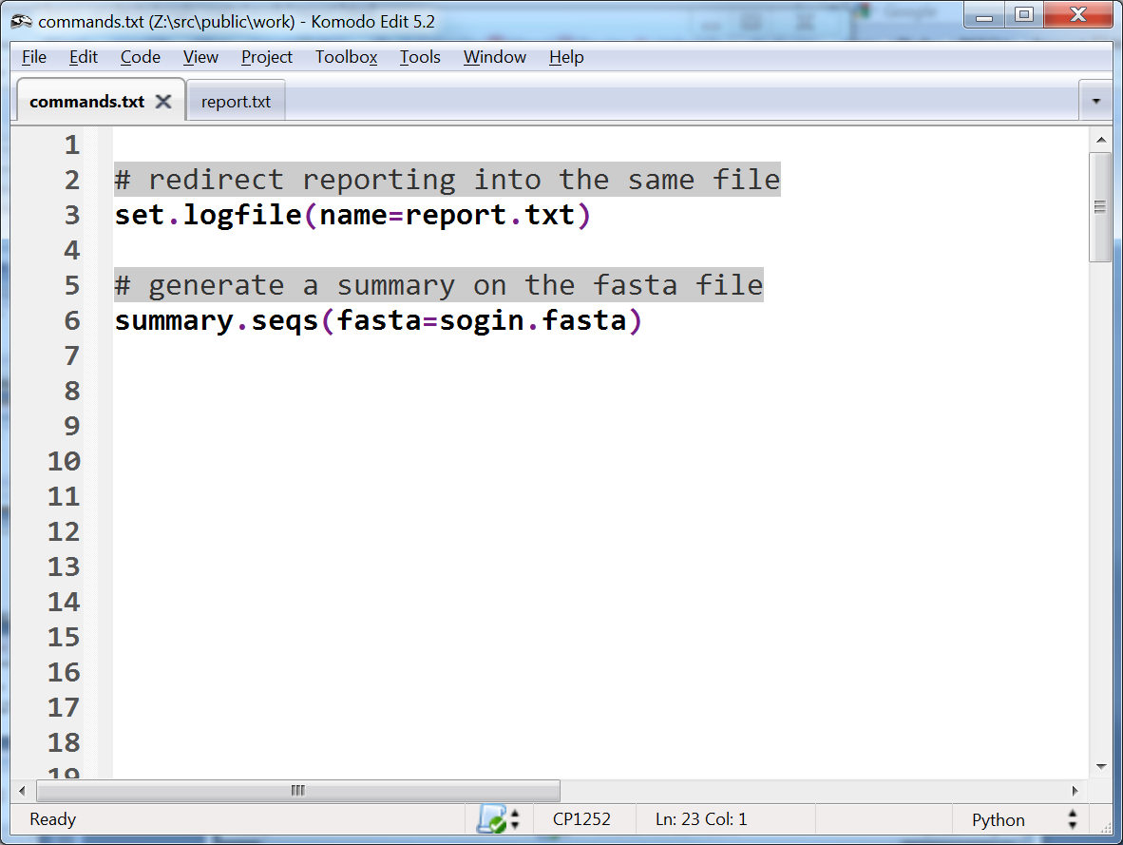

Slide 34
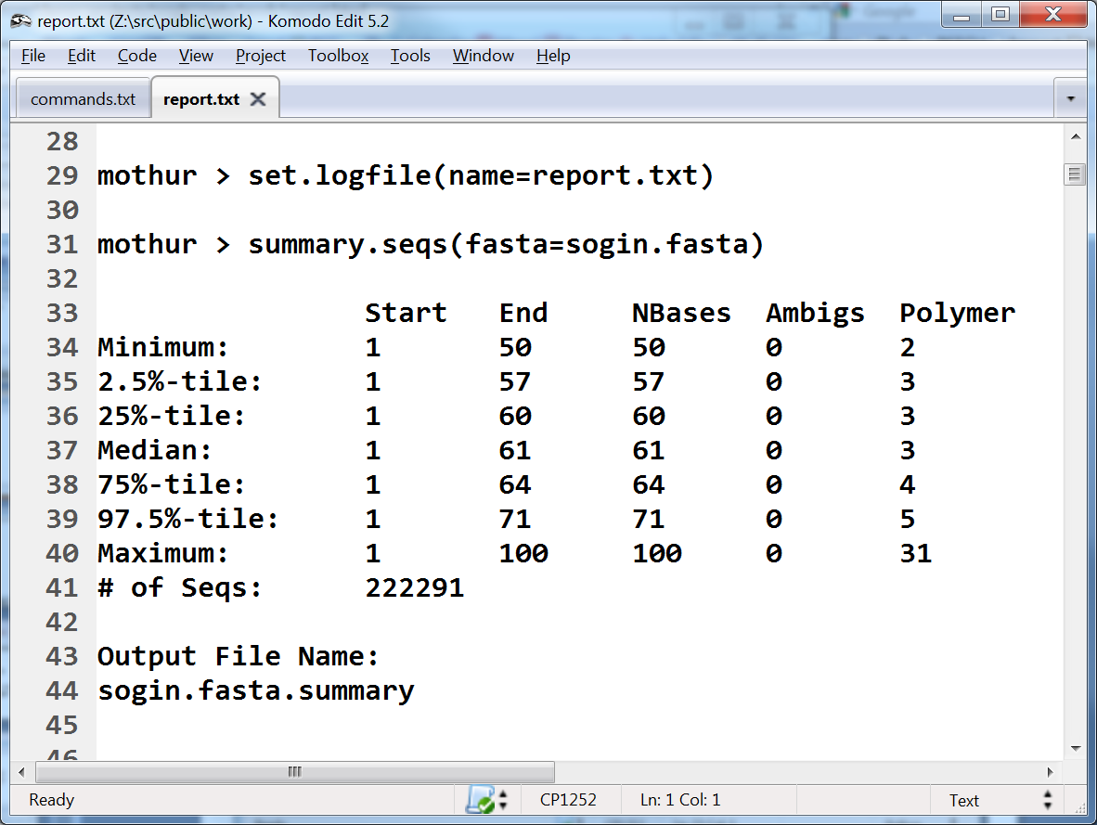

Slide 35
The way mothur works
Commands generate a readable output to the screen
The same output goes to the log file
Each command usually creates one or more result files that we can either load in later stages or plot (analyze)

Slide 36
Quality filtering
We skip this step since the data is published and is quality filtered (and the authors did not provide the original sequence quality data)
See the trim.seq command

Slide 37
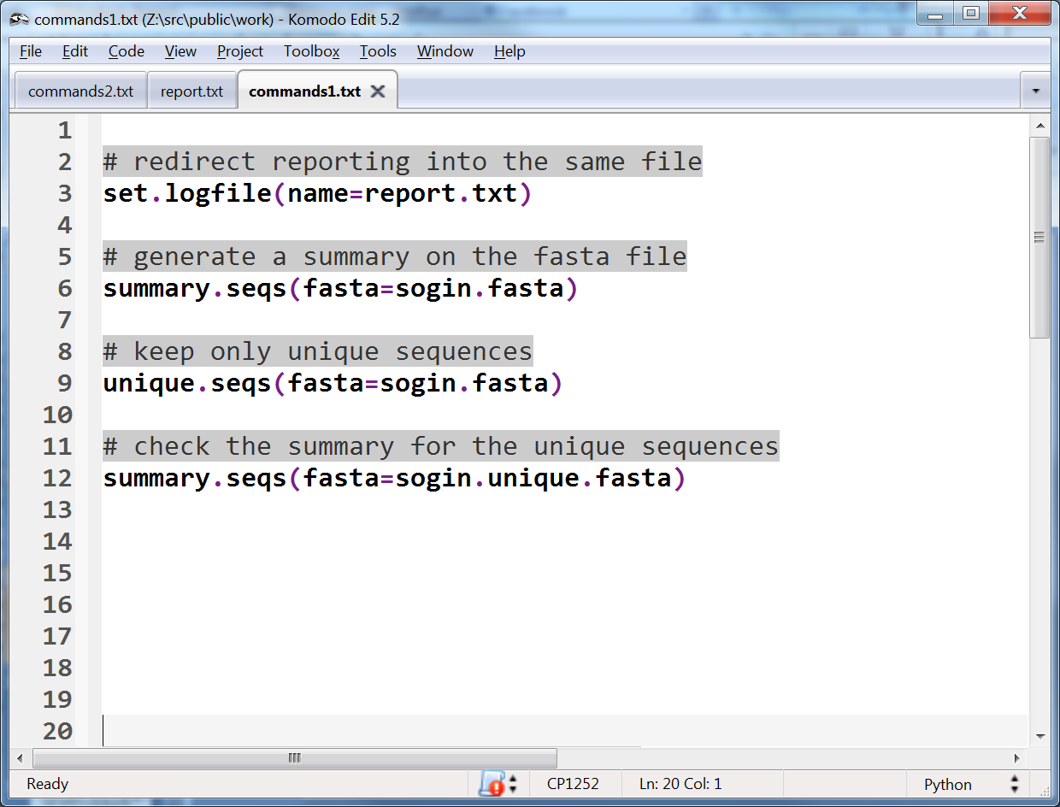
Work on unique sequences - mothur will keep track how many times a sequence was seen

Slide 38
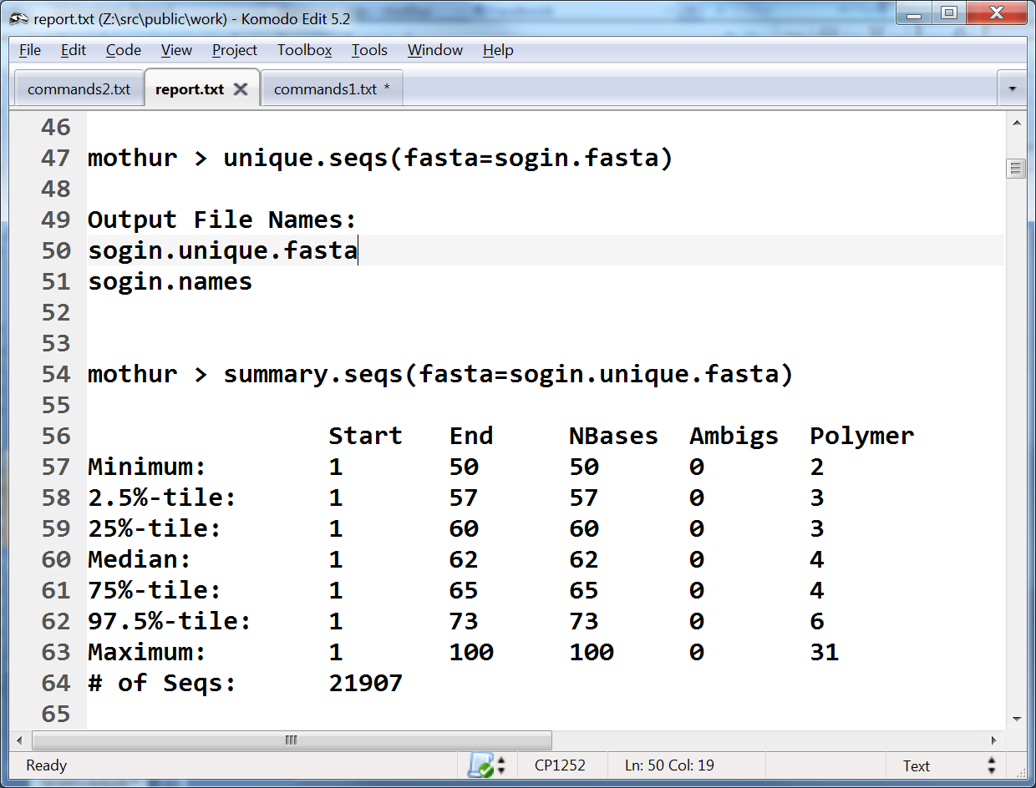
compare to the value before

Slide 39
We skipping a few steps that are not suited for in class exercise
Running the alignments, distances and clustering
The following slides show the commands but we should not do them in class as it may take a while.
The dist folder contains this precomputed dataset
Check the content of the commands1.txt and commands2.txt to see all the commands
We also renamed sogin. unique.filter.fasta --> to good.fasta

Slide 40
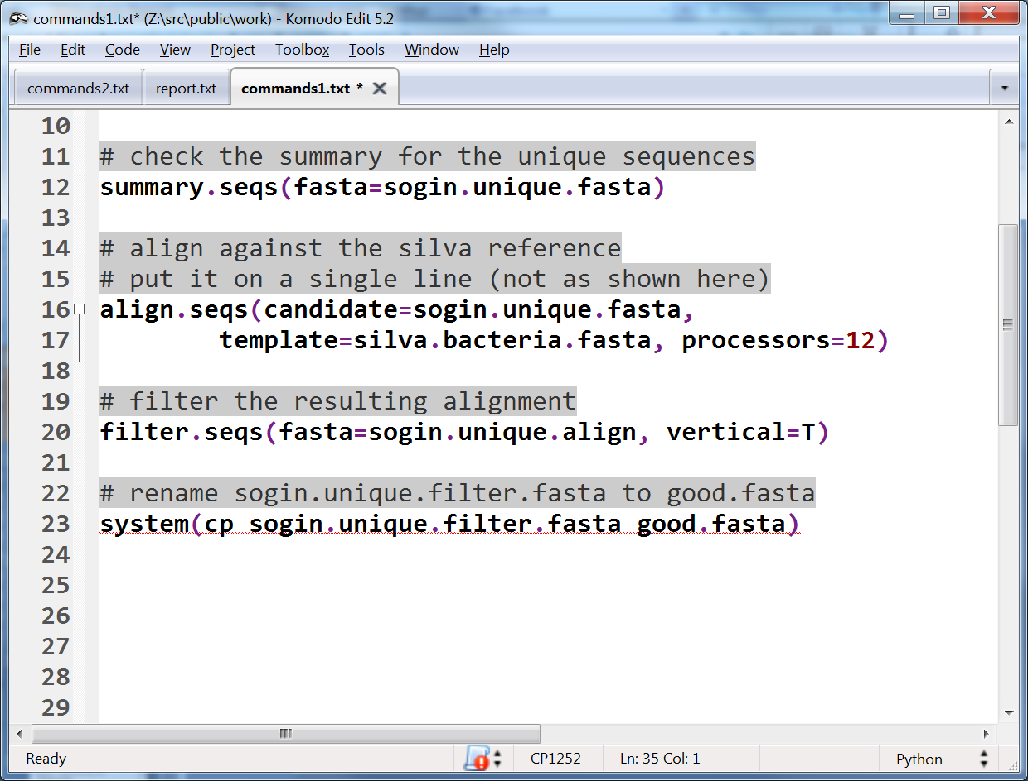
For this you need the silva reference files → 800MB
This can take a bit more - depending on you computer and number of processors - with a very fast computer with 12 processors it took about five minutes

Slide 41
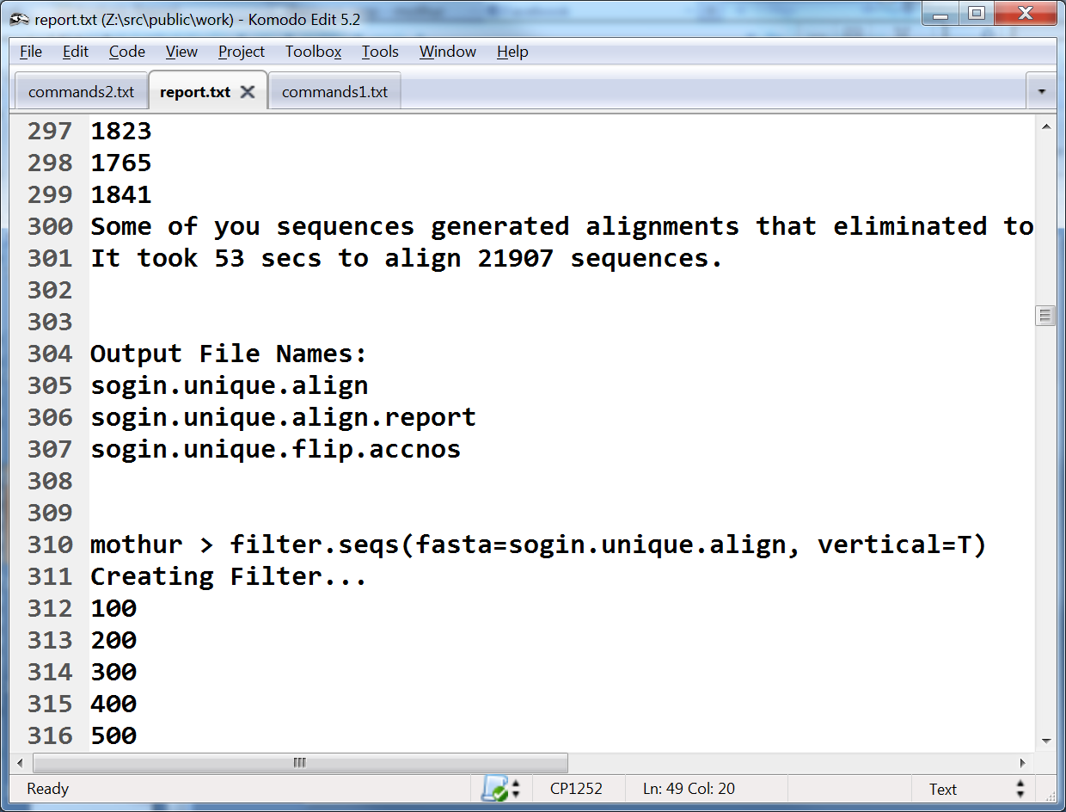

Slide 42
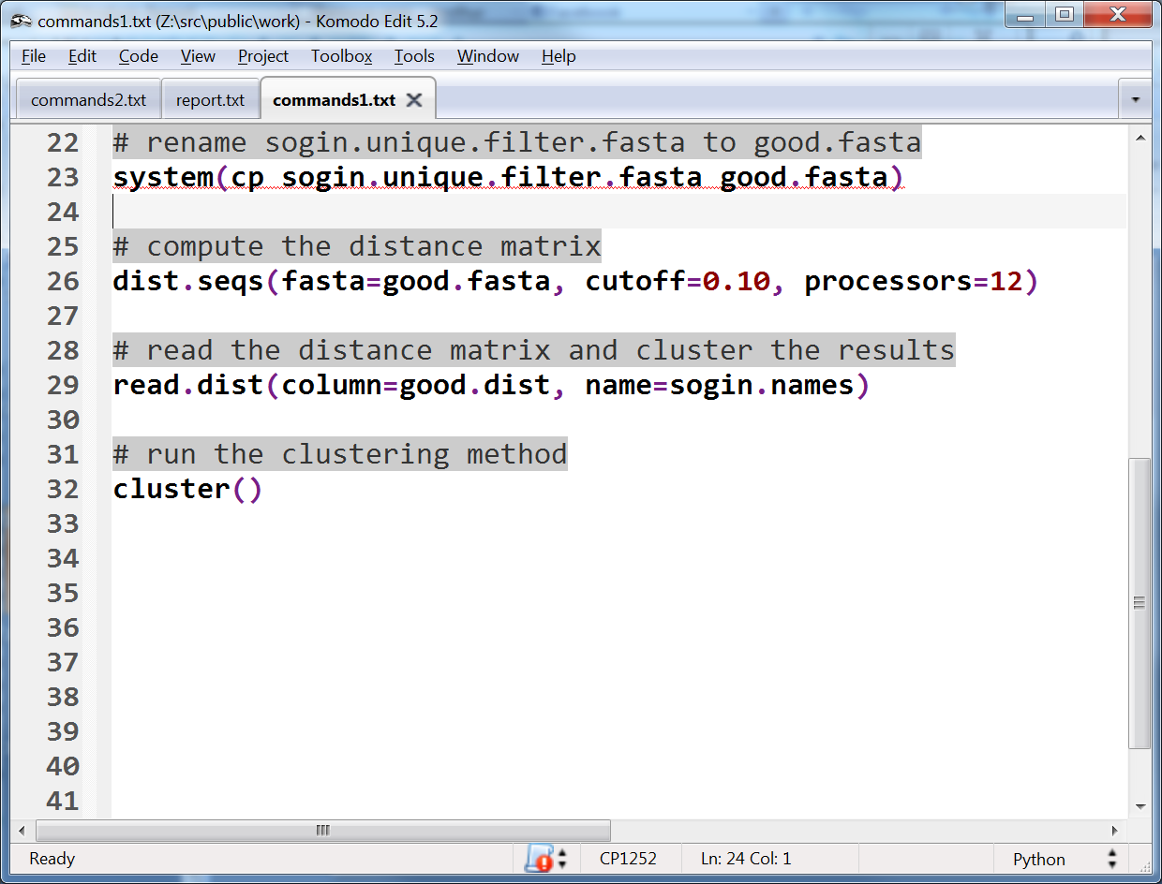
As a result we compute the similarity matrix that interrelates all sequences

Slide 43
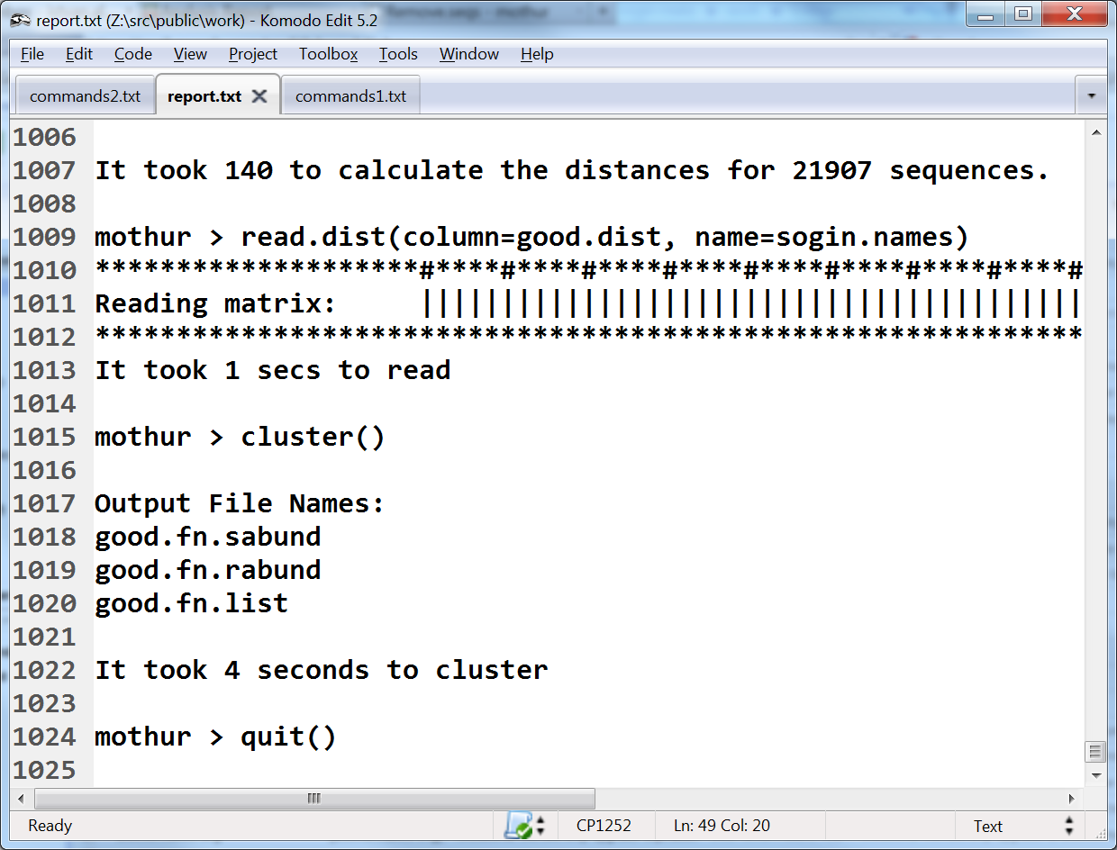
We can now head onto doing analysis

Slide 44
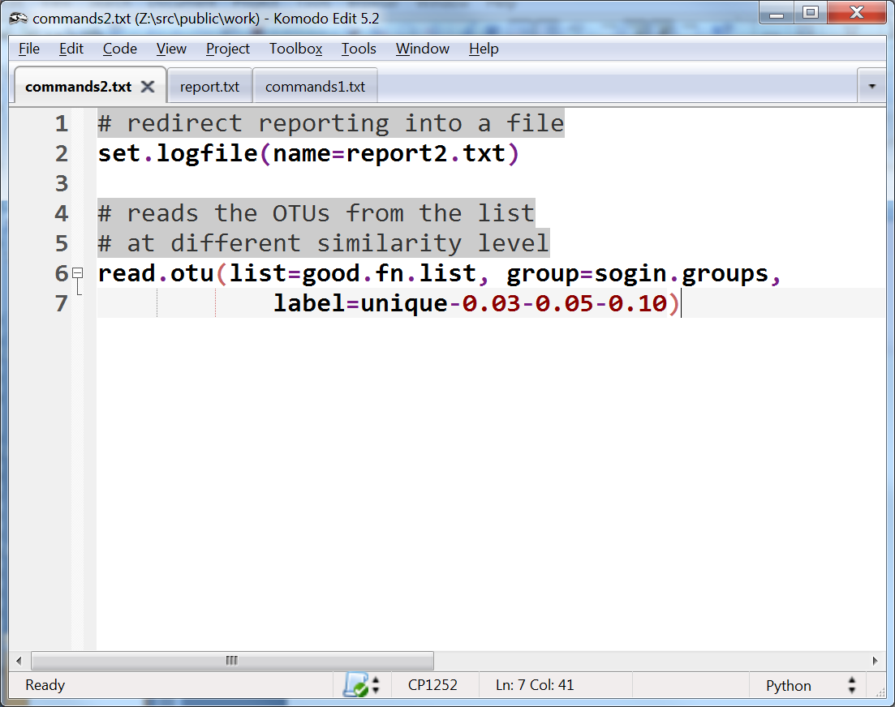
Rarefaction curves

Slide 45
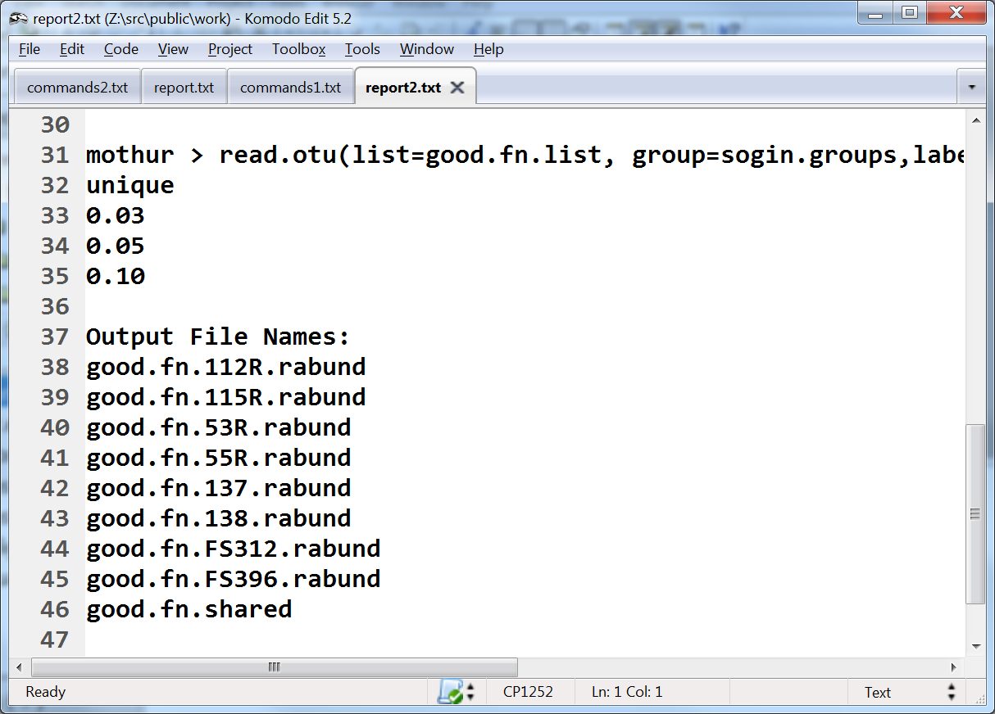
A separate outputfile for each group

Slide 46
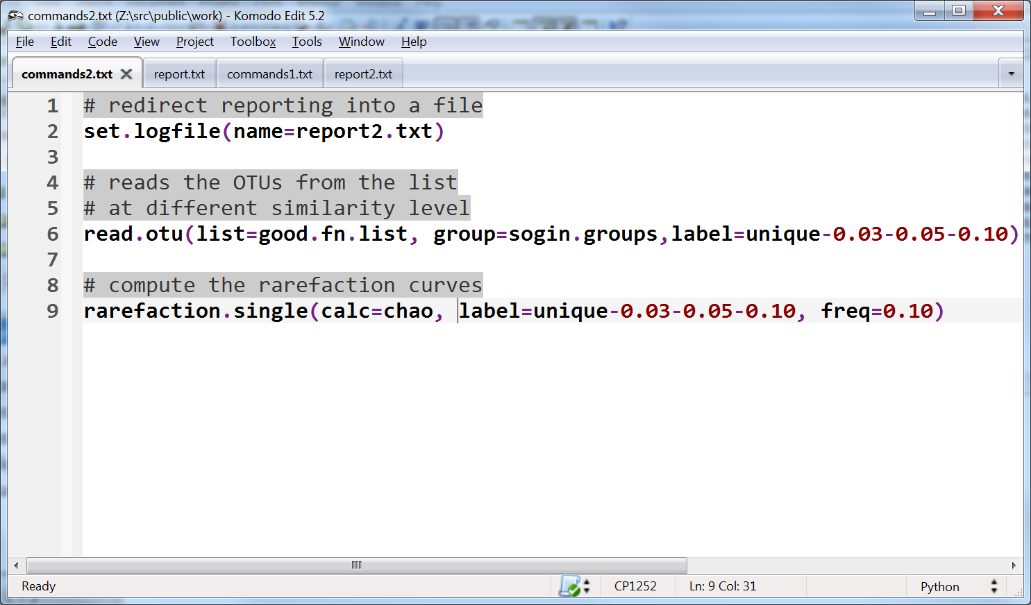
Generate the rarefaction curves

Slide 47
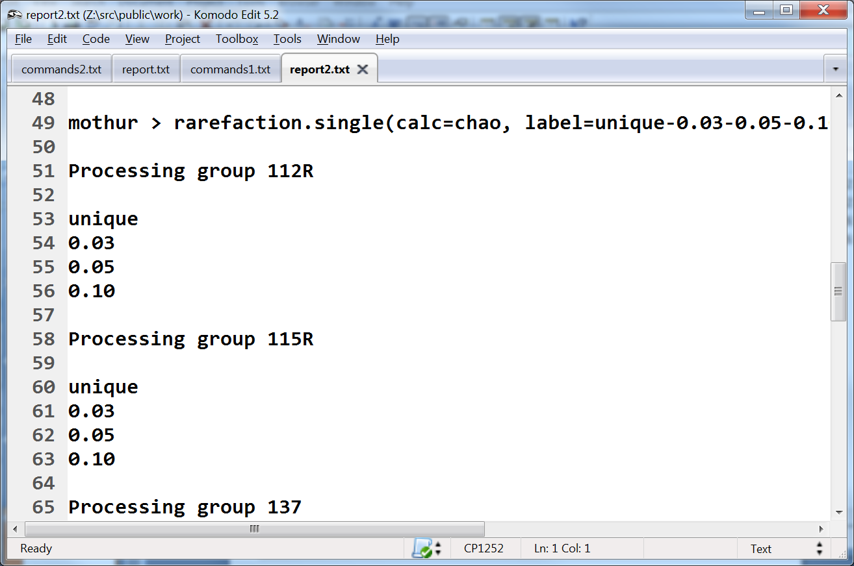
A different file for each group → file extension r_chao

Slide 48
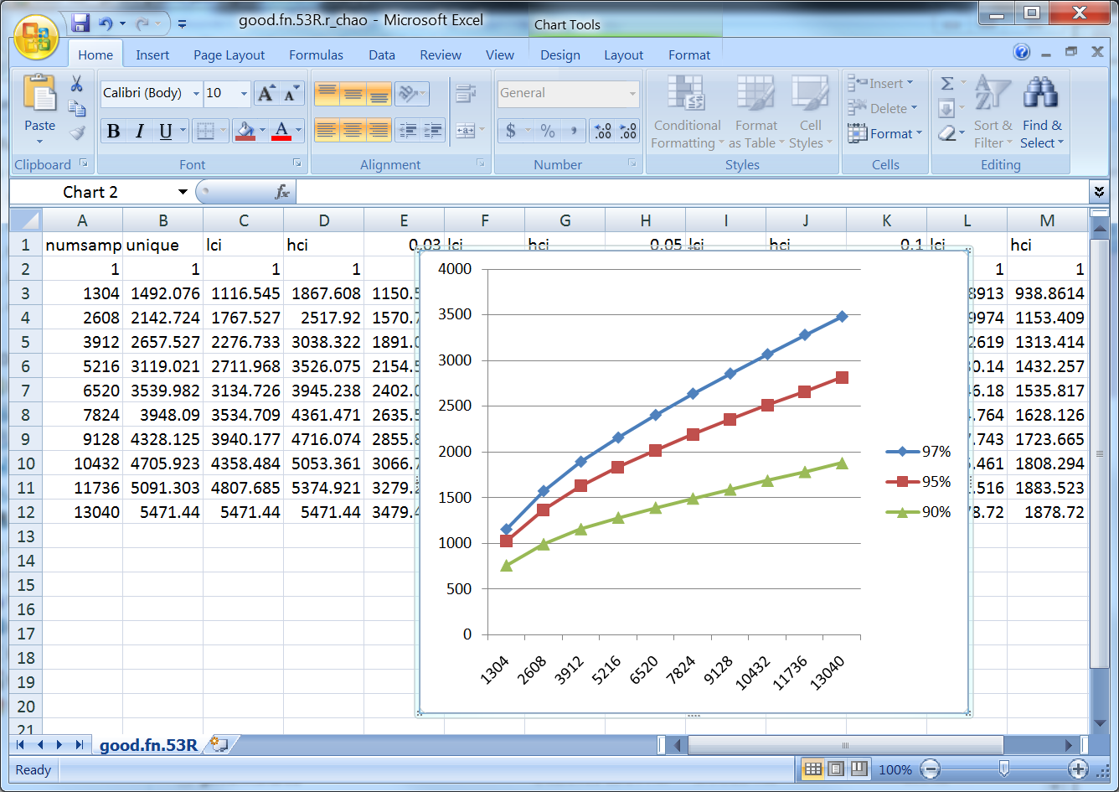
Visualize the rarefaction curve – here shown in Excel - we’ll learn how to do this in R

