Slide 1
Computer are dumb
(And why you care.)
Titus Brown
6/10/11

Slide 2
Outline
Algorithms and scaling
Heuristics in computation
Some thoughts on hardware
Are you right? (Or at least not wrong?)
Whose fault is it that you’re probably wrong? (RCR training!)

Slide 3
Consider: finding SNPs.
Given: reference genome, sequence reads, mapping.
The mapping contains a list of reads, mapped locations within reference, and the location of differences.
How can we find all single-nucleotide variation?

Slide 4
Approach one: by genome
for location in genome:
reference = genome[location]
bases = get_overlapping(location)
for base in bases:
if base != reference:
# count SNP

Slide 5
Approach two: by read
for read in mapped_reads:
for differences in read:
# count SNP

Slide 6
Approach one: by genome
for location in genome:
reference = genome[location]
bases = get_overlapping(location)
for base in bases:
if base != reference:
# count SNP
How does this algorithm scale?
Imagine:
increasing size of genome
increasing number of reads

Slide 7
Approach two: by read
for read in mapped_reads:
for differences in read:
# count SNP
How does this algorithm scale?

Slide 8
Scaling and Big-O notation
The first approach scales with both the size of the genome and the number of reads:
t ~ O(N * M)
The second approach scales with just the number of reads:
t ~ O(M)

Slide 9
Scaling and Big-O notation
The first approach scales with both the size of the genome and the number of reads:
t ~ O(N * M) - why would you want this??
The second approach scales with just the number of reads:
t ~ O(M)

Slide 10
What about a different problem?
I am interested in locations X, Y, and Z.
Give me all SNPs at or near those locations.
for location in list_of_locations:
reference = genome[location]
bases = get_overlapping(location)
for base in bases:
if base != reference:
# count SNP

Slide 11
Important note
Algorithm scaling is independent of the actual time it takes to run.
Scaling tells you how time-to-run scales as the problem size changes, nothing more.

Slide 12
Easy-to-check vs easy-to-find
Given a number, factor it into only prime numbers.
This is hard.
Given a set of prime numbers, verify that they multiple to yield a particular number.
This is easy.

Slide 13
Easy-to-check vs easy-to-find, #2
Suppose:
50 dorm rooms, two students per room
100 students can be admitted, of 400 total
Dean has list of students that cannot be paired.
It is easy to check any particular list of student/room combinations for validity.
In general, it is extremely hard to quickly find a guaranteed solution.

Slide 14
Heuristics
“Heuristics” are short cuts that usually work (but occasionally go horribly wrong).
Not all problems are amenable.
Prime numbers? No good, fast short cut.
Housing? Sure – start with a random solution, eliminate one of each pair that conflicts, until you find a non-conflict..
Heuristics rely on assumptions about the specific type of problem you’re going to tackle, and don’t always work.
If the Dean is evil, he can construct a list of incompatible roommates that breaks your process.
Or he can just gives you a really long list of incompatible roommates.

Slide 15
Example: BLAST
BLASTN filters sequences for exact matches between “words” of length 11:
GAGGGTATGACGATATGGCGATGGAC
||x|||||x|||||||||||x|x||x
GAcGGTATcACGATATGGCGgT-Gag
This results in a O(n log n) algorithm.

Slide 16
Example: BLAST
…but what about pathological situations?
GAGGGTATGACGATATGGCGATGGAC
||x|||||x|||||x|||||x|x||x
GAcGGTATcACGATGTGGCGgT-Gag
This will not be scored as a match, because BLAST only scores matches with a core “seed” match of 11 bases.

Slide 17
Heuristics
Often take advantage of “fast” operations on computers.
What operations are fast are governed by
Algorithmic considerations / fundamental CS
Hardware and software implementations

Slide 18
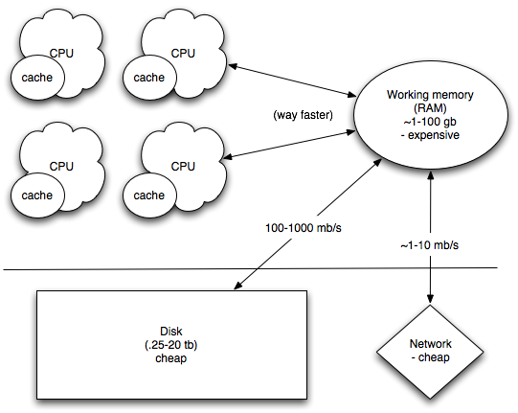
Computer architecture

Slide 19
Computer architecture
Computation is cheap

Slide 20
Computer architecture
Communication between CPUs is pretty cheap.

Slide 21
Computer architecture
Retrieving/sending data from/to the disk or the network is slow.

Slide 22
Computer architecture
Retrieving/sending data from/to the disk or the network is slow.

Slide 23
Questions to ask
Can I split my problem up into small chunks?
(because, if so, I can use more than one computer effectively.)
How does my computation scale?
How does my memory use scale?

Slide 24
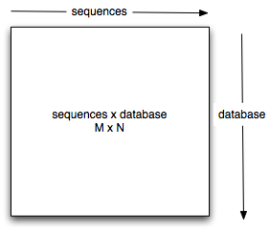
Sequence comparison: n^2

Slide 25
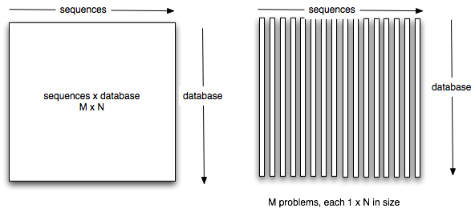
…but “embarrassingly parallel”

Slide 26
Mapping is embarrassingly parallel.
You need to calculate individual overlaps.

Slide 27
Assembly is not.
You need to calculate all overlaps.

Slide 28
Communication between CPUs is slow; this is main factor in splitting up tasks.

Slide 29
None of this is the #1 problem you will face with bioinformatics.
Here is the #1 problem:
How would you know if your answer was right or wrong?

Slide 30
None of this is the #1 problem you will face with bioinformatics.
Here is the #1 problem:
How would you know if your answer was right or wrong?
If you can’t answer this question, then what’s the point?

Slide 31
Controls
Just as with experiments, you can put negative and positive controls in your bioinformatics.
e.g. with BLAST,
Do you see expected matches with the parameters and database you’re using?
Positive controls are often easier than negative, in “discovery-driven” science…

Slide 32
Internal controls
Molecules and sequences for which you have expectations.
“I know this gene comes up, based on qPCR. I expect to see it in my mRNAseq.”

Slide 33
External controls
Does the whole process work?
“I can reproduce what this other person/lab did, with their data, when I use my own software.”
This is much more rarely done…

Slide 34
Black box nature of algorithms
When you listen to a computational biologist explain their clever algorithm…
…it’s a mistake to think that they necessarily know what’s going on.
Software is full of bugs and unintended consequences.

Slide 35
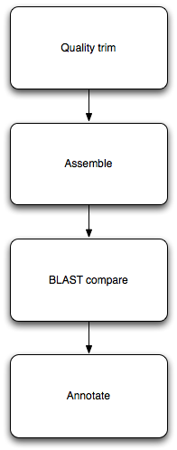
Pipelines
Each step can be understood, and tested/controlled individually.
Each step is re-usable! Just need to figure out input/output formats.
Automate, automate, automate.

Slide 36
Tracking the process
How do you know that your software today is doing the same thing it was doing last month? Or last year? Or in the hands of that other graduate student?
There are tools and processes for dealing with this
Version control (think “change tracking” in Word)
Automated testing (think “automated positive/negative controls”)

Slide 37
Replication vs Reproducibility
Replication: identical results.
Same parameters => same results
Reproducibility: similar results.
Similar parameters => similar results
(What’s “similar”?)
Corroboration:
Similar results seen in a different system

Slide 38
What should our standards be?
For scientists, reproducibility is extremely important.
Replication … less so. It’s very challenging to exactly replicate a given experimental situation.
But, there is a pragmatic reason to think about replication, too.

Slide 39
Replication in computational science
We have spent mucho time making sure that computers do the same thing every time, at the micro level.
If you observe unplanned variation in a computational system, then:
You either are using one of the approximate subsystems, like floating point;
Or you have a bug.

Slide 40
Replication in computational science
So, proximate to an analysis, you should be able to exactly replicate a particular result from a computational analysis.
Then, changing
Data sets
Hardware
Underlying software
…may result in observed differences.

Slide 41
Concluding thoughts
Every step of the process needs to be critically thought about and controlled.
Choice of algorithms can be important, but depends on your problem: the convenient tool in your toolbox may not be well suited to your problem.

