Slide 1
BLAST as a microcosm of all that is wrong with computational biology
Titus Brown
6/7/11

Slide 2
(NCBI) BLAST
You’ve all used it?
Very popular! Fast, sensitive way to find sequence similarity => putative homology.
Primary sequence comparison tool used by biologists, computational biologists.

Slide 3
(NCBI) BLAST
One or more query sequences…
against a “subject” database.
Finds core strong match, extends outwards.
SIRGGGVDHGISDDESQHSGDAGIS
S+RGGG++ G+S++ D+G
SVRGGGIEIGLSEE------DSGAE

Slide 4
Consideration #1
BLAST only cares about sequence similarity.
No positional information taken into account, for e.g. protein domains.

Slide 5
Query: 1628 AHLLVNSQKC-KQTSSECIDTTDNAASVISARAS----TGTLEAEFPINTVASTTNPTPP 1682
N+Q C K C + S++ +A+ + TL F I++ ST T
Sbjct: 1537 MTFHANTQMCVKLDLQSCPTNVASVKSILGEKAAEFSTSSTLSRVFRIDSEGSTQTGT-- 1710
Query: 1683 PQDYTYXXXXXXXXXXXXXXXXXXTHRKRKRETSTLWAPEGFNVTKKQRREPIGQDDLNG 1742
Y +KRKRE LW PEGF + KK+R+E ++LN
Sbjct: 1711 TNYLVYIIAGGGIMVLIIVIAGVIVSQKRKRENGNLWVPEGFQLFKKRRKE----NELNL 1878
Query: 1743 LNGSIHPGELTQLDT-AGTPFLNRWENTSLPQKSNHYHVQYTPENITFLPNNGTVPXXXX 1801
N L++ D A TPFL + + Q S + +L
Sbjct: 1879 NN-------LSKADMNAQTPFL---PHATEAQASKYSASSSDTPETDYL----------- 1995
Query: 1802 XXXXXXXXXXXXXEPTDNRKWTPQHLEAADLSRAGSACTPVTDLTPPPHIDVDEDDVNAR 1861
D R+WTP HLEAA+ S C + TPP + DD+NAR
Sbjct: 1996 --------HGSCASKEDKRQWTPHHLEAANNSNVN--CQIMN--TPPQSECPESDDINAR 2139
Query: 1862 GPDGVTPLMVASIRGGGVDHGISDDESQHSGDAGISGEGSDSMIXXXXXXXXXXXXXTDR 1921
GPDG TPLM+AS+RGGG++ G+S++ D+G GEGSD+MI TDR
Sbjct: 2140 GPDGYTPLMIASVRGGGIEIGLSEE------DSGAEGEGSDNMIAGLILQGASLSATTDR 2301
Query: 1922 SGETXXXXXXXXXXXXXXXXXXXXXXXXNMKDHSGRTPLHSAVAADAQGVFQILLRNRAT 1981
+GET NMKD +GRTPLH++VAADAQGVFQILLRNRAT
Sbjct: 2302 TGETALHLAARYARADAAKRLLDAGADANMKDQTGRTPLHNSVAADAQGVFQILLRNRAT 2481
Query: 1982 DLDARTNDGTTPMILASRLAVEGMVEELISANADVNAVDDHGKSALHWAAAVNNVDAVST 2041
DLDA+TNDGTTP+ILASRLAVEGMVE+LI+A+ADVNAVD+HGKS+LHWAAAVNN DA+
Sbjct: 2482 DLDAKTNDGTTPLILASRLAVEGMVEDLITAHADVNAVDNHGKSSLHWAAAVNNNDAIRA 2661

Slide 6
Query: 862 TCVCTPGFQGPTCANDINECMSPPCKNGGKCRNREPGYFCECLDGYSGVNCEENVDDCAS 921
TC QG T AN C G C N + C C +G++G CE ++ C
Sbjct: 34 TCEVQAASQGTTVAN--------VCNGQGTCINSGNSHTCTCAEGFTGSYCETIINHCDP 189
Query: 922 DPCMNGGTCLDDVNSYKCLCKRGFDGNQCQNDVNECENEPCKNGATCTDYVNSYACTCPP 981
+PC+N C +N Y+C C+ GF G+QCQ D++EC + PC NG TC + +N + C+CP
Sbjct: 190 NPCINAVKCTSGINGYECDCEAGFQGSQCQLDIDECTSNPCMNGGTCFNAINGFQCSCPR 369
Query: 982 GFRGTTCMENIDECNIGSCLNGGTCVDGINSYSCNCMAGFTGANCERDIDECVSSPC--K 1039
G G C C+ C N G C GI S++C C G+ G C DI+EC S+PC +
Sbjct: 370 GTLGVLCEVVSSLCDPNPCQNNGHCTSGIGSFTCQCKPGYGGYLCNGDINECASNPCSTE 549
Query: 1040 NGAPCIHGINTFTCQCLTGYTGPTCAQMVDLCQNNPCRNGGQCSQTGTTSK---CLCTSS 1096
C+ GIN F+C C GY G TC+ C NNPC NG C+ C CT+
Sbjct: 550 GSLDCVQGINEFSCLCKDGYYGDTCSNQASSCSNNPCLNGATCTDNSLEPLRYFCSCTND 729
Query: 1097 YSGVYCDVPRLSCSAAATWQGVEETSLCQHGGQCINSGSTHYCSCRAGYVGSYCETD--- 1153
Y G C++ +C + +C + G+C++ GS YC C GY G+ C ++
Sbjct: 730 YRGKNCEMEFSTCPSLDM--------ICYNDGKCVD-GSAPYCKCPFGYTGTQCMSNTNT 882
Query: 1154 EDDCASY 1160
E C+SY
Sbjct: 883 EKQCSSY 903

Slide 7
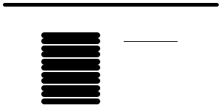
Consideration #2
BLAST is a local alignment algorithm.
Strong matches are reported first; multiple matches may be out of order between query, subject.

Slide 8
Consideration #3
BLAST creates gapped alignments.
This means it’s totally inappropriate for (for example) primer matching, unless you change the parameters.
(Who here has actually changed BLAST parameters?)
SIRGGGVDHGISDDESQHSGDAGIS
S+RGGG++ G+S++ D+G
SVRGGGIEIGLSEE------DSGAE

Slide 9
Consideration #4
BLAST e-values are database-size dependent.
BLAST bit scores are not.
You can’t technically compare e-values from BLASTs against different databases!
Score = 87.0 bits (214), Expect = 5e-16

Slide 10
Consideration #5
BLAST uses an heuristic to speed things up: requires an exact match between 11 bases (DNA) or 3 amino acids in order to start an alignment.
Query: 862 TCVCTPGFQGPTCANDINECMSPPCKNGGKCRNREPGYFCECLDGYSGVNCEENVDDCAS 921
TC QG T AN C G C N + C C +G++G CE ++ C
Sbjct: 34 TCEVQAASQGTTVAN--------VCNGQGTCINSGNSHTCTCAEGFTGSYCETIINHCDP 189
Query: 922 DPCMNGGTCLDDVNSYKCLCKRGFDGNQCQNDVNECENEPCKNGATCTDYVNSYACTCPP 981
+PC+N C +N Y+C C+ GF G+QCQ D++EC + PC NG TC + +N + C+CP
Sbjct: 190 NPCINAVKCTSGINGYECDCEAGFQGSQCQLDIDECTSNPCMNGGTCFNAINGFQCSCPR 369

Slide 11
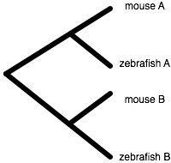
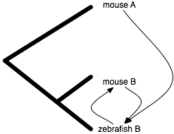
Consideration #6
Reciprocal BLAST is a horrible (but frequently used) heuristic for “orthology”. Intended for:
…but local alignments cause trouble here!

Slide 12
Considerations #7+
BLAST implementation is (was?) impenetrable: completely inextensible, very optimized, built on a huge library.
Does it have bugs? Nobody knows…
V. difficult to embed => difficult to reuse
BLAST text output format changes frequently and is designed for humans only to read; very hard for computers to parse.

Slide 13
BLAST is also kind of inconvenient
No good Web interface for uploading your own databases (that I know of).

Slide 14
So, nobody uses BLAST, right?
Absolutely wrong!
Biologists love it: it’s fast, sensitive, and has a nice Web interface at NCBI.
Bioinformaticians love/hate it:
Biologists => programmers use it by default, and then spend a lot of time correcting for its problems.
Computer scientists => biologists often can’t escape:
Lots of biology behind BLAST; tough to write your own.
Biologists believe in BLAST, and not your own dinky algorithm.

Slide 15
Digression: it’s not BLAST’s fault, really.
Most of the “considerations” I presented are completely obvious and stated clearly all over the place.
Everybody uses BLAST because it’s there, it (mostly) works, and it’s trusted by (almost) everyone.
BLAST use may be starting to break down, though:
Doesn’t scale to volume of data
Default gapping model is inappropriate for short-read mapping
Has significant false positive rate on very divergent proteins (metagenomics, “evolutionarily interesting” organisms)

Slide 16
This course & BLAST
We’ll be (mis)using BLAST just like everyone else.
We’ll show you how to run BLAST at the command line:
Run long jobs on some other computer
Make your own BLAST databases
We’ll show you BLAST output “parsing”
Make your own spreadsheet of matches
Your very own reciprocal BLAST script…

Slide 17
The UNIX command line
Many computer folk, and most bioinformaticians, work with a text interface to their computers: “the command line”.
Sort of the grandaddy of all interfaces… think back to teletypes.
Why?
Writing new programs is much easier if you write them for the command line (text, no graphics)
Simple & flexible (not nec. good) user interface design: none
Simple “pipelining” ability (Th or Fri)
Almost all bioinformatics programs work at the command line, or via a Web interface.

Slide 18
The UNIX command line, part 2
This software can be installed on your computer (Windows) or already exists (Mac OS X).
…but we really, really, really don’t want you to use your own computer to do analyses!
Laptops are sloooow
Data files are big
Your computer is here at KBS, and we don’t want you transferring 50 gb+ of data here!
You’d much rather use your laptop as an interface!
Dilemma. But we have a solution…

Slide 19
Part II: Cloud computing

Slide 20
What is cloud computing?
(for scientists)
You can “rent” access to computers and disk space from a commercial provider of same.
This provides you with a way to scale your computation for “burst” periods, without investing in hardware.
Or you can just use a bigger, faster computer.
(I will demonstrate.)

Slide 21
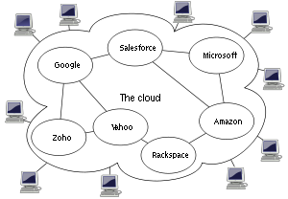
Why “cloud”?!
…because the diagram that CS people use to represent abstract compute resources looks like a cloud.

Slide 22
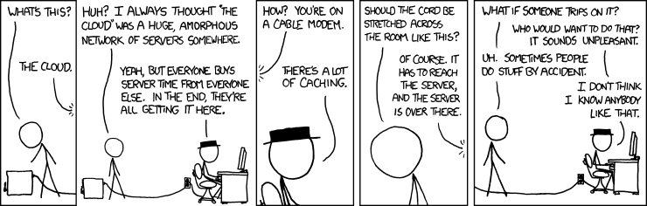
xkcd.com

Slide 23
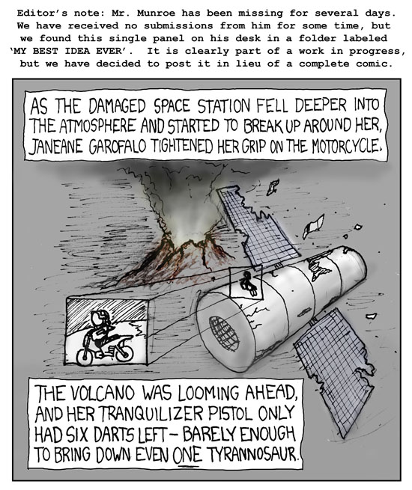

Slide 24
Amazon is a major cloud computing provider
Did you know they rent computers!?
Rumors are that it’s more lucrative than their book selling division… not sure how that’s measured, though.

Slide 25
Terms
EC2 – Elastic Cloud Computing, computer rental from Amazon.
EBS – Elastic Block Storage, virtual hard drive rental from Amazon.

Slide 26
Some quick calculations:
1 small machine, / yr:
1.7gb of RAM, a ~1.0 GHz single-core CPU, 160gb of local disk.
$.085 / hr
8760 hrs / year
=> ~$750 / year.
Not an effective server replacement.

Slide 27
1 high-memory quadruple extra-large instance / yr:
68.4 gb of RAM, 8 core @ ~3.2 GHz, 1.7tb of local disk.
$2.40 / hr
8760 hrs / year
=> $21,000 / year

Slide 28
20 high-CPU extra large machines, for a day:
7gb of RAM, 8 x 2.5 GHz CPUs, 1.7tb of local disk.
$.68 / hr
24 hrs / day
20 machines
=> ~$330/ day.

Slide 29
Why is EC2 so expensive??
They cover all hardware, power, air conditioning and network costs.
That’s actually way more expensive than you think. (Talk to your sysadmin or HPC person…)
They do not operate at 100% capacity,
They want to make $$.

Slide 30
It’s not really that bad…
Used for last year’s course
~25 people
~50gb of data each
=> $800 cost.
We spent more on beer than on computation!
The only part that didn’t work was using my own lab server at the very beginning.

Slide 31
It’s not really that bad #2…
Using for med-memory algorithm testing
1 week / 100 gb of data
Est $250 total.
So, if I need to compute in a hurry:
pay $250
Or, buy a new computer (but no space! And I have to wait to get the computer!)
Or, block my lab from using our compute servers.
Or, use the HPC and wait a week for a bigmem machine.

Slide 32
Renting disk space
Elastic Block Storage lets you persist data local to EC2 instances.
Think of it as a virtual hard drive.
$.10/gb/month.
You can save, store, “snapshot”/backup, and share snapshots.

Slide 33
What are we using it for?
Teaching workshops and classes.
Running our own analyses/data sets in a timely manner.
Sharing data within the lab via EBS snapshots.
Providing data to other people via S3.
Automated testing on clean machines with known software install.

Slide 34
Today’s tutorials
Create (rent) a new machine from Amazon.
Install NCBI BLAST
Download & format some databases
Run BLAST
Produce an excel spreadsheet of best hits
…
Run 2-way BLAST (mouse x zfin, and vice versa)
Calculate reciprocal best hits
Produce an excel spreadsheet

Slide 35
The real point…
Renting machines
Logging into them
Transferring files to/from them without using your laptop.
Transferring files to/from them from/to your laptop (dropbox!)

Slide 36
The other real point…
You can use all of this stuff at home, too.

Slide 37
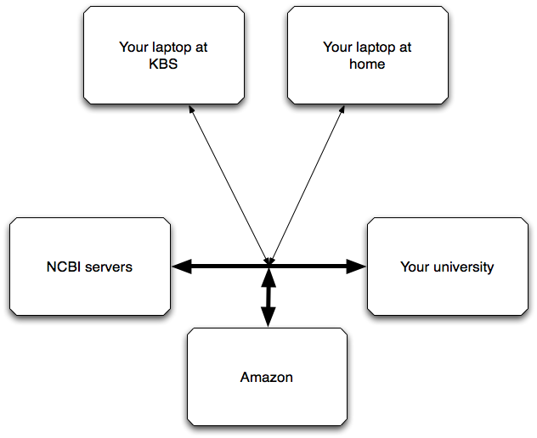
PLEASE DO NOT
Try to transfer 100mb+ of files via Dropbox ☺
Leave your EC2 machine running for no reason. (I’ll explain how to check…)

