Slide 1
MSU Next-gen Sequence Analysis Chip-Seq Analysis
István Albert
Bioinformatics Consulting Center Penn State

Slide 2
Presentations
Lecture 1: Principles of Chip-Seq technology Lecture 2: Interval datatypes
Two out of these
Tutorial 1: Peak Calling, analyzing enriched regions
Tutorial 2: Using the BEDTools package
Tutorial 3: Advanced scripting: fragment size detector
Tutorial 4: Tools I wish I knew about sooner

Slide 3
Problems with Statistics
Descriptive statistics has was founded in the 19th century
Designed to model a few and expensive and observations (agriculture, crop growth)
Now well suited to any situation with lots of measurements and systematic errors
Today we have enormous number of cheap, and biased observations

Slide 4
Topic: Protein - DNA interactions ChIP-Chip and ChIP-Seq studies
ChIP → Chromatin Immuno-Precipitation (used during sample preparation)
Chip → microarray technology to detect bound genomic locations
Seq → high throughput sequencing to detect bound genomic locations

Slide 5
Slide credits
Some of the content on the following slides follow the presentation:
Statistical Methods and Software for mRNA-Seq and ChIP-Seq: Introduction to ChIP-Seq Data Analysis Oleg Mayba, Laurent Jacob, Sandrine Dudoit Division of Biostatistics and Department of Statistics University of California, Berkeley

Slide 6
Chromatin Immuno-Precipitation
It is a well know methodology to detect:
transcription factor binding
polymerase binding
chromatin structure and modifications
etc…

Slide 7
ChIP: Quick Overview
Double stranded
DNA
Proteins
P1
P2
Crosslink bound
Proteins
P1
P2
Fragment/digest DNA around bound locations
IP1
P1
P2
Isolate with protein specific antibody
P1
Reverse cross link then sequence the DNA

Slide 8
The ChIP output
a DNA sample enriched* for fragments associated with the events under study
Coverage depends on the number of sites, efficiency of the IP step.
Accuracy depends on fragmentation strategy: sonication, MNASE digestion, lambda-nuclease digestion
* Note: Lots of other DNA fragments can make it through!

Slide 9
Library preparation
Intermediate step between ChIP and Sequencing. Lots of technical details. The goal is to create sequencing library that will result in best quality of data.
PCR amplification – to increase amount of starting DNA.
Fragment size selection – narrowing down the size distribution of DNA fragments.
Note that each step may also introduce errors and artifacts. Errors almost always accumulate (often quadratically).

Slide 10
Chip-Seq →High throughput sequencing
Fragments are sequenced
Aligned against genome (Bowtie is a good choice for Chip-Seq)
The output is in the form of the intervals (start/end/strand) indicating locations in the genome

Slide 11
Single End sequencing
+
-
Sequencing proceeds in the 5’ to 3’ direction
The biologically meaningful DNA fragment may be (substantially) longer or shorter than the length of the read !!!
Plus we always have more than one fragment in one location and we don’t know which left border is paired up with which right border.

Slide 12
Paired End sequencing
The instrument is able to tag the double stranded DNA
so that it can track which pairs of reads came from the same fragment
Data will comes in pairs of right-left border We always know the width of each fragment!

Slide 13
Alignment to the genome
After alignment we get genomic intervals for each read, minimally:
chrom, start, end, strand
The 5’ locations will then be given by
the start coordinate for the + strand
the end coordinate for the – strand

Slide 14
Other considerations
For single end sequencing each fragment may correspond to 0, 1 or 2 reads. If it has 2 we don’t know which two correspond to one another.
For paired and sequencing each fragment corresponds to 0 or 2 reads. (occasionally 1 because of errors). We know which two correspond to one another.

Slide 15
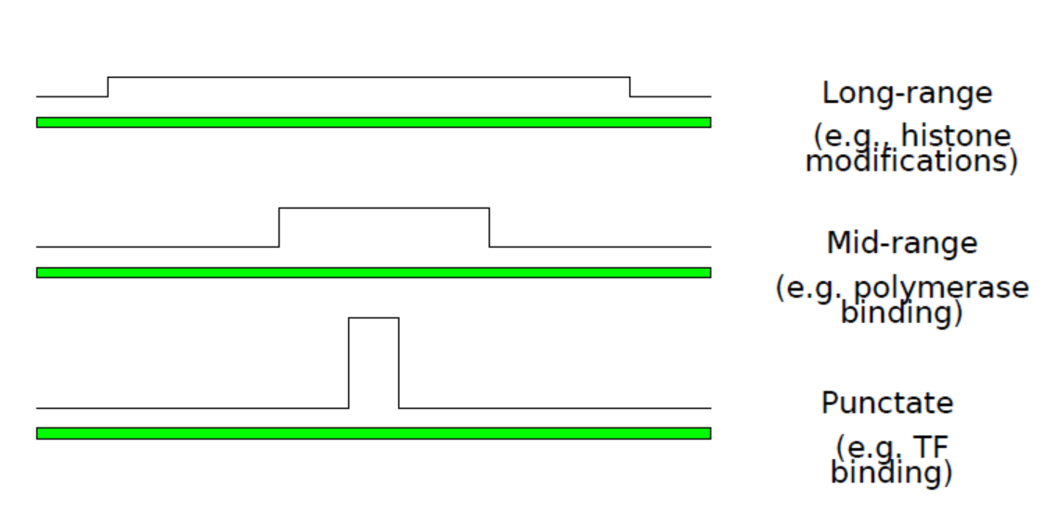
Type of events of interest

Slide 16
Peak Calling
Process of finding the locations enriched due to events of interest
Need to define
Peak Region - contiguous set of basepairs that belong to a peak
Enrichment Level - read-based measure of supporting evidence

Slide 17
Peak calling: base pair level measurements
Typically two strategies:
Find the number of fragments (usually NOT reads) overlapping that position (need to go from reads to fragments)
Find the number of reads (fragment ends) reported at that position (usually taking strandedness into account) Variation: kernel-smoothed read density. This is closer to overlap approach.

Slide 18
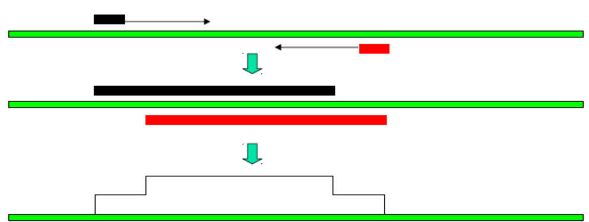
BP level enrichment: overlap
Number of fragments (usually NOT reads) overlapping that position

Slide 19
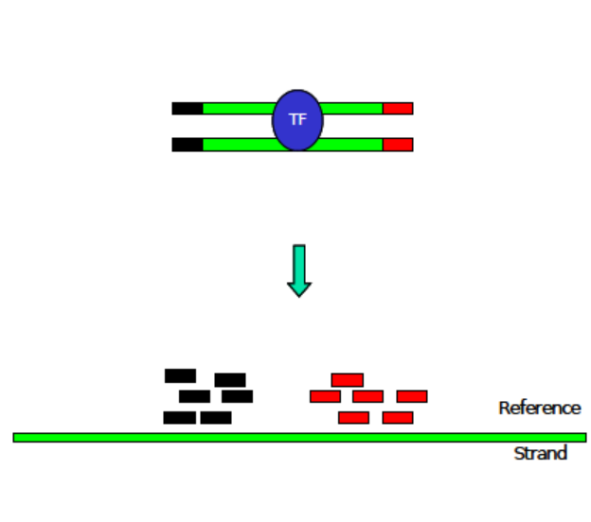
Estimation of Point-Like events

Slide 20
Peak calling tools
Very large selection of tools and techniques: ERANGE, FindPeaks, MACS, QuEST, CisGenome, SISSRS, USeq, PeakSeq, SPP, ChIPSeqR, GLITR, ChIPDiff, T-PIC, BayesPeak, MOSAiCS, CCAT, CSAR,
Featured today as an example (historically precedes most of the tools above)
GeneTrack—a genomic data processing and visualization framework Istvan Albert, Shinichiro Wachi, Cizhong Jiang and B. Franklin Pugh Bioinformatics, 2008

Slide 21
GeneTrack
It performs error corrections and peak predictions
Visualizes data as tracks in a ‘browser’ interface.
Also a integrated into our own LIMS: Laboratory Data Management System LionDB3: with projects, users, data sharing etc.
http://genetrack.googlecode.com the LIMS is at http://liondb3.atlas.bx.psu.edu/

Slide 22
GeneTrack Features
Unique features:
Peak detection and visualization at the same time.
User sees the effect of the peak prediction parameters right away
Much criticized missing component
Lacks the statistical modeling of the background (expected frequencies)

Slide 23

GeneTrack Input Files
Here is a great idea everybody will love I’ll invent a new weakly defined, internally redundant, ambiguous, bulky fruit salad of a data format. Again. [1]
1. from Biostar

Slide 24
Aligning to reference genome
Left border
reads
+ strand
Nucleosome
- strand
Right border
reads

Slide 25
Find the borders
Left border
(Start site)
+ strand
Nucleosome
- strand
Right border
(Start site)

Slide 26
Finding the binding sizes
73 bp
+ strand
Nucleosome
- strand
73 bp
Binding Size = ~146 bp

Slide 27
Shift to the center
+ strand
Nucleosome
- strand

Slide 28
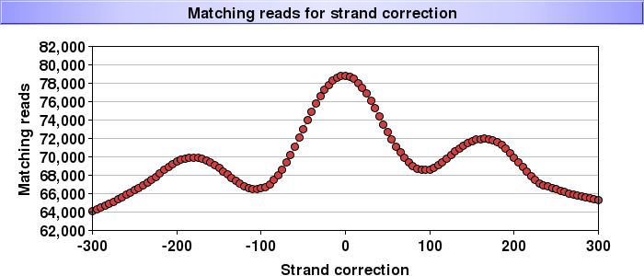
Errors and Noise
Counting positions where reads match up on both strands
Original read count ~ 1 million

Slide 29
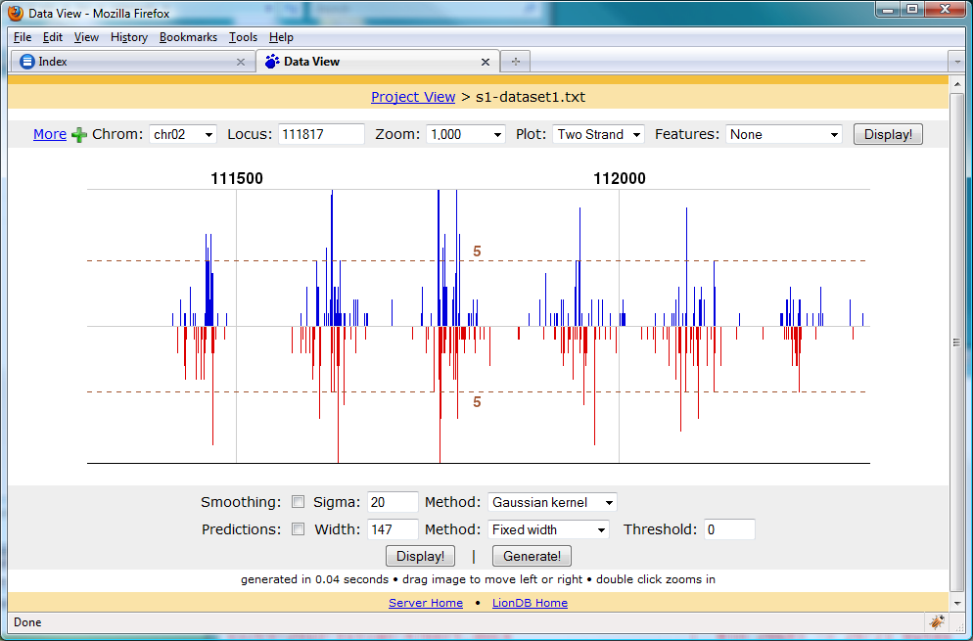
GeneTrack: reads on both strands

Slide 30
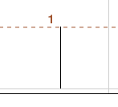
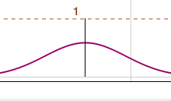
Error Model
Replace every read with the probability of the read falling onto the observed location.
100
100
Each single coordinate will be replaced with a “smudge” of values (hundreds of them).

Slide 31
Sum up your “smudges”
100
Central Limit Theorem guarantees another normal function

Slide 32
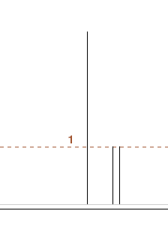
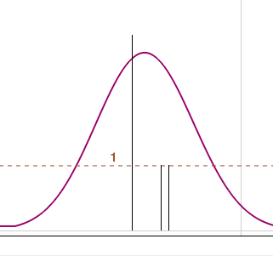
Summing up multiple errors

Slide 33
GeneTrack: revisit the reads

Slide 34
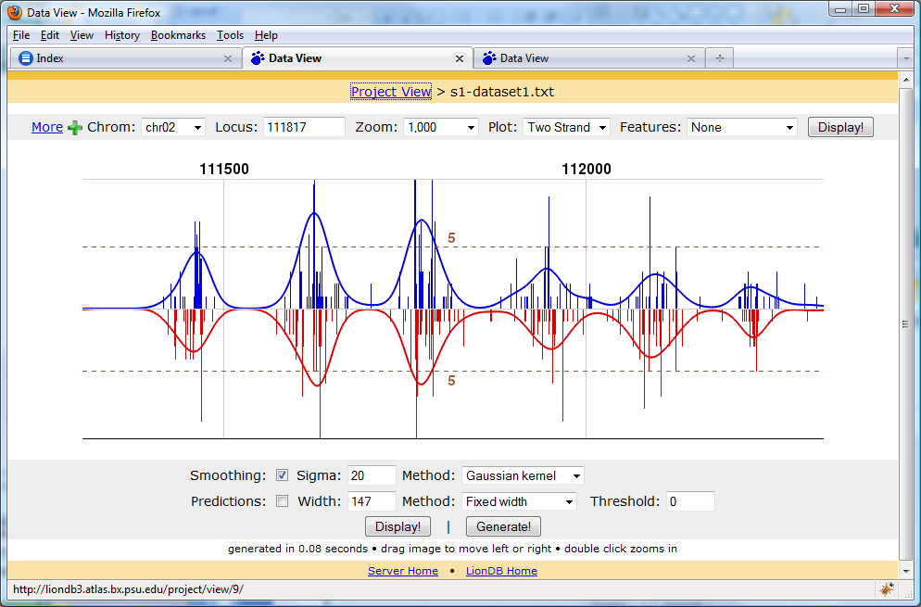
GeneTrack: with smoothing

Slide 35
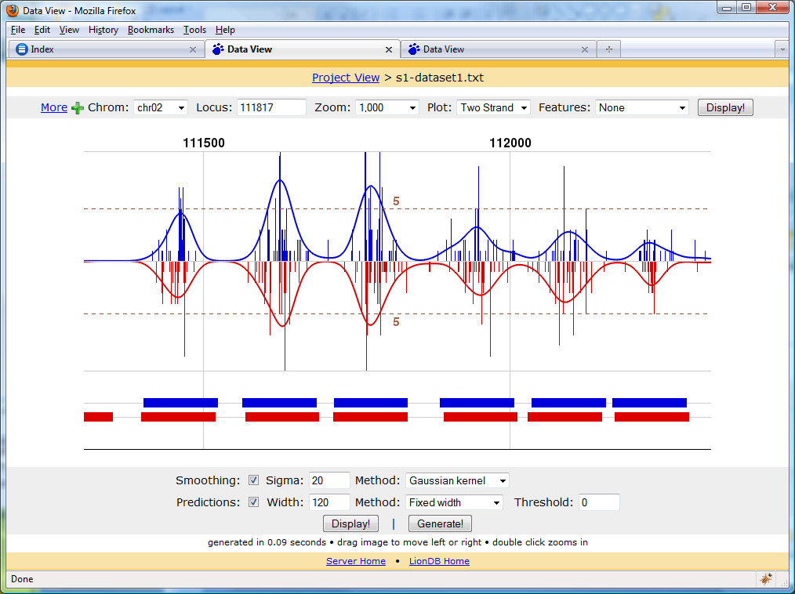
GeneTrack also does peak prediction

Slide 36
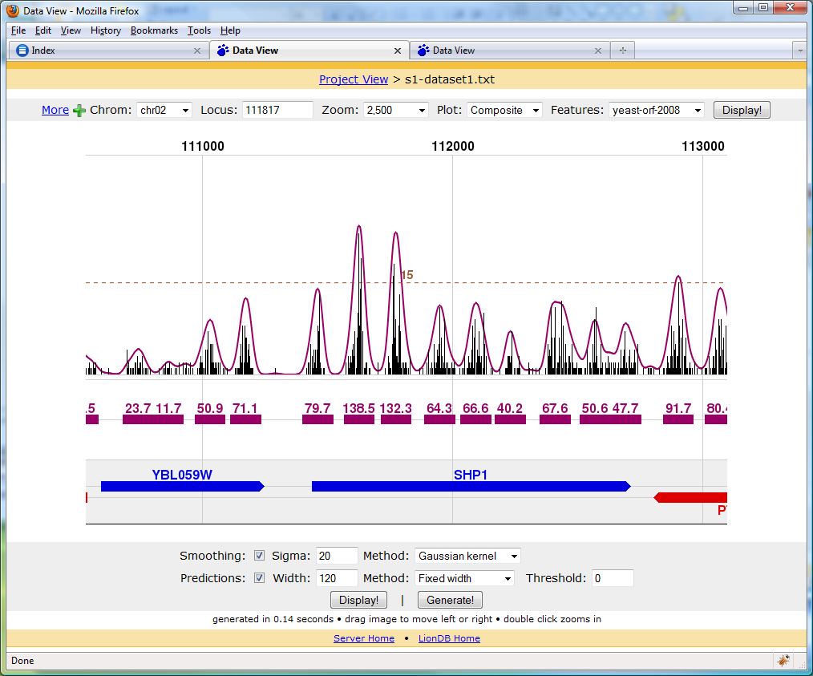
Displayed relative to genomic features

Slide 37
I have my peaks what now?
Two major directions (often both are pursued):
Peak locations relative to known genomic features → GO annotations → Functional inference
Extract the sequence that correspond to the peaks → Motif analyis

Slide 38
What is Chip-Seq data analysis really about?
Manipulating intervals
query
intersect
summarize

Slide 39
Topic: Working with genomic Features
Feature: a genomic region (interval) associated with a certain annotation (description).
Typical attributes to describe a feature
chromosome
start
end
strand
Name
Related tutorial on how to operate on intervals with BEDTools

Slide 40
Genomic coordinates – brief overview
DNA two stranded and directional → But there is only one coordinate system
200
300
upstream
5` forward strand
5` reverse strand
upstream
200
300
Most formats use start < end even on the reverse strand The upstream region – before the 5’ end relative to the direction of transcription

Slide 41
Coordinate systems
0 based → first 10 → 0, 1, 2, … 9
1 based → first 10 → 1, 2, 3, 4, … 10
Typically
0 based are non-inclusive 10:20 → [ 10, 20 )
1 based include both ends 10:20 → [ 10, 20 ]

Slide 42

Why do different indexing systems even exist?
1 based indexing
Third element data[3] First ten : data[1:10]
Second ten: data[11:20]
Third ten : data[21:30]
Size of the slice = 10 → end-start + 1
Empyt slice: data[?] – not sure
Get a five element long segment starting at 1000
data[1000: 10000 + 4 ]
0 based indexing
Third element data[2] First ten : data[0 :10]
Second ten: data[10:20]
Third ten : data[20:30]
Size of the slice = 10 → end – start
Empty slice data[10:10] → size=0
Get a five element long segment starting at 1000
data[1000: 10000 + 5 ]

Slide 43
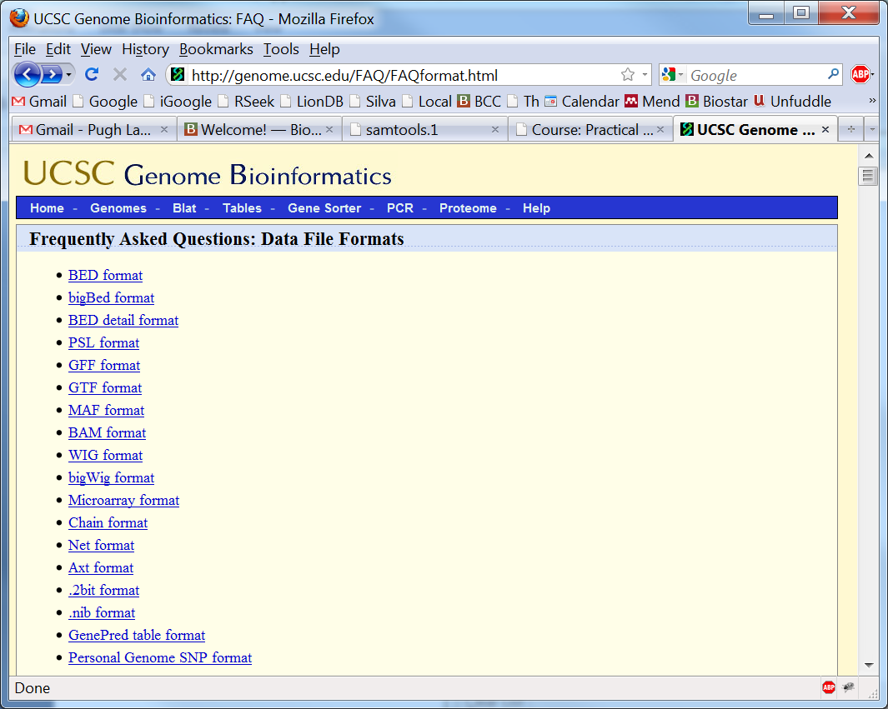
http://genome.ucsc.edu/FAQ/FAQformat.html

Slide 44
Two commonly used formats
BED – UCSC genome browser → 0 based non inclusive → also used to display tracks in the genome browser (US “standard”)
GFF – Sanger institute in Great Britain → 1 based inclusive indexing system (“European standard”)
Neither of them includes column names

Slide 45
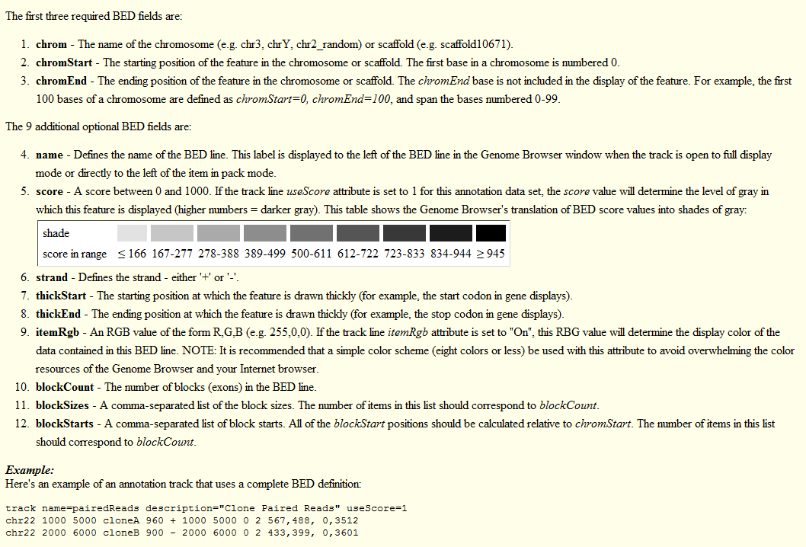
BED Format

Slide 46
GFF format
Search for GFF3 → http://www.sequenceontology.org/gff3.shtml
Tab separated with 9 columns. Missing attributes may be replaced with a dot → .
Seqid (usually chromosome)
Source (where is the data coming from)
Type (usually a term from the sequence ontology)
Start (interval start relative to the seqid)
End (interval end relative to the seqid)
Score (the score of the feature, a floating point number)
Strand (+/-/.)
Phase (used to indicate reading frame for coding sequences)
Attributes (semicolon separated attributes → Name=ABC;ID=1)

Slide 47
We may have data in different coordinate systems! Being “one off” is one of the most common errors in bioinformatics.
Conversion from GFF to BED (start, end) → (start – 1, end)
Conversion from BED to GFF
(start, end) → (start + 1, end)

Slide 48
Typical interval related tasks
Finding intervals relative to one another, for example:
for each interval on one strand find the closest on the other strand
An interval is not a point - these type of problems need to be better specified

Slide 49
Important details
midpoint
upstream
starts
What are the anchor points (the locations that represent the intervals)
Which direction does the comparison proceed – upstream, downstream?

Slide 50
Overlap/intersect
Two features are said to overlap or intersect if they share at least one base in common.
Feature B
Feature A
Feature C
genome

Slide 51
Further complications …
An interval file may or may not be sorted
Usually that means sorted by the start coordinates
Some operations require that the files be sorted!

Slide 52
Where to get genomic features
UCSC: http://genome.ucsc.edu/
Ensembl/Biomart: http://www.ensembl.org/
Numerous custom databases tuned for a certain organism or disease.

Slide 53
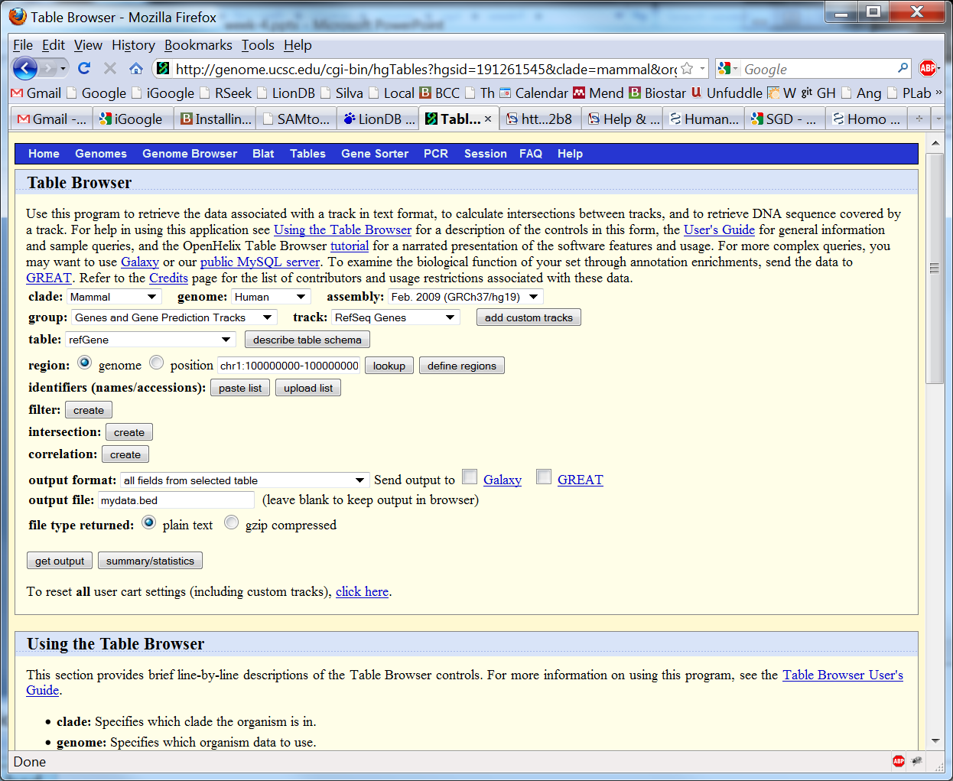
Exporting data from the UCSC genome browser

Slide 54
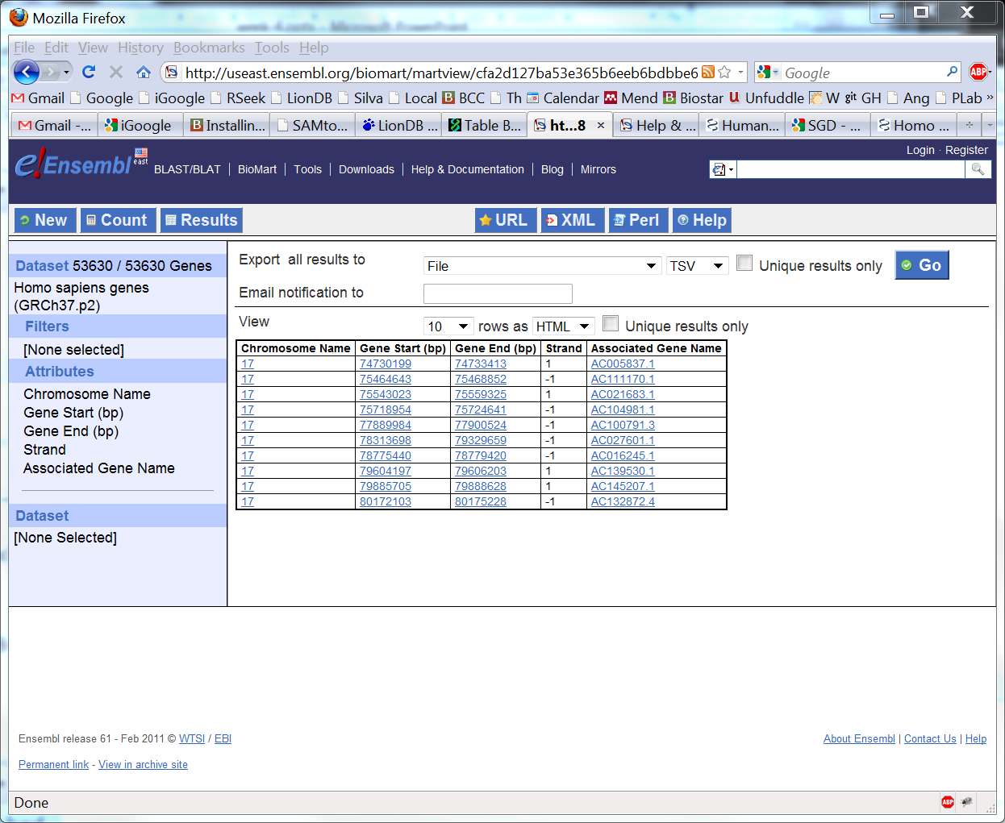
Exporting data from BioMart

Slide 55
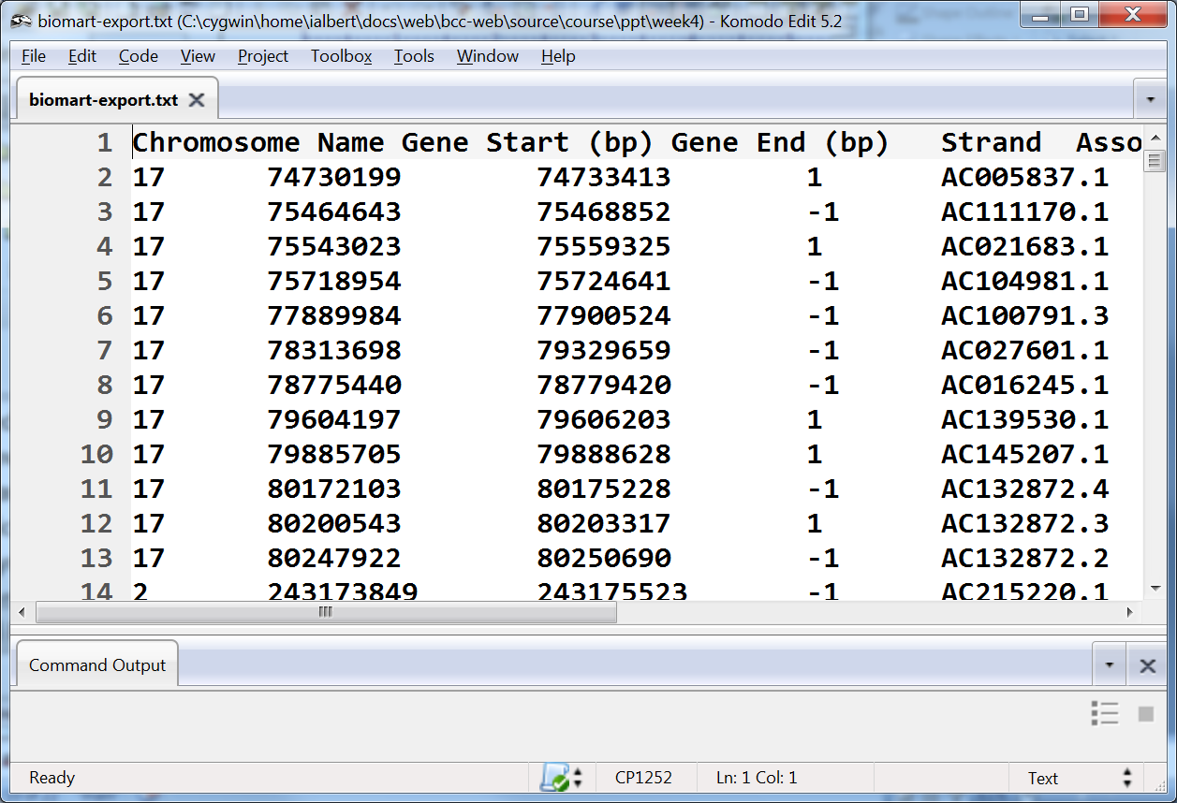
Sometimes we cannot get the data in the exact form we needed
this is not a BED file although it is similar to it – you may not be able to transform it yourself it is a lot easier to find help to transform this file into a BED format than finding it in BED format in the first place

Slide 56
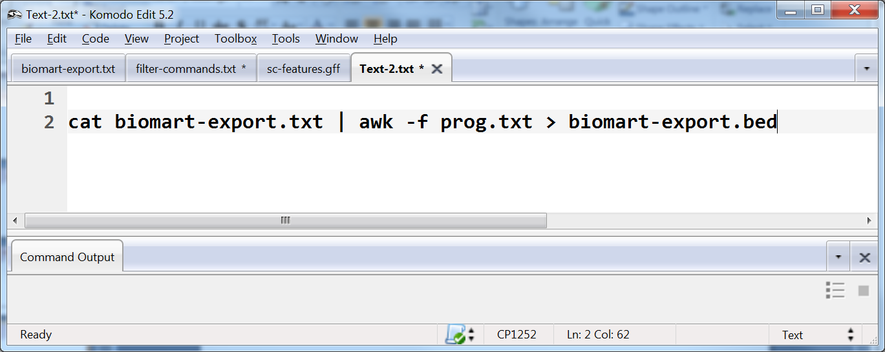
A possible solution
where someone else gives you the content of prog.txt

Slide 57
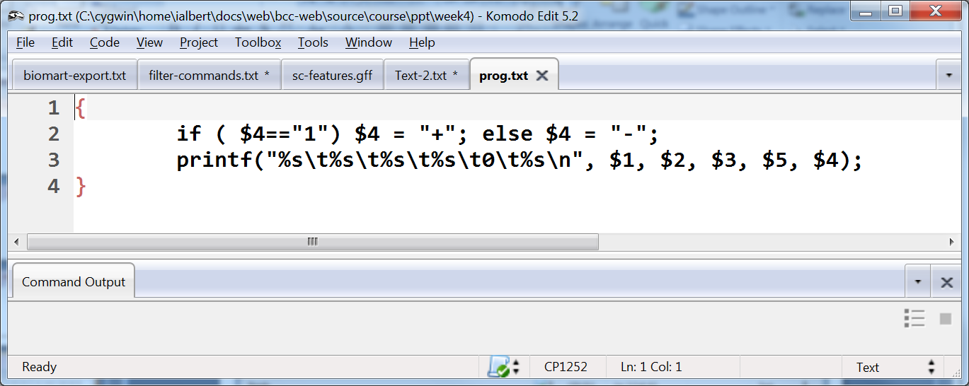
This is what it a prog.txt could look like
You don’t need to know how to make this.
This is (should be) very easy for someone that hired to do programming.

Slide 58
Transition into the tutorial
Peak calling tutorial & Cis-regulatory element annotation systems
BEDTools tutorials

