Slide 1
Lecture 7 - mRNAseq

Slide 2
This week
Today: mRNAseq
Tuesday: ChIP-seq (Istvan Albert)
Wed: Resequencing (Ian Dworkin)
Thursday: Genomes & future (Erich Schwarz)
Friday: post-mortem

Slide 3
This week
Monday 12:30pm – Ian, on data sharing
Monday, ~7pm – Istvan, on metagenomics tools for population structure
Monday, 9pm – “focus groups” discussion
Tuesday 7pm – Titus, on computational challenges of soil metagenomics
Tues, Th – bonfire?
Th – G&T party?
Friday: lunch in Kzoo?

Slide 4
Lecture 6 - mRNAseq

Slide 5
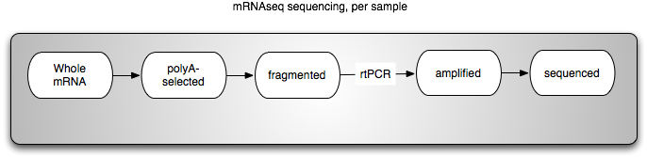
Illumina mRNAseq protocol
Avoids 3’ bias in sequencing

Slide 6
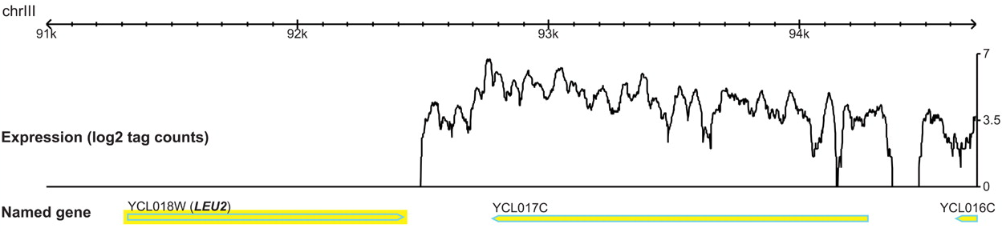
Sequencing the transcriptome
Nagalakshmi et al., Science, 2009

Slide 7
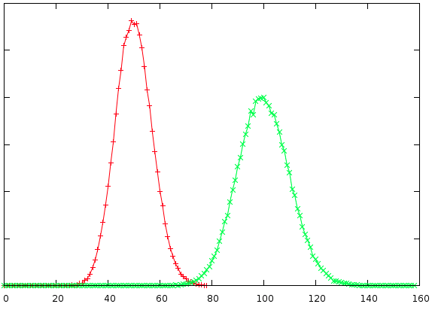
mRNAseq quantitation

Slide 8
mRNAseq vs microarrays
No genome needed for mRNAseq
Microarrays typically (always?) require internal comparison; mRNAseq does not.
mRNAseq seems to be more reproducible & sensitive.

Slide 9
mRNAseq and microarrays
Annotation still critical (and lacking)
Good for hypothesis generation
Not so good for hypothesis validation
Statistical analysis still needed.
Multiple samples still required ☺

Slide 10
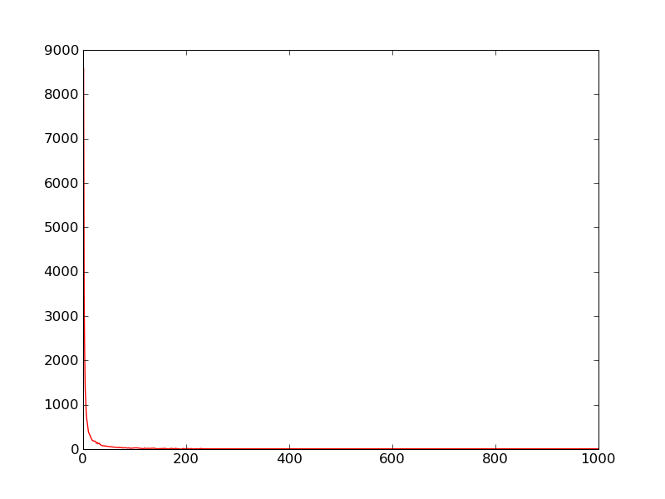
Counting
Distribution of counts heavily weighted towards 0 or 1
Number of genes with that count
Number of counts / gene

Slide 11
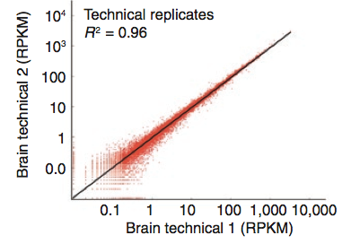
Good r^2 for tech replicates
Mortazavi et al., Nature Methods 2008

Slide 12
High sensitivity
Mortazavi et al. (Nat Met, 2008) estimate that a 2kb mRNA transcript can be robustly detected (~30 reads/gene) at ~.3 transcripts/cell with 50m reads.
RPKM: “reads per kilobase of mRNA”, a measure that normalizes to length.
…does not normalize for sequencing bias!

Slide 13
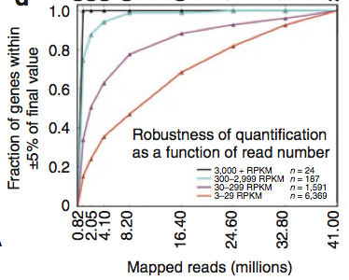
Reasonably robust to # of reads
Mortazavi et al., Nature Methods 2008

Slide 14
mRNAseq analysis
Find or build transcriptome
Map reads to transcriptome
Count and normalize across samples
Compare between samples
Pathway/gene analysis
…challenges for the future

Slide 15
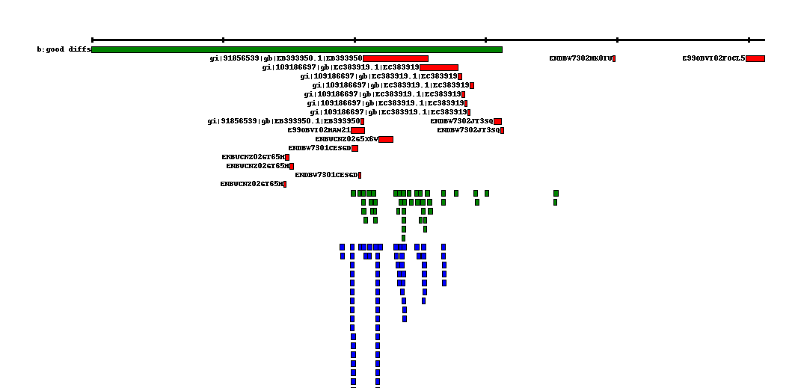
mRNAseq example: lamprey
Notes:
Two different samples from lamprey; red are ESTs, green sample 1, blue sample 2. Must synthesize ESTs, then “count” 1 & 2. This illustrates the challenges fairly nicely ☺ - gb of sequence, lots of “fuzzy” calculations to be done.

Slide 16
Mapping-based approaches
Require reference!
Cufflinks, TopHat, MAKER.

Slide 17
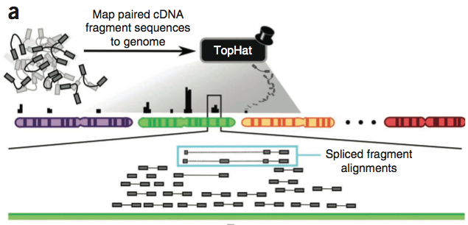
Cufflinks: pipeline for mRNAseq analysis
Trapnell et al., Nat. Biotech 2010

Slide 18
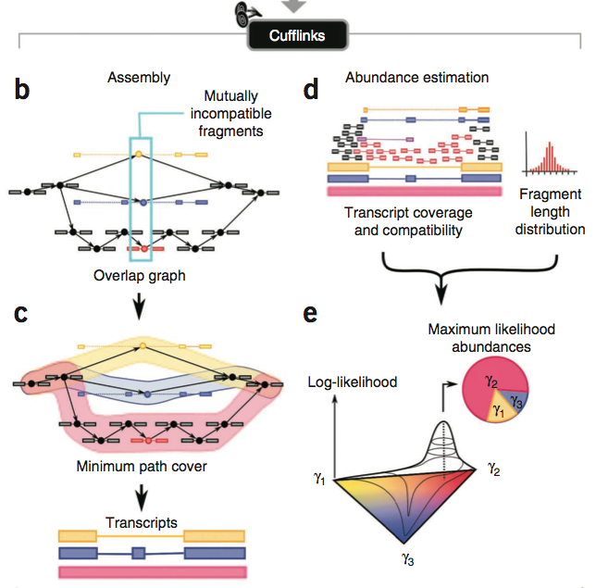
Trapnell et al., Nat. Biotech 2010

Slide 19
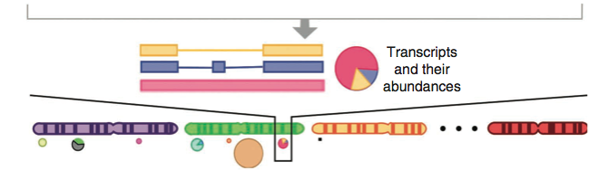
Cufflinks cont.
In mouse muscle cell line,
13.6k known splice isoforms
12.7k novel
Differential regulation of isoforms from 1600 genes.
Trapnell et al., Nat. Biotech 2010

Slide 20
mRNAseq assembly
No reference required!
Resolution of splice variants will depend critically on depth of sequencing.

Slide 21
mRNAseq assembly challenges
Several programs (Trinity, Oases, …) but all have poor scaling.
Multiple k values yield different isoforms, and this is poorly handled by existing software.
Integrating multiple sources of evidence is challenging (454, Sanger, Illumina)

Slide 22
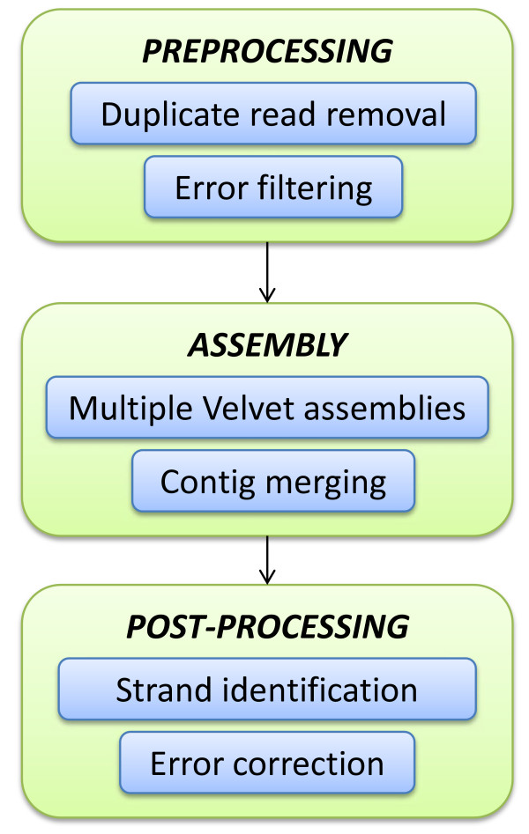
Rnnotator ex.
Cleans up reads
Handles multiple K
Post-processes to
id strand, fix errors

Slide 23
Transcriptome annotation
If no RefSeq…?
Usually done via BLAST.
Consideration: do you require reciprocal best hits, or not?

Slide 24
Quantifying transcripts
Predominant method: map with bowtie/BWA/etc.
Should you eliminate reads that map to more than one transcript?
Yes…
Think repeats, in particular.
…but this will cause trouble for certain kinds of splice variants!

Slide 25
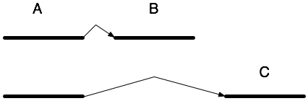
Isoform analysis – some easy…

Slide 26
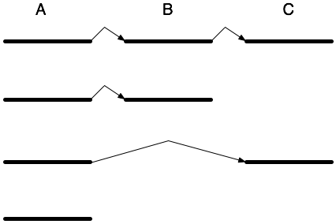
Isoform analysis – some hard
Counting methods currently rely on presence of unique sequence to which to map.

Slide 27
Normalization
In order to compare between mRNAseq samples, you must normalize.
Think qPCR, “standard” genes.
This controls for:
Different mRNA amounts
Different RT efficiency
Different sequencing depth/error rates/etc.
No good way to control for differential RT or sequencing efficiency.
So, can only compare changes in transcript levels between treatments/time points.

Slide 28
Normalization techniques
Normalize to a consistently expressed gene (e.g. “housekeeping”)
Finding housekeeping genes is challenging!
Normalize to maximum expressed gene, or sum, or average.
Quantile normalization normalizes counts assuming source distribution is the same shape.
Will show you the method in tutorial.

Slide 29
Comparison across samples
Why not log2 ratio?
May be ok for naïve hypothesis discovery.
Significance is diluted/difficult because of
Multiple hypothesis testing
Gene expression is not independent!
Likit will demonstrate DEGseq.

Slide 30
“Gene list” …now what?
(Same dilemma as microarrays :)
Look for interesting genes.
Pathway analysis?
GoMiner: classifies genes into “biology coherent” categories and looks for over/underrepresentation
DAVID: same.
Major challenge (FFS…) turns out to be robust interconversion between gene ID formats. Sigh.
???

Slide 31
Research challenges
Better artifact/graph filtering.
Improvements in assembly methodology
Scaling
Combining multiple K
High-quality isoform analysis

