Slide 1
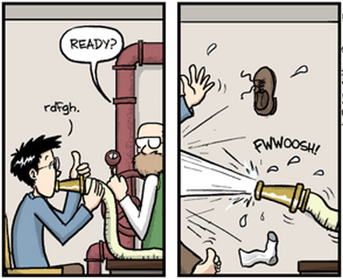
Drinking from a fire hose: analysis of metagenomic data
Rachel Mackelprang, Ph.D.
Assistant Professor of Biology
California State University Northridge
Ph.D. Comics

Slide 2
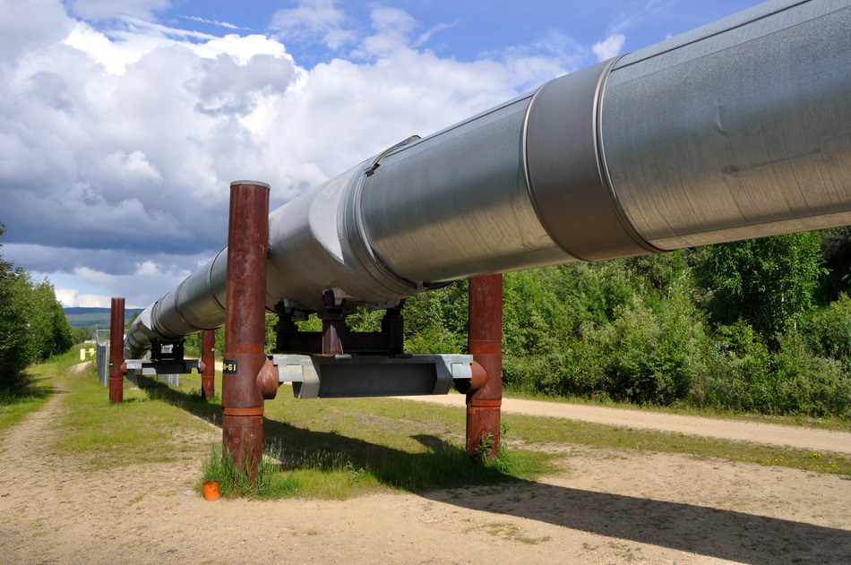
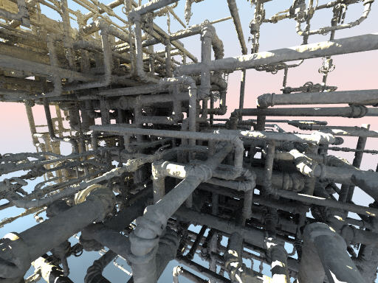
(Alas) There is no one pipeline
There’s more than one way to do it
-Larry Wall
Questions and goals
Community complexity & diversity
Computational resources and expertise

Slide 3
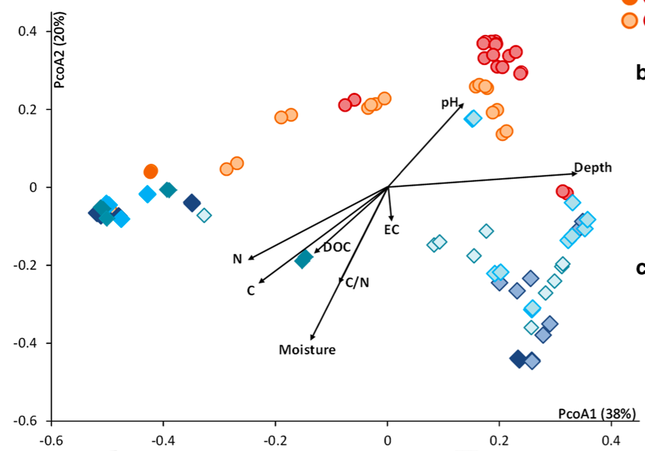
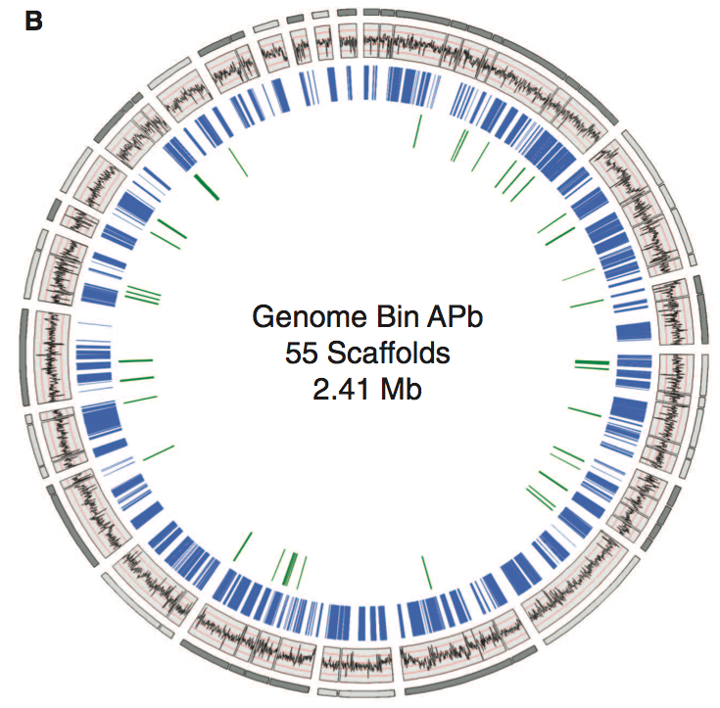
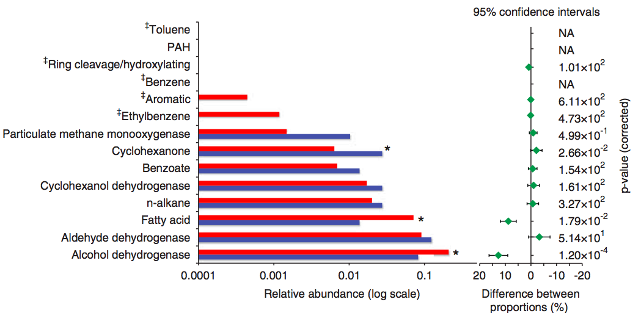
Goals & Questions
The breadth vs depth conundrum
Genomes/large conitgs?
Tas et al. 2014
Hess et al. 2011
Compare ecological patterns with genetic content?
Gene & pathway abundance?
Mason et al. 2012
Notes:
Genomes

Slide 4
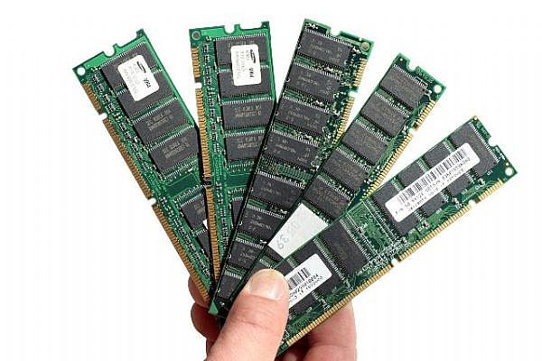
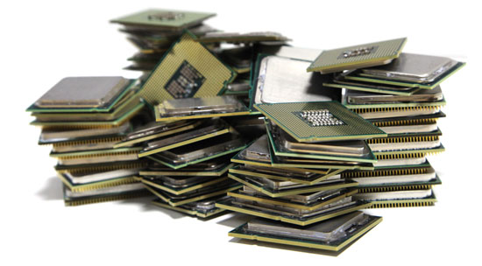
Computational Resources & Requirements
Assembly
Direct Annotation of Reads
Gene 2
Gene 3
Gene 2
Gene 3
Gene 1
Gene 1
Environment 1
Environment 2
Large memory requirements
Loads of nodes
Freely Available Tools
Velvet
ABySS
Meta-IDBA
ALLPATHS
khmer
Freely Available Tools
BLAST
USEARCH
PAUDA
HMMER3

Slide 5
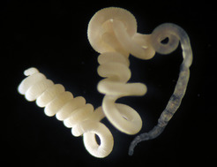
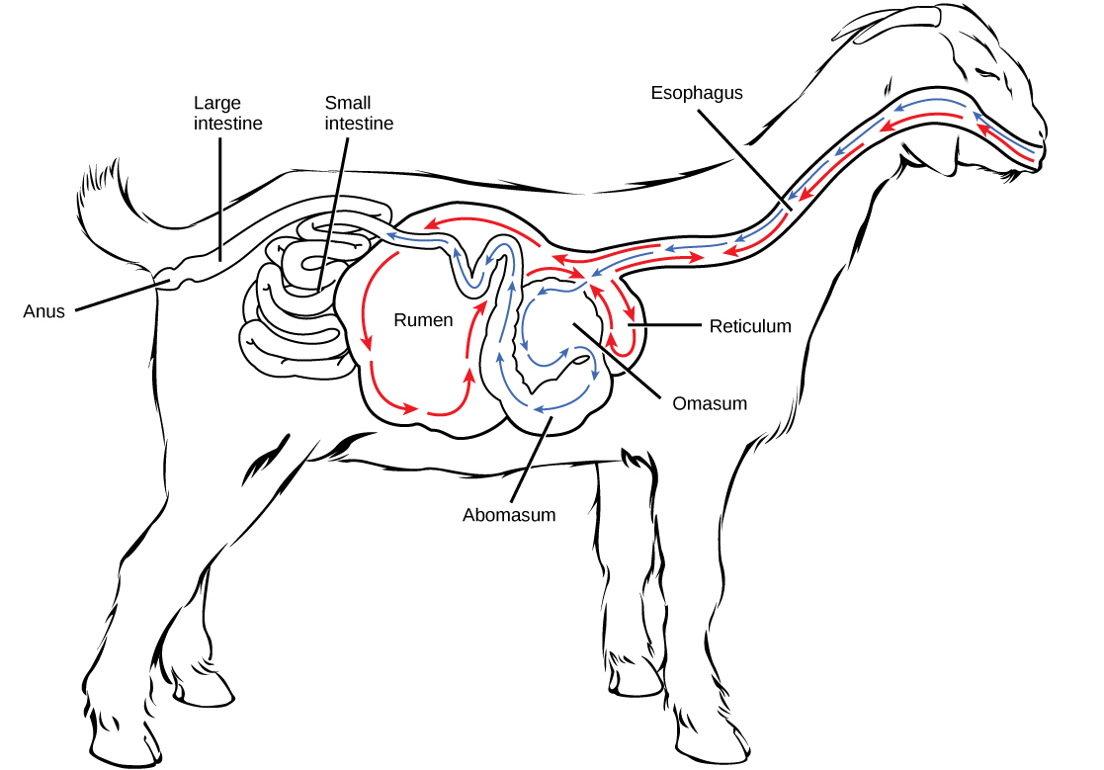
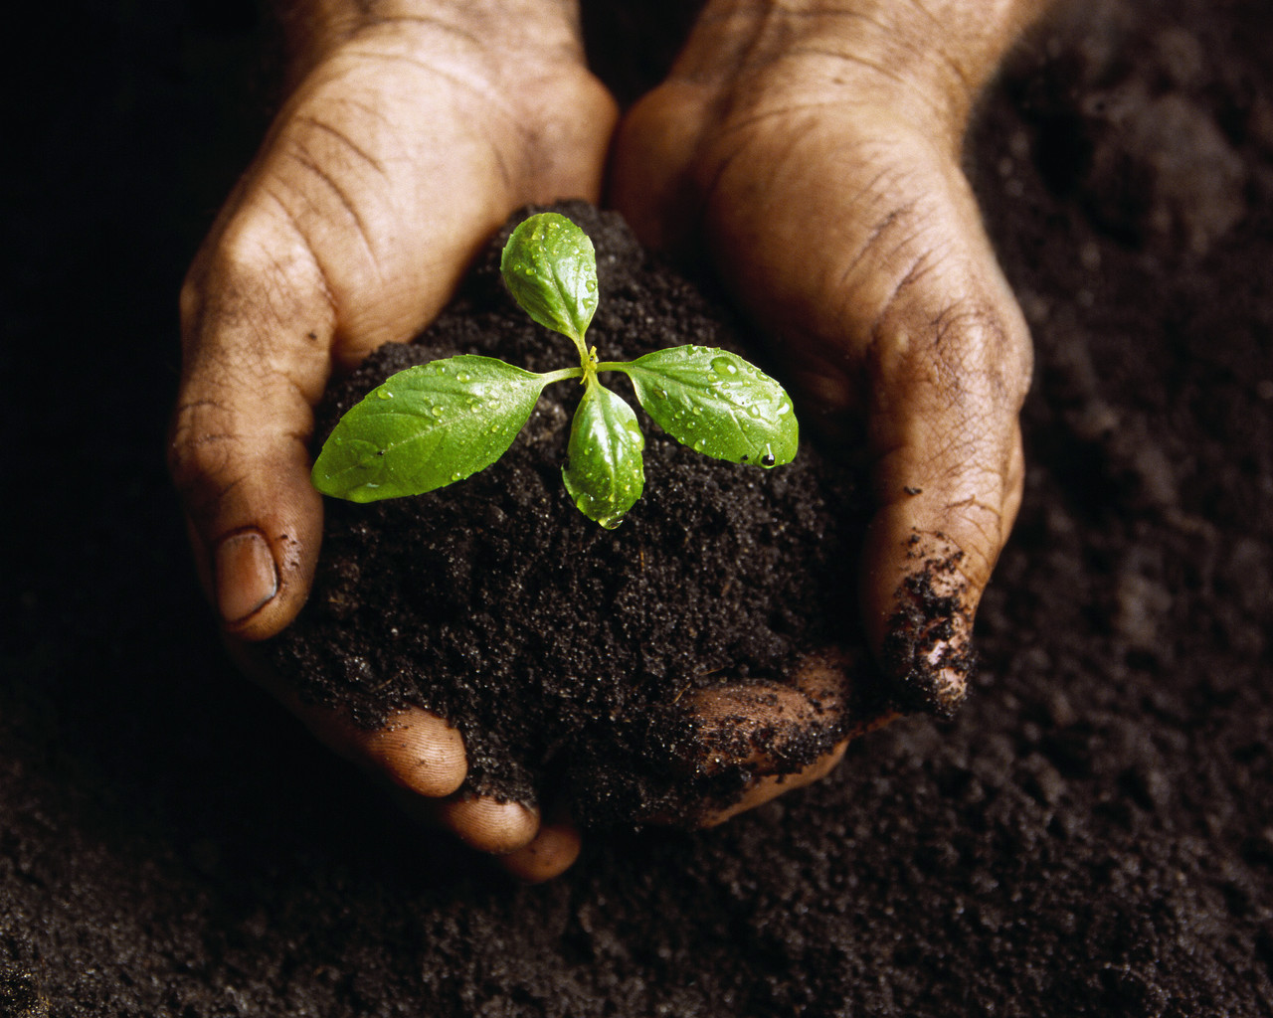
Community Characteristics
Diversity
© Christian Lott
www.cnx.org
www.co.nrcs.usda.gov
Sanger sequencing yielded reasonable coverage
0.5 Tb per sample isn’t nearly enough

Slide 6
Thank you
Looking forward to an interesting discussion

