Slide 1
The disadvantages of bigger data
Greg Caporaso
Assistant Professor, Biological Sciences
Northern Arizona University
caporasolab.us
Twitter/GitHub: @gregcaporaso

Slide 2
The disadvantages of bigger data
It’s harder to share: we already have a hard time making data sets easily accessible

Slide 3
The disadvantages of bigger data
It’s not necessarily better: on its own it doesn’t solve statistical power problems

Slide 4
The disadvantages of bigger data
It’s harder to work with: our software needs to evolve with the size of our data sets

Slide 5
What are (some of) the problems?
Lack of public revision control (this is getting better!), sufficient tests, sufficient documentation.
Software can only run in specific environments (worst case: on one specific centralized server).
Lack of stable APIs make building custom workflows impossible!

Slide 6
What should we do as developers?
Follow coding, testing, and documentation standards.
Use pre-existing software.
Build command line interfaces that are thin wrappers around stable, documented APIs.
Make software easy to install.
  try pip install qiime – you’ll be pleasantly surprised
Release software under BSD/MIT (not GPL!)

Slide 7
What should we do as reviewers?
Require major revisions when reviewing manuscripts that makes use of “in house scripts” or where software is “published on our lab website”
Ask your cluster admin to install (publicly available) software during your review.

Slide 8
What should we do as PIs?
Hire good Research Software Engineers and fight to pay them well.
Force your students and technicians to publish their code early and often and maintain an active GitHub account.

Slide 9
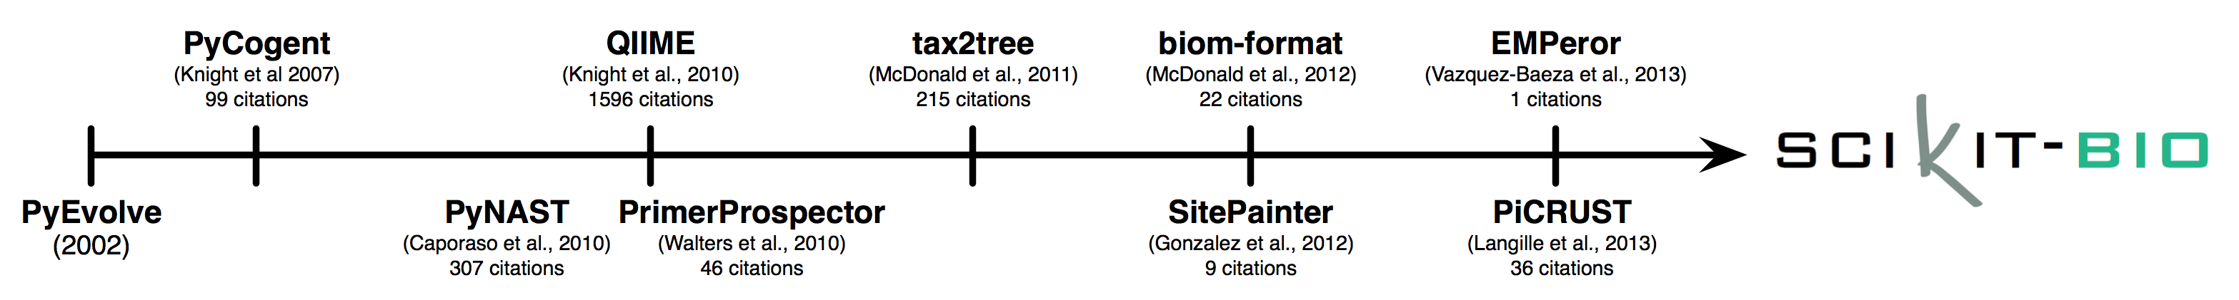
scikit-bio: a framework to make building tools like QIIME easier
github.com/biocore
scikit-bio.org
Twitter/Stack Overflow: #skbio

Slide 10
scikit-bio: a framework to make building tools like QIIME easier
better
than
github.com/biocore
scikit-bio.org
Twitter/Stack Overflow: #skbio

Slide 11

Integration with the python scientific computing stack including scipy, numpy, IPython, matplotlib, pandas
Modern community standards
numpy API documentation standards
Full PEP8 compliance
99% test coverage (via coverage.py)
Native py2/py3 compatibility
Hosted on GitHub
Continuous Integration testing with Travis
Peer-reviewed code via pull requests
BSD-licensed

Slide 12
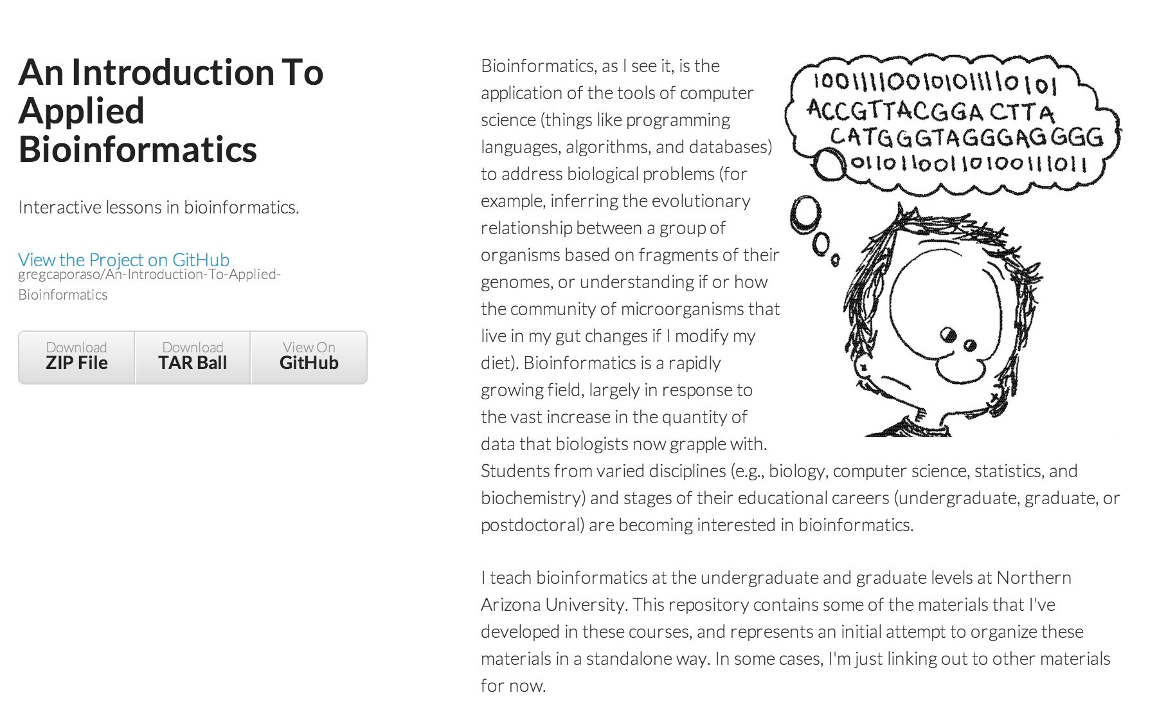
http://applied-bioinformatics.org

Slide 13




Acknowledgements
scikit-bio, QIIME and PyCogent contributors:
Adam Robbins-Pianka (@adamrp) | Antonio Gonzalez (@antgonza) | Daniel McDonald (@wasade) | Evan Bolyen (@ebolyen) | Greg Caporaso (@gregcaporaso) | Jai Ram Rideout (@jairideout) | Jens Reeder (@jensreeder) | Jorge Cañardo Alastuey (@Jorge-C) | Jose Antonio Navas Molina (@josenavas) | Joshua Shorenstein (@squirrelo) | Yoshiki Vázquez Baeza (@ElDeveloper) | @charudatta-navare | John Chase (@johnchase) | Karen Schwarzberg (@karenschwarzberg) | Emily TerAvest (@teravest) | Will Van Treuren (@wdwvt1) | Zech Xu (@RNAer) | Rob Knight (@rob-knight) | Gavin Huttley (@gavin-huttley) | Micah Hamady | Sandra Smit | Cathy Lozupone (@clozupone) | Mike Robeson (@mikerobeson) | Marcin Cieslik | Peter Maxwell | Jeremy Widmann | Zongzhi Liu | Michael Dwan | Logan Knecht (@loganknecht) | Andrew Cochran | Jose Carlos Clemente (@cleme) | Damien Coy | Levi McCracken | Andrew Butterfield | Justin Kuczynski (@justin212k) | Matthew Wakefield (@genomematt)
gregcaporaso@gmail.com
Twitter/GitHub: @gregcaporaso
http://caporasolab.us

Slide 14
This work is licensed under the Creative Commons Attribution 3.0 United States License. To view a copy of this license, visit http://creativecommons.org/licenses/by/3.0/us/ or send a letter to Creative Commons, 171 Second Street, Suite 300, San Francisco, California, 94105, USA.
Feel free to use or modify these slides, but please credit them by placing the following attribution information where you feel that it makes sense:
Slides derived from those originally presented by Greg Caporaso: caporasolab.us.

