Slide 1
Kubernetes Workshop

Slide 2
Agenda
K8s architecture and concepts
AWS fundamentals
Kops/EKS/Minikube
Hands-on

Slide 3
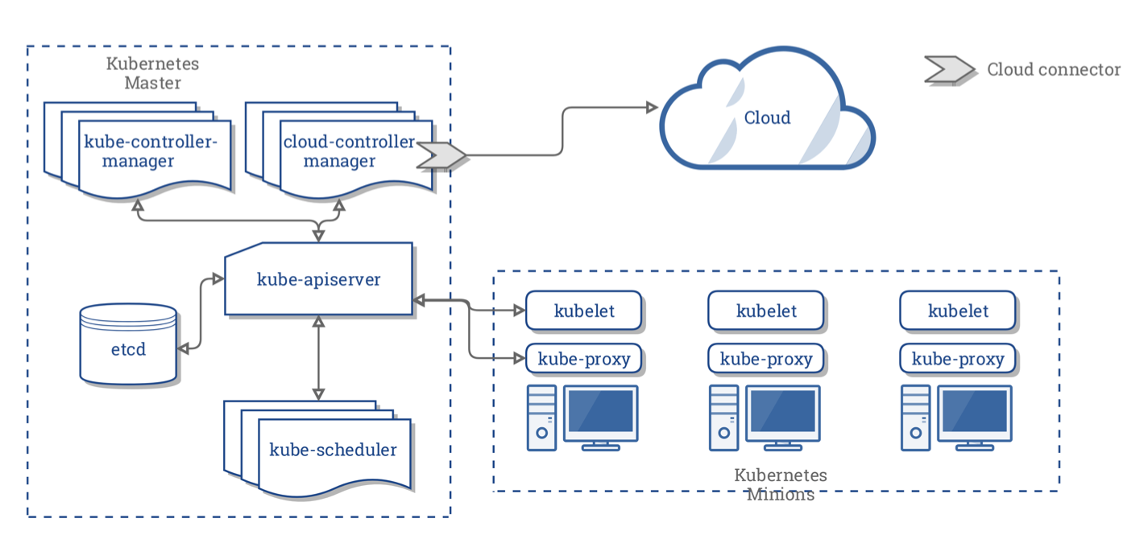
Kubernetes Architecture
Notes:
Kubernetes is made of a central manager (master) and some worker nodes (here called minions).
Master runs
API server: exposes the API with which you can communicate via kubectl
Scheduler: kube-scheduler sees the requests for running containers coming from the API and finds a suitable node to run them
Various controllers
A storage system (etcd) to keep the state of the cluster, container settings and network configuration
Nodes run:
Kubelet: received requests to run the containers, manages any necessary resources and watches them on the local node
Kube-proxy: creates and manages networking rules to expose the container over the network

Slide 4
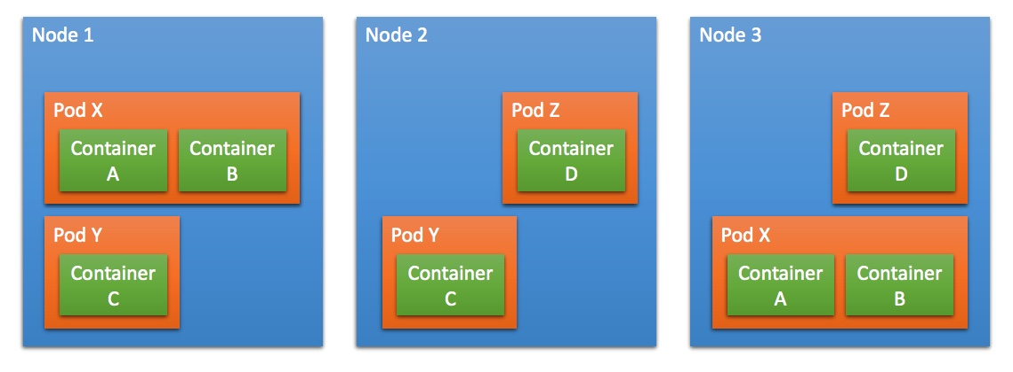
Kubernetes Runtime

Slide 5
What does KuberneteS do?
Provide a runtime environment for Docker containers
Scale and load balance docker containers
Abstract away the infrastructure containers run on
Monitor/health check containers
Declarative definition for running containers
Update containers (also rolling updates)
Storage mounting (allow abstracting infrastructure)
Service discovery and exposure
Labelling and selection of any kind of object

Slide 6
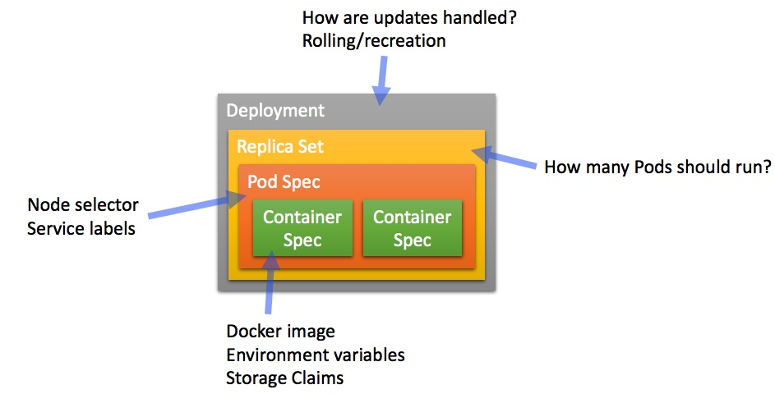
Abstractions: “Boxes in Boxes”
Notes:
Pods are the smallest deployable units of computing that can be created and managed in Kubernetes.
Pods consist of one or more containers which share IP address, access to storage and namespace. Typically, one container inside a pod runs an application, while others support the primary application. You can add labels (key-value pairs), which become part of the object metadata, and are used to select and filter pods.
Orchestration in k8s is managed through a series of watch-loops called controllers. Each controller interrogates the kube-apiserver for a particular object state, modifying the object until it matches the declared state.
The replica set is a controller which deploys an restarts pods, until the the requested number of pods is running.
The deployment ensures that resources are available, such as storage and IP address and deploys a replica set. The deployment specifies how updates to the replica set are handled.

Slide 7
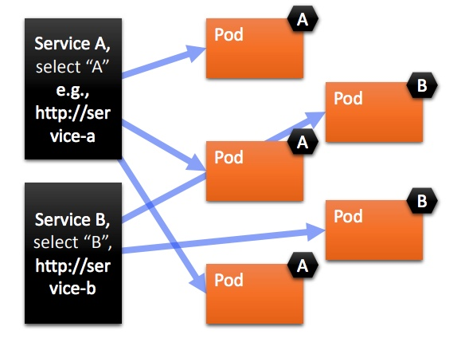
Abstractions: SErvices
Notes:
A service provides a way to refer to a set of Pods (selected by labels) with a single static IP address. It may also provide load balancing, if supported by the provider.

Slide 8
Installation
You can use any of Chef, Puppet, Ansible, Terraform
The hard way:
Kubeadm: https://kubernetes.io/docs/setup/independent/create-cluster-kubeadm/
Kubespray: advanced Ansible playbook to install k8s on varios OS
Kops: create k8s cluster on AWS via a single command
Kube-aws: makes use of AWS Cloud Formation
Kubicorn: makes use of kubeadm
The easy way:
EKS

Slide 9
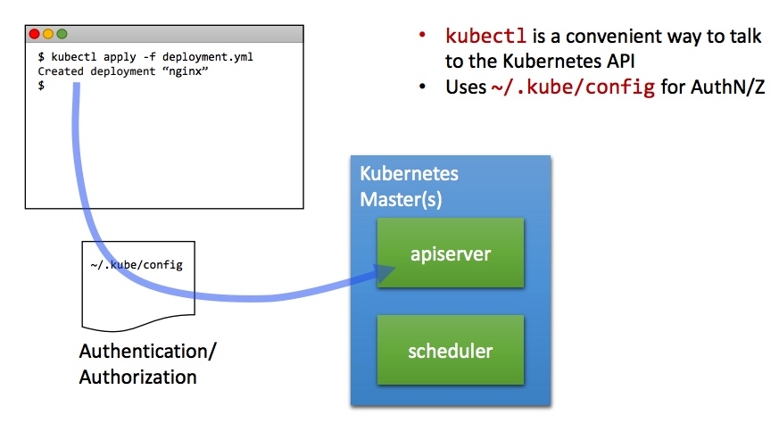
Kubectl

