Slide 1
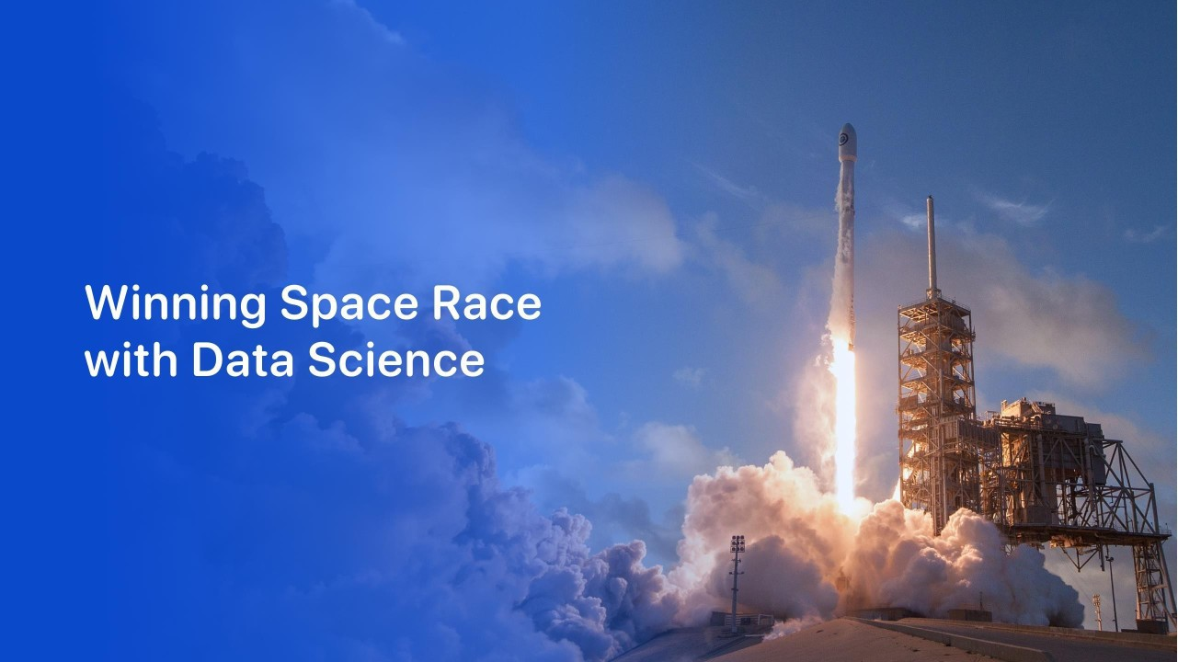

Medam Adi Naga Manendra Reddy
21471A05I0
22nd March 2024

Slide 2
Outline
Executive Summary
Introduction
Methodology
Results
Conclusion
Appendix
2

Slide 3
Executive Summary
Summaryof methodologies
- DataCollection throughAPI
Data Collection with Web Scraping
DataWrangling
Exploratory DataAnalysis with SQL
ExploratoryData AnalysiswithData Visualization
Interactive VisualAnalytics with Folium
Machine LearningPrediction
Summaryof all results
-
-
-
ExploratoryDataAnalysis result Interactive analytics in screenshots Predictive Analyticsresult
3

Slide 4
Introduction
Projectbackgroundand context
Space X advertises Falcon 9 rocket launches on its website with a cost of 62 million dollars; other providers cost upward of 165 million dollars each, much of the savings is because Space X can reuse the first stage. Therefore, if we can determine if the first stage will land, we can determine the cost of a launch. This information can be used if an alternate company wants to bid against space X for a rocket launch. This goal of the project is to create a machine learning pipeline to predict if the first stage will land successfully.
Problems you want to find answers
What factors determine if the rocket will land successfully?
The interactionamongstvarious features that determine the successrate of a successful landing.
What operating conditions needs to be in place to ensure a successful landing program.
4

Slide 5

5

Slide 6
Methodology
Executive Summary
Data collectionmethodology:
Data was collected using SpaceX API and web scraping from Wikipedia.
Perform data wrangling
One-hot encoding was applied to categorical features
Perform exploratorydata analysis (EDA) using visualization and SQL
Perform interactivevisual analytics using Foliumand Plotly Dash
Perform predictive analysis using classification models
How to build, tune, evaluate classification models

Slide 7
Data Collection
The data was collectedusing variousmethods
Data collection was done using get request to the SpaceX API.
Next, we decoded the response content as a Json using .json() function call and turn it into a pandas dataframe using .json_normalize().
We then cleaned the data, checked for missing values and fill in missing values where necessary.
In addition, we performed web scraping from Wikipedia for Falcon 9 launch records with BeautifulSoup.
The objective was to extract the launch records as HTML table, parse the table and convert it to a pandas dataframe for future analysis.

Slide 8
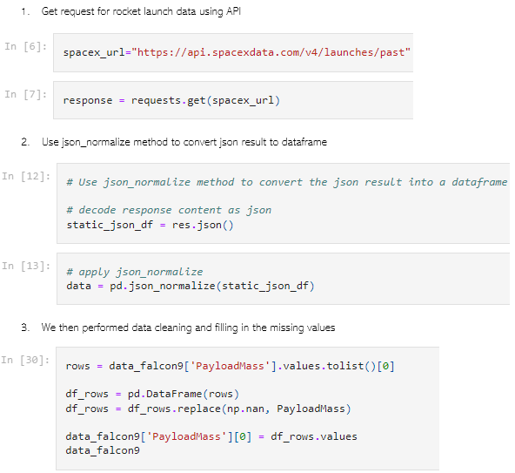
Data Collection – SpaceX API
Weused the get request to the SpaceX APIto collect data, clean the requested data and did some basic data wrangling and formatting.
The link to the notebook is https:
//github.com/chuksoo/IBM- Data-Science
-Capstone- SpaceX/blob/main/Data%20Collect ion%20API.ipynb.

Slide 9
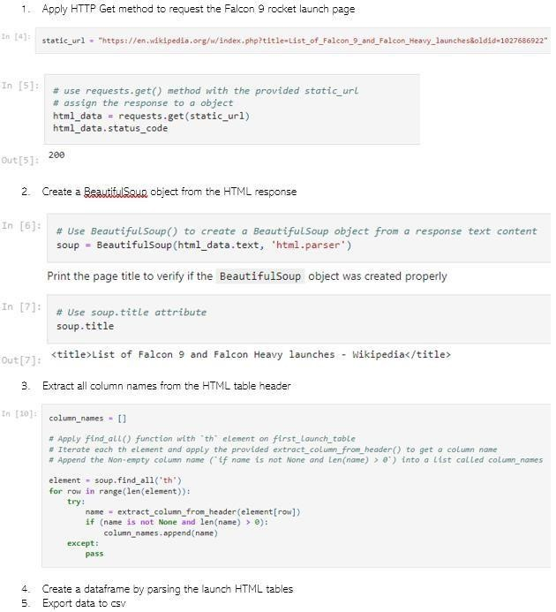
Data Collection - Scraping
We applied web scrappingto webscrap Falcon 9 launch records with BeautifulSoup
Weparsed the table and converted it into a pandas dataframe.
The link to the notebook is https:
//github.com/chuksoo/IBM- Data-Science
-Capstone- SpaceX/blob/main/Data%20Collect ion%20with%20Web%20Scraping
.ipynb.

Slide 10
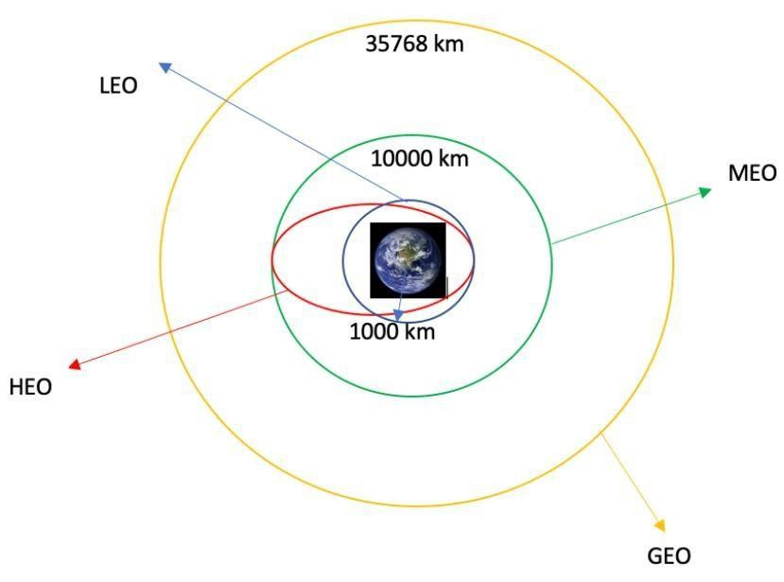
Data Wrangling
We performedexploratorydata analysis and determinedthe training labels.
Wecalculated the number of launches at each site, and the number and occurrence of each orbits
We createdlanding outcome label from outcome column and exported the results to csv.
The link to the notebook is https:
//github.com/chuksoo/IBM-Data- Science- Capstone- SpaceX/blob/main/Data%20Wrangling.ip ynb.

Slide 11
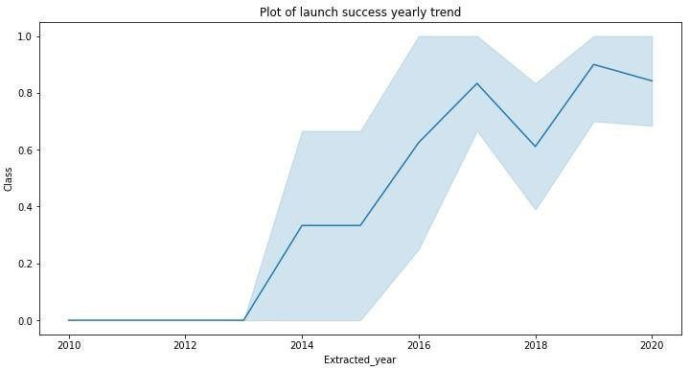
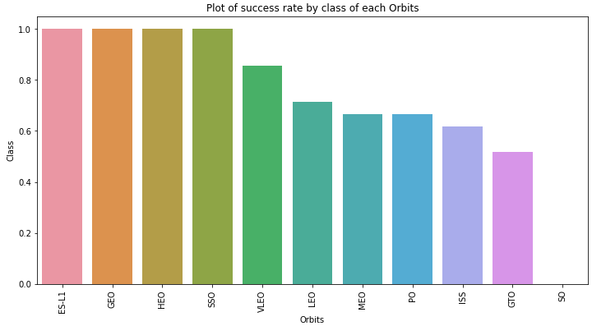
EDA with Data Visualization
We explored the data by visualizing the relationshipbetween flight number and launch Site, payload and launch site, success rate of each orbit type, flight number and orbit type, the launch success yearly trend.
The link to the notebook is https:
//github.com/chuksoo/IBM-Data- Science- Capstone- SpaceX/blob/main/EDA%20with%20D ata%20Visualization.ipynb

Slide 12
EDA with SQL
We loaded the SpaceX dataset into a PostgreSQL database without leaving the jupyter notebook.
Weapplied EDAwith SQLto get insight from the data. Wewrote queries to find out for instance:
-
-
-
-
-
Thenamesofunique launchsites in the spacemission.
Thetotalpayload masscarried by boosters launchedby NASA(CRS) Theaveragepayloadmasscarried by booster version F9 v1.1 Thetotalnumber of successfuland failuremissionoutcomes
Thefailedlandingoutcomesindrone ship,theirbooster versionandlaunchsitenames.
The link to the notebook is https://github.com/chuksoo/IBM-Data-Science- Capstone- SpaceX/blob/main/EDA%20with%20SQL.ipynb

Slide 13
Build an Interactive Map with Folium
Wemarked all launch sites, and added map objects such as markers, circles, lines to mark the success or failure of launches for each site on the folium map.
Weassigned the feature launch outcomes (failure or success) to class 0 and 1.i.e., 0 for failure, and 1 for success.
Using the color-labeledmarker clusters, we identified which launch sites have relativelyhigh success rate.
Wecalculated the distances between a launch site to its proximities. Weanswered some question for instance:
Are launch sites nearrailways, highways and coastlines.
Do launch sites keep certaindistance away from cities.

Slide 14
Build a Dashboard with Plotly Dash
We built an interactive dashboard with Plotly dash
Weplotted pie charts showing the total launches by a certain sites
Weplotted scatter graph showing the relationship with Outcome and Payload Mass (Kg) for the different booster version.
The link to the notebook is https://github.com/chuksoo/IBM-Data-Science- Capstone- SpaceX/blob/main/app.py

Slide 15
Predictive Analysis (Classification)
Weloaded the data using numpy and pandas, transformed the data, split our data into training and testing.
Webuilt different machine learning models and tune different hyperparameters using GridSearchCV.
Weused accuracy as the metric for our model, improved the model using feature engineeringand algorithm tuning.
Wefound the best performing classification model.
The link to the notebook is https://github.com/chuksoo/IBM-Data-Science- Capstone-SpaceX/blob/main/Machine%20Learning%20Prediction.ipynb

Slide 16
Results
Exploratorydata analysis results
Interactive analytics demo in screenshots
Predictive analysis results

Slide 17


Slide 18
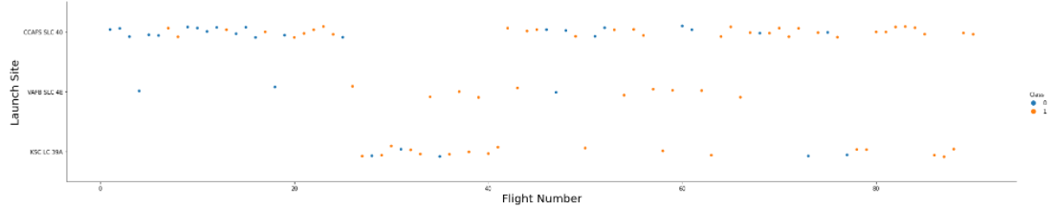
Flight Number vs. Launch Site
From the plot, we found that the larger the flight amount at a launch site, the greater the success rate at a launch site.
18

Slide 19

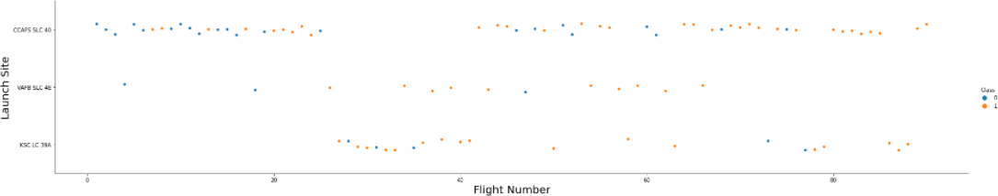
Payload vs. LaunchSite
19

Slide 20

Success Rate vs. Orbit Type
From the plot, we can see that ES-L1, GEO,HEO,SSO,VLEOhad the most success rate.
20

Slide 21
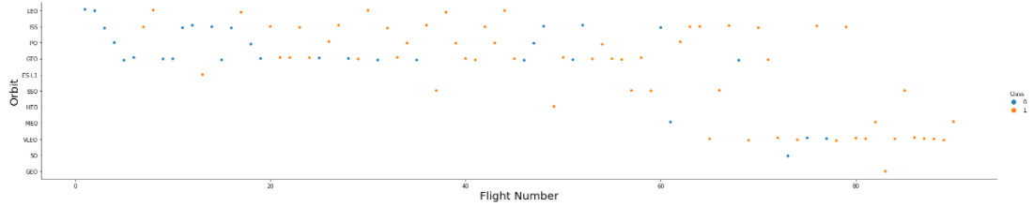
Flight Number vs. Orbit Type
Theplot below shows the Flight Number vs. Orbit type. Weobserve that in the LEO orbit, success is related to the number of flights whereas in the GTO orbit, there is no relationshipbetween flight number and the orbit.
21

Slide 22
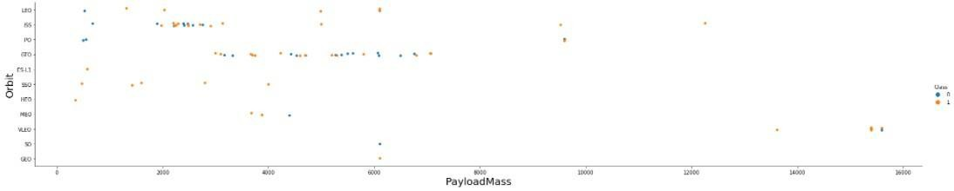
Payload vs. Orbit Type
Wecan observe that with heavy payloads, the successful landing are more for PO, LEOand ISSorbits.
22

Slide 23

Launch SuccessYearly Trend
From the plot, we can observe that successrate since 2013 kept on increasing till 2020.
23

Slide 24

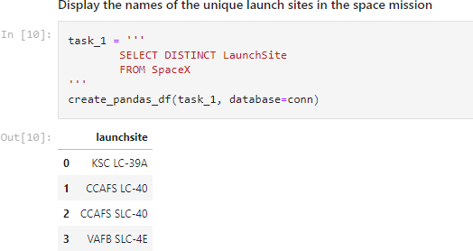
All Launch Site Names
Weused the key word DISTINCT to show only unique launch sites from the SpaceX data.
24

Slide 25
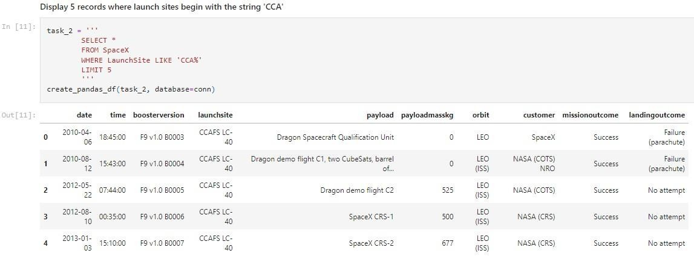
Launch Site Names Begin with 'CCA'
We used the query above to display 5 recordswhere launch sites begin with
`CCA`
25

Slide 26
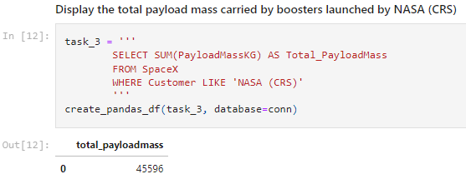
Total Payload Mass
Wecalculated the total payload carried by boosters from NASAas 45596 using the query below
26

Slide 27

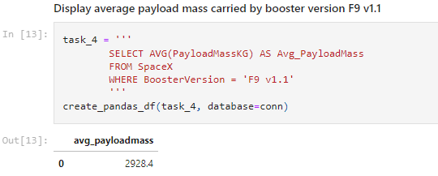
Average Payload Mass by F9 v1.1
Wecalculated the average payloadmass carriedby booster version F9 v1.1 as 2928.4
27

Slide 28
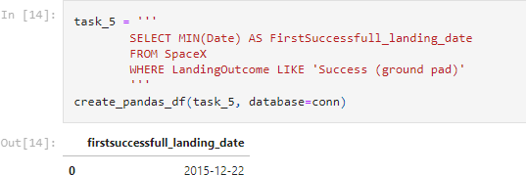
First Successful Ground Landing Date
We observedthat the dates of the first successful landing outcome on ground pad was 22nd December 2015
28

Slide 29
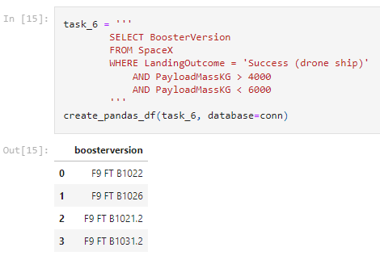
Successful Drone Ship Landing with Payload between 4000 and 6000
We used the WHEREclause to filter for boosterswhichhave successfully landed ondrone ship and appliedthe AND condition to determine successfullanding with payload mass greater than 4000 but less than 6000
29

Slide 30
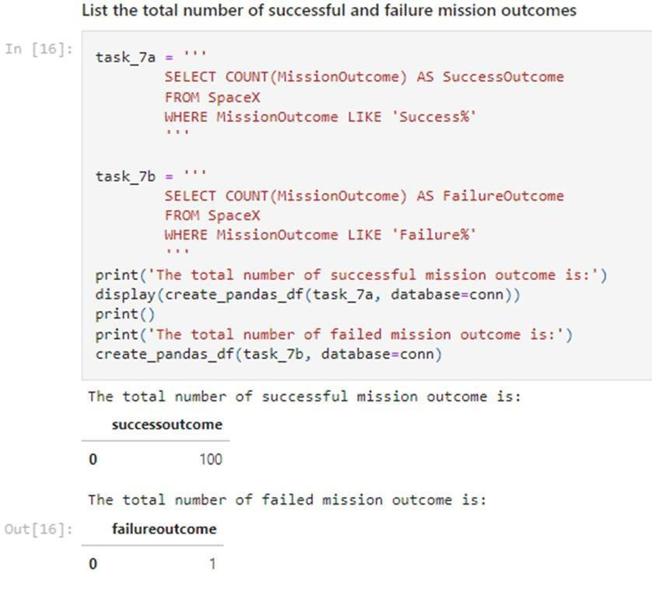
Total Number of Successful and Failure Mission Outcomes
We used wildcardlike ‘%’ to filter for WHEREMissionOutcome was a successor a failure.
30

Slide 31

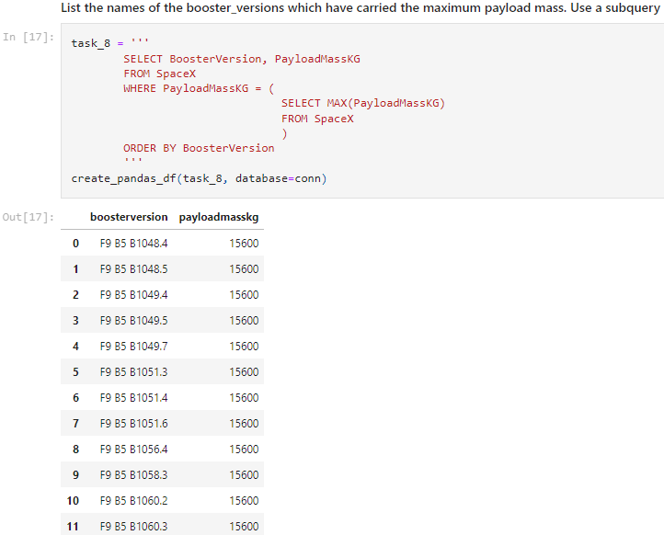
Boosters Carried Maximum Payload
•
Wedeterminedthe booster that have carriedthe maximum payload usingasubqueryinthe WHERE clause and the MAX() function.
31

Slide 32



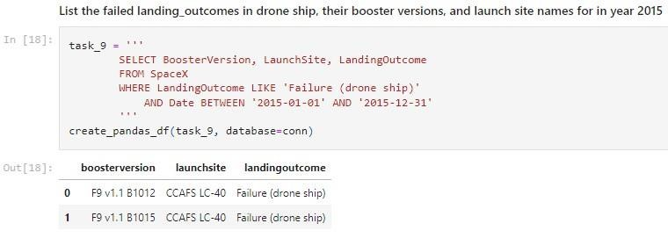
2015 Launch Records
Weused a combinations of the WHEREclause, LIKE,AND,and BETWEENconditions to filter for failed landing outcomes in drone ship, their booster versions, and launch site namesfor year 2015
32

Slide 33
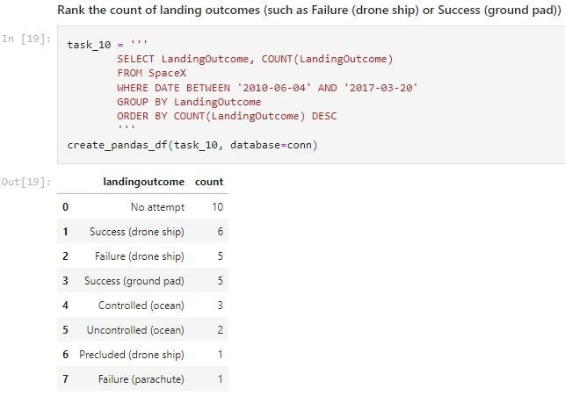

Rank Landing Outcomes Between 2010-06-04 and 2017-03
-20
We selected Landing outcomes and the COUNTof landing outcomes from the data and usedthe WHEREclause to filter for landing outcomes BETWEEN 2010-06-04 to 2010-03-20.
We appliedthe GROUP BY clause to group the landing outcomes and the ORDERBY clause to order the grouped landing outcome in descending order.
33

Slide 34


Slide 35
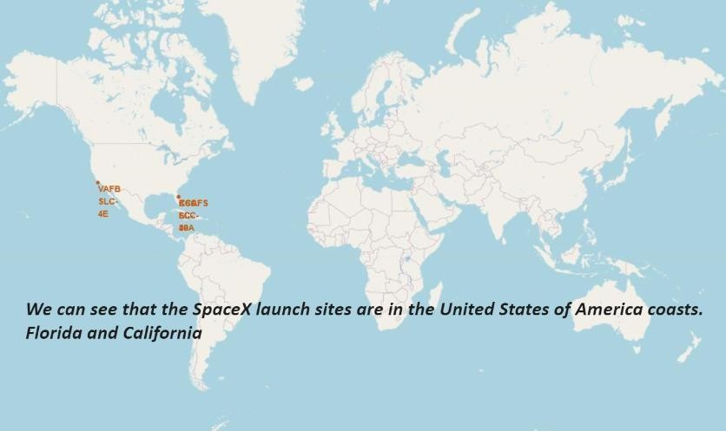
All launch sites global map markers
35

Slide 36
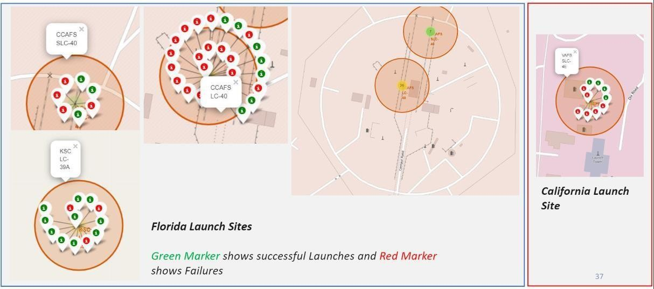
Markers showing launch sites with color labels
36

Slide 37
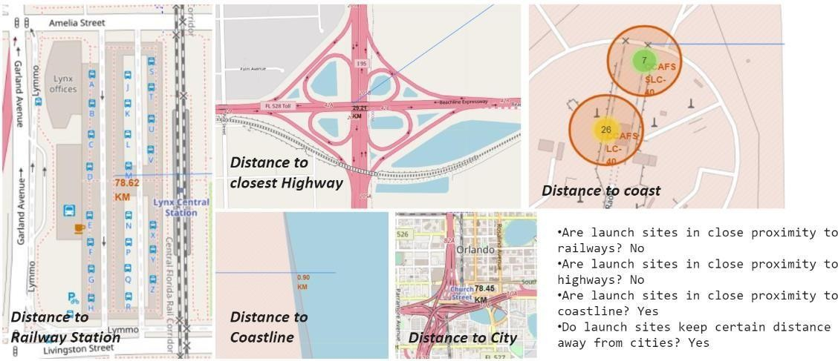
Launch Site distance to landmarks
37

Slide 38


Slide 39
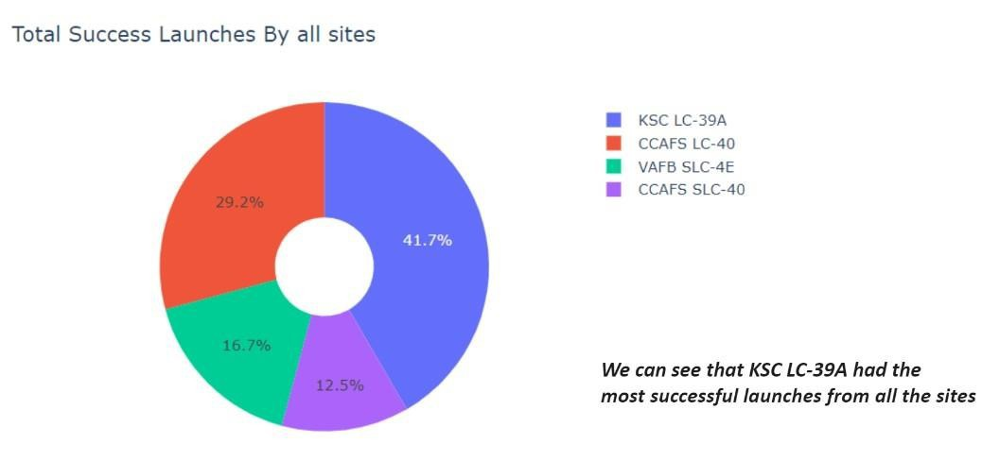
Pie chart showing the success percentage achieved by each launch site
39

Slide 40
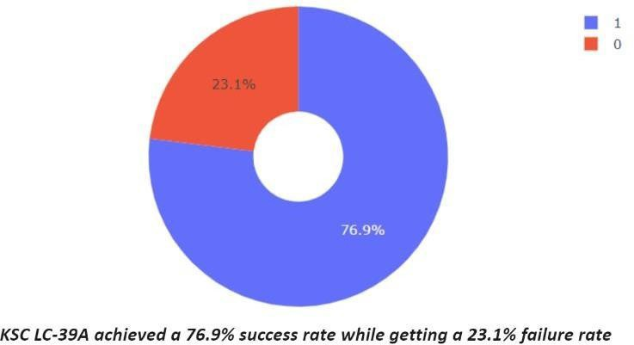
Pie chart showing the Launch site with the highest launch success ratio
40

Slide 41
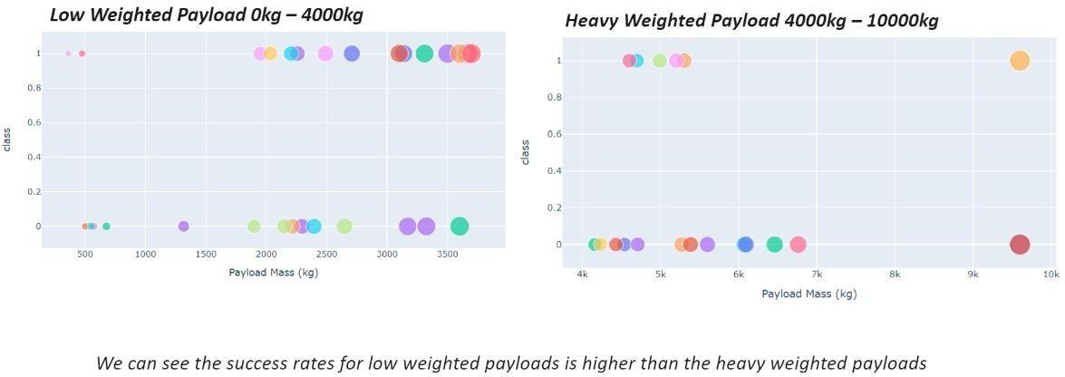
Scatter plot of Payload vs Launch Outcome for all sites, with different payload selected in the range slider
41

Slide 42


Slide 43

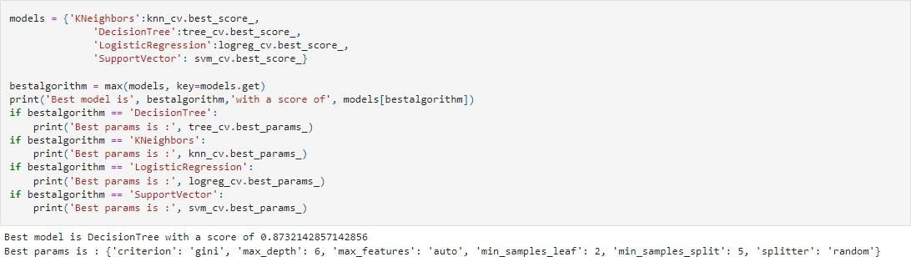
Classification Accuracy
The decision tree classifier is the model with the highest classification accuracy
43

Slide 44
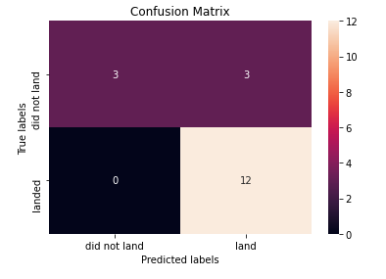
Confusion Matrix
The confusionmatrix for the decision tree classifier shows that the classifier can distinguish between the different classes. The major problem is the false positives.i.e., unsuccessfullanding marked as successful landing by the classifier.
44

Slide 45
Conclusions
We can conclude that:
The larger the flight amount at a launch site, the greater the success rate at a launch site.
Launch success rate started to increase in 2013 till 2020.
Orbits ES-L1, GEO, HEO,SSO, VLEO had the most success rate.
KSCLC-39A had the most successfullaunches of any sites.
The Decision tree classifier is the best machine learning algorithm for this task.
45

Slide 46


