Slide 1
compile-sast
Vulnerabilities as build failures, not CI failures.
Whitney Zilton
BSides Houston · September 17, 2026
Notes:
Open by naming the frustration in the room. This talk is about moving a specific class of security bugs out of the CI pipeline and into the compiler, where developers already live. Set expectations: ~10 minutes of framing, then a live walkthrough of compile-sast, then a discussion pod. Thank BSides Houston and Kristen.

Slide 2
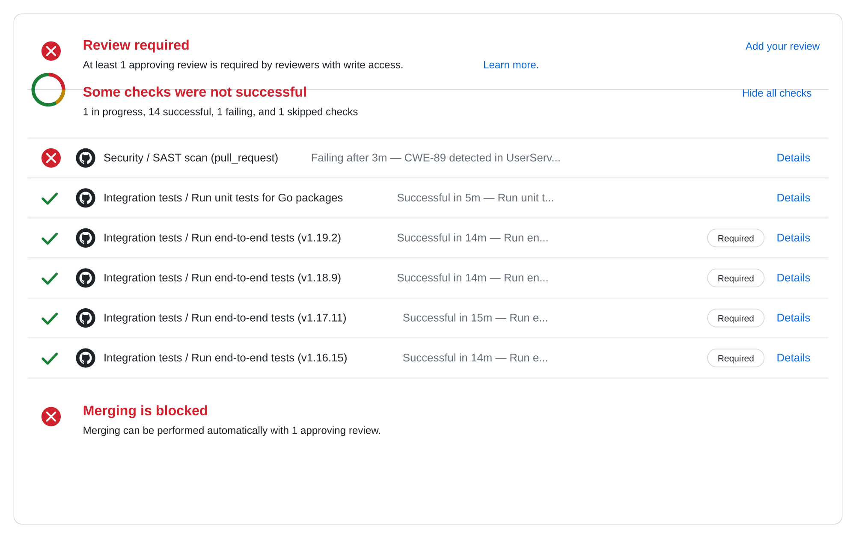
WHY
Motivation for building compile-sast
I finished the Jira ticket in my head.
Code compiles. Tests all pass. Configs are in order. I’m done, right? Right?!
Time to push up my branch… only to see the SAST scan in my ci/cd pipeline failed.
How can I find security vulnerabilities earlier in the SDLC?
compile-sast · BSides Houston 2026
Notes:
Land the emotional beat first — everyone in the room knows this feeling. The point is not that CI SAST is bad. The point is that its feedback arrives after the developer has mentally closed the ticket. Cost of that context switch is what we're going to price out on the next slide.

Slide 3
ABOUT ME
Background
Backend software engineer with over 5 years of experience.
I’ve worked in lots of teams on different languages: Go, Java, Kotlin, Python. Lots of Kafka-based microservices.
I’ve led threat modeling exercises, SAST/DAST/SCA integration, pentest coordination, and CVE remediation on teams.
Software engineer who cares about security 😊
compile-sast · BSides Houston 2026
ziltonportfolio.io
Notes:
30 seconds max on the bio. Do not read the card. Mention that this project came out of the day-job frustrations you're about to describe. If audience is mostly security folks, lean on the developer background. If it's mostly developers, lean on the AppSec pivot.

Slide 4
RELEVANCE
Why should I care?
LLMs suggest what they’ve seen.
Training data is full of MD5 hashes, string-concat SQL, hardcoded secrets in tutorial code. AI assistants happily reproduce those patterns.
"Looks reasonable" isn’t "is secure."
AI suggestions get accepted at higher rates than the same code would be written from scratch. Plausibility bypasses skepticism.
Volume goes up. Review capacity doesn’t.
More code lands per week. The same reviewers still have to catch the vulnerable patterns among all the safe ones.
A compile rule doesn’t care who typed it.
The same guardrail applies to your code, your teammate’s code, and whatever the AI wrote last Tuesday.
compile-sast · BSides Houston 2026
ziltonportfolio.io
Notes:
Don’t make this about "AI is bad." The audience will tune out. The framing is: even if AI-generated code is exactly as safe as human code, the volume argument stands. The point at the right of the slide is the takeaway. Read it out loud, pause, move on. If someone objects that Copilot suggestions are getting better, agree — and note that the compile-time guardrail costs nothing regardless of who’s right about that.

Slide 5
FEEDBACK
The later the signal, the more it costs
Cost of fixing a vulnerability
Compile-sast lives here
Where SAST usually catches it
IDE
Compile
CI
PR review
Production
compile-sast · BSides Houston 2026
ziltonportfolio.io
Notes:
You do not need real numbers here — everyone in the audience has this curve internalized. The specific claim: moving detection two stages left (from CI to compile) is not incremental, it is the difference between "still in flow" and "context switch." That is what the rest of the talk is about.

Slide 6
THESIS
If it can be a compile error,
it should be a compile error.
The compiler is the earliest, cheapest, most trusted feedback surface a developer touches.
compile-sast · BSides Houston 2026
Notes:
Slow down here. This is the sentence the talk hangs on. Read it, pause, then land the follow-up: the compiler is trusted in a way CI is not. A red squiggle or a build failure is not "the security team pushing back on my PR" — it's just the code not being finished yet.

Slide 7
PROJECT INFO
What is compile-sast?
LANGUAGE
MAPPINGS
Kotlin
10 OWASP/CWE-mapped vulnerability classes
K2 / FIR compiler plugin
Enforced at build time
LICENSE
DISTRIBUTION
MIT
Maven Central
permissive, portfolio-friendly
+ Gradle Plugin Portal
compile-sast · BSides Houston 2026
Notes:
This is the "what is it" slide. Keep it fast — do not read the tiles. Emphasize: this is a real published thing, not a research prototype. People can go pull it after the talk.

Slide 8
SCOPE
What is compile-sast not?
Not a full SAST
Not a dependency scanner
No taint tracking, no cross-procedural dataflow, no whole-program analysis. Semgrep, Snyk Code, and CodeQL still catch things this can’t.
compile-sast checks your source. Third-party libraries and transitive dependencies are still your SCA tool’s job.
Not language-agnostic
Not exhaustive
Kotlin only, tied to the K2/FIR checker API. The idea generalizes; the plugin doesn’t.
Each rule targets specific syntactic patterns, not every possible expression of its CWE. False negatives are real: that’s the trade-off for being safe to make blocking.
Complementary, not competitive. Keep this in your build; keep your SAST and SCA in CI.
compile-sast · BSides Houston 2026
ziltonportfolio.io
Notes:
Lead with the honesty. Naming what this tool isn’t buys credibility for what it is. Head off the "why not Semgrep / CodeQL?" question here so it doesn’t derail the demo. Land the bottom line: this sits alongside your existing SAST, it doesn’t replace it.

Slide 9
PROJECT LIMITATIONS
What is compile-sast not?
LANGUAGE
MAPPINGS
Kotlin
10 OWASP/CWE-mapped vulnerability classes
K2 / FIR compiler plugin
Enforced at build time
LICENSE
DISTRIBUTION
MIT
Maven Central
permissive, portfolio-friendly
+ Gradle Plugin Portal
compile-sast · BSides Houston 2026
Notes:
This is the "what is it" slide. Keep it fast — do not read the tiles. Emphasize: this is a real published thing, not a research prototype. People can go pull it after the talk.

Slide 10
LANGUAGE
Why Kotlin?
Kotlin
C#
Go
MECHANISM
MECHANISM
MECHANISM
K2 / FIR checker API
Roslyn analyzers
Out-of-compiler
AVAILABILITY
AVAILABILITY
AVAILABILITY
New in Kotlin 2.0
Standard since ‘15
staticcheck, gosec, golangci-lint
What compile-sast is built on. First-class compiler plugin surface.
.NET has done this for a decade. The template is proven.
Different model: analysis runs alongside the build, not inside it.
C# had this. Go’s ecosystem chose a different model. Kotlin K2 finally opened the door, and I’ve written in Kotlin for two years.
compile-sast · BSides Houston 2026
ziltonportfolio.io
Notes:
The honest answer is layered. Technical: K2 exposes a checker API that Kotlin didn’t have before. Comparative: C# has done this for years with Roslyn, so the pattern is proven; Go’s ecosystem chose to keep analysis outside the compiler and it works fine there. Personal: I use Kotlin at work, so the feedback loop for building rules was tightest here. Do NOT oversell Kotlin over Go or C# — the point is that the shape fits, not that Kotlin is better.

Slide 11
ARCHITECTURE
How it plugs in:
Kotlin source
K2 / FIR checker
Compiler diagnostic
your code
compile-sast rules
build fails, IDE marks the line
1
2
3
Same phase as the type checker.
The build fails. No new tool to install, no CI/CD step to wait on. The same feedback surface Kotlin developers already trust.
compile-sast · BSides Houston 2026
Notes:
Do not go deep on FIR internals unless someone asks — save it for the discussion pod. The point of this slide is: it is a regular compiler plugin, in the same lifecycle as type checking.

Slide 12
COVERAGE
Ten classes, enforced at build time
CWE-798
Hardcoded credentials
CWE-89
SQL injection
CWE-78
OS command injection
CWE-22
Path traversal
CWE-327
Weak cryptographic algorithm
CWE-338
Insecure randomness
CWE-611
XML external entities
CWE-502
Insecure deserialization
CWE-117
Log injection
CWE-918
Server-side request forgery
compile-sast · BSides Houston 2026
Notes:
Do not read all ten. Point out that they map cleanly to OWASP / CWE — this is a deliberate choice for audit-ability. Say which three you're about to walk through in code, then move on quickly.

Slide 13
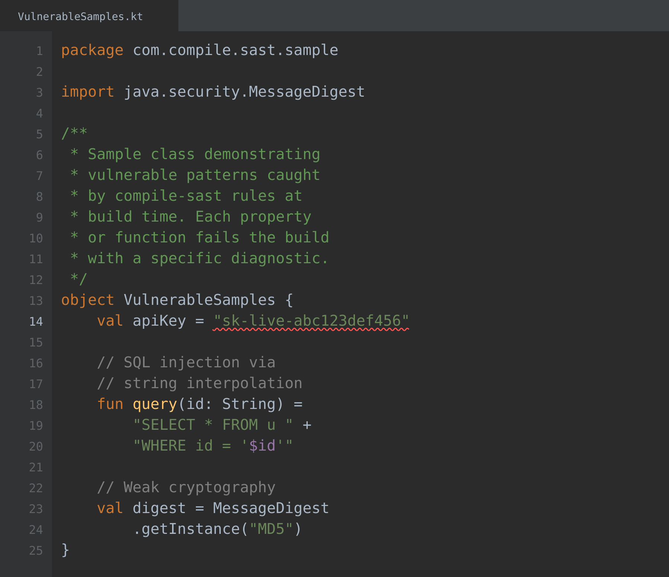
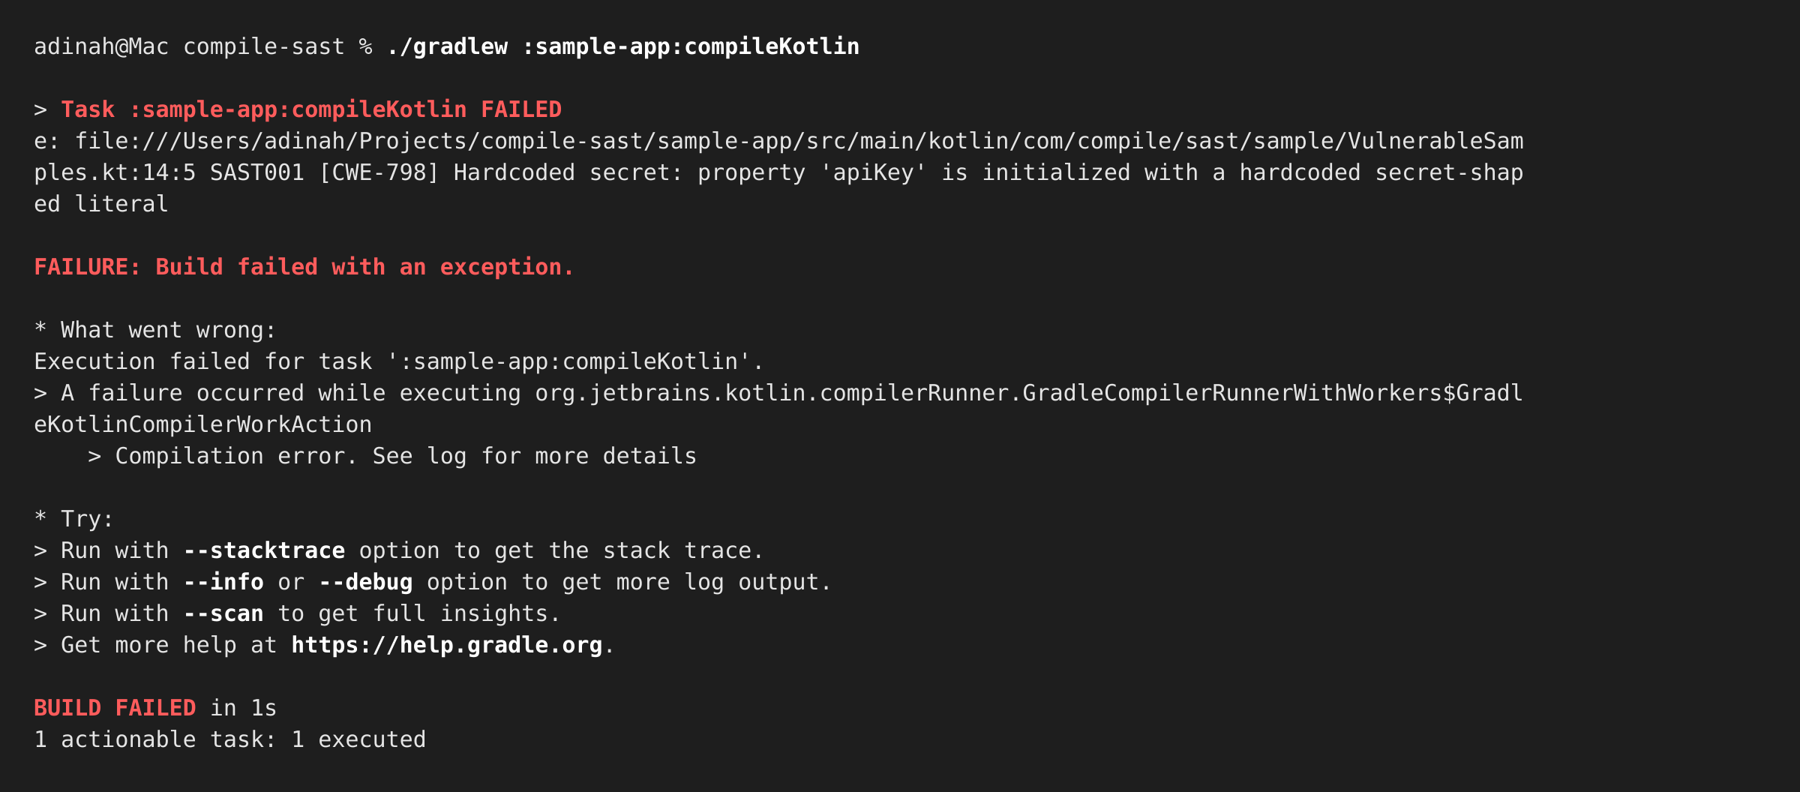
EXAMPLE · CWE-798
Hardcoded credentials
compile-sast · BSides Houston 2026
Notes:
Live-demo hint: keep the example small enough that the whole audience sees the offending line at once. Call out that the message points at the exact expression, not the file.

Slide 14
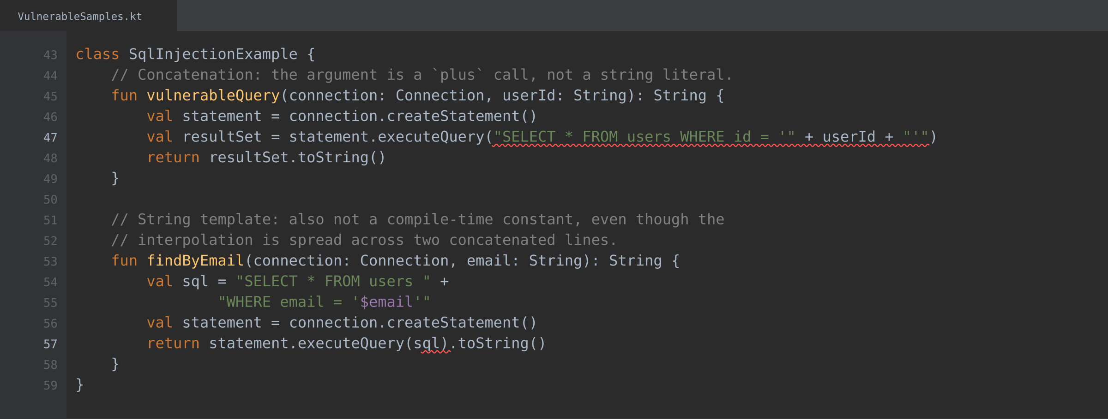
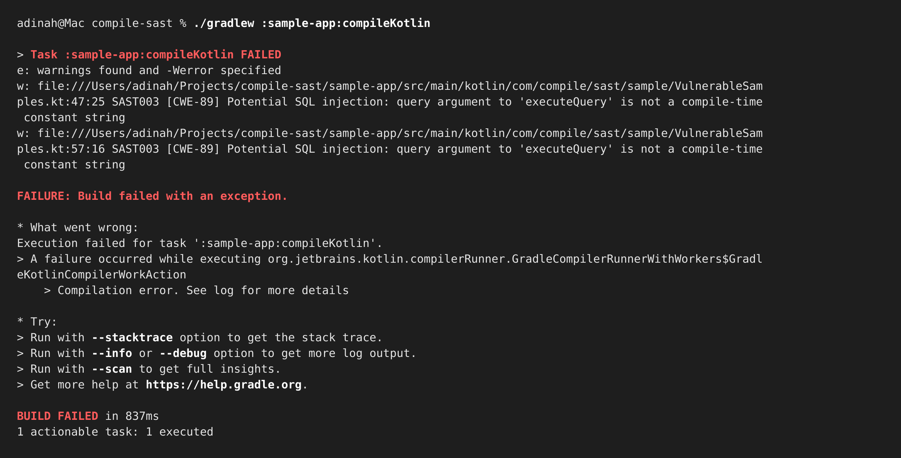
EXAMPLE · CWE-89
SQL injection via string concatenation
compile-sast · BSides Houston 2026
Notes:
This is the crowd-pleaser — everyone recognizes it. Mention: Kotlin string templates make this class especially easy to write and easy to catch — the interpolation is right there in the AST.

Slide 15
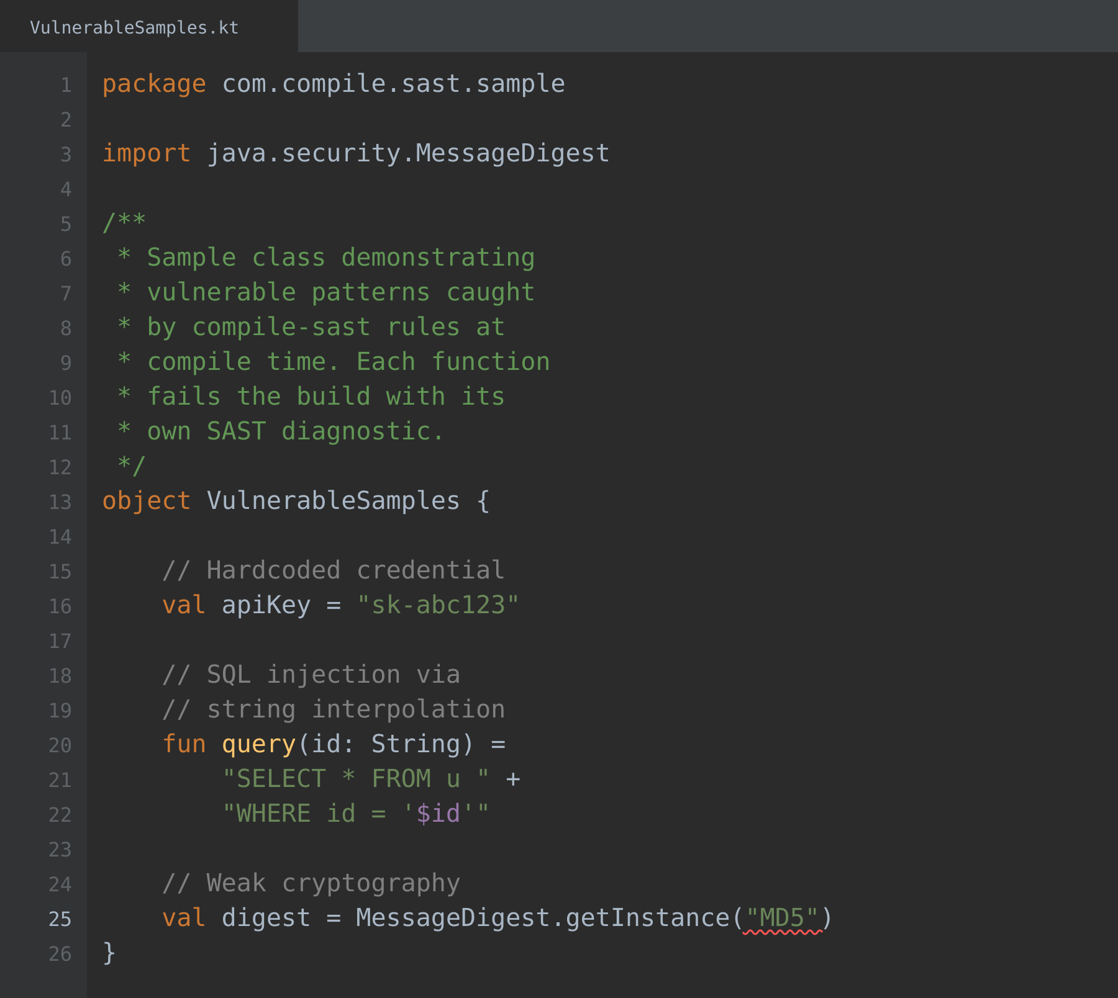
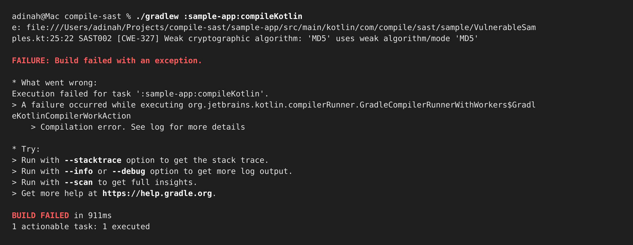
EXAMPLE · CWE-327
Weak cryptographic algorithm
compile-sast · BSides Houston 2026
Notes:
Point out the specificity of the diagnostic: the plugin knows this is a signing context, not a checksum. That distinction is why the rule is safe to make blocking.

Slide 16
LIVE
Demo
What you're about to see
A fresh Kotlin project with a clean build.
Introducing vulnerabilities and watching the build fail.
Fixing them and watching the build come back green.
compile-sast · BSides Houston 2026
Notes:
Before switching to the terminal: set expectations for what "failure" looks like on stage. Have a backup: if any command hangs, cut back to slide 13 and talk through the install instead. Font size in your terminal: bump to at least 18pt so the back row can read.

Slide 17
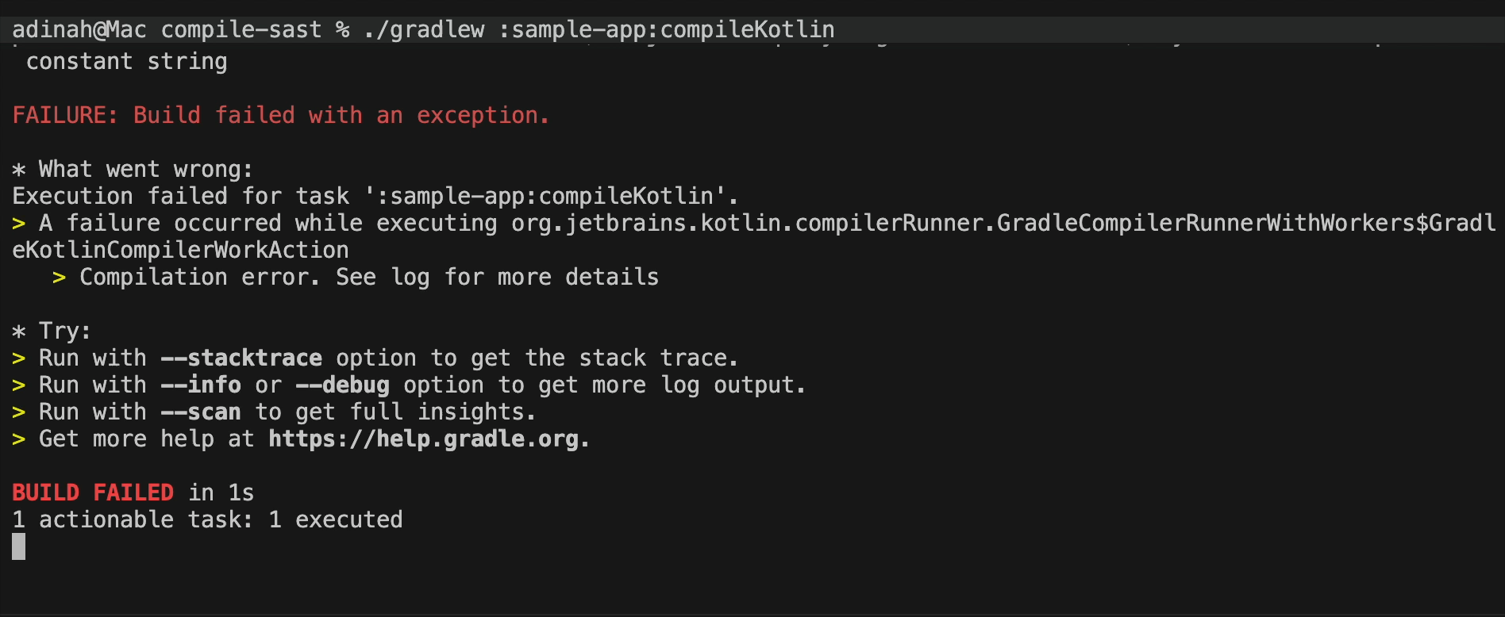
SCREENSHOT
Just in case the live demo doesn’t work :’)
Running ./gradlew :sample-app:compileKotlin in terminal
compile-sast · BSides Houston 2026
Notes:
Point out the specificity of the diagnostic: the plugin knows this is a signing context, not a checksum. That distinction is why the rule is safe to make blocking.

Slide 18
GETTING STARTED
Try it in your project
1
Add the plugin
2
Rebuild
3
Tune per-rule severity
One line in build.gradle.kts
Existing rules run on your source
Everything is opt-out, per module
build.gradle.kts
apply the plugin
plugins {
kotlin("jvm") version "2.0.0"
id("io.ziltonportfolio.compile-sast") version "0.1.0"
}
optional: tune per-rule behavior
compileSast {
rule("hardcoded-credentials").severity = "error"
rule("weak-crypto").severity = "warning"
}
compile-sast · BSides Houston 2026
Notes:
Give the room permission to try it on Monday. Update the version numbers and plugin ID on this slide before shipping the deck.

Slide 19
FUTURE ROADMAP
What's next
More rule classes
Taint tracking added
The next wave targets adjacent gaps: insecure JWT usage, missing session-cookie flags, and framework-specific access-control patterns.
Moves the project from a PoC to a legitimate open source SAST scanning tool.
Beyond Kotlin
SCA compiler plugin
The K2/FIR approach is Kotlin-specific by design, but the same shape works for any typed language with a plugin API.
I’m curious about potential adding more compiler plugins. An SCA scan for third party vulnerabilities (both direct and transitive) would be really cool to explore building.
compile-sast · BSides Houston 2026
Notes:
Keep this slide moving — it's a bridge to the discussion pod. Pick the two items you actually want feedback on and highlight those.

Slide 20
Let's keep talking.
Which rules would you want to be blocking vs. warning?
What's the boundary between "compiler's job" and "linter's job"?
How would you sell build-time enforcement to a skeptical team?
What are some of your thoughts on Shift Left philosophy?
compile-sast · BSides Houston 2026
Notes:
Do not let the deck end with a "thanks slide" that trails off. Ask a discussion prompt out loud and wait through the silence. If nobody bites, name someone in the room whose work you know is related and hand the mic to them. Have contact ready — the pod is the actual value for you.

Slide 21
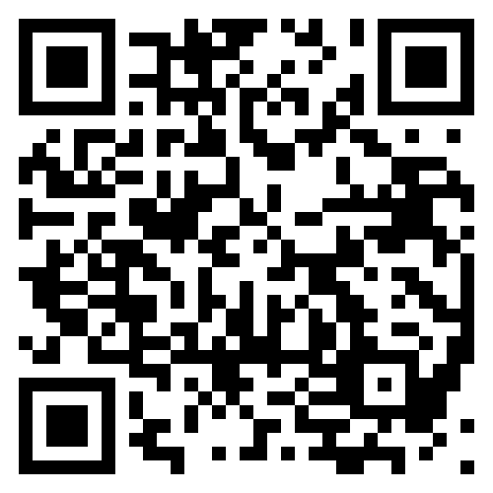
BYE
Connect with me ☺
Github:
https://github.com/adinahhh/compile-sast
Portfolio:
https://ziltonportfolio.io/
compile-sast · BSides Houston 2026
Notes:
Keep this slide moving — it's a bridge to the discussion pod. Pick the two items you actually want feedback on and highlight those.

