Slide 1
Strategic Customer Segmentation & Revenue Optimization
RFM Analysis & Behavioral Clustering
- Nallamilli Adi Narayana Reddy

Slide 2
Business Objective
(The "Why")
Problem: "A 'one-size-fits-all' marketing strategy is inefficient and wastes budget."
Objective: "To segment the customer base using transaction data to identify High-Value customers and At-Risk users."
Goal: "Provide actionable recommendations to maximize Customer Lifetime Value (CLV).

Slide 3
Source: [Kaggle - E-commerce Dataset]
Size: (541909, 8)
Timeframe: 01/12/2010 to 09/12/2011
Dataset Overview
Key Variables:
InvoiceNo: Unique transaction ID
StockCode: Unique product identifier
Description: Product description
Quantity: Number of items purchased
InvoiceDate: Timestamp of purchase
UnitPrice: Price per unit in GBP
CustomerID: Unique customer identifier
Country: Location of the customer

Slide 4
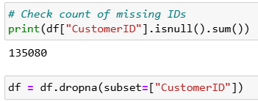
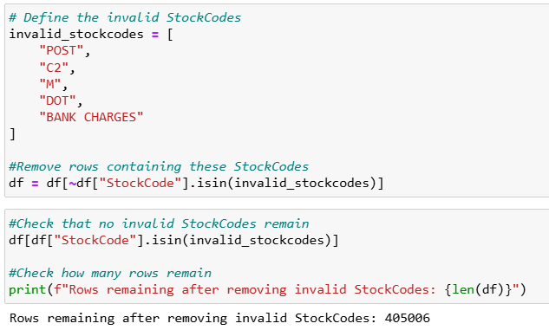
Data Preparation & Integrity
Ensuring Data Quality for Accurate Analysis:
1: Missing Data
Removed 135k records with missing IDs to ensure user trackability.
2: Invalid Codes
Excluded non-product transactions (Postage, Fees) to isolate sales demand.

Slide 5
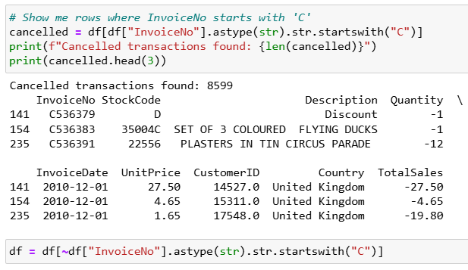
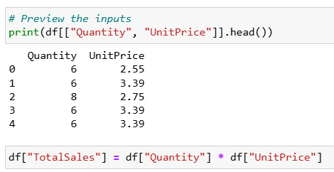
Data Preparation & Integrity
3: Cancellations
Filtered cancelled orders to prevent revenue distortion.
4: Feature Engineering
Calculated Total Sales (Qty * Price) to generate the Monetary (M) metric.

Slide 6
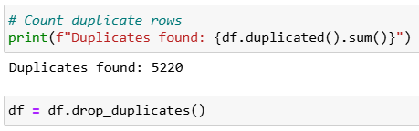
Data Preparation & Integrity
5. Removed Duplicates
Identified and removed 5,220 duplicate entries. Duplicate records would artificially double the Frequency and Revenue numbers, leading to false "High Value" categorizations.

Slide 7
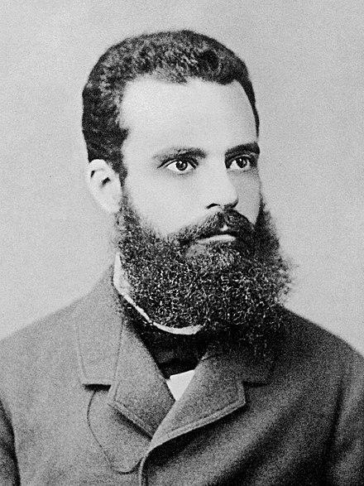
Pareto Principle:
“A small fraction of inputs generates the bulk of the results”

Slide 8
The Customer Insight
26.12%
Of customers contribute to
80%
Of total revenue
The business is highly dependent on a small "Vital Few." Losing a fraction of this top 26% would disproportionately impact the bottom line. Retention of this group is the #1 priority

Slide 9
The Product Insight
23.25%
Of products contribute to
80%
of sales volume
A small catalog drives the majority of sales. The remaining 79% of products ('The Long Tail') may be increasing storage costs without generating significant ROI.

Slide 10
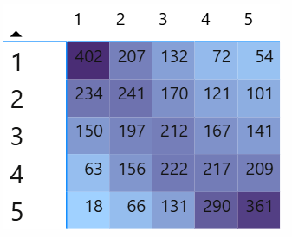
Behavioral Segmentation Methodology (RFM)
The Logic:
1. The Three Pillars of Value: We evaluated every customer on three key behavioural dimensions:
Recency (R): How long since their last purchase? (Proxy for: Engagement)
Frequency (F): How often do they transact? (Proxy for: Loyalty)
Monetary (M): How much total revenue have they generated? (Proxy for: Value)
2. The Scoring Mechanism (Quintiles): Using SQL's NTILE(5) function, we statistically ranked and divided customers into 5 equal groups:
Score 5: Top 20% (Best performance in that category).
Score 1: Bottom 20% (Worst performance in that category).
3. Segmentation Output (Order 1–4):
High Value, Medium Value, Low Value, Dormant
The Visual:
“Concentration of Customer Value: The top-right red zone represents high-frequency, recent buyers (Champions).”

Slide 11
High Value: Recent buyers who spend heavily and frequently.
Medium Value: Regular shoppers with average spending habits.
Low Value: Infrequent buyers or low-ticket purchasers.
Dormant: High past activity but haven't purchased recently (Low Recency).
The Visual
Dormant
Low-Value
Medium-Value
High-Value

Slide 12
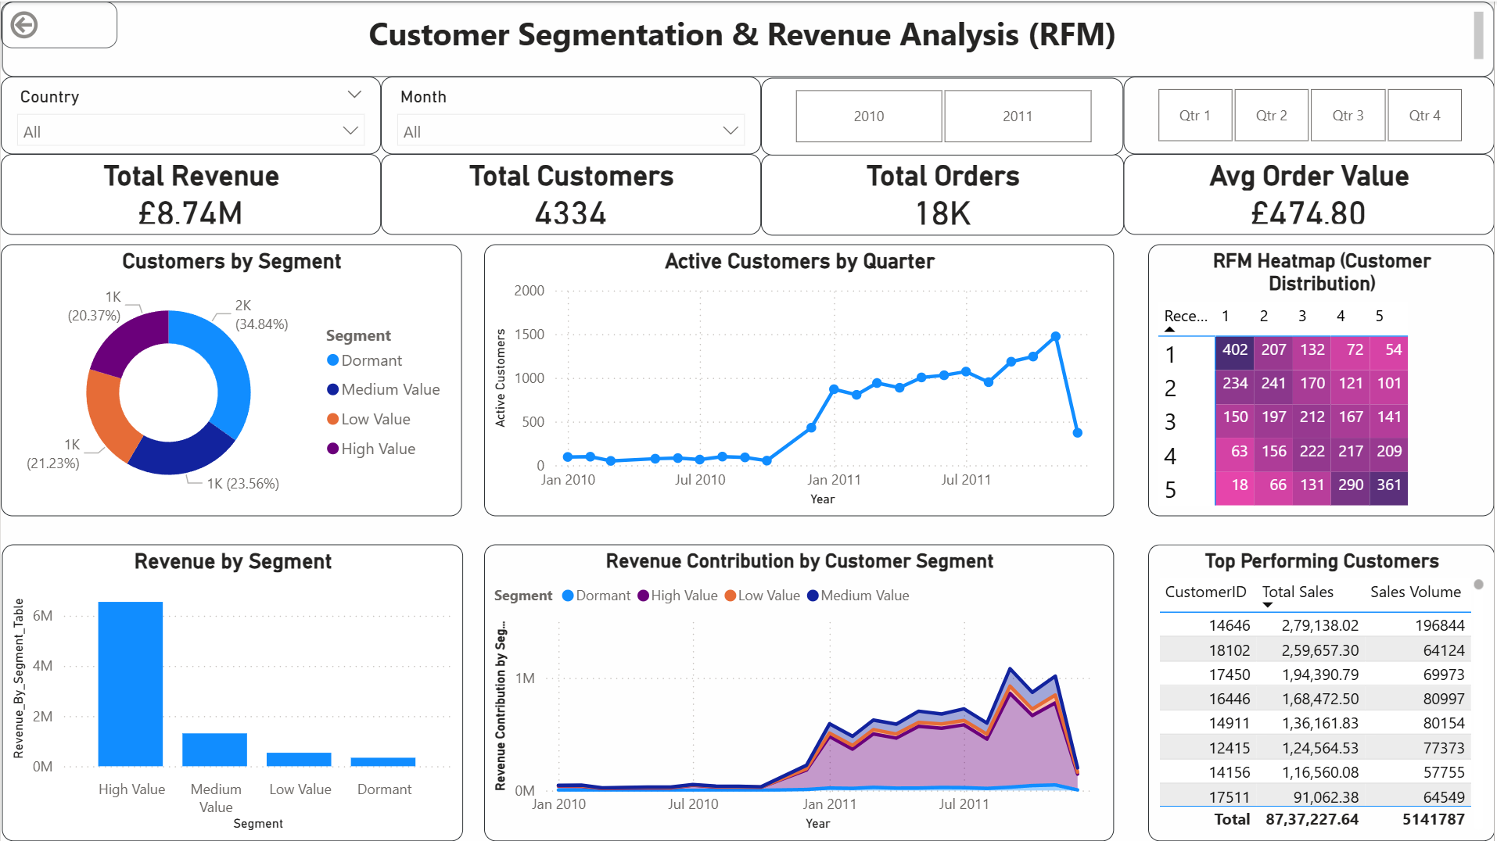
The Dashboard

Slide 13
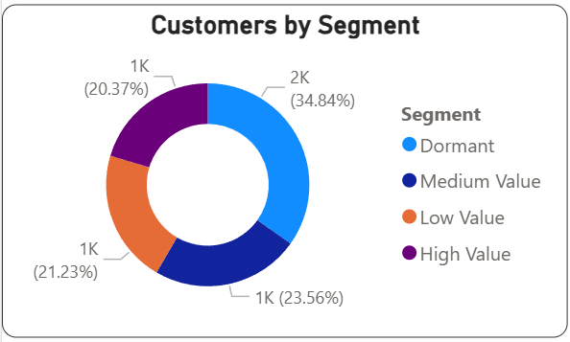
Profile: Top-tier spenders who buy frequently.
Goal: Retention & Advocacy.
Strategy: Implement a VIP Tiered Loyalty Program. Offer early access to new products and exclusive "Member-Only" discounts to lock in their loyalty.
High Value

Slide 14
Profile: Steady customers with average basket size.
Goal: Upsell & Growth.
Strategy: Use "Basket Analysis" (Market Basket) to recommend complementary products. Send personalized "Complete the Look" emails to increase their Average Order Value (AOV).
Medium Value

Slide 15
Profile: Previously active customers who haven't purchased recently.
Goal: Reactivation.
Strategy: Launch an aggressive "Win-Back" campaign. Send surveys to understand why they left, coupled with a high-value, time-sensitive discount (e.g., "We miss you – Take 20% off").
Dormant

Slide 16
Profile: Occasional shoppers or one-time buyers.
Goal: Consistent Engagement.
Strategy: Automate engagement using low-cost channels (Push Notifications / Newsletters). Keep the brand top-of-mind without spending high ad budgets.
Low Value

Slide 17
Thank You!

