Slide 1
KPI Analysis of Lowell General Hospital
Adi Narayana Reddy Nallamilli

Slide 2
Problem Statement and Objective
Problem Statement:
Lowell General Hospital is committed to prioritizing patient well-being. To uphold this mission, we closely monitor key factors that impact patient safety and satisfaction. A structured analysis of these metrics is essential to identify trends, assess performance, and develop data-driven recommendations for enhancing customer satisfaction.
Objective:
Assess KPI impact on customer experience.
Analyze correlations between KPIs.
Benchmark performance and recommend improvements.

Slide 3
Dataset Overview
Source: Lowell General Hospital Dataset
Size: (60, 4)
Timeframe: 01/01/2020 to 01/12/2024
Key Variables:
Month
Average Licensed Bed Occupancy Rate
Unassisted Fall Rate per 1,000 Patient Days
Staff Responsiveness Domain Top Box Score

Slide 4

Understanding KPIs
1. Average Licensed Bed Occupancy Rate
This metric is recorded internally and expressed as a percentage. It represents the proportion of licensed hospital beds that are occupied over a specified period and is calculated as

Slide 5
Understanding KPIs
2. Staff Responsiveness Top Box Score
The HCAHPS survey, administered to patients after discharge, evaluates staff responsiveness using two primary questions:
Q1. How frequently did hospital staff provide assistance soon after you pressed the call button?
Q2. How often did you receive prompt help with bathroom needs or the use of a bedpan?
It is calculated as:

Slide 6
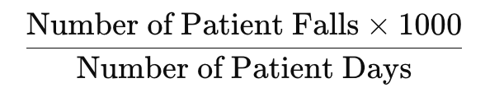
Understanding KPIs
3. Unassisted Patient Falls per 1,000 Patient Days
This metric is reported by the National Database of Nursing Quality Indicators (NDNQI). A patient fall is described as an unintended drop to the ground, whether or not an injury occurs. Unassisted falls occur when no healthcare staff member is present to support the patient. This indicator is calculated as:

Slide 7
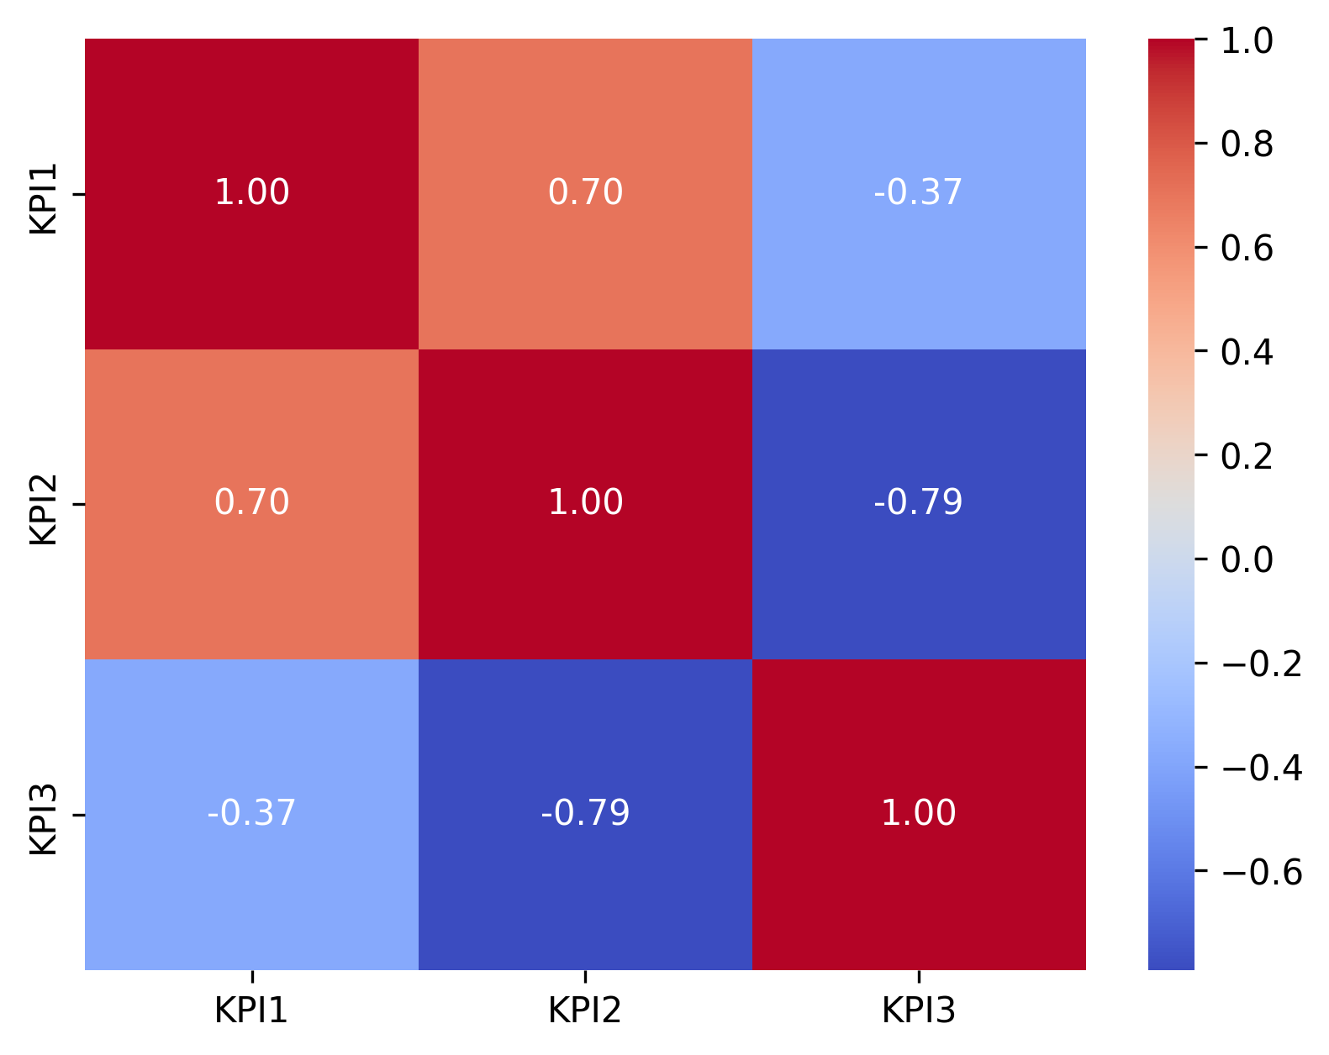
Relationship between the KPIs
Bed Occupancy Rate & Fall Rate per 1,000 Patient Days: 0.70 (Strong positive correlation)
Bed Occupancy Rate & Staff Responsiveness Score: -0.37 (Moderate negative correlation)
Fall Rate per 1,000 Patient Days & Staff Responsiveness Score: -0.79 (Strong negative correlation)
Heatmap of Correlations between KPIs

Slide 8
Relationship between the KPIs
Bed Occupancy Rate & Fall Rate per 1,000 Patient Days: 0.70 (Strong positive correlation)
As the bed occupancy rate rises, the rate of unassisted patient falls also tends to increase.
Interpretation: Higher bed occupancy levels (i.e., more hospitalized patients) may place additional strain on hospital staff, potentially leading to an increase in fall incidents. This highlights a possible need for improved staffing levels or enhanced patient monitoring during periods of high occupancy.

Slide 9
Relationship between the KPIs
Bed Occupancy Rate & Staff Responsiveness Score: -0.37 (Moderate negative correlation)
As bed occupancy levels rise, staff responsiveness scores show a slight decline.
Interpretation: Increased occupancy may place added pressure on hospital staff, which can negatively impact their ability to respond promptly to patient needs. This suggests a potential need for improved resource allocation or targeted training during periods of high demand.

Slide 10
Relationship between the KPIs
Fall Rate per 1,000 Patient Days & Staff Responsiveness Score: -0.79 (Strong negative correlation)
As staff responsiveness scores increase, the rate of patient falls generally decreases.
Interpretation: Higher levels of staff responsiveness are strongly associated with reduced fall rates, as attentive and prompt staff are more likely to anticipate patient needs, enhance safety, and help prevent falls.

Slide 11
Relationship between the KPIs
Summary of Relationships between the KPIs:
Increased bed occupancy is linked to higher fall rates and a modest decline in staff responsiveness. This suggests that hospitals must ensure rising occupancy levels do not place excessive strain on staff, which could negatively affect patient safety and quality of care. Additionally, stronger staff responsiveness is closely associated with lower fall rates, highlighting that improved responsiveness enhances patient safety and helps reduce the occurrence of falls.

Slide 12
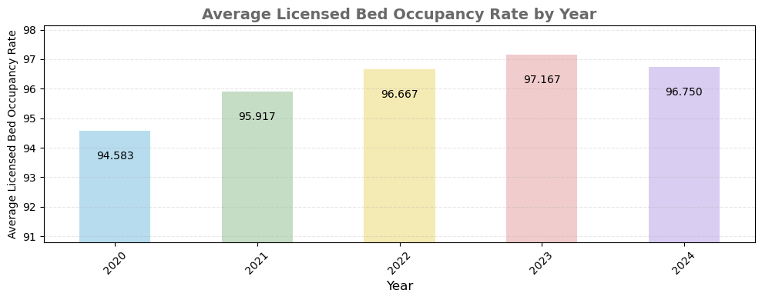
Trends in Data Over Time

Slide 13
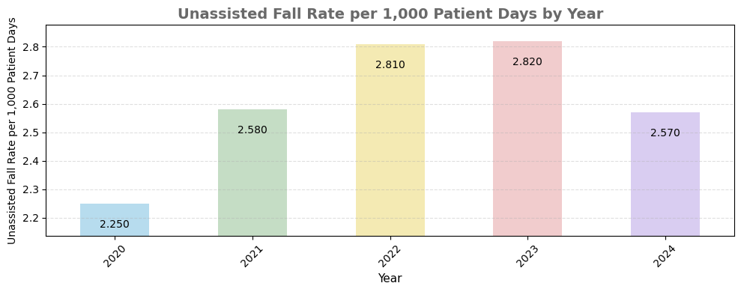
Trends in Data Over Time

Slide 14
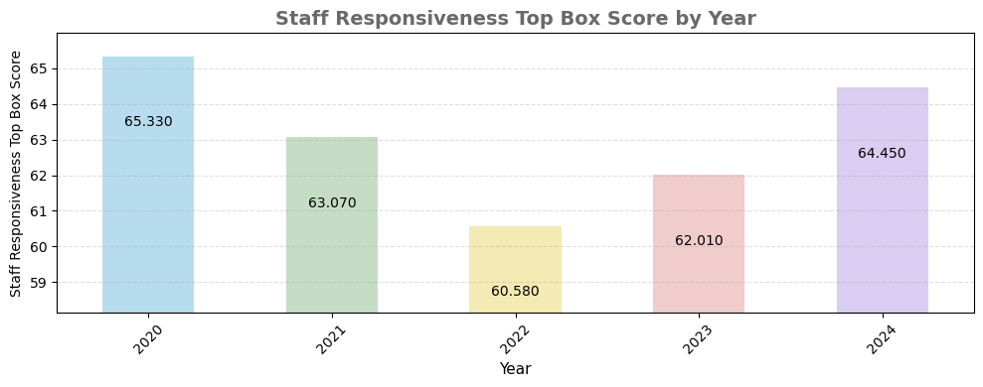
Trends in Data Over Time

Slide 15
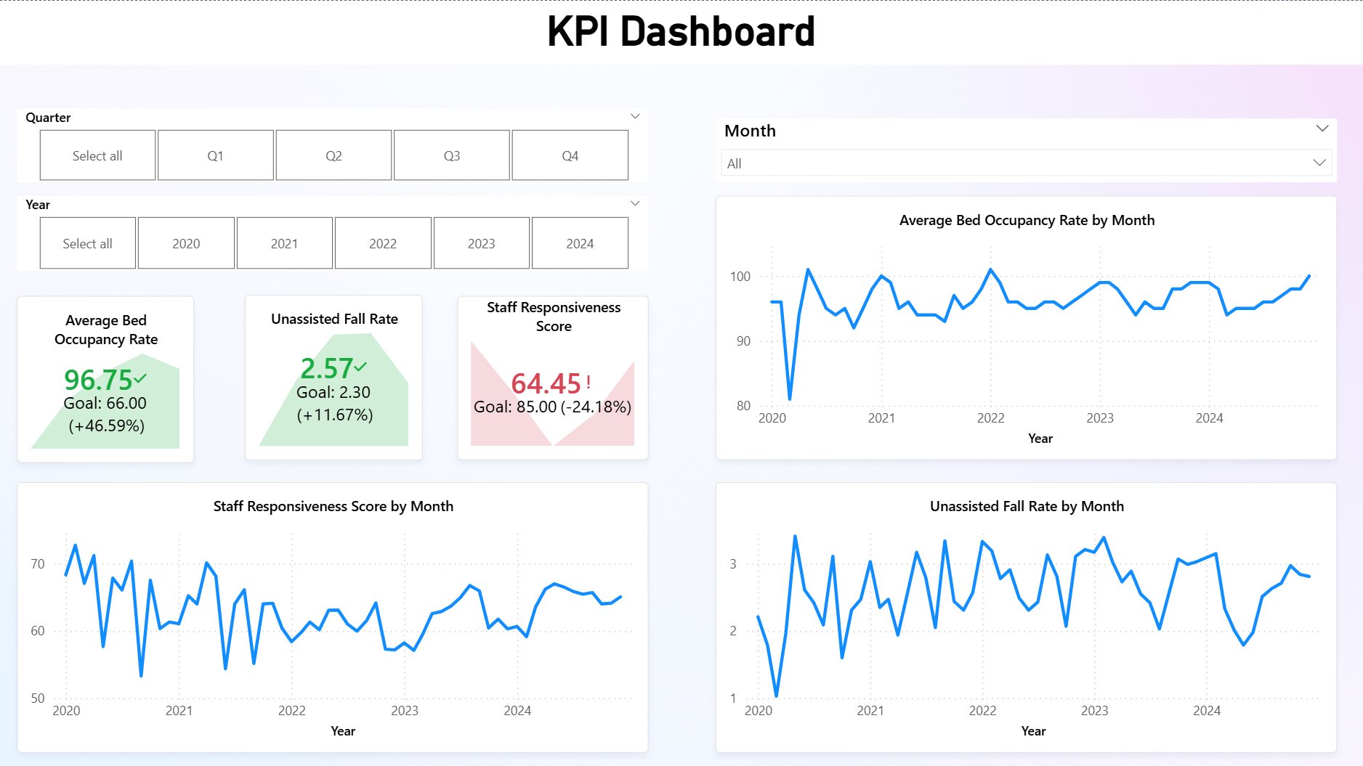

Slide 16
Benchmark Comparison
Average Licensed Bed Occupancy Rate:
LG Hospital: 96.22%
U.S. benchmark: ~66%
Inference:
Your facility shows a much higher occupancy rate than the national norm. This may reflect strong patient inflow, effective bed usage, or possible capacity constraints. Maintaining occupancy consistently above 85% could result in overcrowding, pressure on staff, and lower patient satisfaction.

Slide 17
Benchmark Comparison
Unassisted Fall Rate per 1,000 Patient Days:
L.G. Hospital: 2.61 falls per 1,000 patient days
Benchmark: 2.3 – 13 falls per 1,000 patient days
Inference:
Your hospital’s fall rate sits at the lower end of the national spectrum, which is encouraging. This indicates effective patient safety practices and fall prevention strategies. Nevertheless, ongoing monitoring is important to avoid rises, particularly when bed occupancy is high.

Slide 18
Benchmark Comparison
Staff Responsiveness Domain Top Box Score:
L.G. Hospital: 63.09%
Benchmark: 85% – 90%
Inference:
Your staff responsiveness score falls below industry benchmarks, suggesting potential delays in meeting patient needs. The elevated bed occupancy could be contributing, as staff may be overextended. Enhancing staffing, response times, and communication could improve this performance metric.

Slide 19
Benchmark Comparison
Summary of Benchmark Comparison:
Elevated bed occupancy combined with low staff responsiveness indicates possible operational pressure.
Even with high occupancy, fall prevention measures seem to be working effectively.
Enhancing staff responsiveness could boost patient satisfaction and overall hospital performance.

Slide 20
Thank YOU!

