Slide 1
Restaurant Full Moon – Game Design Document
Lumos^3
Yeonhee Do, Helei Huang

Slide 2
Game Overview
Genre: 2.5D Restaurant Tycoon Game
Two Scenes – Daytime (Kitchen), Nighttime (Street)
Main character – Warewolf
Obligations:
1. Earn money enough to pay the daily rent
2. Clean the street without being caught by passengers

Slide 3
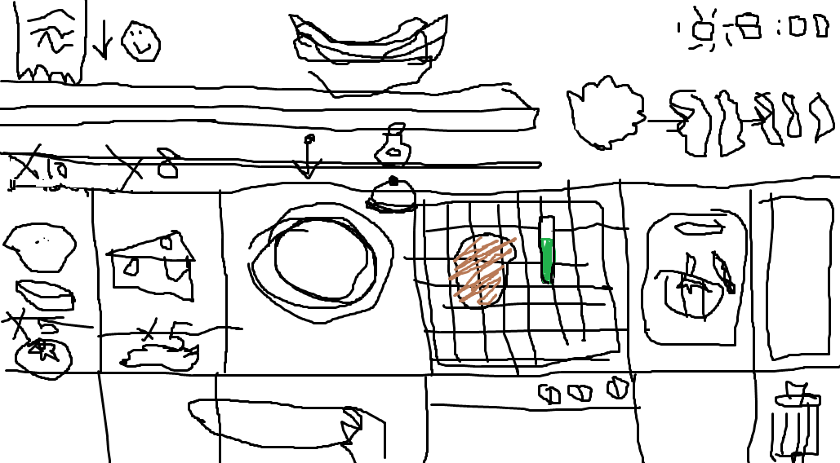

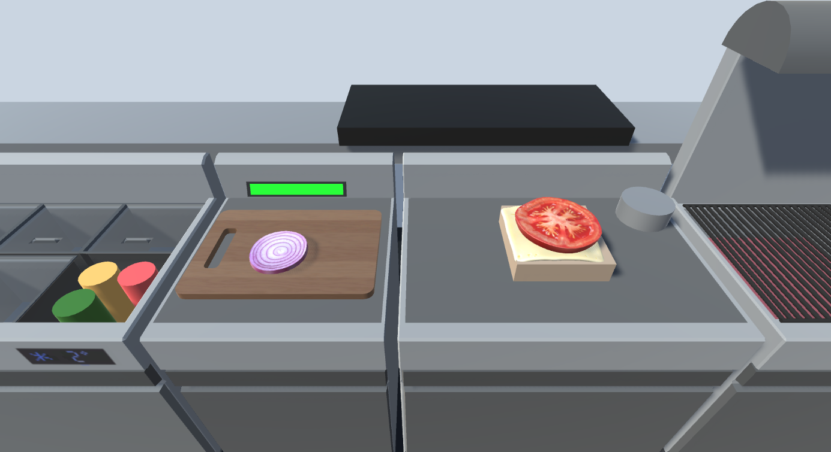
Mock-up : Kitchen

Slide 4
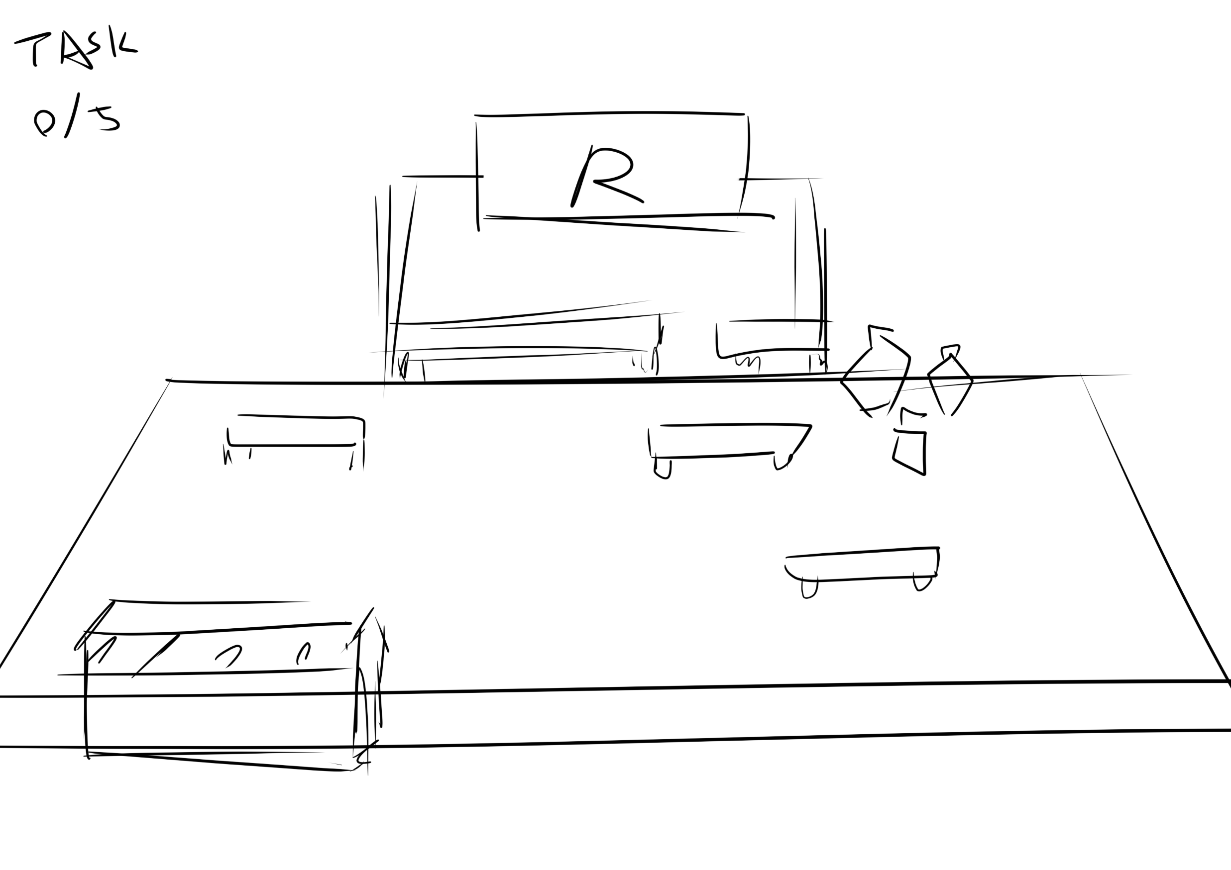
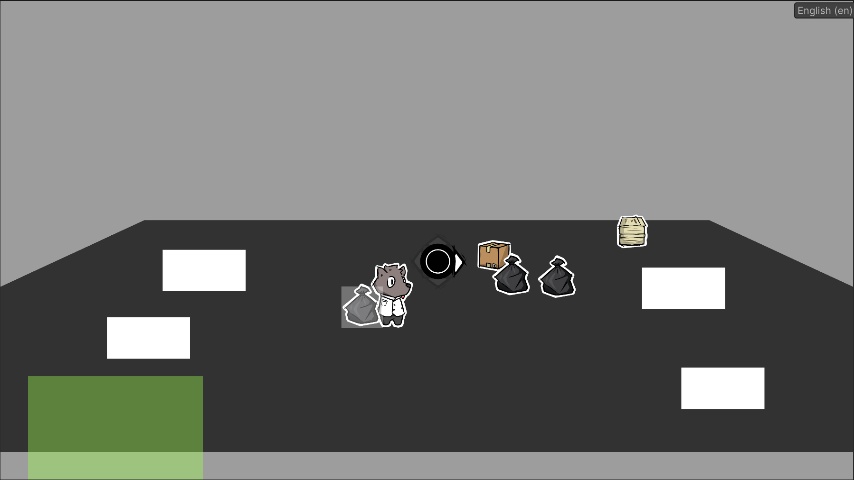
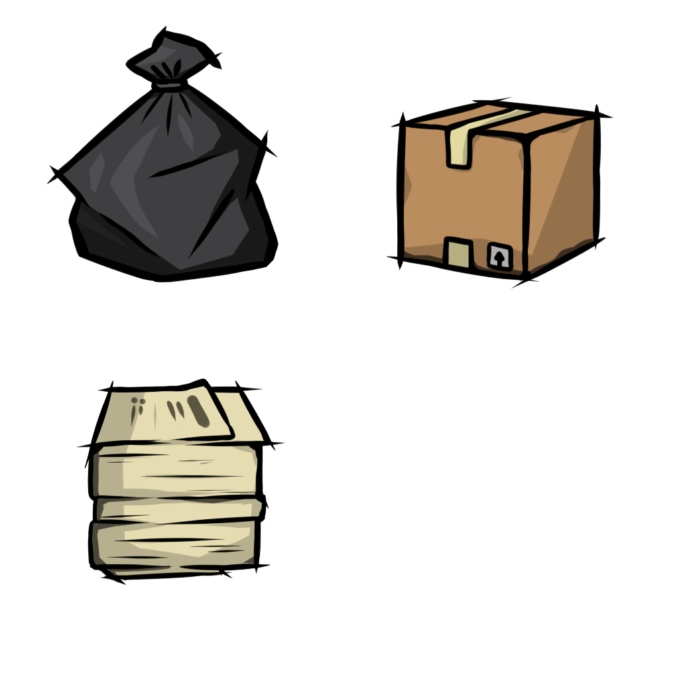
Mock-up : Street

Slide 5
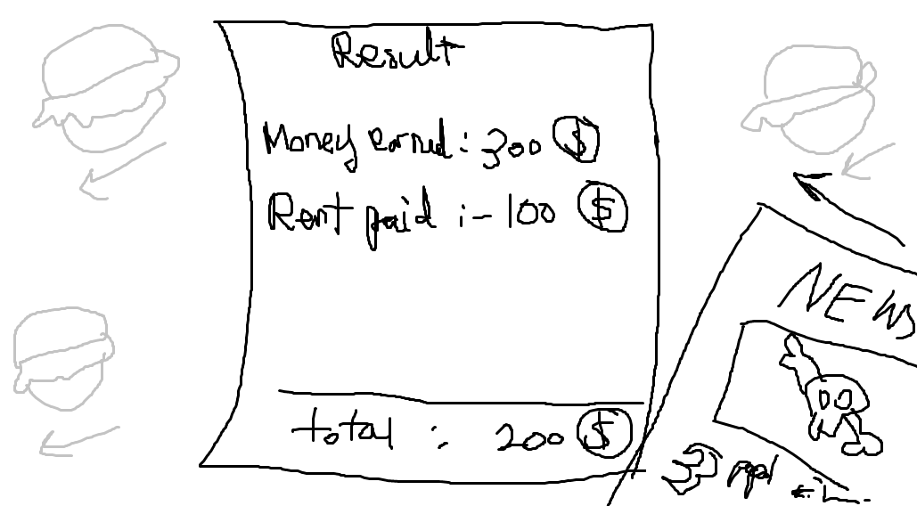
Mock-up : Daily Summary

Slide 6
Controls
< Kitchen >
A, D keys to move camera view
Left mouse button to interact (cut, pick up, put, ring a bell)
< Street >
-W, S, A, D to move around
-Left mouse button to pick up item
-Hold Right mouse button to charge and throw

Slide 7
Design Patterns
Implemented:
Singleton Pattern (Interactor, Data Manager)
Observer Pattern (Cutting Effects)
Factory Pattern (Garbage Generator)
Planned:
Chain Pattern (Price Calculation)
State Pattern (Passengers state)

Slide 8
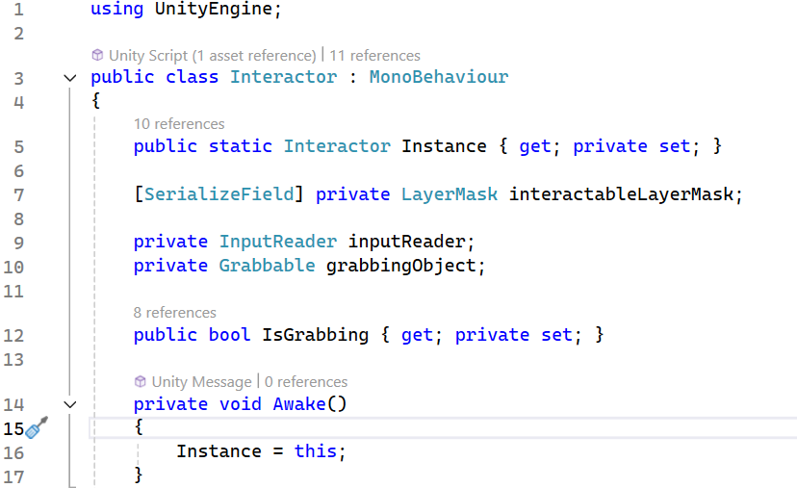
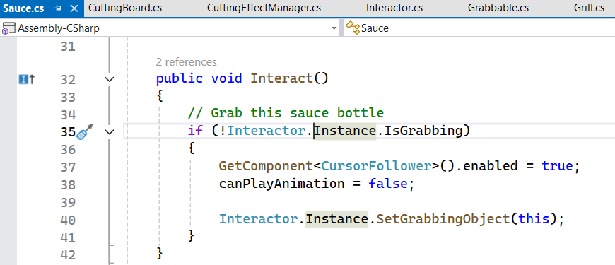
Singleton Pattern Usage Example
Interactor
Interactor will be only one in the kitchen scene and be used in different interactable game objects such as tables, ingredients and sauce bottles. So, I’ve made it as singleton so the interactable objects can access to it.

Slide 9
Observer Pattern Usage Example
Cutting Effects
Whenever player cut an ingredient, visual (cutting progression UI) and sound (cutting sound) should be updated and played. So, instead of triggering the effects one by one, I used observer pattern to trigger those all in once.
(Screenshots are in the following pages =>)

Slide 10
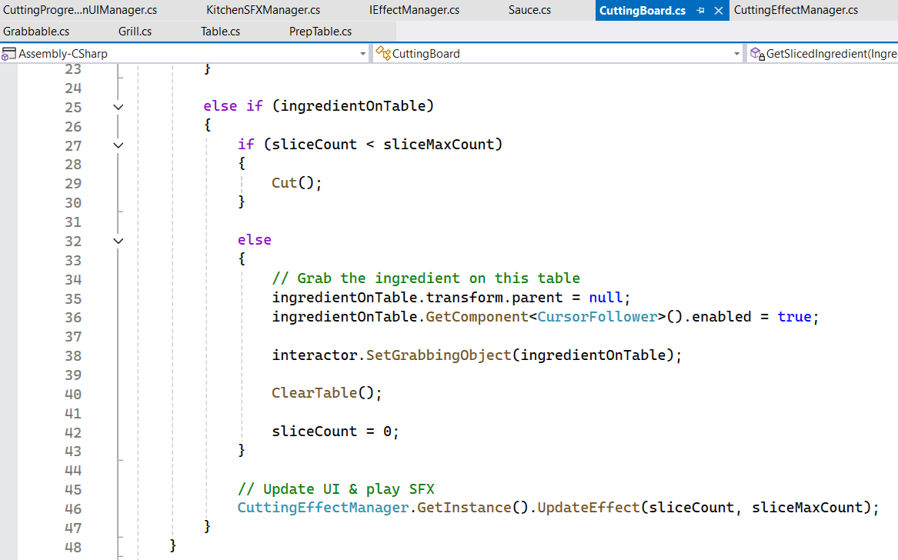
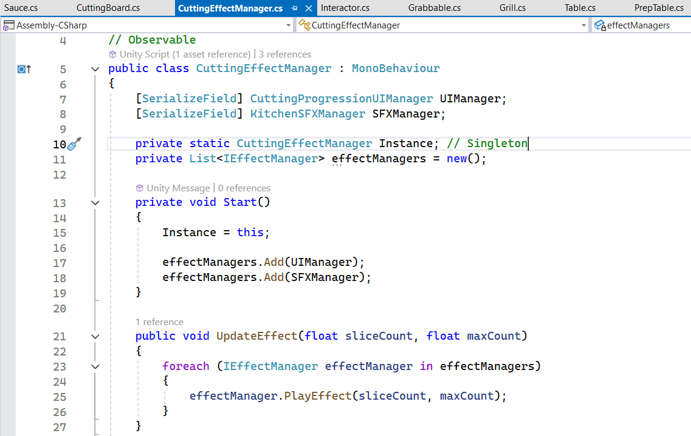
Observer Pattern Usage Example
After player cut an ingredient, Cutting Board class will call Cutting Effect Manager to trigger UpdateEffect() function. Then, Cutting Effect Manager will trigger UpdateEffect() of all of its observers.

Slide 11
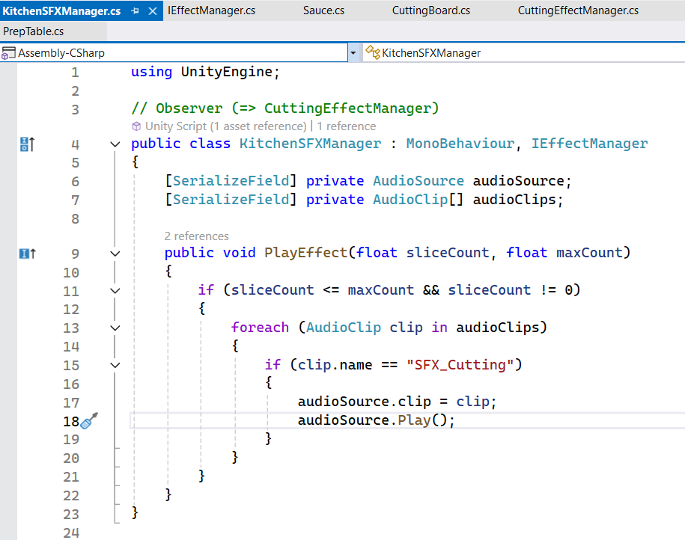
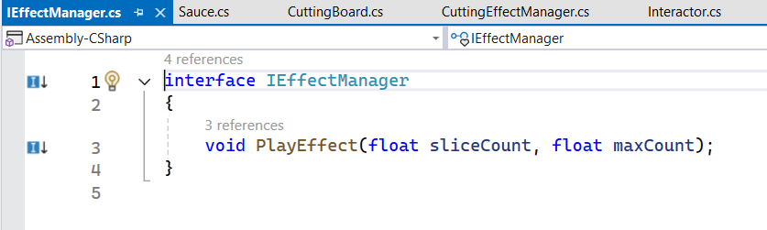
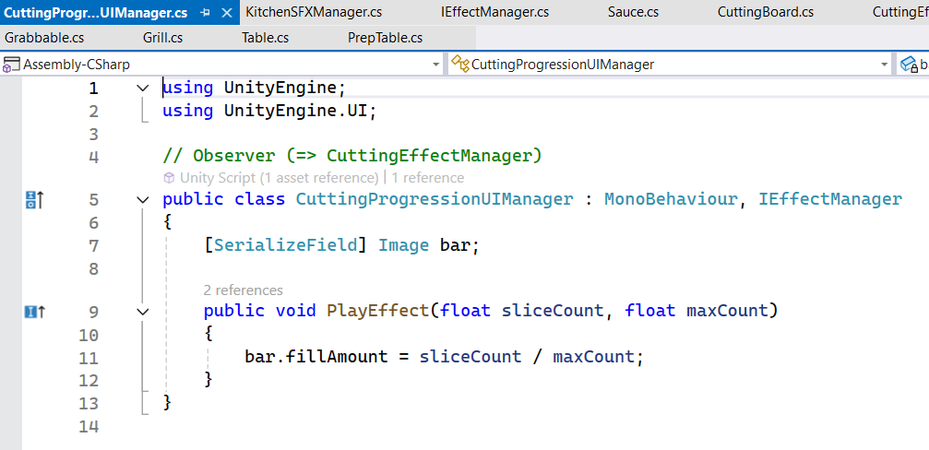
Observer Pattern Usage Example
Kitchen SFX Manager and Cutting Progression UI Manager are the observers of Cutting Effect Manager. Their PlayEffect() functions are called by Cutting Effect Manager every time the player cut an ingredient.

Slide 12
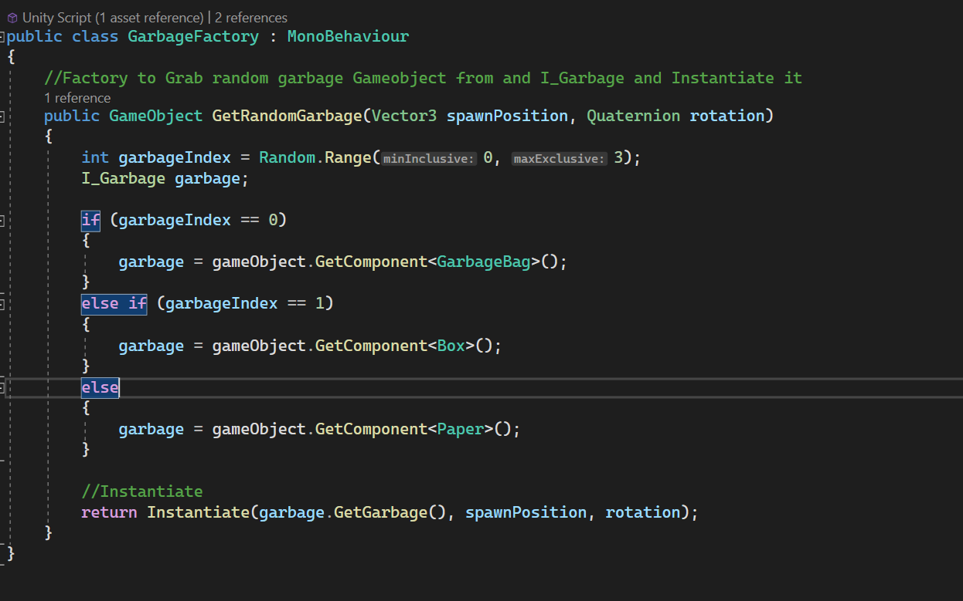
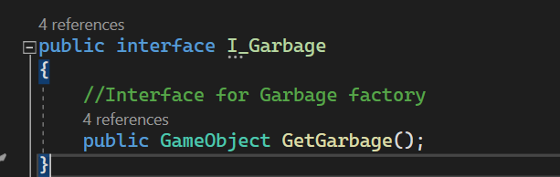
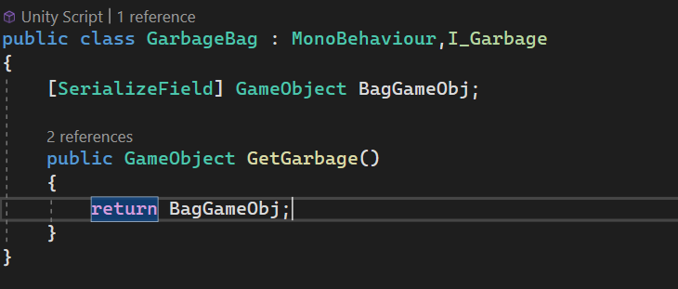
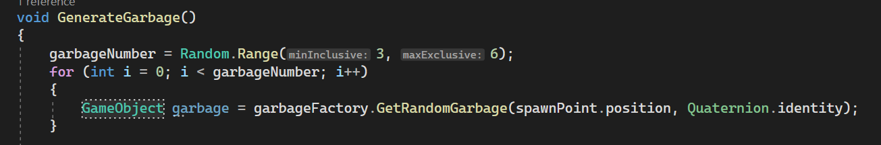
Factory Pattern Usage Example
Garbage Generator
At the beginning of the game, generate random number of garbage bags. There are three type of garbage and factory will instantiate random one from the three.

Slide 13
Chain Pattern Usage Example (Plan)
Process:
Receive an order
Trigger counting cookTime (from RecipeGenerator class)
When player rings a bell (from Interactor class), request price calculating to a handler with its cookTime (from CookingTimer class)
Classes & Functions:
public abstract class PriceHandler - base handler
public class HighPriceConcreteHandler : PriceHandler - Check if the cookTime < highPriceTime, and decide whether to sell the burger with the high price or move on to the next handler
public class MediumPriceConcreteHandler : PriceHandler - Check if the cookTime < mediumPriceTime, and decide whether to sell the burger with the medium price or move on to the next handler
public class LowPriceConcreteHandler : PriceHandler - Sell the burger with the low price

Slide 14
State Pattern Usage Example (Plan)
Process:
State Pattern for NPCs behavior (Patrol → Frightened).
Before npcs detect player, npcs in the Patrol state, Frightened state, Unconscious state
Classes & Functions:
Interface I_state- Interface for NPCs’ state
public class Patrol state : Npcs will patrol the whole area with a slow speed, based on the AI navMesh; if player enter the detect area, npc switch the state
public class Frightened state : Npcs will start running around with faster speed, until they get knock down or escape.
public class Unconscious state : Npcs will stop move and start the count down to wake up

Slide 15
Schedule Breakdown
Kitchen (Yeonhee)
- Cooking Meat Function : by March 23
Generating Recipes Function & UI : by March 30
Cooking timer : by April 3
Recipe check & pricing : by April 10
Player Money UI : by April 13
Rent payment & Daily Summary : by April 19
Switching scene to Street : by April 22
Importing 3D assets : by April 27
Final test & polishing : by April 29

Slide 16
Schedule Breakdown
Street (Helei)
- Garbage Task: March 23
Garbage Task UI: March 30
NPCs AI: April 3
NPCs state and NPCs behaviours: April 10
Street UI: April 13
News’ paper (Kills count) : April 19
Save system: April 22
Fill Up particle effect : April 27
Polishing : April 29

Slide 17
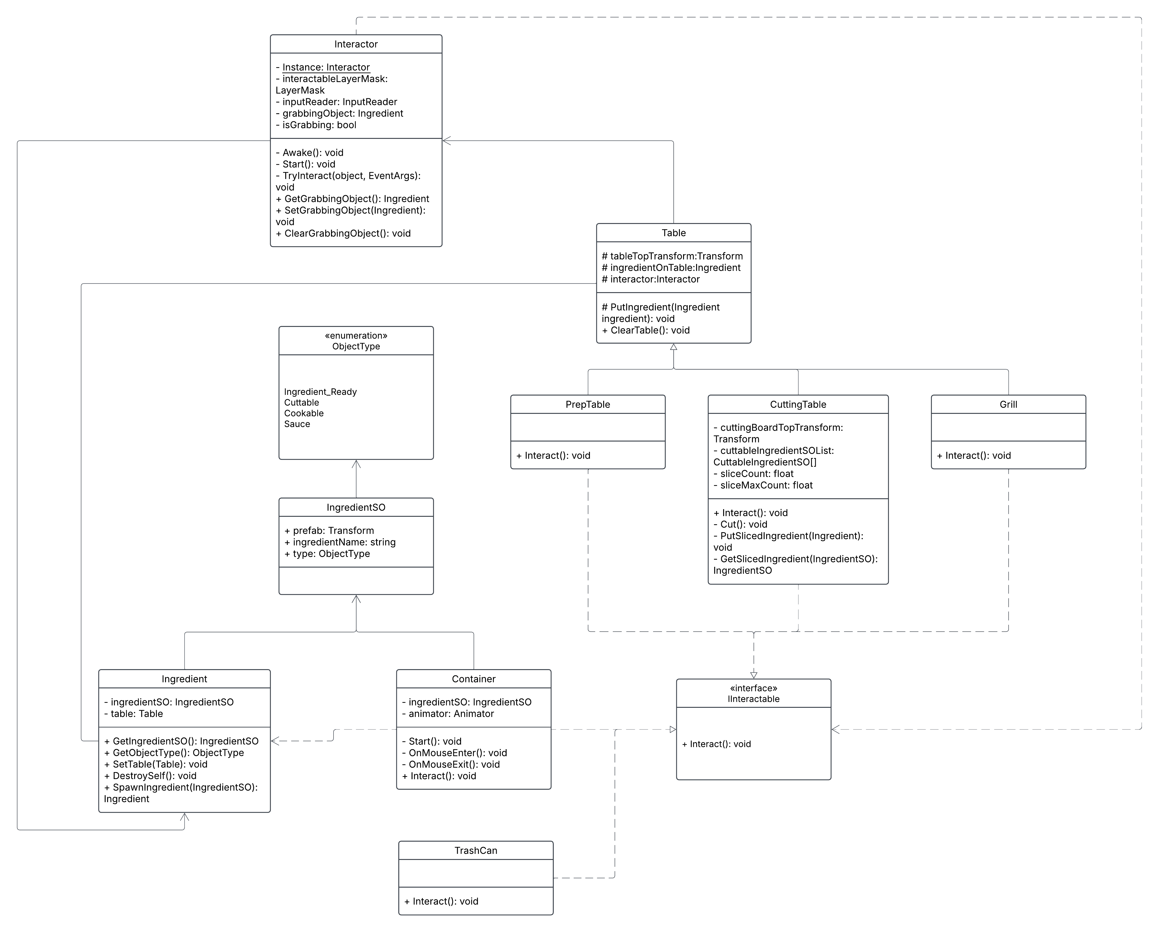
Class diagram

Slide 18
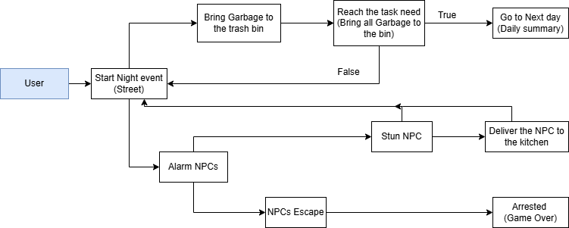
Use case diagram

Slide 19
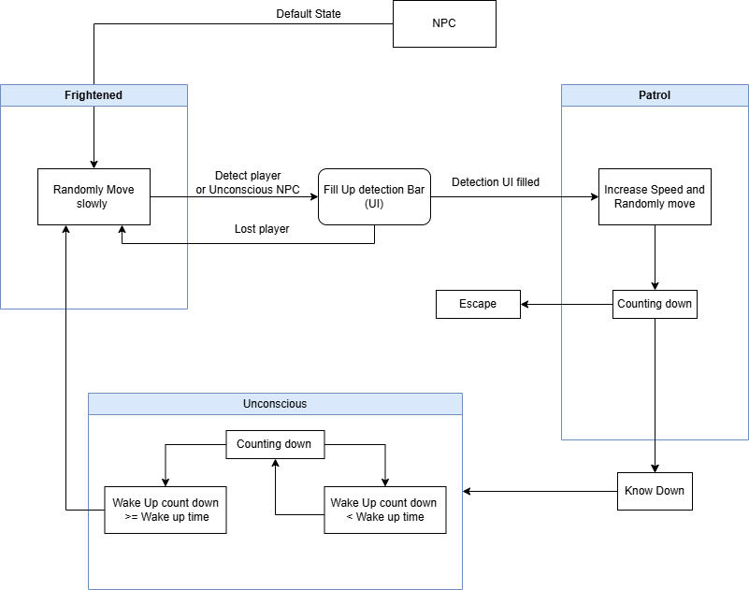
State diagram

