Slide 1
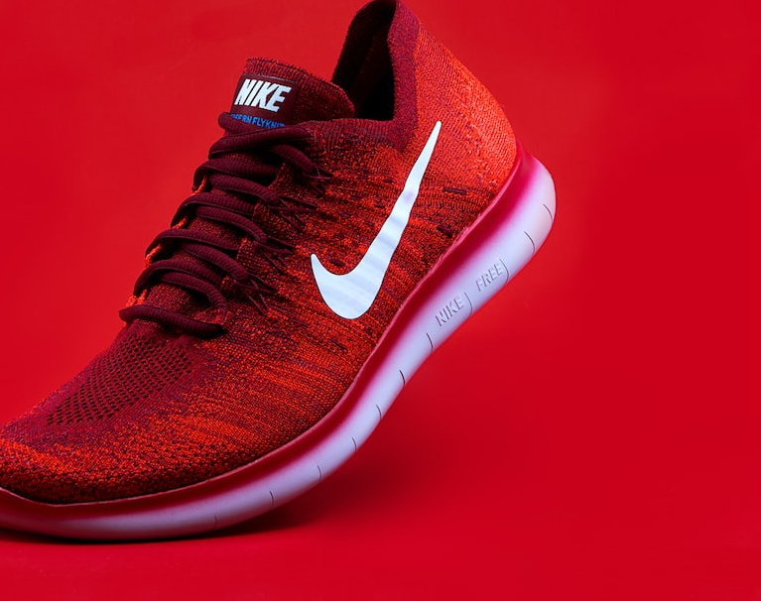
MTL Chaussures

Slide 2
Team Members
Chintan Patel (2024318)
Rohit Saini (2122294)
Aliasgar Gandhi (2122332)

Slide 3
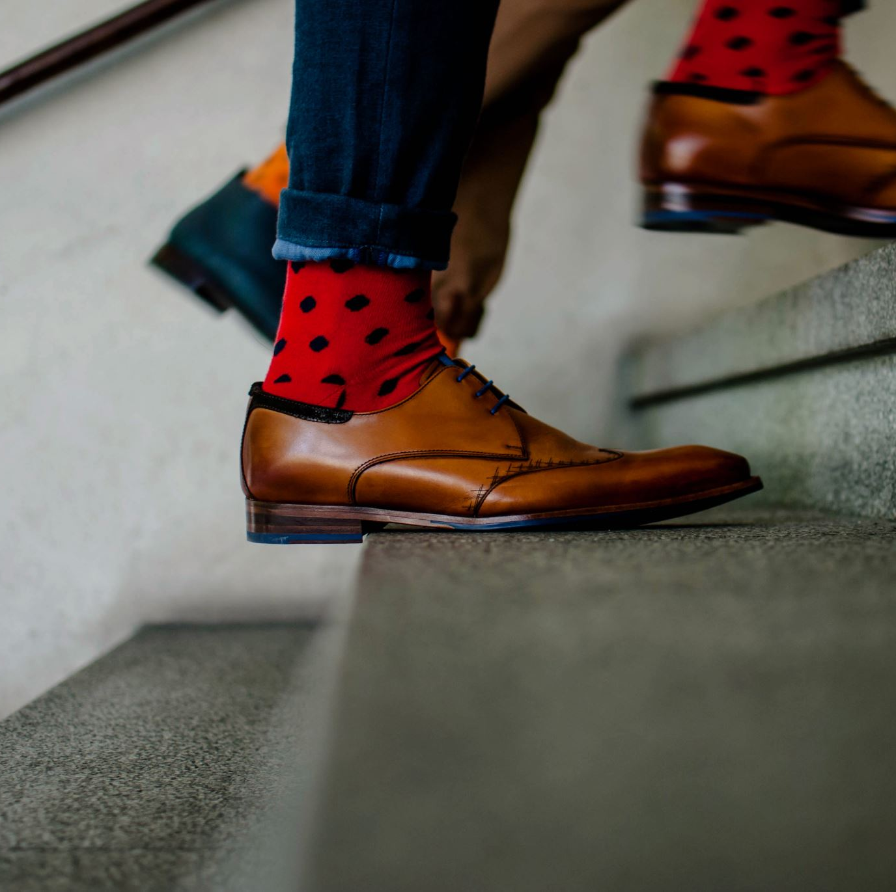
Description
Our project is an ecommerce app for Shoes.
Its goal is to match the versatile fashion of Montreal’s multi-culturalism.
It gives variety of options to people to shop shoes of their choice.

Slide 4
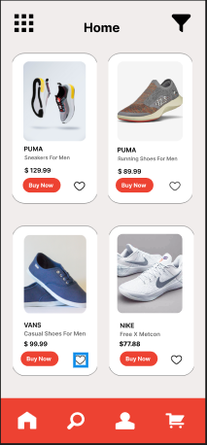
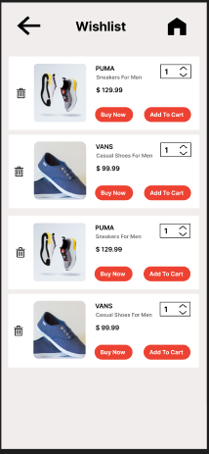
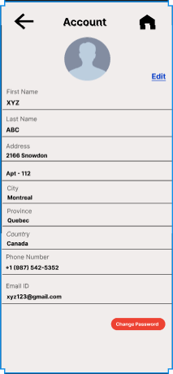
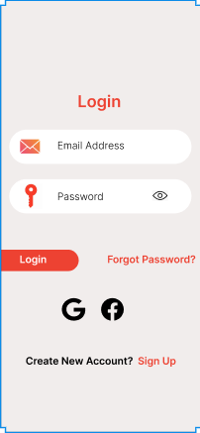
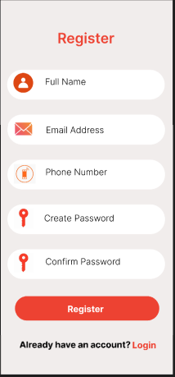
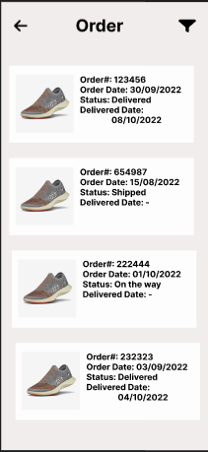
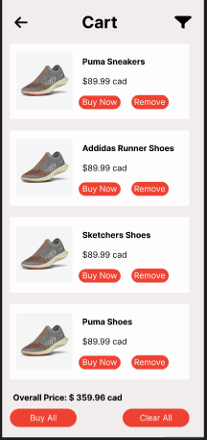
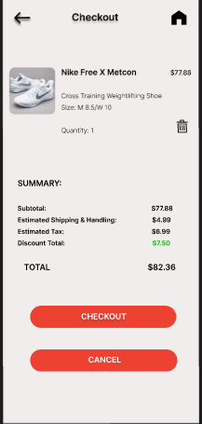
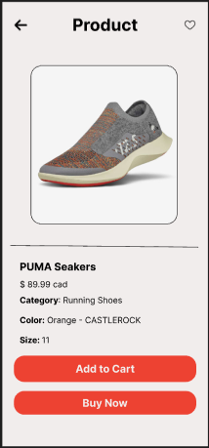
Mockup

Slide 5
Home Screen
This is the first screen of our application.
It will be shown as app loads up. It consists of the most trending products and promotions.

Slide 6
Product Screen
This screen opens up as a user clicks the product tile.
It consists of product detail and also allows user to do following:
Add to cart
Buy Now
Wishlist

Slide 7
Wishlist Screen
This screen is a consists of product list which are liked by users on product page.
User can also add liked product to cart or buy directly.

Slide 8
Cart Screen
Cart screen is the ending screen before going to payment section.
It also allows user to add or remove product from the cart list.
On top of it, we can do payment for all the product in the cart.

Slide 9
Register Screen
Register screen as name says it registers the user’s info.
It is for the first-time users who really wants to enjoy the user experience of the app.

Slide 10
Login Screen
Login is for already registered users.
It can restore all users data.

Slide 11
Account Screen
Account screen is mandatory to do purchases on the app.
Account screen is the one that saves the orders and checkout data.

Slide 12
Checkout Screen
Checkout page if the final confirmation for payment api.
It ensures that user rechecks the product verification.

Slide 13
Order Screen
Order screen is to track the package and to show history of purchases.

Slide 14
Other Information
Number of screen flow: 9 screens.
Chosen Database: Firebase
GitHub link: https://github.com/adinashby-vanier-college/app-dev-2-project-AliasgarGandhi1

