Slide 1



BLOOD FOR LIFE APP
Group members:
Gurjas Singh (2101324)
Nancy Bansal (2021590)
Simranjeet kaur (2102116)

Slide 2

INTRODUCTION
BloodForLife application will make it easy to manage a safe, secure, and accessible blood supply.
This app will help the donors to book, manage and keep track of their donations on the go. Users can locate their nearest donor centres.

Slide 3
WHY THIS APP IS NEEDED?
Conventionally, when a patient needs blood, he/she has to contact a blood bank or a compatible blood group of a donor in their circle, family, and friends. However, it is difficult to find suitable donor within a limited group of people in a given time. In addition, there is no guarantee that blood banks will have compatible blood group in stock. There is also steady increase in blood donation requests posts in social networking sites (like Facebook, twitter, Instagram, etc.) requesting for donation.
As a result, this app is beneficial for donors and requesters to find needed blood type directly and promptly. Blood For Life App allows users in need for blood to find nearest donors.

Slide 4
Blood for life mobile application
This mobile application will allow a user to create their account on the application.
The user can update their profile ( name, contact, email address, address, blood group, age, gender ).
This application can be used by both the donor and receiver.
When a patient needs a blood donation, the clinic (where the patient is admitted) can use the application to contact the blood donors in the vicinity or nearby city based on their location. The registered donors will get notification about the blood donation needed at a specific clinic where they can go and donate.
This application will also show nearby blood donation camps on google map , where the donor can go and donate blood.

Slide 5
FEATURES
Search for donation donor centres near you
Book, view or cancel a donation appointment
Easily sign-up or sign-in to access your account information
View and manage your personal profile
View and manage your notification settings
View your donation history
Share your donation history on social
Send feedback

Slide 6

CHOSEN DATABASE: FireBase
GITHUB LINK : https://github.com/adinashby-vanier-college/app-dev-2-project-gurjas936.git

Slide 7
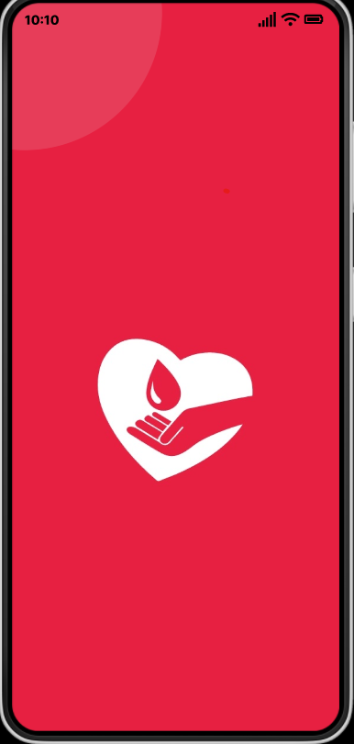
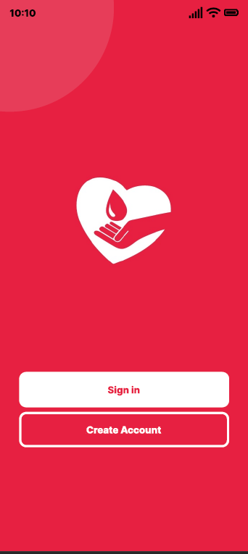
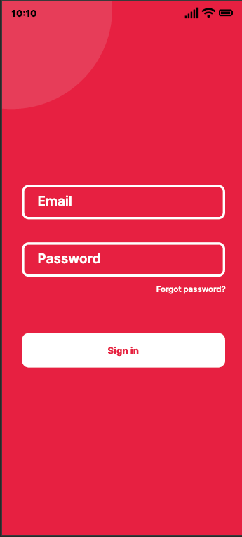
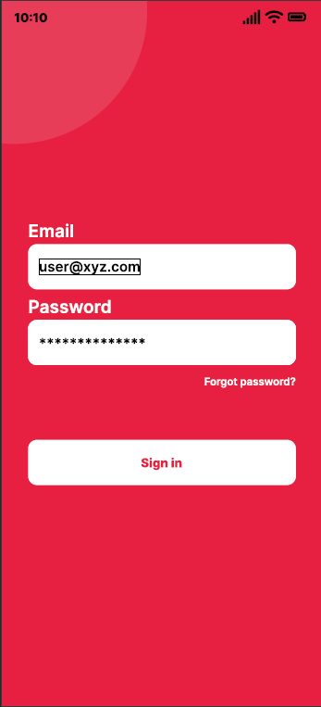
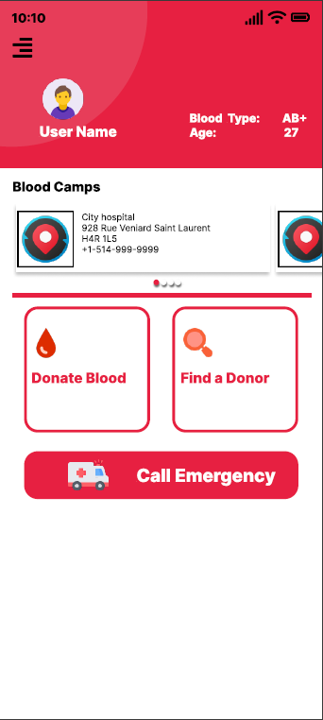
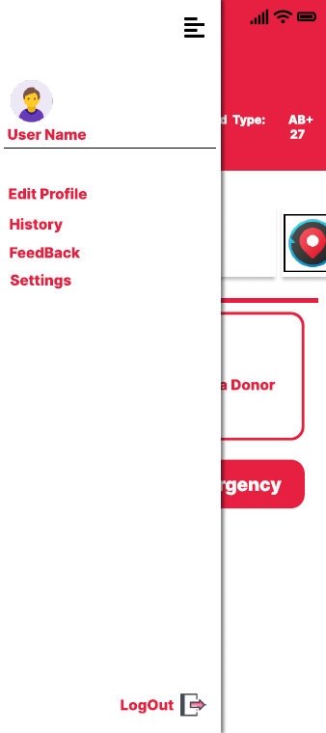
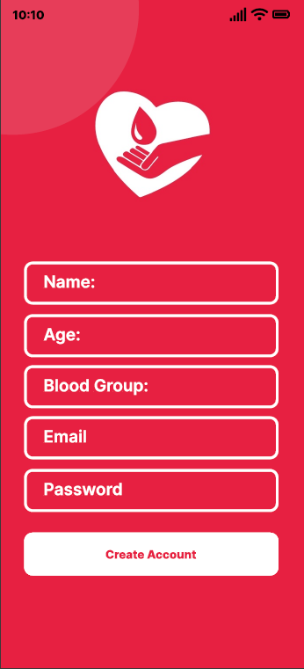
Screenshots:

Slide 8
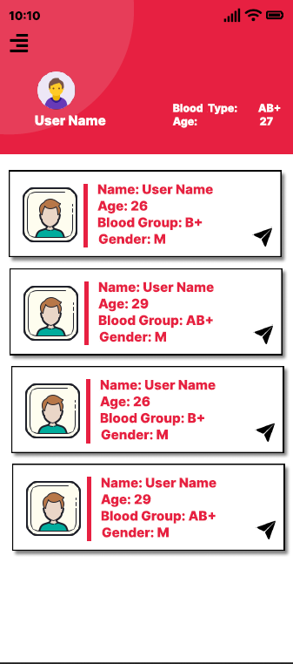
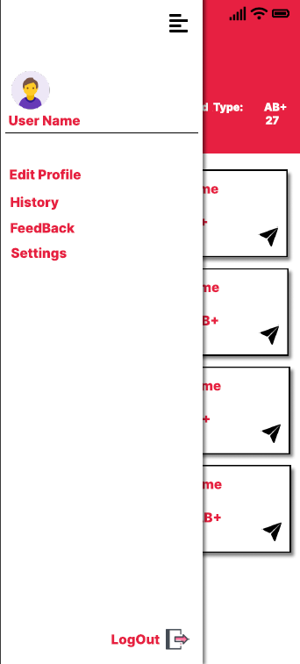
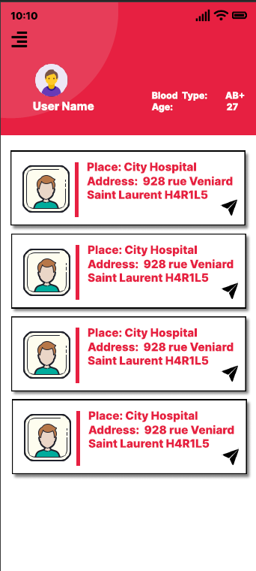

Slide 9
Thank you

