Slide 1

Aero Flights
By Ali Raza, Imran Maslianov and Sayem Shah

Slide 2
Description
Our project is a mobile flight tracker application.
Key Features:
Track live flights on the map
View details and ticket prices
Book upcoming flights through the app
Search and Add your flights to your favorites

Slide 3
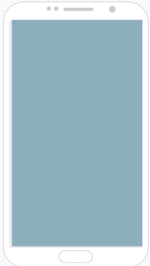
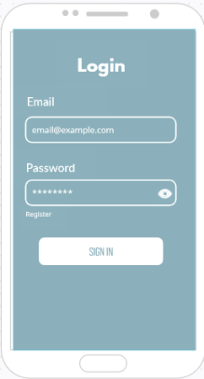
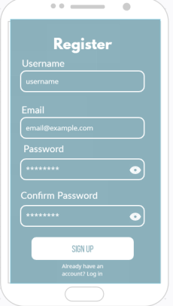
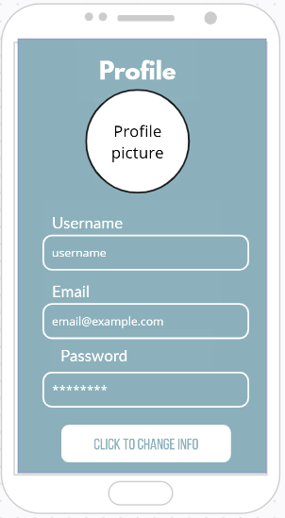
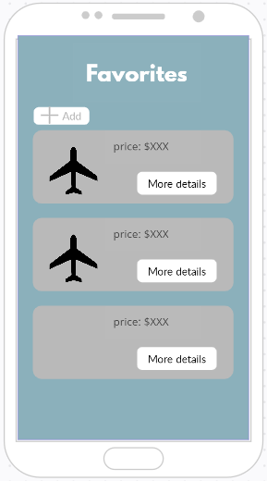
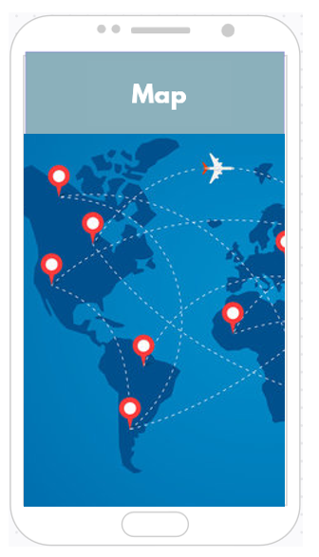
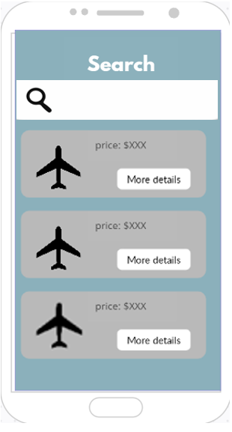
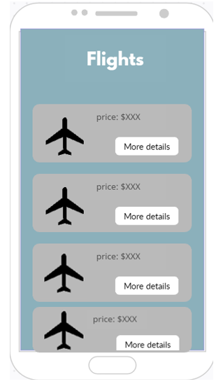



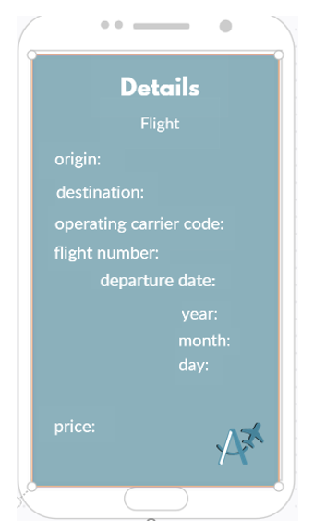
Mock-up
Search
Flight
Aero Flights

Slide 4
Launch
Launch Page of our app showcasing custom-made logo in the middle and name at the bottom.
Aero Flights

Slide 5
Login
Sign In to your account with matching email and password. If they do not have an account, they can Register.

Slide 6
Register
Register and create a new account if they do not have one already. If they already have an account, they can log in. This information is later stored in our Firebase database.

Slide 7
Profile
View and Edit profile. Users can modify their existing username, email or password. Additionally, they can upload a profile picture.

Slide 8
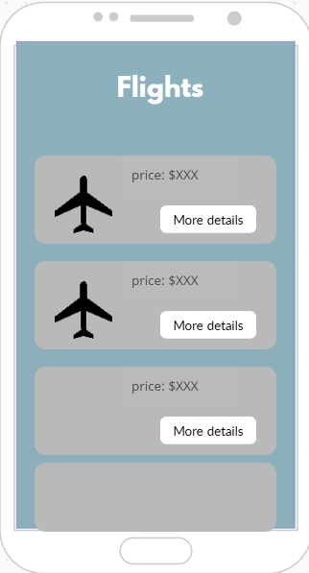

Flights
Browse through the flights that are in the hot for you page. You are also able to view the details as show in the mockup.

Slide 10
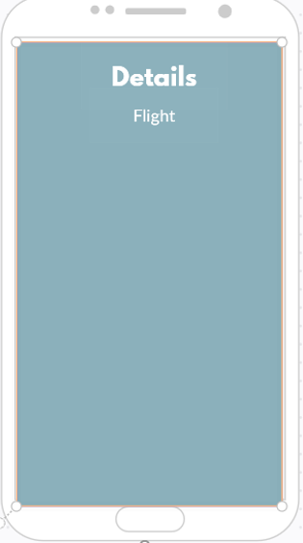








More Details
In the more details page, we will be able to look at the details of the place such as the destination, origin, flight number and etc. You can also see the price.

Slide 11
Favorites
View and Add your favorite flights with their corresponding price to your favorites list. Click on more details to find out more information on that flight.

Slide 12
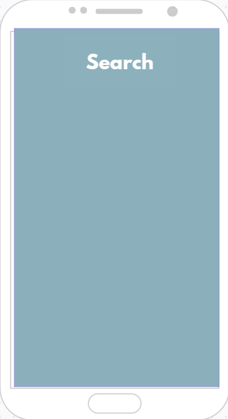

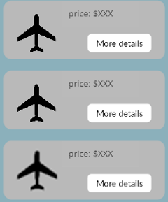
Search Bar
In the search page, you will be able to search for a specific flight based on the destination, arrival, price, etc.

Slide 13
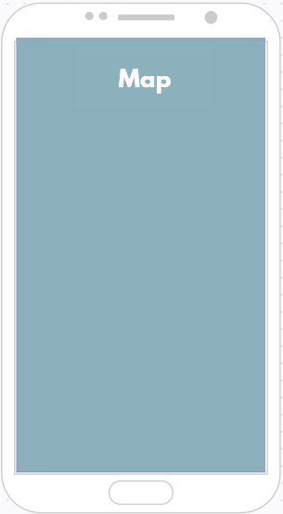

Map
In this page, you will be able to see all of the current flights on an Area as well as the flight path, departure and arrival.

Slide 14
Additional Information
Number of Screen Flows: 9
Chosen Database: Firebase
GitHub Link: Project Aero Flights

