Slide 1
Flight Tracker Application
By Ali Raza, Imran Maslianov and Sayem Shah

Slide 2
Description
Our project is a mobile flight tracker application.
Key Features:
Track live flights on the map
View details and ticket prices
Book upcoming flights through the app
Search and Add your flights to your favorites

Slide 3
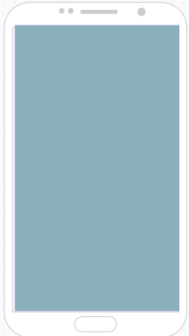
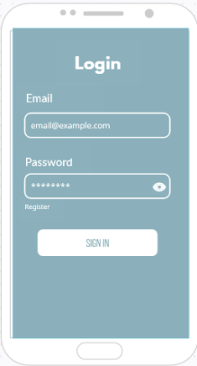
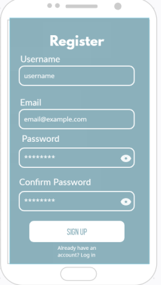
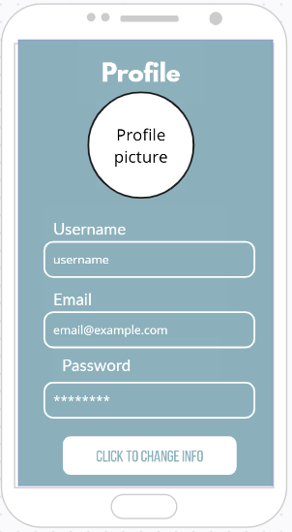
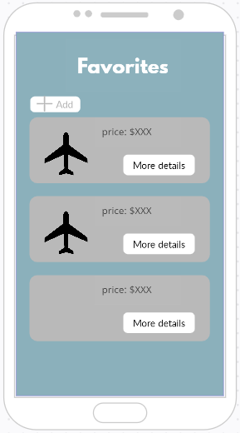


Mock-up
Map
Search
Flight
Aero Flights

Slide 4
Launch
Launch Page of our app showcasing custom-made logo in the middle and name at the bottom.
Aero Flights

Slide 5
Login
Sign In to your account with matching email and password. If they do not have an account, they can Register.

Slide 6
Register
Register and create a new account if they do not have one already. If they already have an account, they can log in. This information is later stored in our Firebase database.

Slide 7
Profile
View and Edit profile. Users can modify their existing username, email or password. Additionally, they can upload a profile picture.

Slide 8
Favorites
View and Add your favorite flights with their corresponding price to your favorites list. Click on more details to find out more information on that flight.

Slide 9
Additional Information
Number of Screen Flows: 8
Chosen Database: Firebase
GitHub Link: Project Aero Flights

