Slide 1

manicode
app
We are creating a nail design inspiration app for Zeynep’s nail business. The premise of the app is to help clients browse, discover, and come up with nail design ideas with the help of a questionnaire that will display designs specific to what they’re looking for.
Clients will be able to share their boards with friends, chat, and send their nail inspiration board directly to Zeynep, their nail tech. So when they sit down to get their nails done, both the nail tech and the client are on the same page, thus saving precious time.

Slide 2

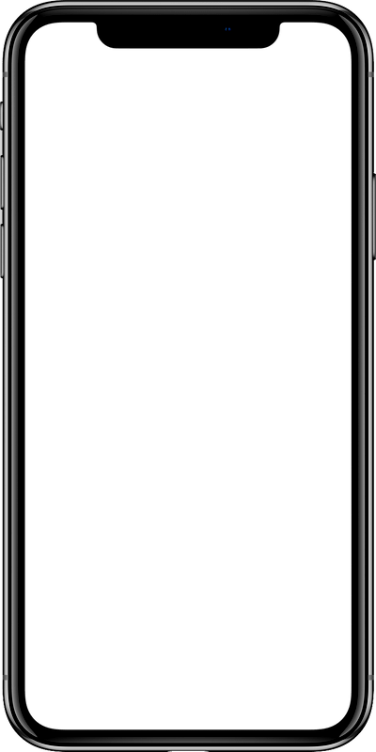
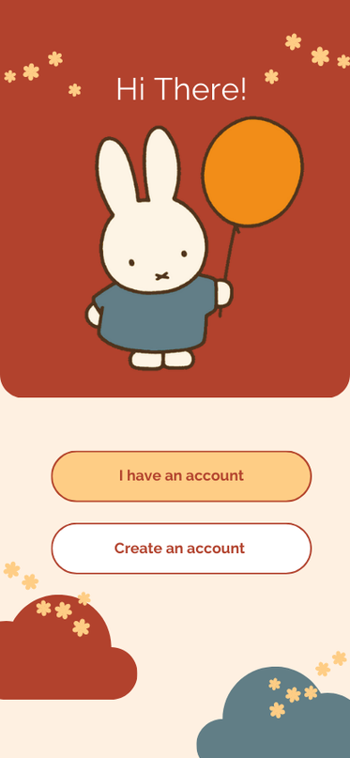
welcome page
Our app starts off with a welcome page and asking users to log in or register.

Slide 3
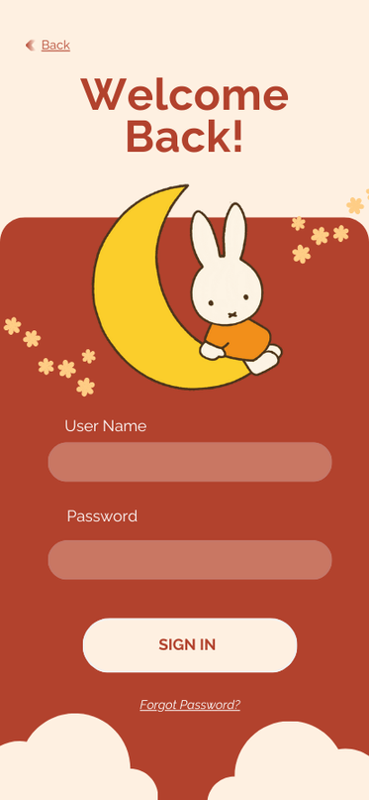
log-in page
Log-in page lets you enter your username and password.
We also have a button to click in case you forgot you password, you can reset it.

Slide 4
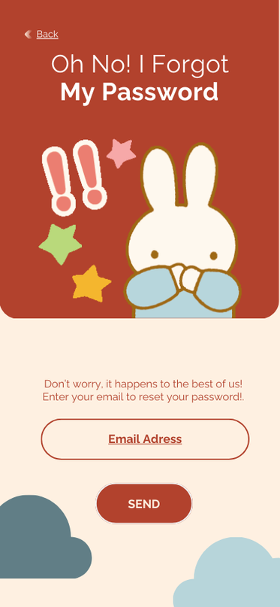
forgot
password
Users will be taken to this page to reset their password through their email.

Slide 5
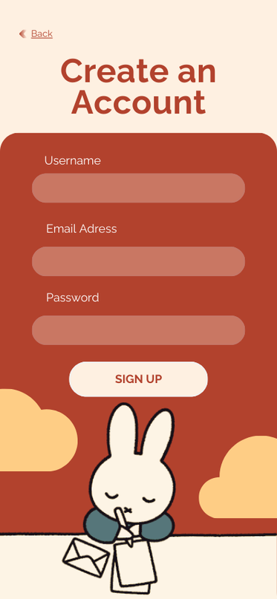
sign-UP page
If they don’t already have an account, they can register using their email.
They create their username for future log-in as well as for display on their profile.

Slide 6
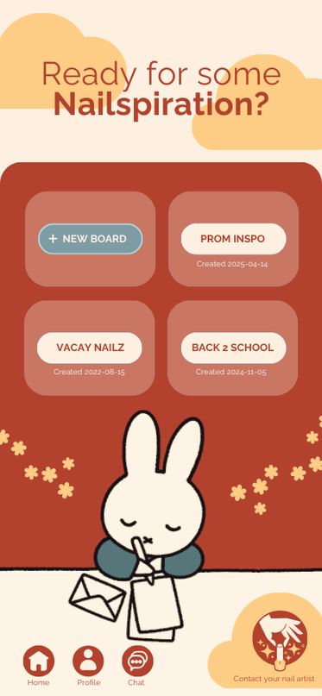
home page
The home page consists of a navbar on the bottom of the screen where you can navigate between the home page, your profile, your messages, and your nail tech’s profile.
There’s also your most recent boards. The first board you see is to create a new board which will take you to the questionnaire that is designed to help you narrow down your ideas.

Slide 7
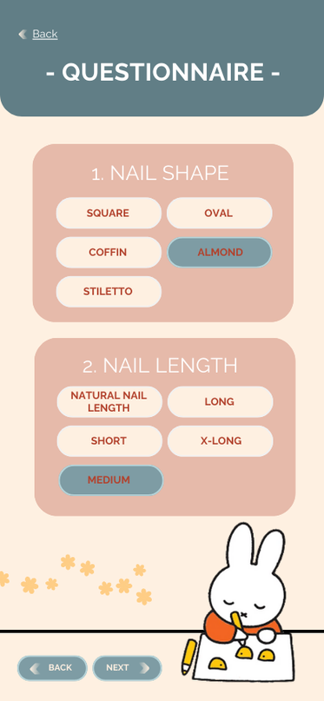
questionnaire page
The questionnaire asks you general and specific nail design questions.
From the shape and length of the nails you want to go for, to the specific designs and techniques you like.
At the end, based on your answers, you will have hundreds of designs displayed for you to choose from and add to your new board.

Slide 8
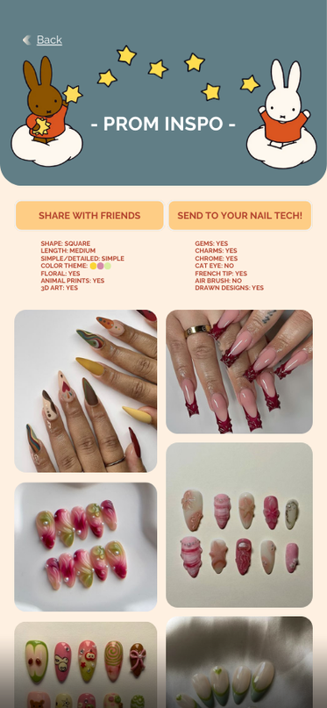
mood board
Your mood board will look like a gallery displaying all the designs you chose.
A brief summary of the answers to your questions will also be displayed for future reference for you and your nail tech.
You can share this board with your friends, and when you’re ready, send the board to your nail tech to let her know this is the inspiration for your next nail set design.

Slide 9
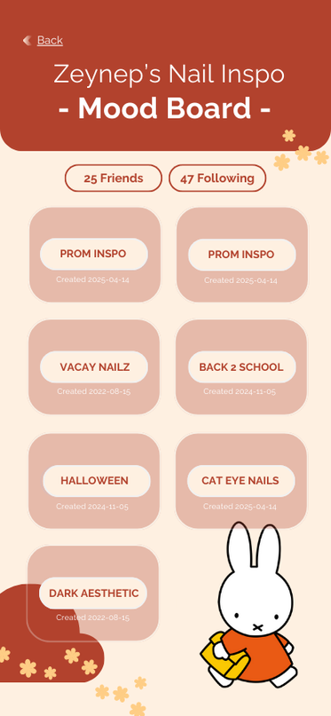
profile page
The profile page displays your username, your friends, people you follow, and your boards.

Slide 10
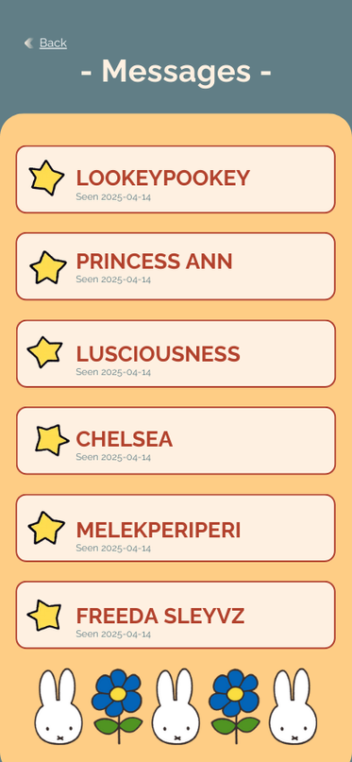
messages page
This page is where you interact with friends.
You simply tap on a friend’s name and it opens the chat page.

Slide 11
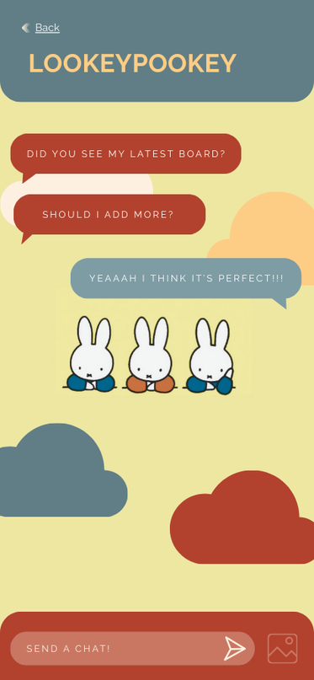
chat page
You can text, share photos, or send you mood boards to your friends.

Slide 12
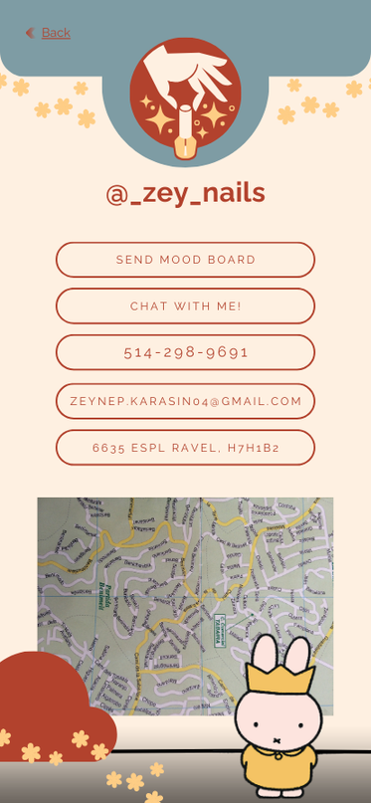
nail artist’s (zeynep) profile
Zeynep’s profile page is the nail artist page that serves as a contact page.
You can see her phone number, mail address, as well as where she is located through a map api.
You can send her your mood boards by tapping the “Send your mood board” button.
You can also schedule an appointment with her through chat.

