Slide 1
MindMate
APPLICATION DEVELOPMENT 2 (MOBILE)
July 15th, 2025
Kristina Cecura &
Aldebaraan Canedo

Slide 2
Description
We are developing a mental health companion app.
Our goal is to provide a simple UI for easy access to the main functions.
Users will be able to practice affirmations, breathing exercises, keep track of their mood logs and journal entries and locate calming locations around them.

Slide 3
About
● Number of screen flows: 10 screens
● Chosen Database: Firebase
● GitHub link: https://github.com/adinashby-vanier-college/app-dev-2-project-mindmate.git

Slide 4
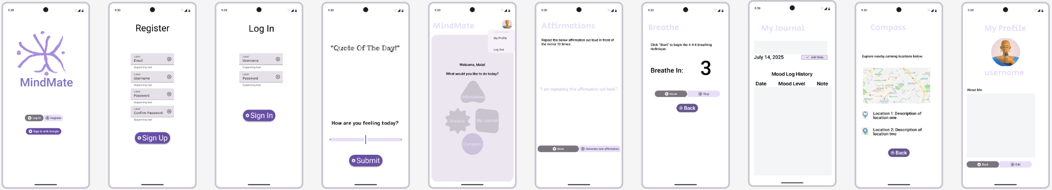
Mockups

Slide 5
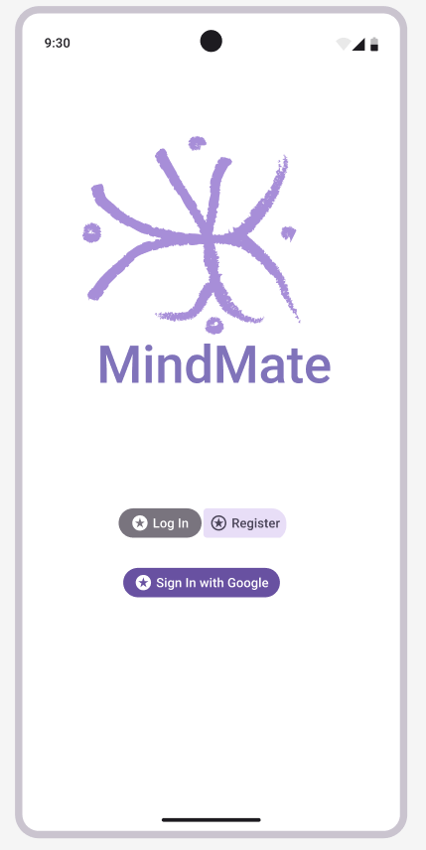
First screen
The first screen will prompt users to register or login to access the main features of the app.

Slide 6
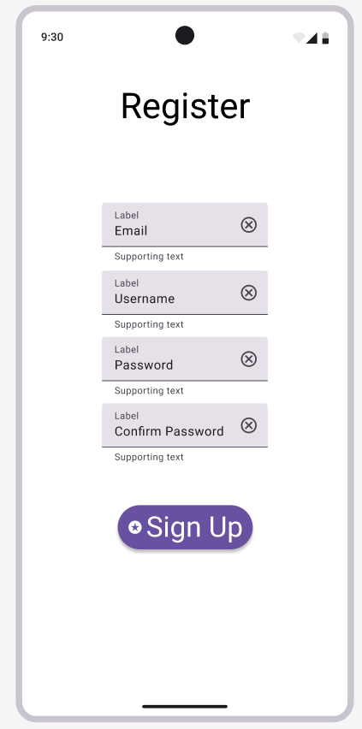
Register screen
The screen the user will see when they click on register button.

Slide 7
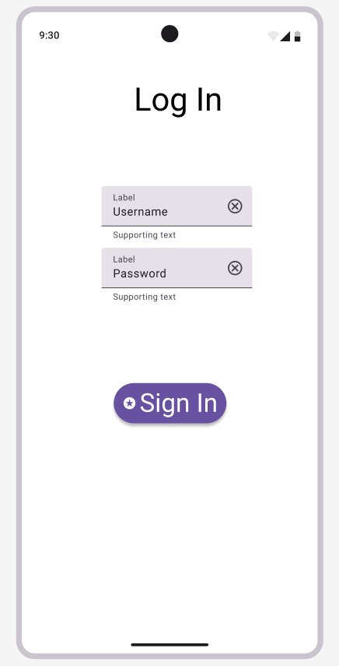
Log in screen
The screen the user will see when they click on log in button.

Slide 8
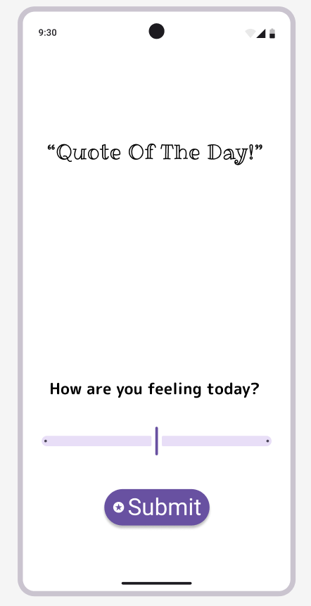
Quote of the day screen
After successfully logging in, the user will see an inspirational quote generated by ZenQuotes API.
They will also be prompted to log their current mood which will be saved in their journal section.

Slide 9
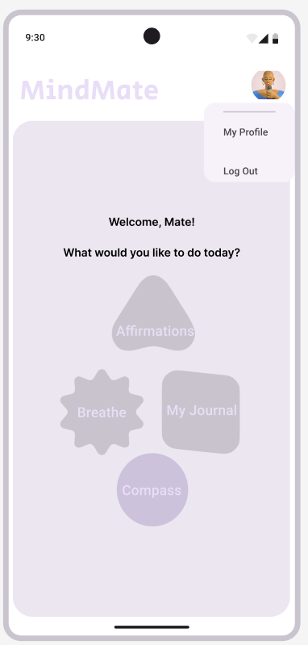
Main screen
In the main screen the user will be able to use the 4 different features.

Slide 10
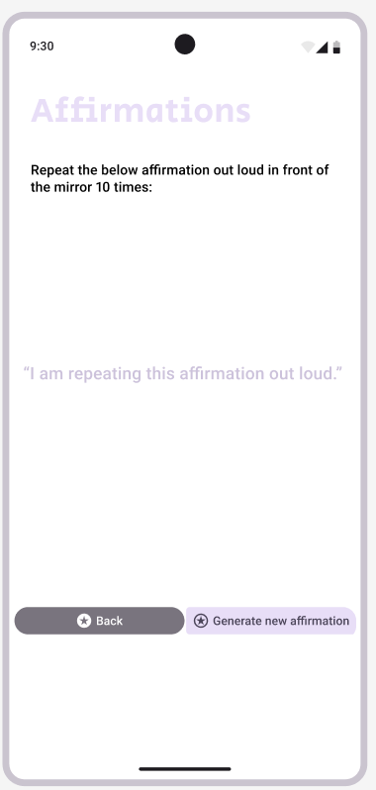
Affirmations screen
In Affirmations screen the user will be able to practice a randomly generated affirmation fetched by Affirmations.dev API.

Slide 11
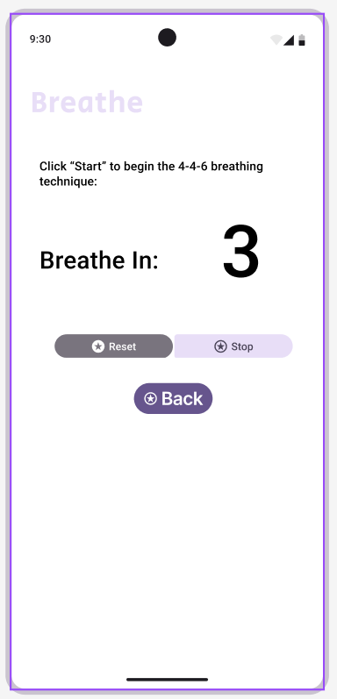
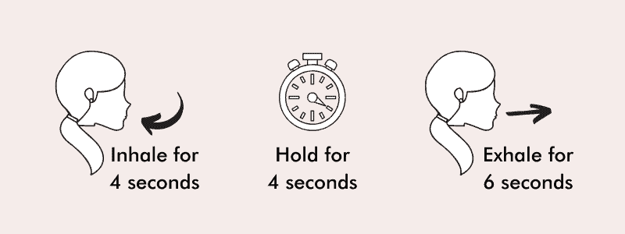
Breathe screen
In Breathe screen the user will be able to practice a calming 4-4-6 breathing technique.
We will create a timer loop until the user clicks any button below.
Once the timer reaches 4, “Breathe In” will change to “Hold” and the timer will be reset. Once it hits 4 again, “Hold” will become “Breathe Out” and the timer will go from 1 to 6.

Slide 12
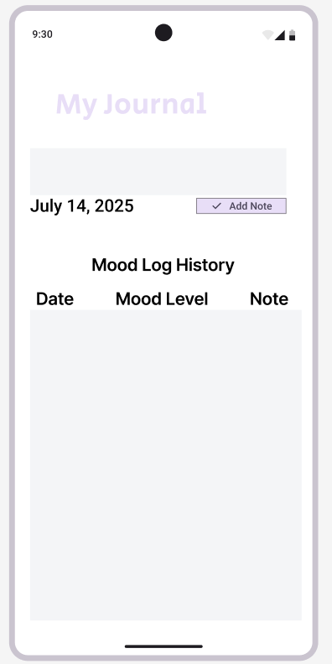
My Journal screen
In My Journal section the user will be able to see their history of logged moods and optional notes.
In this section they will also be able to add a note/journal and that note will be saved and visible in the Mood Log History section.

Slide 13
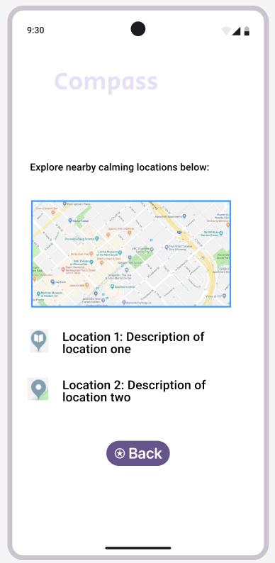
Compass screen
Compass screen will use Geolocation and Google Places APIs to get current location and fetch nearby calming spots (libraries, parks, spas. etc.).

Slide 14
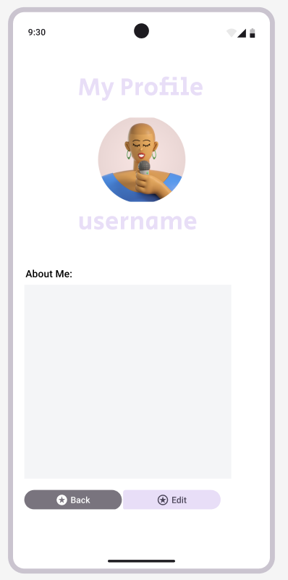
My Profile Screen
In this screen the user can edit their profile settings.

