Slide 1
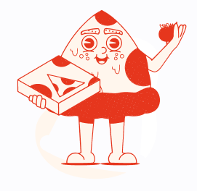
Pizza Delight
Team Members:
Prinsi Hareshbhai Falakiya (2424366)
Poojan Bharatbhai Suthar
Suraj kiran
Course: Mobile Application Development

Slide 2
Description
The proposed project is a Pizza Order System designed to streamline the process of pizza ordering within a restaurant.
The system will provide customers with a user-friendly interface to browse menus, place orders, and receive order confirmations.
Additionally, restaurant staff will have access to manage orders and update the menu in real-time.

Slide 3
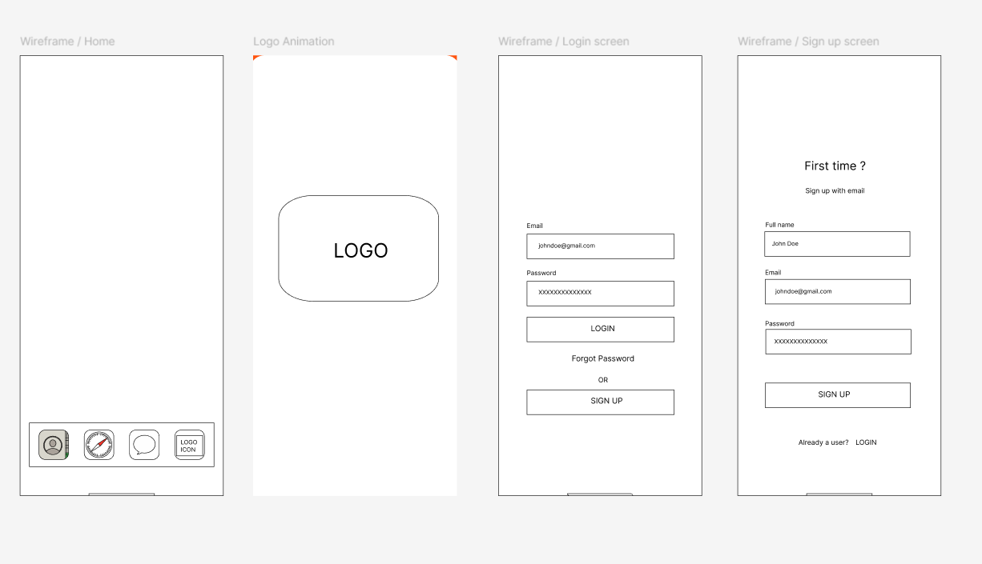
Mock-Up

Slide 4
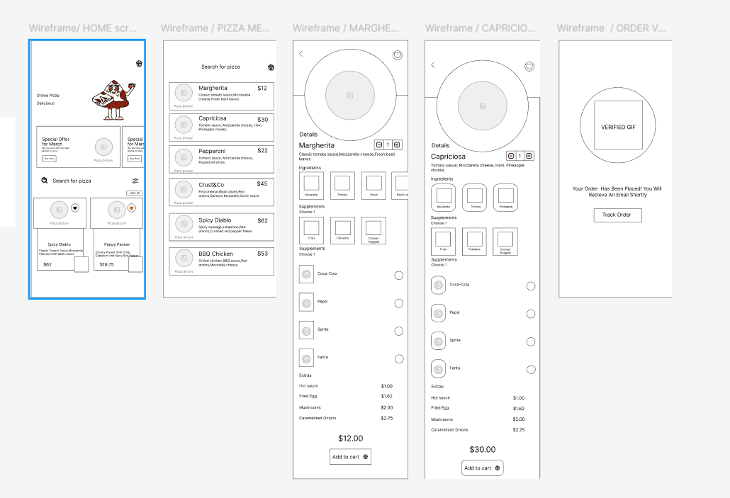

Slide 5
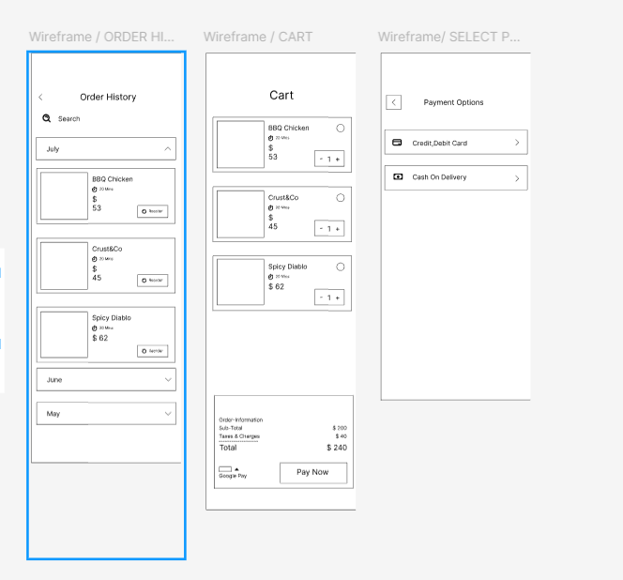

Slide 6
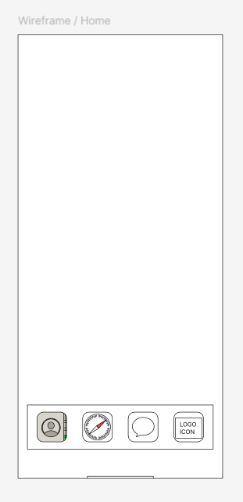
First Screen
This is the initial screen that users see after launching the app.
It features quick navigation icons at the bottom for profile, menu, chat, and logo. It serves as the entry point for users to explore the app.

Slide 7
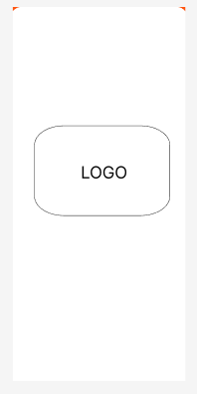
Logo Animation Screen
This screen briefly displays an animated logo during the app's launch.
It helps reinforce brand identity and creates a smooth transition into the main interface.

Slide 8
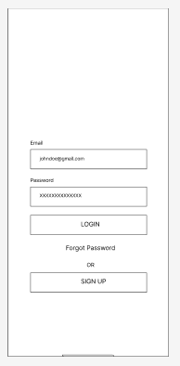
Login Screen
This screen allows users to log in using their email and password.
It also provides options to recover forgotten passwords or switch to the sign-up screen.

Slide 9
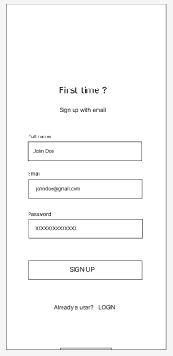
Sign-Up Screen
This screen lets new users create an account by entering their name, email, and password.
A link at the bottom allows existing users to switch to the login screen.

Slide 10
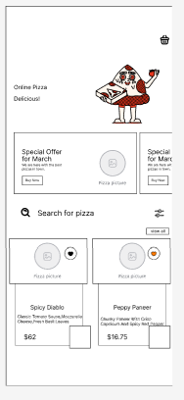
Pizza Menu (Home/Menu Screen)
This screen displays the pizza menu with product images, names, prices, and a search bar.
Users can browse available items and choose their desired pizza.

Slide 11
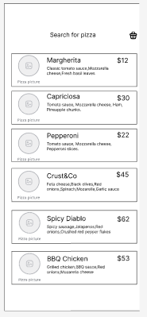
Pizza List Screen
Here users can scroll through various pizza options along with their ingredients and pricing.
Each item has a button to view more details and add it to the cart.

Slide 12
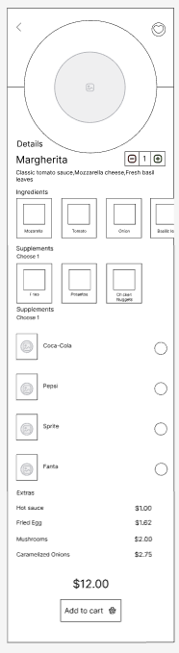
Pizza Detail Screen
This screen displays full details of the Any pizza, including ingredients, supplements, and drink options.
Users can customize their order and add it to the cart.

Slide 13
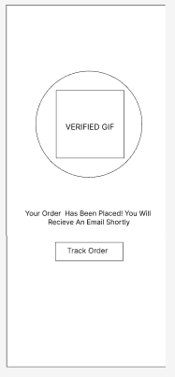
Order Verified Screen
After placing an order, this confirmation screen appears. It informs users that their order has been successfully placed and provides an option to track it.

Slide 14
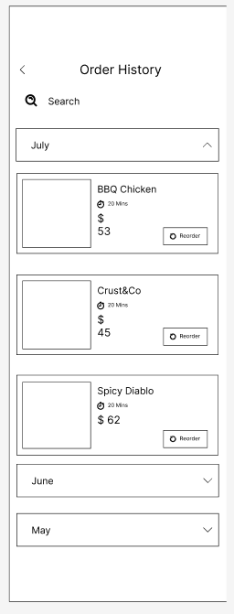
Order History Screen
This screen shows the user’s past orders organized by date.
Users can search for previous purchases and view order details.

Slide 15
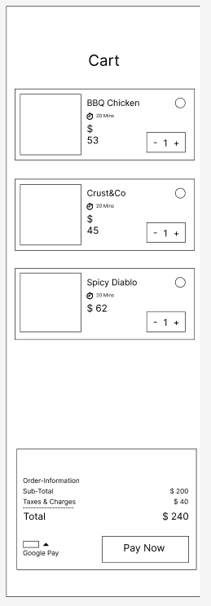
Cart Screen
This screen lists all selected items before checkout. It displays item names, quantities, total cost, and provides an option to proceed to payment.

Slide 16
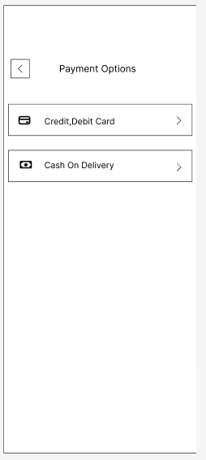
Payment Selection Screen
On this screen, users choose their preferred payment method.
Options include card payment and cash on delivery.

Slide 17
Chosen Database
Firebase Realtime Database
User authentication
Storing order data
Managing product inventory
Real-time updates and history tracking
GitHub Repository
https://github.com/adinashby-vanier-college/app-dev-2-project-pizza-app

Slide 18
Conclusion
A user-friendly and fully functional pizza ordering app.
Implements Firebase for backend management.
Designed for scalability and future features.
Ready for real-world application with minimal improvements.

