Slide 1
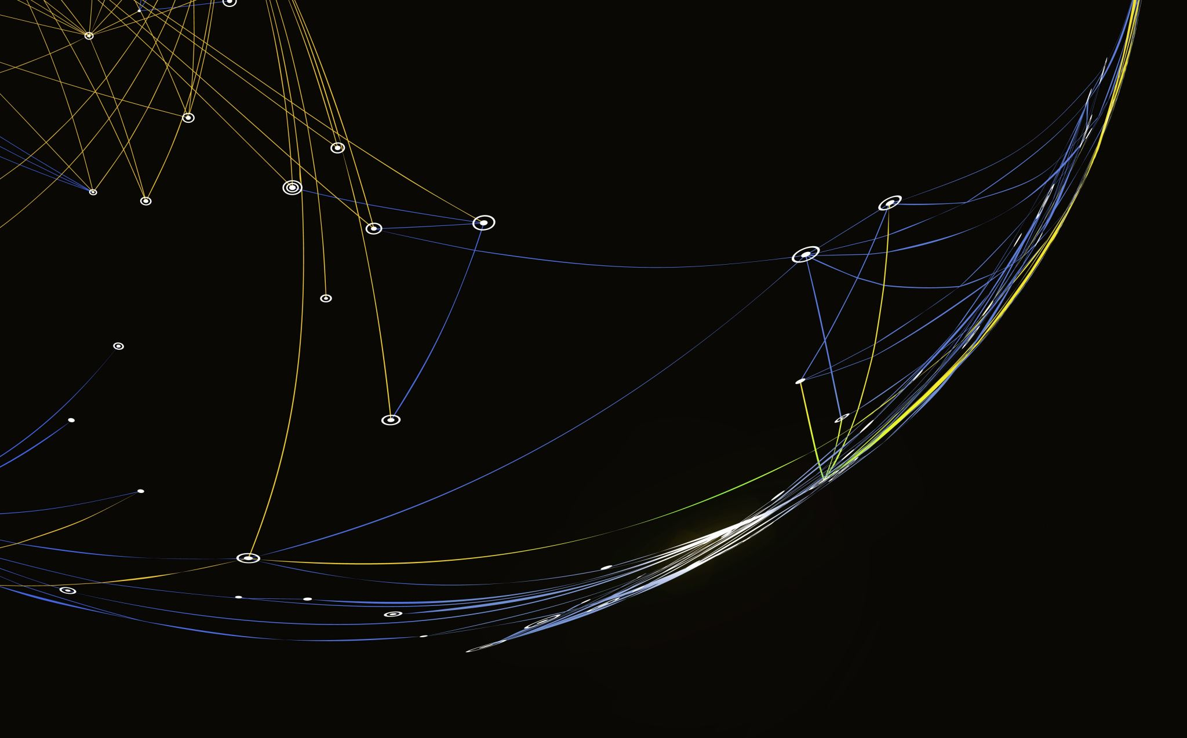
Legend of the Fallen
By: Hanson Yang & Oliver D’Avino

Slide 2
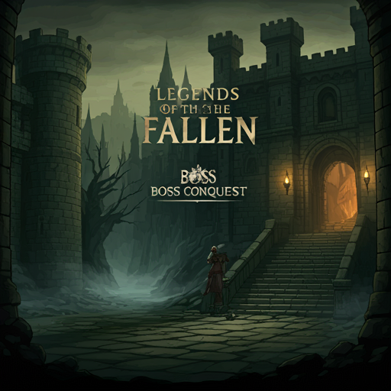
What is our Game?
Side scroller dungeon crawler
Fight enemies in the dungeon
Defeat the final boss

Slide 3
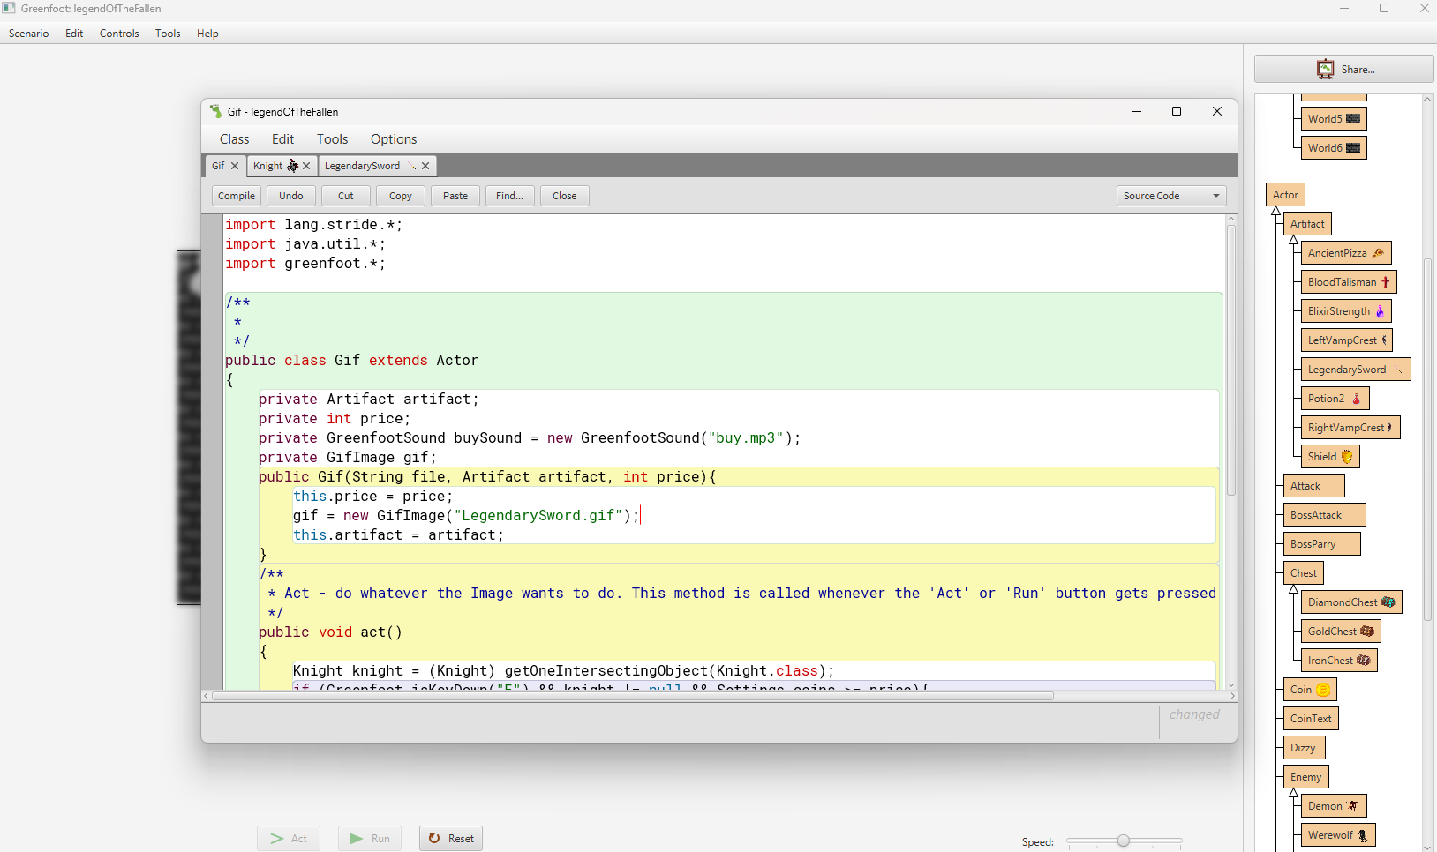
Our Contributions
Hanson: programmer
Coder
Programmer
Created most classes
Made the core mechanics

Slide 4
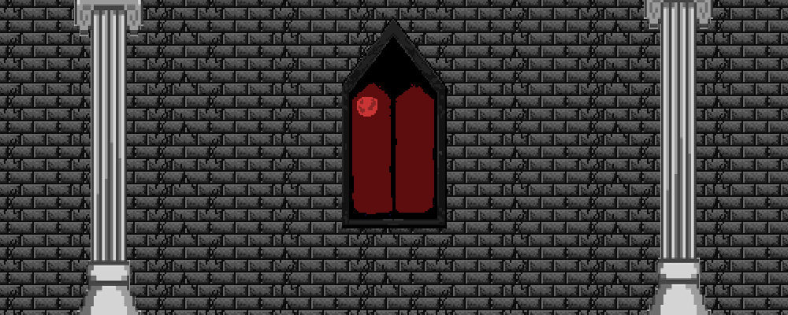
Our Contributions cont.
Oliver: designer
Created the designs of the game
Animated each enemy
Created the background

Slide 5
Main Mechanics
Attack: The attacks damage the enemy and knight
Parry: The parry mechanic can be used by attacking at the right time.
Dash/Movement: Quickly escape situations
Chests: Open chests for loot
Exploration: Explore the dungeon!

Slide 6
Characters
There are 4 characters:
The Knight
Zombies
Werewolves
Demon King

Slide 7
Items
We have plenty of items to assist
Legendary Sword
Elixir of Strength
Left & right Vampire Crest
Ancient Pizza
Blood Talisman
Potion of Healing
Fire Shield

Slide 8
Thank You!
Onto the game!

