Slide 1
E-commerce
Website

Slide 2
Description
The project will be about creating an E-commerce full-stack website. Our presentation will showcase how we've combined intuitive front-end design with powerful back-end capabilities. From browsing a diverse product range to ensuring secure transactions, user registration, authentication, and authorization.

Slide 3
Team Members
Wei Jin
Sean Burke
Malek Kazal

Slide 4

Theme
#96B6C5
Font :
DM Serif Display
#ADC4CE
#EEE0C9
#F1F0E8

Slide 5
Techs & Tools
JavaScript
NodeJS
React
Express.js
MongoDB || MySQL || Firebase
AWS / Git

Slide 6


Slide 7
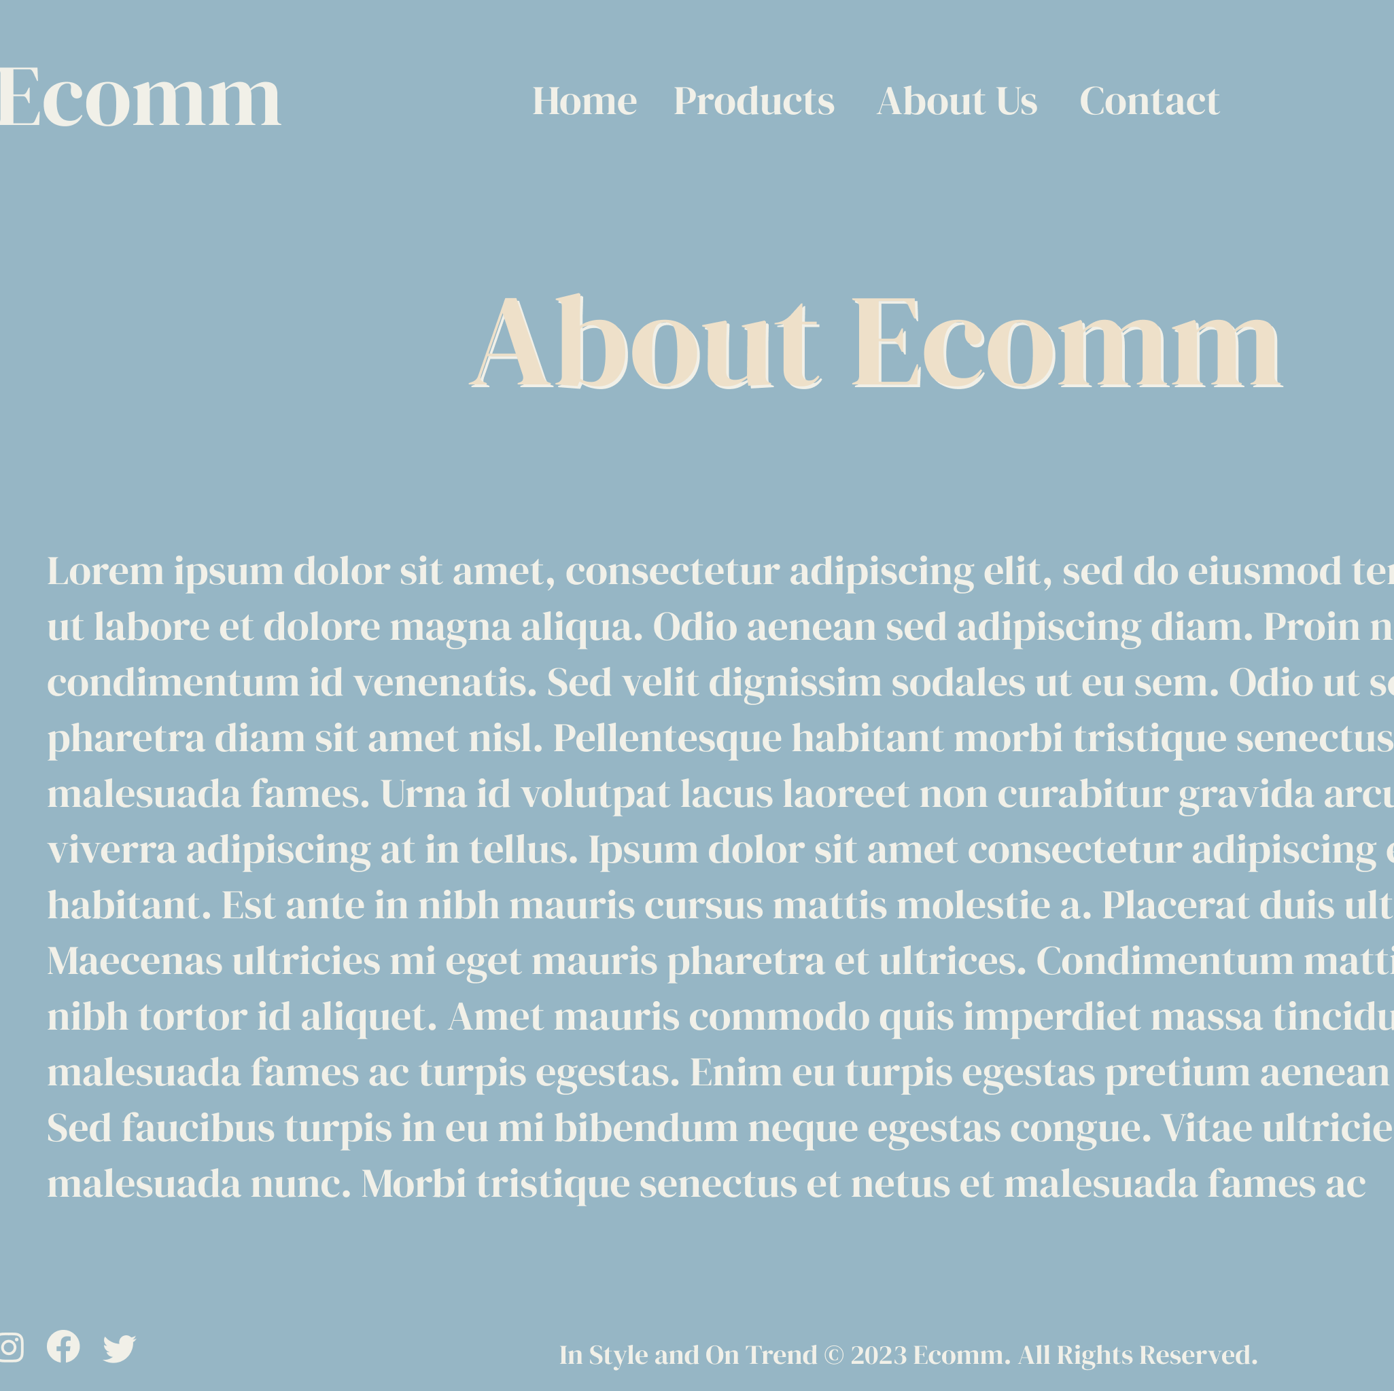
About Us Page

Slide 8
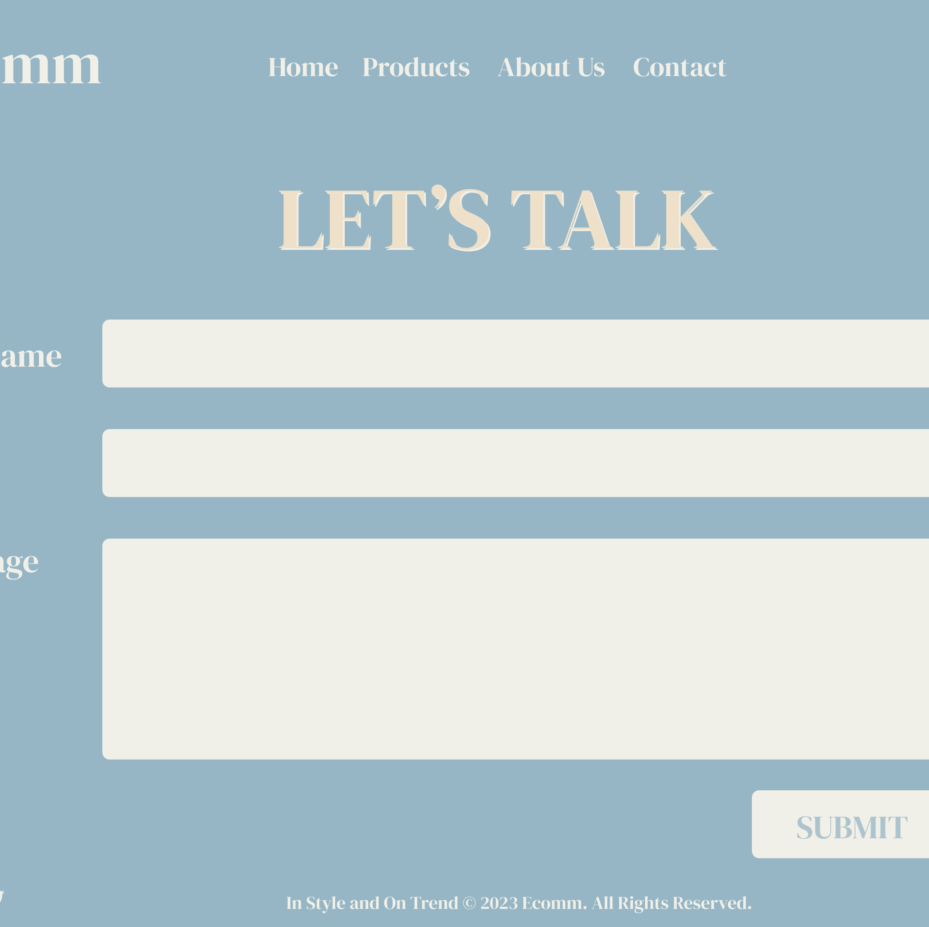
Contact Us Page

Slide 9
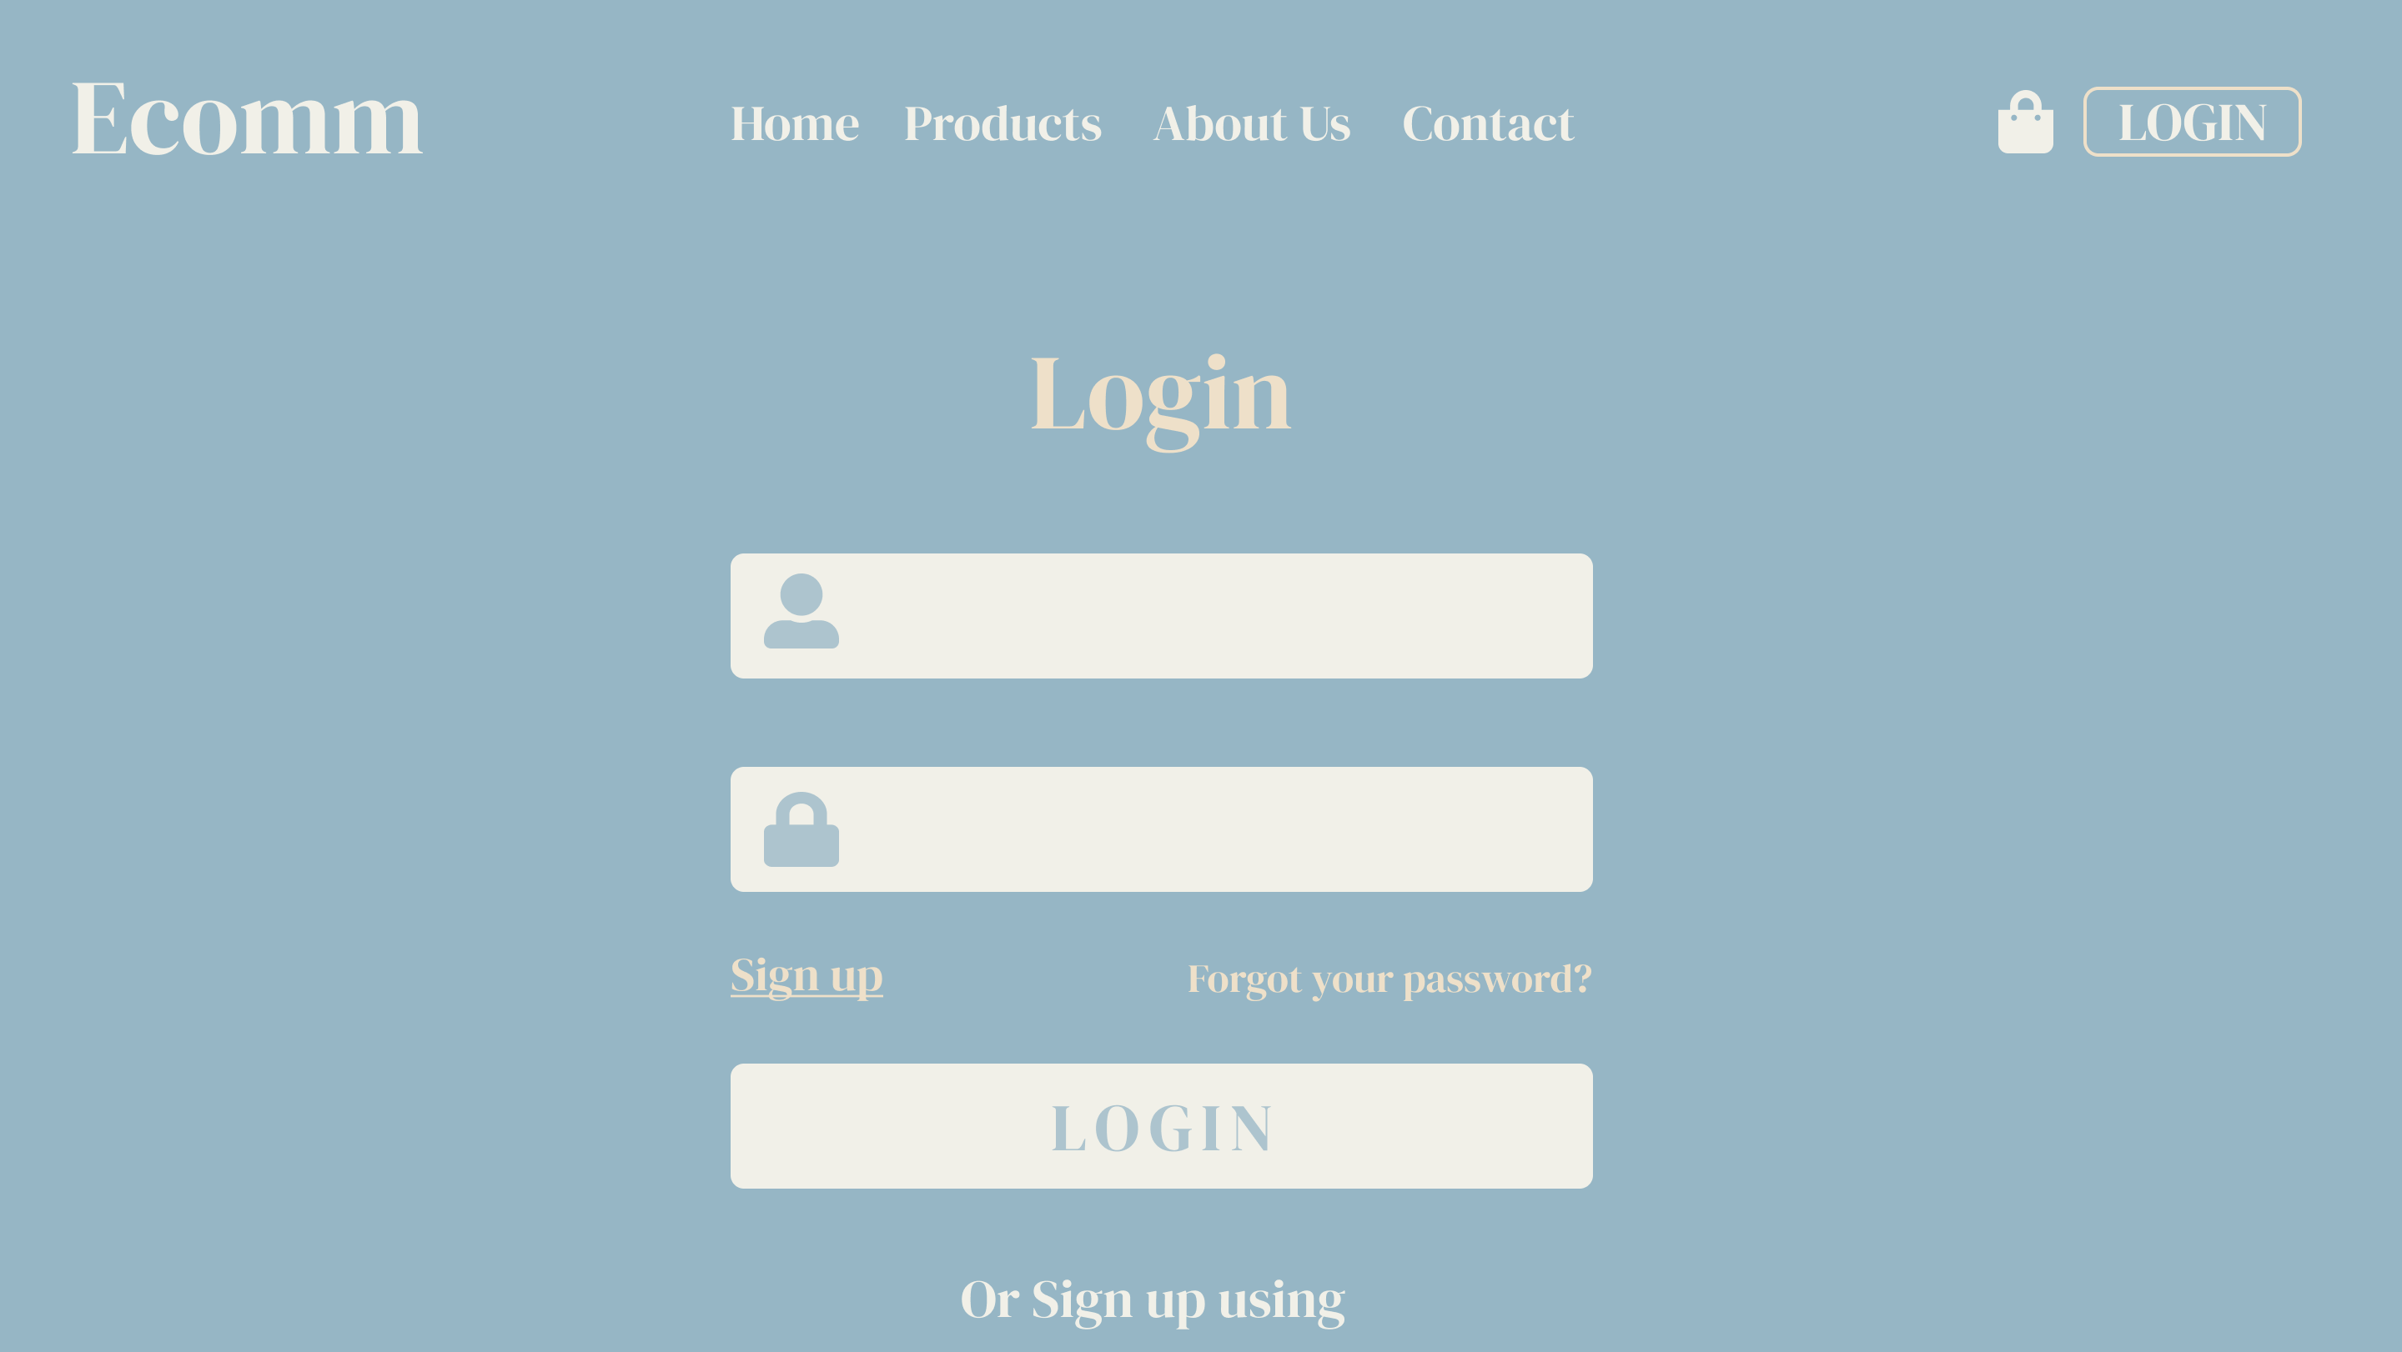

Slide 10
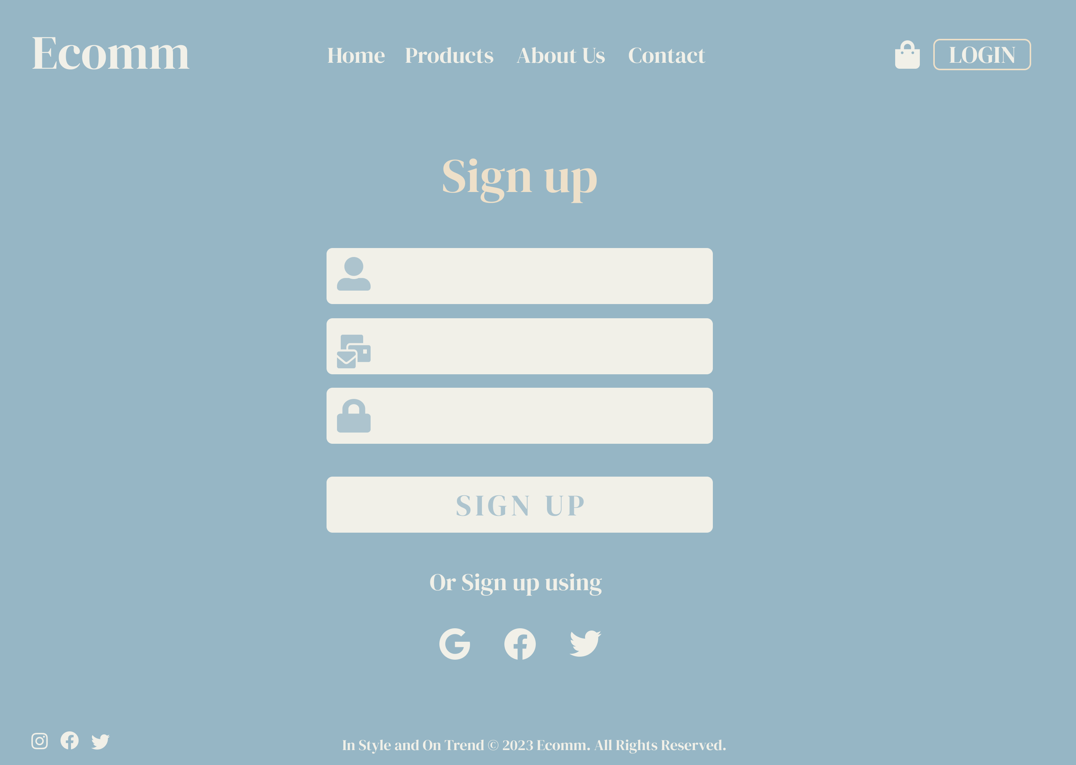
Sign up
Page

Slide 11

Products Page
This page will contain the products data from the database and their details like price, variants, sizes, and buttons like add to cart, add to Wishlist.
The user should be able to press on the product image to open the product page containing more details and description.

Slide 12
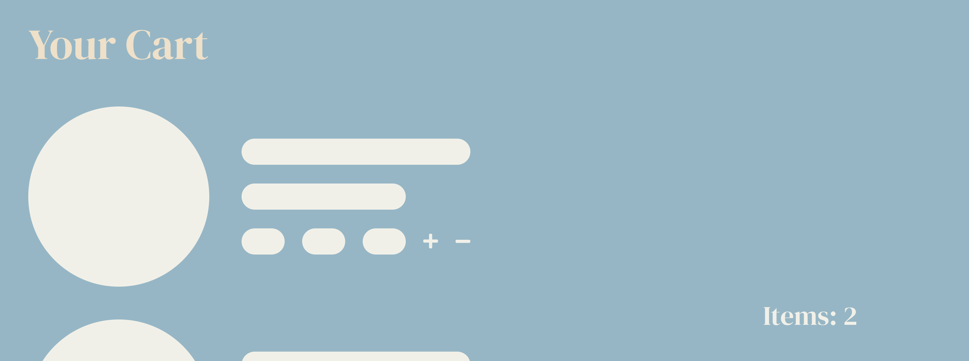
Cart Page
The user should be able to view his items in his cart and remove or add more items, view the total amount, and checkout to purchase the products.

Slide 13
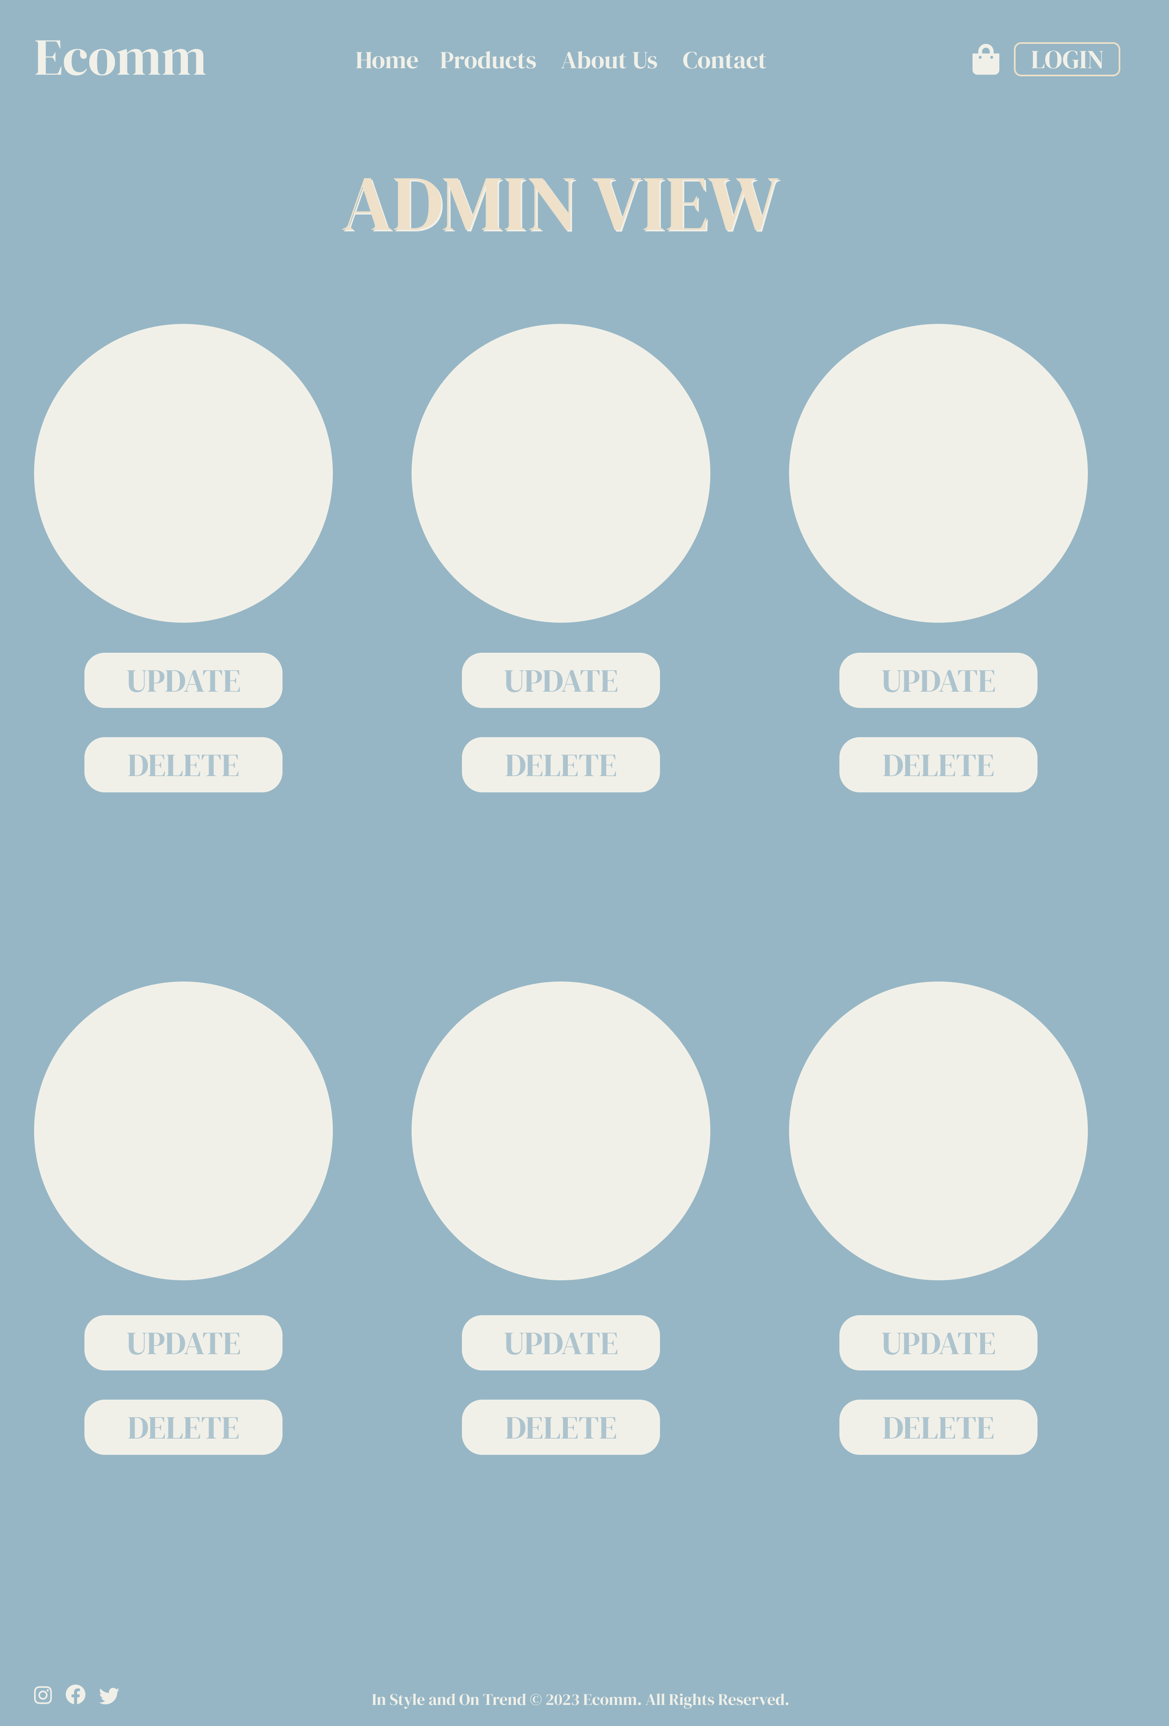
Products-Admin Page
If the user logged in is an Admin, he should be able to view the products page differently, he will be able to edit, and remove a product

