Slide 1
Making Decisions

Slide 2
Relational Operators
Relational operators are used to compare numeric and char values to determine relative order. All of the relational operators are binary, which means they use two operands.
Numeric data is compared in C++ by using relational operators. Each relational operator determines whether a specific relationship exists between two values.
Following table lists all C++ relational operators:
Relational Operator | Meaning
> | Greater than
< | Less than
>= | Greater than or equal to
<= | Less than or equal to
== | Equal to
!= | Not equal to

Slide 3
Relational Expressions (1 of 2)
All the relational operators have left-to-right associativity. Recall that associativity is the order in which an operator works with its operands.
Relational expressions are also known as Boolean expressions, which means their value can only be true or false.
Following are the examples of relational expressions.
12 > 5 is true
7 <= 5 is false
if x is 10, then
x == 10 is true,
x != 8 is true, and
x == 8 is false

Slide 4
Relational Expressions (2 of 2)
Result (value) of a relational expression can be assigned to a variable. Following is an example:
result = x <= y;
In C++, relational expressions represent true states with the number 1, and false states with the number 0.
Do not confuse = and ==

Slide 5
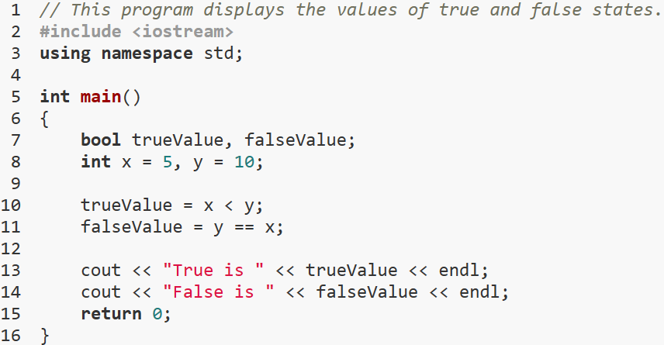
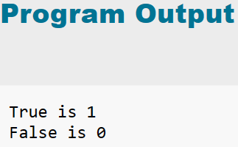
Example-1

Slide 6
The if Statement (1 of 2)
The if statement allows statements to be conditionally executed or skipped over
Models the way we mentally evaluate situations:
"If it is raining, take an umbrella."
"If it is cold outside, wear a coat."

Slide 7
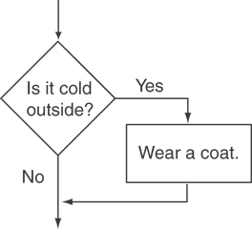
Flowchart for Evaluating a Decision (1 of 2)
Following flowchart shows the logic of a decision structure. The diamond symbol represents a yes/no question or a true/false condition.
The action “Wear a coat” is performed only when it is cold outside. If it is not cold outside, the action is skipped. The action is conditionally executed because it is performed only when a certain condition (cold outside) exists.

Slide 8
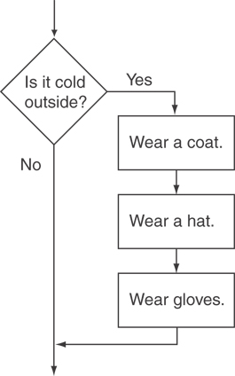
Flowchart for Evaluating a Decision (2 of 2)
Following figure shows a more elaborate flowchart, where three actions are taken only when it is cold outside.

Slide 9
The if Statement (2 of 2)
One way to code a decision structure in C++ is with the if statement. Here is the general format of the if statement:
General Format of the if statement:
if (expression)
statement;
The if statement is simple in the way it works:
If the value of the expression inside the parentheses is true, the very next statement is executed. Otherwise, it is skipped.
The statement is conditionally executed because it only executes under the condition that the expression in the parentheses is true

Slide 10
The if Statement-What Happens
Simplest way to make a decision structure in C++ is with the if statement:
if (expression)
statement;
If the value of the expression inside the parenthesis is true, then the very next statement block is executed.
Otherwise, If the value of the expression is false, then statement block is skipped.
The statement block is conditionally executed because it only executes under the condition that the expression in the parentheses is true.

Slide 11
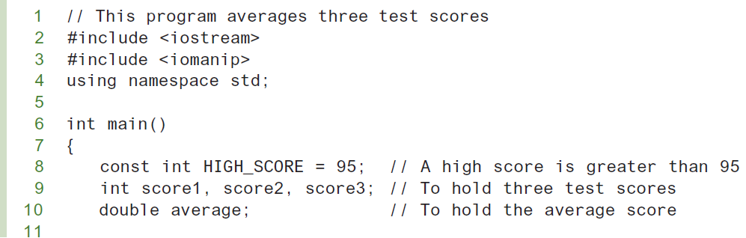
if Statement (1 of 2)
Example-2

Slide 12
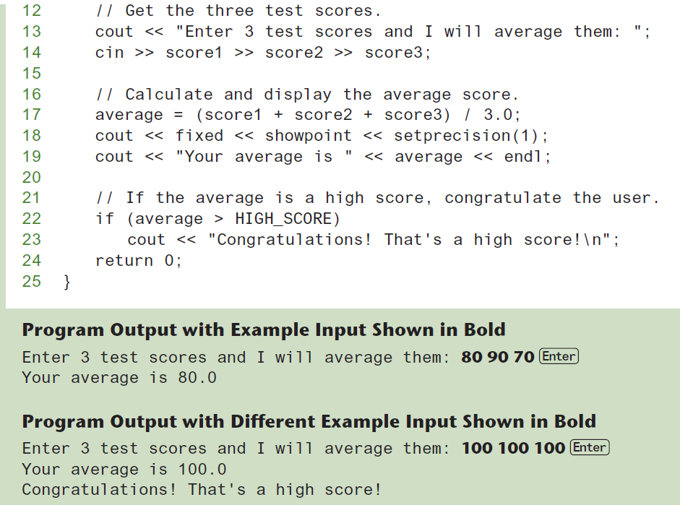
if Statement (2 of 2)

Slide 13
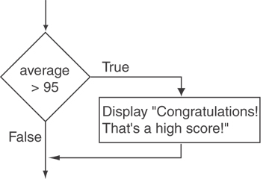
Flowchart for Program 4-2 Lines 22 and 23
Following figure shows the logic of this if statement.

Slide 14
if Statement Notes
Be Careful with Semicolons ;. Semicolons do not mark the end of a line, but the end of a complete C++ statement.
The if statement is not complete without the conditionally executed statement that comes after if (expression)portion .
Do not place ; after the if (expression)portion of if statement
Place statement; on a separate line after (expression), indented. Indentation and spacing are for the human readers of a program, not for the compiler.
if (score > 90)
grade = 'A';
Be careful testing floats and doubles for equality (==).
0 is false; any other value is true. This means that any value, even a negative number, represents as true as long as it is not 0.

Slide 15
Expanding the if Statement
To execute more than one statement as part of an if statement, enclose them in braces { }:
if (score > 90)
{
grade = 'A';
cout << "Good Job!\n";
}
{ } creates a block of code

Slide 16
The if/else statement (1 of 2)
The if/else statement provides two possible paths of execution
Performs one statement or block if the expression is true, otherwise performs another statement or block.
General Format of if/else statement is:
if (expression)
statement1; // or block
else
statement2; // or block

Slide 17
if/else-What Happens
To evaluate:
if (expression)
statement1;
else
statement2;
If the expression is true, then statement1 is executed and statement2 is skipped.
If the expression is false, then statement1 is skipped and statement2 is executed.

Slide 18
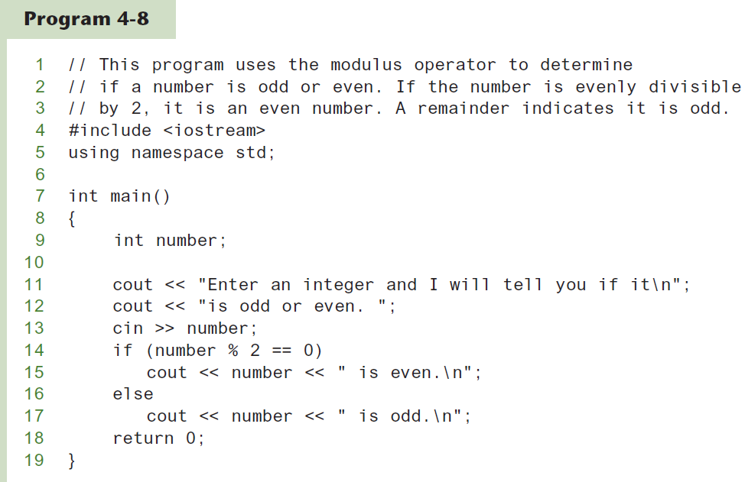
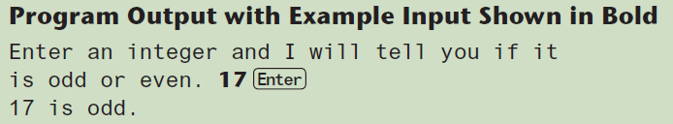
The if/else statement and Modulus Operator
Following program uses the if/else statement along with the modulus operator to determine if a number is odd or even.

Slide 19
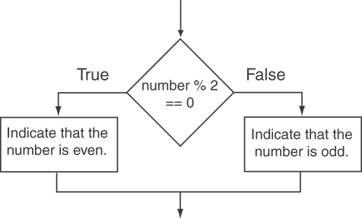
Flowchart for Program 4-8 Lines 14 through 18
This flowchart shows the logic of the if/else statement.
Division by zero is mathematically impossible to perform, and it normally causes a program to crash.
This means the program will prematurely stop running, sometimes with an error message.

Slide 20
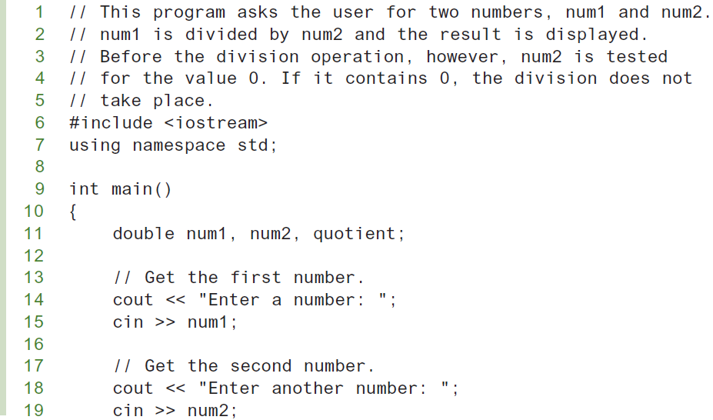
Testing the Divisor in Program 4-9 (1 of 2)
This program shows a way to test the value of a divisor before the division takes place.

Slide 21
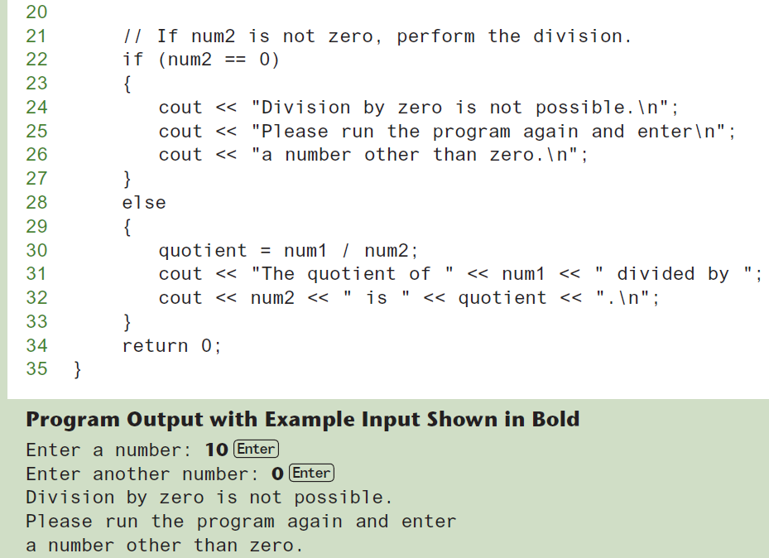
Testing the Divisor in Program 4-9 (2 of 2)

Slide 22
Nested if Statements (1 of 3)
An if statement that is nested inside another if statement
Nested if statements can be used to test more than one condition
Sometimes an if statement must be nested inside another if statement.
For example, consider a banking program that determines whether a bank customer qualifies for a special, low interest rate on a loan. To qualify, two conditions must exist:
(1) the customer must be currently employed, and
(2) the customer must have recently graduated from college (in the past 2 years).
Following flowchart shows an algorithm that could be used in such a program.

Slide 23
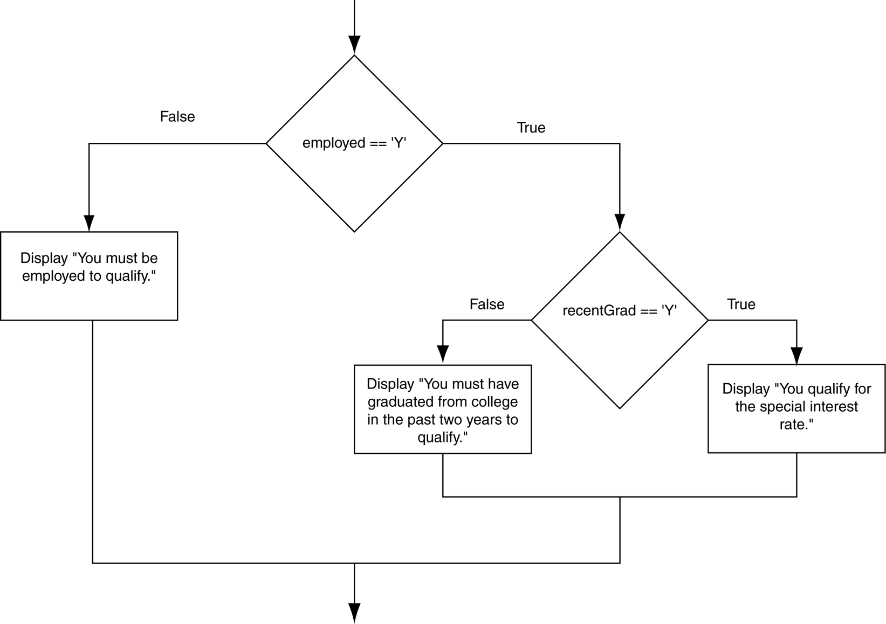
Flowchart for a Nested if Statement

Slide 24
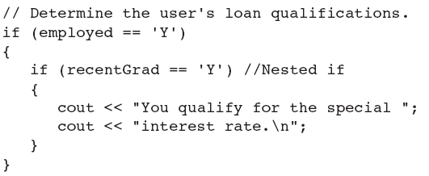
Nested if Statements (2 of 3)
Following C++ code may be used to implement the banking employee loan approval algorithm using nested if statements

Slide 25
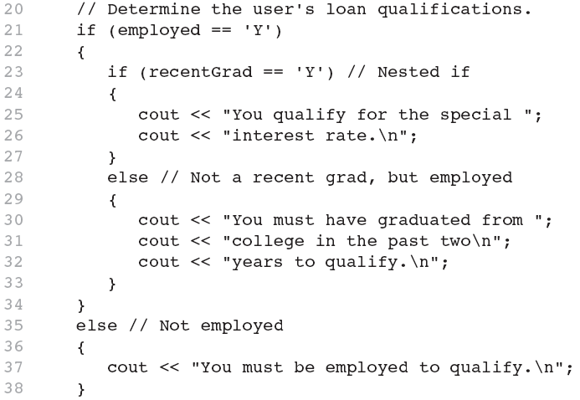
Nested if Statements (3 of 3)
Another C++ code example, for the same algorithm

Slide 26
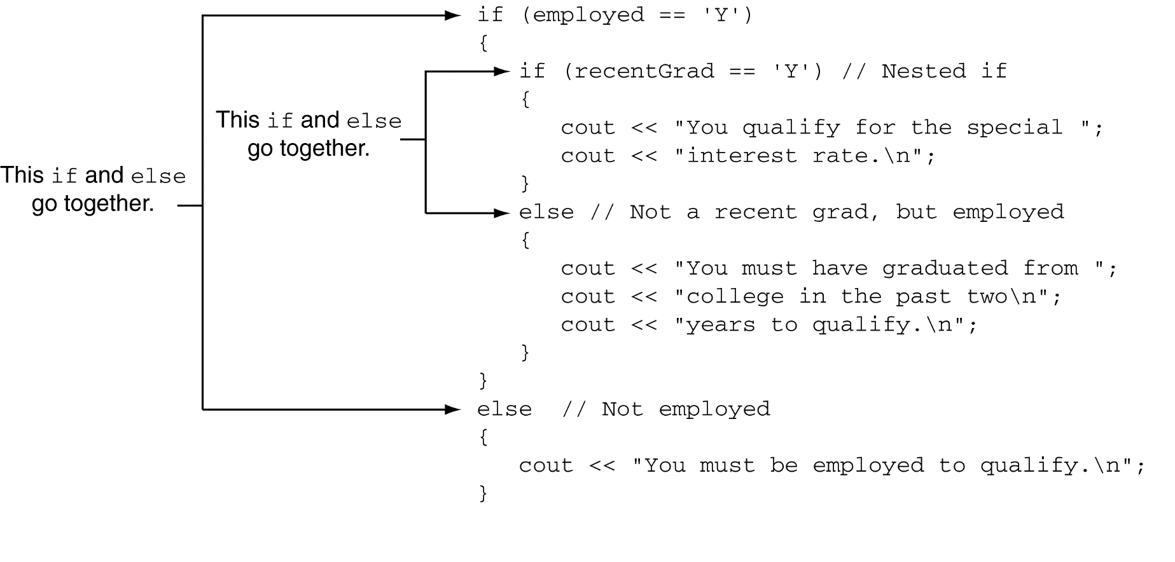
Use Proper Indentation!

Slide 27
The if/else if Statement
Tests a series of conditions until one is found to be true
Often simpler than using nested if/else statements
Can be used to model thought processes such as:
"If it is raining, take an umbrella, else, if it is windy, take a hat, else, take sunglasses”

Slide 28
if/else if Format
if (expression)
statement1; // or block
else if (expression)
statement2; // or block
.
. // other else ifs
.
else if (expression)
statementn; // or block

Slide 29
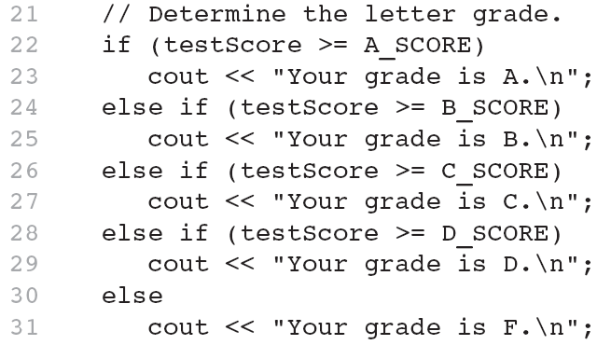
The if/else if Statement

Slide 30
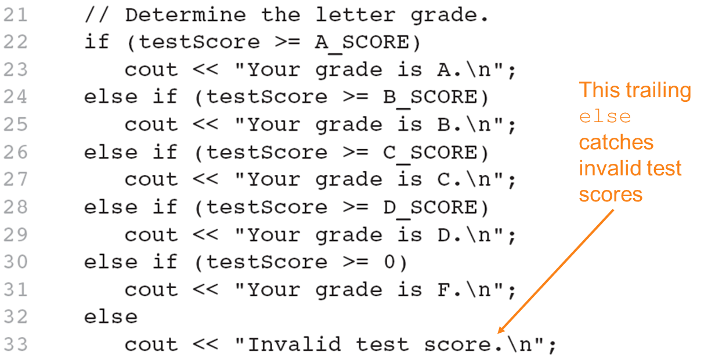
Using a Trailing else to Catch Errors
The trailing else clause is optional, but it is best used to catch errors.

Slide 31
if Statement Initialization (1 of 3)
A feature introduced in C++17
if statements can have an optional initialization clause that is executed before the conditional expression is evaluated
General format:
if (initialization; expression)
{
statement;
statement;
// Place as many statements here as necessary.
}

Slide 32
if Statement Initialization (2 of 3)
General format of if-else with initialization:
if (initialization; expression)
{
statement;
statement;
// Place as many statements here as necessary.
}
else
{
statement;
statement;
// Place as many statements here as necessary.
}

Slide 33
if Statement Initialization (3 of 3)
Example:
if (int len = password.length(); len < MIN_LENGTH)
{
cout << "Your password is too short." << endl;
}
else
{
cout << "Your password has " << len
<< " characters." << endl;
}

Slide 34
Flags
Variable that signals a condition
Usually implemented as a bool variable
Can also be an integer
The value 0 is considered false
Any nonzero value is considered true
As with other variables in functions, must be assigned an initial value before it is used

Slide 35
Logical Operators
Used to create relational expressions from other relational expressions
Operators, meaning, and explanation:
Logical Operator | Meaning
&& | AND New relational expression is true if both expressions are true
|| | OR New relational expression is true if either expression is true
! | NOT Reverses the value of an expression – true expression becomes false, and false becomes true

Slide 36
Logical Operators-Examples
int x = 12, y = 5, z = −4;
(x > y) && (y > z) | true
(x > y) && (z > y) | false
(x <= z) || (y == z) | false
(x <= z) || (y != z) | true
!(x >= z) | false

Slide 37
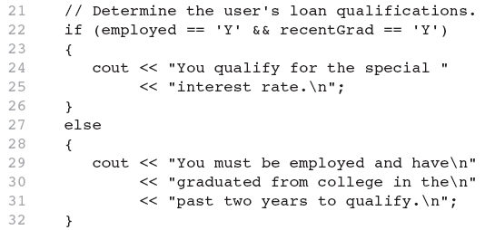
Code Example of logical && operator

Slide 38
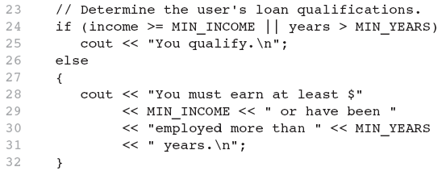
Code Example of logical || Operator

Slide 39
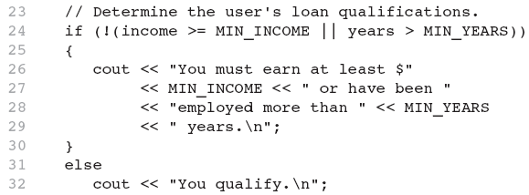
Code Example of logical ! Operator

Slide 40
Logical Operator-Notes
! has highest precedence, followed by &&, then ||
If the value of an expression can be determined by evaluating just the sub-expression on left side of a logical operator, then the sub-expression on the right side will not be evaluated (short circuit evaluation)

Slide 41
Checking Numeric Ranges with Logical Operators
Used to test to see if a value falls inside a range:
if (grade >= 0 && grade <= 100)
cout << "Valid grade";
Can also test to see if value falls outside of range:
if (grade <= 0 || grade >= 100)
cout << "Invalid grade";
Cannot use mathematical notation:
if (0 <= grade <= 100) //doesn’t work!

Slide 42
Menus
Menu-driven program: program execution controlled by user selecting from a list of actions
Menu: list of choices on the screen
Menus can be implemented using if/else if statements

Slide 43
Menu-Driven Program Organization
Display list of numbered or lettered choices for actions
Prompt user to make selection
Test user selection in expression
if a match, then execute code for action
if not, then go on to next expression

Slide 44
Validating User Input
Input validation: inspecting input data to determine whether it is acceptable
Bad output will be produced from bad input
Can perform various tests:
Range
Reasonableness
Valid menu choice
Divide by zero

Slide 45
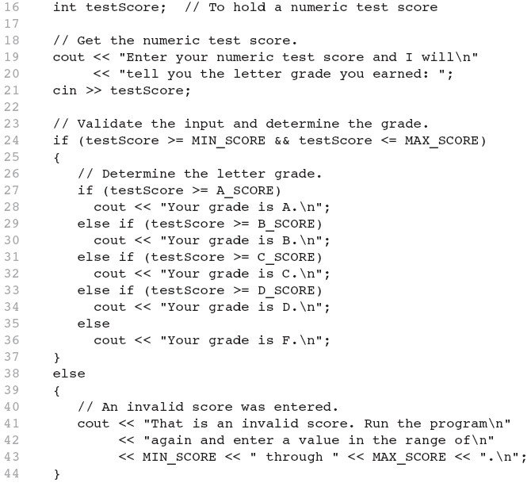
Code Example for Input Validation

Slide 46
Comparing Characters
Characters are compared using their ASCII values
'A' < 'B'
The ASCII value of 'A' (65) is less than the ASCII value of 'B'(66)
'1' < '2'
The ASCII value of '1' (49) is less than the ASCI value of '2' (50)
Lowercase letters have higher ASCII codes than uppercase letters, so
'a' > 'Z'

Slide 47
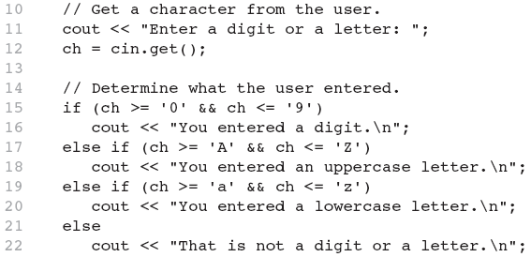
Use of Relational Operators to Compare Characters

Slide 48
Comparing string Objects
Like characters, strings are compared using their ASCII values
string name1 = "Mary";
string name2 = "Mark";
name1 > name2 // true
name1 <= name2 // false
name1 != name2 // true
name1 < "Mary Jane" // true
The characters in each string must match before they are equal

Slide 49
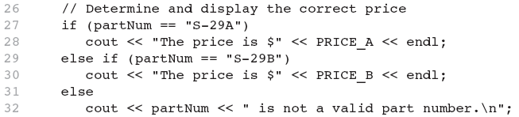
Relational Operators Compare Strings in Program 4-21

Slide 50
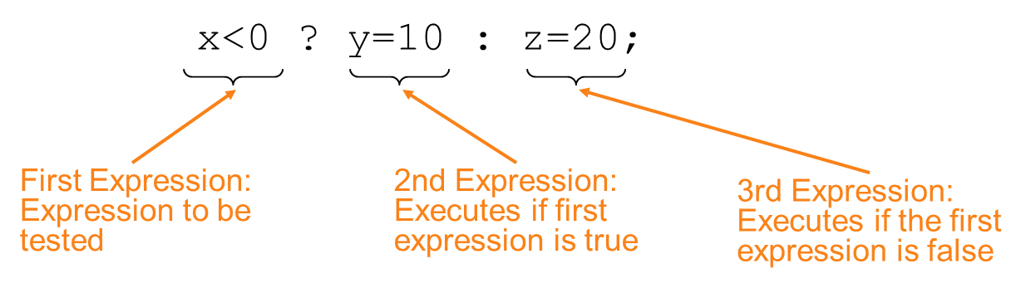
The Conditional Operator (1 of 2)
Can use to create short if/else statements
Format: expr ? expr : expr;

Slide 51
The Conditional Operator (2 of 2)
The value of a conditional expression is
The value of the second expression if the first expression is true
The value of the third expression if the first expression is false
Parentheses () may be needed in an expression due to precedence of conditional operator

Slide 52
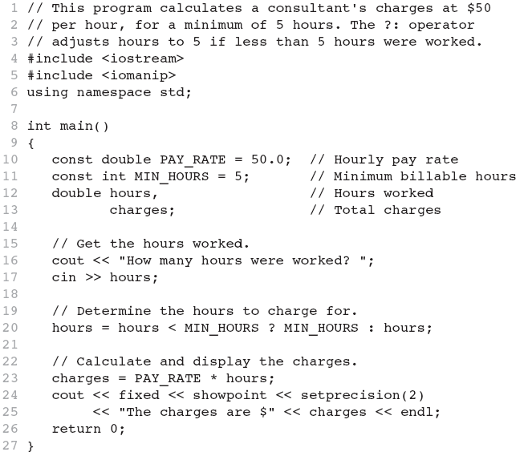
Code Example for The Conditional Operator

Slide 53
The switch Statement (1 of 2)
Used to select among statements from several alternatives
In some cases, can be used instead of if/else if statements

Slide 54
switch Statement Format
switch (expression) //integer
{
case exp1: statement1;
case exp2: statement2;
...
case expn: statementn;
default: statementn+1;
}

Slide 55
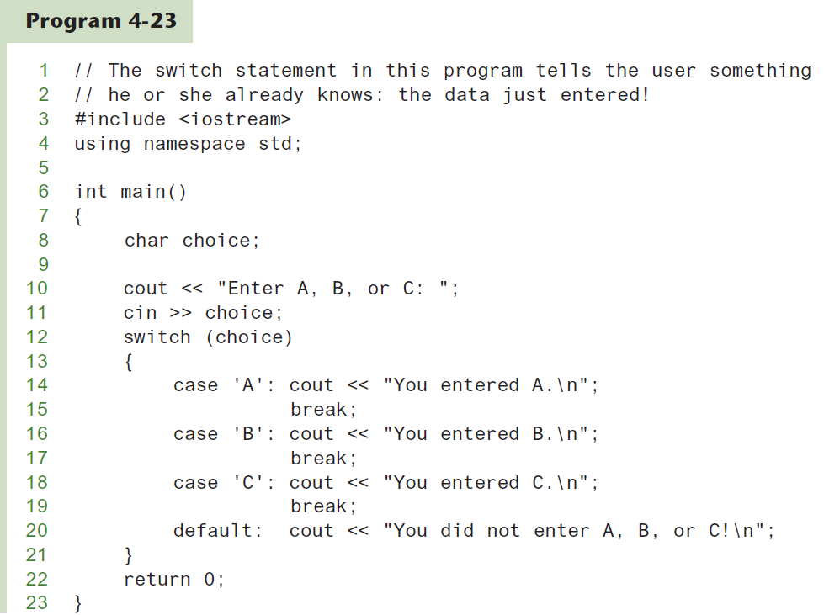
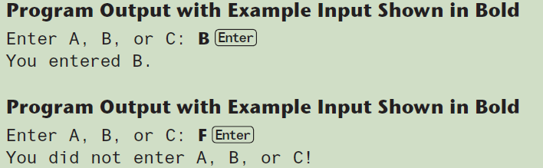
The switch Statement (2 of 2)

Slide 56
switch Statement Requirements
expression must be an integer variable or an expression that evaluates to an integer value
exp1 through expn must be constant integer expressions or literals, and must be unique in the switch statement
default is optional but recommended

Slide 57
switch Statement-How it Works
expression is evaluated
The value of expression is compared against exp1 through expn.
If expression matches value expi, the program branches to the statement following expi and continues to the end of the switch
If no matching value is found, the program branches to the statement after default:

Slide 58
break Statement
Used to exit a switch statement
If it is left out, the program "falls through" the remaining statements in the switch statement

Slide 59
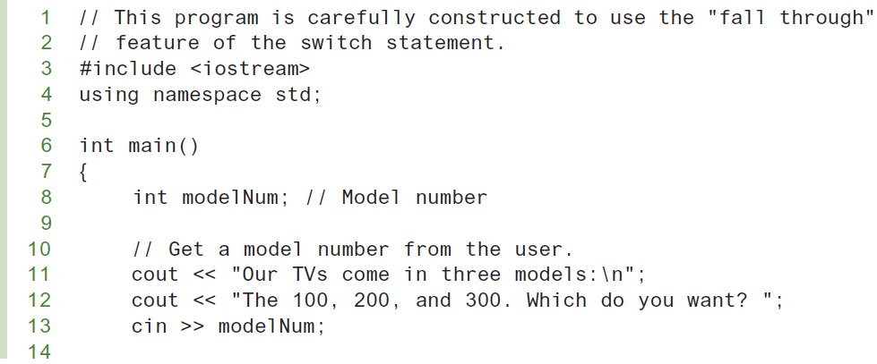
break and default statements (1 of 3)

Slide 60
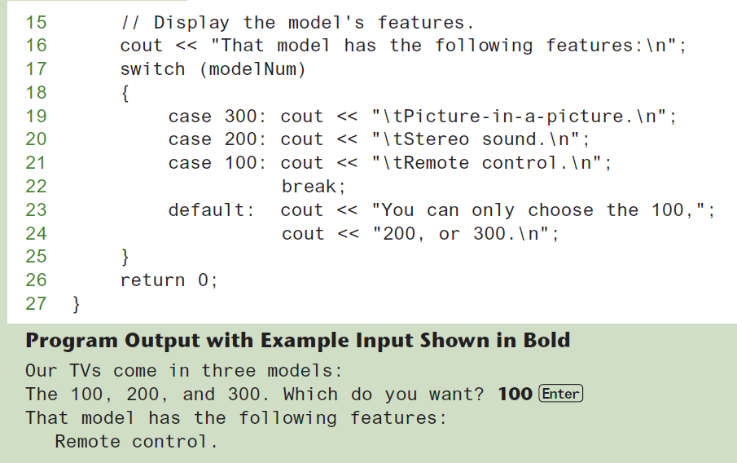
break and default statements (2 of 3)

Slide 61
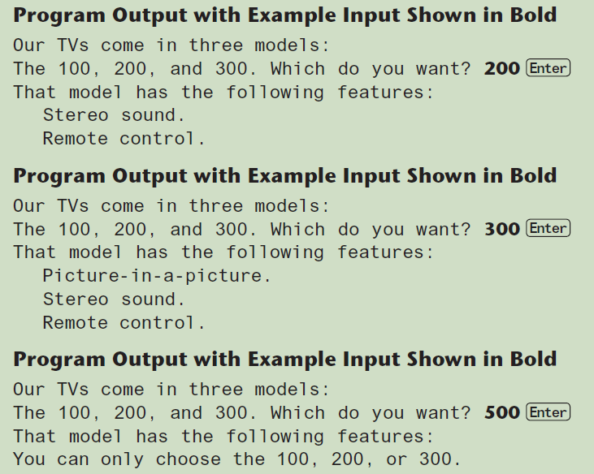
break and default statements (3 of 3)

Slide 62
Using switch in Menu Systems
switch statement is a natural choice for menu-driven program:
display the menu
then, get the user's menu selection
use user input as expression in switch statement
use menu choices as expr in case statements

Slide 63
switch Statement Initialization (1 of 3)
A feature introduced in C++17
switch statements can have an optional initialization clause that is executed before the conditional integer expression is evaluated

Slide 64
switch Statement Initialization (2 of 3)
General format:
switch (Initialization; IntegerExpression)
{
case ConstantExpression:
// place one or more statements here
case ConstantExpression:
// place one or more statements here
// case statements may be repeated as many
// times as necessary
default:
// place one or more statements here
}

Slide 65
switch Statement Initialization (3 of 3)
Example:
switch (int value = abs(number); value)
{
case 1:
cout << "one" << endl;
break;
case 2:
cout << "two" << endl;
break;
default:
cout << "Invalid value" << endl;
break;
}

Slide 66
More About Blocks and Scope
Scope of a variable is the block in which it is defined, from the point of definition to the end of the block
Usually defined at beginning of function
May be defined close to first use

Slide 67
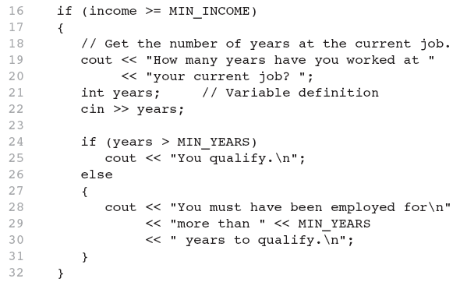
Example of Inner Block Variable Definition

Slide 68
Variables with the Same Name
Variables defined inside { } have local or block scope
When inside a block within another block, can define variables with the same name as in the outer block.
When in inner block, outer definition is not available
Not a good idea

Slide 69
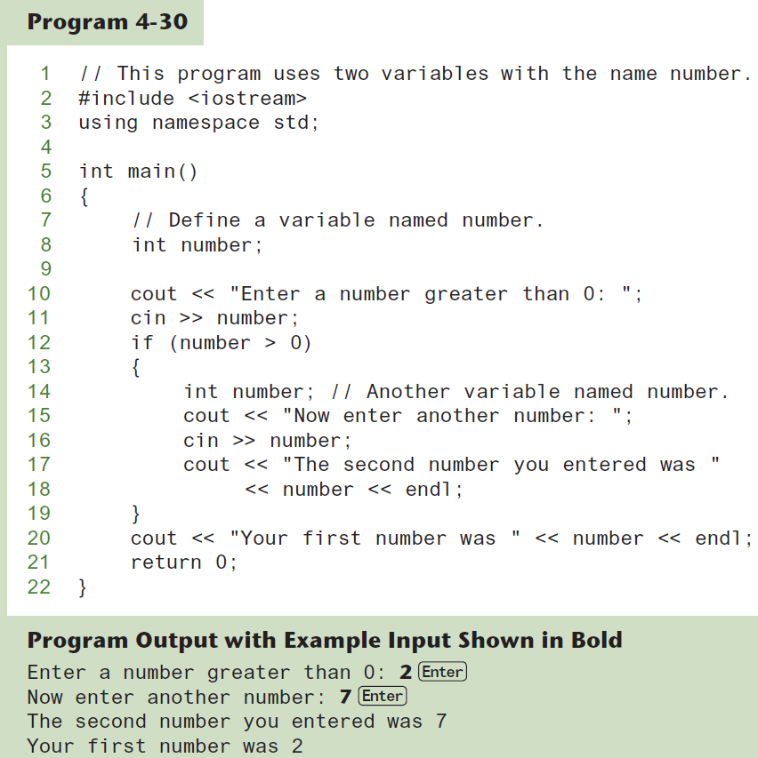
Two Variables with the Same Name

