Slide 1
Structured Data

Slide 2
Abstract Data Types
Abstract data types (ADTs) are data types created by the programmer.
ADTs have their own range (or domain) of data and their own sets of operations that may be performed on them.
ADT is a data type that specifies
values that can be stored
operations that can be done on the values
User of an abstract data type does not need to know the implementation of the data type, e.g., how the data is stored
ADT is very important in computer science and is especially significant in object-oriented programming

Slide 3
Abstraction and Data Types
Abstraction: is a general model of something. It is a definition that captures general characteristics of an object without details
Example: An abstract triangle is a 3-sided polygon. A specific triangle may be scalene, isosceles, or equilateral
Data Type defines the values (range or domain) that can be stored in a variable and the operations that can be performed on it. For example:
short int data type range of values is −32,768 to +32,767.
Data types also define what values a variable may not hold.
integer variables may not be used to hold fractional numbers.

Slide 4
Abstraction and Data Types
An abstract data type (ADT) is a data type created by the programmer and is composed of one or more primitive data types.
The programmer decides what values are acceptable for the data type, as well as what operations may be performed on the data type.
In many cases, the programmer designs his or her own specialized operations.
For example, suppose a program is created to simulate a 12-hour clock. The program could contain three ADTs: Hours, Minutes, and Seconds.
The range of values for the Hours data type would be the integers 1 through 12. If an Hours object is set to 12 and then incremented, it will then take on the value 1.
The range of values for the Minutes and Seconds data types would be 0 through 59. If a Minutes object or a Seconds object is set to 59 then incremented, it will take on the value 0.
Abstract data types often combine several values. In the clock program, the Hours, Minutes, and Seconds objects could be combined to form a single Clock object.

Slide 5
Combining Data into Structures
C++ allows programmer to group several variables together into a single item known as a structure.
Structure: C++ construct that allows multiple variables to be grouped together. General Format:
struct <structName>
{
type1 field1;
type2 field2;
. . .
};
structName is used like a data type name. The variable declarations that appear inside the braces declare members of the structure

Slide 6
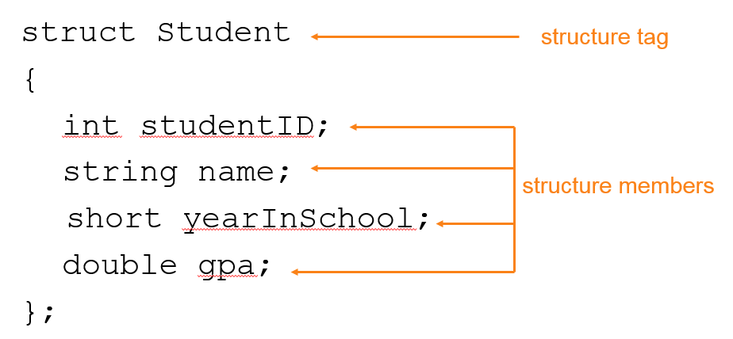
Example struct Declaration
Sometimes a relationship exists between items of different types. For example, in a school information system, following variables may hold data about a single student.
To create a relationship between variables, C++ gives the ability to a programmer to package them together into a structure.

Slide 7
struct Declaration Notes
Before a structure can be used, it must be declared.
Declaration of a structure must have ; after closing }
struct names commonly begin with uppercase letter
Multiple fields of same type can be in comma-separated list, and may be declared on the same line:
string name,
address;
Structure variables are actually made up of other variables known as members.
An instance of a structure is a variable that exists in memory. It contains within it all the members described in the structure declaration.

Slide 8
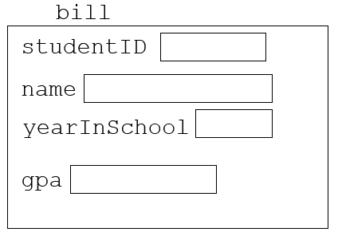
Defining Variables
There are typically two steps to implementing structures in a program:
Create the structure declaration. This establishes the tag (or name) of the structure and a list of items that are members.
Define variables (or instances) of the structure and use them in the program to hold data.
struct declaration does not allocate memory or create variables
To define variables, use structure tag as type name:
Student bill;

Slide 9
Accessing Structure Members
C++ provides the dot operator (a period) to access the individual members of a structure.
The dot operator connects the name of the member variable with the name of the structure variable it belongs to.
Use the dot (.) operator to refer to members of struct variables:
cin >> stu1.studentID;
getline(cin, stu1.name);
stu1.gpa = 3.75;
Member variables can be used in any manner appropriate for their data type

Slide 10
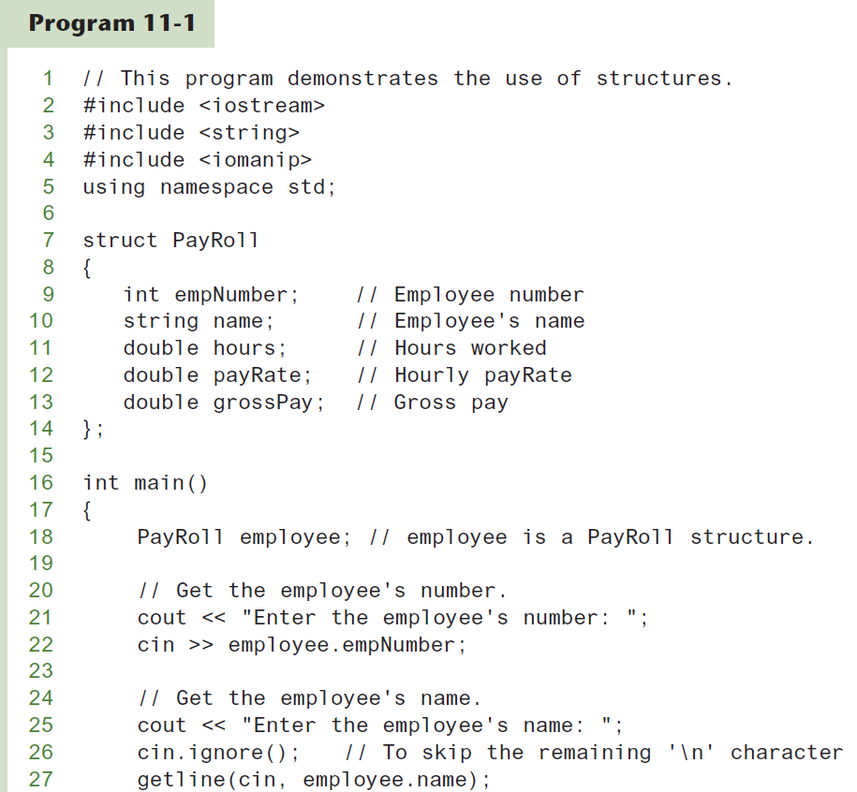
Program uses PayRoll Sturcture (1 of 3)

Slide 11
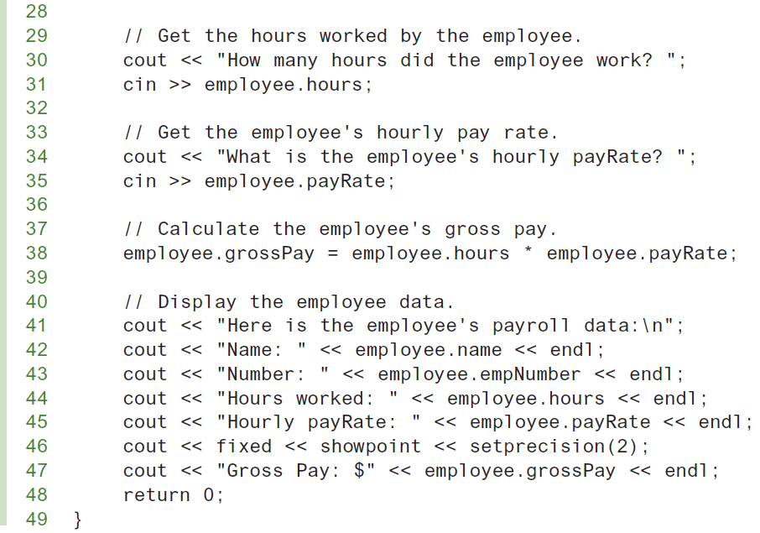
Program uses PayRoll Sturcture (2 of 3)

Slide 12
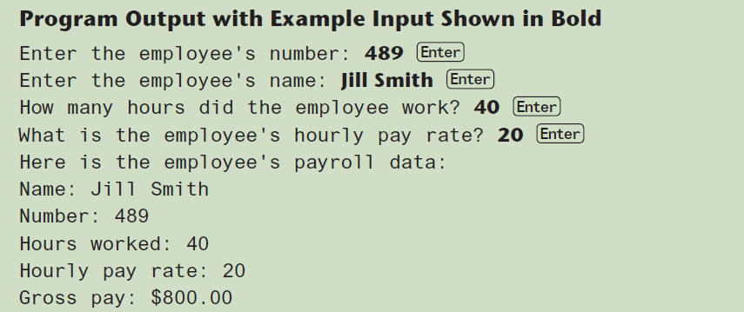
Program uses PayRoll Sturcture (3 of 3)

Slide 13
Displaying a struct Variable
The contents of a structure variable cannot be displayed by passing the entire variable to cout.
To display the contents of a struct variable, must display each field separately, using the dot operator:
cout << bill; // won’t work
cout << bill.studentID << endl;
cout << bill.name << endl;
cout << bill.yearInSchool;
cout << " " << bill.gpa;

Slide 14
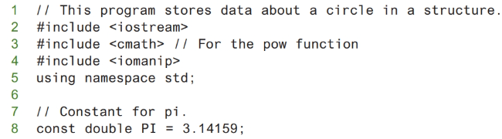
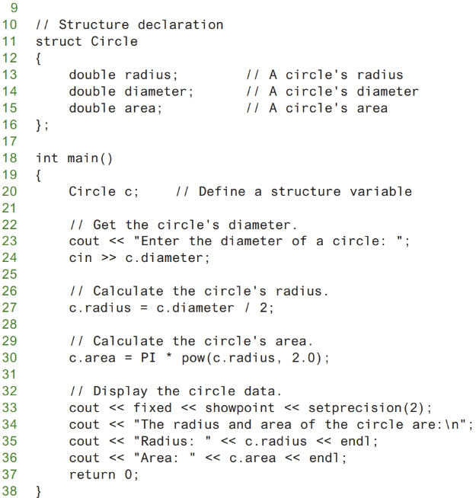
Program uses Sturcture member as Function argument (1 of 3)

Slide 15
Program uses Sturcture member as Function argument (2 of 3)

Slide 16
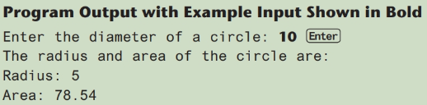
Program uses Sturcture member as Function argument (3 of 3)

Slide 17
Comparing struct Variables
Cannot compare struct variables directly. For example, assume bill and william are Student structure variables. The following statement will cause an error:
if (bill == william) // won’t work
In order to compare two structures, individual members must be compared, as shown in the following code:
if (bill.studentID ==
william.studentID) ...
Structure members that are of a primitive data type can be used with cin, cout, mathematical statements, and any operation that can be performed with regular variables.
The only difference is that the structure variable name and the dot operator must precede the name of a member.

Slide 18
Initializing a Structure
The members of a struct variable can be initialized with starting values when the struct variable is defined, in a fashion similar to the initialization of an array. :
Student s = {11465, "Joan", 2, 3.75};
Can also be initialized member-by-member after definition:
s.name = "Joan";
s.gpa = 3.75;

Slide 19
More on Initializing a Structure
May initialize only some members. For example, the following statement only initializes the studentID member of bill. The name, yearInSchool, and gpa members are left uninitialized.
Student bill = {14579};
Cannot skip over members:
Student s = {1234, "John", , 2.83}; // illegal
Cannot initialize in the structure declaration, since this does not allocate memory

Slide 20
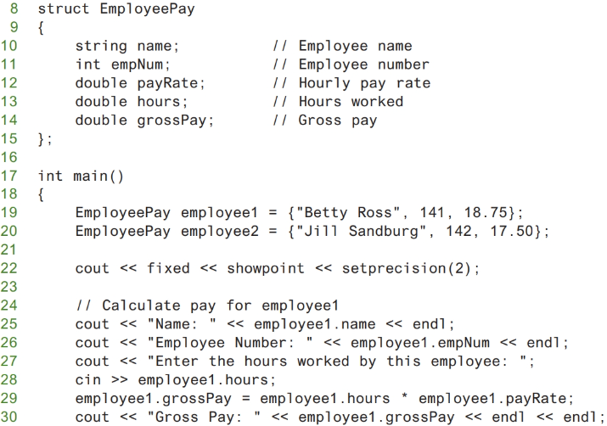
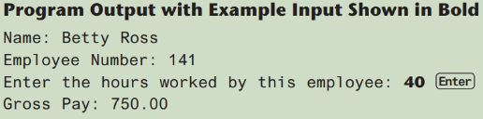
Partially Initialized Structure Variables
Example of partially initialized structure variables.

Slide 21
Arrays of Structures
An array of structures is defined like any other array.
Can be used in place of parallel arrays. The following statement defines an array, stuList, that has 20 elements. Each element is a Student structure. const int NUM_STUDENTS = 20; Student stuList[NUM_STUDENTS];
Individual structures accessible using subscript notation
Fields within structures accessible using dot notation. For example, the following statement refers to the studentID member of stuList[5]:
cout << stuList[5].studentID;

Slide 22
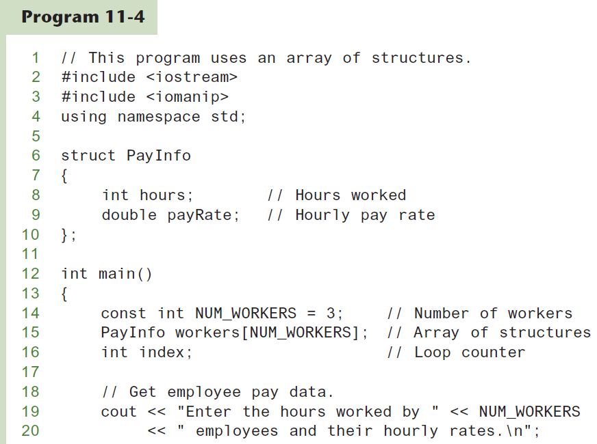
Program uses a single array of structures (1 of 3)

Slide 23
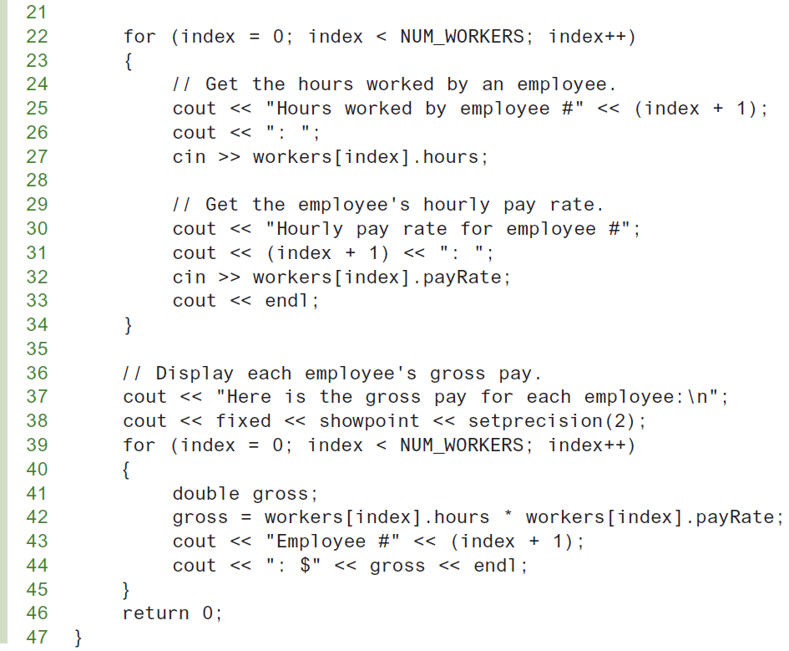
Program uses a single array of structures (2 of 3)

Slide 24
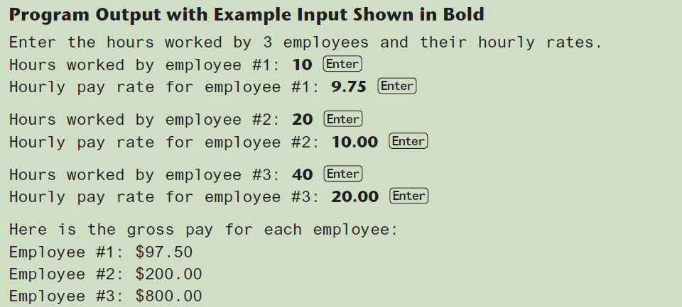
Program uses a single array of structures (3 of 3)

Slide 25
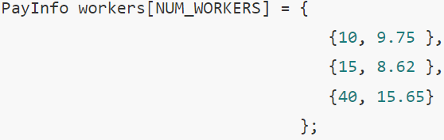
Initializing a Structure Array
To initialize a structure array, simply provide an initialization list for one or more of the elements.
For example, the array in previous program could have been initialized as follows:

Slide 26
Nested Structures
A structure can contain another structure as a member. For example, consider the following structure declarations:
struct PersonInfo
{ string name,
address,
city;
};
struct Student
{ int studentID;
PersonInfo pData;
short yearInSchool;
double gpa;
};
The PersonInfo structure has three members: name, address and city, all strings. Notice the second member of the Student structure, pdata, is a PersonInfo structure.

Slide 27
Members of Nested Structures
Use the dot operator multiple times to refer to fields of nested structures.
The following statements show examples of accessing members of the pData variable, which is inside stu:
Student stu;
stu.pData.name = "Joanne";
stu.pData.city = "Tulsa";

Slide 28
Structures as Function Arguments
Like other variables, the individual members of a structure variable may be used as function arguments:
computeGPA(stu.gpa);
May pass entire struct variables to functions:
showData(stu);
Structures, like all variables, are normally passed by value into a function. Can use reference parameter if function needs to modify contents of structure variable

Slide 29
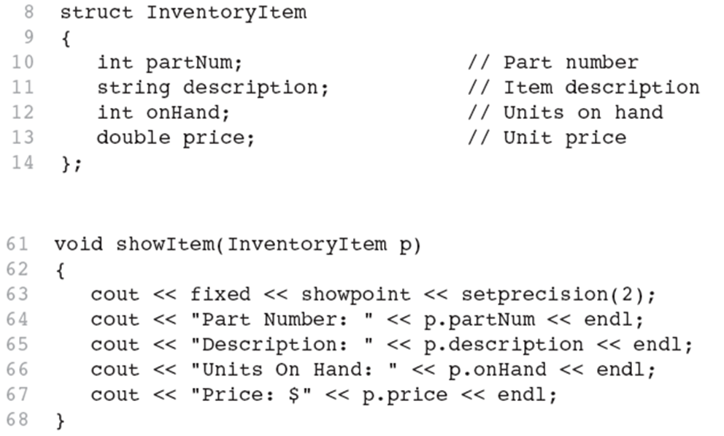
Excerpts from Program 11-6
Following example shows that struct argument p is passed by value to showItem function

Slide 30
Structures as Function Arguments - Notes
Using value parameter for structure can slow down a program, waste space
Using a reference parameter will speed up program, but function may change data in structure
Using a const reference parameter allows read-only access to reference parameter, does not waste space, speed

Slide 31
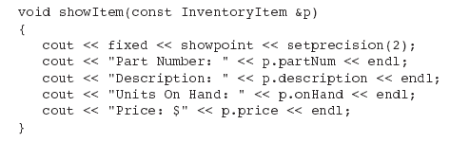
Revised showItem Function
The showItem function is shown here, modified to use a constant reference parameter.
This version of the function is more efficient than the original version because the amount of time and memory consumed in the function call is reduced.

Slide 32
Returning a Structure from a Function
Just as functions can be written to return an int, long, double, or other data type, they can also be designed to return a struct:
Student getStudentData(); // prototype
stu1 = getStudentData(); // call
When a function returns a struct, it is always necessary for the function to have a local struct variable to hold the member values that are to be returned. Function must define a local struct variable:
for internal use
for use with return statement

Slide 33
Returning a Structure from a Function Example
Student getStudentData()
{ Student tempStu;
cin >> tempStu.studentID;
getline(cin, tempStu.pData.name);
getline(cin, tempStu.pData.address);
getline(cin, tempStu.pData.city);
cin >> tempStu.yearInSchool;
cin >> tempStu.gpa;
return tempStu;
}

Slide 34
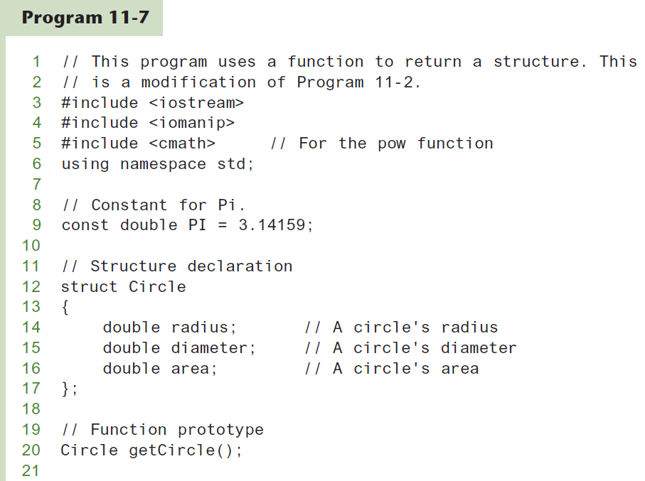
Returning a Structure from a Function Program Example (1 of 3)
The function getCircle gets the circle’s diameter from the user and calculates the circle’s radius and area. The diameter, radius, and area are stored in a local structure variable, tempCircle, which is returned from the function.

Slide 35
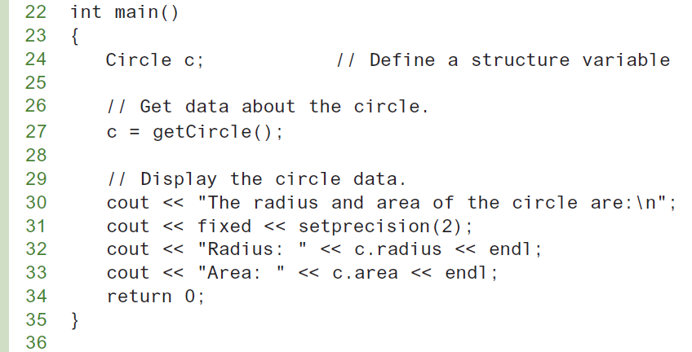
Returning a Structure from a Function Program Example (2 of 3)

Slide 36
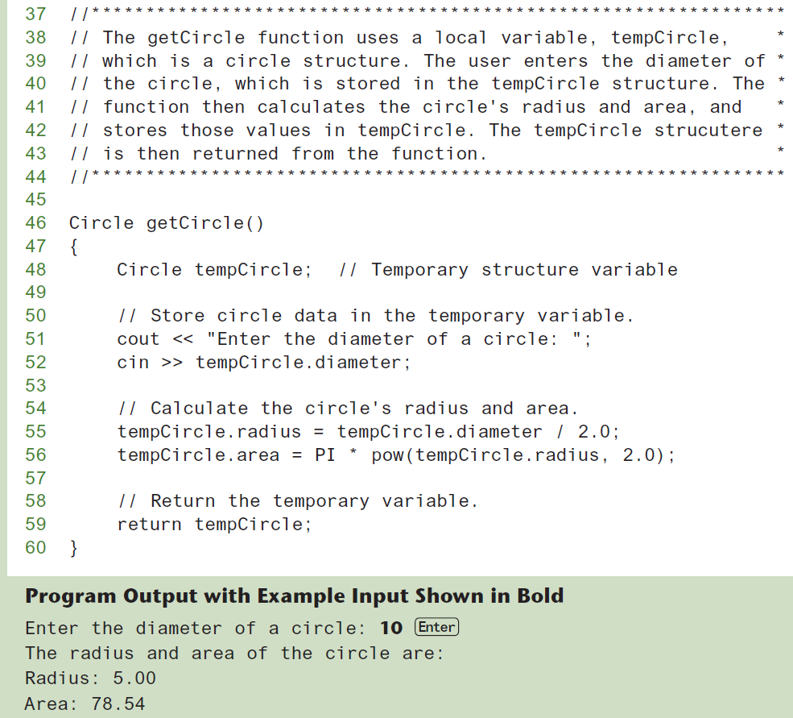
Returning a Structure from a Function Program Example (3 of 3)

Slide 37
Structured Binding Declarations (1 of 3)
A structured binding declaration defines a set of variables and initializes them with the values that are stored in a structure.
A process known as unpacking a structure
Can also be used to unpack arrays (see Chapter 7)
Structured binding declarations were introduced in C++ 17

Slide 38
Structured Binding Declarations (2 of 3)
A structured binding declaration allows programmer to write one statement that defines a set of variables and initializes those variables with the values that are stored in a structure.
General format:
auto [variable1, variable2, etc...] = structureVar;
The statement begins with the auto key word, followed by a list of variable names enclosed in square brackets ([]). Next, an assignment operator appears, followed by the name of structure variable.
When the statement executes, the variables that are named inside the square brackets will be defined and initialized with the values that are stored in the structure.

Slide 39
Structured Binding Declarations (3 of 3)
Example:
struct Automobile
{
string make;
int year;
double mileage;
};
Automobile car = { "Porsche", 2020, 12400.0 };
auto [first, second, third] = car;
cout << first << endl;
cout << second << endl;
cout << third << endl;
This code will display:
Porsche
2020
12400.0

Slide 40
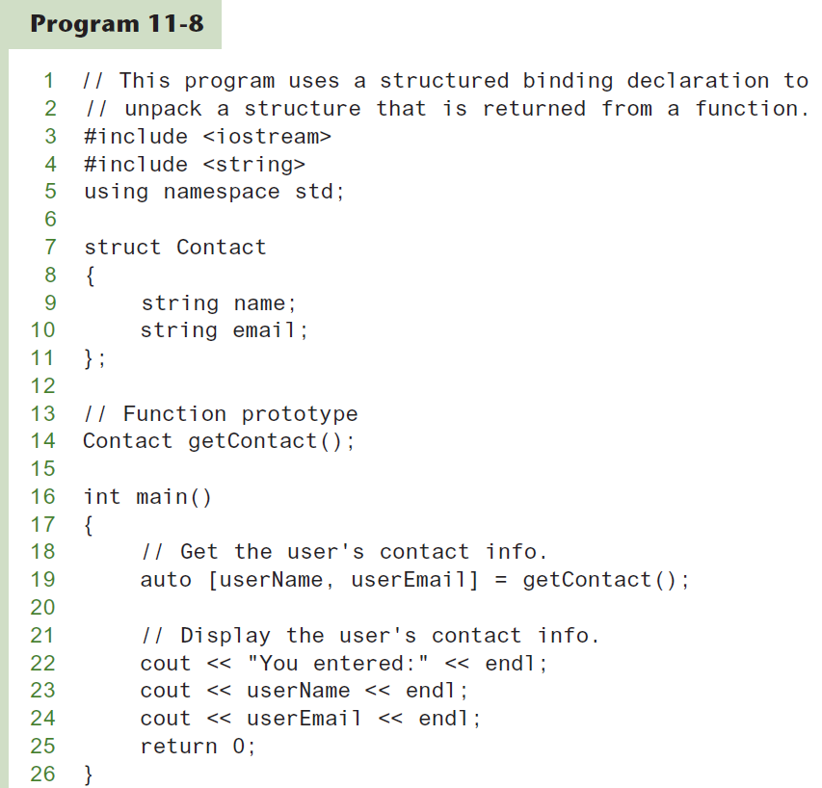
Structured binding Program Example (1 of 2)

Slide 41
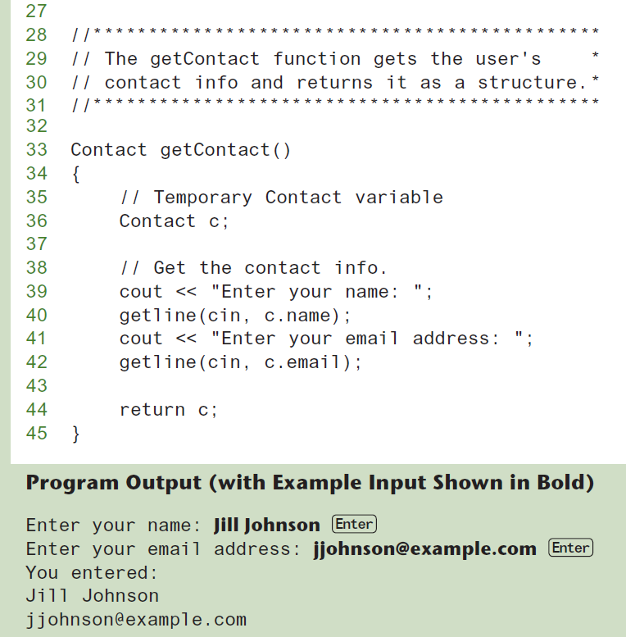
Structured binding Program Example (2 of 2)

Slide 42
Pointers to Structures
A structure variable has an address
Pointers to structures are variables that can hold the address of a structure:
Student *stuPtr;
Can use & operator to assign address:
stuPtr = & stu1;
Structure pointer can be a function parameter

Slide 43
Accessing Structure Members via Pointer Variables
Must use () to dereference pointer variable, not field within structure:
cout << (*stuPtr).studentID;
Can use structure pointer operator [it consists of a hyphen (-) followed by the greater-than symbol (>)] to eliminate () and use clearer notation:
cout << stuPtr->studentID;
NOTE: The structure pointer operator is supposed to look like an arrow, thus visually indicating that a “pointer” is being used.

Slide 44
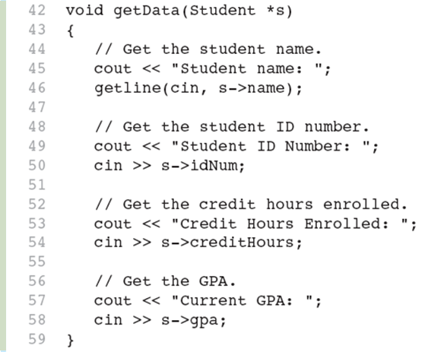
Pointer to a structure as function parameter
getData functions shows that a pointer to a structure may be used as a function parameter, allowing the function to access the members of the original structure argument.

Slide 45
Enumerated Data Types (1 of 9)
An enumerated data type is a programmer-defined data type. It consists of values known as enumerators, which represent integer constants.
An enumerated type declaration begins with the key word enum, followed by the name of the type, followed by a list of identifiers inside braces, and is terminated with a semicolon.
Here is the general format of an enumerated type declaration: enum TypeName { One or more enumerators };

Slide 46
Enumerated Data Types (2 of 9)
Example: Following is an example of an enumerated data type declaration:
enum Day { MONDAY, TUESDAY, WEDNESDAY, THURSDAY, FRIDAY`};
The identifiers MONDAY, TUESDAY, WEDNESDAY, THURSDAY, and FRIDAY, which are listed inside the braces, are enumerators. They represent the values that belong to the Day data type.

Slide 47
Enumerated Data Types (3 of 9)
enum Day { MONDAY, TUESDAY, WEDNESDAY, THURSDAY,FRIDAY };
Note that the enumerators are not strings, so they are not enclosed in quotes. They are identifiers.

Slide 48
Enumerated Data Types (4 of 9)
Once you have created an enumerated data type in your program, you can define variables of that type. Example:
Day workDay;
This statement defines workDay as a variable of the Day type.

Slide 49
Enumerated Data Types (5 of 9)
We may assign any of the enumerators MONDAY, TUESDAY, WEDNESDAY, THURSDAY, or FRIDAY to a variable of the Day type. Example:
workDay = WEDNESDAY;

Slide 50
Enumerated Data Types (6 of 9)
So, what is an enumerator?
Think of it as an integer named constant
Internally, the compiler assigns integer values to the enumerators, beginning at 0.

Slide 51
Enumerated Data Types (7 of 9)
enum Day { MONDAY, TUESDAY, WEDNESDAY, THURSDAY, FRIDAY`};
In memory...
MONDAY = 0 TUESDAY = 1 WEDNESDAY = 2 THURSDAY = 3 FRIDAY = 4

Slide 52
Enumerated Data Types (8 of 9)
Using the Day declaration, the following code...
cout << MONDAY << " "
<< WEDNESDAY << " “
<< FRIDAY << endl;
...will produce this output:
0 2 4

Slide 53
Assigning an integer to an enum Variable
You cannot directly assign an integer value to an enum variable. This will not work:
workDay = 3; // Error!
Instead, you must cast the integer:
workDay = static_cast<Day>(3);

Slide 54
Assigning an Enumerator to an int Variable
You CAN assign an enumerator to an int variable. For example:
int x;
x = THURSDAY;
This code assigns 3 to x.

Slide 55
Comparing Enumerator Values
Enumerator values can be compared using the relational operators. For example, using the Day data type the following code will display the message "Friday is greater than Monday.“
if (FRIDAY > MONDAY)
{
cout << "Friday is greater "
<< "than Monday.\n";
}

Slide 56
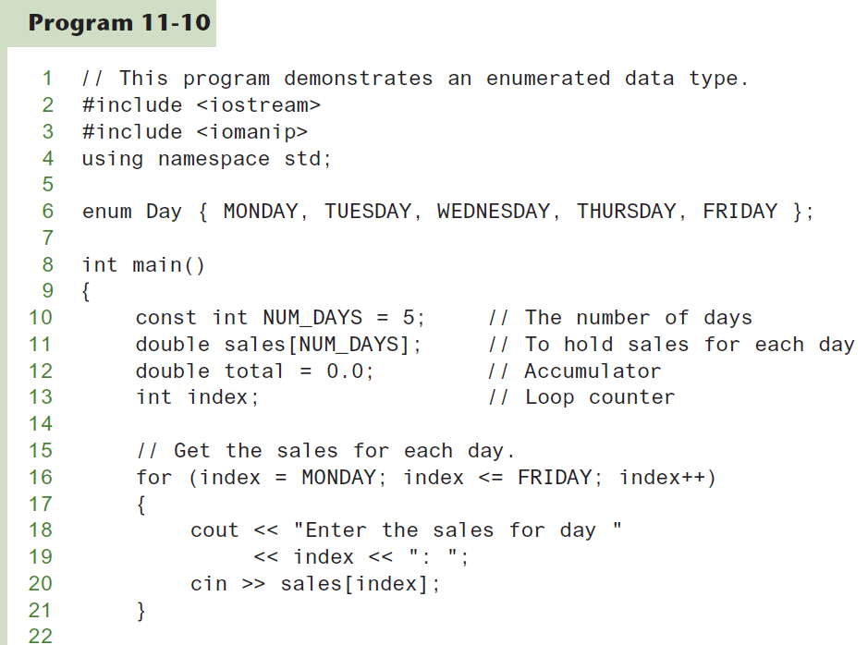
enum Data type Program Example (1 of 2)

Slide 57
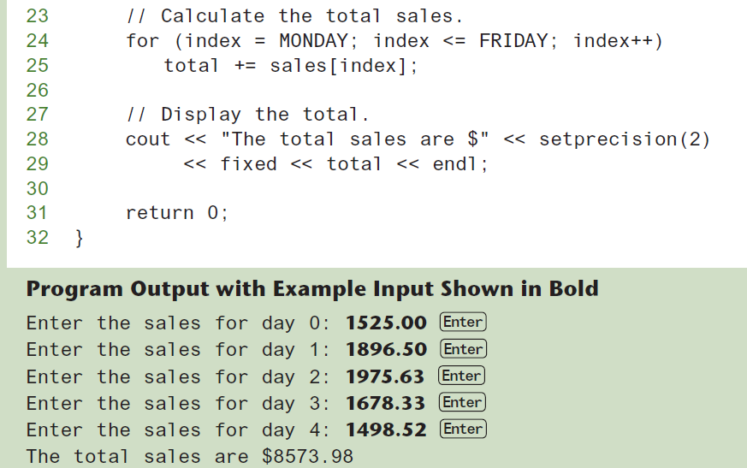
enum Data type Program Example (2 of 2)

Slide 58
Enumerated Data Types (9 of 9)
Program 11-9 shows enumerators used to control a loop:
// Get the sales for each day.
for (index = MONDAY; index <= FRIDAY; index++)
{
cout << "Enter the sales for day "
<< index << ": ";
cin >> sales[index];
}

Slide 59
Anonymous Enumerated Types
An anonymous enumerated type is simply one that does not have a name. For example, in Program 11-10 we could have declared the enumerated type as:
enum { MONDAY, TUESDAY,
WEDNESDAY, THURSDAY,
FRIDAY };

Slide 60
Using Math Operators with enum Variables (1 of 2)
You can run into problems when trying to perform math operations with enum variables. For example:
Day day1, day2; // Define two Day variables. day1 = TUESDAY; // Assign TUESDAY to day1. day2 = day1 + 1;// ERROR! Will not work!
The third statement will not work because the expression day1 + 1 results in the integer value 2, and you cannot store an int in an enum variable.

Slide 61
Using Math Operators with enum Variables (2 of 2)
You can fix this by using a cast to explicitly convert the result to Day, as shown here:
// This will work.
day2 = static_cast<Day>(day1 + 1);

Slide 62
Using an enum Variable to Step through an Array's Elements (1 of 3)
Because enumerators are stored in memory as integers, you can use them as array subscripts. For example:
enum Day { MONDAY, TUESDAY, WEDNESDAY,
THURSDAY, FRIDAY };
const int NUM_DAYS = 5;
double sales[NUM_DAYS];
sales[MONDAY] = 1525.0;
sales[TUESDAY] = 1896.5;
sales[WEDNESDAY] = 1975.63;
sales[THURSDAY] = 1678.33;
sales[FRIDAY] = 1498.52;

Slide 63
Using an enum Variable to Step through an Array's Elements (2 of 3)
Remember, though, you cannot use the ++ operator on an enum variable. So, the following loop will NOT work.
Day workDay; // Define a Day variable
// ERROR!!! This code will NOT work.
for (workDay = MONDAY; workDay <= FRIDAY; workDay++)
{
cout << "Enter the sales for day "
<< workDay << ": ";
cin >> sales[workDay];
}

Slide 64
Using an enum Variable to Step through an Array's Elements (3 of 3)
You must rewrite the loop’s update expression using a cast instead of ++:
for (workDay = MONDAY; workDay <= FRIDAY;
workDay = static_cast<Day>(workDay + 1))
{
cout << "Enter the sales for day "
<< workDay << ": ";
cin >> sales[workDay];
}

Slide 65
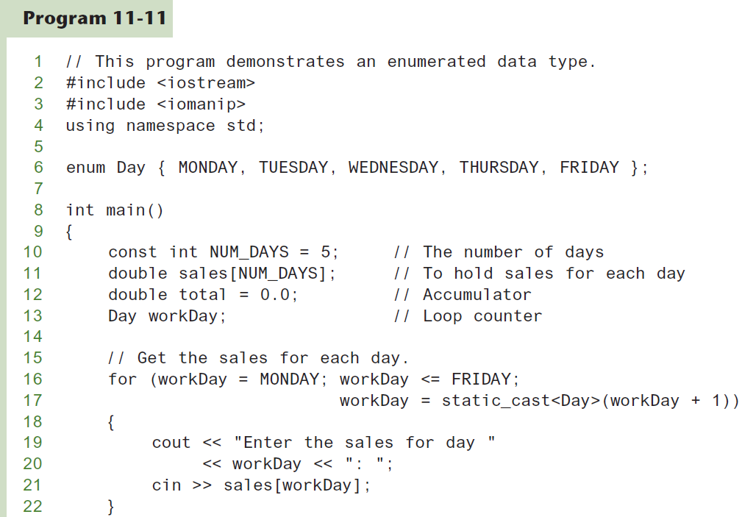
enum Data type to step through an Array (1 of 2)

Slide 66
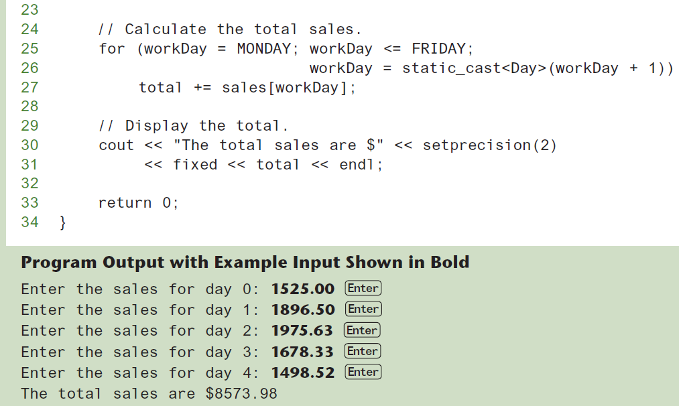
enum Data type to step through an Array (2 of 2)

Slide 67
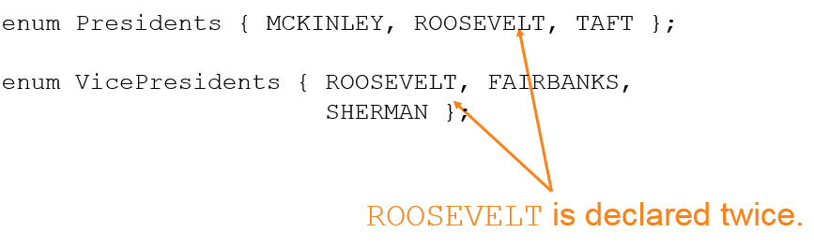
Enumerators Must Be Unique Within the same Scope
Enumerators must be unique within the same scope. (Unless strongly typed)
For example, an error will result if both of the following enumerated types are declared within the same scope:

Slide 68
Strongly Typed enums (1 of 2)
In C++ 11 and later, you can use a new type of enum , known as a strongly typed enum
Allows you to have multiple enumerators in the same scope with the same name
enum class Presidents { MCKINLEY, ROOSEVELT, TAFT };
enum class VicePresidents { ROOSEVELT, FAIRBANKS, SHERMAN };

Slide 69
Strongly Typed enums (2 of 2)
Prefix the enumerator with the name of the enum , followed by the :: operator:
Presidents prez = Presidents::ROOSEVELT;
VicePresidents vp = VicePresidents::ROOSEVELT;
Use a cast operator to retrieve integer value:
int x = static_cast<int>(Presidents::ROOSEVELT);

Slide 70
Declaring the Type and Defining the Variables in One Statement
You can declare an enumerated data type and define one or more variables of the type in the same statement. For example:
enum Car { PORSCHE, FERRARI, JAGUAR } sportsCar;
This code declares the Car data type and defines a variable named sportsCar.

