Slide 1
Advanced File Operations

Slide 2
File Operations
File is a set of data stored on a computer’s storage media, often on a disk drive. Data can be saved to files and then later reused.
Almost all real-world programs use files to store and retrieve data. Programs can read from, write to files
Files processing is used in many applications:
Word processing
Databases
Spreadsheets
Compilers

Slide 3
Using Files
An input stream is a sequence from which data can be read;
An output stream is a sequence to which data can be written; and
An input-output stream is a sequence of data that allows both reading and writing. The keyboard is the standard example of an input stream, and the monitor screen is the standard example of an output stream.
C++ provides various classes for working with streams. These include:
istream and ostream data types for standard input and output;
ifstream data type objects for input files
ofstream data type objects for output files
fstream data type objects for both input, output files for file IO; and
Files processing requires fstream header file
Can use >>, << to read from, write to a file
Can use eof member function to test for end of input file

Slide 4
Using Files
Following Table-1 compares the ifstream, ofstream, and fstream data types. All of these data types require the <fstream> header file. rings.
Table-1: Files Stream Data Types
Data Type | Description
ifstream | Input File Stream: This data type can be used only to read data from files into memory.
ofstream | Output File Stream: This data type can be used to create files and write data to them
fstream | File Stream: This data type can be used to create files, write data to them, and read data from them.

Slide 5
fstream Object
fstream object can be used for either input or output. The following statement defines an fstream object named dataFile:
fstream dataFile;
As with ifstream and ofstream objects, programmer use an fstream object’s open function to open a file.
An fstream object’s open function requires two arguments:
The first argument is a string containing the name of the file.
The second argument is a file access flag that indicates the mode in which developer wish to open the file. Sample modes:
ios::in – tells C++ to open the file in input mode, which allows data to be read from the file
ios::out – tells C++ to open the file in output mode. Output mode allows data to be written to a file

Slide 6
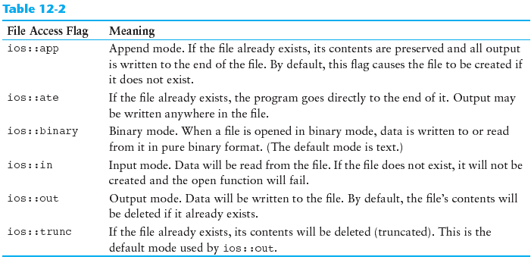
File Access Flags
There are many file access flags, as listed in following Table-2.
Table-2: File Access Mode Flags

Slide 7
File Access Flags
the ios::out flag causes the file’s contents to be deleted if the file already exists.
the ios::in flag causes the file’s existing contents are preserved.
By using different combinations of access flags, developer can open files in many possible modes. Several access flags can be be used together if they are connected with the | operator.
The following statement opens the file in such a way that data will only be written to its end:
dataFile.open("info.txt", ios::out | ios::app);
In the following statement, dataFile is an fstream object:
dataFile.open(“info.txt", ios::in | ios::out);
This statement opens the file info.txt in both input and output modes. This means data may be written to and read from the file.

Slide 8
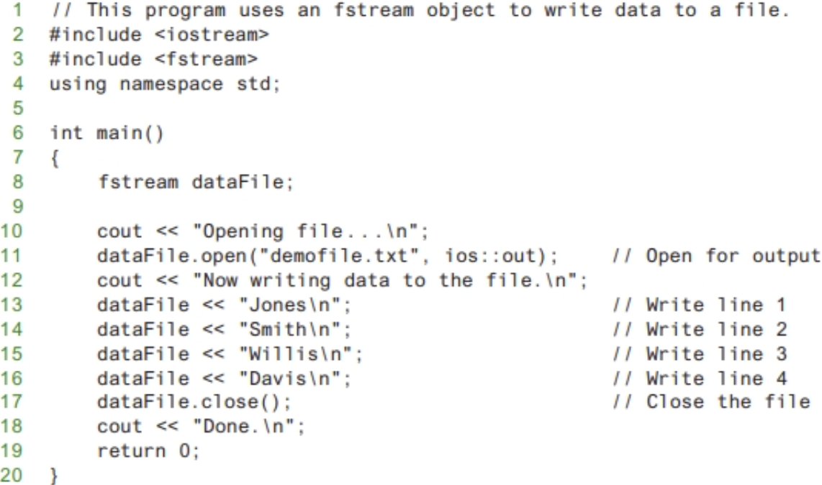
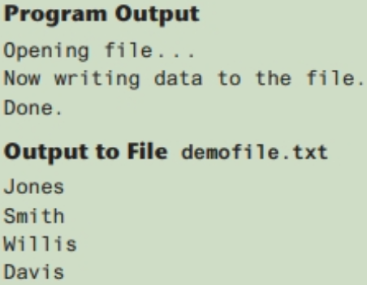
Example-Using fstream object to open a File (1 of 2)

Slide 9
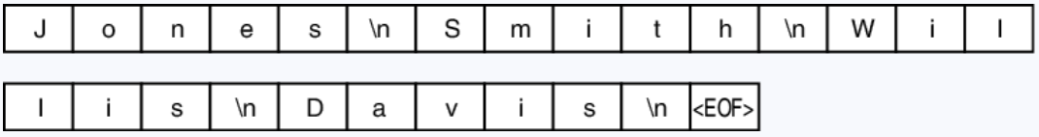
Example-Using fstream object to open a File (2 of 2)
The file output shown on the previous slide, is the way it would appear if the file contents were displayed on the screen. The \n characters cause each name to appear on a separate line.
The actual file contents, however, appear as a stream of characters as shown in the following Figure:
\n characters are written to the file along with all the other characters.
The characters are added to the file sequentially, in the order they are written by the program. The very last character is an end-of-file marker. It is a character that marks the end of the file, and is automatically written when the file is closed.

Slide 10
Using Files - Example
// copy 10 numbers between files
// open the files
fstream infile("input.txt", ios::in);
fstream outfile("output.txt", ios::out);
int num;
for (int i = 1; i <= 10; i++)
{
infile >> num; // use the files
outfile << num;
}
infile.close(); // close the files
outfile.close();

Slide 11
File Open Modes with ifstream and ofstream Objects
Following table describes each data type’s default open mode.
Table-3: Default Open Mode
File Type | Default Open Mode
ifstream: | The file is open for input only Data may be read from the file, but not written to it. The file’s contents will be read from its beginning. open function call fails if file does not exists
ofstream: | The file is open for output only Data may be written to the file, but not read from the file. File created if the file does not exists File contents erased if file already exists

Slide 12
More File Open Details
Can use filename, flags in definition:
ifstream gradeList("grades.txt");
File stream object set to 0 (false) if open failed:
if (!gradeList) ...
Can also check fail member function to detect file open error:
if (gradeList.fail()) ...

Slide 13
Checking for a File’s Existence Before Opening It
To determine whether a file already exists before opening it for output.
First attempting to open the file for input. If the file does not exist, the open operation will fail. In that case, create the file by opening it for output. The following code gives an example:
fstream dataFile;
dataFile.open("values.txt", ios::in);
if (dataFile.fail())
{
// The file does not exist, so create it.
dataFile.open("values.txt", ios::out);
//
// Continue to process the file . . .
//
}
else // The file already exists.
{
dataFile.close();
cout << "The file values.txt already exists.\n";
}

Slide 14
File Output Formatting
File output may be formatted in the same way that screen output is formatted.
Use the same techniques with file stream objects as with cout: showpoint, setw(x), showprecision(x), etc.
Requires iomanip to use manipulators

Slide 15
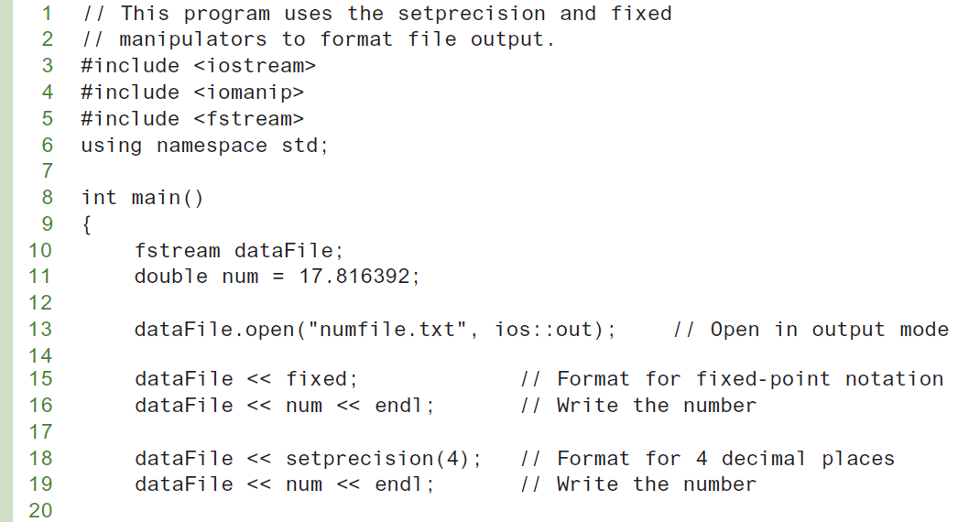
File Output Formatting Example (1 of 2)

Slide 16
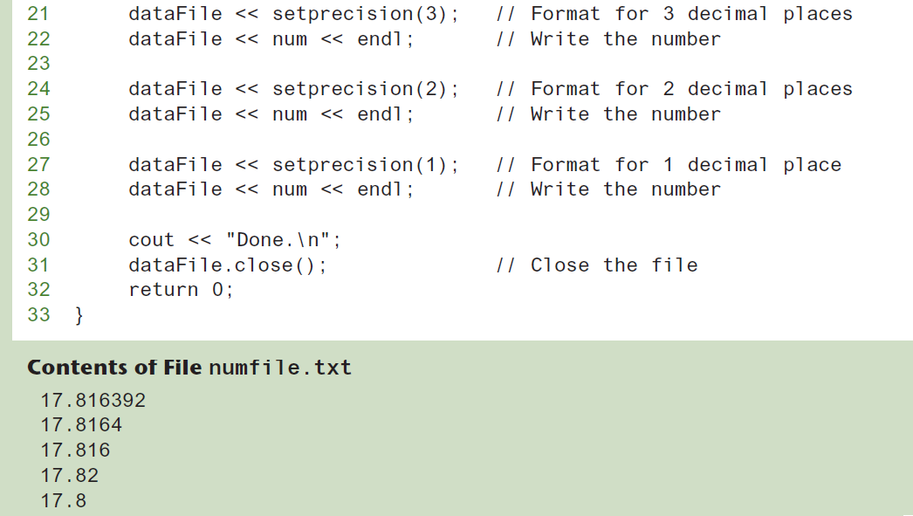
File Output Formatting Example (2 of 2)

Slide 17
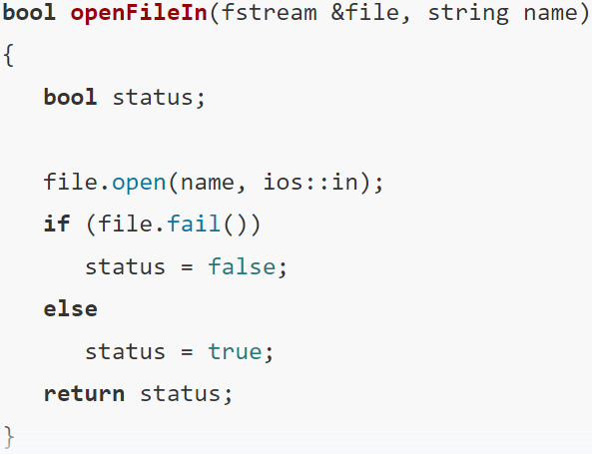
Passing File Stream Objects to Functions (1 of 4)
File stream objects may be passed by reference to functions.
It is very useful to pass file stream objects to functions
Be sure to always pass file stream objects by reference
The openFile function shown below uses an fstream reference object parameter:

Slide 18
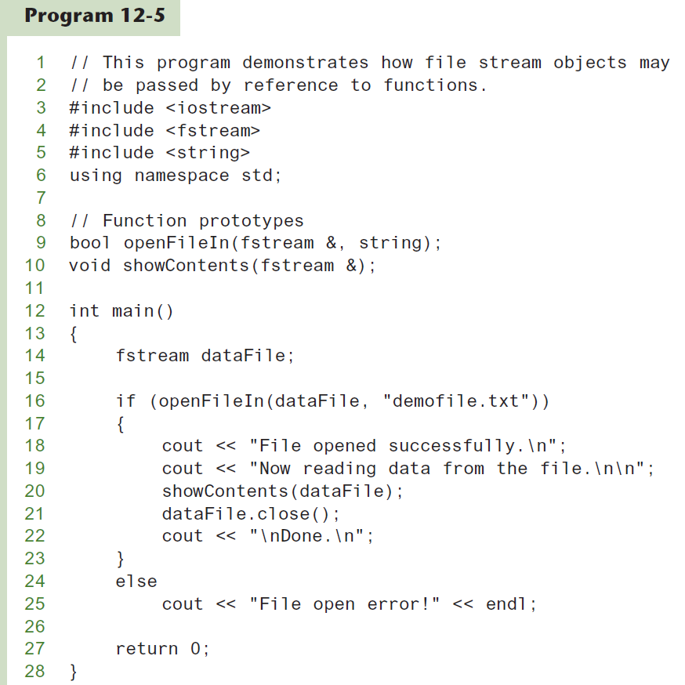
Passing File Stream Objects to Functions
(2 of 4)

Slide 19
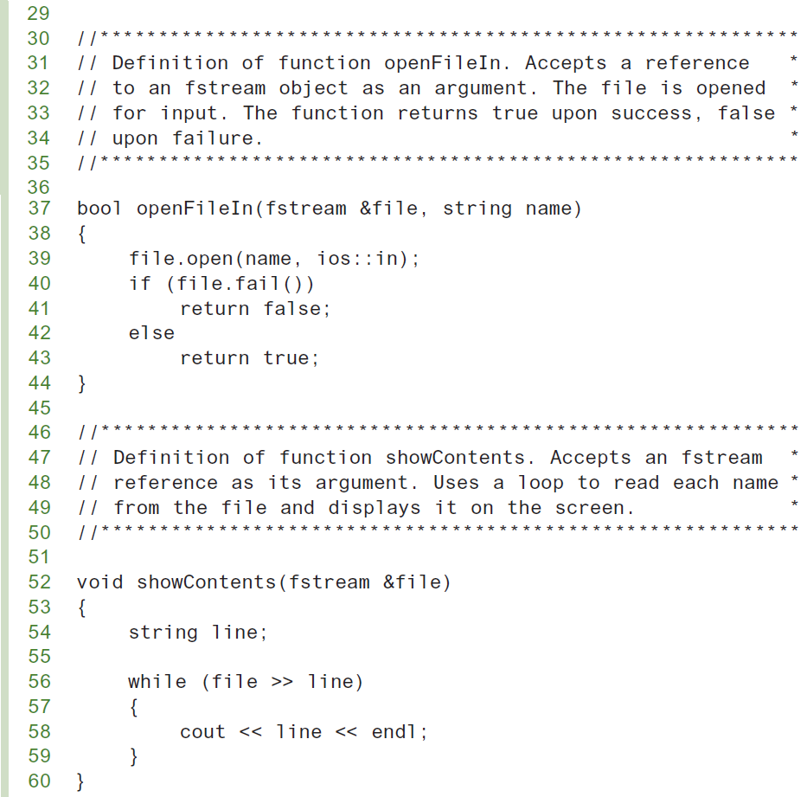
Passing File Stream Objects to Functions (3 of 4)

Slide 20
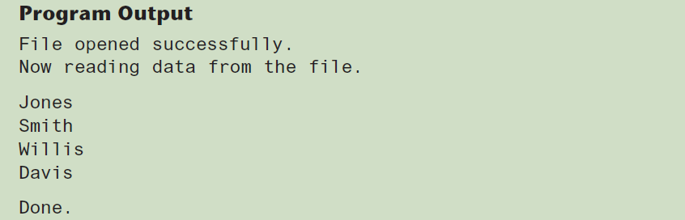
Passing File Stream Objects to Functions
(4 of 4)
The internal state of file stream objects changes with most every operation.
File stream objects should always be passed to functions by reference to ensure internal consistency.

Slide 21
More Detailed Error Testing
All stream objects have error state bits that indicate the condition of the stream. All stream objects contain a set of bits that act as flags.
Developer can examine error state bits to determine stream status
Table-4 lists stream bits. These bits can be tested/cleared by stream member functions listed in Table-5:
Table-4: Stream Bits
Bit | Description
ios::eofbit | set when end of an input file stream is detected
ios::failbit | set when an attempted operation failed
ios::hardfail | set when an error occurred and no recovery
ios::badbit | set when an invalid operation attempted
ios::goodbit | set when no other bits are set. Indicates the stream is in good condition.

Slide 22
Member Functions / Flags (1 of 2)
Table-5: Functions to Test the State of Stream Bits
Function | Description
eof() | true if eofbit set, false otherwise
fail() | true if failbit or hardfail set, false otherwise
bad() | true if badbit set, false otherwise
good() | true if goodbit set, false otherwise
clear() | clear all flags (no arguments), or clear a specific flag

Slide 23
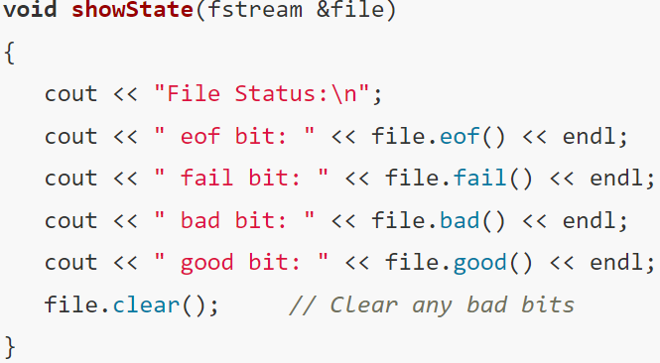
Member Functions / Flags (2 of 2)
The function showState, accepts a file stream reference as its argument. It shows the state of the file by displaying the return values of the eof(), fail(), bad(), and good() member functions.

Slide 24
Member Functions for Reading and Writing Files
File stream objects have member functions for more specialized file reading and writing
Functions that may be used for input with whitespace, to perform single character I/O, or to return to the beginning of an input file
Member functions:
getline: reads a “line” of data, including whitespace characters.
get: reads a single character
put: writes a single character

Slide 25
The getline Function
getline function call example:
getline(dataFile, str,'\n');
Three arguments in the getline statement:
dataFile : Name of a file stream object
str : Name of a string object
'\n': Delimiter character of your choice
Examples, using the file stream object myFile, and the string objects name and address:
getline(myFile, name);
getline(myFile, address, '\t');
If left out, '\n' is default for third argument

Slide 26
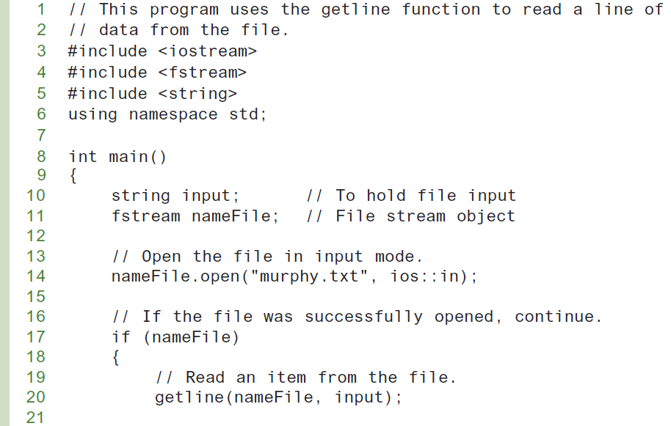
Program using the getline Function (1 of 2)

Slide 27
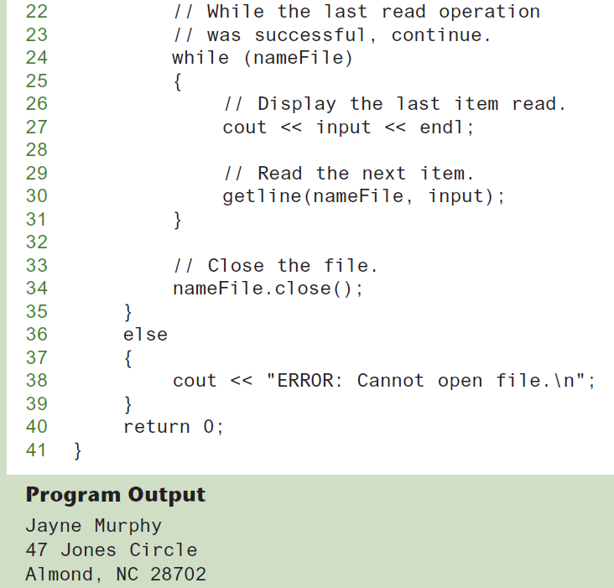
Program using the getline Function (2 of 2)

Slide 28
Single Character I/O - get Function
The file stream object’s get member function reads a single character from a file. Following is an example of its usage:
char letterGrade;
gradeFile.get(letterGrade);
In the above example get function will read any single character, including whitespace and store in letterGrade variable
Program on next two slides shows the use of get function
The user is asked for the name of a file. The file is opened and the get function is used in a loop to read the file’s contents, one character at a time
Program will display the contents of any file. The get function even reads whitespaces, so all the characters will be shown exactly as they appear in the file.

Slide 29
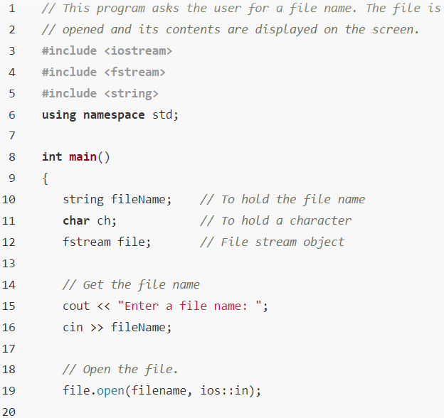
Program using the get Function (1 of 2)

Slide 30
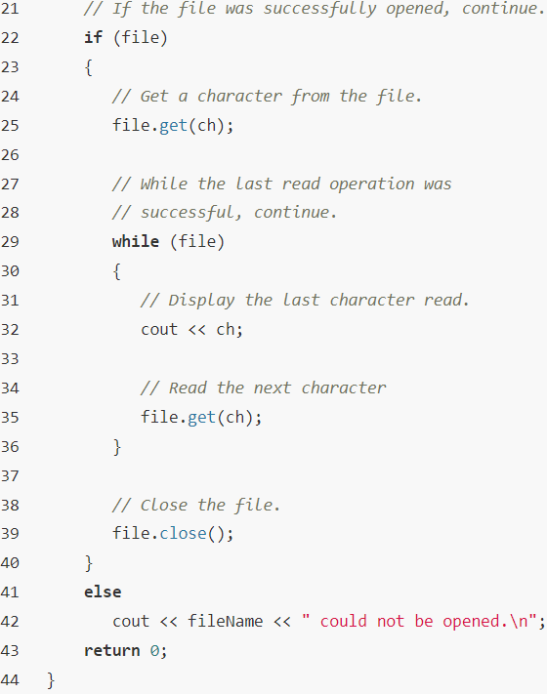
Program using the get Function (2 of 2)

Slide 31
Single Character I/O - put Function
The file stream object’s put member function writes a single character to a file. Following is an example of its usage:
char letterGrade;
reportFile.put(letterGrade);
letterGrade variable contents will be written to the file associated with the file stream object reportFile
Program on next two slides shows the use of put function

Slide 32
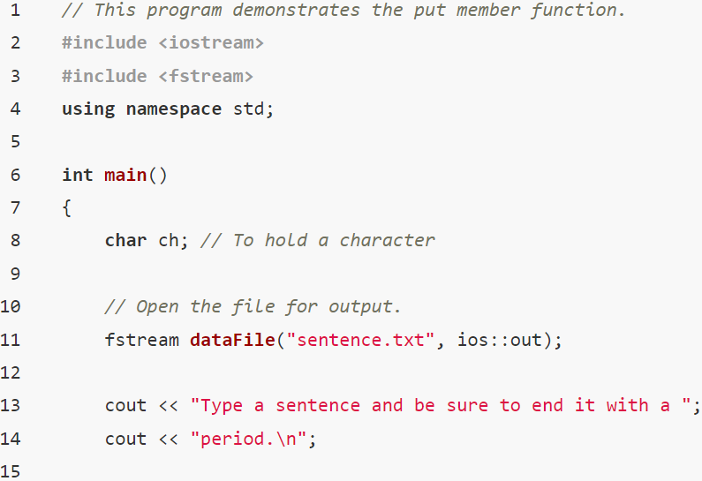
Program using the put Function (1 of 2)

Slide 33
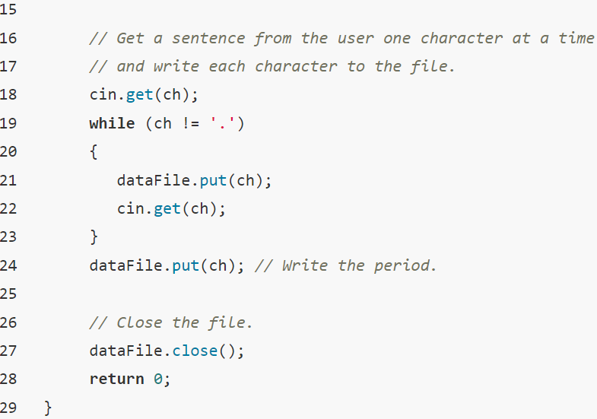
Program using the put Function (2 of 2)

Slide 34
Working with Multiple Files
It is possible to have more than file open at a time in a program
In many real-world applications, data about a single item are categorized and written to several different files.
Multiple files may be open for input or output by defining multiple file stream objects.
Need to define file stream object for each file
Program on next two slides, asks the user for a file name. The file is opened and read. Each character is converted to uppercase and written to a second file called out.txt.

Slide 35
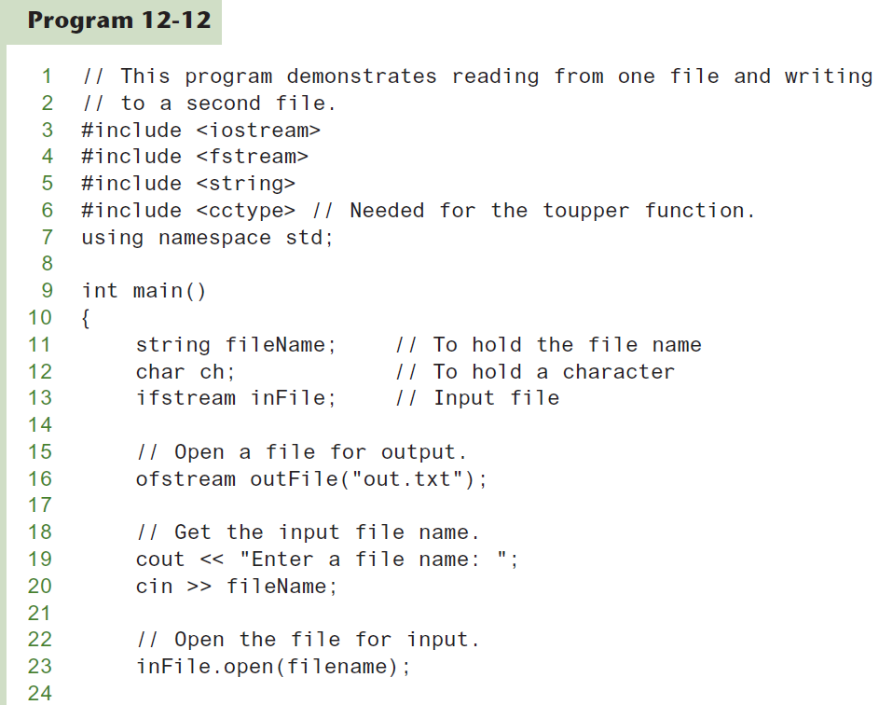
Program using the get and put Function
(1 of 3)

Slide 36
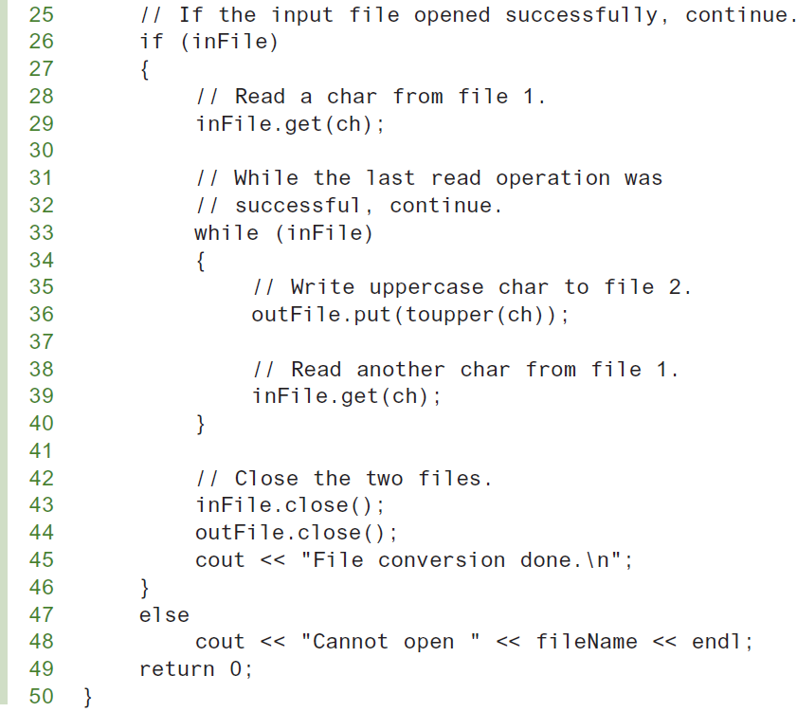
Program using the get and put Function
(2 of 3)

Slide 37
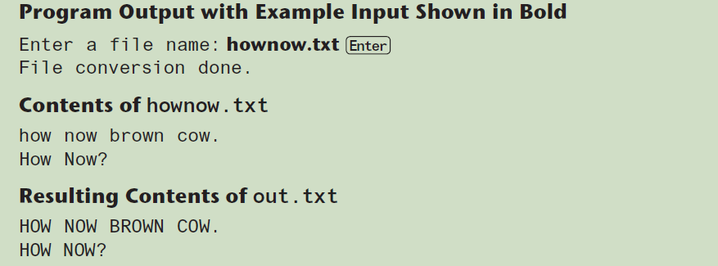
Program using the get and put Function
(2 of 3)

Slide 38
Binary Files (1 of 8)
Binary file contains unformatted, non-ASCII data
Data can be stored in a file in its pure, binary format.
The first step is to open the file in binary mode. This is accomplished by using the ios::binary flag. Here is an example:
inFile.open("nums.dat", ios::in | ios::binary);
Notice the ios::out and ios::binary flags are joined in the statement with the | operator. This causes the file to be opened in both output and binary modes. By default, files are opened in text mode.

Slide 39
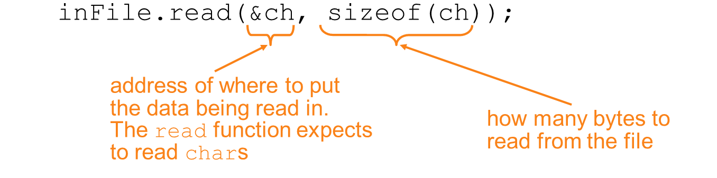
Binary Files (2 of 8)
Use read and write instead of <<, >>
char ch;
// read in a letter from file
// send a character to a file
outFile.write(&ch, sizeof(ch));

Slide 40
Binary Files (3 of 8)
The file stream object’s write member function is used to write binary data to a file. The general format of the write member function is:
fileObject.write(address, size);
Let’s look at the parts of this function call format:
﻿fileObject is the name of a file stream object.
address is the starting address of the section of memory that is to be written to the file. This argument is expected to be the address of a char (or a pointer to a char).
size is the number of bytes of memory to write. This argument must be an integer value.

Slide 41
Binary Files (4 of 8)
For example, the following code uses a file stream object named file to write a character to a binary file:
char letter = 'A';
file.write(&letter, sizeof(letter));
The first argument passed to the write function is the address of the letter variable. This tells the write function where the data that is to be written to the file is located
The second argument is the size of the letter variable, which is returned from the sizeof operator. This tells the write function the number of bytes of data to write to the file
Because the sizes of data types can vary among systems, it is best to use the sizeof operator to determine the number of bytes to write.

Slide 42
Binary Files (5 of 8)
The file stream object’s read member function is used to read binary data from a file into memory. The general format of the read member function is:
fileObject.read(address, size);
Let’s look at the parts of this function call format:
﻿fileObject is the name of a file stream object.
address is the starting address of the section of memory where the data being read from the file is to be stored. This argument is expected to be the address of a char (or a pointer to a char).
size is the number of bytes of memory to read from the file. This argument must be an integer value.

Slide 43
Binary Files (6 of 8)
For example, suppose we want to read a single character from a binary file and store that character in the letter variable. The following code uses a file stream object named file to do just that:
char letter;
file.read(&letter, sizeof(letter));
The first argument passed to the read function is the address of the letter variable. This tells the read function where to store the value that is read from the file.
The second argument is the size of the letter variable. This tells the read function the number of bytes to read from the file.
After this function executes, the letter variable will contain a character that was read from the file.
Program on next two slides, demonstrates writing a char array to a file then reading the data from the file back into memory.

Slide 44
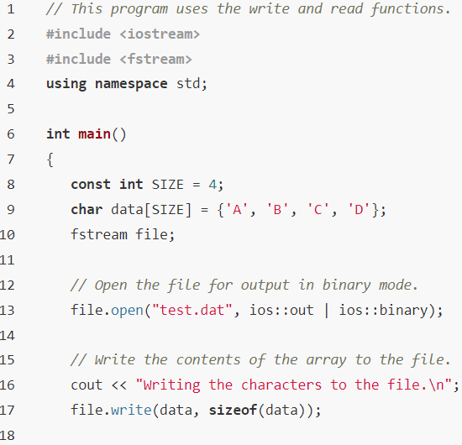
Binary Files (7 of 8)

Slide 45
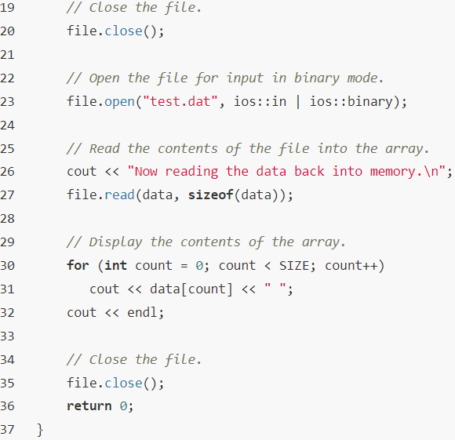
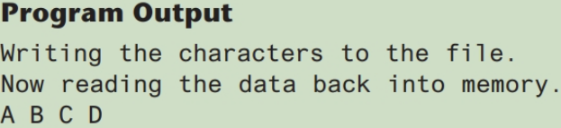
Binary Files (8 of 8)

Slide 46
Writing Data other than char to Binary Files (1 of 5)
Because the write and read member functions expect their first argument to be a pointer to a char, programmer must use a type cast when writing and reading items that are of other data types.
To convert a pointer from one type to another, programmer should use the reinterpret_cast type cast. The general format of the type cast is
reinterpret_cast<dataType>(value)
where dataType is the target data type, and value is the value that need to be convert.
For example, the following code uses the type cast to store the address of an int in a c`har pointer variable:
int x = 65;
char *ptr = nullptr;
ptr = reinterpret_cast<char *>(&x);

Slide 47
Writing Data other than char to Binary Files (2 of 5)
The following code shows how to use the type cast to pass the address of an integer as the first argument to the write member function:
int x = 27;
file.write(reinterpret_cast<char *>(&x), sizeof(x));
After the function executes, the contents of the variable x will be written to the binary file associated with the file object.
The following code shows an int array being written to a binary file:
const int SIZE = 10;
int numbers[SIZE] = {1, 2, 3, 4, 5, 6, 7, 8, 9, 10};
file.write(reinterpret_cast<char *>(numbers), sizeof(numbers));
After this function call executes, the contents of the numbers array will be written to the binary file.

Slide 48
Writing Data other than char to Binary Files (3 of 5)
The following code shows values being read from the file and stored into the numbers array:
const int SIZE = 10;
int numbers[SIZE];
file.read(reinterpret_cast<char *>(numbers), sizeof(numbers));
Program on next two slides, demonstrates writing an int array to a file then reading the data from the file back into memory.

Slide 49
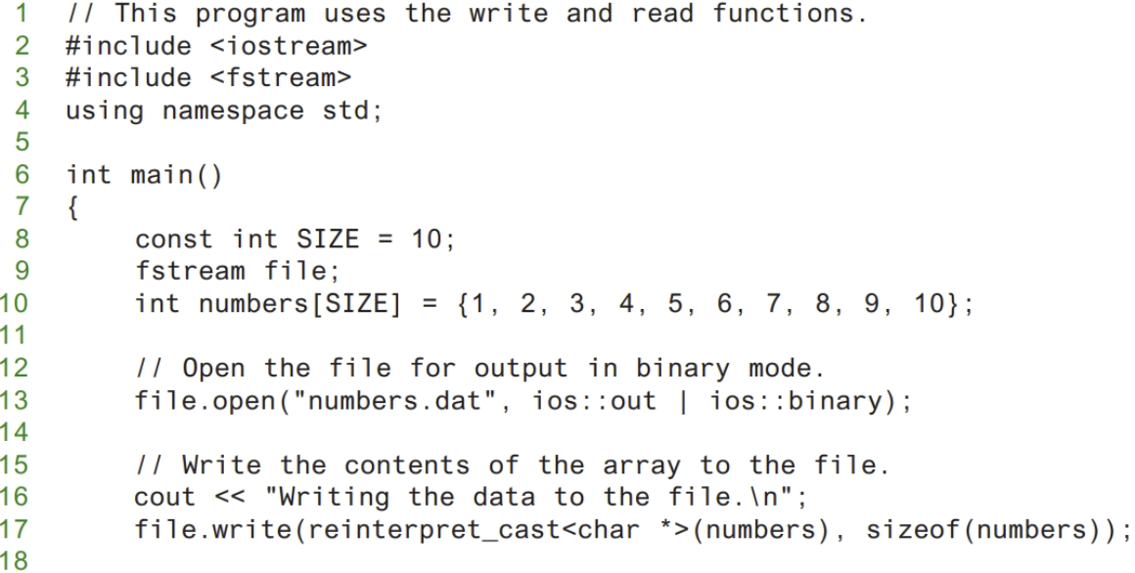
Writing Data other than char to Binary Files (4 of 5)

Slide 50
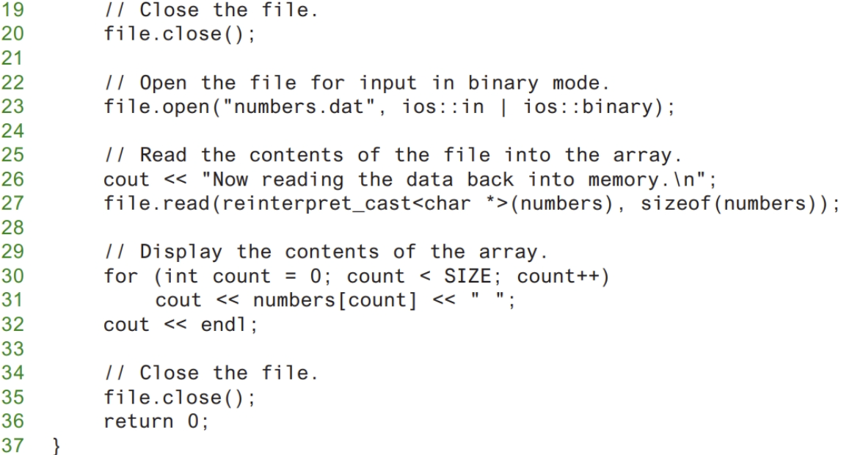
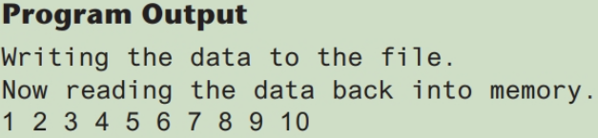
Writing Data other than char to Binary Files (5 of 5)

