Slide 1
Introduction to Classes

Slide 2
Procedural and Object-Oriented Programming
There are two common programming methods in practice today:
Procedural programming is a method of writing software centered on the procedures or functions, that carry out the actions of the program.
The program's data, typically stored in variables, is separate from these functions. So developer must pass the variables to the functions that need to work with them.
Object-Oriented programming practice is centered on the creating and using objects.
An object is a software entity that combines both data and the functions that operate on it in a single unit. Objects are instances of ADTs that represent the data and its functions
Objects are created from abstract data types that encapsulate data and functions together.

Slide 3
Limitations of Procedural Programming
Procedural programming has worked well for software developers for many years.
However, as programs become larger and more complex, the separation of a program’s data from the code that operates on it can lead to problems.
For example, quite often a program's specifications change, resulting in the need to change the format of the data or the design of a data structure.
When the structure of the data changes, the code that operates on the data must also be changed to accept the new format.
Finding all the code that needs changing results in additional work for programmers and an opportunity for bugs to be introduced into the code.
Programs that are based on complex function hierarchies are:
difficult to understand and maintain
difficult to modify and extend
easy to break

Slide 4
Object-Oriented Programming Terminology (1 of 2)
class: like a struct (allows bundling of related variables), but variables and functions in the class can have different properties than in a struct
object: an instance of a class, in the same way that a variable can be an instance of a struct
An object is a software entity that contains both data and procedures. The data contained in an object are known as the object’s attributes. The procedures an object performs are called member functions
The object is, conceptually, a self-contained unit consisting of attributes (data) and procedures (functions).

Slide 5
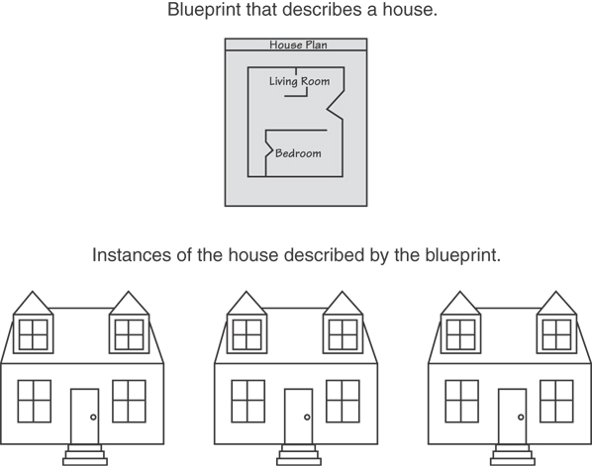
Classes and Objects
A Class is like a blueprint and objects are like houses built from the blueprint

Slide 6
Object-Oriented Programming Terminology (2 of 2)
attributes: members of a class
The data contained in an object are known as the object’s attributes.
methods or behaviors: member functions of a class
The procedures an object performs are called member functions
Only an object’s member functions may access the object’s data
Encapsulation refers to the combining of data and code into a single object.

Slide 7
More on Objects
data hiding: restricting access to certain members of an object
data hiding refers to an object’s ability to hide its data from code that is outside the object. Only the object’s member functions may directly access and make changes to the object’s data.
An object typically hides its data, but allows outside code to access its member functions.
The object’s member functions provide programming statements outside the object with indirect access to the object’s data.
public interface: members of an object that are available outside of the object. This allows the object to provide access to some data and functions without sharing its internal details and design, and provides some protection from data corruption

Slide 8
Introduction to Classes
A class is a data type defined by the programmer, consisting of variables and functions. The members of a class are private by default.
Objects are created from a class. Each object that is created from a class is called an instance of the class.
The programmer determines the attributes and functions that are necessary then creates a class.
A class is code that specifies the attributes and member functions that a particular type of object may have.
Format:
class ClassName
{
declaration;
declaration;
};

Slide 9
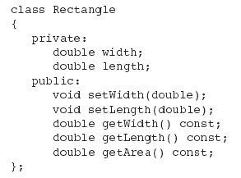
Class Example (1 of 2)

Slide 10
Access Specifiers (1 of 2)
C++ provides the key words private and public, which programmer may use in class declarations. Used to control access to members of the class.
These key words are known as access specifiers because they specify how class members may be accessed.
public: can be accessed by functions outside of the class
private: can only be called by or accessed by functions that are members of the class

Slide 11
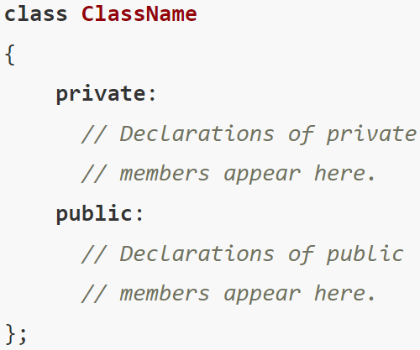
Access Specifiers (2 of 2)
Access specifiers are followed by a colon (:) then followed by one or more member declarations.
In this general format, the private access specifier is used first. All of the declarations that follow it, up to the public access specifier, are for private members.
Then, all of the declarations that follow the public access specifier are for public members.

Slide 12
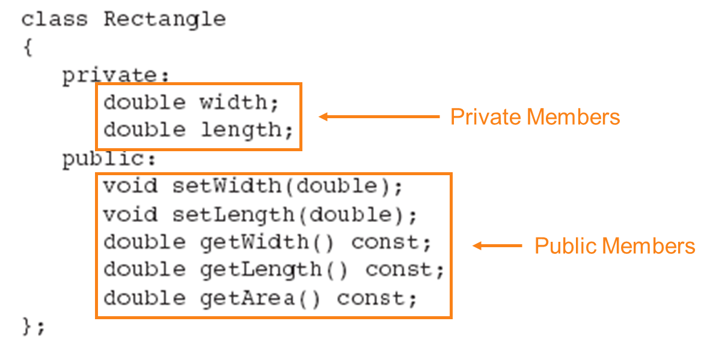
Class Example (2 of 2)

Slide 13
More on Access Specifiers
Can be listed in any order in a class
Can appear multiple times in a class
If not specified, the default is private

Slide 14

Using const With Member Functions
When the key word const appearing after the parentheses in a member function declaration, it specifies that the function will not change any data in the calling object.
The const key word must also appear in the function header.
When a member function is marked as const, the const key word must appear in both the declaration and the function header.

Slide 15
Defining a Member Function
When defining a member function:
Put prototype in class declaration
Define function using class name and scope resolution operator (::) outside the class declaration.
//*************************************************************
// setWidth assigns its argument to the private member width. *
//*************************************************************
void Rectangle::setWidth(double w)
{
width = w;
}

Slide 16
Accessors and Mutators
Mutator: a member function that stores a value in a private member variable, or changes its value in some way
Accessor: a member function that retrieves a value from a private member variable. Accessors do not change an object's data, so they should be marked const.
Some programmers refer to mutators as setter functions because they set the value of an attribute, and accessors as getter functions because they get the value of an attribute.

Slide 17
Defining an Instance of a Class
An object is an instance of a class. Class objects are created with simple definition statements, just like variables.
Following is the general format of a simple object definition statement
ClassName objectName;
Defined like structure variables:
Rectangle r;
Defining a class object is called the instantiation of a class. In this statement, r is an instance of the Rectangle class.
Access members using dot operator:
r.setWidth(5.2);
cout << r.getWidth();
Compiler error if attempt to access private member using dot operator

Slide 18
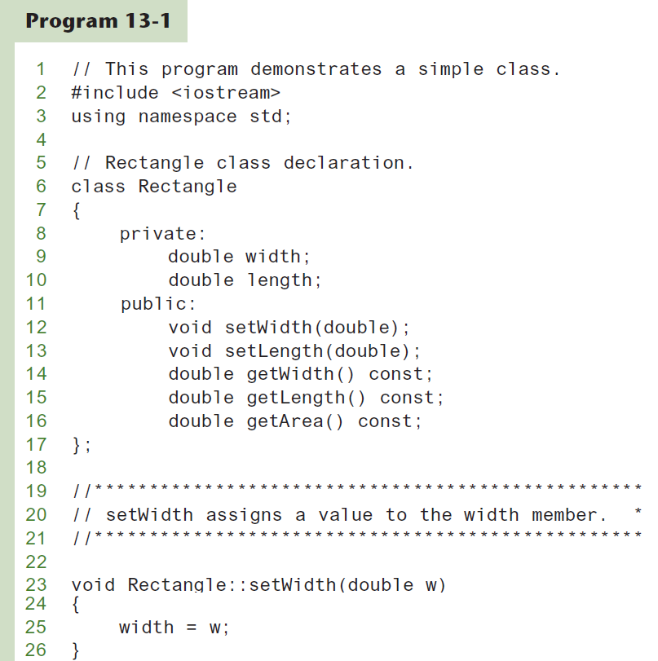
Program Example-01 (1 of 4)

Slide 19
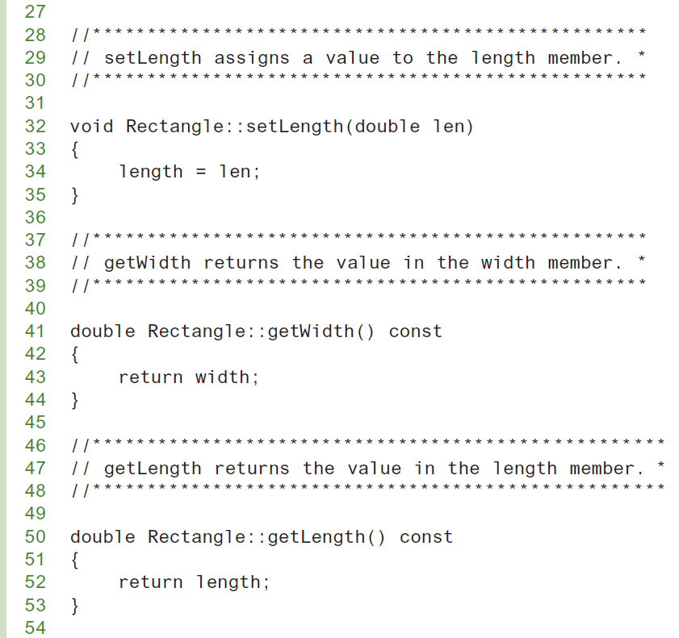
Program Example-01 (2 of 4)

Slide 20
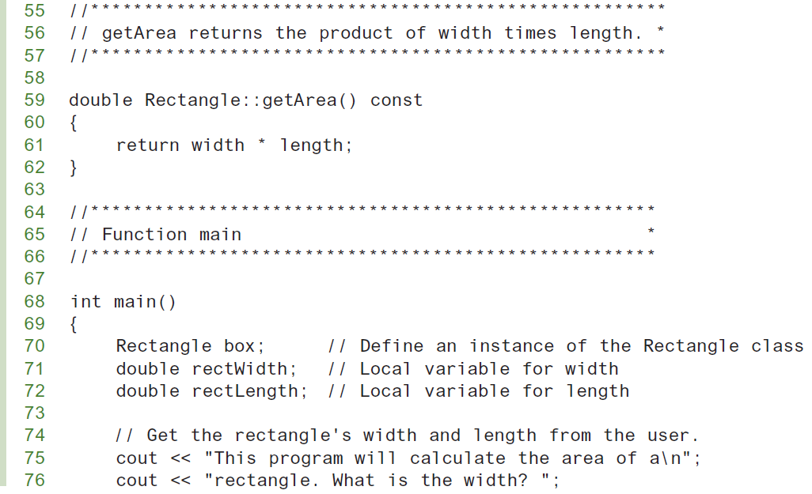
Program Example-01 (3 of 4)

Slide 21
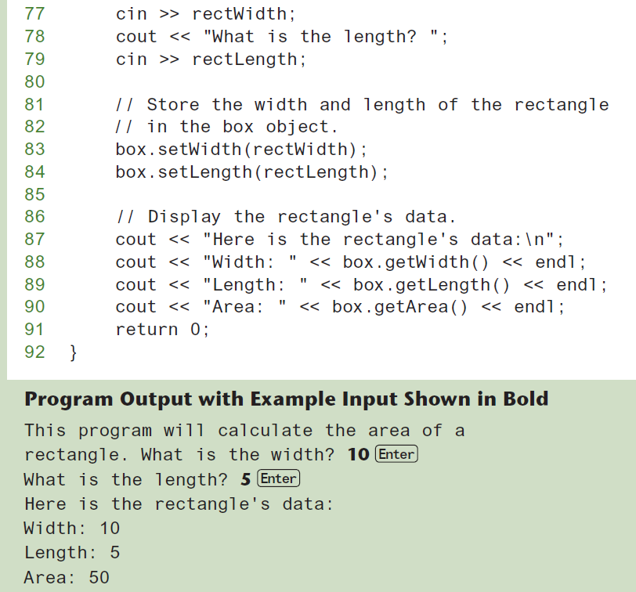
Program Example-01 (4 of 4)

Slide 22
Avoiding Stale Data
Some data is the result of a calculation.
In the Rectangle class the area of a rectangle is calculated.
length x width
If we were to use an area variable here in the Rectangle class, its value would be dependent on the length and the width.
If we change length or width without updating area, then area would become stale.
To avoid stale data, it is best to calculate the value of that data within a member function rather than store it in a variable.

Slide 23
Pointer to an Object
Can define a pointer to an object:
Rectangle *rPtr = nullptr;
Can access public members via pointer:
rPtr = &otherRectangle;
rPtr->setLength(12.5);
cout << rPtr->getLength() << endl;

Slide 24
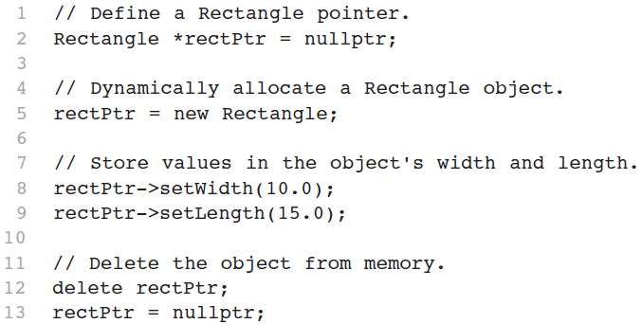
Dynamically Allocating an Object
We can also use a pointer to dynamically allocate an object.

Slide 25
Why Have Private Members?
Making data members private provides data protection
Data can be accessed only through public member functions
Public member functions define the class’s public interface

Slide 26
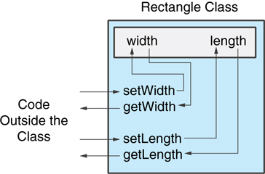
Accessing an Object’s Private Members
Code outside the class must use the class's public member functions to interact with the object.

Slide 27
Separating Specification from Implementation
Place class declaration in a header file that serves as the class specification file. Name the file ClassName.h, for example, Rectangle.h
Place member function definitions in ClassName.cpp, for example, Rectangle.cpp File should #include the class specification file
Programs that use the class must #include the class specification file, and be compiled and linked with the member function definitions

Slide 28
Inline Member Functions
Member functions can be defined
inline: in class declaration
after the class declaration
Inline appropriate for short function bodies:
int getWidth() const
{ return width; }

Slide 29
Rectangle Class with Inline Member Functions
1 // Specification file for the Rectangle class 2 // This version uses some inline member functions. 3 #ifndef RECTANGLE_H 4 #define RECTANGLE_H 5 6 class Rectangle 7 { 8 private: 9 double width; 10 double length; 11 public: 12 void setWidth(double); 13 void setLength(double); 14 15 double getWidth() const 16 { return width; } 17 18 double getLength() const 19 { return length; } 20 21 double getArea() const 22 { return width * length; } 23 }; 24 #endif

Slide 30
Tradeoffs – Inline vs. Regular Member Functions
Regular functions – when called, compiler stores return address of call, allocates memory for local variables, etc.
Code for an inline function is copied into program in place of call – larger executable program, but no function call overhead, hence faster execution

Slide 31
Constructors
Member function that is automatically called when an object is created
Purpose is to construct an object
Constructor function name is class name
Has no return type

Slide 32
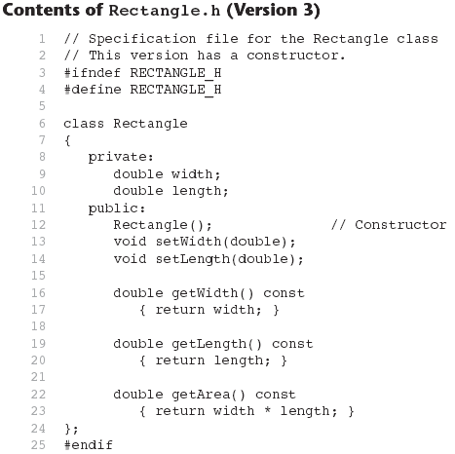

Slide 33
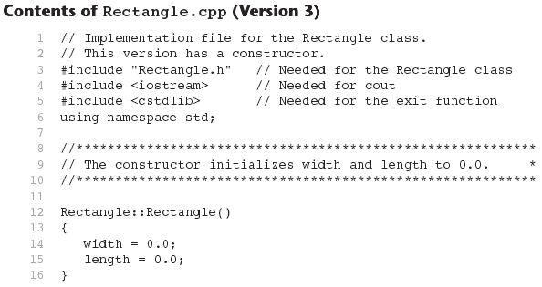
Contents of Rectangle.ccp Version 3 (1 of 2)

Slide 34
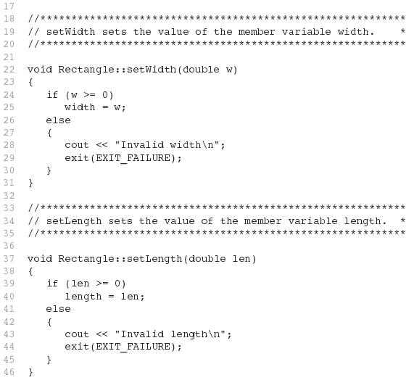
Contents of Rectangle.ccp Version 3 (2 of 2)

Slide 35
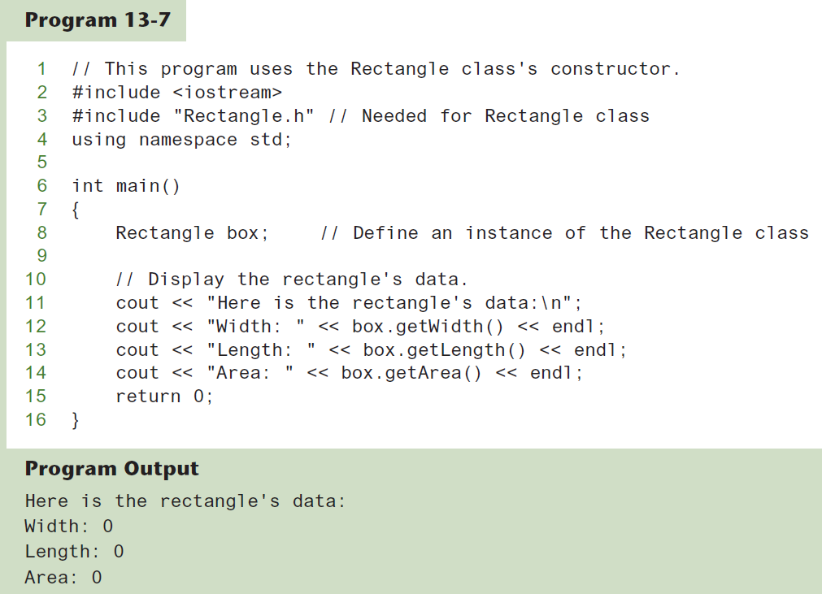
Program Example-2

Slide 36
In-Place Initialization
If you are using C++11 or later, you can initialize a member variable in its declaration statement, just as you can with a regular variable.
This is known as in-place initialization. Here is an example:
class Rectangle
{
private:
double width = 0.0;
double length = 0.0;
public:
Public member functions appear here…
};

Slide 37
Default Constructors
A default constructor is a constructor that takes no arguments.
If programmer write a class with no constructor at all, when the class is compiled, C++ will write a default constructor that does nothing. C++ generated the following constructor:
Rectangle::Rectangle()
{ }
A simple instantiation of a class (with no arguments) calls the default constructor:
Rectangle r;

Slide 38
Passing Arguments to Constructors (1 of 2)
A constructor can have parameters and can accept arguments when an object is created. To create a constructor that takes arguments:
indicate parameters in prototype:
Rectangle(double, double);
Use parameters in the definition:
Rectangle::Rectangle(double w, double len) { width = w; length = len; }

Slide 39
Passing Arguments to Constructors (2 of 2)
Constructors may accept arguments in the same way as other functions.
When a class has a constructor that accepts arguments, programmer can pass initialization values to the constructor, at the object creation time of that class.
For example, the following code shows another version of the Rectangle class constructor. This version of the constructor accepts arguments for the rectangle’s width and length. Programmer can pass arguments to the constructor when programmer create an object of Rectangle class:
Rectangle r(10, 5);

Slide 40
Using Default Arguments with Constructors
Like other functions, constructors may have default arguments.
Default arguments are passed to parameters automatically if no argument is provided in the function call.
The default value is listed in the parameter list of the function’s declaration or the function header. For Example, consider the following constructor of the Sale class
Sale(double cost, double rate = 0.05)
{ itemCost = cost;
taxRate = rate; }
If an object of this Sale class is defined with only one argument (for the cost parameter) passed to the constructor, the default argument 0.05 will be provided for the rate parameter.

Slide 41
More About Default Constructors
If a constructor has default arguments for all its parameters, it can be called with no explicit arguments. It then becomes the default constructor. For example, suppose a constructor for the Sale class had been written as the following:
Sale(double cost = 0.0, double rate = 0.05)
{ itemCost = cost;
taxRate = rate; }
This constructor has default arguments for each of its parameters. As a result, the constructor can be called with no arguments, as shown here:
Sale itemSale;
Because this constructor can be called with no arguments, it is the default constructor.

Slide 42
Classes with No Default Constructor
When all of a class's constructors require arguments, then the class has NO default constructor.
When this is the case, programmer must pass the required arguments to the constructor when creating an object. Otherwise, a compiler error will result.

Slide 43
Destructors
Member function automatically called when an object is destroyed
Destructor are member functions with the same name as the class, preceded by a tilde character (~). For example, the destructor for the Rectangle class would be named, ~Rectangle
Like constructors, destructor has no return type.
Destructors cannot accept arguments, so they never have a parameter list; takes no arguments
Only one destructor per class, i.e., it cannot be overloaded
Destructors perform shutdown procedures when the object goes out of existence. For example, a common use of destructors is to free memory that was dynamically allocated by the class object.
If constructor allocates dynamic memory, destructor should release it

Slide 44
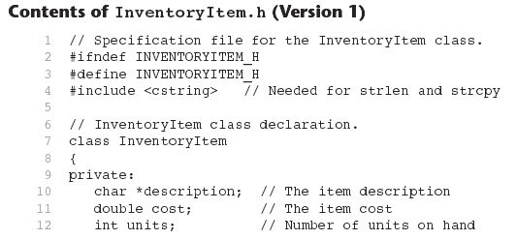
Contents of InventoryItem.h Version1 (1 of 2)

Slide 45
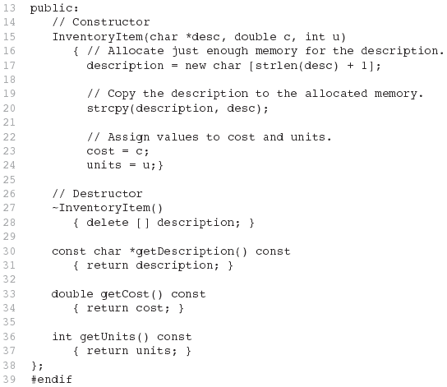
Contents of InventoryItem.h Version1 (2 of 2)

Slide 46
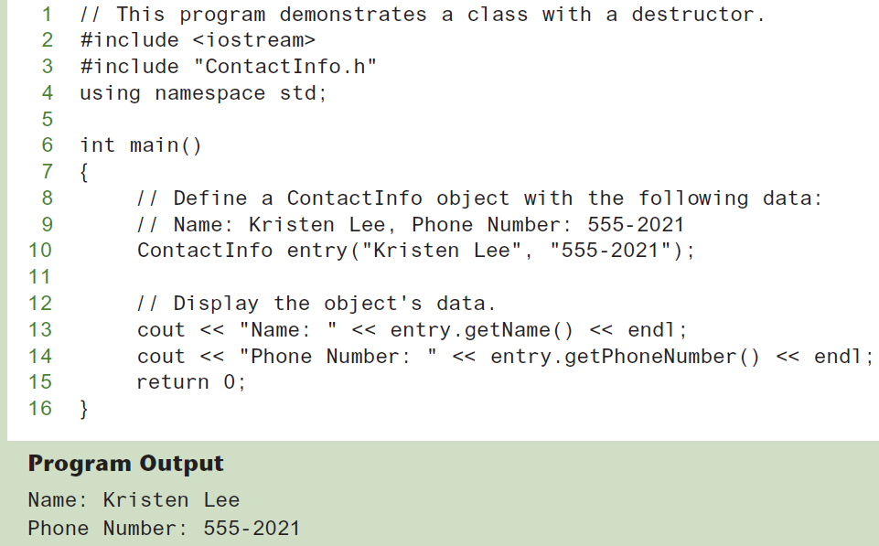
Program Example-4

Slide 47
Constructors, Destructors, and Dynamically Allocated Objects
When an object is dynamically allocated with the new operator, its constructor executes:
Rectangle *r = new Rectangle(10, 20);
When the object is destroyed, its destructor executes (automatically called):
delete r;

Slide 48
Overloading Constructors
A class can have more than one constructor
Overloaded constructors in a class must have different parameter lists:
Rectangle(); Rectangle(double);
Rectangle(double, double);
See the example of overloaded constructors in Inventory.h

Slide 49
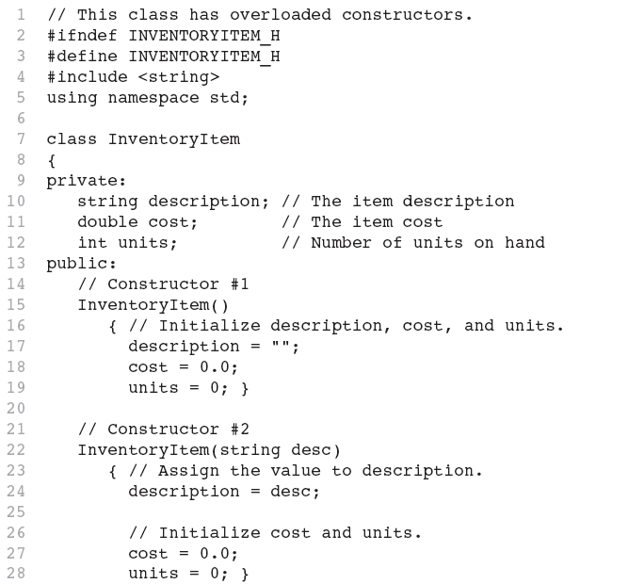
Contents of InventoryItem.h Version 2 (1 of 2)

Slide 50
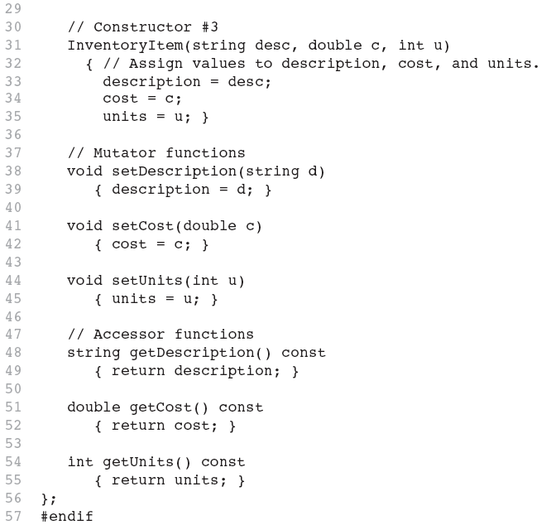
Contents of InventoryItem.h Version 2 (2 of 2)

Slide 51
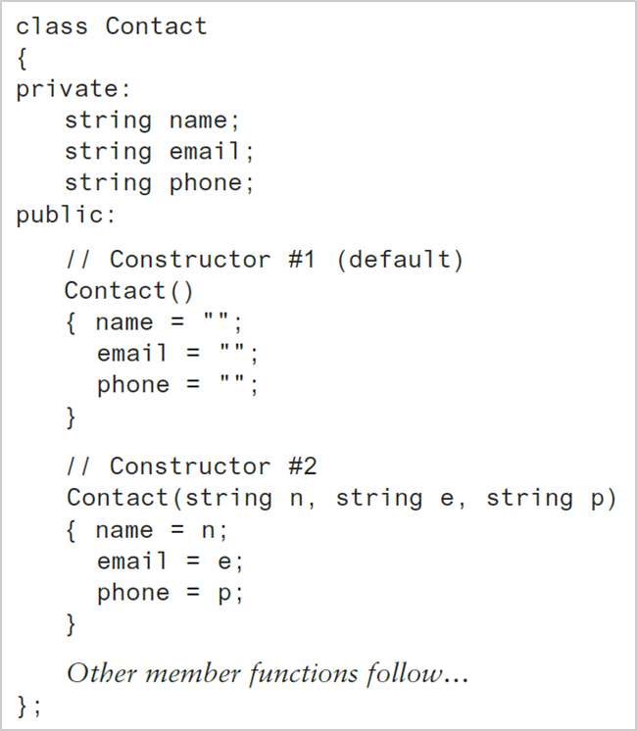
Constructor Delegation (1 of 3)
Sometimes a class will have multiple constructors that perform a similar set of steps. For example, look at the Contact class:

Slide 52
Constructor Delegation (2 of 3)
Both constructors perform a similar operation: They assign values to the name, email, and phone member variables.
The default constructor assigns empty strings to the members, and the parameterized constructor assigns specified values to the members.

Slide 53
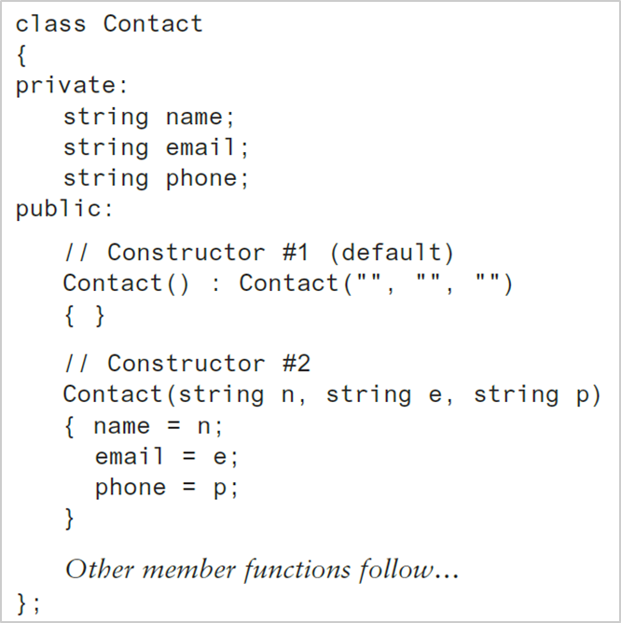
Constructor Delegation (3 of 3)
Beginning with C++ 11, it is possible for one constructor to call another constructor in the same class.
This is known as constructor delegation.
In this version of the class, the default constructor calls constructor #2. Notice that a colon appears at the end of the default constructor’s header, followed by a call to constructor #2 with three empty strings listed inside the parentheses.

Slide 54
Only One Default Constructor and One Destructor
Do not provide more than one default constructor for a class.
It would be an error to create a constructor that accepts no parameters along with another constructor that has default arguments for all its parameters. In such a case, the compiler would not be able to resolve which constructor to execute. For example:
Square();
Square(int = 0); // will not compile
Since a destructor takes no arguments, there can only be one destructor for a class.
Because destructors take no arguments, the compiler has no way to distinguish different destructors.

Slide 55
Member Function Overloading
Non-constructor member functions can also be overloaded:
void setCost(double);
void setCost(char *);
Must have unique parameter lists as for constructors

Slide 56
Using Private Member Functions
A private member function can only be called by another member function
It is used for internal processing by the class, not for use outside of the class
See the initName()and initPhone() private member functions in ContactInfo.h (Version 2)
In this version of the class, the logic in the constructor is modularized. It calls two private member functions: initName() and initPhone().
The initName() function allocates memory for the name attribute and initializes it with the value pointed to by the n parameter.
The initPhone() function allocates memory for the phone attribute and initializes it with the value pointed to by the p parameter.

Slide 57
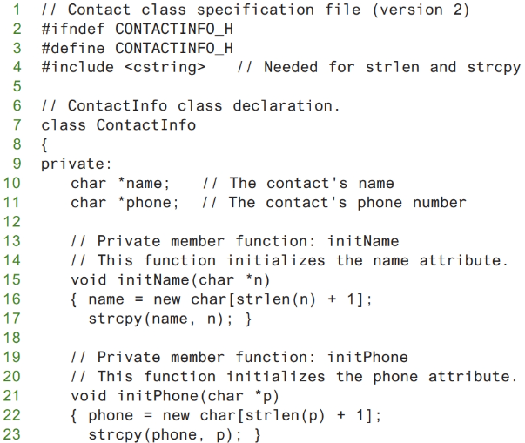
Contents of ContactInfo.h Version 2 (1 of 2)

Slide 58
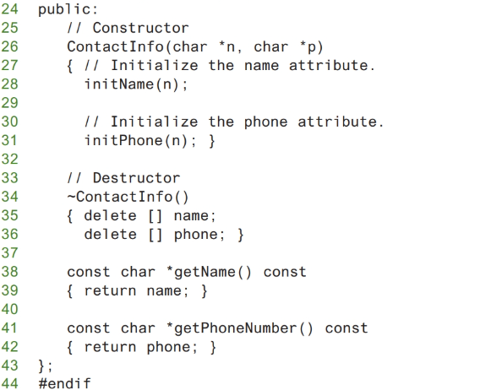
Contents of ContactInfo.h Version2 (2 of 2)

Slide 59

Arrays of Objects (1 of 4)
Objects can be the elements of an array.
Following statement defines an array of 40 InventoryItem objects. The name of the array is inventory, and the default constructor is called for each object in the array.
Default constructor for object is used when array is defined

Slide 60
Arrays of Objects (2 of 4)
If programmer wish to define an array of objects and call a constructor that requires arguments, then programmer must specify the arguments for each object individually in an initializer list. Here is an example:
The compiler treats each item in the initializer list as an argument for an array element’s constructor. Recall that the second constructor in the InventoryItem class (version 2) declaration takes the item description as an argument.
So, this statement defines an array of three objects and calls that constructor for each object.
The constructor for inventory[0] is called with “Hammer” as its argument, the constructor for inventory[1] is called with “Wrench” as its argument, and the constructor for inventory[2] is called with “Pliers” as its argument.

Slide 61
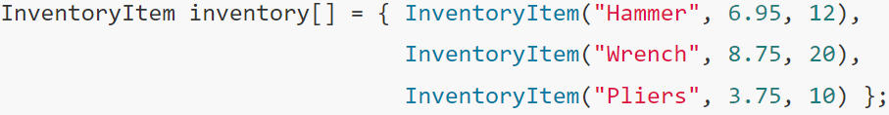
Arrays of Objects (3 of 4)
If the constructor requires more than one argument, the initializer must take the form of a function call:
This statement calls the third constructor in the InventoryItem class (version 2) declaration, for each object in the inventory array.

Slide 62
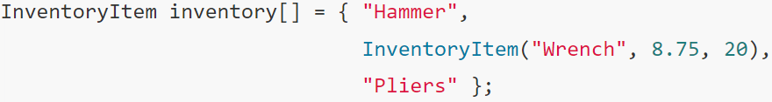
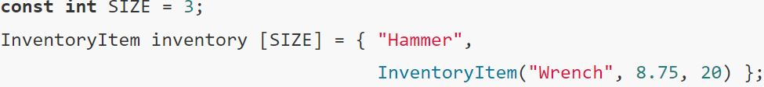
Arrays of Objects (4 of 4)
It is not necessary to call the same constructor for each object in an array. For example, look at the following statement:
This statement calls the second constructor for inventory[0] and inventory[2], and calls the third constructor for inventory[1].
If an initializer for all of the objects in an array is not provided, the default constructor will be called for each object that does not have an initializer.
For example, the following statement defines an array of three objects, but only provides initializers for the first two. The default constructor is called for the third object.

Slide 63
Accessing Objects in an Array
Objects in an array are referenced using subscripts, just like any other data type in an array.
Member functions are referenced using dot notation:
inventory[2].setUnits(30);
cout << inventory[2].getUnits();
This statement sets the units variable of inventory[2] to the value 30.
Program Example-5 shows an array of InventoryItem objects being used in a complete program.

Slide 64
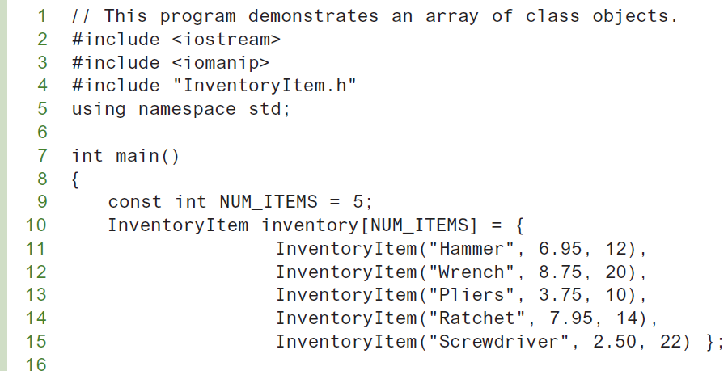
Program Example-5 (1 of 2)

Slide 65
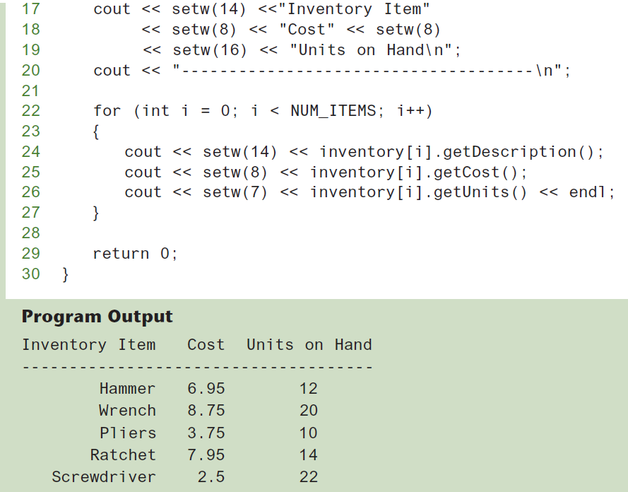
Program Example-5 (2 of 2)

Slide 66
The Unified Modeling Language
UML stands for Unified Modeling Language.
The UML provides a set of standard diagrams for graphically depicting object-oriented systems

Slide 67
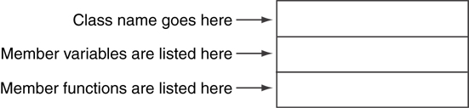
UML Class Diagram
A UML diagram for a class has three main sections.

Slide 68
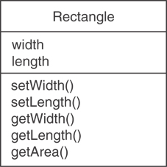
Example: A Rectangle Class
class Rectangle
{
private:
double width;
double length;
public:
bool setWidth(double);
bool setLength(double);
double getWidth() const;
double getLength() const;
double getArea() const;
};

Slide 69
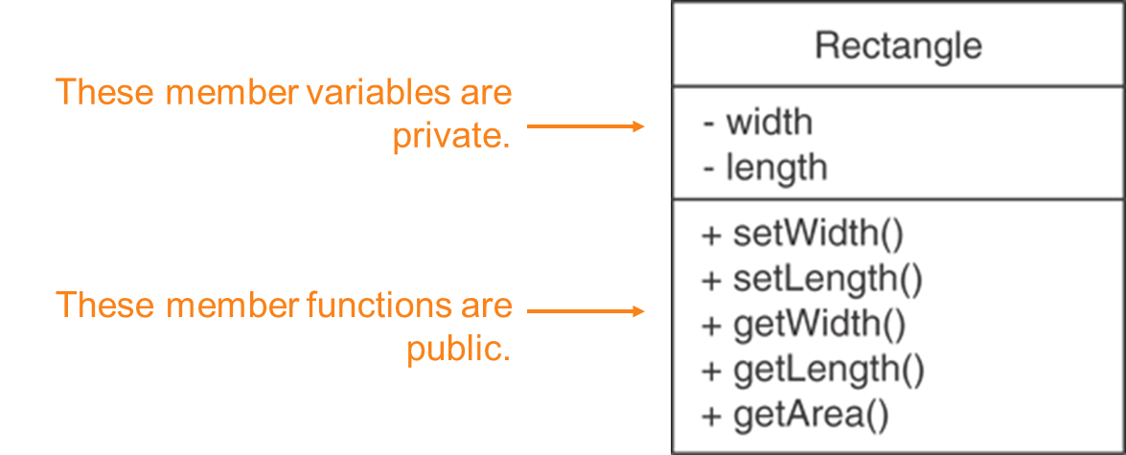
UML Access Specification Notation
In UML you indicate a private member with a minus (−) and a public member with a plus(+).

Slide 70
UML Data Type Notation
To indicate the data type of a member variable, place a colon followed by the name of the data type after the name of the variable.
width : double
length : double

Slide 71
UML Parameter Type Notation
To indicate the data type of a function’s parameter variable, place a colon followed by the name of the data type after the name of the variable.
+ setWidth(w : double)

Slide 72
UML Function Return Type Notation
To indicate the data type of a function’s return value, place a colon followed by the name of the data type after the function’s parameter list.
+ setWidth(w : double) : void

Slide 73
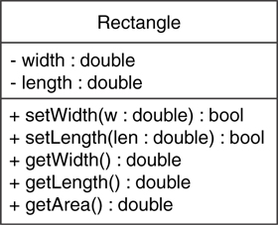
The Rectangle Class

Slide 74
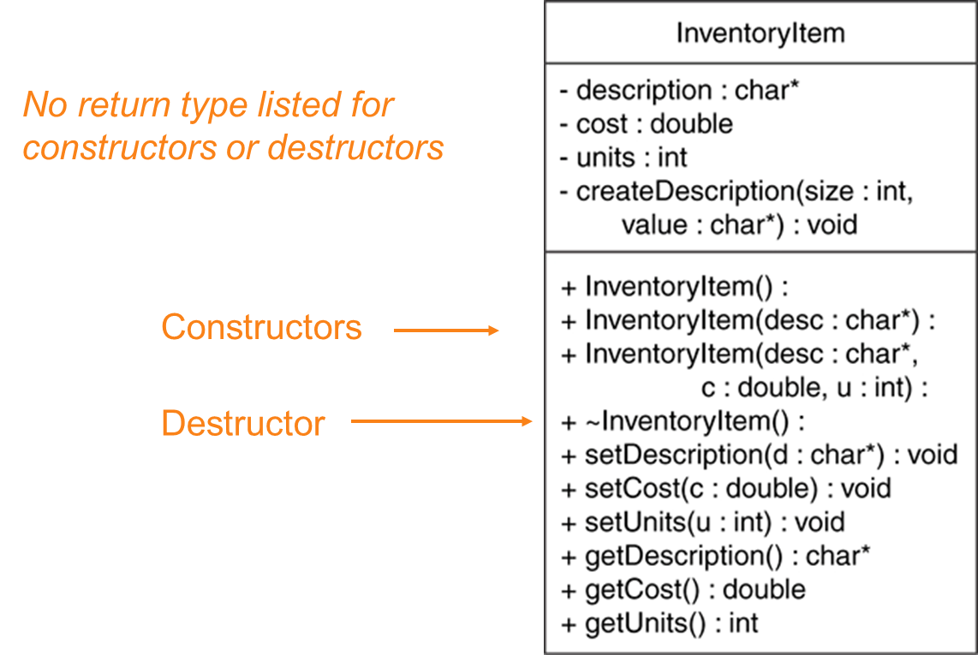
Showing Constructors and Destructors

