Slide 1
Expressions and Interactivity

Slide 2
The cin Object (1 of 4)
Standard input object
Like cout, requires iostream file
Used to read input from keyboard
Information retrieved from cin with >>
Input is stored in one or more variables

Slide 3
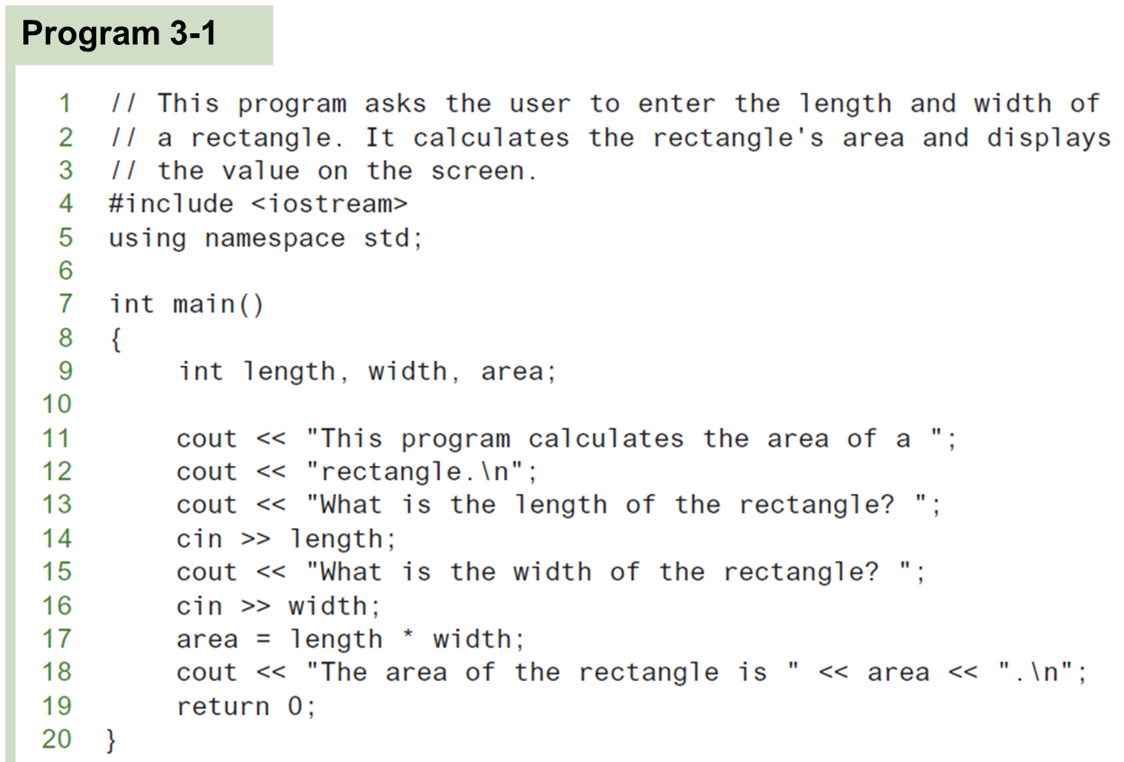
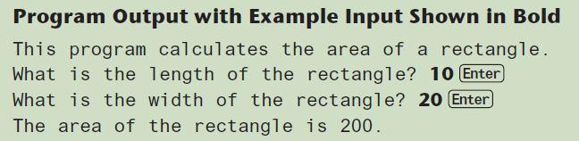
The cin Object (2 of 4)

Slide 4
The cin Object (3 of 4)
cin converts data to the type that matches the variable:
int height;
cout << "How tall is the room? ";
cin >> height;

Slide 5
Displaying a Prompt
A prompt is a message that instructs the user to enter data.
You should always use cout to display a prompt before each cin statement.
cout << "How tall is the room? ";
cin >> height;

Slide 6
The cin Object (4 of 4)
Can be used to input more than one value:
cin >> height >> width;
Multiple values from keyboard must be separated by spaces
Order is important: first value entered goes to first variable, etc.

Slide 7
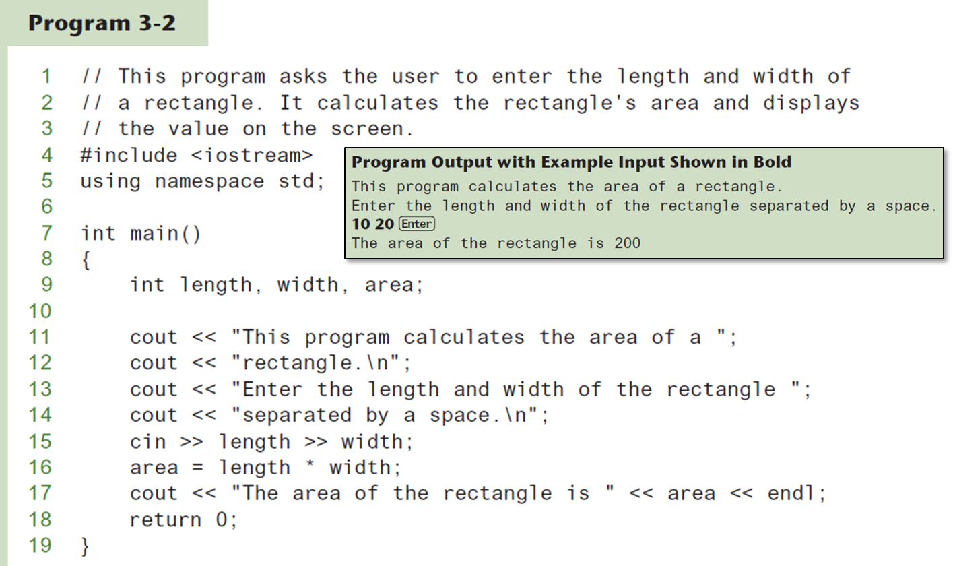
Using cin To Read Multiple Values

Slide 8
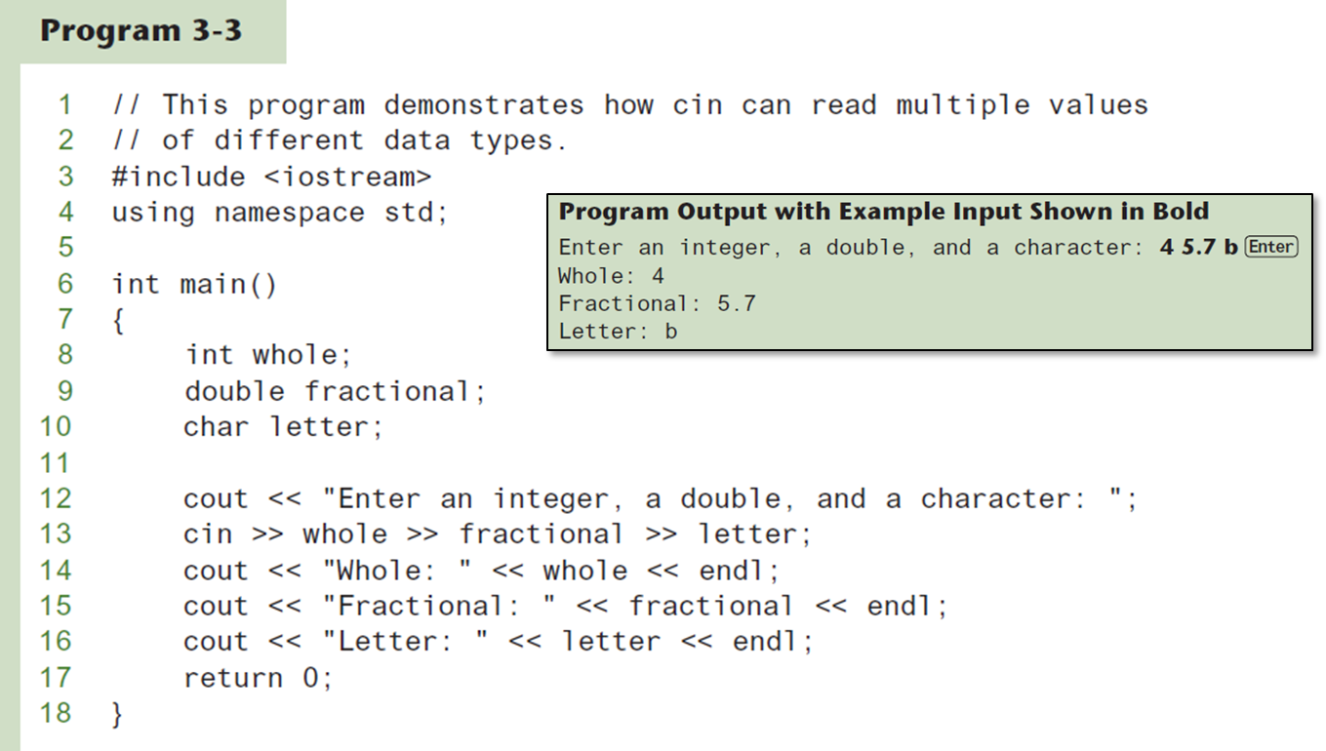
Using cin To Read Values of Different Data Types

Slide 9
Mathematical Expressions
Can create complex expressions using multiple mathematical operators
An expression can be a literal, a variable, or a mathematical combination of constants and variables
Can be used in assignment, cout, other statements:
area = 2 * PI * radius;
cout << "border is: " << 2*(l+w);

Slide 10
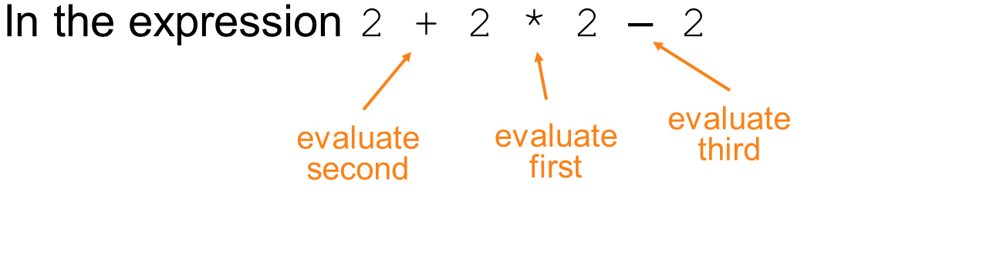
Order of Operations (1 of 2)
In an expression with more than one operator, operatros are evaluated in the following order:
− (unary negation), in order, left to right
* / % in order, left to right
+ - in order, left to right

Slide 11
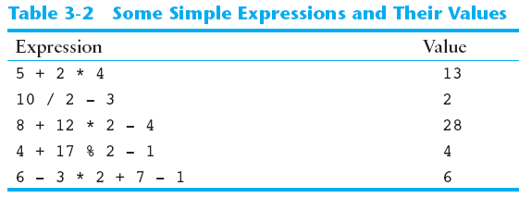
Order of Operations (2 of 2)

Slide 12
Associativity of Operators
− (unary negation) associates right to left
*, /, %, +, -associate right to left
parentheses ( ) can be used to override the order of operations:

Slide 13
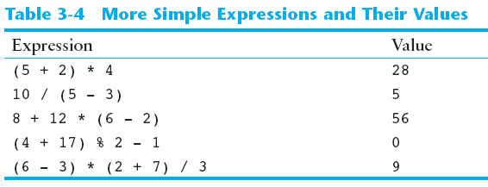
Grouping with Parentheses

Slide 14
Algebraic Expressions (1 of 2)
Multiplication requires an operator:
Area=lw is written as
There is no exponentiation operator:
is written as
Parentheses may be needed to maintain order of operations:
is written as

Slide 15
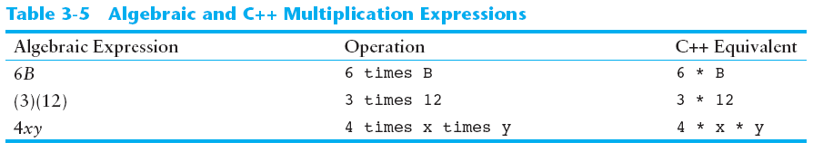
Algebraic Expressions (2 of 2)

Slide 16
When You Mix Apples with Oranges: Type Conversion
Operations are performed between operands of the same type.
If not of the same type, C++ will convert one to be the type of the other
This can impact the results of calculations.

Slide 17
Hierarchy of Types
Highest:
long double
double
float
unsigned long
long
unsigned int
int
Lowest:
Ranked by largest number they can hold

Slide 18
Type Coercion
Type Coercion: automatic conversion of an operand to another data type
Promotion: convert to a higher type
Demotion: convert to a lower type

Slide 19
Coercion Rules
1) char, short, unsigned short automatically promoted to int
2) When operating on values of different data types, the lower one is promoted to the type of the higher one.
3) When using the = operator, the type of expression on right will be converted to type of variable on left

Slide 20
Overflow and Underflow
Occurs when assigning a value that is too large (overflow) or too small (underflow) to be held in a variable
Variable contains value that is ‘wrapped around’ set of possible values
Different systems may display a warning/error message, stop the program, or continue execution using the incorrect value

Slide 21
Type Casting (1 of 2)
Used for manual data type conversion
Useful for floating point division using ints:
double m; m = static_cast<double>(y2-y1)/(x2-x1);
Useful to see int value of a char variable:
char ch = 'C';
cout << ch << " is "
<< static_cast<int>(ch);

Slide 22
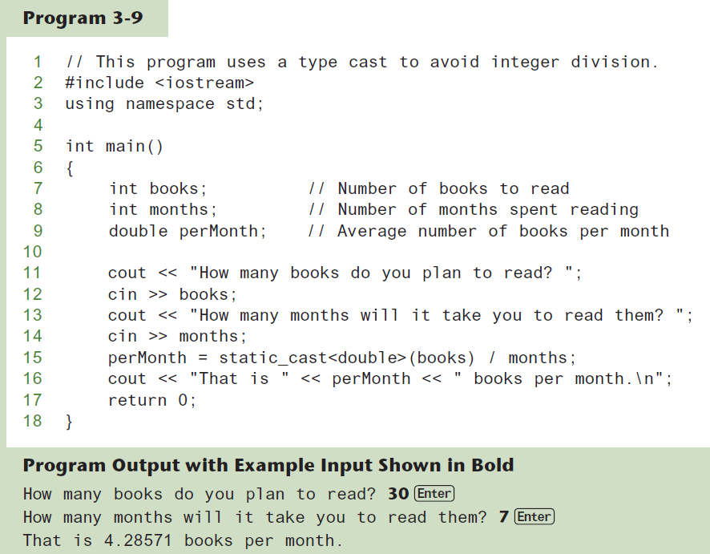
Type Casting (2 of 2)

Slide 23
C-Style and Prestandard Type Cast Expressions
C-Style cast: data type name in ()
cout << ch << " is " << (int)ch;
Prestandard C++ cast: value in ()
cout << ch << " is " << int(ch);
Both are still supported in C++, although static_cast is preferred

Slide 24
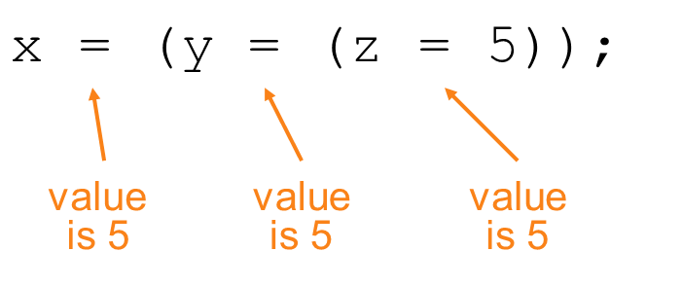
Multiple Assignment and Combined Assignment
The = can be used to assign a value to multiple variables:
x = y = z = 5;
Value of = is the value that is assigned
Associates right to left:

Slide 25
Combined Assignment (1 of 2)
Look at the following statement:
sum = sum + 1;
This adds 1 to the variable sum.

Slide 26
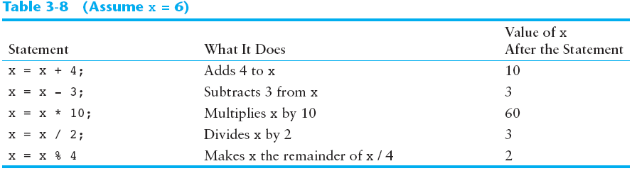
Other Similar Statements

Slide 27
Combined Assignment (2 of 2)
The combined assignment operators provide a shorthand for these types of statements.
The statement
sum = sum + 1;
is equivalent to
sum += 1;

Slide 28
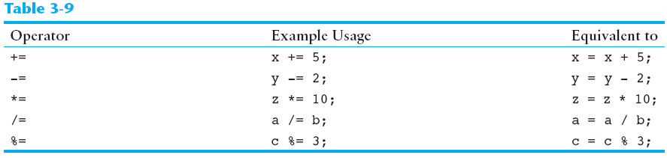
Combined Assignment Operators

Slide 29
Formatting Output
Can control how output displays for numeric, string data:
size
position
number of digits
Requires iomanip header file

Slide 30
Stream Manipulators (1 of 3)
Used to control how an output field is displayed
Some affect just the next value displayed:
setw(x): print in a field at least x spaces wide. Use more spaces if field is not wide enough

Slide 31
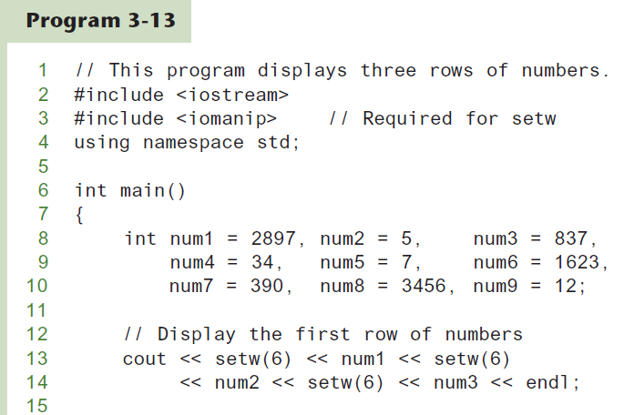
The setw Stream Manipulator (1 of 2)

Slide 32
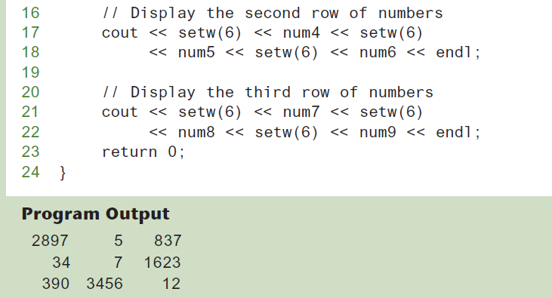
The setw Stream Manipulator (2 of 2)

Slide 33
Stream Manipulators (2 of 3)
Some affect values until changed again:
fixed: use decimal notation for floating-point values
setprecision(x): when used with fixed, print floating-point value using x digits after the decimal. Without fixed, print floating-point value using x significant digits
showpoint: always print decimal for floating-point values

Slide 34
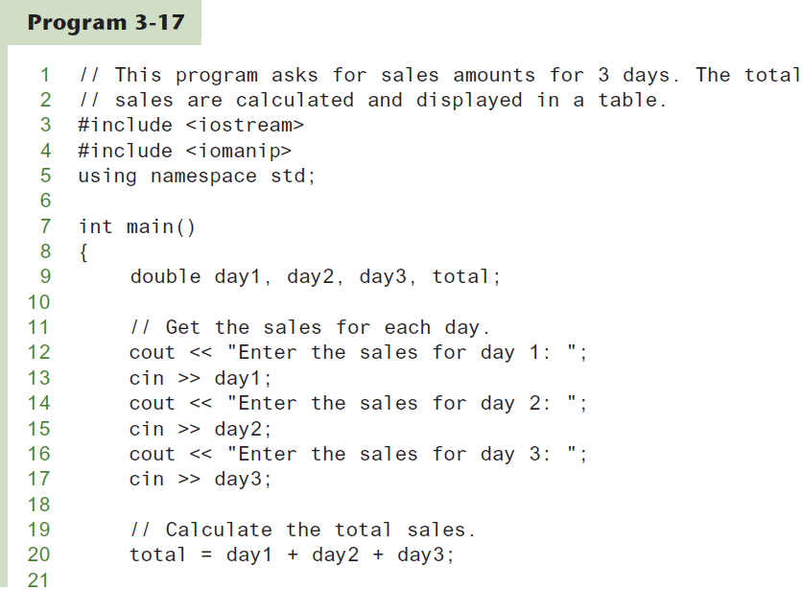
More Stream Manipulators (1 of 2)

Slide 35
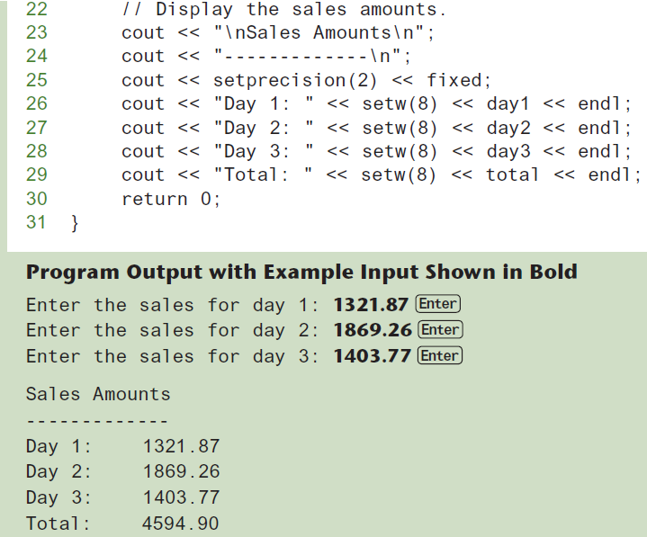
More Stream Manipulators (2 of 2)

Slide 36
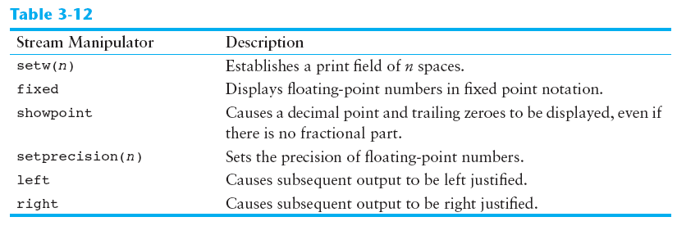
Stream Manipulators (3 of 3)

Slide 37
Working with Characters and string Objects (1 of 3)
Using cin with the >> operator to input strings can cause problems:
It passes over and ignores any leading whitespace characters (spaces, tabs, or line breaks)
To work around this problem, you can use a C++ function named getline.

Slide 38
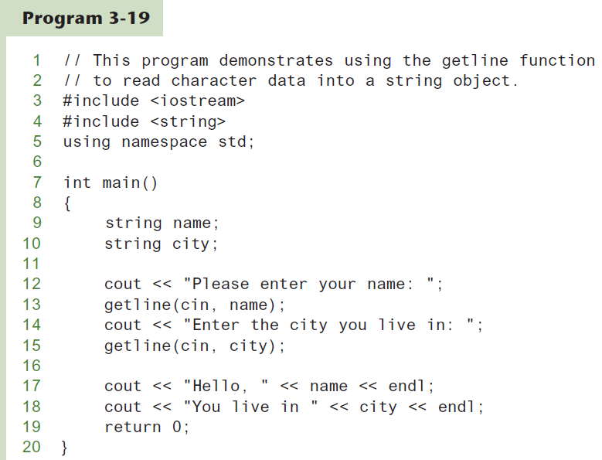
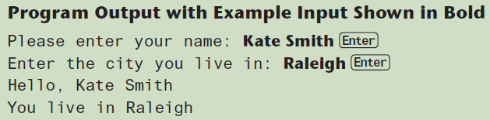
Using getline in Program 3-19

Slide 39
Working with Characters and string Objects (2 of 3)
To read a single character:
Use cin:
char ch;
cout << "Strike any key to continue";
cin >> ch;
Problem: will skip over blanks, tabs, <CR>
Use cin.get():
cin.get(ch);
Will read the next character entered, even whitespace

Slide 40
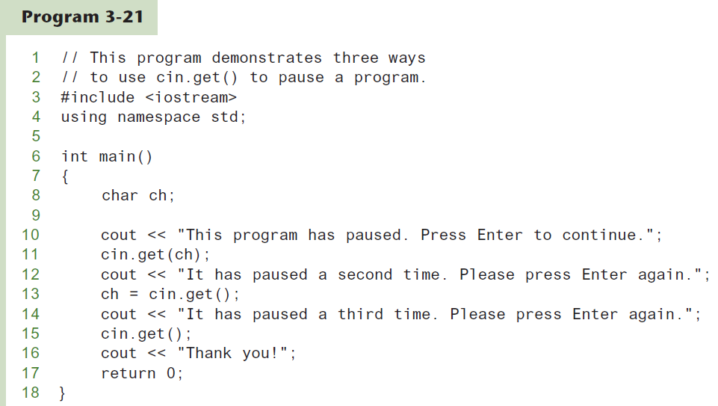
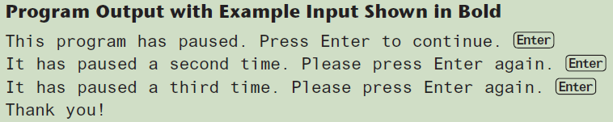
Using cin.get()

Slide 41
Working with Characters and string Objects (3 of 3)
Mixing cin >> and cin.get() in the same program can cause input errors that are hard to detect
To skip over unneeded characters that are still in the keyboard buffer, use cin.ignore():
// skip next char
cin.ignore();
// skip the next 10 chars or until '\n'
cin.ignore(10, '\n');

Slide 42
string Member Functions and Operators
To find the length of a string:
string state = "Texas";
int size = state.length();
To concatenate (join) multiple strings:
greeting2 = greeting1 + name1;
greeting1 = greeting1 + name2;
Or using the += combined assignment operator:
greeting1 += name2;

Slide 43
More Mathematical Library Functions (1 of 2)
Require cmath header file
Take double as input, return a double
Commonly used functions:
sin | Sine
cos | Cosine
tan | Tangent
sqrt | Square root
log | Natural (e) log
abs | Absolute value (takes and returns an int)

Slide 44
More Mathematical Library Functions (2 of 2)
These require cstdlib header file
rand(): returns a random number (int) between 0 and the largest int the compute holds. Yields same sequence of numbers each time program is run.
srand(x): initializes random number generator with unsigned int x

Slide 45
Random Numbers
Random numbers are useful in many applications, such as
Games and simulations
Statistical analysis
Data encryption

Slide 46
Generating Random Numbers (1 of 5)
Use this #include statement:
#include <random>
Create the following objects:
A random number engine to generate a random sequence of bits
A distribution object to format the bits into numbers of a specific data type, within a specified range

Slide 47
Generating Random Numbers (2 of 5)
Example: Generate a random integer in the range 0-100:
random_device myEngine;
uniform_int_distribution<int> randomInt(0, 100);
int number = randomInt(myEngine);

Slide 48
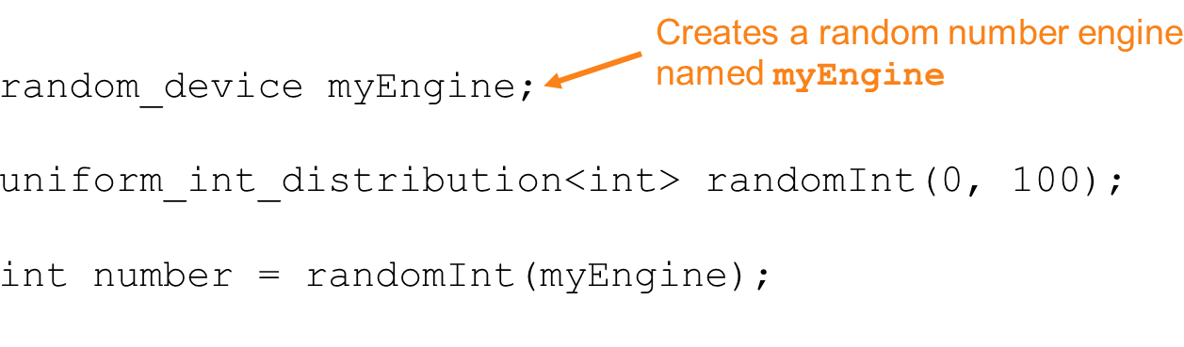
Generating Random Numbers (3 of 5)
Example: Generate a random integer in the range 0-100:

Slide 49
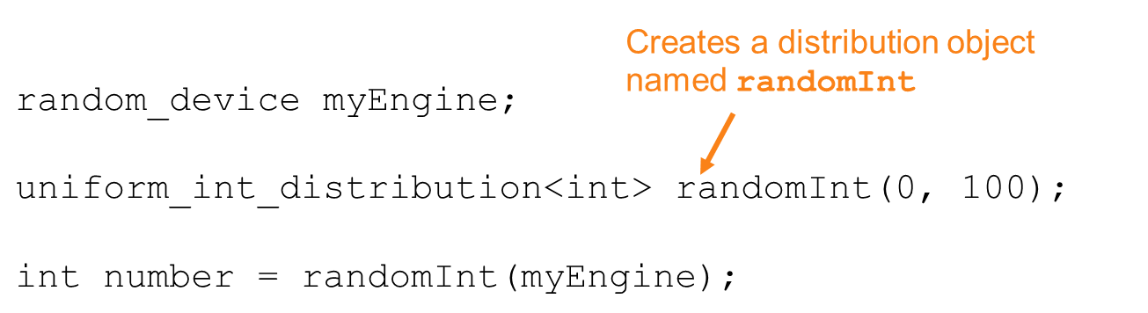
Generating Random Numbers (4 of 5)
Example: Generate a random integer in the range 0-100:

Slide 50
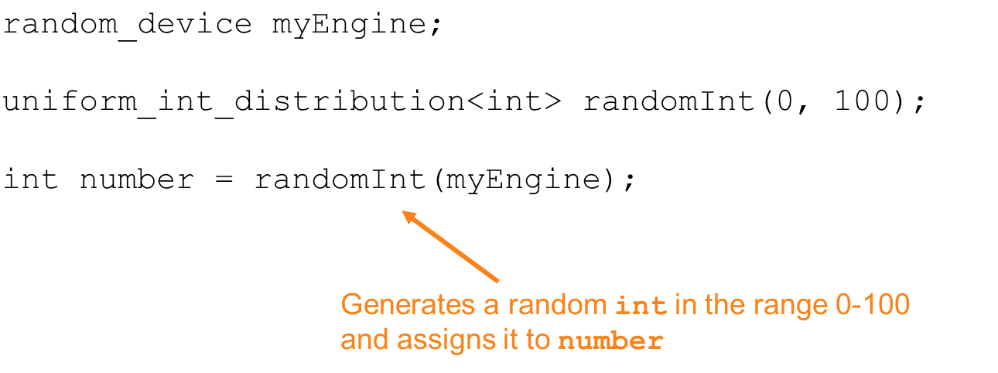
Generating Random Numbers (5 of 5)
Example: Generate a random integer in the range 0-100:

Slide 51
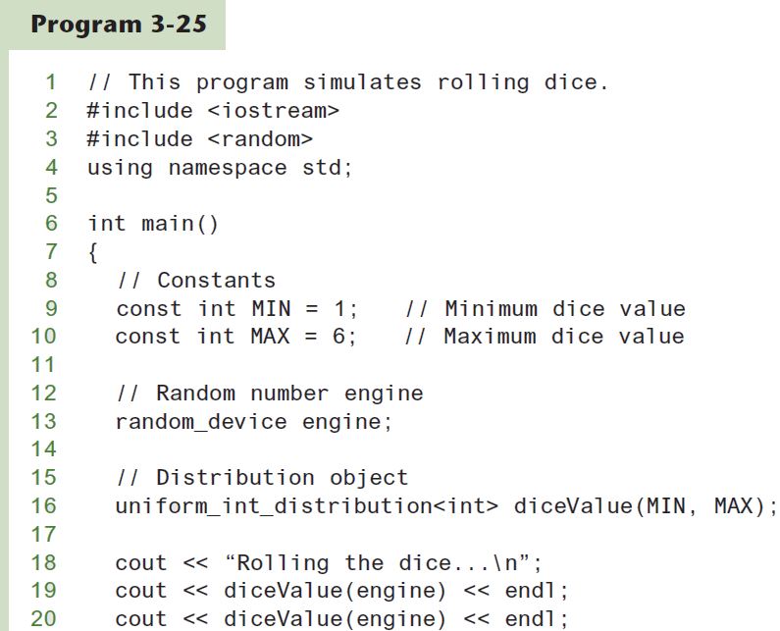
Simulating Dice (1 of 2)

Slide 52
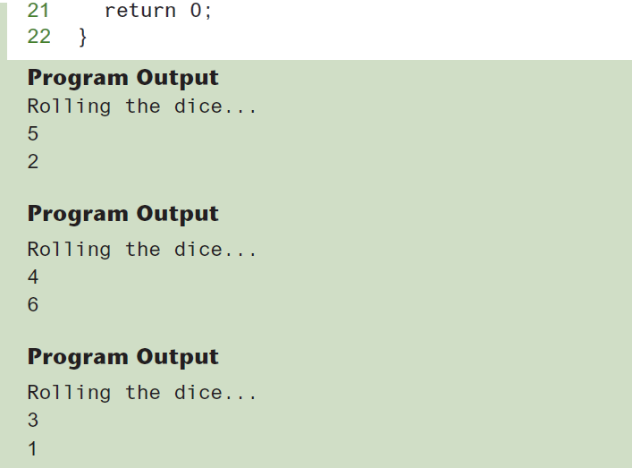
Simulating Dice (2 of 2)

Slide 53
Hand Tracing a Program
Hand trace a program: act as if you are the computer, executing a program:
step through and ‘execute’ each statement, one-by-one
record the contents of variables after statement execution, using a hand trace chart (table)
Useful to locate logic or mathematical errors

Slide 54
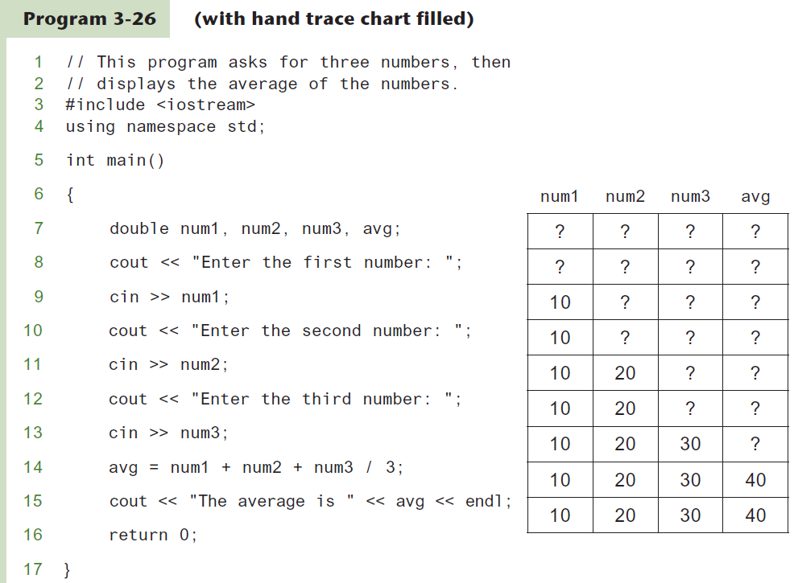
Program 3-26 with Hand Trace Chart

Slide 55
A Case Study
General Crates, Inc. builds custom-designed wooden crates.
You have been asked to write a program that calculates the:
Volume (in cubic feet)
Cost
Customer price
Profit of any crate GCI builds

Slide 56
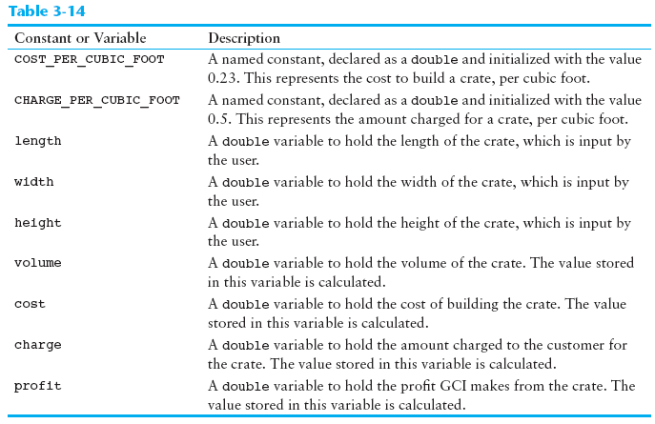
Variables

Slide 57
Program Design
The program must perform the following general steps:
Step 1:
Ask the user to enter the dimensions of the crate
Step 2:
Calculate:
the crate’s volume
the cost of building the crate
the customer’s charge
the profit made
Step 3:
Display the data calculated in Step 2.

Slide 58
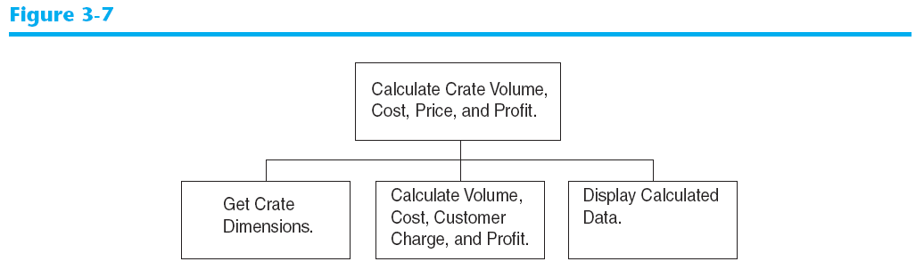
General Hierarchy Chart

Slide 59
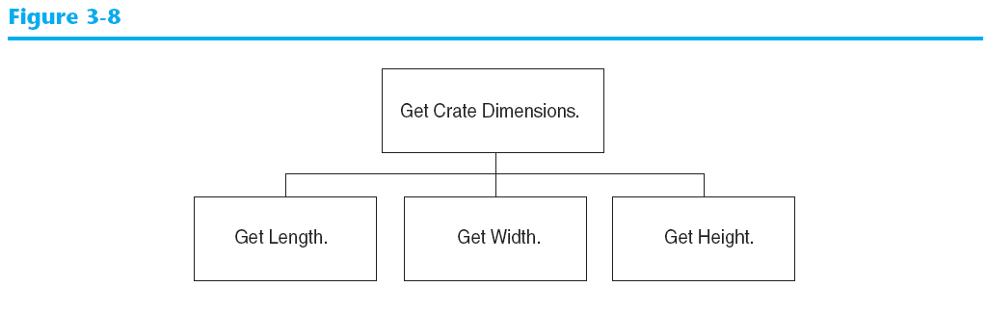
Get Crate Dimensions

Slide 60
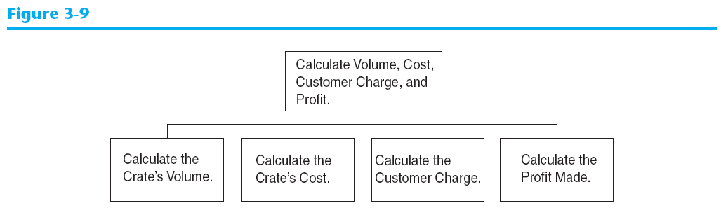
Calculate Volume, Cost, Customer Charge, and Profit

Slide 61
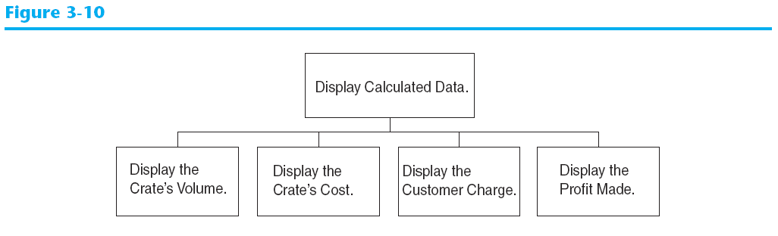
Display Calculated Data

Slide 62
Psuedocode
Ask the user to input the crate's length.
Ask the user to input the crate's width.
Ask the user to input the crate's height.
Calculate the crate's volume.
Calculate the cost of building the crate.
Calculate the customer's charge for the crate.
Calculate the profit made from the crate.
Display the crate's volume.
Display the cost of building the crate.
Display the customer's charge for the crate.
Display the profit made from the crate.

Slide 63
Calculations
The following formulas will be used to calculate the crate’s volume, cost, charge, and profit:

Slide 64
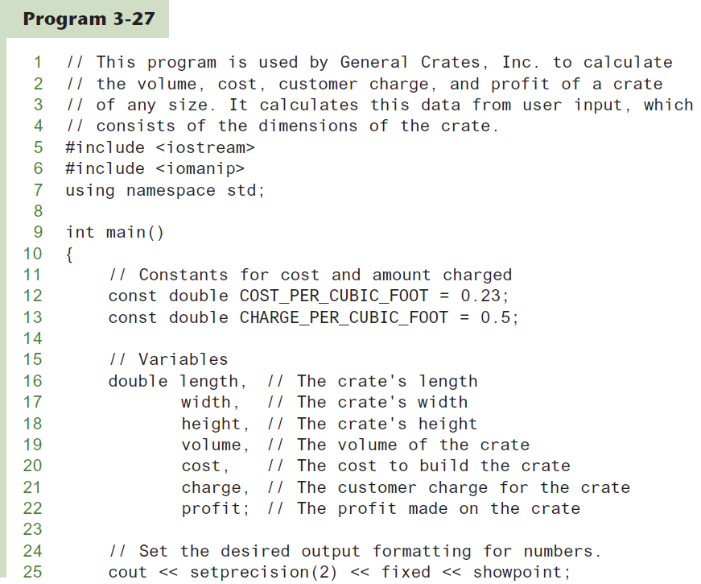
The Program (1 of 3)

Slide 65
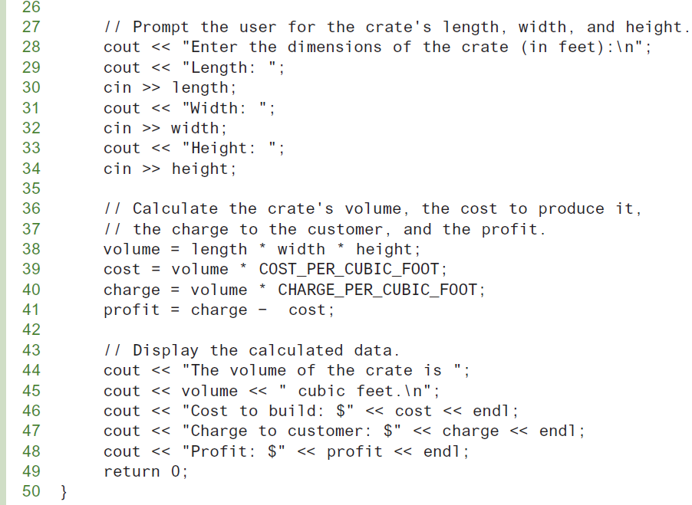
The Program (2 of 3)

Slide 66
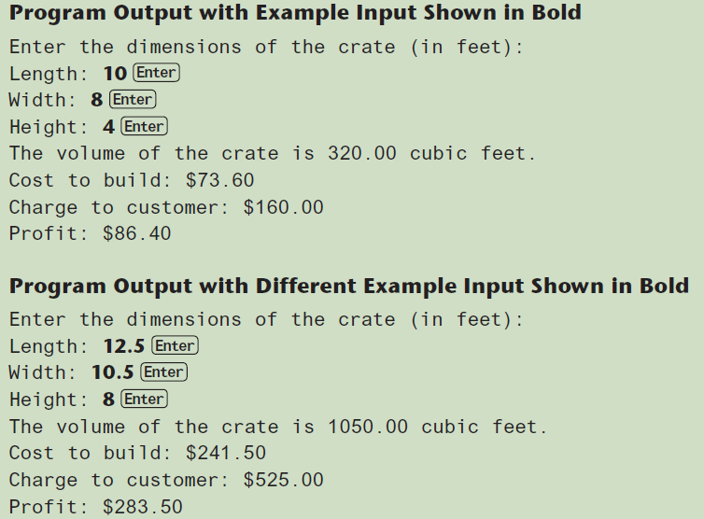
The Program (3 of 3)

