Slide 1
Loops and Files

Slide 2
Learning Objectives
The Increment and Decrement Operators
Introduction to Loops: The while Loop
Using the while Loop for Input Validation
Counters
The do-while Loop
The for Loop
Keeping a Running Total
Sentinels
Focus on Software Engineering: Deciding Which Loop to Use
Nested Loops
Using Files for Data Storage
Optional Topics: Breaking and Continuing a Loop

Slide 3
The Increment and Decrement Operators (1 of 2)
C++ provides a set of simple unary operators designed just for incrementing and decrementing variables.
++ is the increment operator.
It adds one to a variable (operand).
val++; is the same as val = val + 1;
++ can be used before (prefix) or after (postfix) a variable:
++val; val++;

Slide 4
The Increment and Decrement Operators (2 of 2)
−− is the decrement operator.
It subtracts one from a variable (operand).
val−−; is the same as val = val − 1;
−− can be also used before (prefix) or after (postfix) a variable:
−−val; val−−;

Slide 5
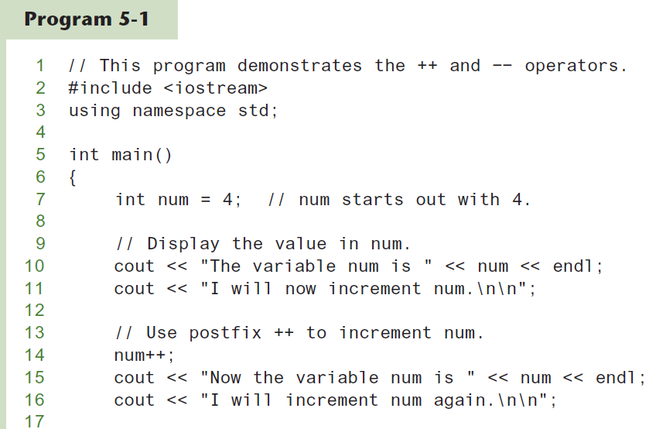
Increment and Decrement Operators (1 of 2)

Slide 6
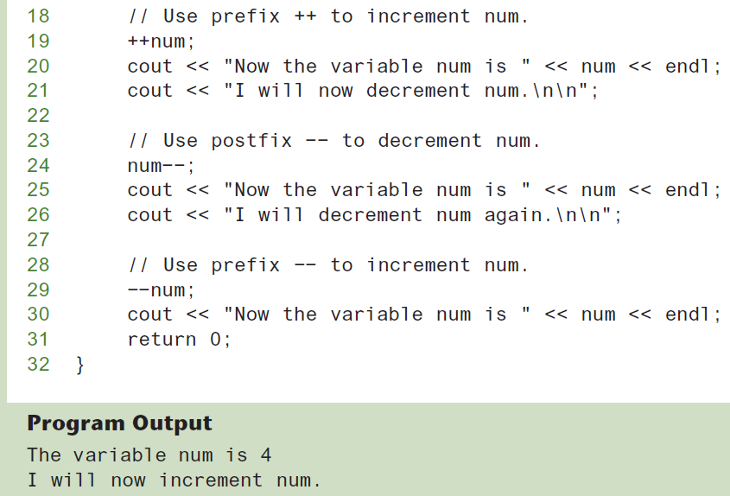
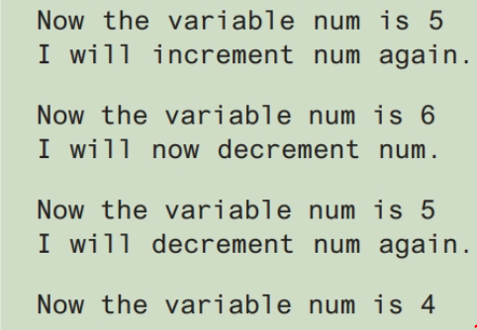
Increment and Decrement Operators (2 of 2)

Slide 7
Prefix vs. Postfix
++ and −− operators can be used in complex statements and expressions
In prefix mode (++val, −−val) the operator increments or decrements, then returns the value of the variable
In postfix mode (val++, val−−) the operator returns the value of the variable, then increments or decrements

Slide 8
Prefix vs. Postfix - Examples
int num, val = 12;
cout << val++; // displays 12,
// val is now 13;
cout << ++val; // sets val to 14,
// then displays it
num = −−val; // sets val to 13,
// stores 13 in num
num = val−−; // stores 13 in num,
// sets val to 12

Slide 9
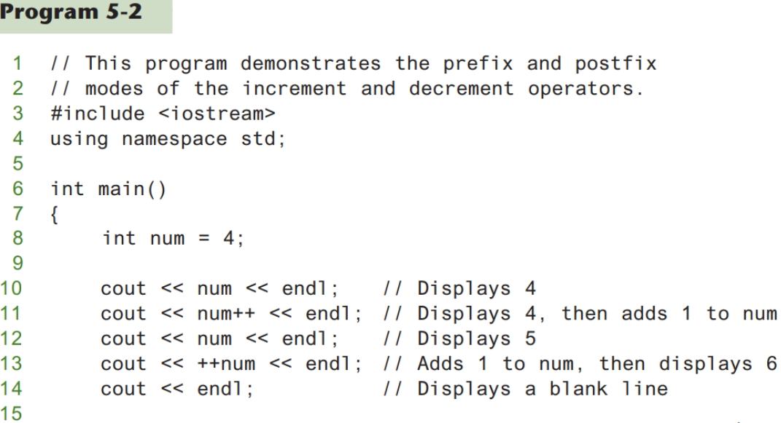
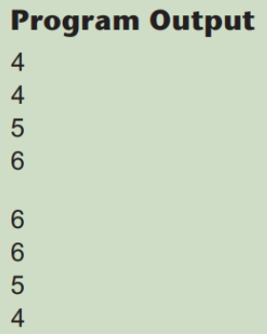
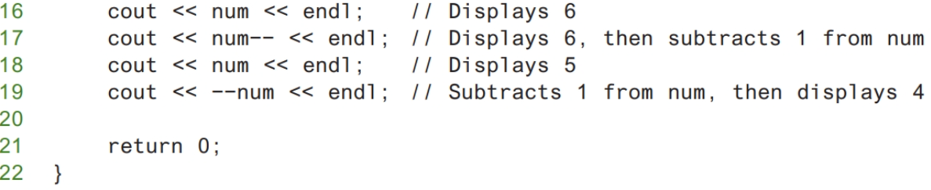
The Difference between Prefix vs. Postfix Modes

Slide 10
Notes on Increment and Decrement
Can be used in expressions:
result = num1++ + −−num2;
Must be applied to something that has a location in memory. Cannot have:
result = (num1 + num2)++;
Can be used in relational expressions:
if (++num > limit)
pre- and post-operations will cause different comparisons

Slide 11
Introduction to Loops: The while Loop
Loop: a control structure that causes a statement or statements to repeat
General format of the while loop:
while (expression)
statement;
statement; can also be a block of statements enclosed in { }
The while loop is known as a pretest loop, which means it tests its expression before each iteration.
An important characteristic of the while loop is that the loop will never iterate if the test expression is false to start with.

Slide 12
The while Loop – How It Works
while (expression)
statement;
expression is evaluated before each iteration
if true, then statement is executed, and expression is evaluated again
if false, then the loop is finished and program statements following statement execute

Slide 13
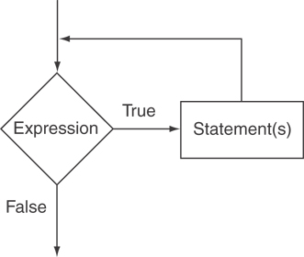
The Logic of a while Loop

Slide 14
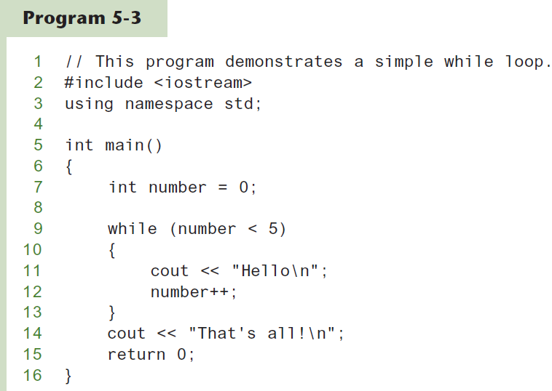
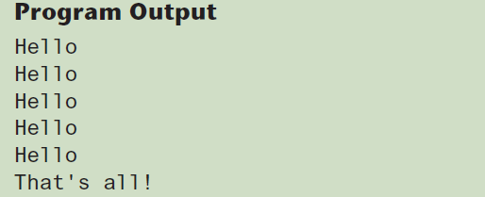
The while loop in Program 5-3

Slide 15
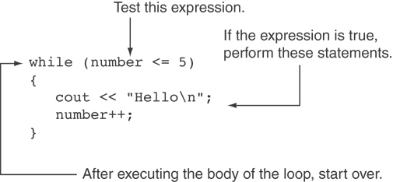
How the while Loop in Program 5-3 Lines 9 through 13 Works

Slide 16
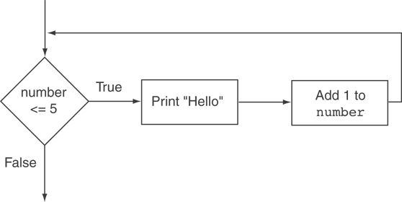
Flowchart of the while Loop in Program 5-3

Slide 17
The while Loop is a Pretest Loop
expression is evaluated before the loop executes. The following loop will never execute:
int number = 6; while (number <= 5) {
cout << "Hello\n";
number++;
}

Slide 18
Watch Out for Infinite Loops
The loop must contain code to make expression become false
Otherwise, the loop will have no way of stopping
Such a loop is called an infinite loop, because it will repeat an infinite number of times

Slide 19
Example of an Infinite Loop
If a loop does not have a way of stopping, it is called an infinite loop.
An infinite loop continues to repeat until the program is interrupted. Here is an example of an infinite loop:
int number = 1; while (number <= 5) {
cout << "Hello\n";
}

Slide 20
Using the while Loop for Input Validation (1 of 2)
Input validation is the process of inspecting data that is given to the program as input and determining whether it is valid.
The while loop can be used to create input routines that reject invalid data, and repeat until valid data is entered.

Slide 21
Using the while Loop for Input Validation (2 of 2)
Here's the general approach, in pseudocode:
Read an item of input
While the input is invalid
Display an error message
Read the input again
End While

Slide 22
Input Validation Example
cout << "Enter a number less than 10: ";
cin >> number;
while (number >= 10)
{
cout << "Invalid Entry!"
<< "Enter a number less than 10: ";
cin >> number;
}

Slide 23
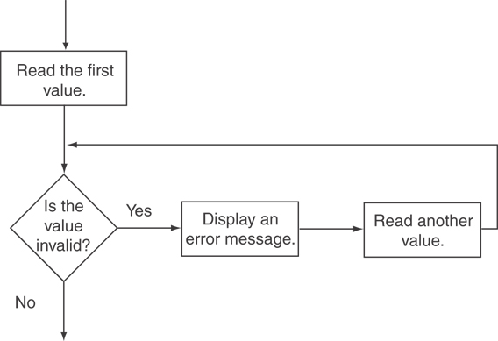
Flowchart for Input Validation

Slide 24
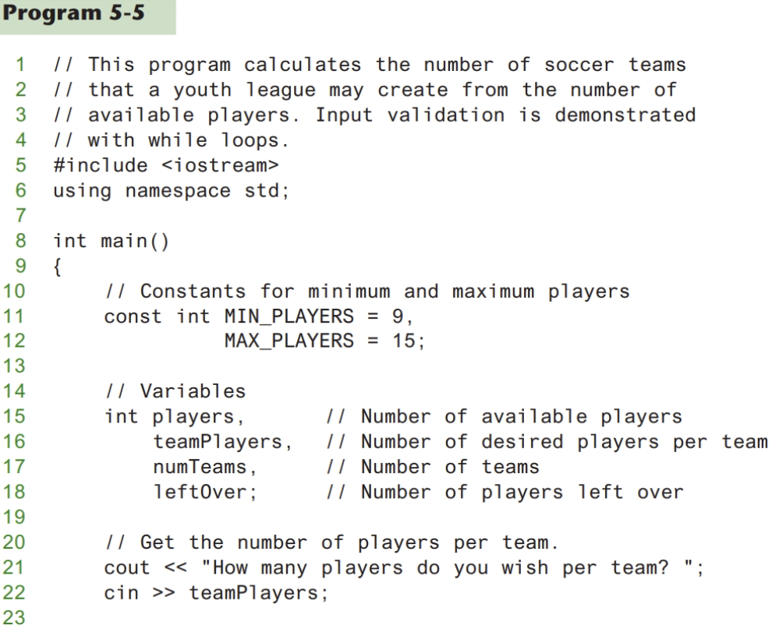
Input Validation in Program 5-5

Slide 25
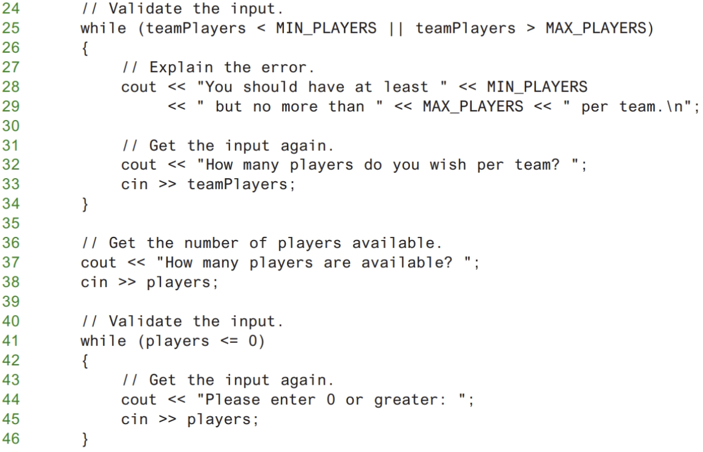
Input Validation in Program 5-5

Slide 26
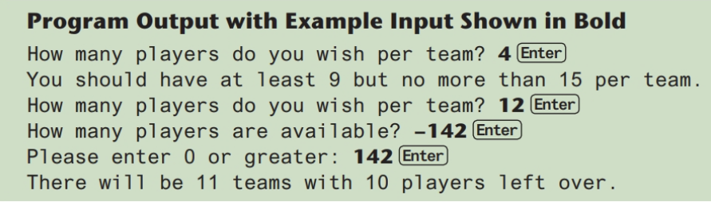
Input Validation in Program 5-5

Slide 27
Counters
Counter: a variable that is incremented or decremented each time a loop repeats
Can be used to control execution of the loop (also known as the loop control variable)
Must be initialized before entering loop
Sometimes it’s important for a program to control or keep track of the number of iterations a loop performs.
For example, Program 5-6 displays a table consisting of the numbers 1 through 10 and their squares, so its loop must iterate 10 times.

Slide 28
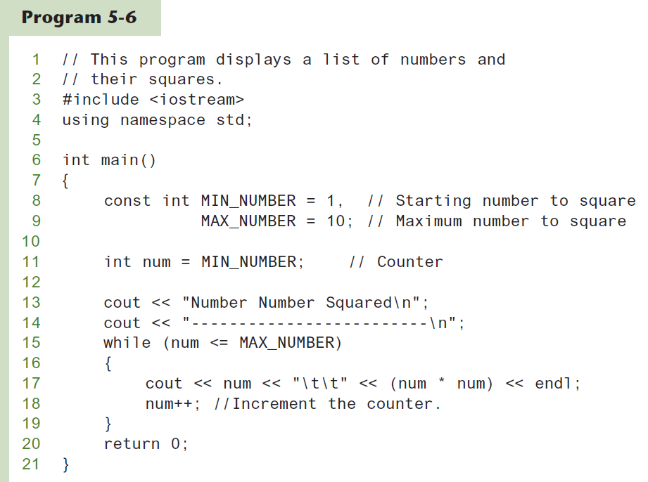
A Counter Variable Controls the Loop in Program 5-6 (1 of 2)

Slide 29
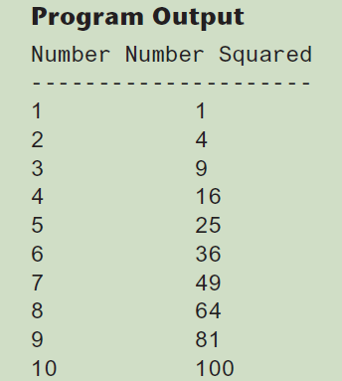
A Counter Variable Controls the Loop in Program 5-6 (2 of 2)

Slide 30
The do-while Loop
do-while: a posttest loop – execute the loop, then test the expression
General Format:
do
statement; // or block in { }
while (expression);
Note that a semicolon is required after (expression)

Slide 31
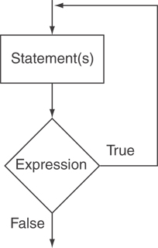
The Logic of a do-while Loop

Slide 32
An Example do-while Loop
The do-while loop is a posttest loop, which means its expression is tested after each iteration.
Although the test expression is false, this loop will execute one time because do-while is a posttest loop
int x = 1;
do
{
cout << x << endl;
} while(x < 0);

Slide 33
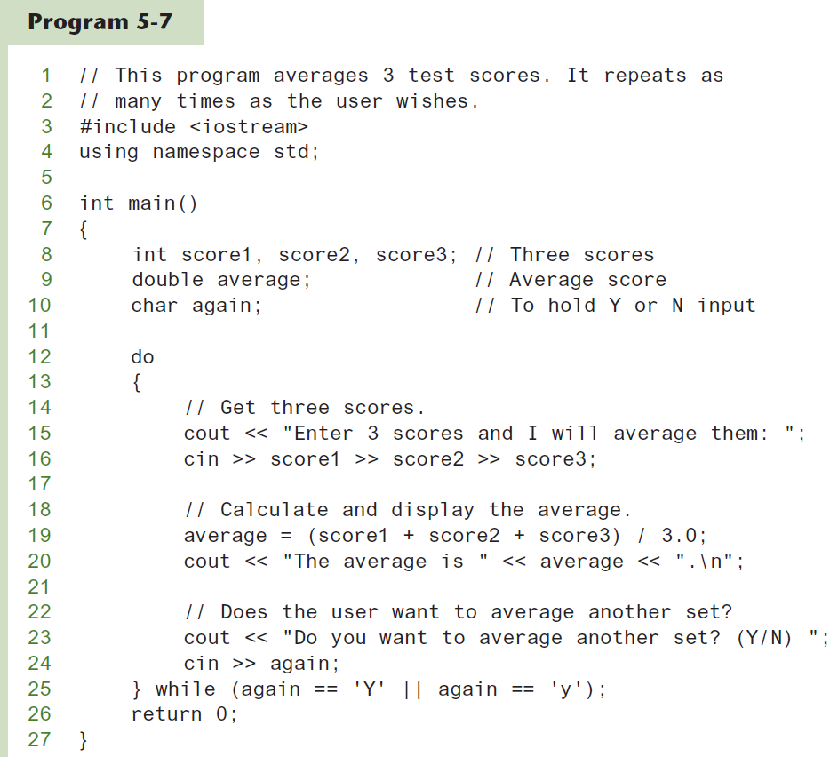
A do-while Loop in Program 5-7 (1 of 2)

Slide 34
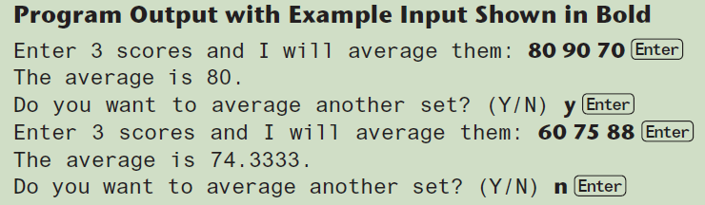
A do-while Loop in Program 5-7 (2 of 2)

Slide 35
do-while Loop Notes
Loop always executes at least once
Execution continues as long as expression is true, stops repetition when expression becomes false
Useful in menu-driven programs to bring user back to menu to make another choice

Slide 36
The for Loop
The for loop is ideal for performing a known number of iterations. Useful for counter-controlled loop
General Format:
for(initialization; test; update)
statement; // or block in { }
No semicolon after the update expression or after the )

Slide 37
for Loop - Mechanics
for(initialization; test; update)
statement; // or block in { }
Perform initialization
Evaluate test expression
If true, execute statement
If false, terminate loop execution
Execute update, then re-evaluate test expression

Slide 38
for Loop - Example
int count;
for (count = 1; count <= 5; count++)
cout << "Hello" << endl;

Slide 39
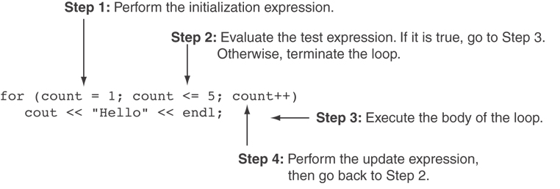
A Closer Look at the Previous Example

Slide 40
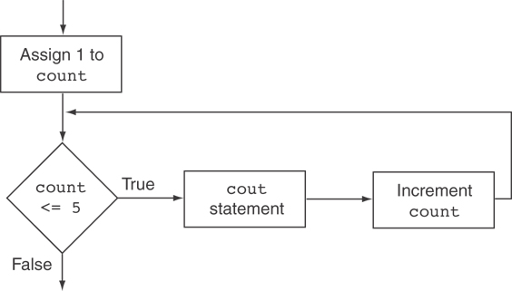
Flowchart for the Previous Example

Slide 41
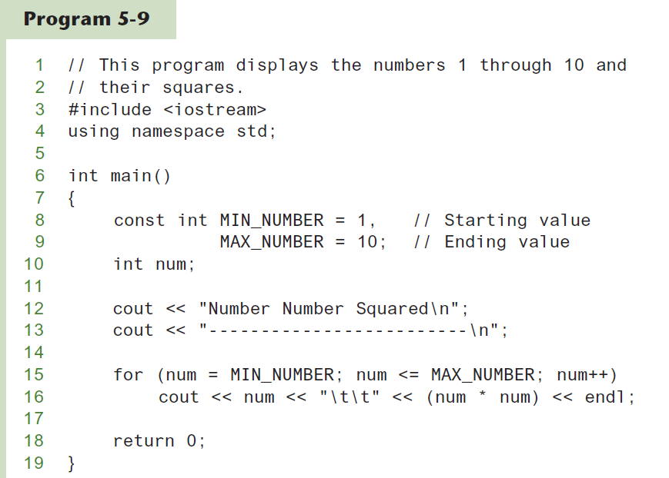
A for Loop in Program 5-9 (1 of 2)

Slide 42
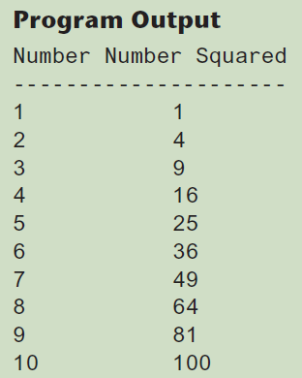
A for Loop in Program 5-9 (2 of 2)

Slide 43
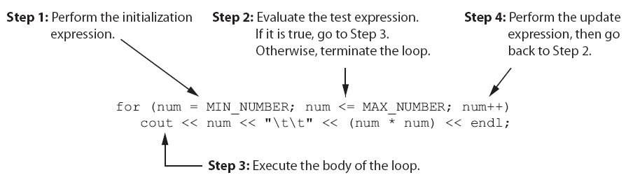
A Closer Look at Lines 15 and 16 in Program 5-9

Slide 44
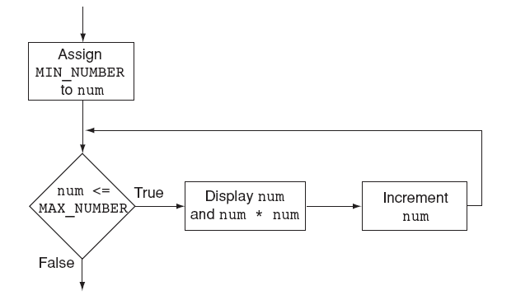
Flowchart for Lines 15 and 16 in Program 5-9

Slide 45
When to Use the for Loop
In any situation that clearly requires
an initialization
a false condition to stop the loop
an update to occur at the end of each iteration

Slide 46
The for Loop is a Pretest Loop
The for loop tests its test expression before each iteration, so it is a pretest loop.
The following loop will never iterate:
for (count = 11; count <= 10; count++)
cout << "Hello" << endl;

Slide 47
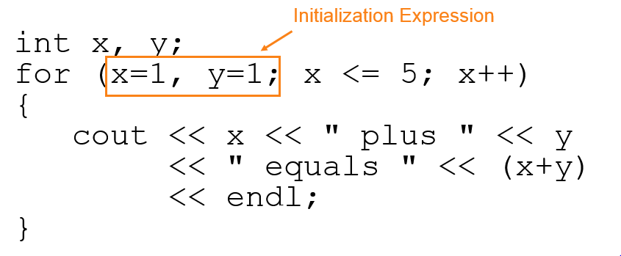
for Loop - Modifications (1 of 4)
You can have multiple statements in the initialization expression. Separate the statements with a comma:

Slide 48
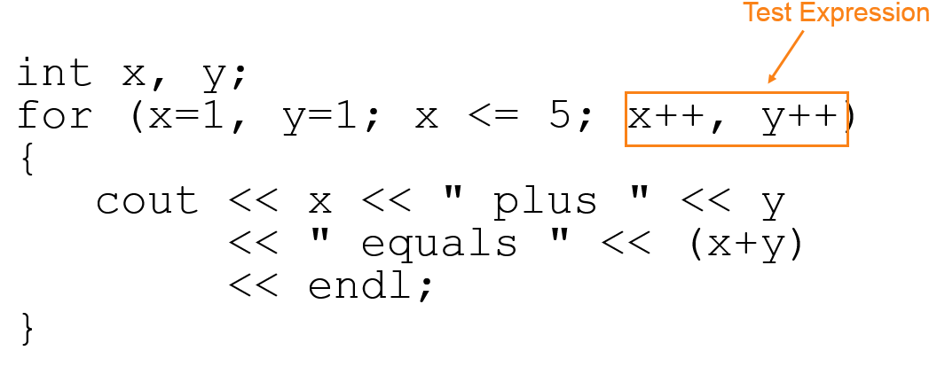
for Loop - Modifications (2 of 4)
You can also have multiple statements in the test expression. Separate the statements with a comma:

Slide 49
for Loop - Modifications (3 of 4)
You can omit the initialization expression if it has already been done:
int sum = 0, num = 1;
for (; num <= 10; num++)
sum += num;

Slide 50
for Loop - Modifications (4 of 4)
You can declare variables in the initialization expression:
int sum = 0;
for (int num = 0; num <= 10; num++)
sum += num;
The scope of the variable num is the for loop.

Slide 51
Keeping a Running Total
Running Total: accumulated sum of numbers from each repetition of loop
Accumulator: variable that holds running total
int sum=0, num=1; // sum is the
while (num <= 10) // accumulator
{ sum += num;
num++;
}
cout << "Sum of numbers 1 – 10 is"
<< sum << endl;

Slide 52
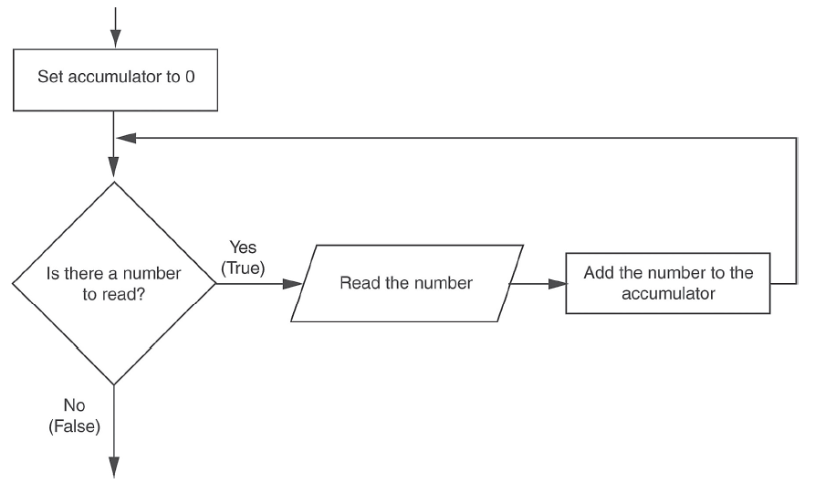
Logic for Keeping a Running Total

Slide 53
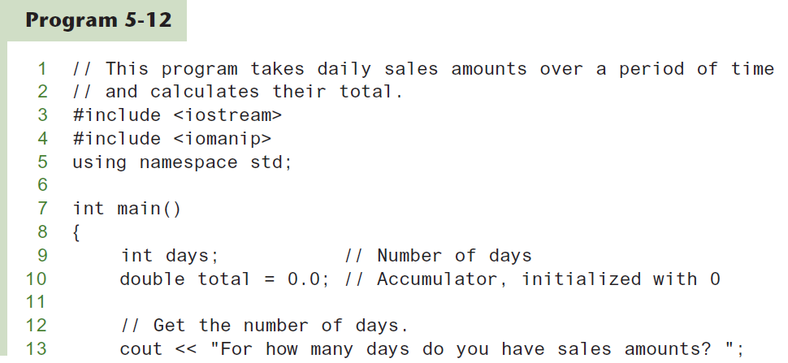
A Running Total in Program 5-12 (1 of 2)

Slide 54
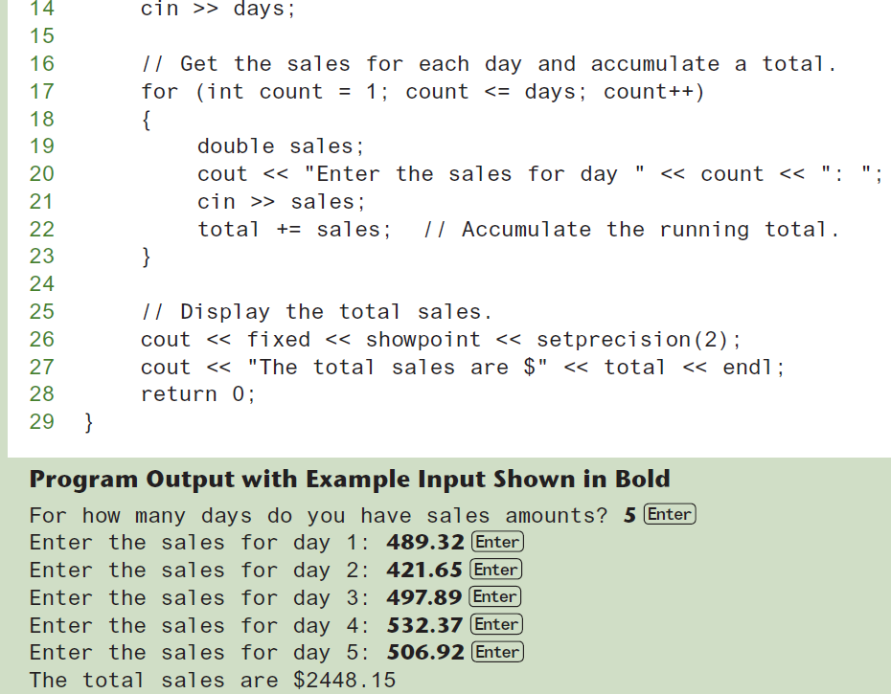
A Running Total in Program 5-12 (2 of 2)

Slide 55
Sentinels
sentinel: value in a list of values that indicates end of data
Special value that cannot be confused with a valid value, e.g., −999 for a test score
Used to terminate input when user may not know how many values will be entered

Slide 56
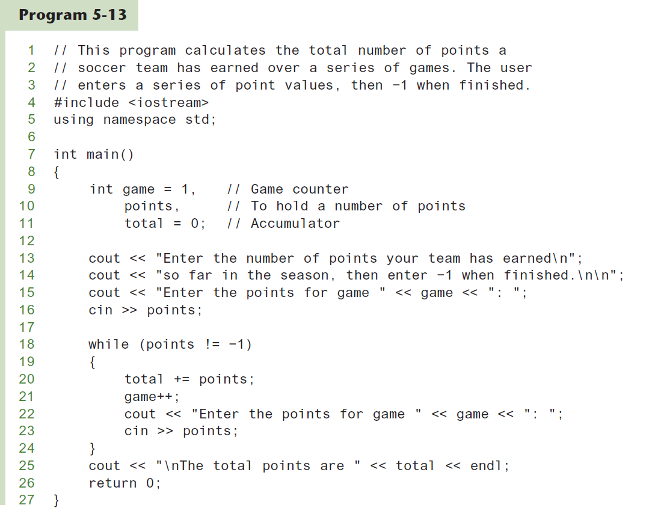
A Sentinel in Program 5-13 (1 of 2)

Slide 57
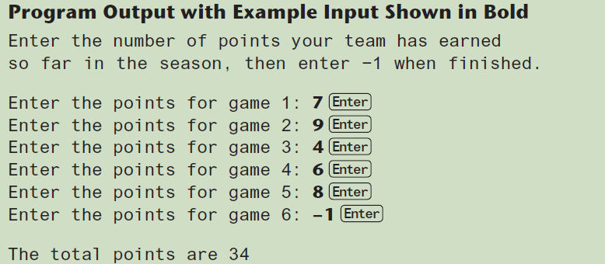
A Sentinel in Program 5-13 (2 of 2)

Slide 58
Deciding Which Loop to Use
The while loop is a conditional pretest loop
Iterates as long as a certain condition exits
Validating input
Reading lists of data terminated by a sentinel
The do-while loop is a conditional posttest loop
Always iterates at least once
Repeating a menu
The for loop is a pretest loop
Built-in expressions for initializing, testing, and updating
Situations where the exact number of iterations is known

Slide 59
Nested Loops
A nested loop is a loop inside the body of another loop
Inner (inside), outer (outside) loops:
for (row=1; row<=3; row++) //outer
for (col=1; col<=3; col++)//inner
cout << row * col << endl;

Slide 60
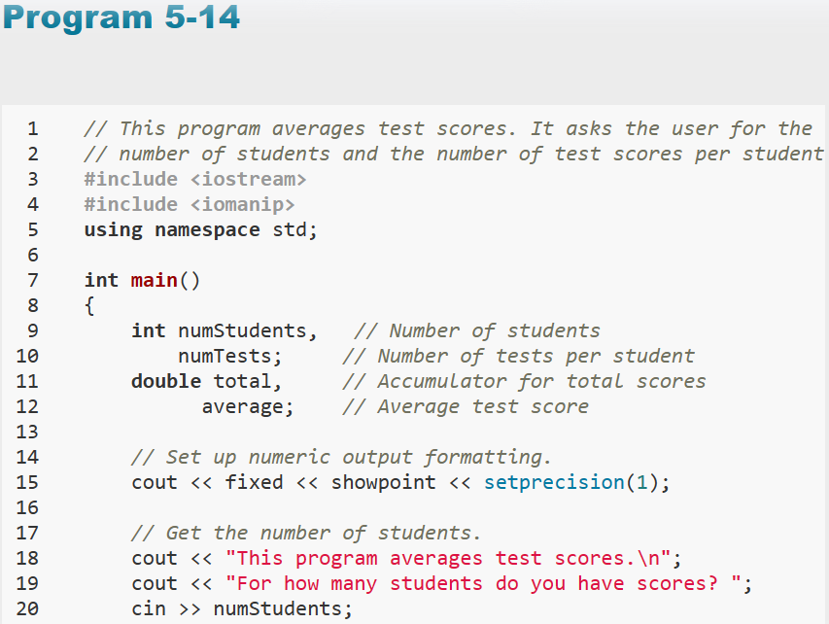
Nested for Loop in Program 5-14

Slide 61
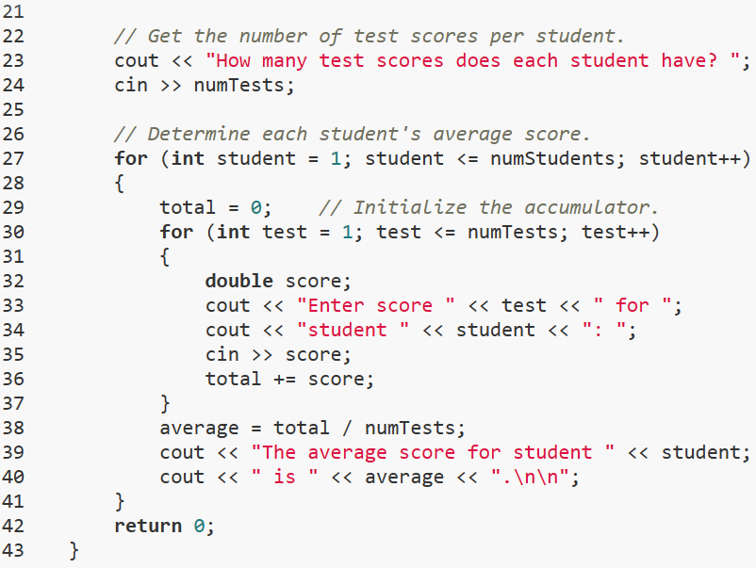
Nested for Loop in Program 5-14

Slide 62
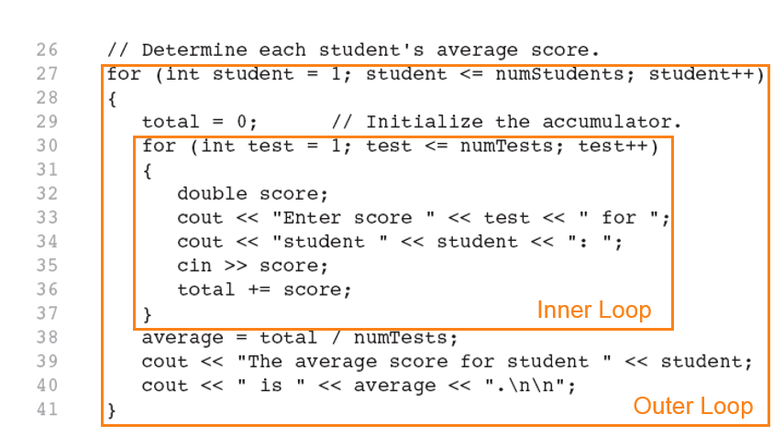
Nested for Loop in Program 5-14

Slide 63
Nested Loops - Notes
Inner loop goes through all repetitions for each repetition of outer loop
Inner loop repetitions complete sooner than outer loop
Total number of repetitions for inner loop is product of number of repetitions of the two loops.

Slide 64
Using Files for Data Storage
Can use files instead of keyboard, monitor screen for program input, output
Allows data to be retained between program runs
Steps:
Open the file
Use the file (read from, write to, or both)
Close the file

Slide 65
Files: What is Needed
Use fstream header file for file access
File stream types:
ifstream for input from a file
ofstream for output to a file
fstream for input from or output to a file
Define file stream objects:
ifstream infile;
ofstream outfile;

Slide 66
Opening Files
Create a link between file name (outside the program) and file stream object (inside the program)
Use the open member function:
infile.open("inventory.dat");
outfile.open("report.txt");
Filename may include drive, path info.
Output file will be created if necessary; existing file will be erased first
Input file must exist for open to work

Slide 67
Testing for File Open Errors
Can test a file stream object to detect if an open operation failed:
infile.open("test.txt");
if (!infile)
{
cout << "File open failure!";
}
Can also use the fail member function

Slide 68
Using Files
Can use output file object and << to send data to a file:
outfile << "Inventory report";
Can use input file object and >> to copy data from file to variables:
infile >> partNum;
infile >> qtyInStock >>
qtyOnOrder;

Slide 69
Using Loops to Process Files
The stream extraction operator >> returns true when a value was successfully read, false otherwise
Can be tested in a while loop to continue execution as long as values are read from the file:
while (inputFile >> number) ...

Slide 70
Closing Files
Use the close member function:
infile.close();
outfile.close();
Don’t wait for operating system to close files at program end:
may be limit on number of open files
may be buffered output data waiting to send to file

Slide 71
Letting the User Specify a Filename
In many cases, you will want the user to specify the name of a file for the program to open.
In C++ 11, you can pass a string object as an argument to a file stream object’s open member function.

Slide 72
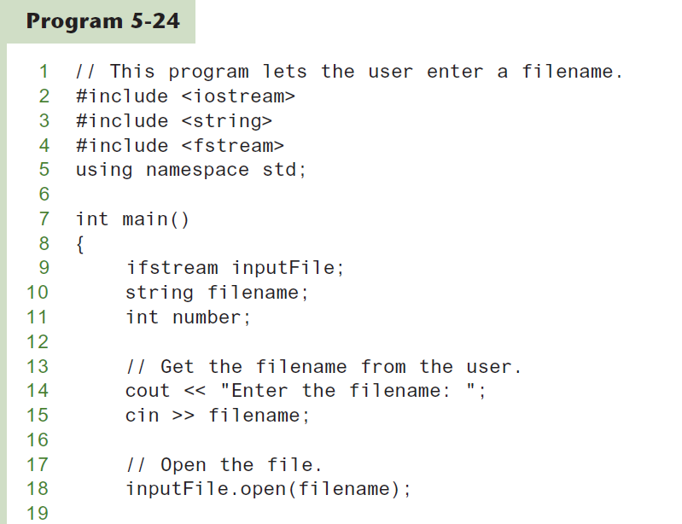
Letting the User Specify a Filename (1 of 3)

Slide 73
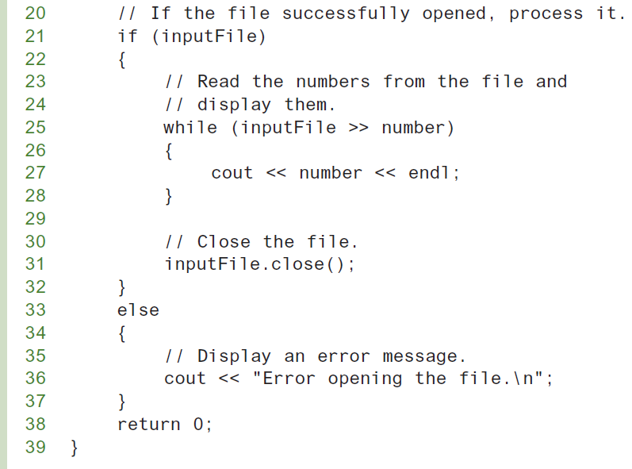
Letting the User Specify a Filename (2 of 3)

Slide 74
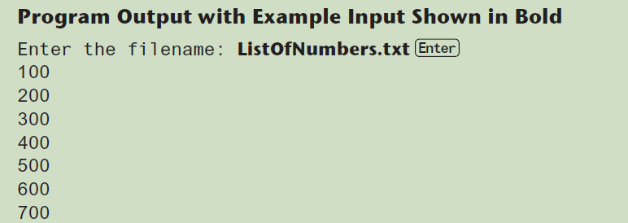
Letting the User Specify a Filename (3 of 3)

Slide 75
Using the c_str Member Function in Older Versions of C++ (1 of 2)
Prior to C++ 11, the open member function requires that you pass the name of the file as a null-terminated string, which is also known as a C-string.
String literals are stored in memory as null-terminated C-strings, but string objects are not.

Slide 76
Using the c_str Member Function in Older Versions of C++ (2 of 2)
string objects have a member function named c_str
It returns the contents of the object formatted as a null-terminated C-string.
Here is the general format of how you call the c_str function:
stringObject.c_str()
Line 18 in Program 5-24 could be rewritten in the following manner:
inputFile.open(filename.c_str());

Slide 77
Breaking Out of a Loop
Can use break to terminate execution of a loop
Use sparingly if at all – makes code harder to understand and debug
When used in an inner loop, terminates that loop only and goes back to outer loop

Slide 78
The continue Statement
Can use continue to go to end of loop and prepare for next repetition
while, do-while loops: go to test, repeat loop if test passes
for loop: perform update step, then test, then repeat loop if test passes
Use sparingly – like break, can make program logic hard to follow

