Slide 1
Characters, C-Strings, and More About the string Class

Slide 2
Character Testing
The C++ library provides several functions that allow developer to test the value of a character. These functions test a single char argument and return either true or false.
To use these functions developer must include the <cctype> header file.
FUNCTION | MEANING
isalpha | true if arg. is a letter, false otherwise
isalnum | true if arg. is a letter or digit, false otherwise
isdigit | true if arg. is a digit 0-9, false otherwise
islower | true if arg. is lowercase letter, false otherwise
isprint | true if arg. is a printable character, false otherwise
ispunct | true if arg. is a punctuation character, false otherwise
isupper | true if arg. is an uppercase letter, false otherwise
isspace | true if arg. is a whitespace character, false otherwise

Slide 3
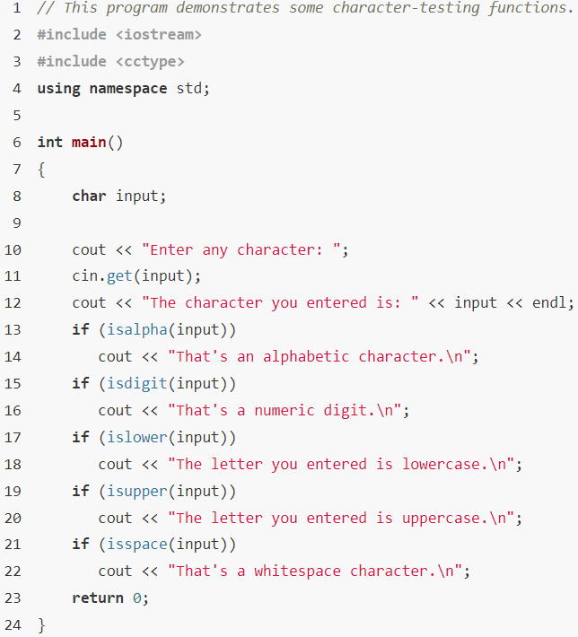
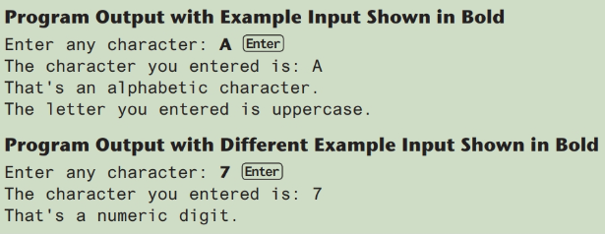
Character Testing Program

Slide 4
Character Case Conversion (1 of 2)
The C++ library offers two functions toupper and tolower, for converting a character to uppercase or lowercase. Each of the functions accepts a single character argument.
Require cctype header file to include
The toupper Function:
toupper: if char argument is lowercase letter, return uppercase equivalent; otherwise, return input unchanged
char ch1 = 'H'; char ch2 = 'e'; char ch3 = '!';
cout << toupper(ch1); // displays 'H'
cout << toupper(ch2); // displays 'E'
cout << toupper(ch3); // displays '!'

Slide 5
Character Case Conversion (2 of 2)
The tolower Function:
tolower: if char argument is uppercase letter, return lowercase equivalent; otherwise, return input unchanged
char ch1 = 'H';
char ch2 = 'e';
char ch3 = '!';
cout << tolower(ch1); // displays 'h'
cout << tolower(ch2); // displays 'e'
cout << tolower(ch3); // displays '!'

Slide 6

C-Strings (1 of 2)
C-string is a sequence of characters stored in adjacent memory locations and terminated by NULL character.
A null character or null terminator is a byte holding the ASCII code 0.
The purpose of the null terminator is to mark the end of the C-string. Without it, there would be no way for a program to know the length of a C-string.
In C++, all string literals are stored in memory as C-strings.
String literal (string constant): sequence of characters enclosed in double quotes " " :
"Hi there!“
NOTE: Remember that \0 (“slash zero”) is the escape sequence representing the null terminator. It stands for the ASCII code 0.

Slide 7
C-Strings (2 of 2)
Array of chars can be used to define storage for string: const int SIZE = 20; char city[SIZE];
Leave room for NULL at the end
Developer can implicitly size a char array by initializing it with a string literal, as shown here:
char name[] = "Jasmine";
After this code executes, the name array will be created with eight elements, initialized with the characters 'J','a', 's', 'm', 'i', 'n', 'e', and '\0'.
C-string input can be performed by using cin object
Input is whitespace-terminated. Allows the user to enter a string (with no whitespace characters)
No check to see if enough space
For input containing whitespace, and to control amount of input, use cin.getline().For example cin.getline(city, SIZE)

Slide 8
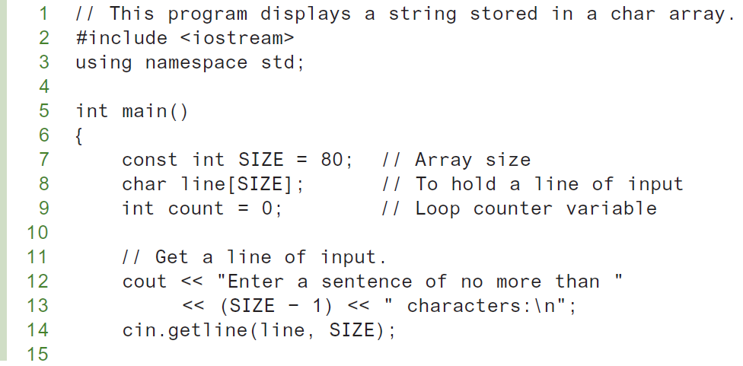
Displaying C-Strings in a Program (1 of 2)
Following program displays a string stored in an array. It uses a loop to display each character in the array until the null terminator is encountered.

Slide 9
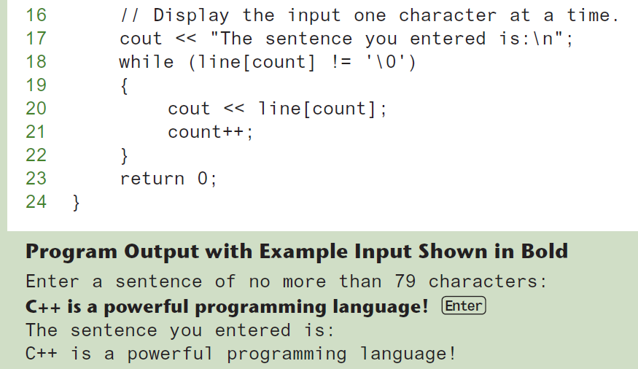
Displaying C-Strings in a Program (2 of 2)

Slide 10
Library Functions for Working with C-Strings (1 of 8)
The C++ library has numerous functions for handling C-strings. These functions perform various tests and manipulations, and require the <cstring> header file be included.
Functions take one or more C-strings as arguments. Can use:
C-string name
pointer to C-string
literal string

Slide 11
Library Functions for Working with C-Strings (2 of 8)
C++ library provides many functions for manipulating and testing C-strings. These functions all require the <cstring> header file to be included.
The strlen Function:
strlen(str)// returns length of C-string str
const int SIZE = 20;
char city[SIZE] = "Missoula";
cout << strlen(city); // prints 8
The length of a string is not to be confused with the size of the array holding it.
Remember, the only information being passed to strlen is the beginning address of a C-string. It doesn’t know where the array ends, so it looks for the null terminator to indicate the end of the string.

Slide 12
Library Functions for Working with C-Strings (3 of 8)
The strcat Function:
The strcat function accepts two pointers to C-strings as its arguments. The function concatenates, or appends second string to the end of first string.
WARNING: If the array holding the first string isn’t large enough to hold both strings, strcat will overflow the boundaries of the array.
It is programmer’s responsibility to make sure the array holding string1 is large enough to hold string1 plus string2 plus a null terminator.
strcat(string1, string2)//appends string2 to the end of string1
const int SIZE = 20
char location[SIZE] = "Missoula, ";
char state[3] = "MT";
strcat(location, state); // location now has "Missoula, MT"

Slide 13
Library Functions for Working with C-Strings (4 of 8)
The strcpy Function:
The strcpy function can be used to copy second argument string to the memory location specified by the first argument, including the null terminator.
If anything is already stored in the location referenced by the first argument, it is overwritten.
The first argument usually references an array.
strcpy(str1, str2)// copies str2 to str1
const int SIZE = 20;
char fname[SIZE] = "Maureen", name[SIZE];
strcpy(name, fname);
Note: strcat and strcpy perform no bounds checking to determine if there is enough space in receiving character array to hold the string it is being assigned.

Slide 14
Library Functions for Working with C-Strings (5 of 8)
The strncat and strncpy Functions:
Because the strcat and strcpy functions can potentially overwrite the bounds of an array, they make it possible to write unsafe code.
As an alternative, programmer should use ­strncat and strncpy whenever possible.
The strncat functions works like strcat, except it takes a third argument specifying the maximum number of characters from the second string to append to the first. Here is an example call to strncat:
strncat(string1, string2, 10);
When this statement executes, strncat will append no more than 10 characters from string2 to string1.
The following code shows an example of calculating the maximum number of characters that can be appended to an array:

Slide 15
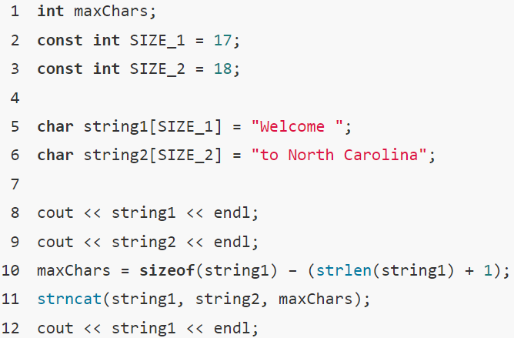
Library Functions for Working with C-Strings (6 of 8)
The statement in line 10 calculates the number of empty elements in string1. It does this by subtracting the length of the string stored in the array plus 1 for the null terminator.

Slide 16
Library Functions for Working with C-Strings (7 of 8)
The strncpy Function:
The strncpy function allows to copy a specified number of characters from a string to a destination. Calling strncpy is similar to calling strcpy, except using a third argument specifying the maximum number of characters from the second string to copy to the first. Here is an example call to strncpy:
strncpy(string1, string2, 5);
When this statement executes, strncpy will copy no more than five characters from string2 to string1.
The following code shows an example of using the strncpy function:

Slide 17
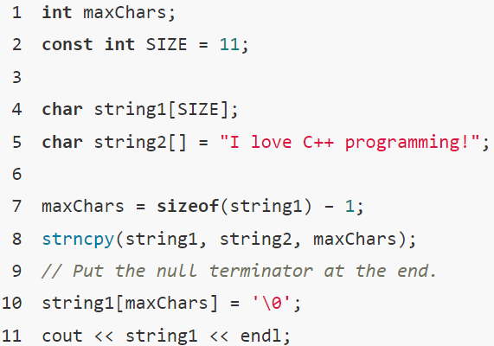
Library Functions for Working with C-Strings (8 of 8)
Notice a statement was written in line 10 to put the null terminator at the end of string1. This is because maxChars was less than the length of string2, and strncpy did not automatically place a null terminator there.

Slide 18
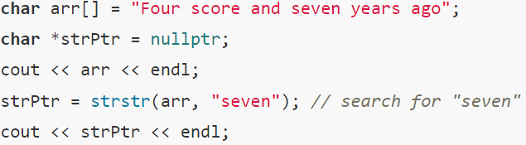
C-string Inside a C-string (1 of 2)
The strstr Function:
strstr(str1, str2)// finds the first occurrence of str2 in str1.
If the function finds the second string inside the first, it returns the address of the occurrence of the second string within the first string. Otherwise, it returns NULL if no match. Here is an example:

Slide 19

C-string Inside a C-string (2 of 2)
In this code, strstr will locate the string “seven” inside the string “Four score and seven years ago.” It will return the address of the first character in “seven” which will be stored in the pointer variable strPtr. If run as part of a complete program, this segment will display the following:

Slide 20
The strcmp Function
Because C-strings are stored in char arrays, relational operators cannot be used to compare two C-strings. To compare C-strings, programmer should use the library function strcmp.
The strcmp function takes two C-strings as arguments and returns an integer that indicates how the two strings compare to each other. Here is the function’s prototype:
int strcmp(char *string1, char *string2);
The function takes two C-strings as parameters (actually, pointers to C-strings) and returns an integer result. The value of the result is set accordingly:
The result is zero if the two strings are equal on a character-by-character basis.
The result is negative if string1 comes before string2 in alphabetical order.
The result is positive if string1 comes after string2 in alphabetical order.

Slide 21
C-String/Numeric Conversion Functions (1 of 2)
The C++ library provides functions for converting C-strings and string objects to numeric data types and vice versa.
Requires <cstdlib> header file
FUNCTION | PARAMETER | ACTION
atoi | C-string | converts C-string to an int value, returns the value
atol | C-string | converts C-string to a long value, returns the value
atof | C-string | converts C-string to a double value, returns the value
itoa | int,C-string, int | converts 1st int parameter to a C-string, stores it in 2nd parameter. 3rd parameter is base of converted value

Slide 22
C-String/Numeric Conversion Functions (2 of 2)
int iNum;
long lNum;
double dNum;
char intChar[10];
iNum = atoi("1234"); // puts 1234 in iNum
lNum = atol("5678"); // puts 5678 in lNum
dNum = atof("35.7"); // puts 35.7 in dNum
itoa(iNum, intChar, 8); // puts the string
// "2322" (base 8 for 1234₁₀) in intChar

Slide 23
C-String/Numeric Conversion Functions - Notes
if C-string contains non-digits, results are undefined
function may return result up to non-digit
function may return 0
itoa does no bounds checking – make sure there is enough space to store the result

Slide 24
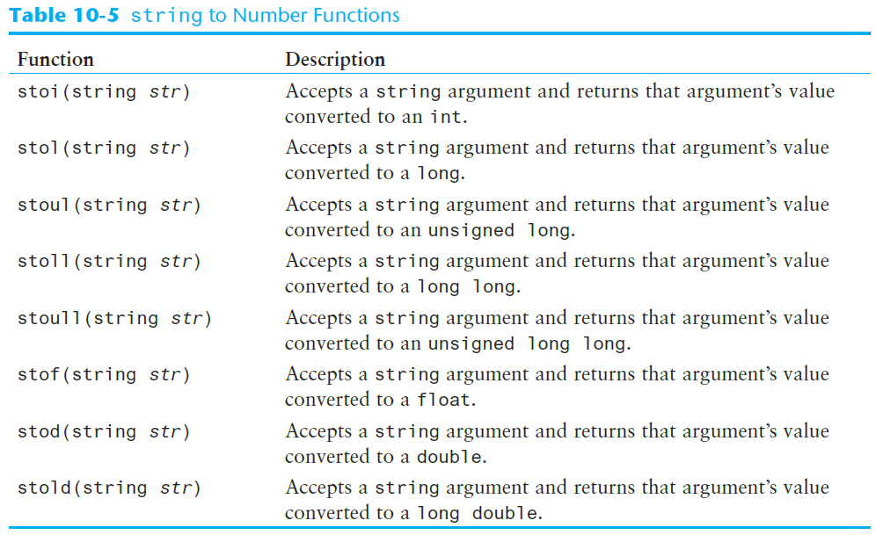
string to Number Conversion

Slide 25
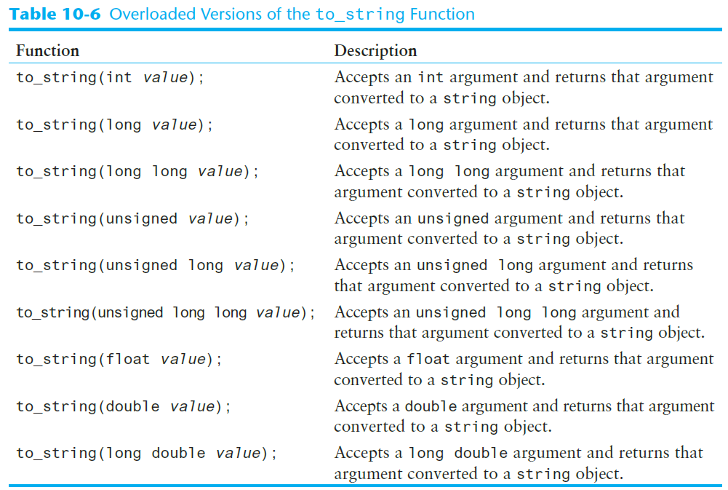
The to_string Function

Slide 26
Writing Your Own C-String Handling Functions
Designing C-String Handling Functions
can pass arrays or pointers to char arrays
Can perform bounds checking to ensure enough space for results
Can anticipate unexpected user input

Slide 27
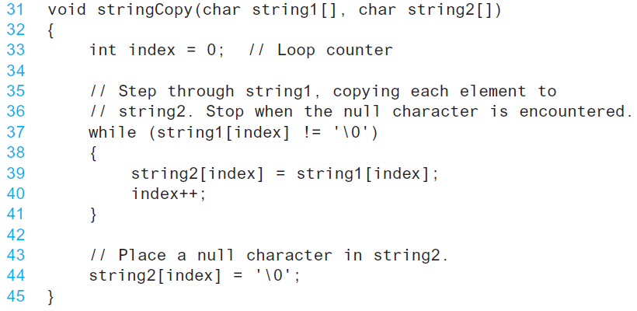
Function to copy a C-String from one array to another array

Slide 28
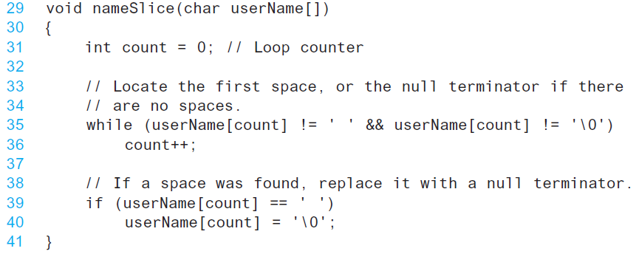
Function to replace space with null terminator

Slide 29
The C++ string Class
Special data type supports working with strings
#include <string>
Can define string variables in programs:
string firstName, lastName;
Can receive values with assignment operator:
firstName = "George";
lastName = "Washington";
Can be displayed via cout
cout << firstName << " " << lastName;

Slide 30
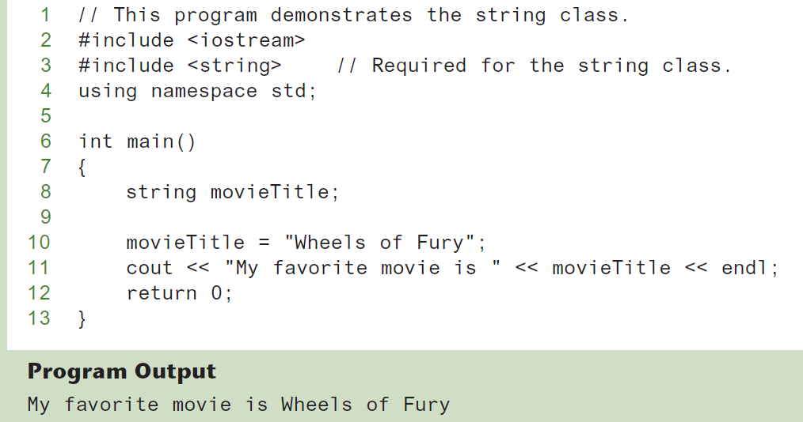
Using the string class in a Program

Slide 31
Input into a string Object (1 of 2)
Use cin >> to read an item into a string:
string firstName;
cout << "Enter your first name:";
cin >> firstName;

Slide 32
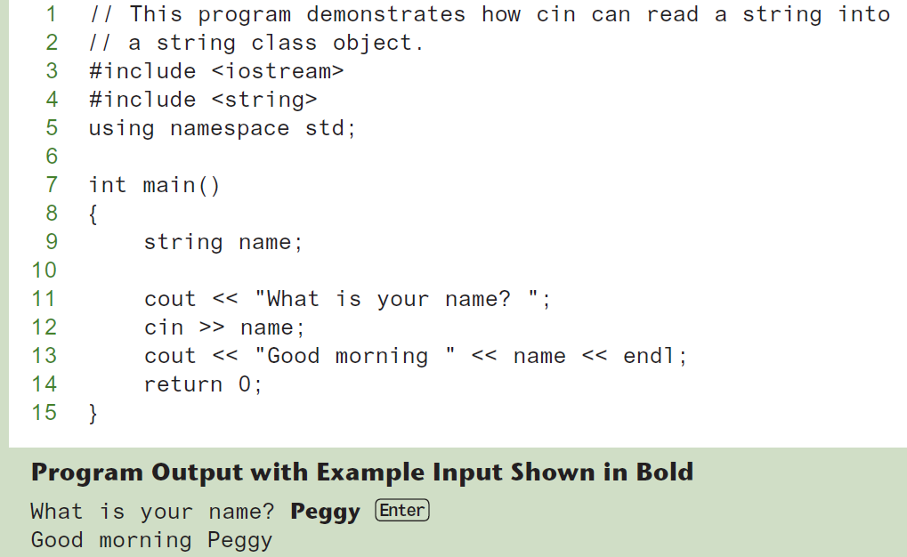
Using cin and string objects

Slide 33
Input into a string Object (2 of 2)
Use getline function to put a line of input, possibly including spaces, into a string:
string address;
cout << "Enter your address:";
getline(cin,address);

Slide 34
string Comparison
Can use relational operators directly to compare string objects:
string str1 = "George",
str2 = "Georgia";
if (str1 < str2)
cout << str1 << " is less than "
<< str2;
Comparison is performed similar to strcmp function. Result is true or false

Slide 35
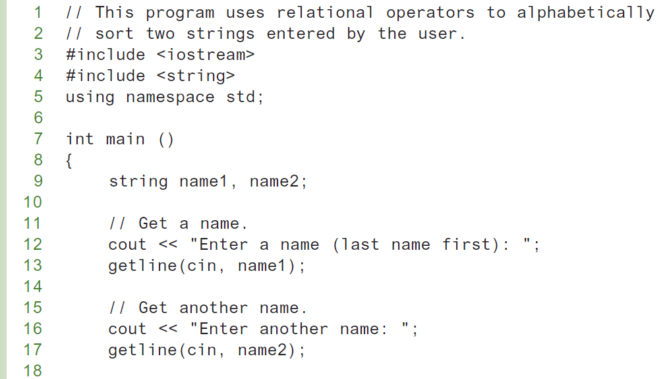
Using relational operators to sort string objects

Slide 36
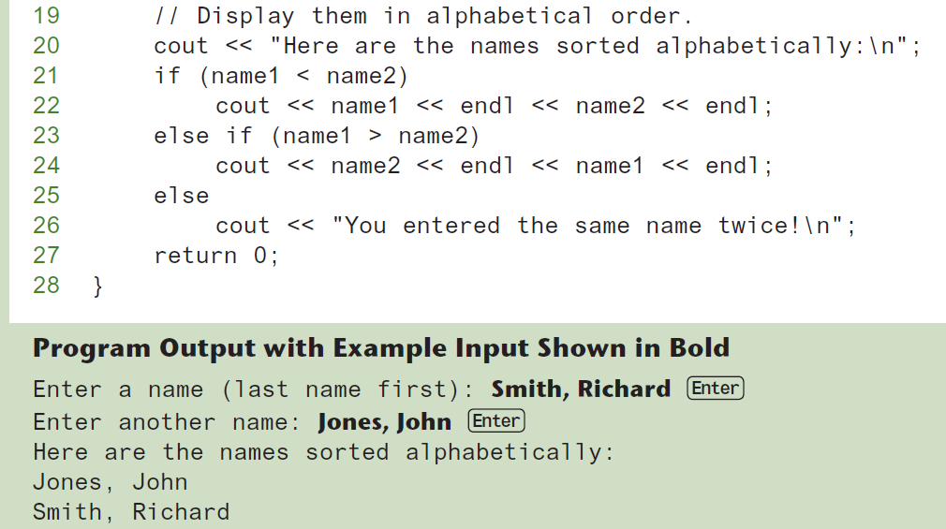
Using relational operators to sort string objects

Slide 37
Other Definitions of C++ strings
There are a variety of ways to initialize a string object when they are defined. Following Table shows several example definitions and describes each.
Definition | Meaning
string name; | defines an empty string object
string myname("Chris"); | defines a string and initializes it
string yourname(myname); | defines a string and initializes it
string aname(myname, 3); | defines a string and initializes it with first 3 characters of myname
string verb(myname,3,2); | defines a string and initializes it with 2 characters from myname starting at position 3
string noname('A', 5); | defines string and initializes it to 5 'A's

Slide 38
Using auto To Define a string Object (1 of 2)
The following statement does not define a string object:
auto str = "Hello World";
This statement defines str as either
const char * or const char[12]

Slide 39
Using auto To Define a string Object (2 of 2)
When using the auto key word to define a string object, append the s suffix to the string literal:
auto str = "Hello World"s;
This statement defines str as a string object

Slide 40
string Operators (1 of 2)
The string class supports several operators, which are described in following table.
OPERATOR | MEANING
>> | extracts characters from stream up to whitespace, insert into string
<< | inserts string into stream
= | assigns string on right to string object on left
+= | appends string on right to end of contents on left
+ | concatenates two strings
[] | references character in string using array notation
>, >=, <, <=, ==, != | relational operators for string comparison. Return true or false

Slide 41
string Operators (2 of 2)
string word1, phrase;
string word2 = "Dog";
cin >> word1; // user enters "Hot "
// word1 has "Hot"
phrase = word1 + word2; // phrase has
// "Hot Dog"
phrase += "on a bun";
for (int i = 0; i < 16; i++)
cout << phrase[i]; // displays
// "Hot Dog on a bun"

Slide 42
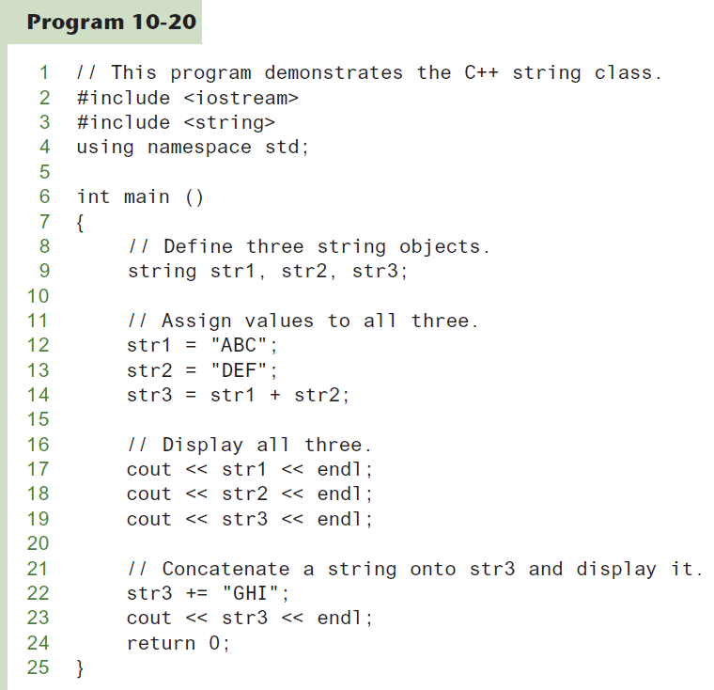
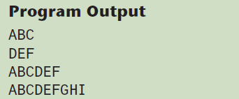
Demonstration of string Operators

Slide 43
string Member Functions (1 of 2)
Are behind many overloaded operators
Categories:
assignment: assign, copy, data
modification: append, clear, erase, insert, replace, swap
space management: capacity, empty, length, resize, size
substrings: find, front, back, at, substr
comparison: compare
See Table 10-8 for a list of functions.

Slide 44
string Member Functions (2 of 2)
string word1, word2, phrase;
cin >> word1; // word1 is "Hot"
word2.assign("Dog");
phrase.append(word1);
phrase.append(word2); // phrase has "Hot Dog"
phrase.append("with mustard relish", 13);
// phrase has "Hot Dog with mustard"
phrase.insert(8, "on a bun");
cout << phrase << endl; // displays
// "Hot Dog on a bun with mustard"

Slide 45
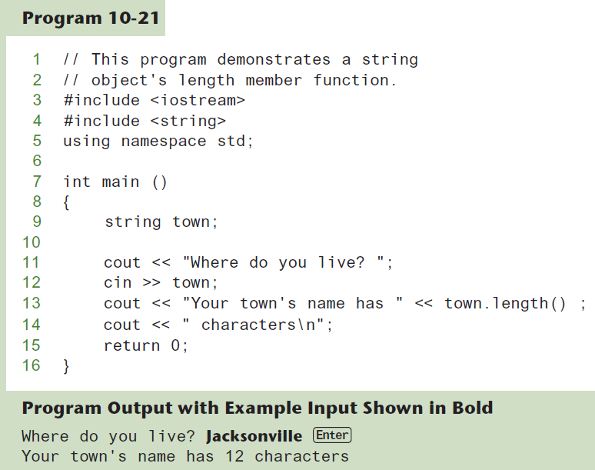
string Member Functions in Program

