Slide 1
Pointers

Slide 2
Getting the Address of a Variable
Each variable in program is stored at a unique memory location which has a unique memory address
Every variable is allocated a section of memory large enough to hold a value of the variable’s data type. On a PC, for instance, it’s common for 1 byte to be allocated for chars, 2 bytes for shorts, 4 bytes for ints, longs, and floats, and 8 bytes for doubles.
Each byte of memory has a unique address. A variable’s address is the address of the first byte allocated to that variable.
Use address operator & to get address of a variable:
int num = -99;
cout << &num; // prints address in hexadecimal

Slide 3
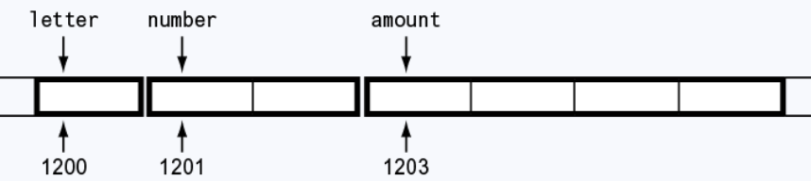
Address of a Variable
Suppose the following variables are defined in a program:
char letter;
short number;
float amount;
Following figure illustrates how they might be arranged in memory and shows their addresses.
Note: The addresses of the variables shown here, are arbitrary values used only for illustration purposes.

Slide 4
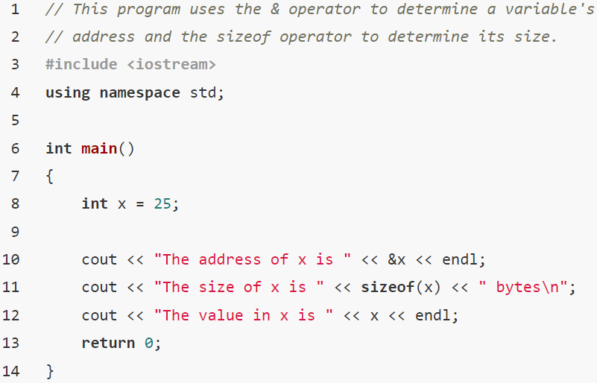

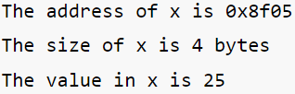
Address of a Variable
Following program demonstrates the use of the address operator to display the address, size, and contents of a variable.
Note: The address of the variable x is displayed in hexadecimal. This is the way addresses are normally shown in C++.

Slide 5
Pointer Variables
Pointer variable : Often just called a pointer, it's a special variable that holds an address of a memory location
Because a pointer variable holds the address of another piece of data, it "points" to some piece the data
Pointer variables also allow programmer to work with the data that they point to.

Slide 6
Something Like Pointers: Arrays
We have already worked with something similar to pointers, when we learned to pass arrays as arguments to functions.
For example, suppose we use this statement to pass the array numbers to the showValues function:
showValues(numbers, SIZE);

Slide 7
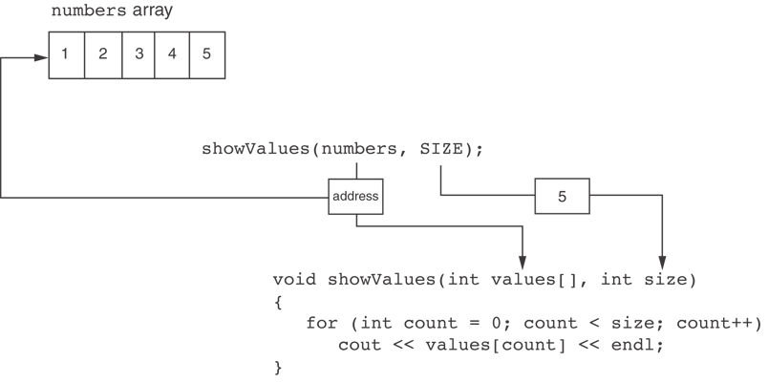
Something Like Pointers : Arrays
The values parameter, in the showValues function, points to the numbers array.
C++ automatically stores the address of numbers in the values parameter.
In the function, the values parameter receives the address of the numbers array.

Slide 8
Something Like Pointers: Reference Variables (1 of 3)
We have also worked with something like pointers when we learned to use reference variables.
A reference variable acts as an alias for another variable. It is called a reference variable because it references another variable in the program. Anything we do to the reference variable is actually done to the variable it references.
Suppose we have this function:
void getOrder(int &donuts) {
cout << "How many doughnuts do you want? "; cin >> donuts;
}
And we call it with this code: int jellyDonuts; getOrder(jellyDonuts);

Slide 9
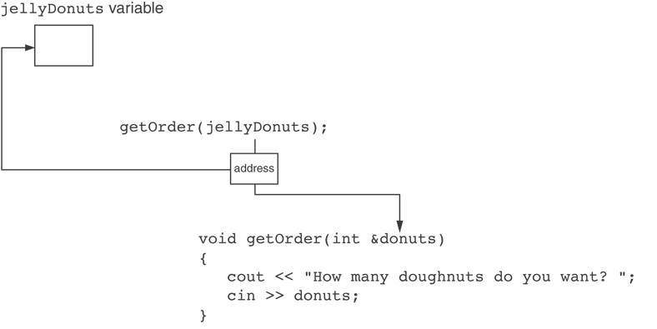
Something Like Pointers: Reference Variables (2 of 3)
The donuts parameter, in the getOrder function, points to the jellyDonuts variable.
C++ automatically stores the address of jellyDonuts in the donuts parameter.

Slide 10
Something Like Pointers: Reference Variables (3 of 3)
Inside the getOrder function, the donuts parameter references the jellyDonuts variable. Anything done to the donuts parameter is actually done to the jellyDonuts variable.
When the user enters a value, the cin statement uses the donuts reference variable to indirectly store the value in the jellyDonuts variable.
Notice the connection between the donuts reference variable and the jellyDonuts argument is automatically established by C++ when the function is called.
When programmer is writing this code, he don’t have to go through the trouble of finding the memory address of the jellyDonuts variable then properly storing that address in the donuts reference ­variable.
When programmer is storing a value in the donuts variable, he don’t have to specify that the value should actually be stored in the jellyDonuts variable. C++ handles all of that automatically.

Slide 11
Pointer Variables (1 of 4)
Pointer variables are yet another way using a memory address to work with a piece of data.
Pointer variables are similar to arrays and reference variables, but pointer variables operate at amore "low-level" than arrays and reference variables.
This means that C++ does not automatically do as much work for the programmer with pointer variables as it does with reference variables.
In order to make a pointer variable reference another item in memory, programmers are responsible for finding the address they want to store in the pointer and correctly using it.
Programmer’s code has to specify that the value should be stored in the location referenced by the pointer variable, and not in the pointer variable itself.

Slide 12
Pointer Variables (2 of 4)
Definition of a pointer variable looks much like any other definition.
int *intptr;
The asterisk in front of the variable name indicates that intptr is a pointer variable. The int data type indicates that intptr can be used to hold the address of an integer variable.
Read as:
“intptr can hold the address of an int”
Spacing in definition does not matter:
int * intptr; // same as above
int* intptr; // same as above

Slide 13
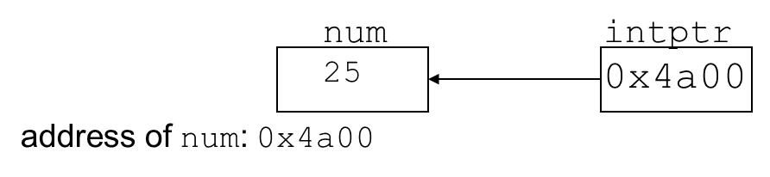
Pointer Variables (3 of 4)
Assigning an address to a pointer variable:
int *intptr;
intptr = &num;
Memory layout:

Slide 14
Pointer Variables (4 of 4)
Initialize pointer variables with the special value nullptr.
In C++ 11, the nullptr key word was introduced to represent the address 0.
With older compiler that does not support the C++ 11 standard, pointer variables should be initialize with the integer 0, or the value NULL.
The value NULL is defined in the <iostream> header file (as well as other header files) to represent the value 0.
Here is an example of how to define a pointer variable and initialize it with the value nullptr:
int *ptr = nullptr;

Slide 15
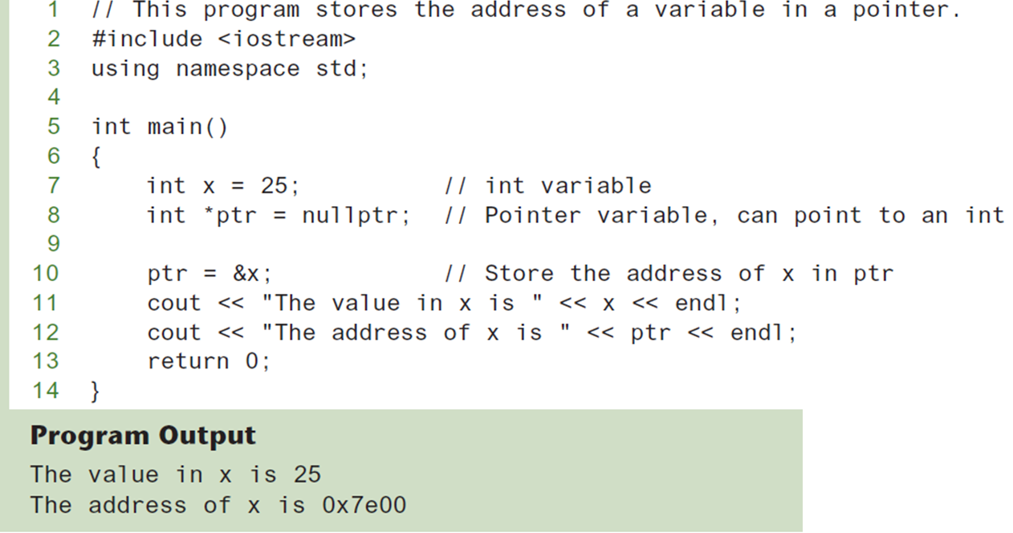
Program Example of Pointer Variable

Slide 16
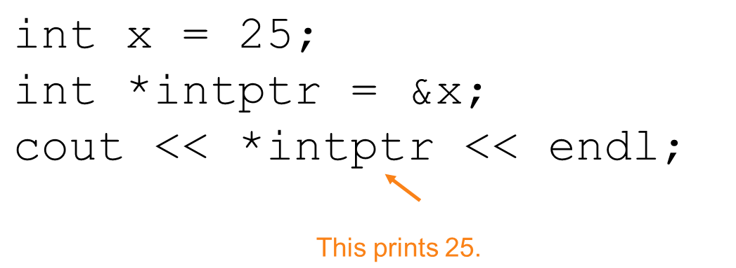
The Indirection Operator
Pointer could be used to change the contents of the variable.
The indirection operator (*) dereferences a pointer. When the indirection operator is placed in front of a pointer variable name, it dereferences the pointer.
It allows you to access the item that the pointer points to.

Slide 17
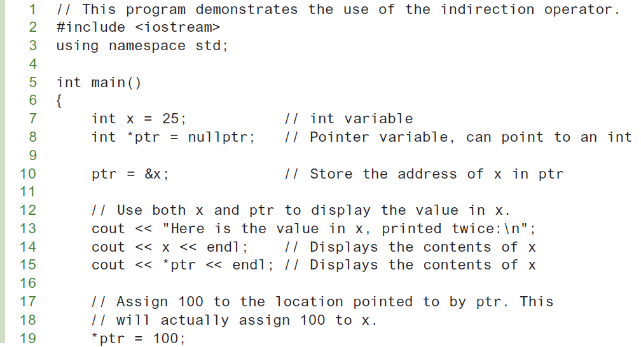
Program Example of Indirection Operator (1 of 2)

Slide 18
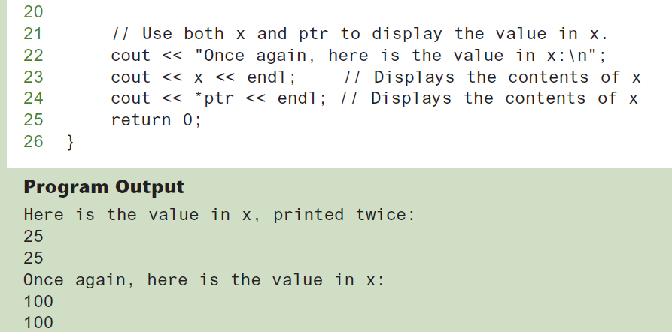
Program Example of Indirection Operator (2 of 2)

Slide 19
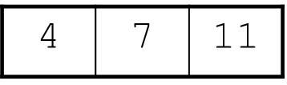
The Relationship Between Arrays and Pointers (1 of 2)
Array name, without brackets and a subscript, actually represents the starting address of array
int vals[] = {4, 7, 11};
starting address of vals: 0x4a00
cout << vals; // displays
// 0x4a00
cout << vals[0]; // displays 4

Slide 20
The Relationship Between Arrays and Pointers (2 of 2)
Array name can be used as a pointer constant:
int vals[] = {4, 7, 11};
cout << *vals; // displays 4
Pointer can be used as an array name:
int *valptr = vals;
cout << valptr[1]; // displays 7

Slide 21
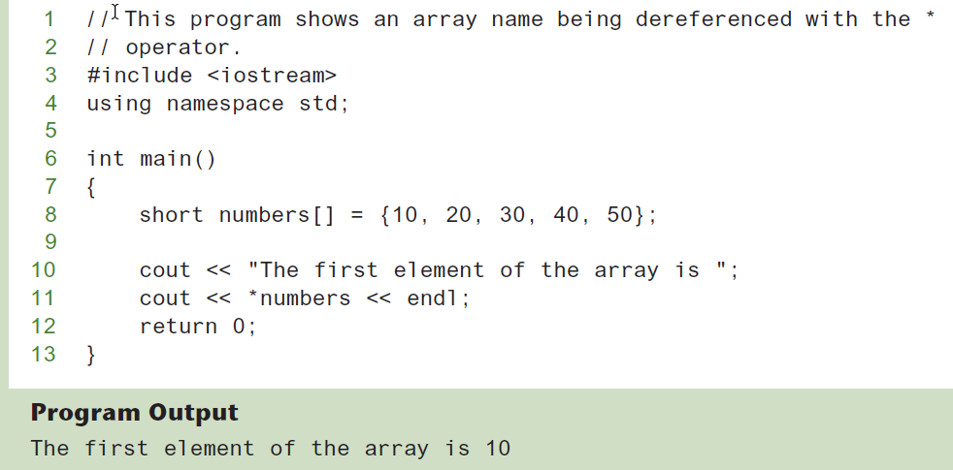
The Array Name Being Dereferenced

Slide 22
Pointers in Expressions
Given:
int vals[]={4,7,11}, *valptr;
valptr = vals;
What is valptr + 1? It means (address in valptr) + (1 * size of an int)
cout << *(valptr+1); //displays 7
cout << *(valptr+2); //displays 11
Must use ( ) as shown in the expressions
NOTE: The parentheses are critical when adding values to pointers. The * operator has precedence over the + operator, so the expression *number + 1 is not equivalent to *(number + 1). *number + 1 adds one to the contents of the first element of the array, while *(number + 1) adds one to the address in number, then dereferences it.

Slide 23
Array Access (1 of 2)
Array elements can be accessed in many ways:
When working with arrays, remember the following rule:
array[index] is equivalent to *(array + index)
Array access method | Example
array name and [] | vals[2] = 17;
pointer to array and [] | valptr[2] = 17;
array name and subscript arithmetic | *(vals + 2) = 17;
pointer to array and subscript arithmetic | *(valptr + 2) = 17;

Slide 24
Array Access (2 of 2)
Conversion: vals[i] is equivalent to *(vals + i)
No bounds checking performed on array access, whether using array name or a pointer
WARNING: Remember that C++ performs no bounds checking with arrays. When stepping through an array with a pointer, it’s possible to give the pointer an address outside of the array.

Slide 25
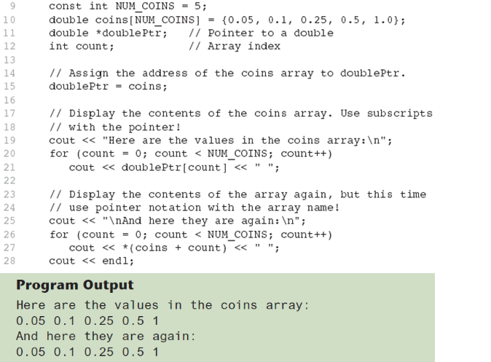
Example of Close Relationship Between Array Name and Pointer

Slide 26
Pointer Arithmetic
Operations on pointer variables:
Operation | Example int vals[]={4,7,11}; int *valptr = vals;
++, −− | valptr++; // points at 7 valptr--; // now points at 4
+, − (pointer and int) | cout << *(valptr + 2); // 11
+=, −= (pointer and int) | valptr = vals; // points at 4 valptr += 2; // points at 11
− (pointer from pointer) | cout << valptr–val; // difference //(number of ints) between valptr // and val

Slide 27
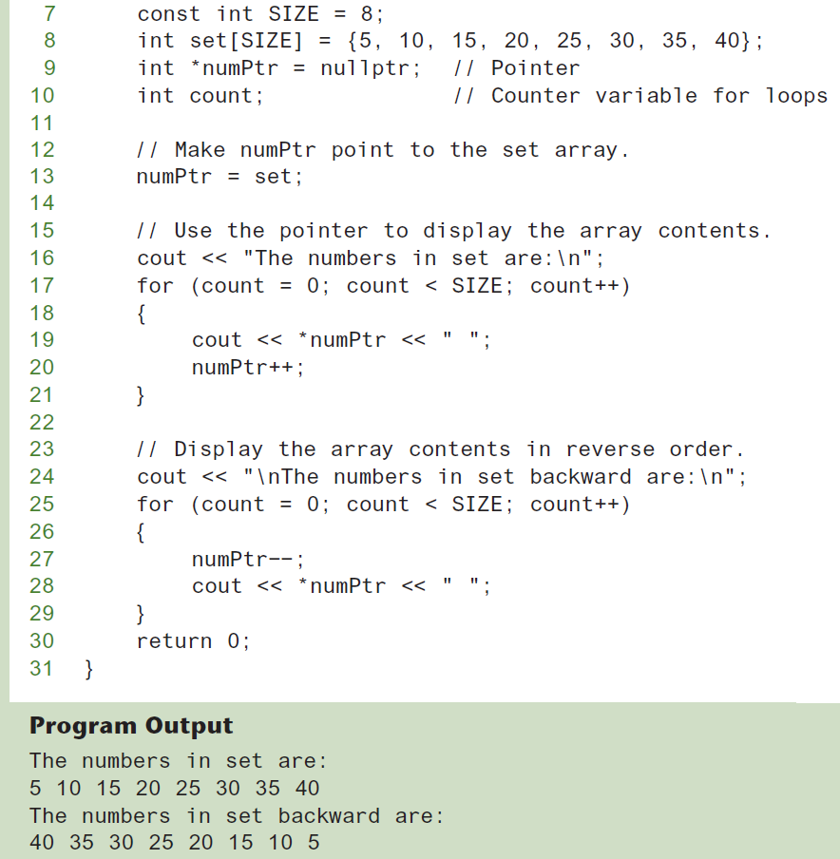
Example of Pointer Arithmetic

Slide 28
Initializing Pointers
Can initialize at definition time:
int num, *numptr = &num;
int val[3], *valptr = val;
A pointer can only be initialized with the address of an object that has already been defined. The following is illegal, because pint is being initialized with the address of an object that does not exist yet:
int *pint = &myValue; // Illegal!
int myValue;
Cannot mix data types:
double cost;
int *ptr = &cost; // won’t work
Can test for an invalid address for ptr with:
if (!ptr) ...

Slide 29
Comparing Pointers
C++ relational operators (>, <, >=, <=, ==, !=) can be used to compare addresses in pointers
If one address comes before another address in memory, the first address is considered “less than” the second.
Comparing addresses in pointers is not the same as comparing contents pointed at by pointers:
The following if statement compares the addresses stored in the pointer variables ptr1 and ptr2:
if (ptr1 == ptr2) // compares addresses
The following if statement, compares the values that ptr1 and ptr2 point to:
if (*ptr1 == *ptr2) // compares contents

Slide 30
Pointers as Function Parameters
A pointer can be a function parameter
Works like reference variable to allow change to argument from within function
Requires:
asterisk * on parameter in prototype and heading
void getNum(int *ptr); // ptr is pointer to an int
asterisk * in body to dereference the pointer
cin >> *ptr;
address as argument to the function
getNum(&num); // pass address of num to getNum

Slide 31
Example of Pointers as Function Parameters
void swap(int *x, int *y)
{ int temp;
temp = *x;
*x = *y;
*y = temp;
}
int num1 = 2, num2 = −3;
swap(&num1, &num2);

Slide 32
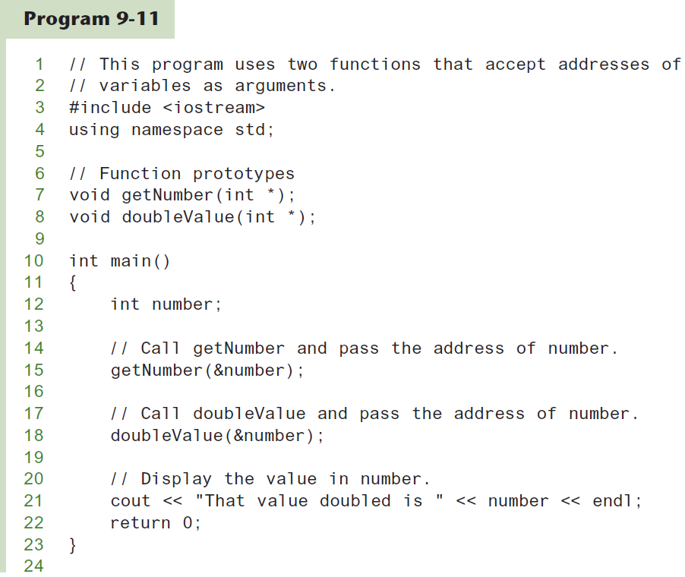
Pointers as Function Parameters (1 of 2)

Slide 33
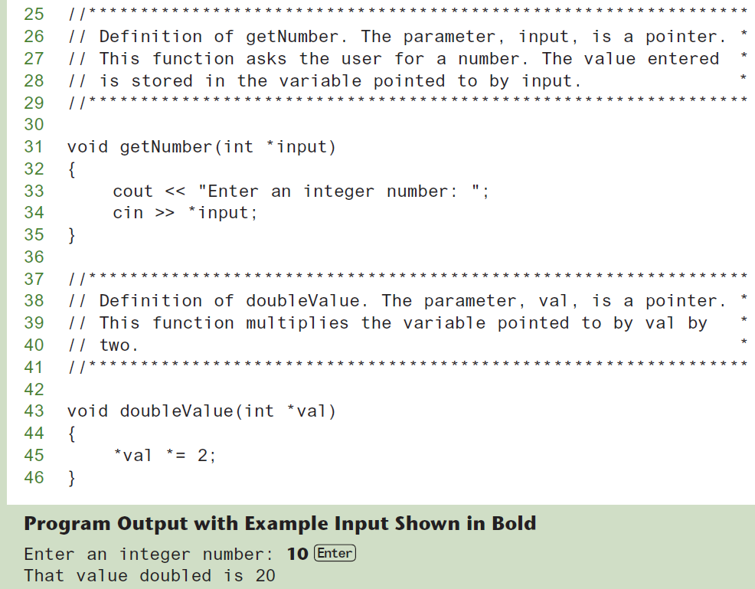
Pointers as Function Parameters (2 of 2)

Slide 34
Pointers to Constants (1 of 3)
If we want to store the address of a constant in a pointer, then we need to store it in a pointer-to-const.

Slide 35
Pointers to Constants (2 of 3)
Example: Suppose we have the following definitions:
const int SIZE = 6; const double payRates[SIZE] =
{ 18.55, 17.45, 12.85,
14.97, 10.35, 18.89 };
In this code, payRates is an array of constant doubles.

Slide 36
Pointers to Constants (3 of 3)
Suppose we wish to pass the payRates array to a function? Here's an example of how we can do it.
void displayPayRates(const double *rates, int size) {
for (int count = 0; count < size; count++) {
cout << "Pay rate for employee " << (count + 1)
<< " is $" << *(rates + count) << endl;
}
}
The parameter, rates, is a pointer to const double.

Slide 37
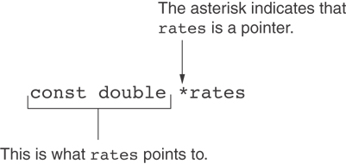
Declaration of a Pointer to Constant
rates is a pointer to const double
Although a constant’s address can be passed only to a pointer to const, a pointer to const can also receive the address of a nonconstant item.

Slide 38
Constant Pointers (1 of 2)
const key word can also be used to define a constant pointer.
A constant pointer is a pointer that is initialized with an address, and cannot point to anything else.
Following are the differences between a pointer to const and a const pointer:
A pointer to const points to a constant item. The data that the pointer points to cannot change, but the pointer itself can change.
While a const pointer, it is the pointer itself that is constant. Once the pointer is initialized with an address, it cannot point to anything else.
The following code shows an example of a const pointer:
int value = 22; int * const ptr = &value;

Slide 39
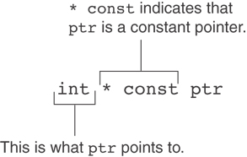
Constant Pointers (2 of 2)
ptr is a const pointer to int
Constant pointers must be initialized with a starting value.
If a constant pointer is used as a function parameter, the parameter will be initialized with the address that is passed as an argument into the function, and cannot be changed to point to anything else while the function is executing.

Slide 40
Constant Pointers to Constants (1 of 2)
A constant pointer to a constant is:
a pointer that points to a constant
a pointer that cannot point to anything except what it is pointing to
Example: int value = 22; const int * const ptr = &value;
In this code, ptr is a const pointer to a const int. Notice the word const appears before int, indicating that ptr points to a const int, and it appears after the asterisk, indicating that ptr is a constant pointer.

Slide 41
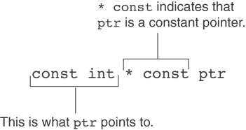
Constant Pointers to Constants (2 of 2)
ptr is a const pointer to const int

Slide 42
Dynamic Memory Allocation (1 of 2)
Can allocate storage for a variable while program is running
Computer returns address of newly allocated variable
Uses new operator to allocate memory:
double *dptr = nullptr;
dptr = new double;
new returns address of memory location

Slide 43
Dynamic Memory Allocation (2 of 2)
Programmer allow the program to create its own variables “on the fly.” This is called dynamic memory allocation, and is only possible through the use of pointers.
C++ program requests dynamically allocated memory through the new operator. const int SIZE = 25; double *arrayPtr = new double[SIZE];
Can then use [] or pointer arithmetic to access array:
for(i = 0; i < SIZE; i++)
*arrayptr[i] = i * i;
or
for(i = 0; i < SIZE; i++)
*(arrayptr + i) = i * i;
C++ throws an exception and terminates the program, if not enough memory available to allocate

Slide 44
Releasing Dynamic Memory
When a program is finished using a dynamically allocated chunk of memory, it should release it for future use. Use delete operator to free dynamic memory that was allocated with new operator.
Following is an example of how delete is used to free a single variable, pointed to by fptr:
delete fptr;
If arrayptr points to a dynamically allocated array, the [] symbol must be placed between delete and arrayptr:
delete [] arrayptr;
Only use delete with pointers holding address of dynamic memory.
Failure to release dynamically allocated memory can cause a program to have a memory leak.

Slide 45
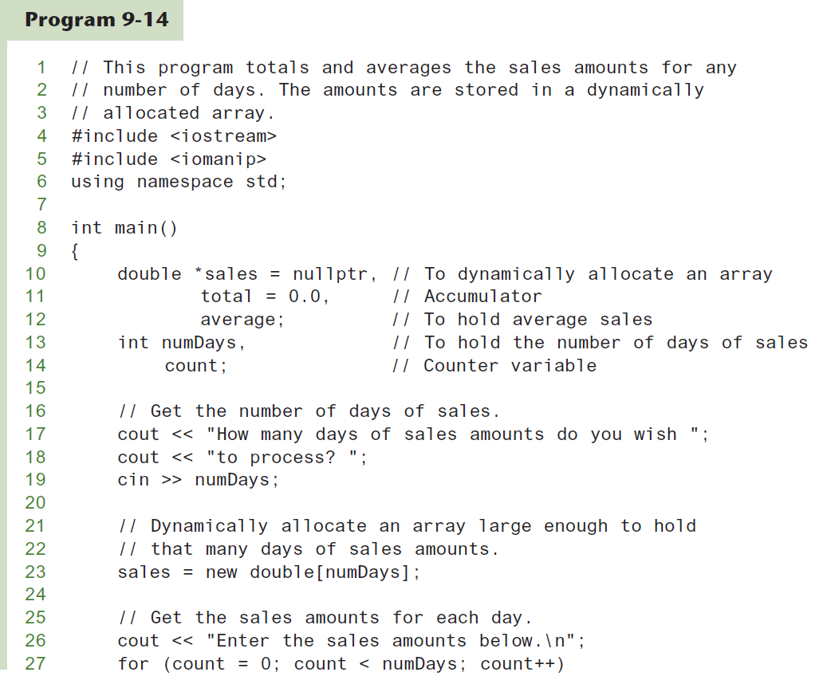
Dynamic Memory Allocation (1 of 3)

Slide 46
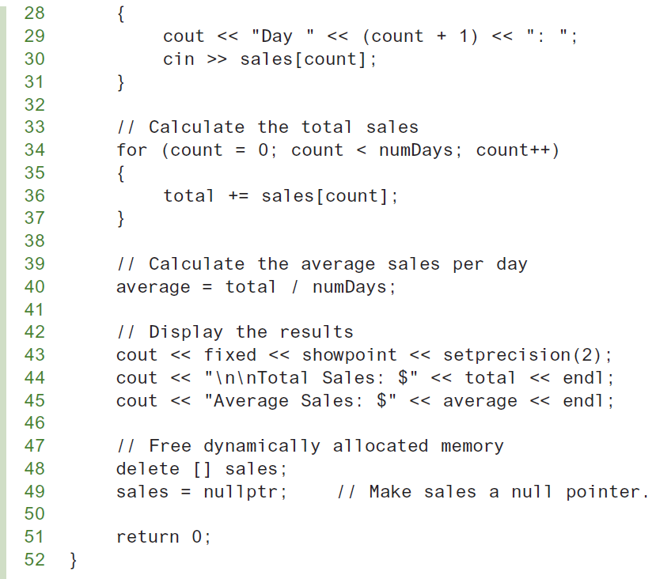
Dynamic Memory Allocation (2 of 3)

Slide 47
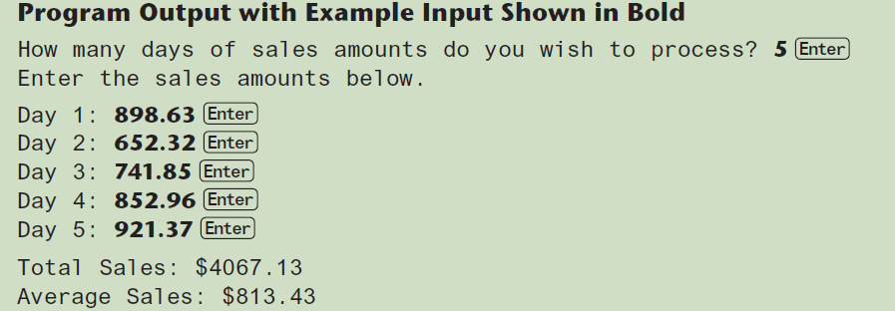
Dynamic Memory Allocation (3 of 3)
Notice that in line 49 nullptr is assigned to the sales pointer. The delete operator is designed to have no effect when used on a null pointer.

Slide 48
Returning Pointers from Functions
Like any other data type, functions may return pointers.
Pointer can be the return type of a function:
int* newNum();
The function must not return a pointer to a local variable in the function.
A function should only return a pointer:
to data that was passed to the function as an argument, or
to dynamically allocated memory

Slide 49
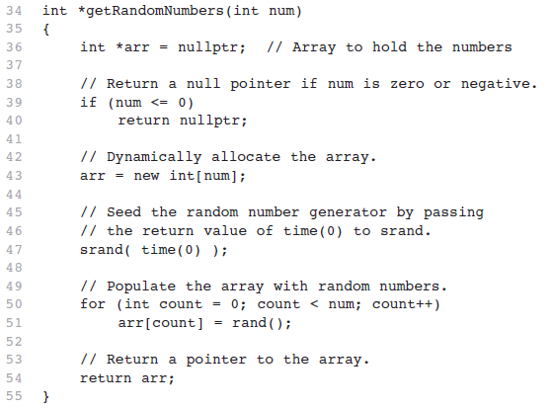
Pointer Returning Function Example

Slide 50
Using Smart Pointers to Avoid Memory Leaks (1 of 2)
C++ 11 introduced smart pointers, objects that work like pointers, but have the ability to automatically delete dynamically allocated memory that is no longer being used.
A smart pointer automatically deletes a chunk of dynamically allocated memory when the memory is no longer being used. This helps to prevent memory leaks from occurring.
Modern C++ provides three types of smart pointer:
unique_ptr
shared_ptr
weak_ptr
To use any of the smart pointers, must #include the memory header file:
#include <memory>
In this book, we introduce unique_ptr:
unique_ptr<int> ptr( new int );

Slide 51
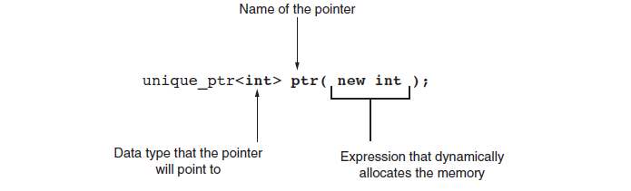
Using Smart Pointers to Avoid Memory Leaks (2 of 2)
The notation <int> indicates that the pointer can point to an int .
The name of the pointer is ptr .
The expression new int allocates a chunk of memory to hold an int.
The address of the chunk of memory will be assigned to ptr.

Slide 52
Smart Pointer Types
Smart Pointer Type | Description
unique_ptr | A unique_ptr is the sole owner of a piece of dynamically allocated memory. No two unique_ptrs can point to the same piece of memory. When a unique_ptr goes out of scope, it automatically deallocates the piece of memory that it points to.
shared_ptr | A shared_ptr can share ownership of a piece of dynamically allocated memory. Multiple pointers of the shared_ptr type can point to the same piece of memory. The memory is deallocated when the last shared_ptr that is pointing to it is destroyed.
weak_ptr | A weak_ptr does not own the memory it points to, and cannot be used to access the memory’s contents. It is used in special situations where the memory pointed to by a shared_ptr must be referenced without increasing the number of shared_ptrs that own it.

Slide 53
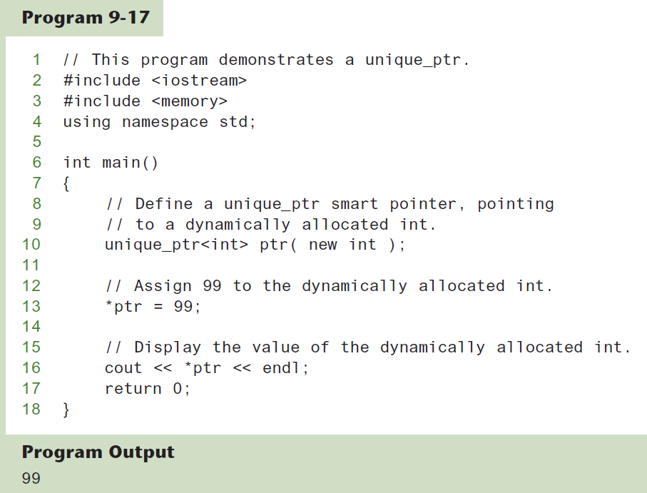
Using Smart Pointers Example

