Slide 1
Inheritance, Polymorphism, and Virtual Functions

Slide 2
What Is Inheritance?
Provides a way to create a new class from an existing class
The new class is a specialized version of the existing class

Slide 3
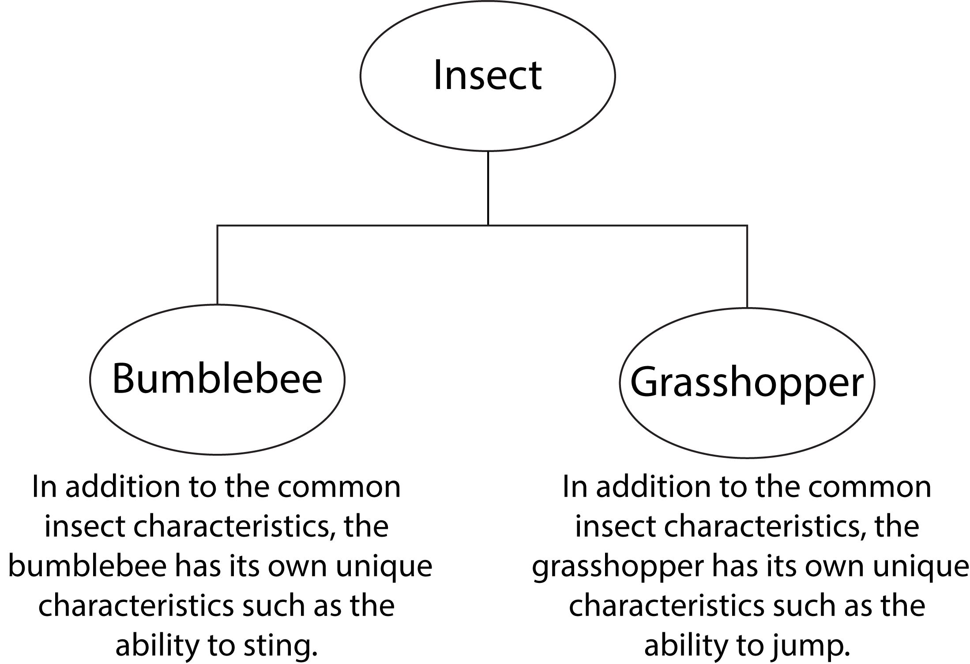
Example: Insects

Slide 4
The "is a" Relationship
Inheritance establishes an "is a" relationship between classes.
A poodle is a dog
A car is a vehicle
A flower is a plant
A football player is an athlete

Slide 5
Inheritance – Terminology and Notation
Base class (or parent) – inherited from
Derived class (or child) – inherits from the base class
Notation:
class Student // base class
{
. . .
};
class UnderGrad : public student
{ // derived class
. . .
};

Slide 6
Back to the ‘is a’ Relationship
An object of a derived class 'is a(n)' object of the base class
Example:
an UnderGrad is a Student
a Mammal is an Animal
A derived object has all of the characteristics of the base class

Slide 7
What Does a Child Have?
An object of the derived class has:
all members defined in child class
all members declared in parent class
An object of the derived class can use:
all public members defined in child class
all public members defined in parent class

Slide 8
Protected Members and Class Access
protected member access specification: like private, but accessible by objects of derived class
Class access specification: determines how private, protected, and public members of base class are inherited by the derived class

Slide 9
Class Access Specifiers
public – object of derived class can be treated as object of base class (not vice-versa)
protected – more restrictive than public, but allows derived classes to know details of parents
private – prevents objects of derived class from being treated as objects of base class.

Slide 10
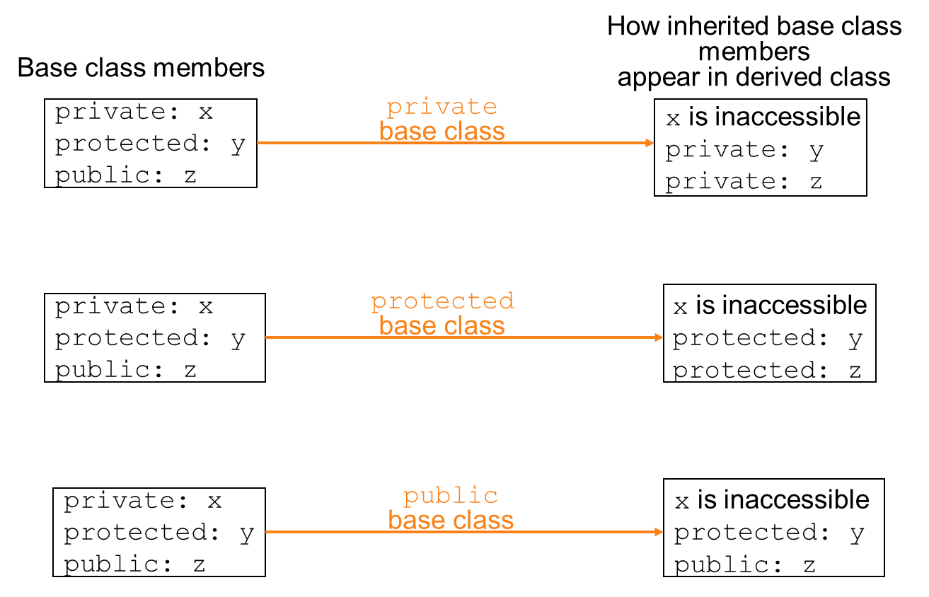
Inheritance vs. Access

Slide 11
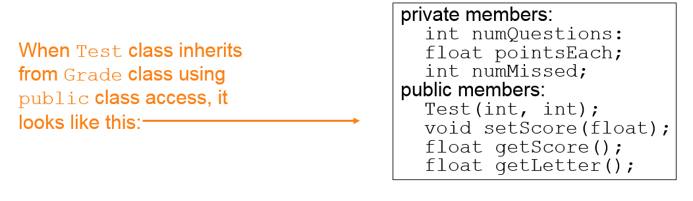
More Inheritance vs. Access
class Grade
private members:
char letter;
float score;
void calcGrade();
public members:
void setScore(float);
float getScore();
char getLetter();
class Test : public Grade
private members:
int numQuestions;
float pointsEach;
int numMissed;
public members:
Test(int, int);

Slide 12
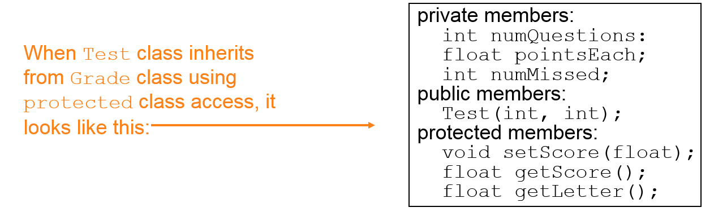
More Inheritance vs. Access (2)
class Grade
private members:
char letter;
float score;
void calcGrade();
public members:
void setScore(float);
float getScore();
char getLetter();
class Test : protected Grade
private members:
int numQuestions;
float pointsEach;
int numMissed;
public members:
Test(int, int);

Slide 13
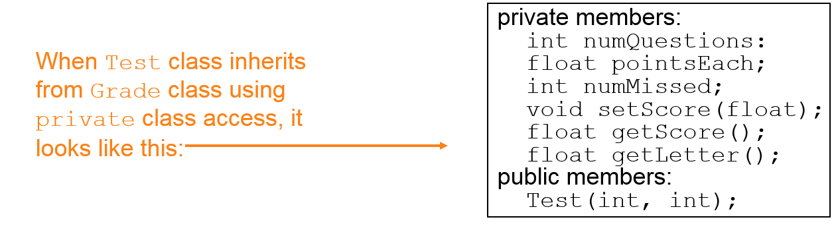
More Inheritance vs. Access (3)
class Grade
private members:
char letter;
float score;
void calcGrade();
public members:
void setScore(float);
float getScore();
char getLetter();
class Test : private Grade
private members:
int numQuestions;
float pointsEach;
int numMissed;
public members:
Test(int, int);

Slide 14
Constructors and Destructors in Base and Derived Classes (1 of 4)
Derived classes can have their own constructors and destructors
When an object of a derived class is created, the base class’s constructor is executed first, followed by the derived class’s constructor
When an object of a derived class is destroyed, its destructor is called first, then that of the base class

Slide 15
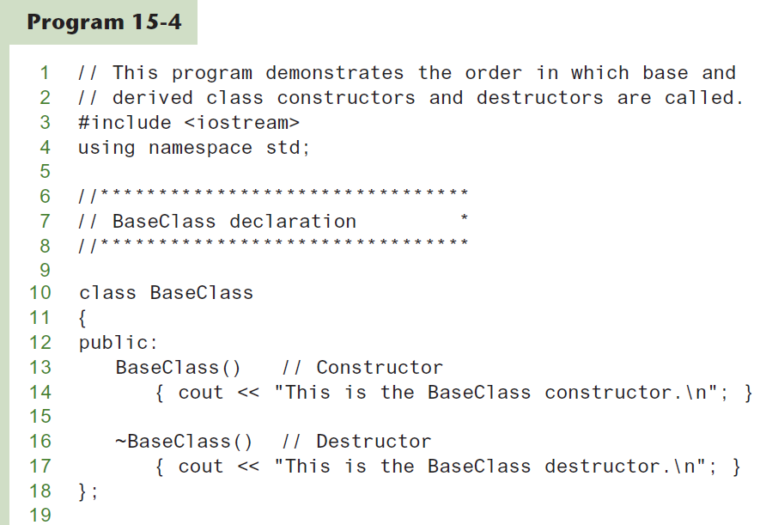
Constructors and Destructors in Base and Derived Classes (2 of 4)

Slide 16
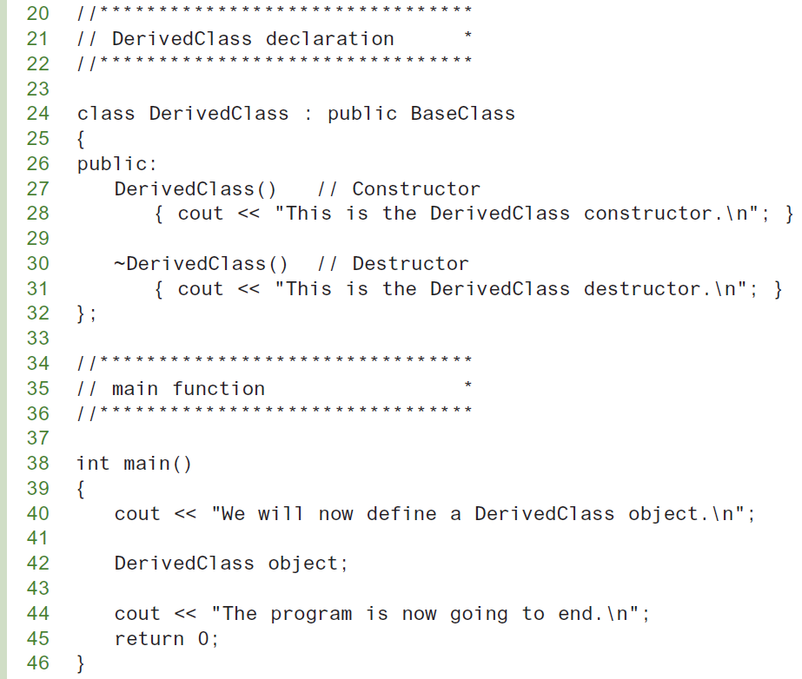
Constructors and Destructors in Base and Derived Classes (3 of 4)

Slide 17
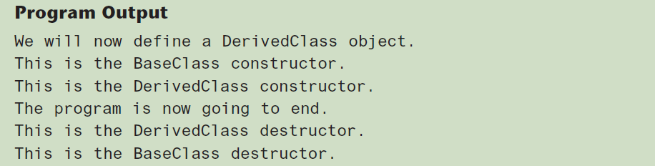
Constructors and Destructors in Base and Derived Classes (4 of 4)

Slide 18
Passing Arguments to Base Class Constructor (1 of 2)
Allows selection between multiple base class constructors
Specify arguments to base constructor on derived constructor heading:
Square::Square(int side) :
Rectangle(side, side)
Can also be done with inline constructors
Must be done if base class has no default constructor

Slide 19
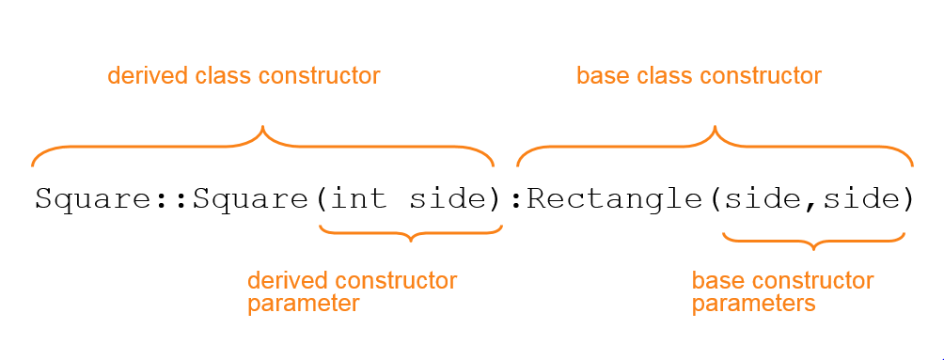
Passing Arguments to Base Class Constructor (2 of 2)

Slide 20
Constructor Inheritance (1 of 3)
In a derived class, some constructors can be inherited from the base class.
The constructors that cannot be inherited are:
the default constructor
the copy constructor
the move constructor

Slide 21
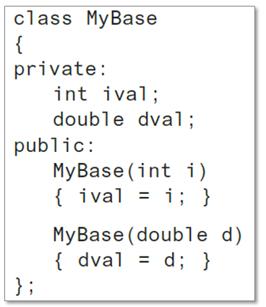
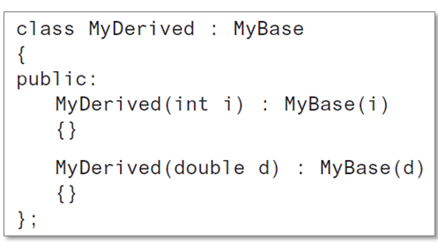
Constructor Inheritance (2 of 3)
Consider the following:

Slide 22
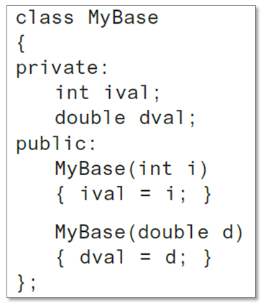
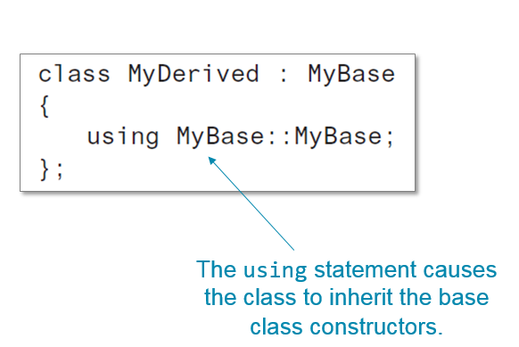
Constructor Inheritance (3 of 3)
We can rewrite the MyDerived class as:

Slide 23
Redefining Base Class Functions (1 of 2)
Redefining function: function in a derived class that has the same name and parameter list as a function in the base class
Typically used to replace a function in base class with different actions in derived class

Slide 24
Redefining Base Class Functions (2 of 2)
Not the same as overloading – with overloading, parameter lists must be different
Objects of base class use base class version of function; objects of derived class use derived class version of function

Slide 25
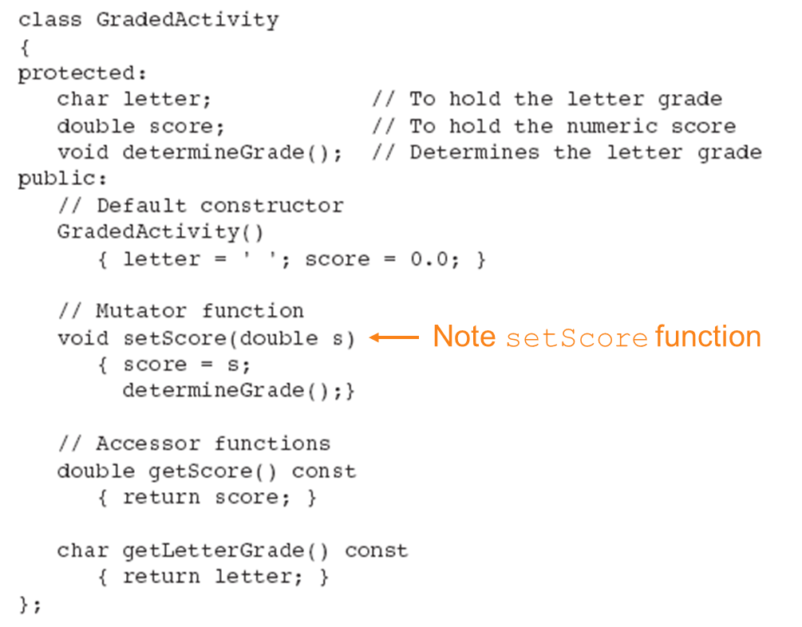
Base Class

Slide 26
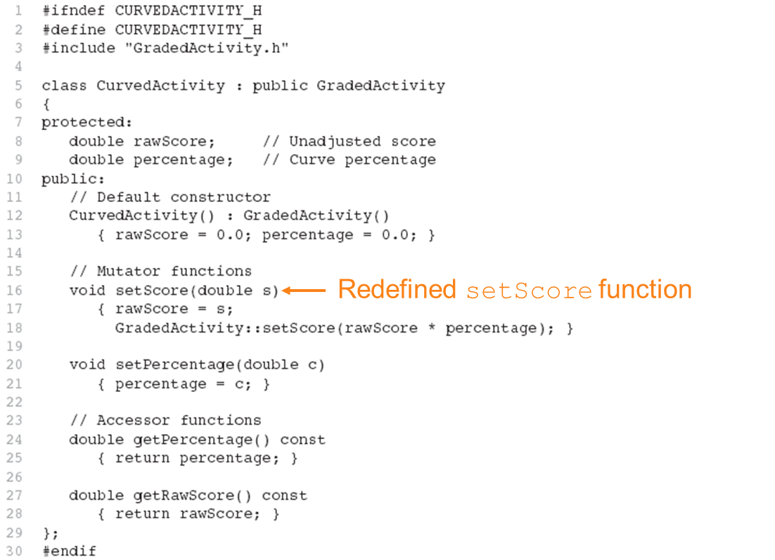
Derived Class

Slide 27
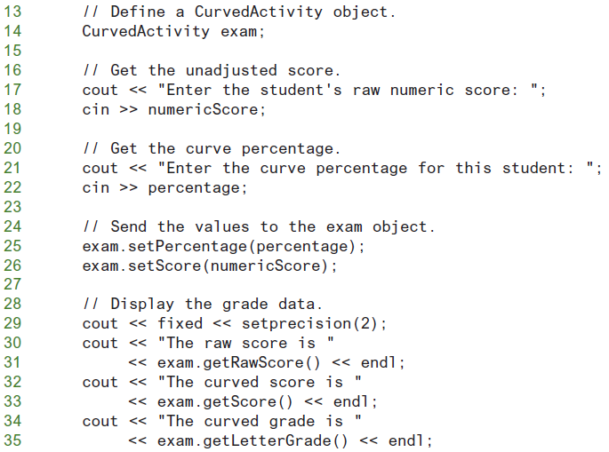
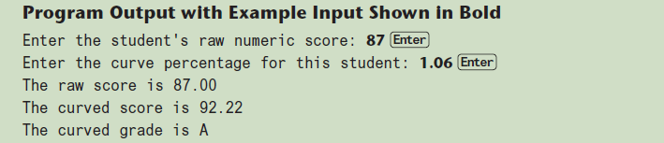
From Program 15-7

Slide 28
Problem with Redefining (1 of 2)
Consider this situation:
Class BaseClass defines functions x() and y(). x() calls y().
Class DerivedClass inherits from BaseClass and redefines function y().
An object D of class DerivedClass is created and function x() is called.
When x() is called, which y() is used, the one defined in BaseClass or the the redefined one in DerivedClass?

Slide 29
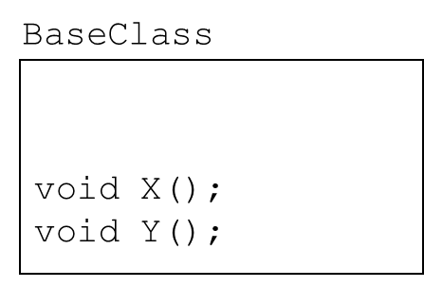
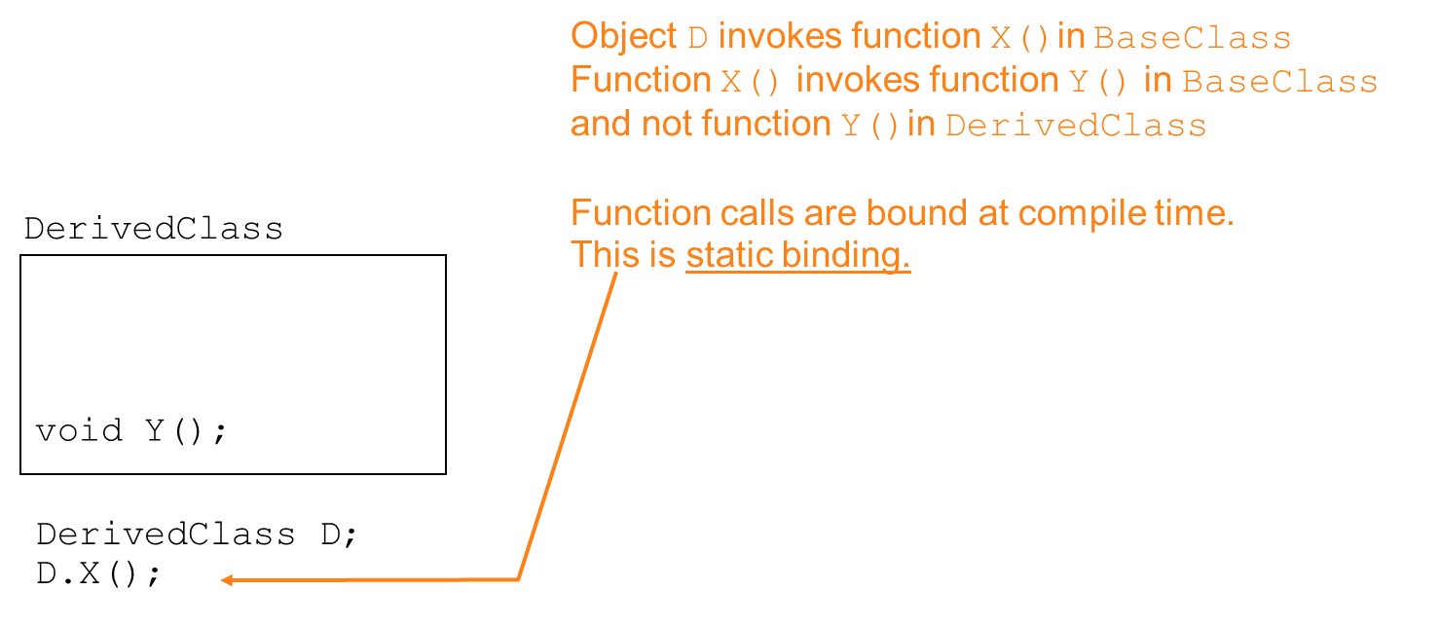
Problem with Redefining (2 of 2)

Slide 30
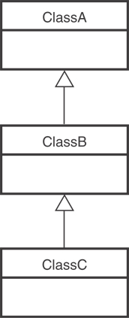
Class Hierarchies (1 of 2)
A base class can be derived from another base class.

Slide 31
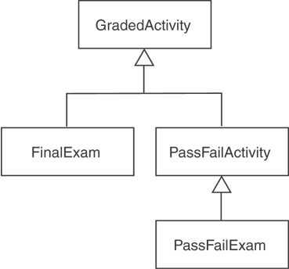
Class Hierarchies (2 of 2)
Consider the GradedActivity, FinalExam, PassFailActivity, PassFailExam hierarchy in Chapter 15.

Slide 32
Polymorphism and Virtual Member Functions
Virtual member function: function in base class that expects to be redefined in derived class
Function defined with key word virtual:
virtual void Y() {...}
Supports dynamic binding: functions bound at run time to function that they call
Without virtual member functions, C++ uses static (compile time) binding

Slide 33
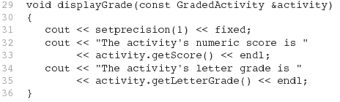
Consider this function (from Program 15-9)
Because the parameter in the displayGrade function is a GradedActivity reference variable, it can reference any object that is derived from GradedActivity.
A problem occurs in Program 15-10 however...

Slide 34
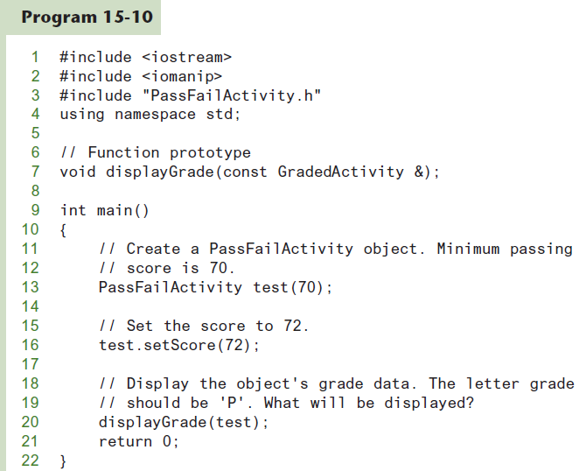

Slide 35
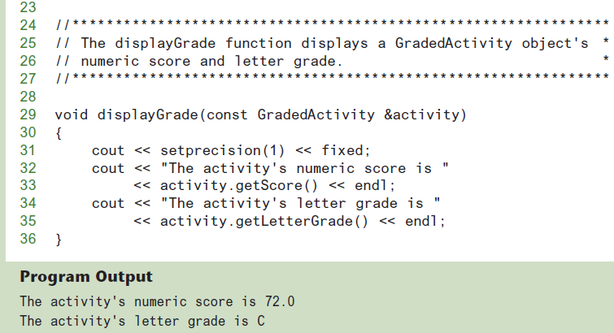
The getLetterGrade member function returned ‘C’ instead of ‘P’.
GradedActivity class’s getLetterGrade function was executed instead of the PassFailActivity class’s version of the function.

Slide 36
Static Binding
Program 15-10 displays 'C' instead of 'P' because the call to the getLetterGrade function is statically bound (at compile time) with the GradedActivity class's version of the function.
We can remedy this by making the function virtual.

Slide 37
Virtual Functions (1 of 2)
A virtual function is dynamically bound to calls at runtime.
At runtime, C++ determines the type of object making the call, and binds the function to the appropriate version of the function.

Slide 38
Virtual Functions (2 of 2)
To make a function virtual, place the virtual key word before the return type in the base class's declaration:
virtual char getLetterGrade() const;
The compiler will not bind the function to calls. Instead, the program will bind them at runtime.

Slide 39
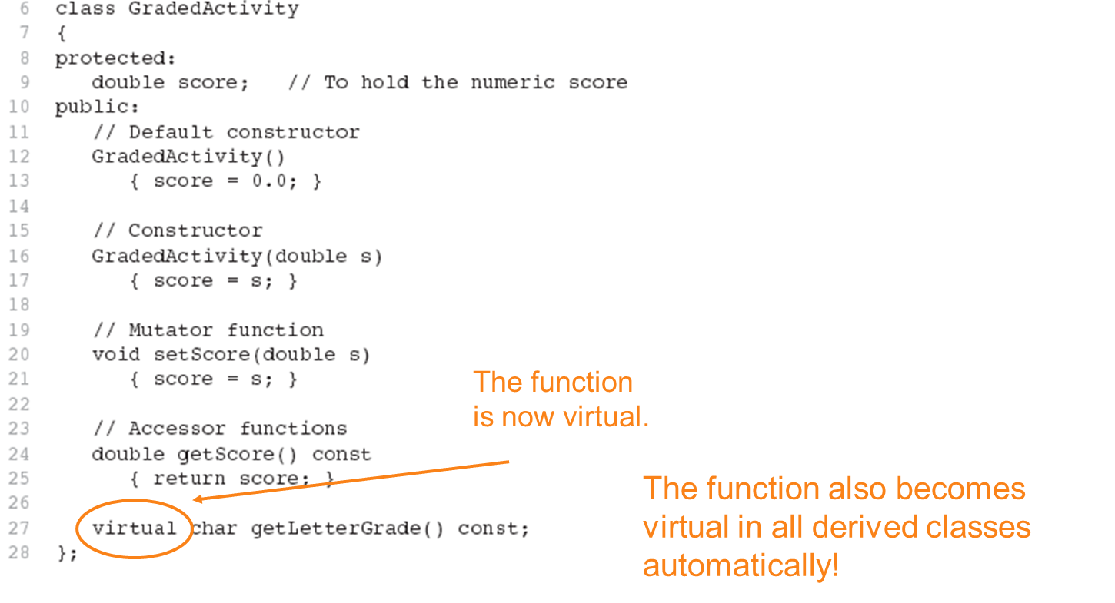
Updated Version of GradedActivity

Slide 40

If we recompile our program with the updated versions of the classes, we will get the right output, shown here: (See Program 15-11 in the book.)
This type of behavior is known as polymorphism. The term polymorphism means the ability to take many forms.
Program 15-12 demonstrates polymorphism by passing
objects of the GradedActivity and PassFailExam classes to the displayGrade function.

Slide 41
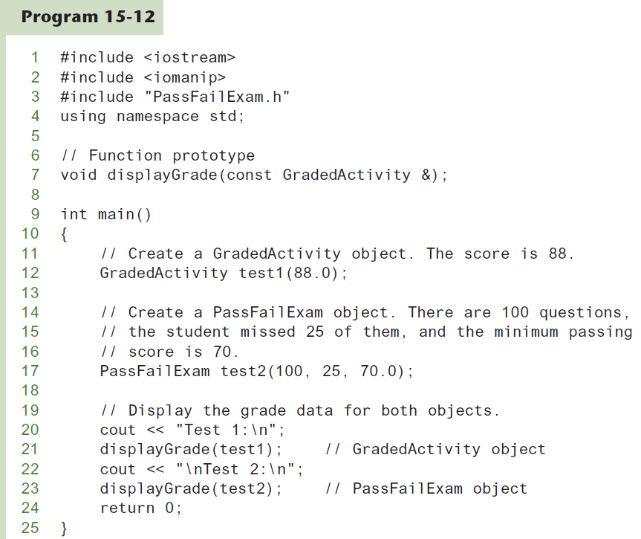

Slide 42
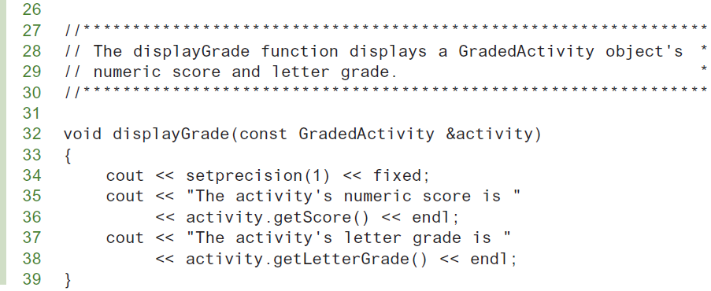
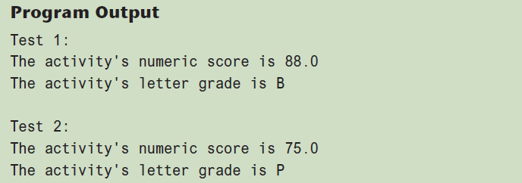

Slide 43
Polymorphism Requires References or Pointers
Polymorphic behavior is only possible when an object is referenced by a reference variable or a pointer, as demonstrated in the displayGrade function.

Slide 44

Base Class Pointers (1 of 2)
Can define a pointer to a base class object
Can assign it the address of a derived class object

Slide 45
Base Class Pointers (2 of 2)
Base class pointers and references only know about members of the base class
So, you can’t use a base class pointer to call a derived class function
Redefined functions in derived class will be ignored unless base class declares the function virtual

Slide 46
Redefining vs. Overriding
In C++, redefined functions are statically bound and overridden functions are dynamically bound.
So, a virtual function is overridden, and a non-virtual function is redefined.

Slide 47
Virtual Destructors
It's a good idea to make destructors virtual if the class could ever become a base class.
Otherwise, the compiler will perform static binding on the destructor if the class ever is derived from.
See Program 15-14 for an example

Slide 48
C++ 11's override and final Key Words
The override key word tells the compiler that the function is supposed to override a function in the base class.
When a member function is declared with the final key word, it cannot be overridden in a derived class.
See Programs 15-7 and 15-8 for an example

Slide 49
Abstract Base Classes and Pure Virtual Functions (1 of 2)
Pure virtual function: a virtual member function that must be overridden in a derived class that has objects
Abstract base class contains at least one pure virtual function:
virtual void Y() = 0;
The = 0 indicates a pure virtual function
Must have no function definition in the base class

Slide 50
Abstract Base Classes and Pure Virtual Functions (2 of 2)
Abstract base class: class that can have no objects. Serves as a basis for derived classes that may/will have objects
A class becomes an abstract base class when one or more of its member functions is a pure virtual function

Slide 51
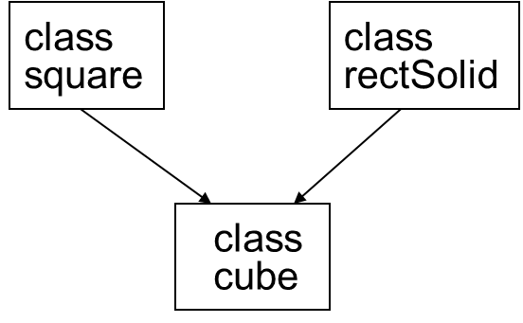
Multiple Inheritance (1 of 3)
A derived class can have more than one base class
Each base class can have its own access specification in derived class's definition:
class cube : public square,
public rectSolid;

Slide 52
Multiple Inheritance (2 of 3)
Arguments can be passed to both base classes' constructors:
cube::cube(int side) :
square(side),
rectSolid(side, side, side);
Base class constructors are called in order given in class declaration, not in order used in class constructor

Slide 53
Multiple Inheritance (3 of 3)
Problem: what if base classes have member variables/functions with the same name?
Solutions:
Derived class redefines the multiply-defined function
Derived class invokes member function in a particular base class using scope resolution operator ::
Compiler errors occur if derived class uses base class function without one of these solutions

