Slide 1
Arrays and Vectors

Slide 2
Arrays Hold Multiple Values
Array: An array works like a variable that can store multiple values of the same data type
Values in an array are stored in adjacent memory locations
Array is declared using [] operator.
Following is a definition of an array of integers:
int tests[5];
The name of this array is tests.
The number inside the brackets is the array’s size declarator. It indicates the number of elements, or values, the array can hold. The tests array can store five elements, each element is an integer.

Slide 3
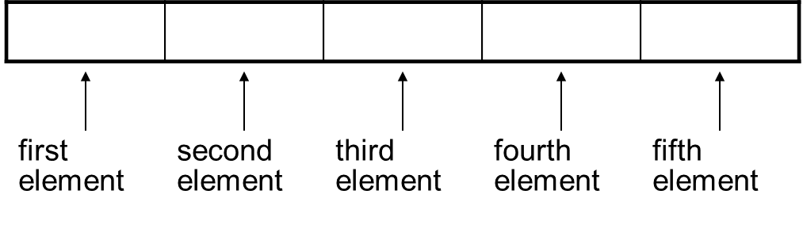
Array - Memory Layout
The definition:
int tests[5];
allocates the following memory:

Slide 4
Array Terminology (1 of 2)
In the definition
int tests[5];
int is the data type of the array elements
tests is the name of the array
5, in [5], is the size declarator. It shows the number of elements in the array.
An array’s size declarator must be a constant integer expression with a value greater than zero. It can be either a literal, as in the previous example, or a named constant, as shown in the following:
const int NUM_DAYS = 6;
int days[NUM_DAYS];

Slide 5
Array Terminology (2 of 2)
The size of an array is:
the total number of bytes allocated for it
(number of elements) * (number of bytes for each element)
Examples:
int tests[5] is an array of 20 bytes, assuming 4 bytes for an int
long double measures[10]is an array of 80 bytes, assuming 8 bytes for a long double

Slide 6
Size Declarators
Named constants are commonly used as size declarators.
const int SIZE = 5; int tests[SIZE];
This eases program maintenance when the size of the array needs to be changed.

Slide 7
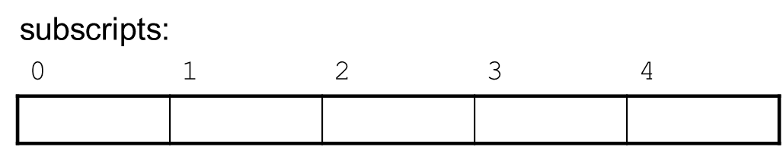
Accessing Array Elements (1 of 3)
Even though an entire array has only one name, the elements may be accessed and used as individual variables. This is possible because each element is assigned a number known as a subscript.
A subscript is used as an index to pinpoint a specific element within an array. The first element is assigned the subscript 0, the second element is assigned 1, and so forth.
Each element in an array is assigned a unique subscript. These subscripts are used to access the elements.
Subscripts numbering in C++ always starts at 0

Slide 8
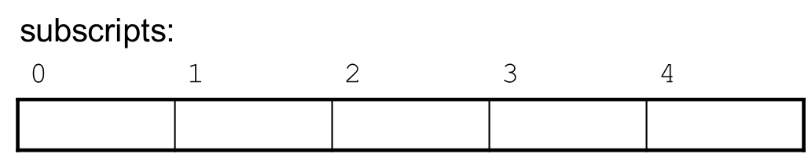
Accessing Array Elements (2 of 3)
The last element’s subscript is n-1, where n is the total number of elements in the array.

Slide 9
Accessing Array Elements (3 of 3)
Array elements can be used as regular variables:
tests[0] = 79;
cout << tests[0];
cin >> tests[1];
tests[4] = tests[0] + tests[1];
Arrays must be accessed via individual elements:
cout << tests; // not legal

Slide 10
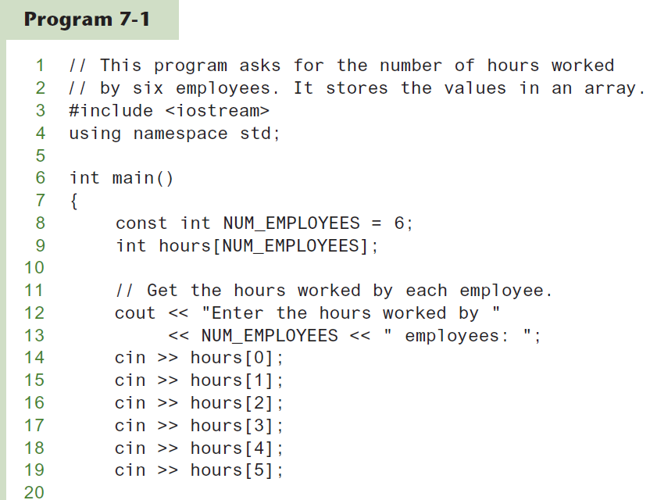
Accessing Array Elements (1 of 2)
Following code shows the array hours being used to store and display values entered by the user.

Slide 11
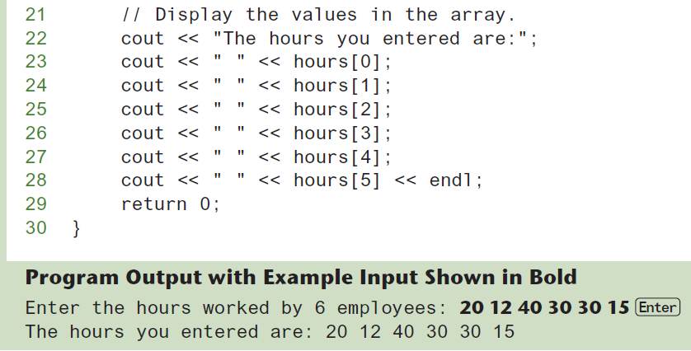
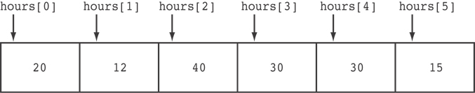
Accessing Array Elements (2 of 2)
Here are the contents of the hours array, with the values entered by the user in the example output:

Slide 12
Accessing Array Contents
Can access element with a constant or literal subscript:
cout << tests[3] << endl;
Can use integer expression as subscript:
int i = 5;
cout << tests[i] << endl;

Slide 13
Using a Loop to Step Through an Array
Even though the size declarator of an array definition must be a constant or a literal, subscript numbers can be stored in variables.
This makes it possible to use a loop to “step through” an entire array, performing the same operation on each element.
Example – The following code defines an array, numbers, and assigns 99 to each element:
const int ARRAY_SIZE = 5;
int numbers[ARRAY_SIZE];
for (int count = 0; count < ARRAY_SIZE; count++)
numbers[count] = 99;

Slide 14
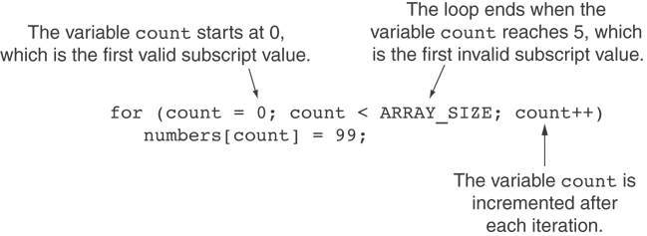
A Closer Look At the Loop

Slide 15
Default Initialization
Global array → all elements initialized to 0 by default
Local array → all elements uninitialized by default

Slide 16
Array Initialization
Like regular variables, C++ allows developer to initialize an array’s elements when array is created
Arrays can be initialized with an initialization list. The series of values inside the braces and separated with commas is called an initialization list.
const int SIZE = 5; int tests[SIZE] = {79,82,91,77,84};
The values are stored in the array in the order in which they appear in the list.
An array’s initialization list cannot have more values than the array has elements.

Slide 17
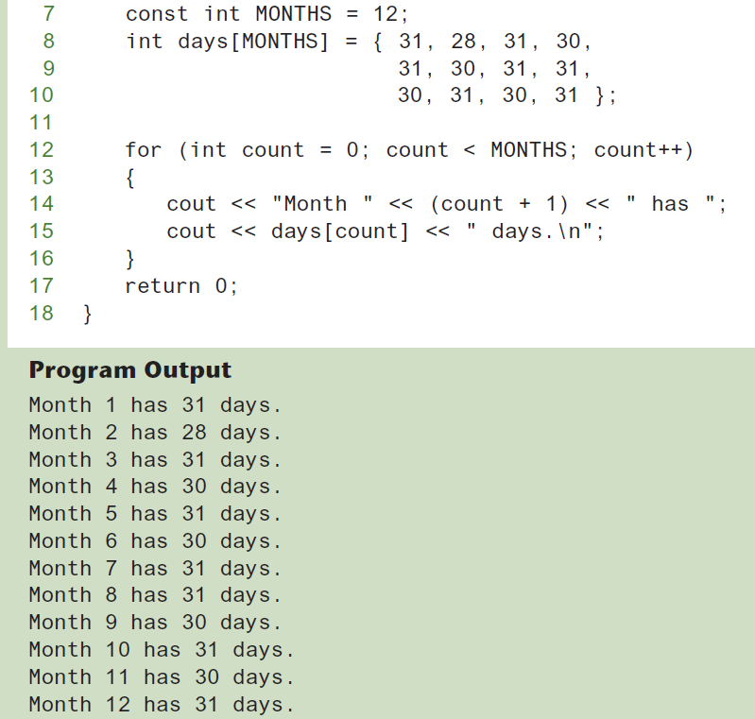
Initialization List Code Example

Slide 18
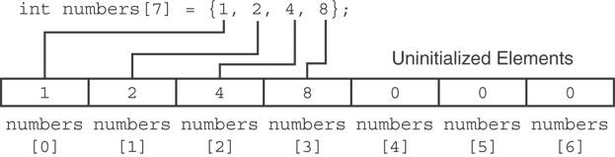
Partial Array Initialization
If array is initialized with fewer initial values than the size declarator, the remaining elements will be set to 0:
The uninitialized elements of a string array will contain empty strings. This is true even if the array is defined locally.
If a local array is completely uninitialized, its elements will contain “garbage,” like all other local variables.

Slide 19
Implicit Array Sizing
It’s possible to define an array without specifying its size, as long as an initialization list is provided.
C++ automatically makes the array large enough to hold all the initialization values.
Array size will be determined by the size of the initialization list:
int quizzes[]={12,17,15,11};
Must use either array size declarator or initialization list at array definition

Slide 20
No Bounds Checking in C++ (1 of 2)
C++ does not perform array bounds checking. This means developer can write programs with subscripts that go beyond the boundaries of a particular array.
When a value is used as an array element’s subscript, C++ does not check it to make sure it is a valid subscript.
In other words, developer can use subscripts that are beyond the bounds of the array.
C++ is a popular language for software developers who have to write fast, efficient code. To increase runtime efficiency, C++ does not provide many of the common safeguards to prevent unsafe memory access found in other languages.

Slide 21
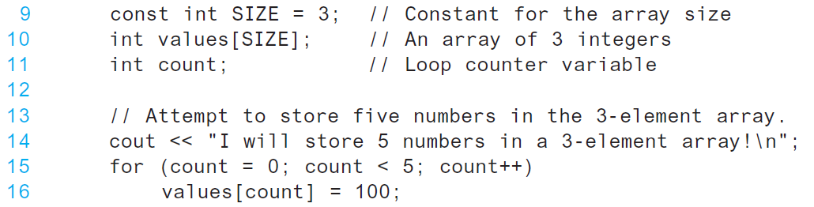
No Bounds Checking Code Example
The following code defines a three-element array, and then writes five values to it!

Slide 22
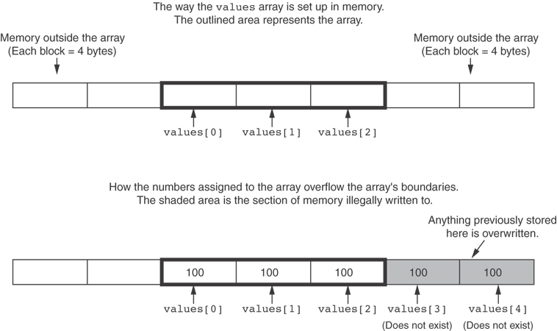
What the Code Does

Slide 23
No Bounds Checking in C++ (2 of 2)
Be careful not to use invalid subscripts.
Doing so can corrupt other memory locations, crash program, or lock up computer, and cause elusive bugs.
It’s easy for C++ programmers to make careless mistakes that allow programs to access areas of memory that are supposed to be off-limits. Programmers must always make sure that any time they assign values to array elements, the values are written within the array’s boundaries.

Slide 24
Off-By-One Errors
An off-by-one error happens when developer use array subscripts that are off by one.
This can happen when developer start subscripts at 1 rather than 0.
Following code is an example of off-by-one error:
Because 100 is an invalid subscript, the program will write data beyond the array’s boundaries.
// This code has an off-by-one error.
const int SIZE = 100;
int numbers[SIZE];
for (int count = 1; count <= SIZE; count++)
numbers[count] = 0;

Slide 25
The Range-Based for Loop (1 of 2)
C++ 11 provides a specialized version of the for loop that, in many circumstances, simplifies array processing.
The range-based for loop is a loop that iterates once for each element in an array.
Each time the loop iterates, it copies an element from the array to a built-in variable, known as the range variable.
The range-based for loop automatically knows the number of elements in an array.
You do not have to use a counter variable.
You do not have to worry about stepping outside the bounds of the array.

Slide 26
The Range-Based for Loop (2 of 2)
Following is the general format of the range-based for loop:
for (dataType rangeVariable : array)
statement;
dataType is the data type of the range variable.
rangeVariable is the name of the range variable. This variable will receive the value of a different array element during each loop iteration.
array is the name of an array on which you wish the loop to operate.
statement is a statement that executes during a loop iteration. If you need to execute more than one statement in the loop, enclose the statements in a set of braces.

Slide 27
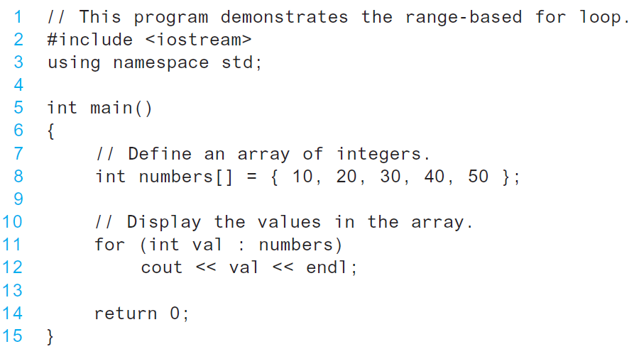
Program with range-based for loop

Slide 28
Modifying an Array with a Range-Based for Loop (1 of 3)
As the range-based for loop executes, its range variable contains only a copy of an array element.
You cannot use a range-based for loop to modify the contents of an array unless you declare the range variable as a reference.
To declare the range variable as a reference variable, simply write an ampersand (&) in front of its name in the loop header.
Program segment on next slide demonstrates, use of a range-based for loop to modify the contents of an array by declaring the range variable as a reference variable to modify an array with a range variable.

Slide 29
Modifying an Array with a Range-Based for Loop (2 of 3)
1 const int SIZE = 5; 2 int numbers[5];
// Get values for the array. 3 for (int &val : numbers) 4 {
5 cout << "Enter an integer value: "; 6 cin >> val;
7 }
// Display the values in the array. 8 cout << "Here are the values you entered:\n"; 9 for (int val : numbers)
10 cout << val << endl;

Slide 30
Modifying an Array with a Range-Based for Loop (3 of 3)
You can use the auto key word with a reference range variable. For example, the code in lines 3 through 7 on previous slide could have been written like this:
for (auto &val : numbers)
{
cout << "Enter an integer value: ";
cin >> val;
}
Notice in line 3 the range variable, val, has an ampersand (&) written in front of its name. This declares val as a reference variable. As the loop executes, the val variable will not merely contain a copy of an array element, but it will be an alias for the element.
Any changes made to the val variable will actually be made to the array element it references.

Slide 31
The Range-Based for Loop versus the Regular for Loop
The range-based for loop can be used in any situation where you need to step through the elements of an array, and you do not need to use the element subscripts.
It will not work, however, in situations where you need the element subscript for some purpose. If you need the element subscript for some purpose, use the regular for loop.

Slide 32
Processing Array Contents
Array elements can be treated as ordinary variables of the same type as the array’s type
When using ++, -- operators, don’t confuse the element with the subscript:
tests[i]++; // add 1 to tests[i]
tests[i++]; // increment i, no
// effect on tests

Slide 33
Array Assignment
To copy one array to another,
Don’t try to assign one array to the other:
newTests = tests; // Won't work
Instead, assign element-by-element:
for (i = 0; i < ARRAY_SIZE; i++)
newTests[i] = tests[i];

Slide 34
Printing the Contents of an Array (1 of 3)
You can display the contents of a character array by sending its name to cout:
char fName[] = "Henry";
cout << fName << endl;
But, this ONLY works with character arrays!

Slide 35
Printing the Contents of an Array (2 of 3)
For other types of arrays, you must print element-by-element:
for (i = 0; i < ARRAY_SIZE; i++)
cout << tests[i] << endl;

Slide 36
Printing the Contents of an Array (3 of 3)
In C++ 11 you can use the range-based for loop to display an array's contents, as shown here:
for (int val : numbers)
cout << val << endl;

Slide 37
Summing and Averaging Array Elements (1 of 2)
Use a simple loop to add together array elements:
int tnum;
double average, sum = 0;
for(tnum = 0; tnum < SIZE; tnum++)
sum += tests[tnum];
Once summed, can compute average:
average = sum / SIZE;

Slide 38
Summing and Averaging Array Elements (2 of 2)
In C++ 11 you can use the range-based for loop, as shown here:
double total = 0; // Initialize accumulator
double average; // Will hold the average
for (int val : scores)
total += val;
average = total / NUM_SCORES;

Slide 39
Finding the Highest Value in an Array
int count;
int highest;
highest = numbers[0];
for (count = 1; count < SIZE; count++)
{
if (numbers[count] > highest)
highest = numbers[count];
}
When this code is finished, the highest variable will contains the highest value in the numbers array.

Slide 40
Finding the Lowest Value in an Array
int count;
int lowest;
lowest = numbers[0];
for (count = 1; count < SIZE; count++)
{
if (numbers[count] < lowest)
lowest = numbers[count];
}
When this code is finished, the lowest variable will contains the lowest value in the numbers array.

Slide 41
Partially-Filled Arrays
If it is unknown how much data an array will be holding:
Make the array large enough to hold the largest expected number of elements.
Use a counter variable to keep track of the number of items stored in the array.

Slide 42
Comparing Arrays
To compare two arrays, you must compare element-by-element:
const int SIZE = 5;
int firstArray[SIZE] = { 5, 10, 15, 20, 25 };
int secondArray[SIZE] = { 5, 10, 15, 20, 25 };
bool arraysEqual = true; // Flag variable
int count = 0; // Loop counter variable
// Compare the two arrays.
while (arraysEqual && count < SIZE)
{
if (firstArray[count] != secondArray[count])
arraysEqual = false;
count++;
}
if (arraysEqual)
cout << "The arrays are equal.\n";
else
cout << "The arrays are not equal.\n";

Slide 43
Structured Binding Declarations (1 of 2)
A structured binding declaration defines a set of variables and initializes them with the values that are stored in an array.
Structured binding declarations were introduced in C++ 17
General format:
auto [variable1, variable2, etc...] = array;

Slide 44
Structured Binding Declarations (2 of 2)
Example:
int testScores[] = { 80, 90, 100 };
auto [score1, score2, score3] = testScores;
cout << score1 << endl;
cout << score2 << endl;
cout << score3 << endl;
This code will display:
80
90
100

Slide 45
Using Parallel Arrays
Parallel arrays: two or more arrays that contain related data
A subscript is used to relate arrays: elements at same subscript are related
Arrays may be of different types

Slide 46
Parallel Array Example
const int SIZE = 5; // Array size
int id[SIZE]; // student ID
double average[SIZE]; // course average
char grade[SIZE]; // course grade
...
for(int i = 0; i < SIZE; i++) {
cout << "Student ID: " << id[i]
<< " average: " << average[i]
<< " grade: " << grade[i]
<< endl;
}

Slide 47
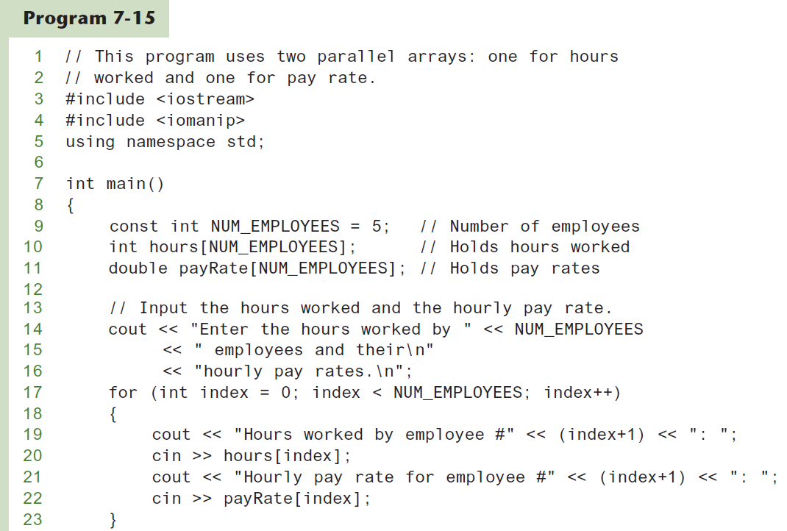
Parallel Arrays in Program (1 of 3)

Slide 48
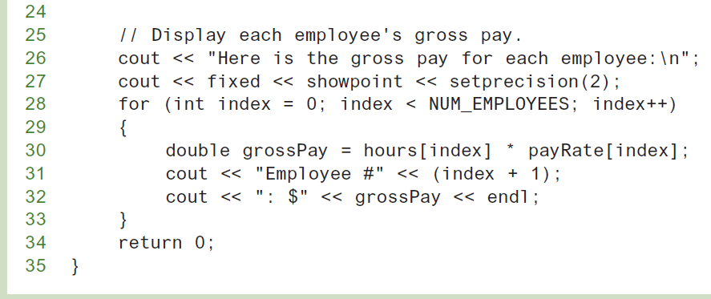
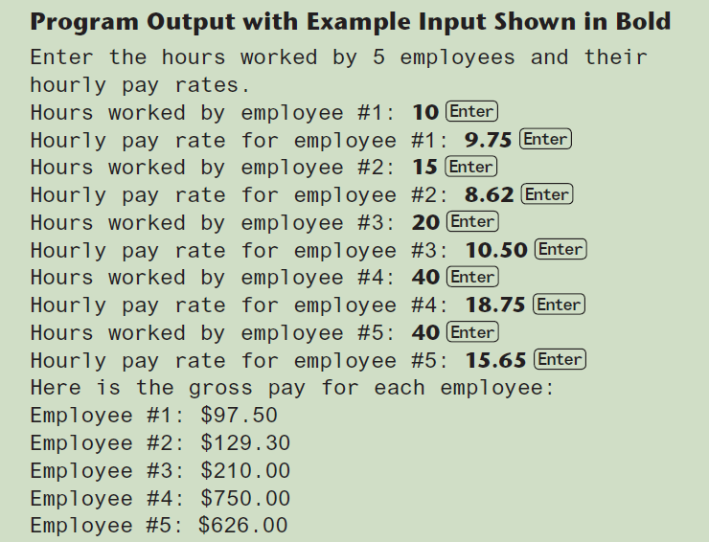
Parallel Arrays in Program (2 of 3)

Slide 49
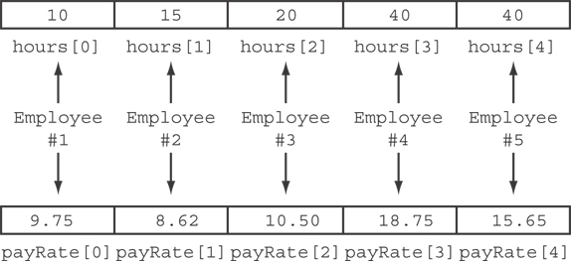
Parallel Arrays in Program (3 of 3)
The hours and payRate arrays are related through their subscripts:

Slide 50
Arrays as Function Arguments (1 of 2)
When an entire array is passed to a function, it is not passed by value, but passed by reference.
Remember, in C++ the name of an array without brackets and a subscript is actually the beginning address of the array.
To pass an array to a function, just use the array name:
showScores(tests);
To define a function that takes an array parameter, use empty [] for array argument:
// function prototype
void showScores(int []);
// function header
void showScores(int tests[])

Slide 51
Arrays as Function Arguments (2 of 2)
When passing an array to a function, it is common to pass array size so that function knows how many elements to process:
showScores(tests, ARRAY_SIZE);
Array size must also be reflected in prototype, header:
// function prototype
void showScores(int [], int);
// function header
void showScores(int tests[], int size)
The tests parameter variable in the showScores function can accept the address of any integer array, and can be used to reference that array.
7-51

Slide 52
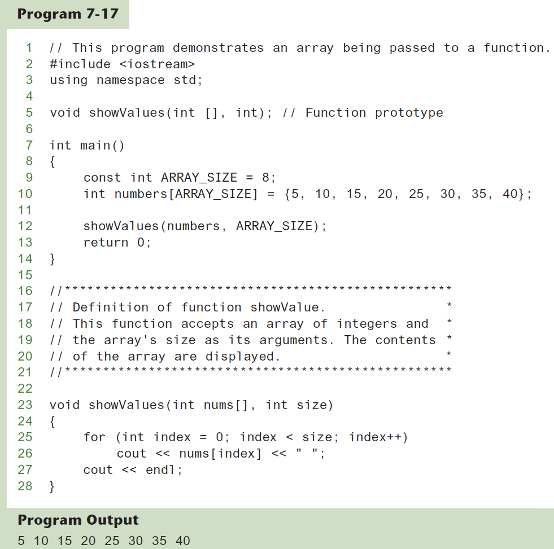
Passing an Array to a Function

Slide 53
Modifying Arrays in Functions
Array names in functions are like reference variables – changes made to array in a function are reflected in actual array in calling function
Array parameters work like reference variables. They give the function direct access to the original array. Any changes made with the array parameter are actually made on the original array used as the argument.
Need to exercise caution that array is not inadvertently changed by a function

Slide 54
Using const Array Parameters
Prevent a function from making changes to an array argument by using the const key word in the parameter declaration.
Example:
void showValues(const int nums[], int size)
{
for (int index = 0; index < size; index++)
cout << nums[index] << " ";
cout << endl;
}
When an array parameter is declared as const, the function is not allowed to make changes to the array’s contents.
If a statement in the function attempts to modify the array, an error will occur at compile time. That way, the function will fail to compile if programmer inadvertently write code in it that modifies the array.

Slide 55
Structured Binding Declarations and Array Arguments
If an array has been passed as an argument into a function, you cannot use a structured binding declaration in the receiving function to unpack the array.
This is because the compiler does not know the size of the array that might be passed into the parameter.
You can only use a structured binding declaration to unpack an array that has a known size.
For example, one that has been defined in the same function as where the structured binding declaration is used.

Slide 56
Two-Dimensional Arrays
A two-dimensional array is like several identical arrays put together. It is useful for storing multiple sets of data.
Programmer can define one array for multiple sets of data
Two-dimensional arrays, which are sometimes called 2D arrays, can hold multiple sets of data. It is best to think of a two-dimensional array as having rows and columns of elements.
Like a table in a spreadsheet
To define a two-dimensional array, two size declarators are required:
const int ROWS = 4, COLS = 3;
int exams[ROWS][COLS];
First declarator is number of rows; second is number of columns. Notice each number is enclosed in its own set of brackets.

Slide 57
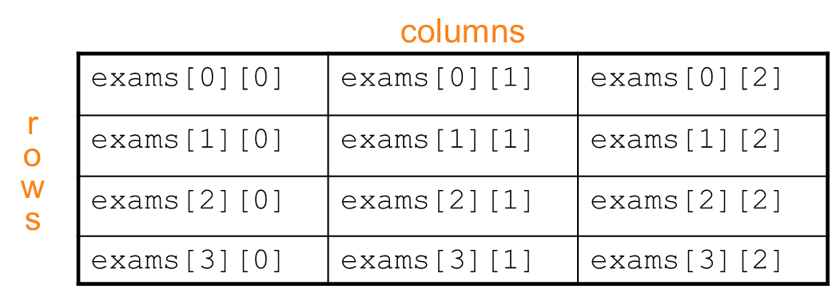
Two-Dimensional Array Representation
const int ROWS = 4, COLS = 3;
int exams[ROWS][COLS];
When processing the data in a two-dimensional array, each element has two subscripts: one for its row, and another for its column.
Use two subscripts to access element:
exams[2][2] = 86;

Slide 58
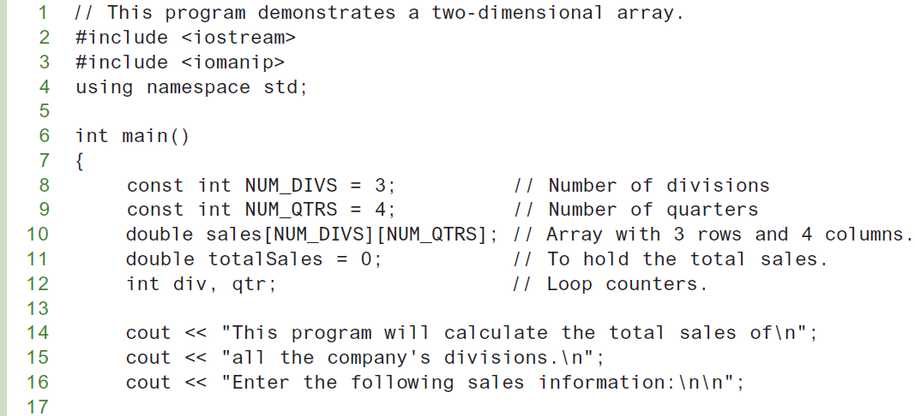
A Two-dimensional Array in Program (1 of 3)

Slide 59
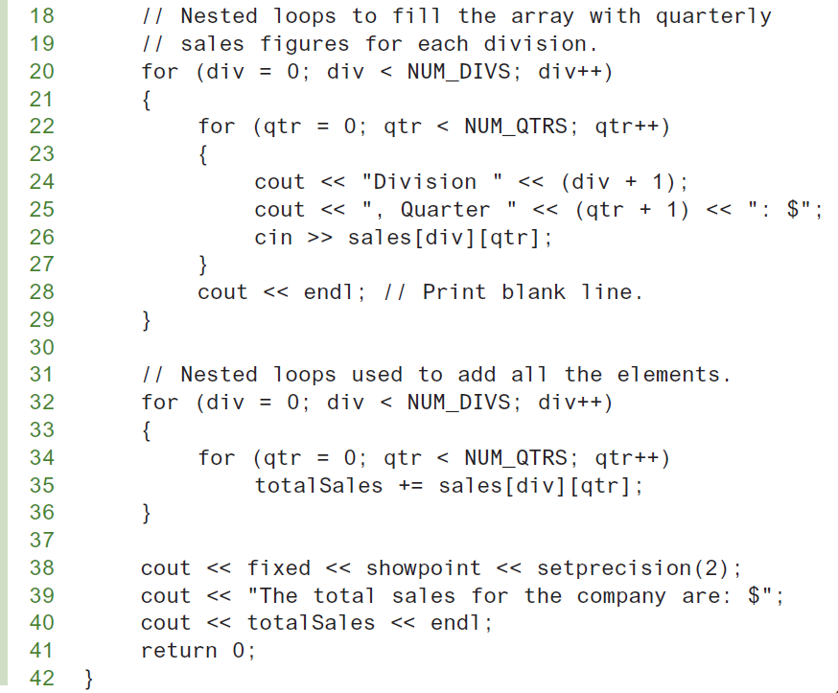
A Two-dimensional Array in Program (2 of 3)

Slide 60
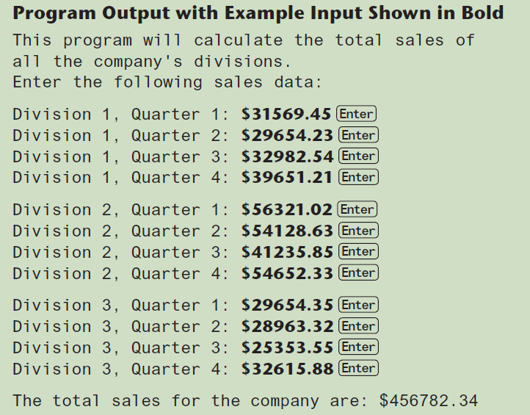
A Two-dimensional Array in Program (3 of 3)

Slide 61
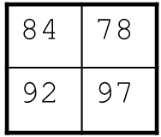
2D Array Initialization
Two-dimensional arrays are initialized row-by-row. When initializing a two-dimensional array, it helps to enclose each row’s initialization list in a set of braces. Here is an example:
const int ROWS = 2, COLS = 2; int exams[ROWS][COLS] = { {84, 78}, {92, 97} };
The extra braces that enclose each row’s initialization list are optional. Can omit inner { }. Because the extra braces visually separate each row, however, it’s a good idea to use them.
Some initial values in a row – array elements without initial values will be set to 0 or NULL

Slide 62
Two-Dimensional Array as Parameter, Argument
Use array name as argument in function call:
getExams(exams, 2);
When a two-dimensional array is passed to a function, the parameter type must contain a size declarator for the number of columns.
C++ requires the columns to be specified in the function prototype and header. Use empty [] for row, size declarator for column in prototype, header:
const int COLS = 2; // Prototype void getExams(int [][COLS], int);
// Header void getExams(int exams[][COLS], int rows)

Slide 63
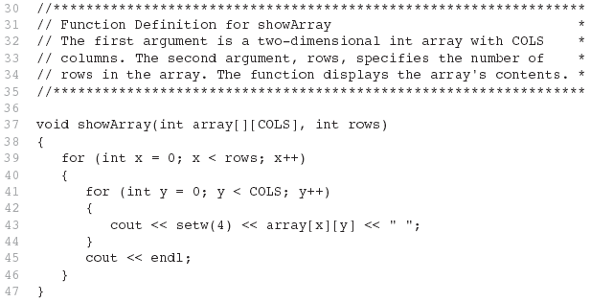
Example – The showArray Function

Slide 64
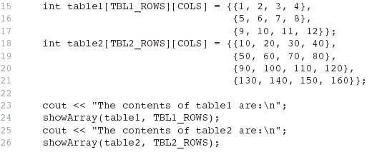
How showArray is Called

Slide 65
Summing All the Elements in a Two-Dimensional Array (1 of 2)
To sum all the elements of a two-dimensional array, use a pair of nested loops to add the contents of each element to an accumulator.
Given the following definitions:
const int NUM_ROWS = 5; // Number of rows
const int NUM_COLS = 5; // Number of columns
int total = 0; // Accumulator
int numbers[NUM_ROWS][NUM_COLS] =
{{2, 7, 9, 6, 4},
{6, 1, 8, 9, 4},
{4, 3, 7, 2, 9},
{9, 9, 0, 3, 1},
{6, 2, 7, 4, 1}};

Slide 66
Summing All the Elements in a Two-Dimensional Array (2 of 2)
// Sum the array elements.
for (int row = 0; row < NUM_ROWS; row++)
{
for (int col = 0; col < NUM_COLS; col++)
total += numbers[row][col];
}
// Display the sum.
cout << "The total is " << total << endl;

Slide 67
Summing the Rows of a Two-Dimensional Array (1 of 2)
Sometimes programmer may need to calculate the sum of each row in a two-dimensional array.
Given the following definitions:
const int NUM_STUDENTS = 3;
const int NUM_SCORES = 5;
double total; // Accumulator
double average; // To hold average scores
double scores[NUM_STUDENTS][NUM_SCORES] =
{{88, 97, 79, 86, 94},
{86, 91, 78, 79, 84},
{82, 73, 77, 82, 89}};

Slide 68
Summing the Rows of a Two-Dimensional Array (2 of 2)
// Get each student's average score.
for (int row = 0; row < NUM_STUDENTS; row++)
{
// Set the accumulator.
total = 0;
// Sum a row.
for (int col = 0; col < NUM_SCORES; col++)
total += scores[row][col];
// Get the average
average = total / NUM_SCORES;
// Display the average.
cout << "Score average for student "
<< (row + 1) << " is " << average <<endl;
}

Slide 69
Summing the Columns of a Two-Dimensional Array (1 of 2)
Sometimes programmer may need to calculate the sum of each column in a two-dimensional array.
Given the following definitions:
const int NUM_STUDENTS = 3;
const int NUM_SCORES = 5;
double total; // Accumulator
double average; // To hold average scores
double scores[NUM_STUDENTS][NUM_SCORES] =
{{88, 97, 79, 86, 94},
{86, 91, 78, 79, 84},
{82, 73, 77, 82, 89}};

Slide 70
Summing the Columns of a Two-Dimensional Array (2 of 2)
// Get the class average for each score.
for (int col = 0; col < NUM_SCORES; col++)
{
// Reset the accumulator.
total = 0;
// Sum a column
for (int row = 0; row < NUM_STUDENTS; row++)
total += scores[row][col];
// Get the average
average = total / NUM_STUDENTS;
// Display the class average.
cout << "Class average for test " << (col + 1)
<< " is " << average << endl;
}

Slide 71
Arrays with Three or More Dimensions
C++ does not limit the number of dimensions that an array may have. It is possible to create arrays with multiple dimensions, to model data that occur in multiple sets.
C++ allows you to create arrays with virtually any number of dimensions. Programmer can define arrays with any number of dimensions:
short rectSolid[2][3][5];
double timeGrid[3][4][3][4];
When writing functions that accept multi-dimensional arrays as arguments, all but the first dimension must be explicitly stated in the parameter list, in function prototype, and function heading:
void getRectSolid(short [][3][5]);

Slide 72
Introduction to the STL vector
The Standard Template Library (STL) is a collection of data types and algorithms that programmers may use in their programs. These data types and algorithms are programmer-defined. They are not part of the C++ language, but were created in addition to the built-in data types.
The STL offers a vector data type, which in many ways, is superior to standard arrays. A vector is a container that can store data. Can hold values of any type:
vector<int> scores;
Automatically adds space as more is needed – no need to determine size at definition
Can use [] to access elements

Slide 73
Declaring Vectors
Programmer must use: #include<vector>
Declare a vector to hold int element:
vector<int> scores;
Declare a vector with initial size 30:
vector<int> scores(30);
Declare a vector and initialize all elements to 0:
vector<int> scores(30, 0);
Declare a vector initialized to size and contents of another vector:
vector<int> finals(scores);
After this statement executes, finals will be a copy of scores.

Slide 74
Using an Initialization List with a Vector
If you are using C++ 11, you can initialize a vector with a list of values:
vector<int> numbers { 10, 20, 30, 40 };
To store a value in an element that already exists in a vector, you may use the array subscript operator [].
Use push_back member function to add element to a full array or to an array that had no defined size:
scores.push_back(75);
Use size member function to determine size of a vector:
howbig = scores.size();

Slide 75
Removing Vector Elements
Use pop_back member function to remove last element from vector:
scores.pop_back();
To remove all contents of vector, use clear member function:
scores.clear();
To determine if vector is empty, use empty member function:
while (!scores.empty()) ...

Slide 76
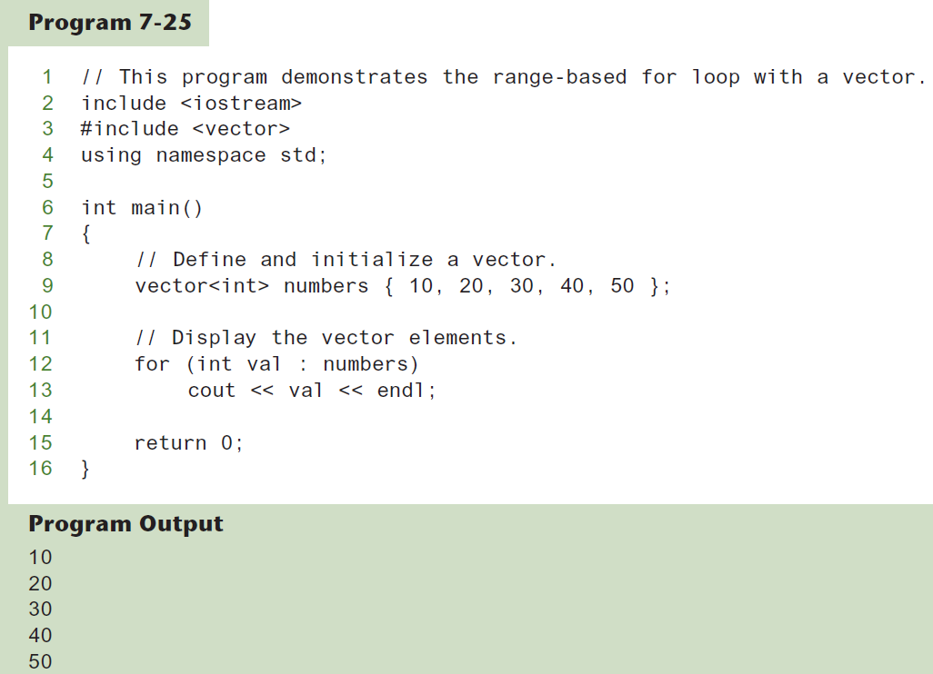
Using the Range-Based for Loop with a vector

Slide 77
Other Useful Member Functions
Member Function | Description | Example
at(i) | Returns the value of the element at position i in the vector | cout << vec1.at(i);
capacity() | Returns the maximum number of elements a vector can store without allocating more memory | maxElements = vec1.capacity();
reverse() | Reverse the order of the elements in a vector | vec1.reverse();
resize (n, val) | Resizes the vector so it contains n elements. If new elements are added, they are initialized to val. | vec1.resize(5, 0);
swap(vec2) | Exchange the contents of two vectors | vec1.swap(vec2);

