Slide 1
Searching and Sorting Arrays

Slide 2
Introduction to Search Algorithms
Search: locate an item in a list of information (collection of data)
Search Algorithm: A search algorithm is a method of locating a specific item in a larger collection of data
Two algorithms for searching the contents of an array :
Linear search
Binary search

Slide 3
Linear Search (1 of 2)
The linear search is a very simple algorithm. Also called the sequential search algorithm.
Starting at the first element, this algorithm sequentially steps through an array examining each element until it locates the value it is searching for.
It uses a loop to sequentially step through an array, starting with the first element
It compares each element with the value being searched for, and stops when either the value is found or the end of the array is encountered.
If the value being searched for is not in the array, the algorithm will unsuccessfully search to the end of the array.

Slide 4
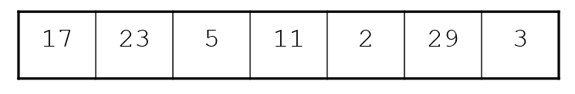
Linear Search - Example
Array numlist contains:
Searching for the the value 11, linear search examines 17, 23, 5, and 11
Searching for the the value 7, linear search examines 17, 23, 5, 11, 2, 29, and 3

Slide 5
Linear Search (2 of 2)
Linear Search Algorithm in Pseudocode:
Set found to false;
Set position to −1;
Set index to 0
While index < number of elts. and found is false
If list[index] is equal to search value
found = true
position = index
End If
Add 1 to index
End While
Return position

Slide 6
C++ code For Linear Search Function
int linearSearch(int arr[], int size, int value)
{
int index = 0; // Used as a subscript to search the array
int position = -1; // To record the position of search value
bool found = false; // Flag to indicate if value was found
while (index < size && !found)
{
if (arr[index] == value) // If the value is found
{
found = true; // Set the flag
position = index; // Record the value's subscript
}
index++; // Go to the next element
}
return position; // Return the position, or -1
}

Slide 7
Linear Search - Tradeoffs
Benefits: Simplicity
Easy algorithm to understand and implement
Data in the array can be in any order
Disadvantages: Inefficient (slow)
For array of N elements, examines
N/2 elements on average for value in array,
N elements for value not in array
As the number of failed search attempts increases, so does the average number of comparisons.
Obviously, the linear search should not be used on large arrays if the speed is important.

Slide 8
Binary Search (1 of 2)
The binary search is a clever algorithm that is much more efficient than the linear search.
Requires array elements to be in order
Instead of testing the array’s first element, this algorithm starts with the element in the middle.
Divides the array into three sections:
middle element
elements on one side of the middle element
elements on the other side of the middle element
If the middle element is the correct value, done. Otherwise, go to step 1. using only the half of the array that may contain the correct value.
Continue steps 1. and 2. until either the value is found or there are no more elements to examine

Slide 9
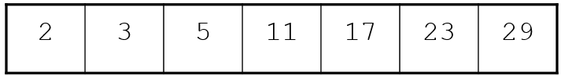
Binary Search - Example
Array numlist2 contains:
Searching for the the value 11, binary search examines 11 and stops
Searching for the the value 7, linear search examines 11, 3, 5, and stops

Slide 10
Binary Search (2 of 2)
Binary Search Algorithm in Pseudocode
Set first to 0
Set last to the last subscript in the array
Set found to false
Set position to -1
While found is not true and first is less than or equal to last
Set middle to the subscript half-way between array[first] and array[last].
If array[middle] equals the desired value
Set found to true
Set position to middle
Else If array[middle] is greater than the desired value
Set last to middle − 1
Else
Set first to middle + 1
End If.
End While.
Return position.

Slide 11
C++ code For Binary Search Function
int binarySearch(int array[], int size, int value)
{
int first = 0, // First array element
last = size − 1, // Last array element
middle, // Mid point of search
position = −1; // Position of search value
bool found = false; // Flag
while (!found && first <= last)
{
middle = (first + last) / 2; // Calculate mid point
if (array[middle] == value) // If value is found at mid
{
found = true;
position = middle;
}
else if (array[middle] > value) // If value is in lower half
last = middle − 1;
else
first = middle + 1; // If value is in upper half
}
return position;
}

Slide 12
Binary Search - Tradeoffs
Benefits:
Much more efficient than linear search.
For array of N elements, performs at most log₂N comparisons
Powers of 2 are used to calculate the maximum number of comparisons the binary search will make on an array of any size.
Simply find the smallest power of 2 that is greater than or equal to the number of elements in the array.
Disadvantages:
Requires that array elements be sorted

Slide 13
Introduction to Sorting Algorithms
Sort: arrange values into an order:
Alphabetical
Ascending numeric
Descending numeric
Sorting algorithms are used to arrange data into some order.
A sorting algorithm is a technique for stepping through an array and rearranging its contents in some order.
Two algorithms considered here:
Bubble sort
Selection sort

Slide 14
Bubble Sort
The bubble sort is an easy way to arrange data in ascending or descending order.
It is called the bubble sort algorithm because as it makes passes through and compares the elements of the array, certain values “bubble” toward the end of the array with each pass.
Concept:
Compare 1st two elements
If out of order, exchange them to put in order
Move down one element, compare 2nd and 3rd elements, exchange if necessary. Continue until end of array.
Pass through array again, exchanging as necessary
Repeat until pass made with no exchanges

Slide 15
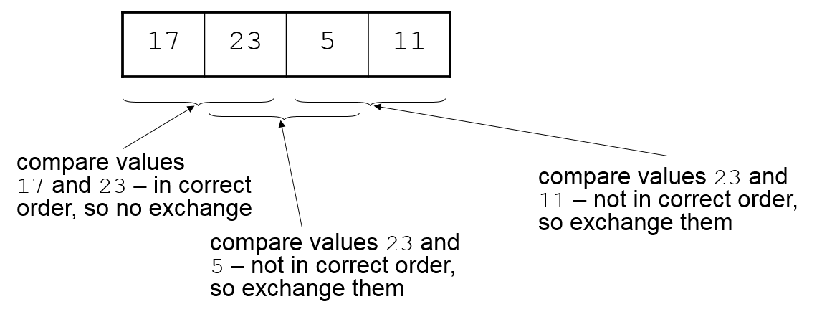
Bubble Sort Example – First Pass
Array numlist3 contains:

Slide 16
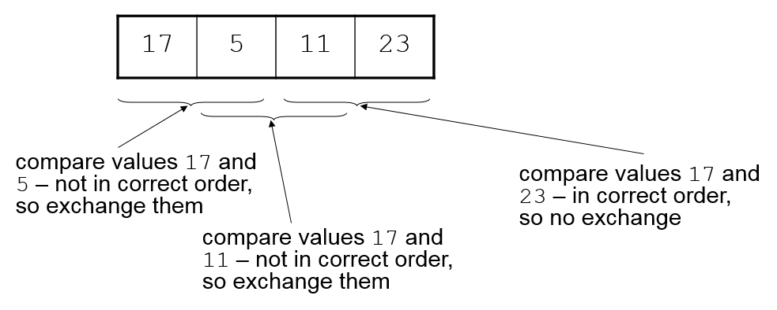
Bubble Sort Example – Second Pass
After first pass, array numlist3 contains:

Slide 17
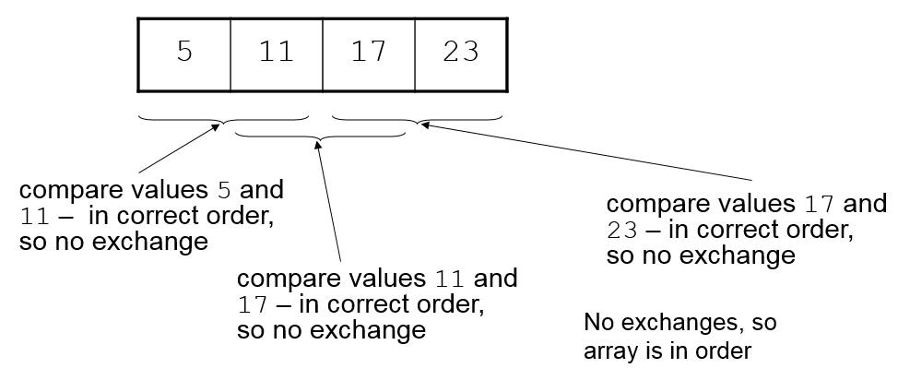
Bubble Sort Example – Third Pass
After second pass, array numlist3 contains:

Slide 18
Bubble Sort
Bubble Sort Algorithm in Pseudocode:
For maxElement = each subscript in the array, from the last to the first
For index = 0 To maxElement - 1
If array[index] > array[index + 1]
swap array[index] with array[index + 1]
End If
End For
End For

Slide 19
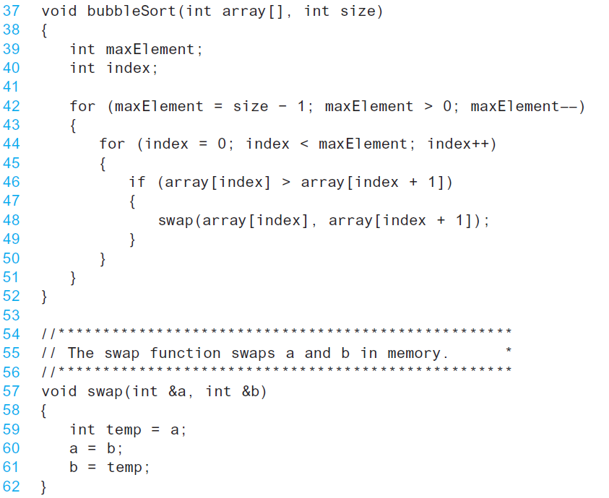
C++ code For Bubble Sort Function

Slide 20
Bubble Sort - Tradeoffs
Benefit:
Easy to understand and implement
Disadvantage:
Inefficient: slow for large arrays
It is inefficient because values move by only one element at a time toward their final destination in the array.

Slide 21
Selection Sort
The selection sort algorithm usually performs fewer swaps because it moves items immediately to their final position in the array.
The selection sort works as follows, for sort in ascending order:
Locate smallest element in array. Exchange it with element in position 0
Locate next smallest element in array. Exchange it with element in position 1.
Continue until all elements are arranged in order

Slide 22
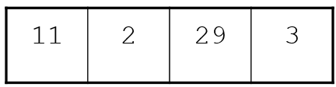
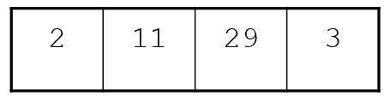
Selection Sort - Example
Array numlist contains:
Smallest element is 2. Exchange 2 with element in 1st position in array:

Slide 23
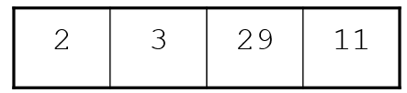
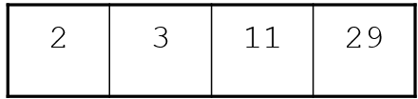
Example (Continued)
Next smallest element is 3. Exchange 3 with element in 2nd position in array:
Next smallest element is 11. Exchange 11 with element in 3rd position in array:

Slide 24
Selection Sort
Selection Sort Algorithm in Pseudocode:
For start = each array subscript, from the first to the next-to-last
minIndex = start
minValue = array[start]
For index = start + 1 0 To size – 1
If array[index] < minValue
minValue = array[index]
minIndex = index
End If
End For
Swap array[minIndex] with array[start]
End For

Slide 25
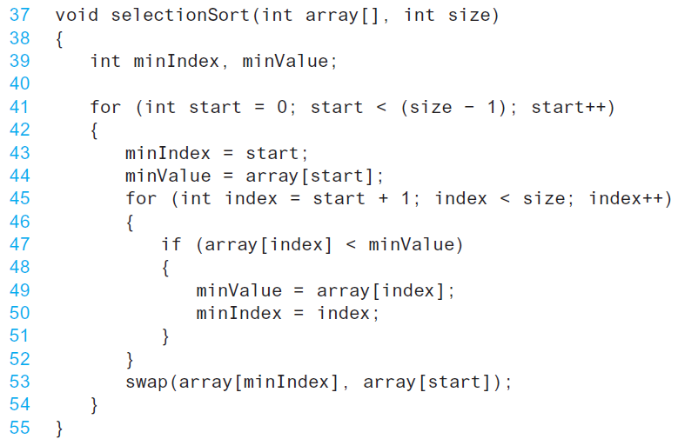
C++ code For Selection Sort Function

Slide 26
Selection Sort - Tradeoffs
Benefit:
More efficient than Bubble Sort, since fewer exchanges
Disadvantage:
May not be as easy as Bubble Sort to understand

Slide 27
Sorting and Searching Vectors
Sorting and searching algorithms can be applied to STL vectors as well as arrays
Need slight modifications to functions to use vector arguments:
vector <type> & used in prototype
No need to indicate vector size – functions can use size member function to calculate

