Slide 1
NP-probeseq-T1

Slide 2
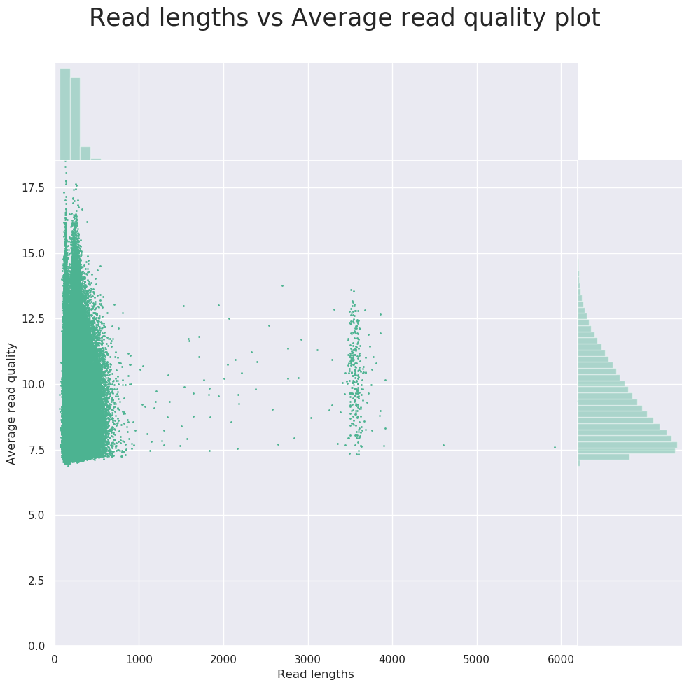
Mean read length | 212.7
Mean read quality | 9.2
Median read length | 201.0
Median read quality | 8.8
Number of reads | 430,285.0

Slide 3
Results from mapping (minimap)
mapped to : | Mapped Reads | % reads Mapped | Mapped Nucleotides | Reads Mapped to Probe Coordinates | mean mapping length
converted genome | 160000 | 51 | 6409791 | 80179 | 40.06
non converted genome | 50906 | 16 | 1336681 | 1451 | 26.26
mybaits-methyl probes | 114825 | 36 | 7152000 | 0 | 62.29
mybaits probes | 3544 | 1 | 181095 | 0 | 51.10

Slide 4
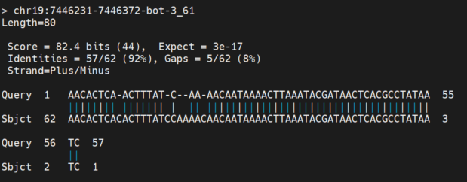
Blast of adapter trimmed reads against the MyBait Probes
 | Reads | Percent
Aligned to probe | 43320 | 46.75308
Not aligned | 49337 | 53.24692

