Slide 1

INTRODUCTION
Project Title - “Android E-Learning Application (Online)”.

Slide 2
OBJECTIVES
• Make all the system computerize.
• Reduce time consumption.
• No paper management.
• Learn anytime anywhere.
• Paperless, Go green.
• Get updated to current affairs in educational field.
• Smart use of technology.

Slide 3


TECHNOLOGIES USED
FRONT END

Slide 4


TECHNOLOGIES USED
BACK END

Slide 5

TECHNOLOGIES USED
DATABASE
Firebase Storage

Slide 6

HARDWARE AND SOFTWARE REQUIREMENTS
HARDWARE:
RAM : Min. 512 MB.
MINIMUM MEMORY : 1GB (Gigabyte).
SOFTWARE:
Operating System : Android.
Minimum SDK : 18.
Minimum Version : Android 4.4.2 (KitKat).

Slide 7
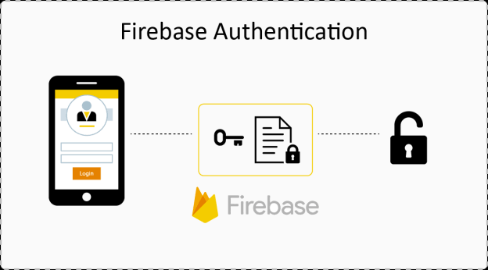
MODULES
AUTHENTICATION

Slide 8
MODULES
AUTHENTICATION

Slide 9
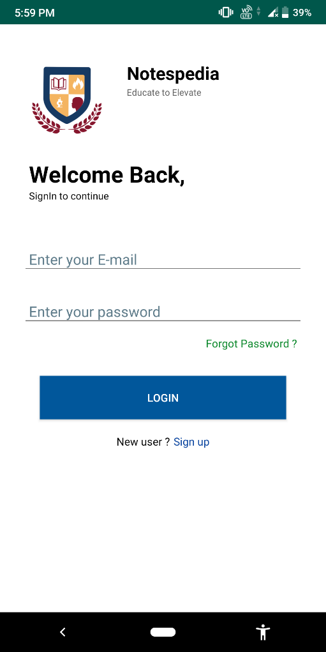
MODULES
LOGIN ACTIVITY

Slide 10
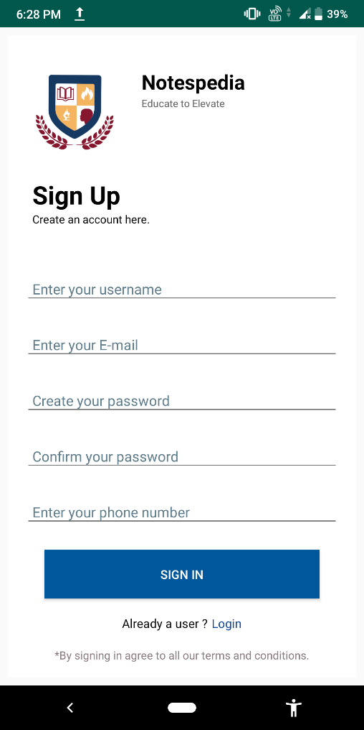
MODULES
SIGNUP ACTIVITY

Slide 11
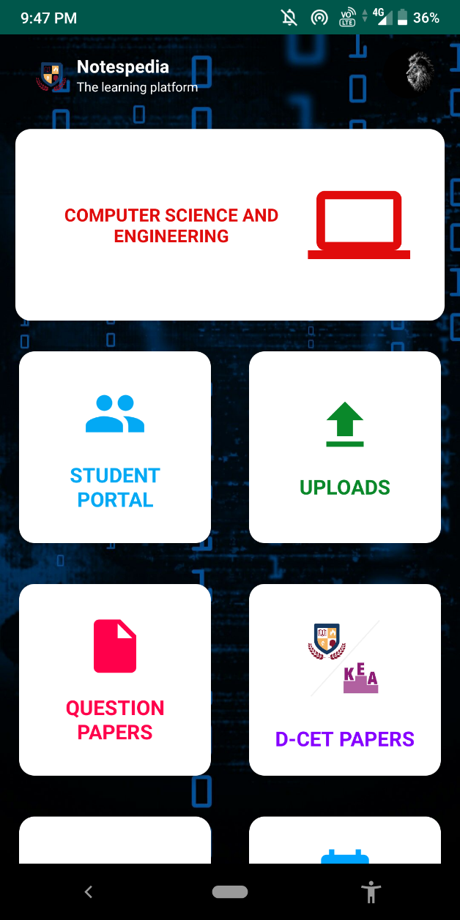
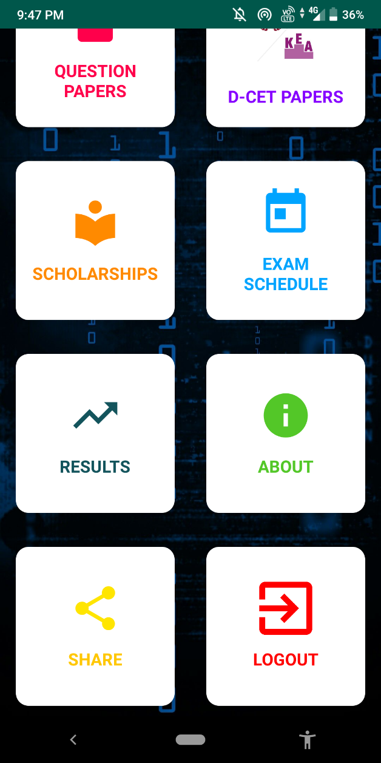
MODULES
HOME ACTIVITY

Slide 12
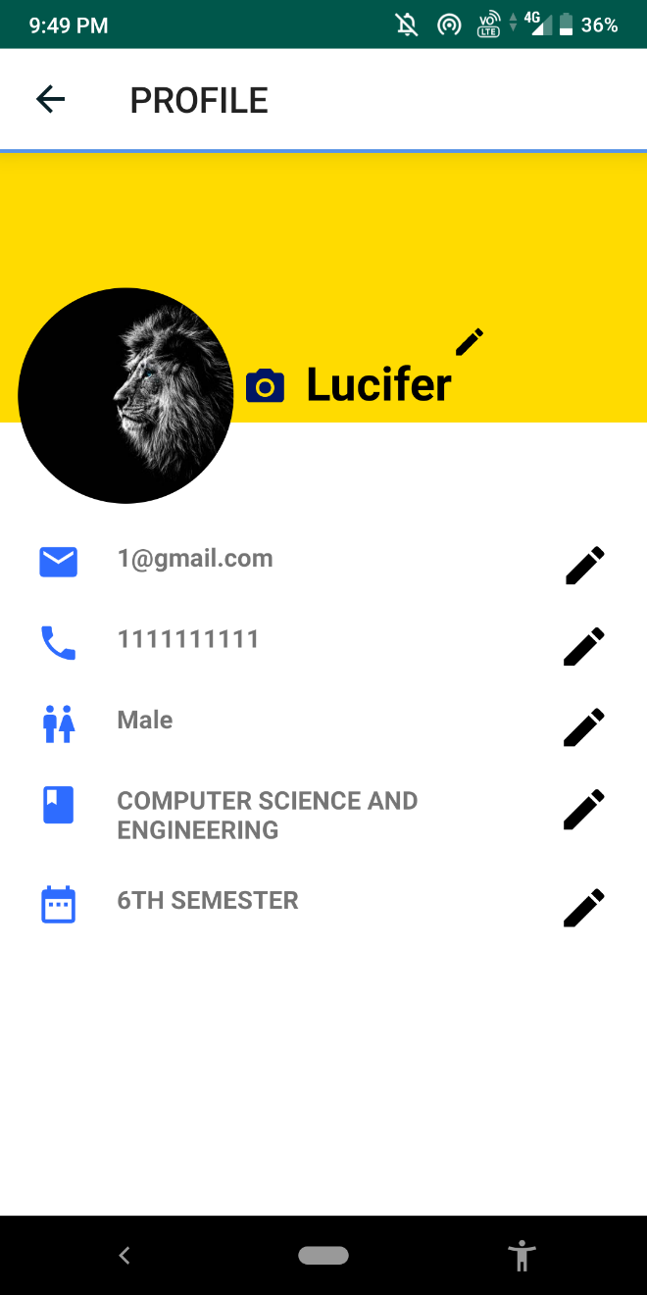
MODULES
PROFILE ACTIVITY

Slide 13
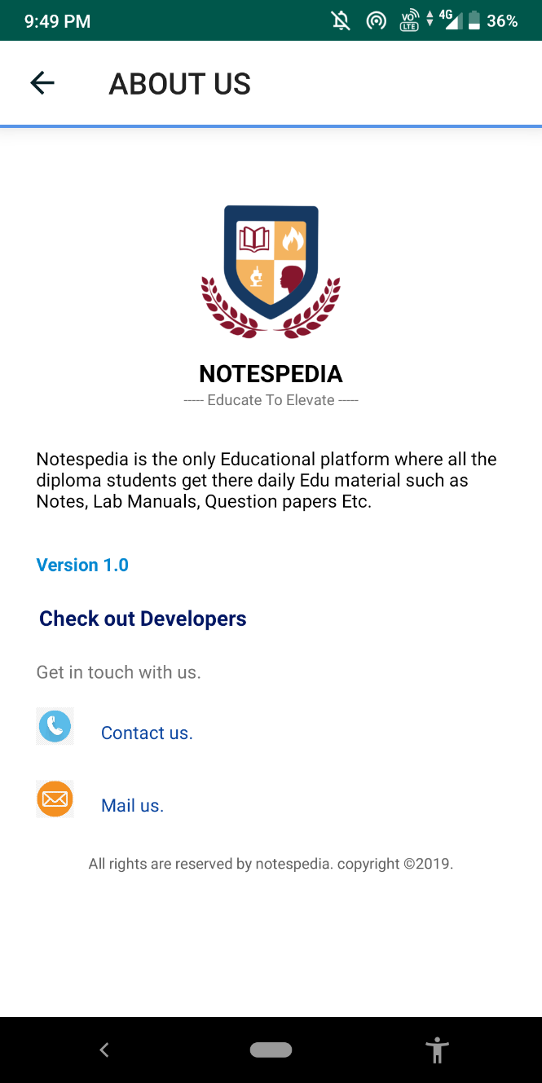
MODULES
ABOUT US ACTIVITY

Slide 14
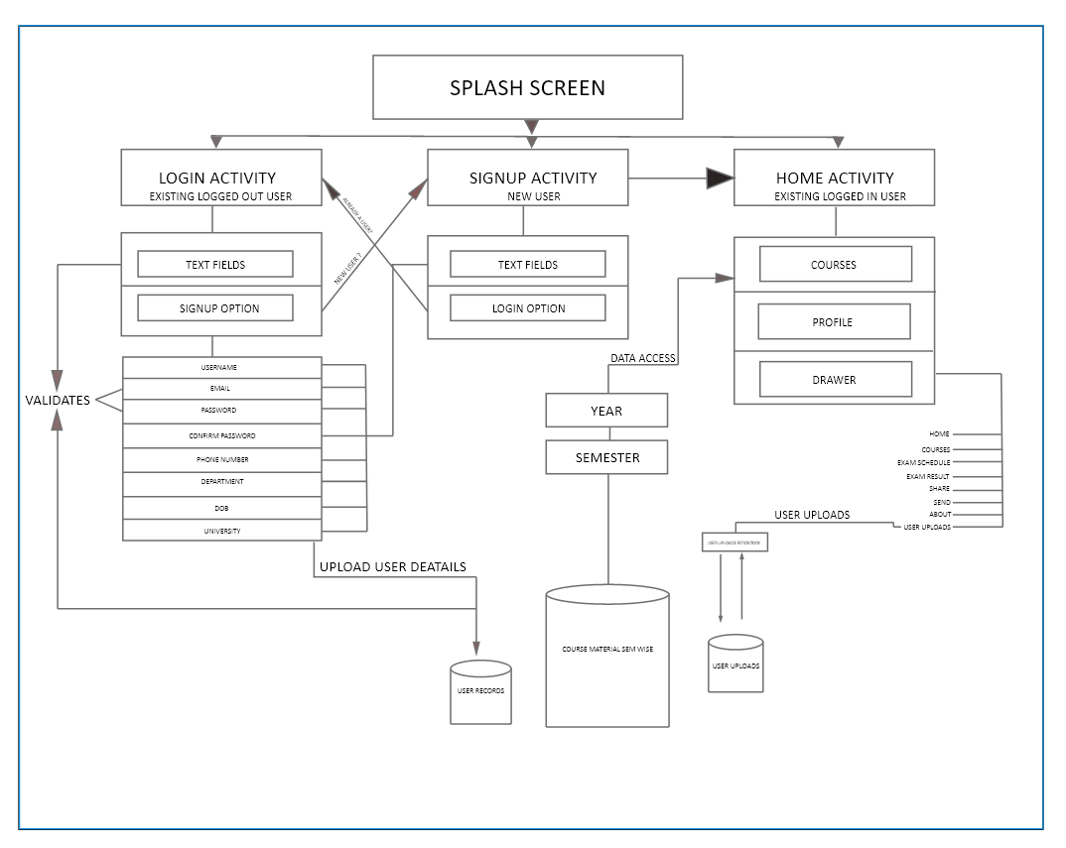
SYSTEM ARCHITECTURE DESIGN

Slide 15
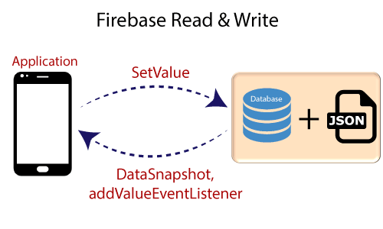
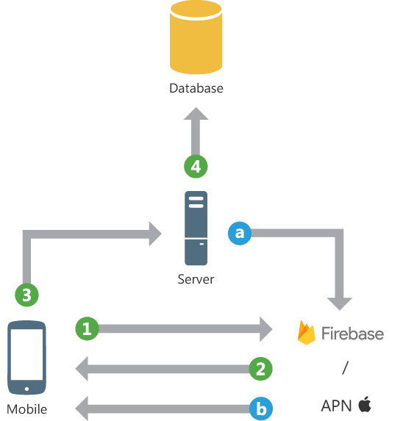
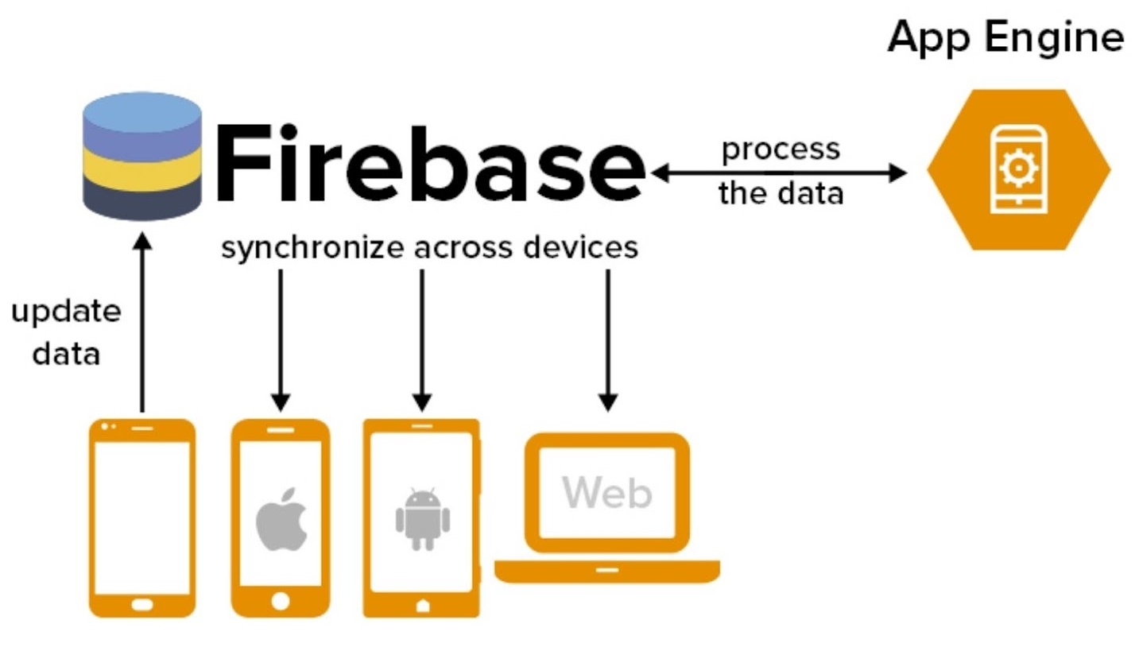
WORKING
ALWAYS IN SYNCHRONIZATION

Slide 16

FUTURE SCOPE
E-learning has rapidly evolved from a thing of the future to a practical approach towards education.
It will continue to be an extremely useful classroom teaching tool as well as self-study platform.
Experimental subjects, skill-based learning and military training will come to depend more heavily on e-learning solutions.
E-learning websites demand no such age bars. Anyone willing to learn anything, anytime is allowed to do so.

Slide 17

So our main aim in future will be to overcome all those boundaries and difficulties, and create a proper educational app which can solve all the problems of students and coordinators simultaneously.

Slide 18


