Slide 1

What is PHP ?

Slide 2
PHP is Acronym of
"PHP Hypertext Preprocessor"

Slide 3



WORKING OVERVIEW
REQUEST
SERVER FILESYSTEM
HTML & DATA
RESPONSE
SERVER

Slide 4



PHP on Server Side
PHP Code Works with ..
Server

Slide 5

PHP Essentials
Php File Extension

Slide 6
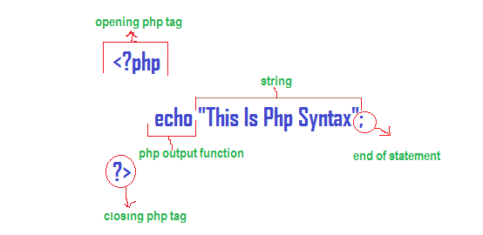
PHP Essentials

Slide 7
Task 1: Printing
<?php
echo "Hello World!";
?>

Slide 8
Task 2: Embedding
<html>
<body>
<h1>My first PHP page</h1>
<?php
echo "Hello World!";
?>
</body>
</html>

Slide 9
Task 3: Variables
<html>
<body>
<?php
$greet = "Hello world!";
echo $greet;
?>
</body>
</html>

Slide 10
Task 4: if..else..
<?php
$num1 = 10;
$num2 = 20;
if ($num1 < $num2) {
echo "Have a good day!";
} else {
echo "Have a good night!";
}
?>

Slide 11
Task 4: While Loop
<?php
$x = 0;
while($x <= 100) {
echo "The number is: $x <br>";
$x = $x + 10;
}
?>

Slide 12
Task 4: For Loop
<?php
for ($x = 0; $x <= 10; $x++) {
echo "The number is: $x <br>";
}
?>

Slide 13
End

Slide 14

What is MySQL ?

Slide 15
What is MySQL ?
MySQL is a relational database management
system (RDBMS) developed by Oracle that is
based on structured query language (SQL).

Slide 16
Create Database ?
CREATE DATABASE workshop_db;

Slide 17
Create Table?
CREATE TABLE users (
email varchar(255),
username varchar(255),
phone integer,
password varchar(255)
);

Slide 18
Insert into Table?
INSERT INTO users
(email, username, phone, password)
VALUES
('Alice@gmail.com', 'Alice', '9876543210', '1234');

Slide 19
Read from Table?
SELECT * FROM users;
SELECT email FROM users;
SELECT email FROM users WHERE email=’Alice@gmail.com’;

Slide 20
Update Table?
UPDATE users SET username='Bob' WHERE email = 'Alice@gmail.com';

Slide 21
Delete from Table?
DELETE FROM users WHERE email='Alice@gmail.com';
TRUNCATE users;

Slide 22
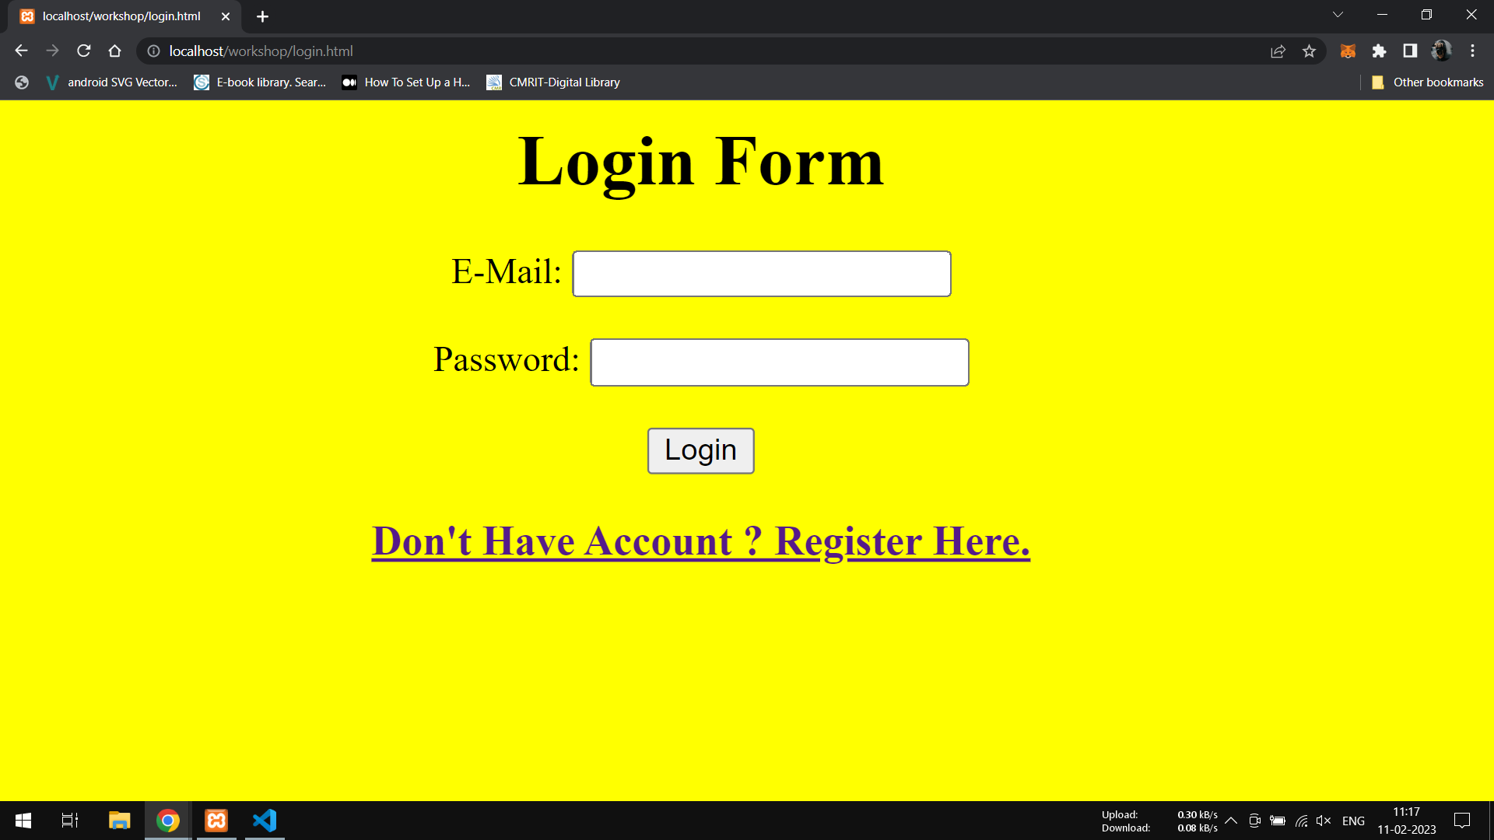
Task

Slide 23
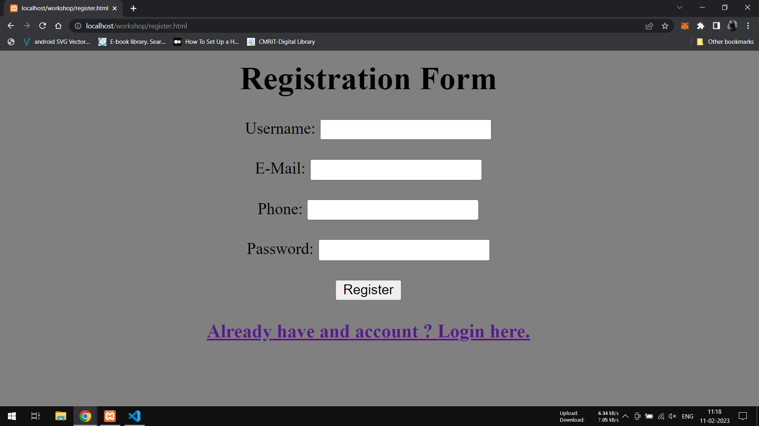
Task

Slide 24
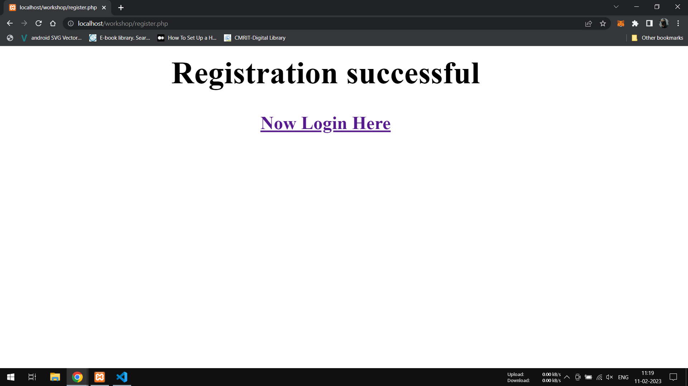
Task

Slide 25
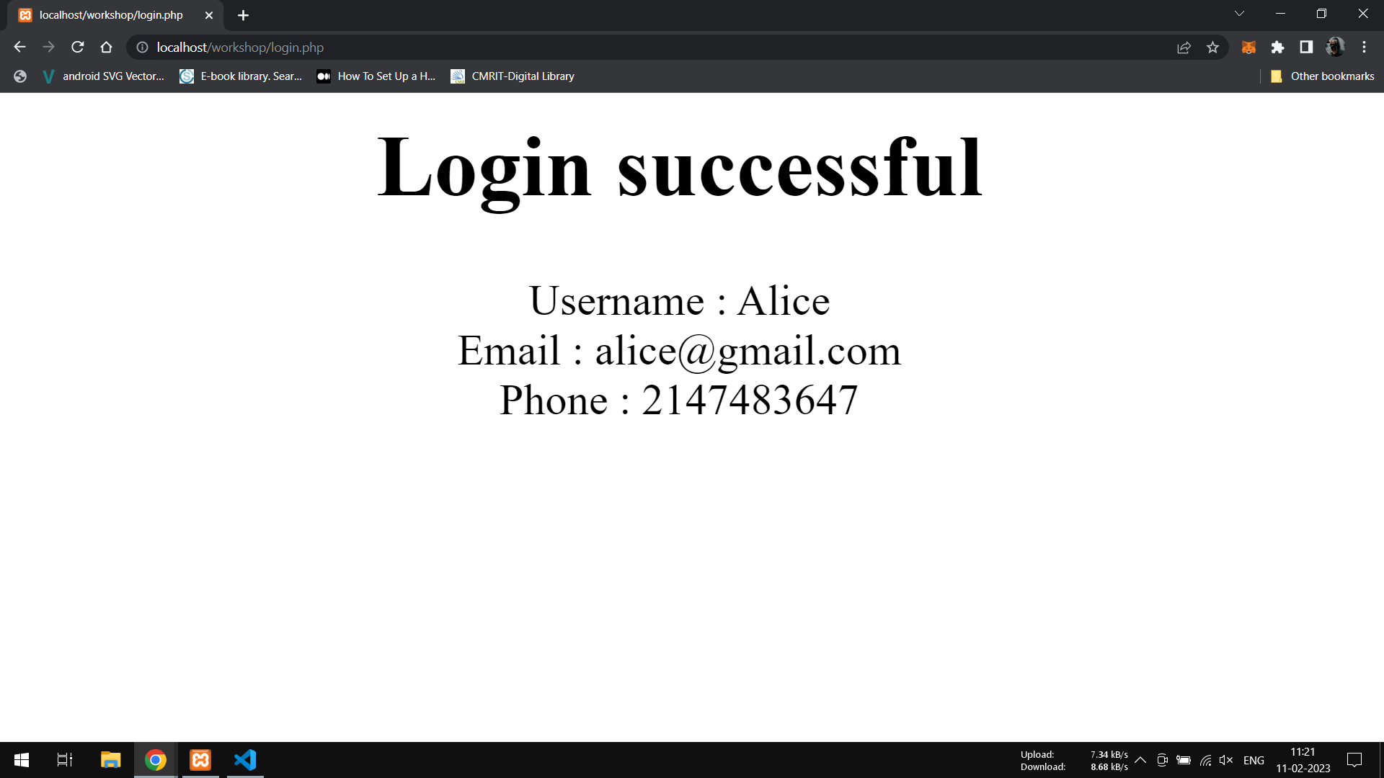
Task

