Slide 1
DevOps Milestone 2 Project
Team: Tech Titans
Aniket Manjare
Riddhi Sansare
Jitendra Patel
Kajal Yadav
Srushti Khandade
Adinath Mahangare

Slide 2
Problem Statement
Create an end-to-end CI/CD pipeline in AWS platform using Jenkins as the orchestration tool, GitHub as the SCM, Maven as the Build tool, Deploy in a docker instance and create a Docker image, Store the docker image in ECR, Achieve Kubernetes deployment using the ECR image. Build a sample java web app using maven.

Slide 3
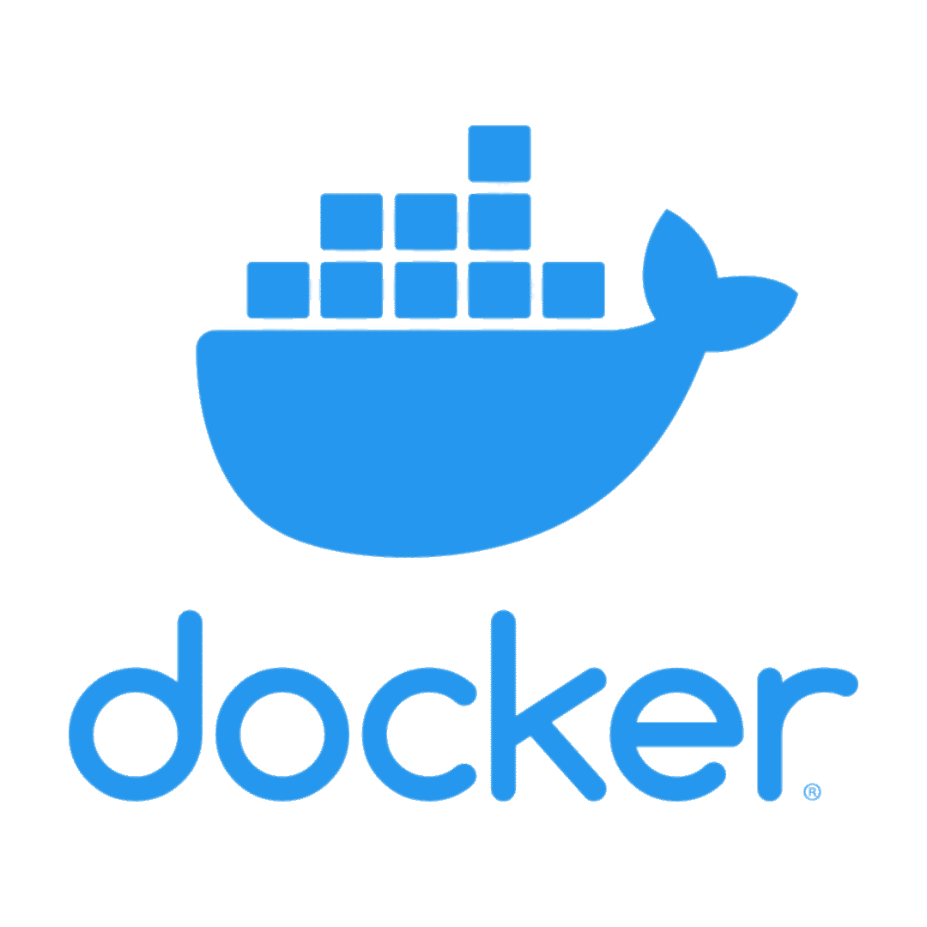
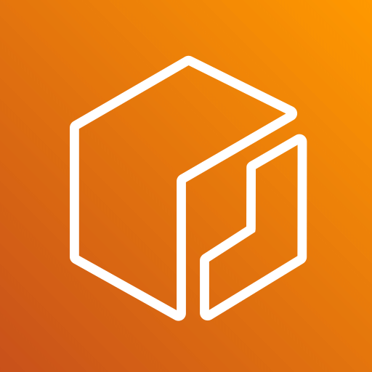
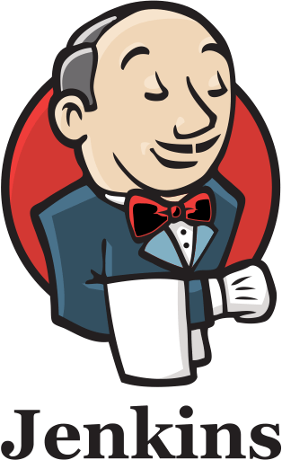
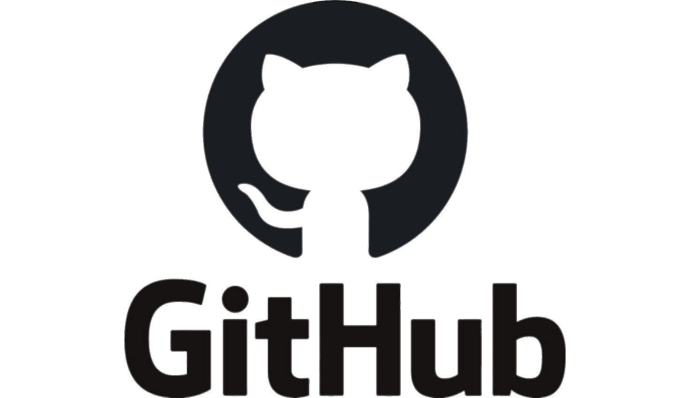
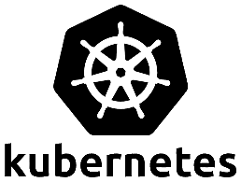
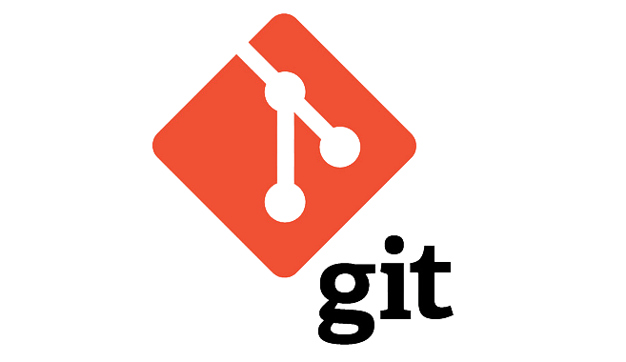
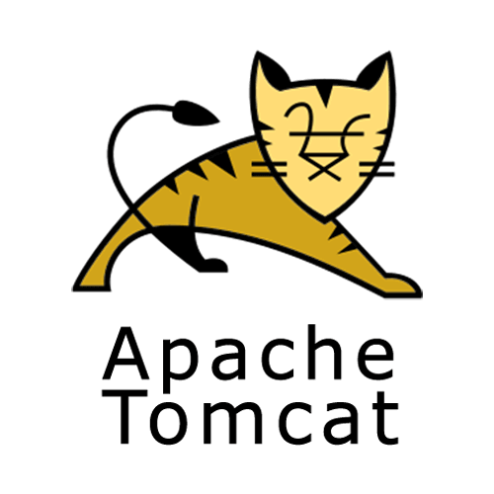
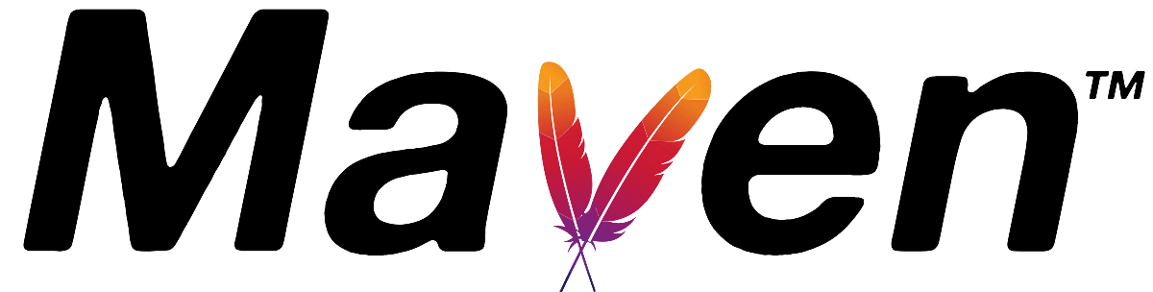
Architecture Diagram
aws access key
ECR
ssh
aws access key
webhook
ssh
ssh
credentials

Slide 4
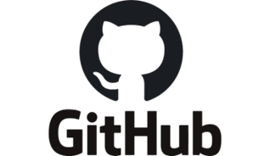
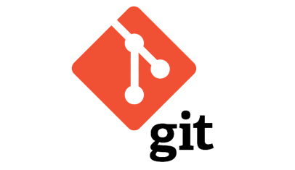
Developer Server
Git is a distributed version control system used to manage and track changes in the source code.
Developer server is used by developers to build, test and improve software before pushing to production.
Set up Git on dev-server
Connection between Dev-Server and GitHub using ssh-key
Connection between Local and Remote Repository using remote (origin)
Add >> Commit >> Push

Slide 5
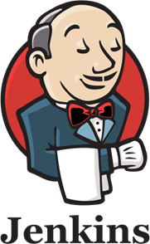
Jenkins Server
Jenkins is an open-source automation server that facilitates software projects’ continuous integration and delivery
Jenkins server
SSH key for authentication (connected Jenkins-server to local machine)
Pre-requisites packages : git and java installed
Installed Jenkins and started the Jenkins dashboard
Installed all necessary plugins
Webhook: notify Jenkins of repository changes

Slide 6

Maven
Maven is a tool that is used for building and managing any Java-based project.
1. Plugin: Maven Integration Plugin installed
2. Tools section: Java & Maven Installation paths added
3. Changed configuration of already installed GitHub Plugin
4. Created maven project & added GitHub repository
5. For automatic build: enabled GitHub hook trigger
Build successfully!

Slide 7
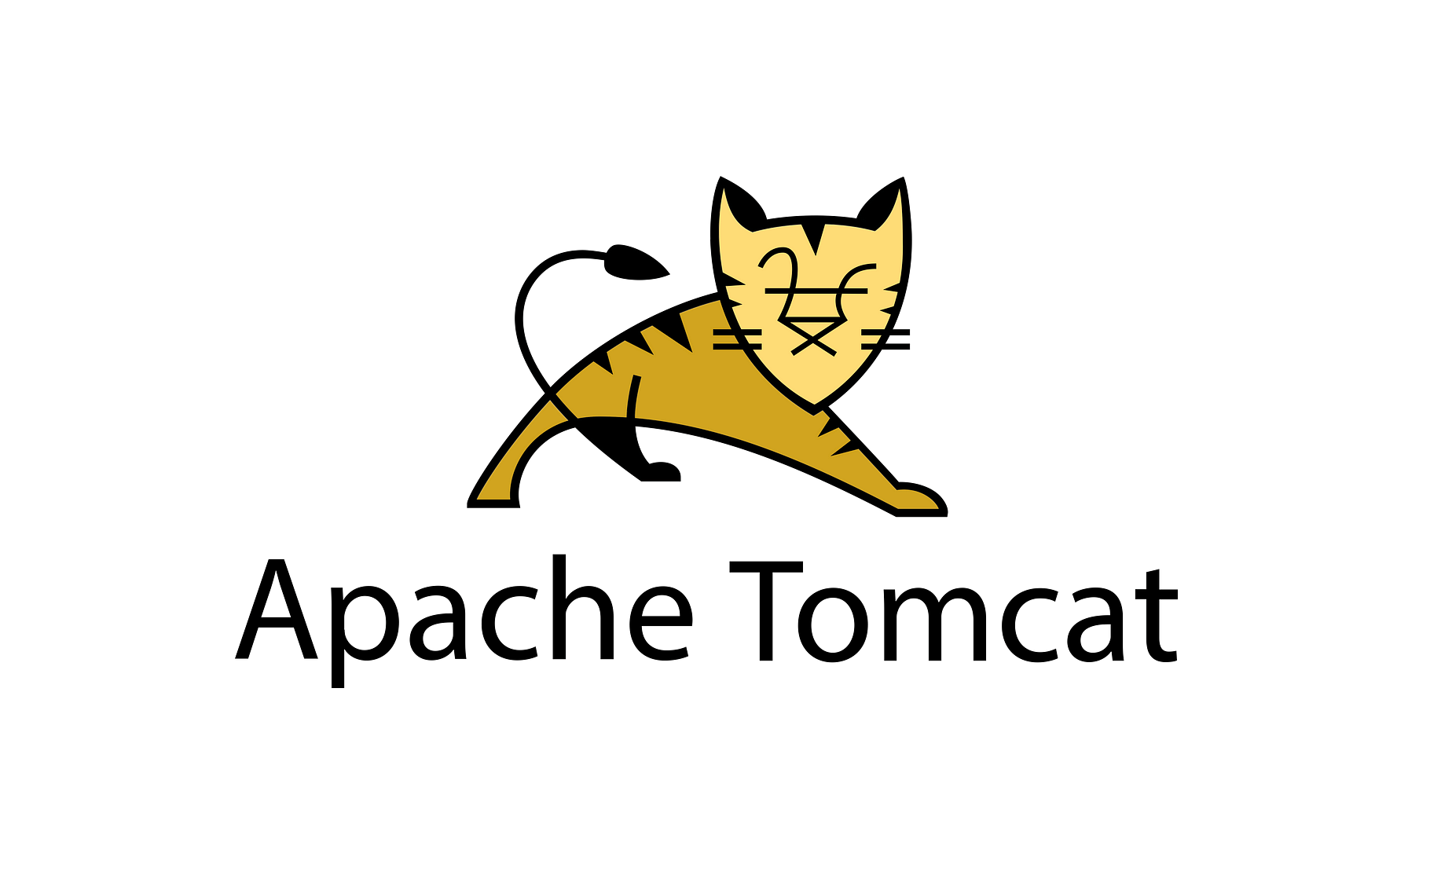
Tomcat Server
Tomcat is an open-source web server and also a servlet container that is used to deploy Java-based web applications. Primarily used for hosting Java-based web applications
Created a EC2 Instances named Tomcat-server
Java Installation and Tomcat Installation
Configuration ( added users and roles in tomcat-users.xml)
Integration and Deployment in Jenkins
Post-Build Actions (Configured Jenkins to deploy WAR files)
Build and Successfully deployed and accessed the Java web application via Tomcat's webapps URL

Slide 8
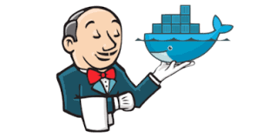
Docker Server
Docker is an open-source platform that enables developers to automate the deployment, scaling and management of applications in lightweight ,portable containers that includes all necessary dependencies
Ec2 instance creation
Docker and Jenkin integration
Added publish over SSH
Added Jenkins and Docker ssh-servers
setup Jenkins to transfer artifacts securely

Slide 9
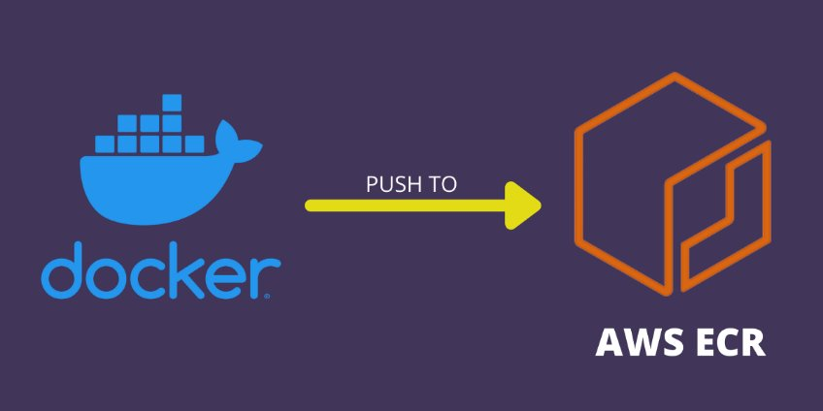
Elastic Container Registry
ECR is fully managed container registry, to store and manage Docker images, enabling seamless integration and deployment within our CI/CD pipeline.
Create repository in AWS ECR
Add User configure with Docker Server
Build Docker image and push it to ECR

Slide 10

Kubernetes Server
Kubernetes is an open-source platform for automating the deployment, scaling and management of containerized applications.
Cluster creation.
Jenkins-k8s integration.
Deployment and service.
Configuring Jenkins Pipeline.
Execution
Accessing the Webapp.

Slide 11
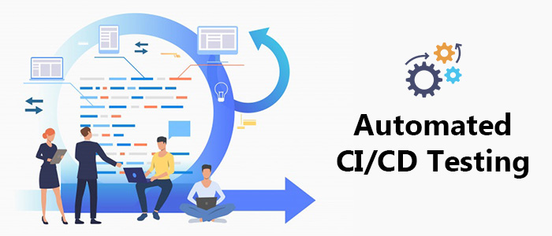
Automation
The idea behind automating Jenkins builds is to set up Jenkins to automatically
trigger a build whenever changes are pushed to a GitHub repository.
Source Code Management (SCM).
-GitHub credentials in Jenkins(Webhook)
-Jenkins configuration (GIT-scm polling)
Making changes to the application.
Automatic build triggers in Jenkins.
(Webhook notification).
Pushing Docker Image to ECR.
Kubernetes Deployment.
Automatic update in Web app .
(IP of the service)

Slide 12
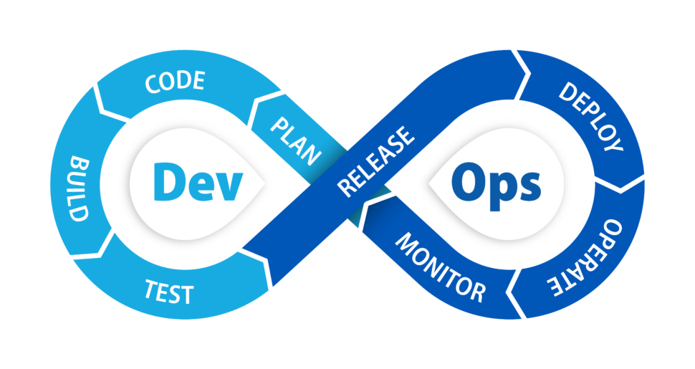
Conclusion
The conclusion of this project highlights the successful creation of an end-to-end CI/CD pipeline using AWS.
CI (Continuous integration):
Jenkins- automates the build process.
GitHub- SCM and triggering builds.
Maven- build java web app
CD (Continuous deployment)
Docker: create containerized images.
Kubernetes: deployed the app.
Overall, this project showcases the power of automating software development and deployment, bringing together the strengths of CI/CD tools for a smooth, continuous delivery experience.

Slide 13
Thank You
From Team Tech Titans

