Slide 1



X
Analysis & Design of KlinikGo Online Registration System
Klinikgo Health System Analyst Project-Based Internship Program
Presented by
Adinda Aulia Balqis

Slide 2



Experience
Visual Communication Design – F&B Marketing
Plan structured content flows and communication strategies based on audience behavior.
Turn campaign ideas into organized workflows, templates, and visual systems.
Collaborate with marketing teams to translate business goals into clear visual execution.
Quality Assurance Bootcamp – Sanbercode
Adinda Aulia Balqis
Applied Software Testing Life Cycle (STLC) through hands-on projects, including test planning, test case design, execution, and bug reporting.
Performed manual testing (functional, regression, smoke) and automation testing using Cypress (POM), Katalon, Postman for API testing, and SQL for data validation.
Delivered a final project recognized as Best Project of the batch.
Information Systems graduate with experience across Visual Design, UI/UX, and Quality Assurance. Through these roles, I learned to understand the Software Development Life Cycle end to end, from requirements, user flows, and system design to testing and documentation. This shaped my systematic way of thinking and my strong interest in System Analysis, where business needs are translated into structured system solutions.
UI/UX Virtual Internship Project – Nuri
Conducted user research to identify pain points and define problem statements.
Developed user flows, wireframes, and prototypes from user and business requirements.
Translated user needs into structured digital solutions and documentation.

Slide 3
Case Study
As a System Analyst at Klinikgo, I am assigned to design a comprehensive system diagram that represents the patient registration process through the KlinikGo web platform.
This platform enables patients to register online, select their preferred doctor, and schedule an appropriate visit time. In developing this diagram, I am required to apply standard and widely recognized system diagram symbols to ensure clarity, consistency, and professional representation.

Slide 4
Business Needs & System
Patients must fill out the registration form by entering:
Medical Record Number, WhatsApp number, preferred appointment day and time, and selected doctor (for existing patients).
Complete patient data, WhatsApp number, preferred appointment day and time, and selected doctor (for new patients).
Doctor schedules may change at any time. Providing a WhatsApp number is mandatory to receive sudden schedule change notifications.
If the data is complete and valid, the system sends a registration confirmation to the patient via email or WhatsApp.
The system also displays an online registration confirmation page containing information such as the registration number and other registration details.
The online registration number or proof must be brought on the day of re-registration:
Existing BPJS patients can re-register at the APM machine.
New patients and existing non-BPJS patients can re-register at the Online Registration Counter.
The doctor consultation queue number follows the order of the online registration.
Patients who have completed online registration are expected to arrive on time, at least 1 hour before the doctor’s clinic schedule.

Slide 5
System Design
1
Flowchart
2
Data Flow Diagram DFD 0
3
Use Case Diagram
4
Activity Diagram
5
Sequence Diagram

Slide 6
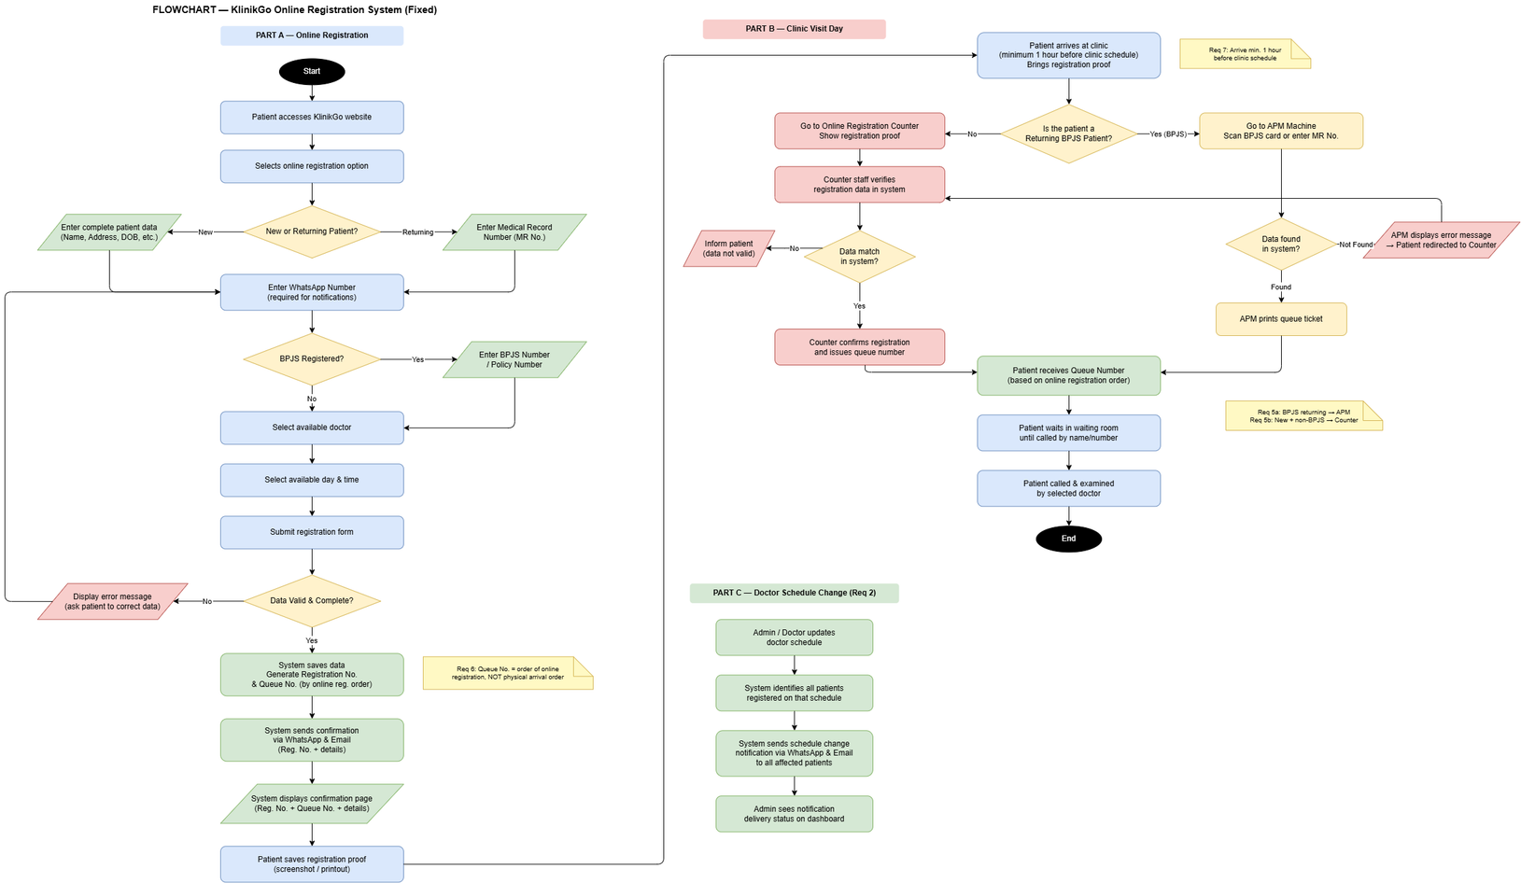
FLOWCHART
KlinikGo Online Registration System
This diagram illustrates the interactions between system actors — Patient, Counter Staff, and Admin/Doctor — and the available system functions. It shows that patients can register online (as new or returning), view doctor schedules, receive confirmations, and get notified of schedule changes. Counter Staff handles re-registration and data verification at the counter, while Admin/Doctor manages doctor schedules and triggers change notifications to affected patients.

Slide 7
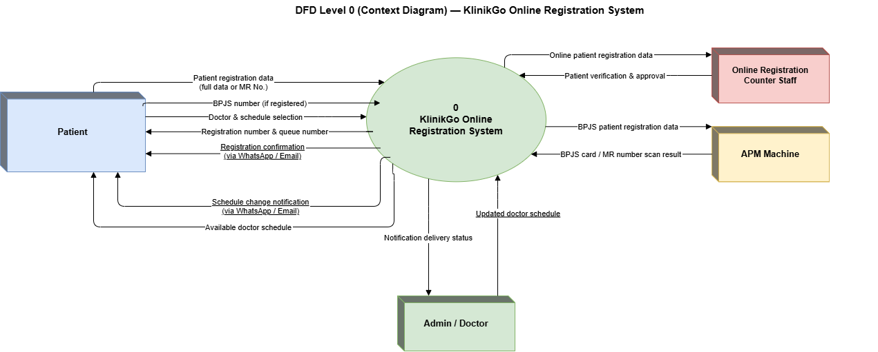
DFD 0
KlinikGo Online Registration System
Patients input registration data, WhatsApp numbers, doctor preferences, and BPJS numbers, and in return receive registration confirmations, queue numbers, and schedule change notifications via WhatsApp and Email. Counter Staff receives patient data for verification and sends back approvals. The APM Machine exchanges BPJS scan data for returning BPJS patients. Admin/Doctor submits schedule updates and receives notification delivery status from the system.

Slide 8
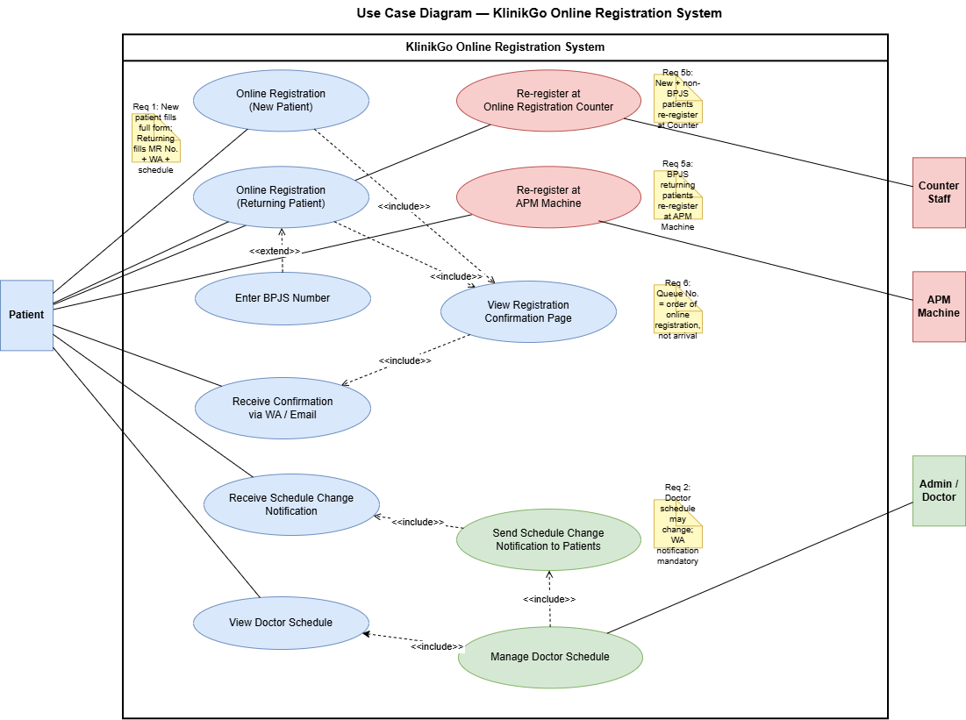
Usecase Diagram
KlinikGo Online Registration System
This diagram provides a high-level overview of data flows between the KlinikGo Online Registration System and all external entities. Patients input registration data, WhatsApp numbers, doctor preferences, and BPJS numbers, and in return receive registration confirmations, queue numbers, and schedule change notifications via WhatsApp and Email. Counter Staff receives patient data for verification and sends back approvals. The APM Machine exchanges BPJS scan data for returning BPJS patients. Admin/Doctor submits schedule updates and receives notification delivery status from the system.

Slide 9
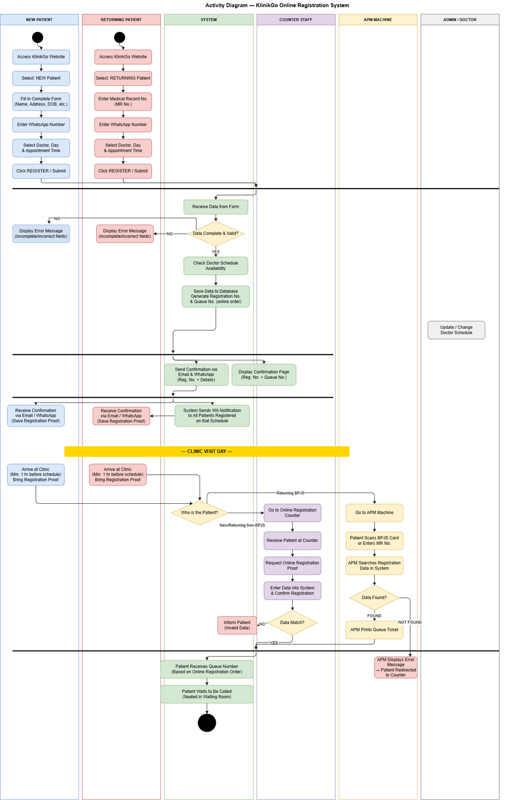
Activity Diagram
KlinikGo Online Registration System
This diagram maps the detailed actions of all six parties involved — New Patient, Returning Patient, System, Counter Staff, APM Machine, and Admin/Doctor — using swimlanes. It captures the complete end-to-end process: from form submission and data validation, to schedule availability checking, confirmation sending, and clinic-day re-registration. It clearly shows the split between BPJS returning patients (APM lane) and other patients (Counter lane), and highlights that queue numbers follow online registration order.

Slide 10
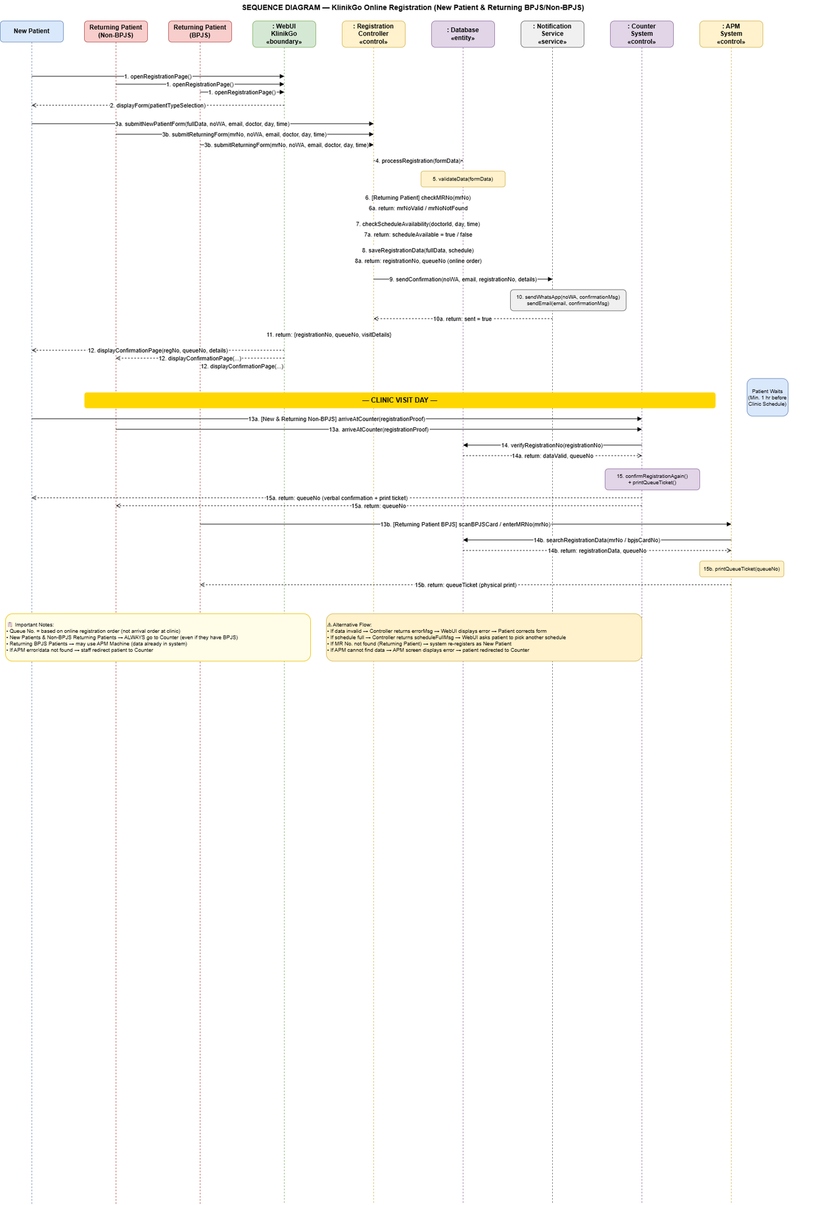
Sequence Diagram
KlinikGo Online Registration System
This diagram shows the chronological message exchanges between system components during the registration process, covering all three patient types: New Patient, Returning Non-BPJS, and Returning BPJS. It traces calls from the WebUI through the Registration Controller, Database, and Notification Service — including data validation, MR number verification, schedule availability checks, data saving, and confirmation delivery via WhatsApp and Email. The clinic visit day section shows verification at the Counter (for new and non-BPJS patients) and at the APM Machine (for BPJS returning patients).

Slide 11
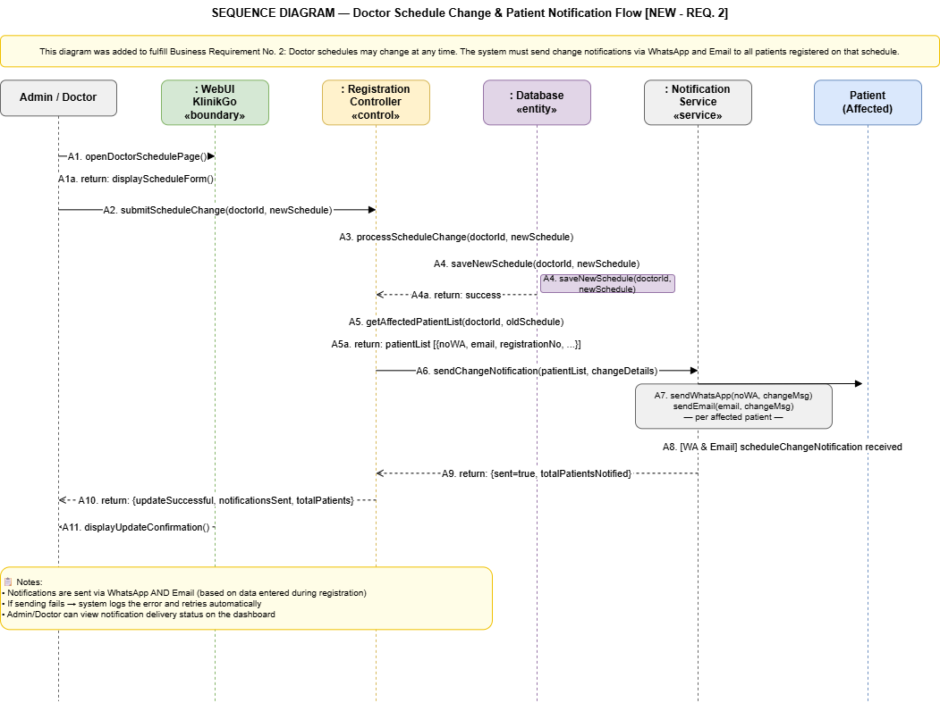
Sequence Diagram
Doctor Schedule Change & Patient Notification Flow
This diagram specifically addresses Business Requirement No. 2: doctor schedules can change at any time, and the system must notify all registered patients immediately. It shows the full sequence from Admin/Doctor submitting a schedule update, the system saving the new schedule, retrieving the list of affected patients, and the Notification Service dispatching WhatsApp and Email messages to each patient. The Admin can monitor notification delivery status from the dashboard.

Slide 12
Thank You
X

