Slide 1
Dog and Cat Breeds
Presented by: Adindutochi Nwosu
Date: September 19th, 2022

Slide 2
Table of Content
Purpose Statement
Data Presentation
Conclusion

Slide 3
Purpose Statement Objective
The dataset used in this analysis is a structured data of dog and cat breeds. The dataset contains information of different dog and cat breeds. The quantity sold for each breed and the price it was sold for can be identified in the dataset. There are factors in the dataset that can easily affect the price of each breed like the temperament, popularity and intelligence. The object of this analysis is to used these different factors to find trends.

Slide 4
Data Presentation
Top breeds based on Popularity
Dog | Popularity | Cat | Popularity
Norwegian Lundehund | 190 | American Wirehair | 41
Sloughi | 188 | Korat | 40
Foxhound | 187 | LaPerm | 39
Hound | 187 | Burmilla | 38
Otterhound | 186 | Turkish Van | 37
Cirneco dell'Etna | 184 | Bobtail | 36
Harrier | 183 | Havana | 35
Dandi Dinmont Terrier | 182 | Bombay | 34
Chinook | 179 | Ragamuffin | 32
English Coonhound | 178 | Balinese | 31
Finnish Spitz | 177 | Turkish Angora | 29
Polish Lowland Sheepdog | 176 | Somali | 28
Canaan Dog | 175 | Chartreux | 27
Pharaoh Hound | 174 | American Curl | 26
Finnish Lapphund | 173 | Selkirk Rex | 25
These tables show the top and bottom dog and cat breeds based on their popularity. The Norwegian Lundehund and American Wirehair are the most popular amongst the breeds while the Exotic Shorthair cat is less known amongst the cats. The Black Labrador Retriever, Chocolate Labrador Retriever, Labrador Retriever and Yellow Labrador Retriever are a dog breed that are not widely known.
Bottom breeds based on Popularity
Dog | Popularity | Cat | Popularity
Black Labrador Retriever | 1 | Exotic Shorthair | 1
Chocolate Labrador Retriever | 1 | Persian | 2
Labrador Retriever | 1 | Maine Coon | 3
Yellow Labrador Retriever | 1 | Ragdoll | 4
German Shepherd Dog | 2 | British Shorthair | 5
Shepherd | 2 | American Shorthair | 6
White German Shepherd | 2 | Abyssinian | 7
Golden Retriever | 3 | Canadian Hairless | 8
Retriever | 3 | Sphynx (hairless cat) | 8
French Bulldog | 4 | Siamese | 9
English Bulldog | 5 | Scottish Fold | 10
Beagle | 6 | Cornish Rex | 11
Poodle | 7 | Devon Rex | 12
Standard Poodle | 7 | Oriental Long Hair | 13
Rottweiler | 8 | Oriental Short Hair | 13

Slide 5
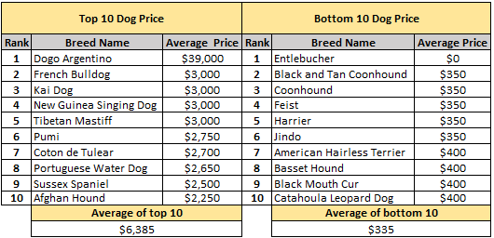
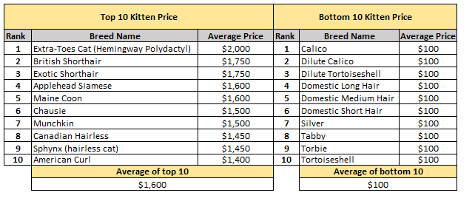
The Dogo Argentino is the most expensive dog with a price of $39,000. The average price for the top and bottom breeds are computed as seen in the tables. The average price for the top 10 dog breed is $6,385 while the bottom 10 is $335.
While Extra-Toes Cat (Hemingway Polydactyl) is the most expensive kitten priced at $2,000, the average price for the top 10 kitten is $1,600 and the bottom 10 is $100.

Slide 6
There are four different cat fur types. The bald, short, medium and long. Cat breeds with short fur are more in number compared to cats that are bald with just with just 2 breed.
Each cat breed has a temperament that is associated to it. A breed that has the potential to be a pet has to be affectionate, so in total there are 27 breeds that are affectionate and 40 without the affectionate temperament. It means a large proportion of cat breed do not have the potential to serve as a pet.

Slide 7
The dog breed are categorized into different groups, and the group with the most number of dogs is the working group. The southern group has the least dogs with just 1 breed.
Just like the cat, dogs are also associated with different temperaments. Analysis show that there are more dogs that do not have the affectionate temperament compared to those that do.

Slide 8
Top Dog breed with Most and Least sales
Analysis of the dataset shows that the Irish Water Spaniel is the most sold breed with 74,172 pups and the Foxhound made the least sale with 4 pups.

Slide 9
Top Cat breed with Most and Least sales
The Tuxedo had the most sales amongst the cat breeds with 210 kittens sold, closely followed by Turkish Van with 198 kittens sold while the Abyssinian made the least sales with 4 kittens.

Slide 10
Conclusion
One would think intelligence would be a factor in determining the price of a dog breed but the analysis tells a different story. As expected the analysis indicates that the kittens with lower prices made more sales but it was not the same with dogs as that trend was absent. Popularity also did not have an influence in determining the price or quantity sold of both dog and cat breeds.

