Slide 1
Twitter Seniment Analysis with Natural Language Processing
Jeremy Lee
Module 4 Presentation
January 29, 2020

Slide 2
Why do we need to evaluate the sentiment of tweets?
Twitter is the public opinion marketplace
3 in 4 look to Twitter users for advice
9 in 10 changed opinion because of Twitter advice
Easier and less expensive than conducting a survey
No in person events due to COVID-19 which means no in person feedback
Notes:
Twitter is full of opinions – good, bad, and indifferent. Twitter is free to access
Surveys are going to be costly! We have to come up with good questions, make decisions on how to evaluate responses. Costs to administer the survey and without past survey data how can we predict the response rate?
No in person feedback – there’s no way to put the product or service in the hands of the customers. There’s no way to get visual cues (smiles and body language can’t be observed)

Slide 3
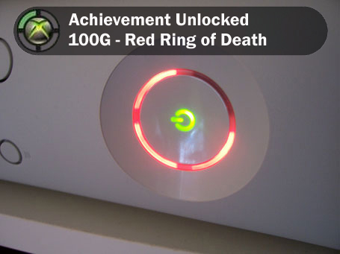
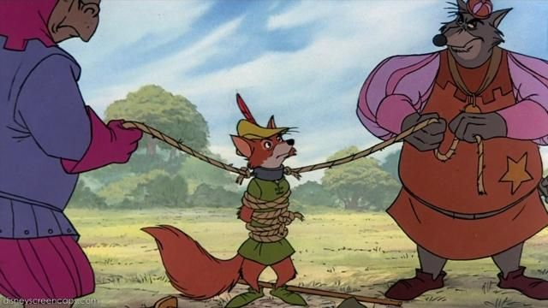
Companies Affected by Public Opinion
Microsoft
Robinhood
Company Action: Doubled price of subscription to Xbox Live Gold ($60 -> $120)
Public Reaction: Swift backlash via Twitter and mainstream gaming media outlets
Result: Microsoft reversed their position on pricing
Company Action: Halted trading of Gamestop and AMC Theater stock after stock price shot up exponentially
Public Reaction: Calls for unfair business practices on Twitter
Result: Surge in negative app reviews on Google Play resulting in a 1 star rating
Notes:
Xbox decided to increase the price (double) of their online gaming subscription. Allows users to play games online against people all over the world. Online gaming market was expected to be over 57 million users in 2020. People don’t want to pay more just to play with their friends, and there’s a pandemic. Interestingly enough, Twitter users and gaming media severely criticized the decision as being toine deaf. Microsoft announced their reversal via Twitter
Robinhood – sudden surge in purchase of gamestop and AMC stock which had been suffering recently. Halted by Robinhood and other trading/investment companies Calls of unfair market regulation via Twitter. Voiced their displeasure via app reviews in the Google Play store. Now has a 1 star rating which is going to open the market for competitors.

Slide 4
What do types of Tweets do we want our model to detect?
Focus on identifying neutral/negative tweets
Need to market and advertise towards negative/neutral users so that they can become future customers
Positive tweets are likely from users who already have a positive opinion of the product
Notes:
Good tweets are indicative of good opinions. If you have a good opinion of something you are more likely to buy it. Negative tweets have the opposite effect – they may not be a part of the customer base and we want to drive them over to our side. People care about what other people have to say about a product and which means we want those negative/neutral reviews to become positive

Slide 5
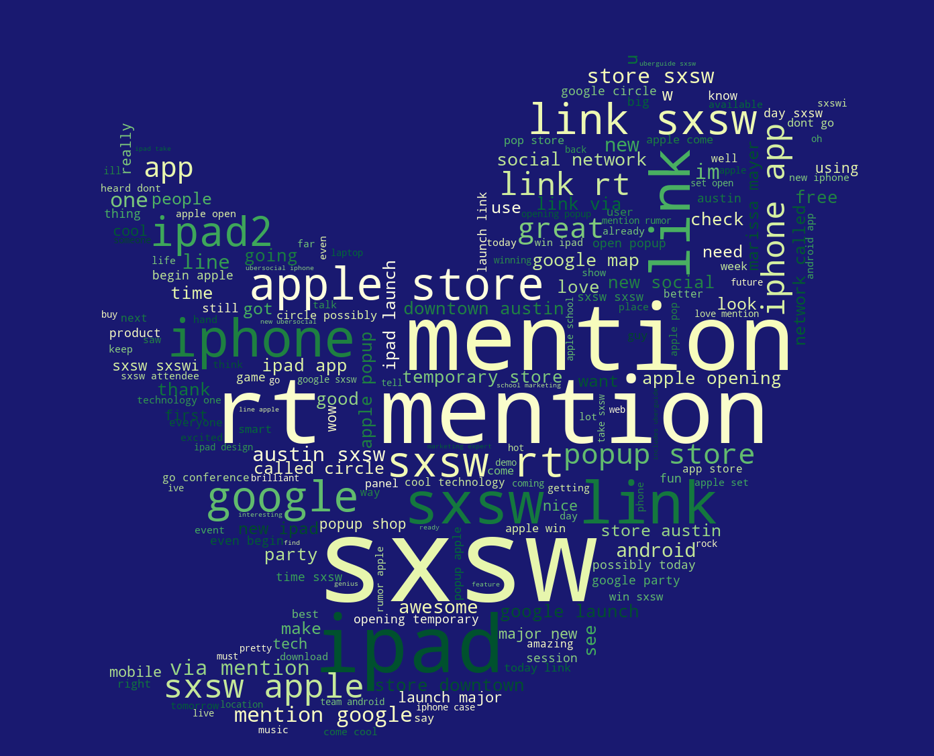
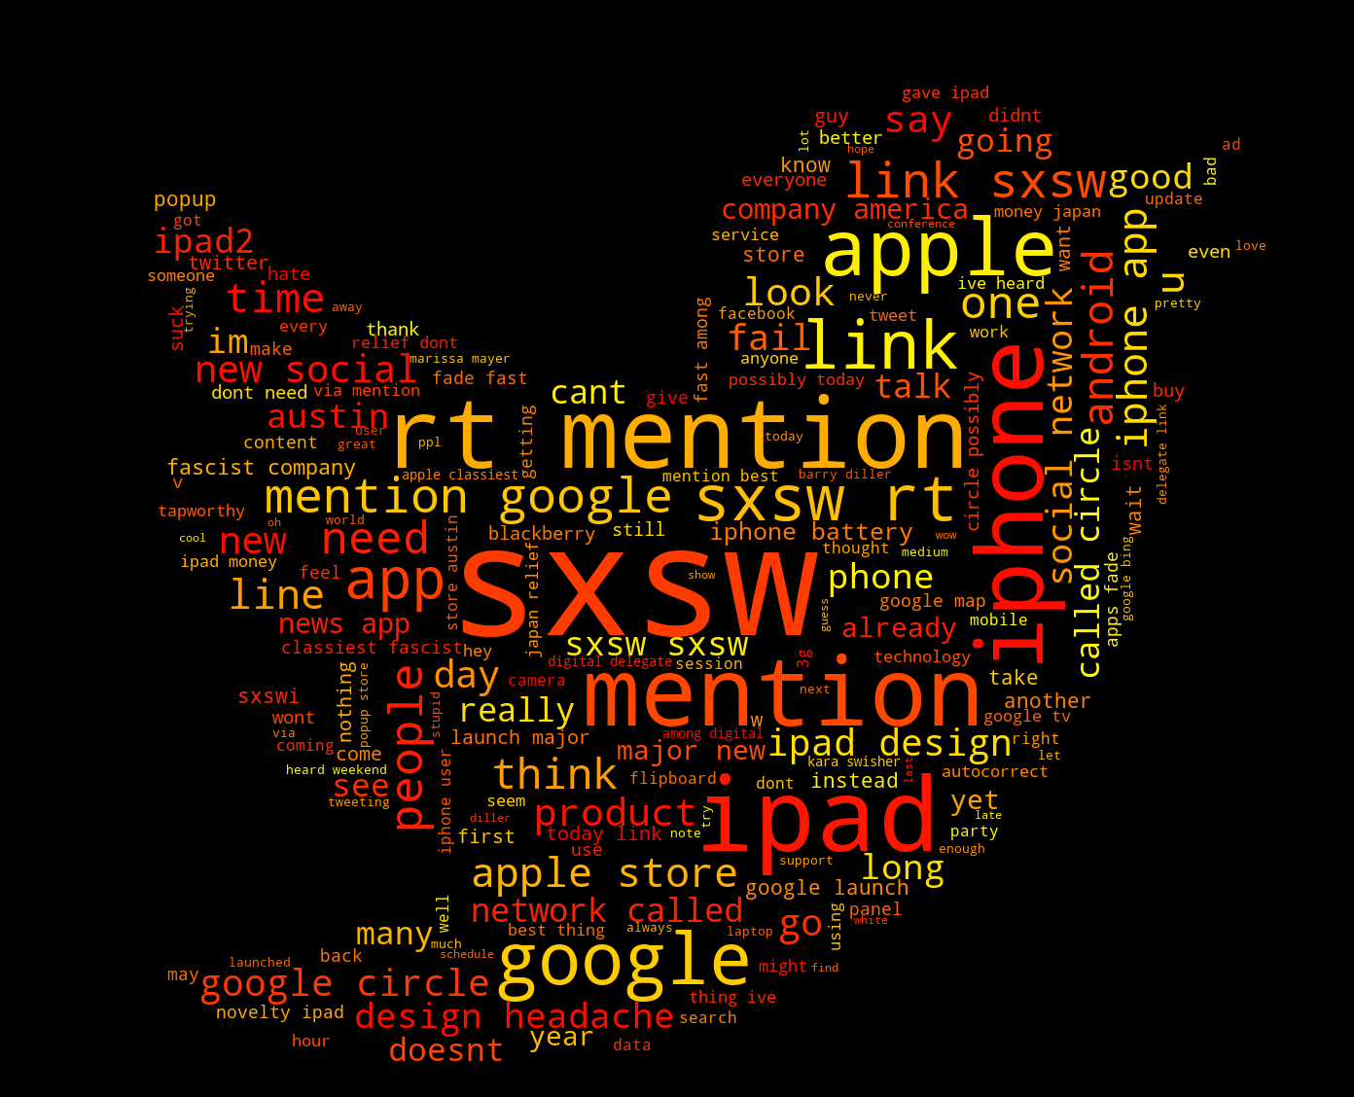
What do positive and negative tweets look like?
Notes:
Positive: Love, great, awesome, amazing
Negative: fascist company, design headache, classist, iphone battery, suck

Slide 6
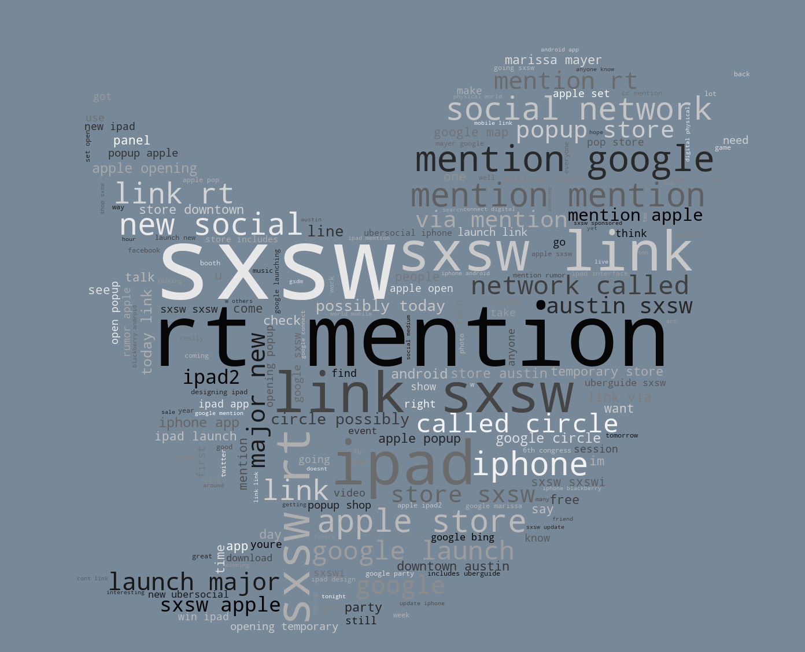
Neutral Tweets
Notes:
More of the same common words, notably charged/emotional words

Slide 7
Model Performance
Overall 72% accurate in classifying sentiment
Out of all negative/neutral tweets in our test set, we classified 90% of them correctly
Of all tweets classified by the model as positive, 70% were actually positive
Better at classifying negative tweets than positive tweets
Notable positive words: Cool, smart great, awesome, nice
Notable negative words: headache, spending, enough, challenge, battery
Notes:
72% accurate overall. Not bad! But still room for improvement
90% detection for neutral/negative tweets, so we are good at detecting those negative/neutral customers. This means we can do more analysis on those tweets and use that to inform our marketing and adversting – Tweet Detection can help us with market segmentation
Model had identified positive and negative words that we some of which we saw in the wordcloud, gives us confidence that a well tuned model is a good investment

Slide 8
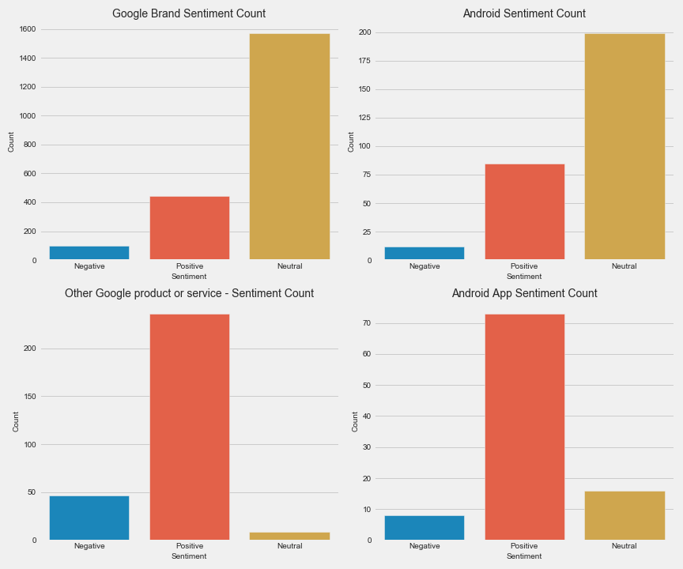
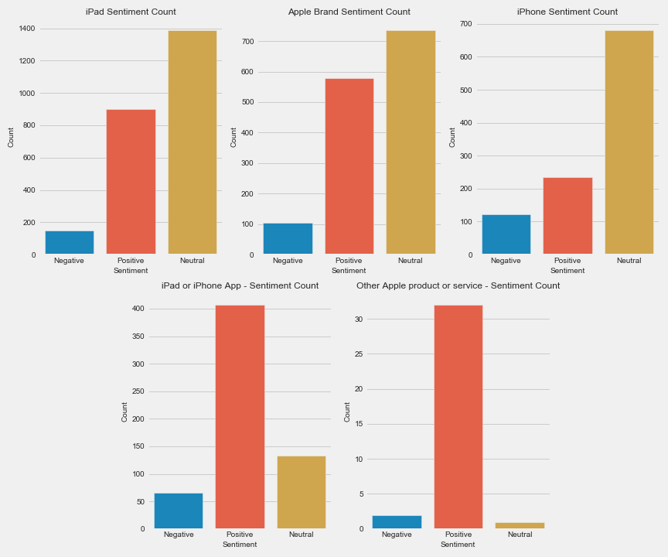
Recommendations
Release good usable software – apps make great hardware!
Curate discussions on social media – create hashtags for users with positive words
Make sure new products are a step forward
Avoid development of new forms of social media
Notes:
For both apple and google, apps and services are overwhelmingly positive. Focus on building a great app or service
Use hashtags that include positive words detected by the model? Ask users to tweet why they are excited about a product, why they love a product, why they think it’s cool
Iterate and improve – the word battery showed up in wordcloud and model – so that means that a new cell phone should improve upon battery life (note that iphone 12 is noticeably worse than iphone 11)

Slide 9
Future Work
Develop a program that can automatically grab tweets for analysis
01
Build a model to evaluate posts/comments on other forms of social media (i.e. YouTube comments)
02
Incorporate trending data to see how opinions/brands of products change over time
03
Train and test models that incorporate engagement on social media
04
Replies, retweets, and likes for Twitter
Notes:
We need a program that can easily get tweets from Twitter and pass them through the model
We shouldn’t just focus on Twitter, if we livestream on Youtube we need a way to read and evaluate those comments as well
Time series analysis – public opinion changes over time. Need to understand why so we can make sure we are consistently trending upward
Need more info about engagement with a tweet – likes and retweets – see if this improves the model or not

Slide 10
Thank You!

