Slide 1
COVID-19 ICU Admission Prediction Analysis
Group 9
Adina Dingankar
Arathi Nair
Priya Johny

Slide 2
Table of Contents
01
04
02
05
03
06
Scope of the project
Logical Architecture
Motivation
EDA & Pre-processing
Expected Outcome
Demo

Slide 3

Scope of the project
Health care systems are currently overwhelmed with the high demand in ICU beds, professionals and other health care resources.
There is an urgency to make better predictions to prepare and avoid the collapse in health care systems.
AIM: To predict admission to the ICU of confirmed COVID19 cases.

Slide 4


Motivation
Used artificial intelligence (AI) to predict Covid patients' oxygen needs on a global scale
The research was sparked by the pandemic and set out to build an AI tool to predict how much extra oxygen a Covid-19 patient may need in the first days of hospital care, using data from four continents
Article: https://www-news--medical-net.cdn.ampproject.org/c/s/www.news-medical.net/amp/news/20210915/Hospitals-use-artificial-intelligence-to-predict-Covid-patientse28099-oxygen-needs.aspx

Slide 5
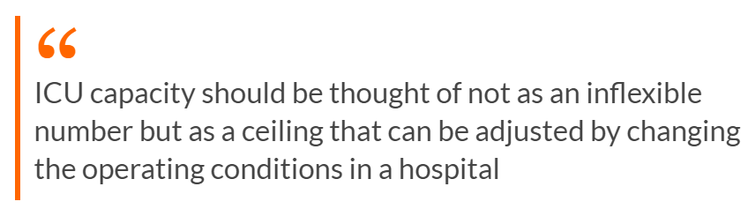
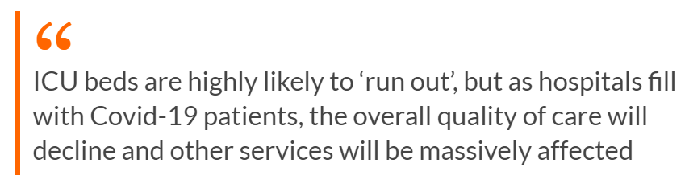

Why ICU prediction is important now?
Article: The Irish Times - What happens if ICU beds run out in Irish hospitals?

Slide 6
Dataset
The dataset contains anonymized data from Hospital Sírio-Libanês, São Paulo and Brasilia. All data were anonymized following the best international practices and recommendations.
Source: Kaggle
https://www.kaggle.com/S%C3%ADrio-Libanes/covid19
Shape: 1925 Rows X 231 Columns
Features: 54 features
Patient demographic information (03)
Patient previous grouped diseases (09)
Blood results (36)
Vital signs (06)
The features are expanded to mean, median, min, max and relative difference
Except 6 columns, all the other columns have null values
Data has been cleaned and scaled by column according to Min Max Scaler to fit between -1 and 1.

Slide 7
Expected Outcomes
We make use of AWS components to build, train, and our deploy model.
We upload our Covid ICU dataset and create a new notebook via sagemaker to compare results and deploy model for ICU bed prediction.

Slide 8


AWS Components
1. S3
S3 as the object storage service
Cost-effective storage classes
Easy-to-use management features
Creation of the bucket for storing the data
2. AWS Sage Maker
To build, train, and deploy machine learning (ML) models
AWS Sage Maker uses notebook and Python with boto to connect with the S3 bucket

Slide 9
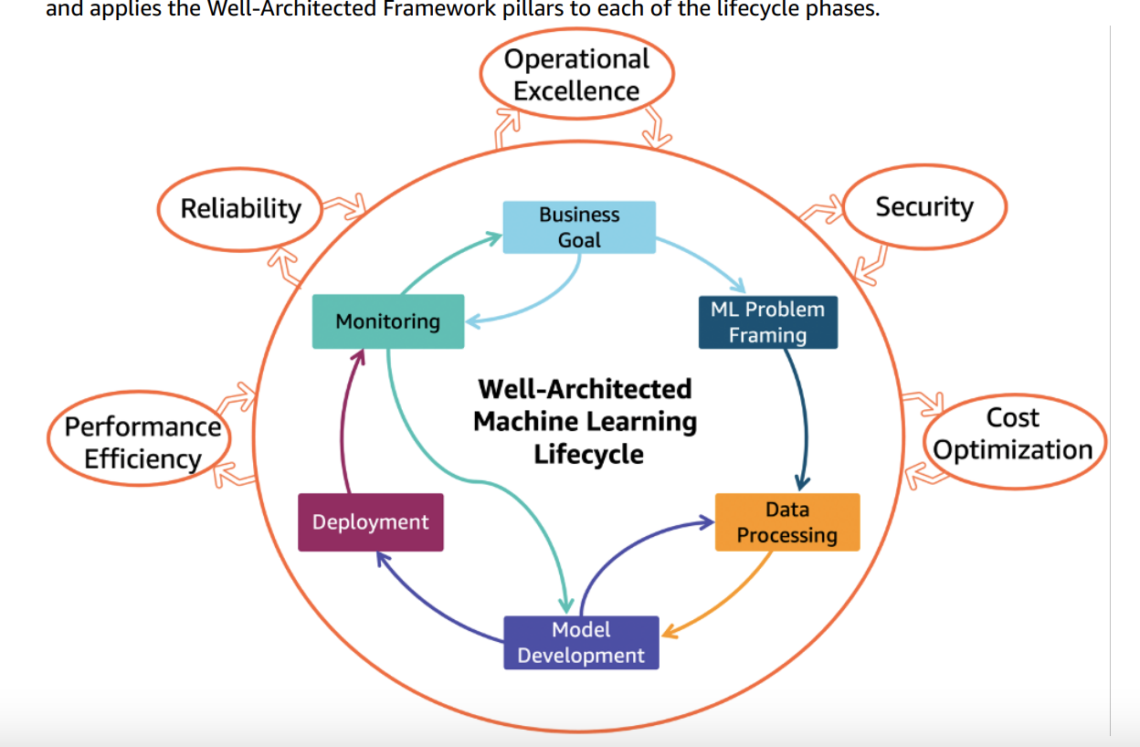
Logical Architecture
Problem is framed as ML problem: what is observed and what should be predicted (target variable).We then deploy using AWS services.

Slide 10

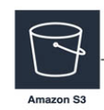
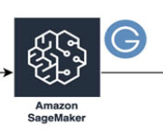
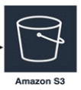
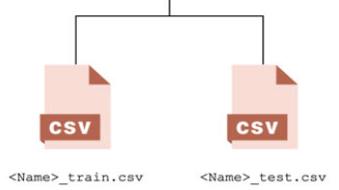
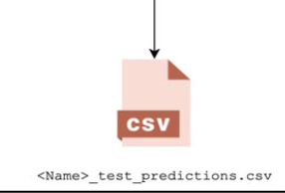
Architecture
The pipeline will be implementing will be as followed:
The pretrained machine learning model will be developed since all the data processing and data modelling will be performed on on-premise.
AWS S3 will be used for storage purpose to store the data and serialized model.
The pretrained model will be fed to the AWS Sage Maker to perform predictions.

Slide 11
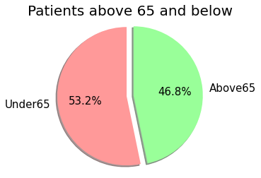
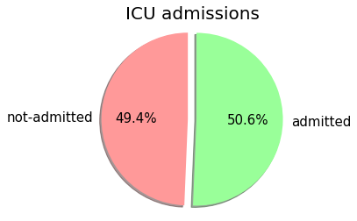
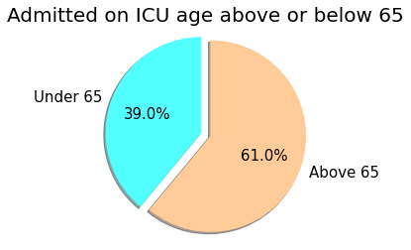
EDA
Distribution of patients based on age group admitted into ICU after 12 hours
(Total number of patients =385)

Slide 12
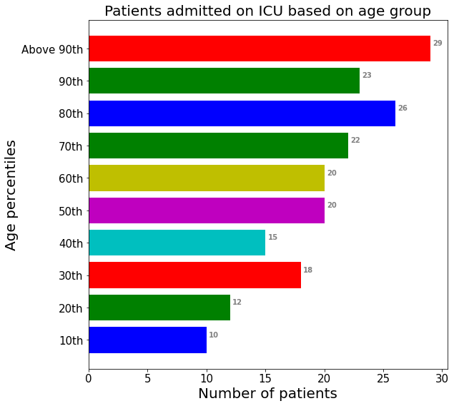
EDA
Patients admitted to ICU based on different age percentile

Slide 13
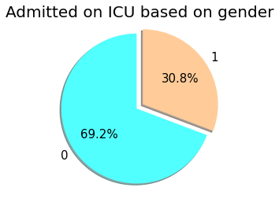
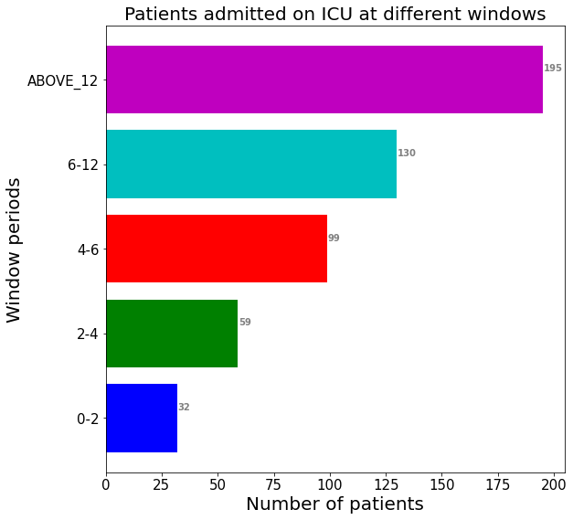
EDA
*The gender column has been already encoded in numerical format so the values '0' and '1' aren't clear what gender category they refer to i.e: male or females

Slide 14
Data Preprocessing
Missing values are imputed using next or previous entry
Missingness in data was more on the expanded column – Analysis based on scatter plot showed ‘mean’ values are the best choice
Remove the expanded columns (only columns with mean values are considered), the data now has 1925 rows and 56 columns
Converted target 'ICU’ to ‘ICU_SUM’ based on whether a patient has been eventually shifted to ICU
To build a clinically relevant model author has advised only to use data related to WINDOW (0-2)
One hot encoded the Categorical column ‘AGE_PERCENTIL’
Drop the columns: "PATIENT_VISIT_IDENTIFIER", "WINDOW", "ICU"

Slide 15

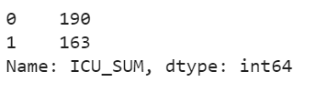
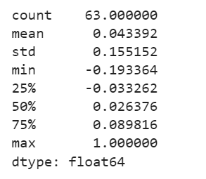
Data Preprocessing
Previously discussed preprocessing techniques helped in handling class imbalance and multi-collinearity issue
Descriptive statistics of correlation between target and other variables show the high collinearity has been reduced
The final data has 353 Rows and 57 Columns
Train-test-validation set ratio is 80%-20%-20%

Slide 16
DEMO

Slide 17
THANK YOU

