Slide 1
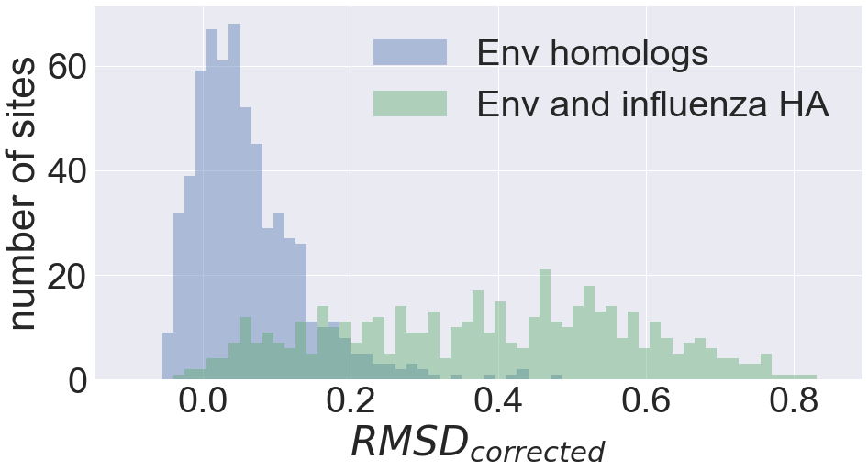
A)
B)

Slide 2
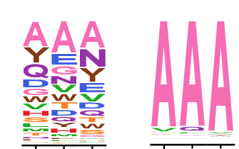
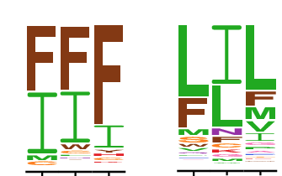
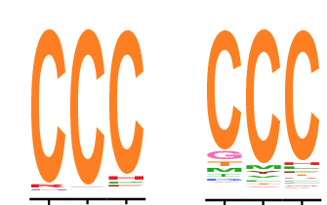
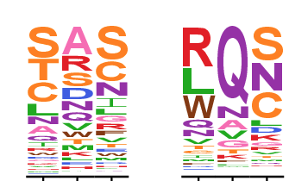
replicates
site
BG505
BF520
RMSD_{between} − RMSD_{within} = RMSD_{corrected}
512
0.65
0.18
0.47
309
0.66
0.36
0.30
296
0.19
0.12
0.07
607
0.52
0.55
-0.03

