Slide 1
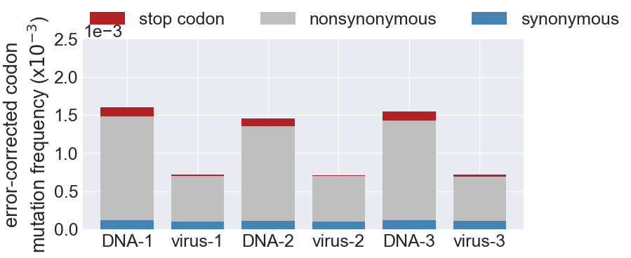
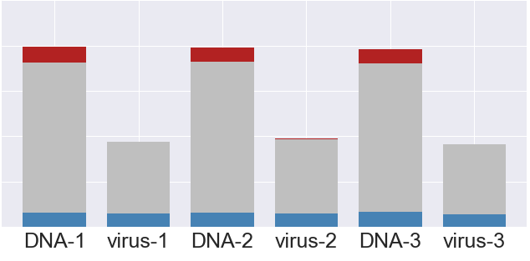
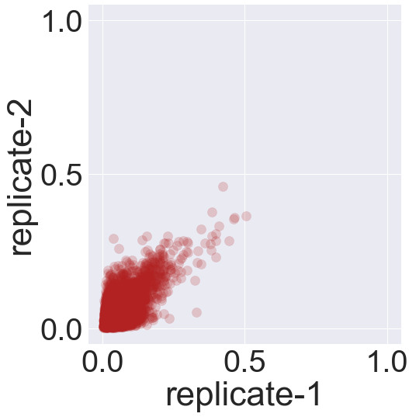
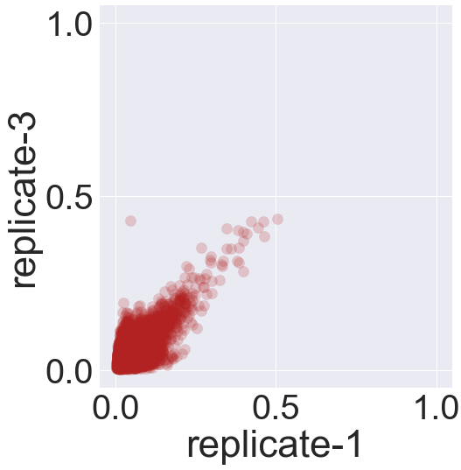

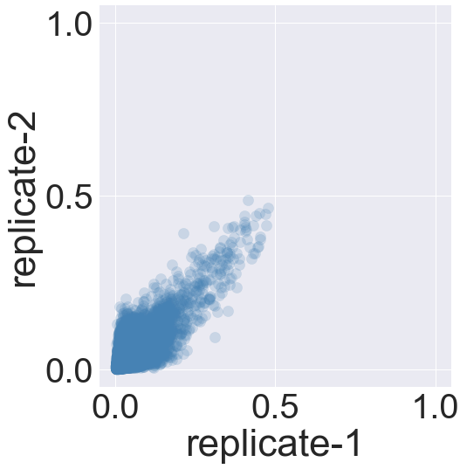
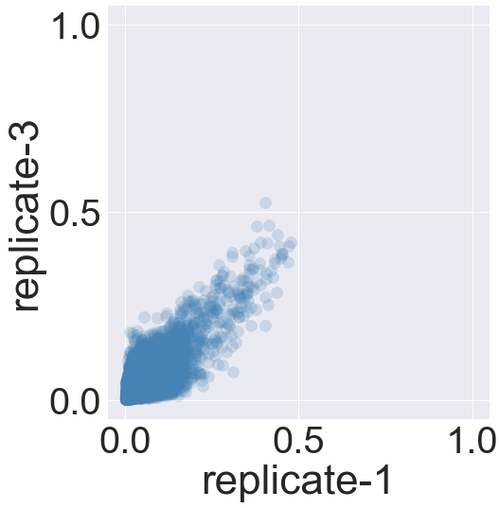

A)
15%
14%
17%
3%
6%
3%
BF520
BG505
B)
BF520
R = 0.59
R = 0.64
R = 0.61
C)
BG505
R = 0.75
R = 0.75
R = 0.75

