Slide 1
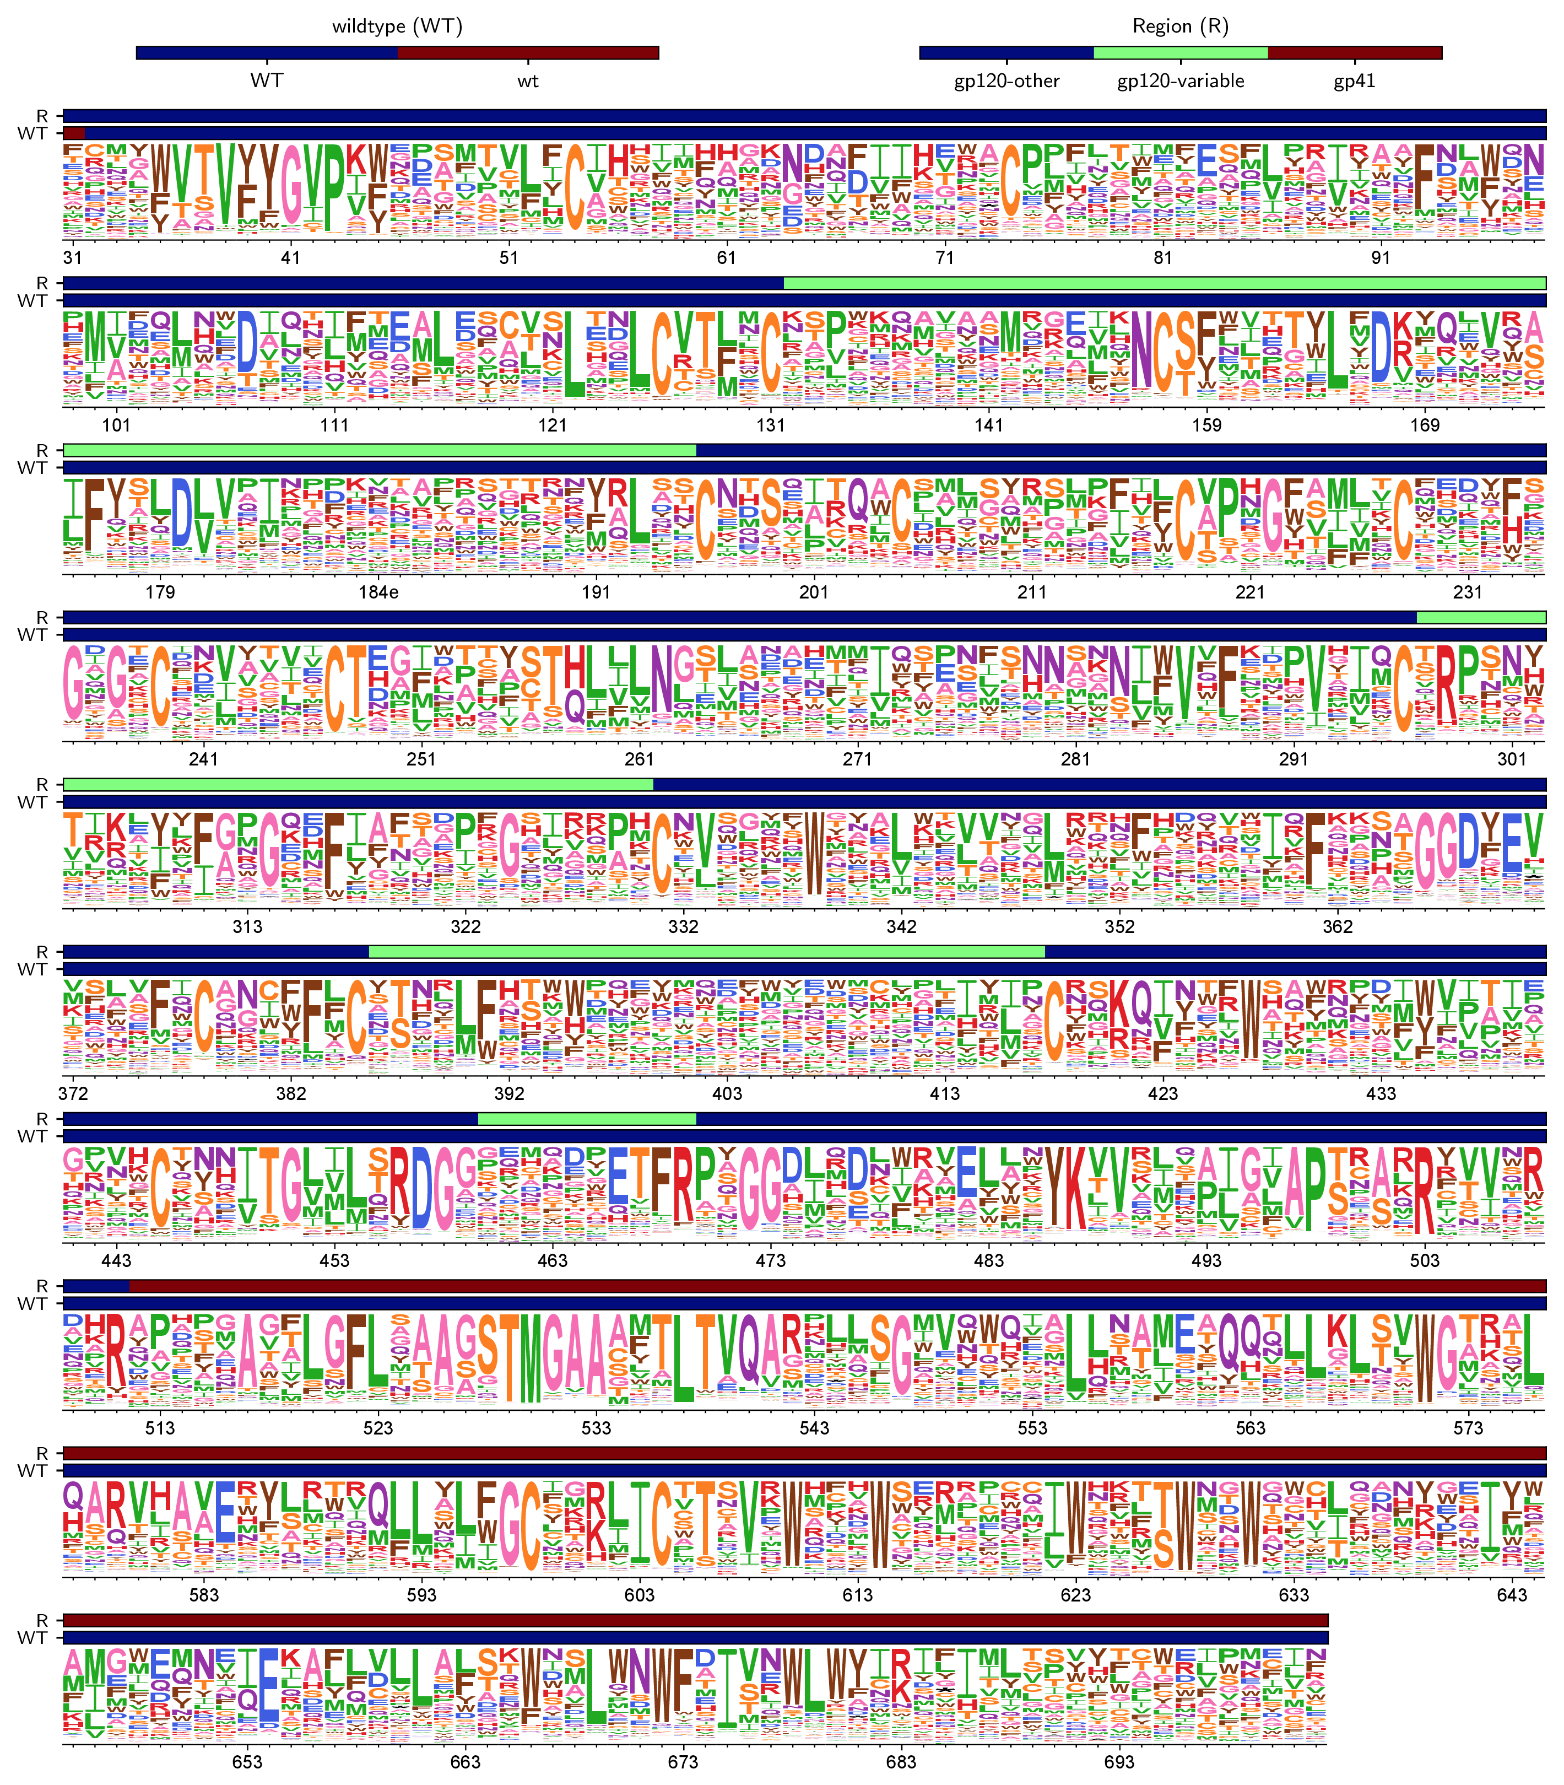
AENLWVTVYYGVPVWKDAETTLFCASDAKAYETEKHNVWATHACVPTDPNPQEIHLENVTEEFNMWKN
NMVEQMHTDIISLWDQSLKPCVKLTPLCVTLQCTNVTNNITDDMRGELKNCSFNMTTELRDKKQKVYS
LFYRLDVVQINENQGNRSNNSNKEYRLINCNTSAITQACPKVSFEPIPIHYCAPAGFAILKCKDKKFN
GTGPCPSVSTVQCTHGIKPVVSTQLLLNGSLAEEEVMIRSENITNNAKNILVQFNTPVQINCTRPNNN
TRKSIRIGPGQAFYATGDIIGDIRQAHCNVSKATWNETLGKVVKQLRKHFGNNTIIRFANSSGGDLEV
TTHSFNCGGEFFYCNTSGLFNSTWISNTSVQGSNSTGSNDSITLPCRIKQIINMWQRIGQAMYAPPIQ
GVIRCVSNITGLILTRDGGSTNSTTETFRPGGGDMRDNWRSELYKYKVVKIEPLGVAPTRAKRRVVGR
EKRAVGIGAVFLGFLGAAGSTMGAASMTLTVQARNLLSGIVQQQSNLLRAIEAQQHLLKLTVWGIKQL
QARVLAVERYLRDQQLLGIWGCSGKLICTTNVPWNSSWSNRNLSEIWDNMTWLQWDKEISNYTQIIYG
LLEESQNQQEKNEQDLLALDKWASLWNWFDISNWLWYIKIFIMIVGGLIGLRIVFAVL

