Slide 1
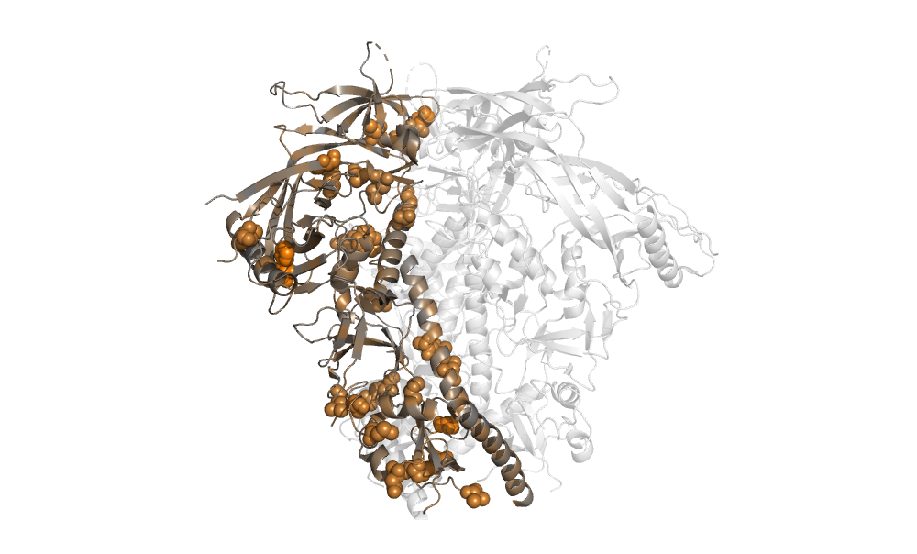
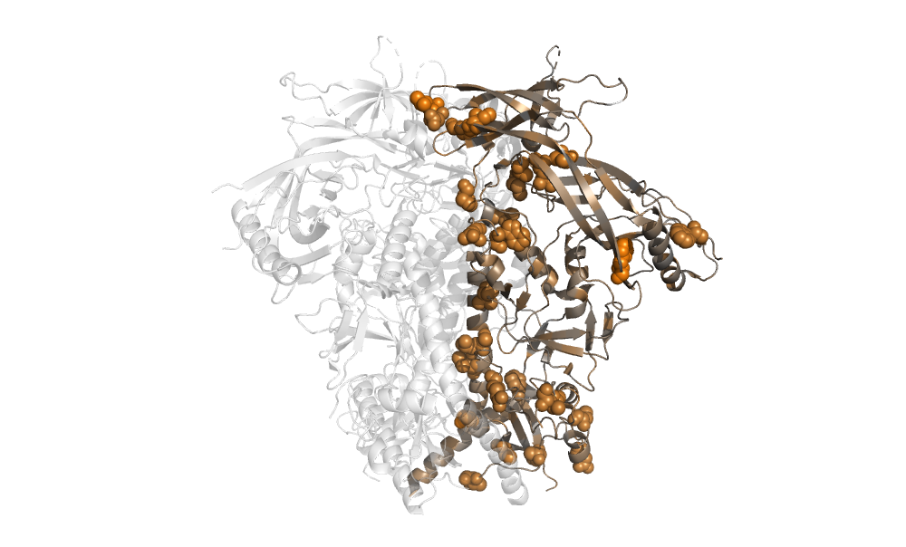
120º

Slide 2
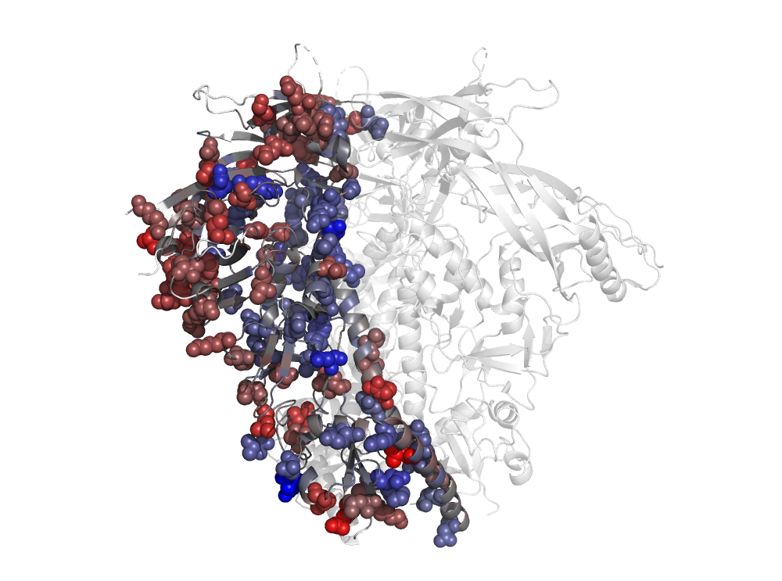
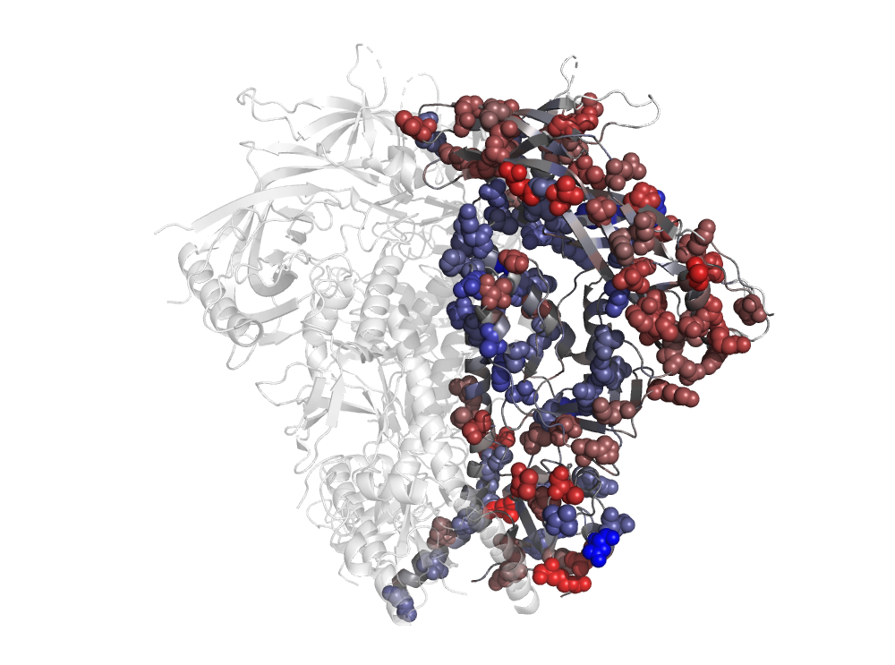
120º

Slide 3
Placeholder image. The real image should have one monomer colored gray to orange by the magnitude of the shift (RMSDcorrected) with sites of significant shifts in spheres. The data are in ./figures/BG505_to_BF520_prefs_dist.csv.
This image should go in the file: ./figures/shifts_on_structure/shifts_on_structure.pdf
120º

