Slide 1
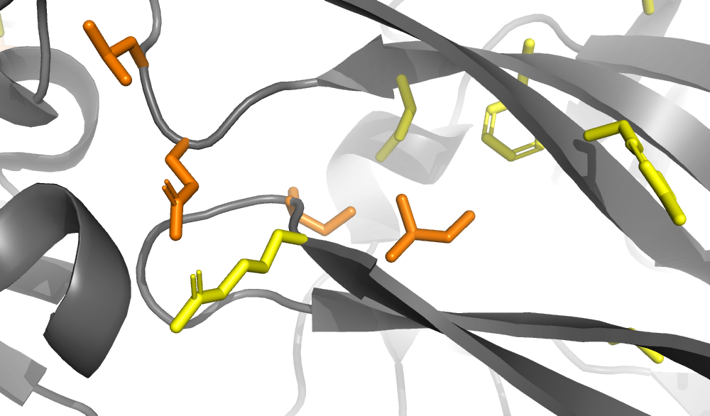
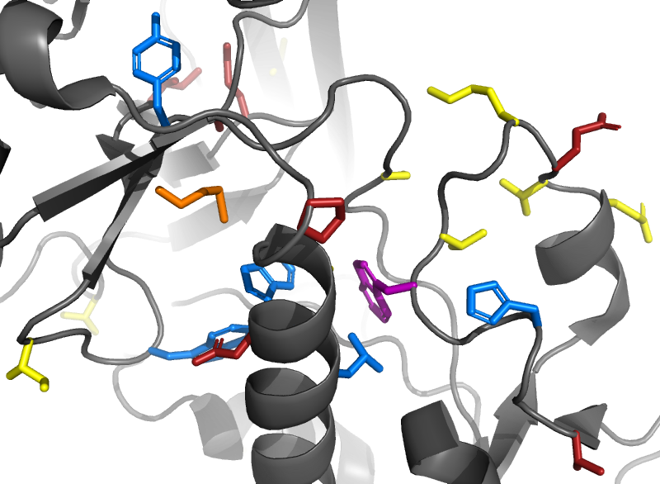
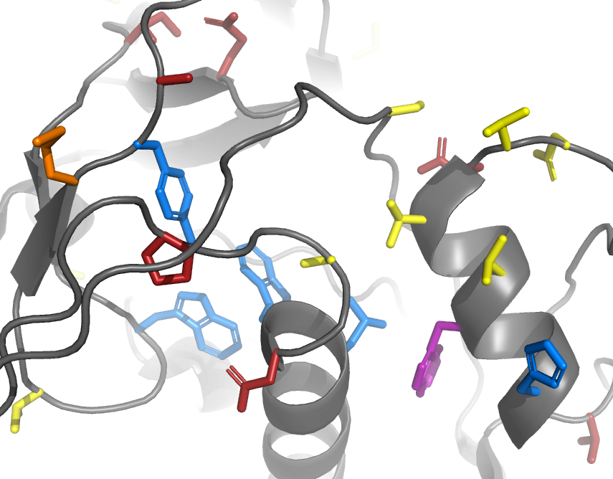
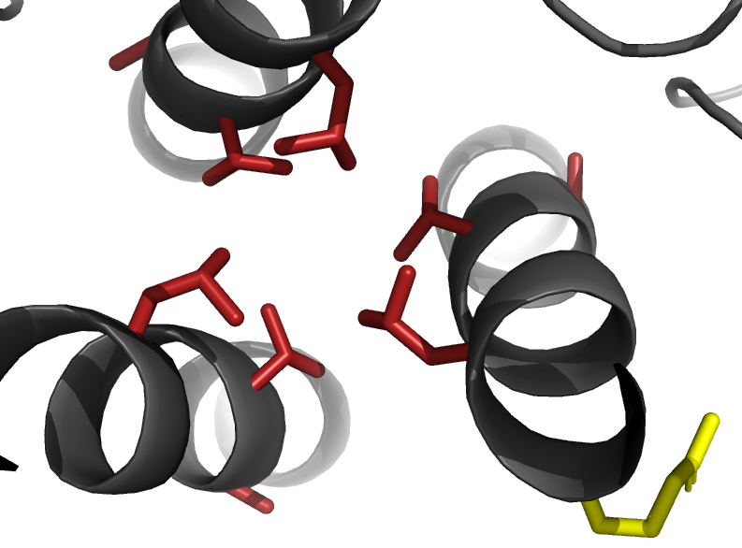
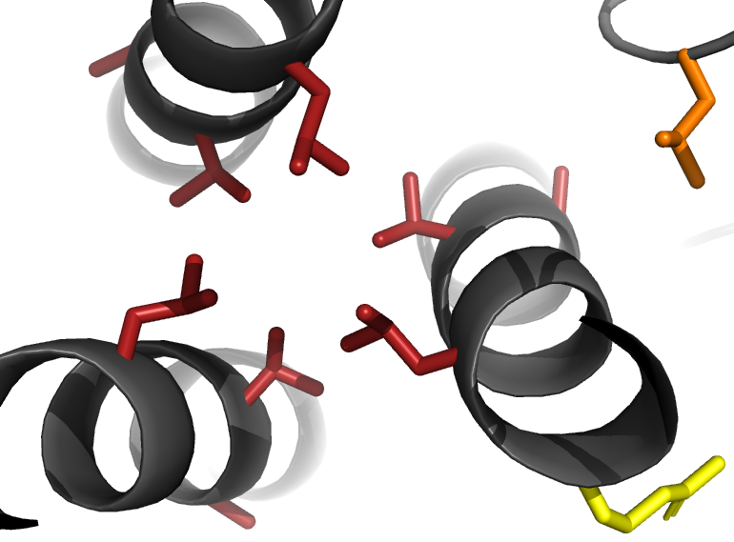
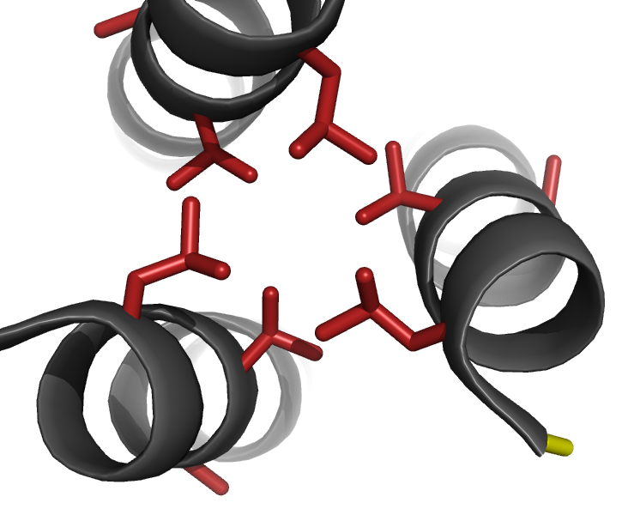
A)
Closed pre-fusion conformation
Key:
Blue: sites in the hydrophobic network
Purple: the one site that has shifted and is also in the hydrophobic network
Red: sites that have shifted
Orange: sites that have both shifted and substituted
Yellow: sites that have substituted
165
161
Trimer apex
164
309
307
308
B)
Closed pre-fusion conformation
Open CD4-bound conformation
435
420
381
420
381
64
434
436
436
118
435
64
Conformationally dynamic region
434
69
72
118
113
72
75
113
69
75
C)
Closed pre-fusion conformation
Open CD4-bound conformation
Post-fusion six-helix bundle
583
582
583
520
583
582
Inter-protomer helical bundle
582
587
588
587
587
588
588

