Slide 1
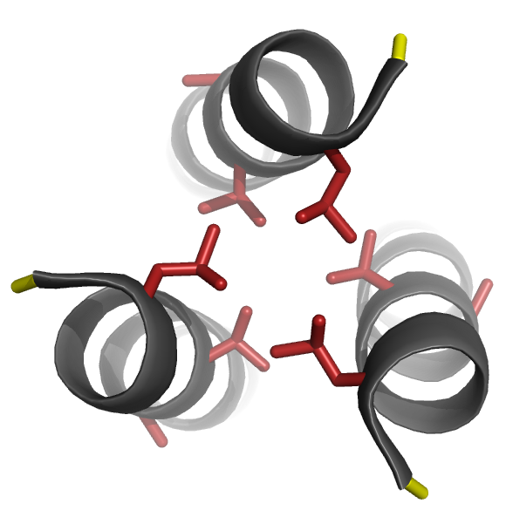
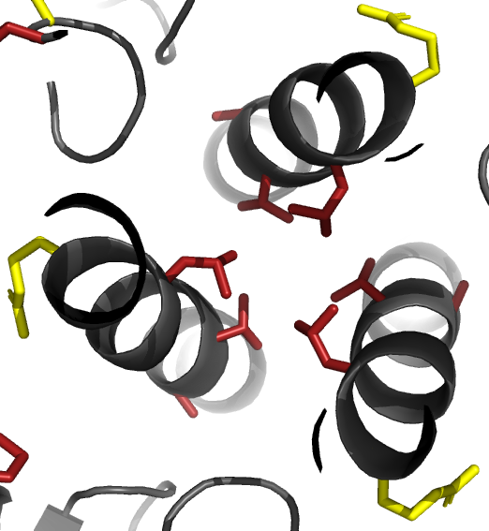
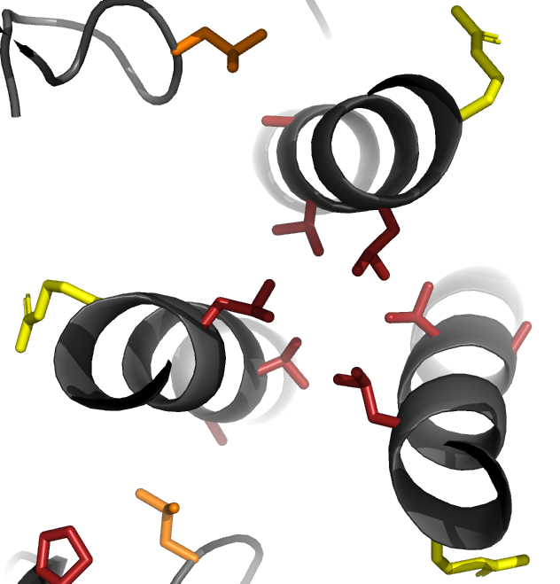
Post-fusion six-helix bundle
Closed pre-fusion conformation
Open CD4-bound conformation
582
588
588
588
587
582
582
583
583
587
583
587

