Slide 1
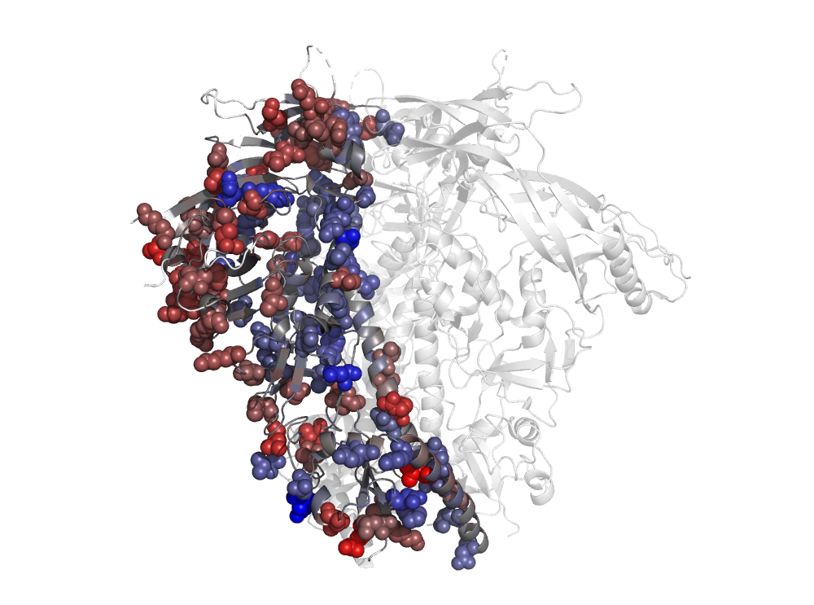
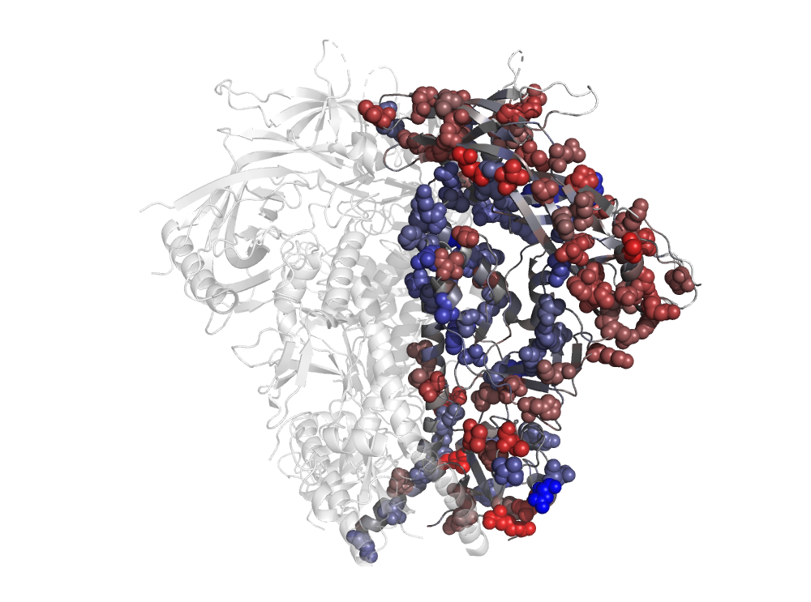
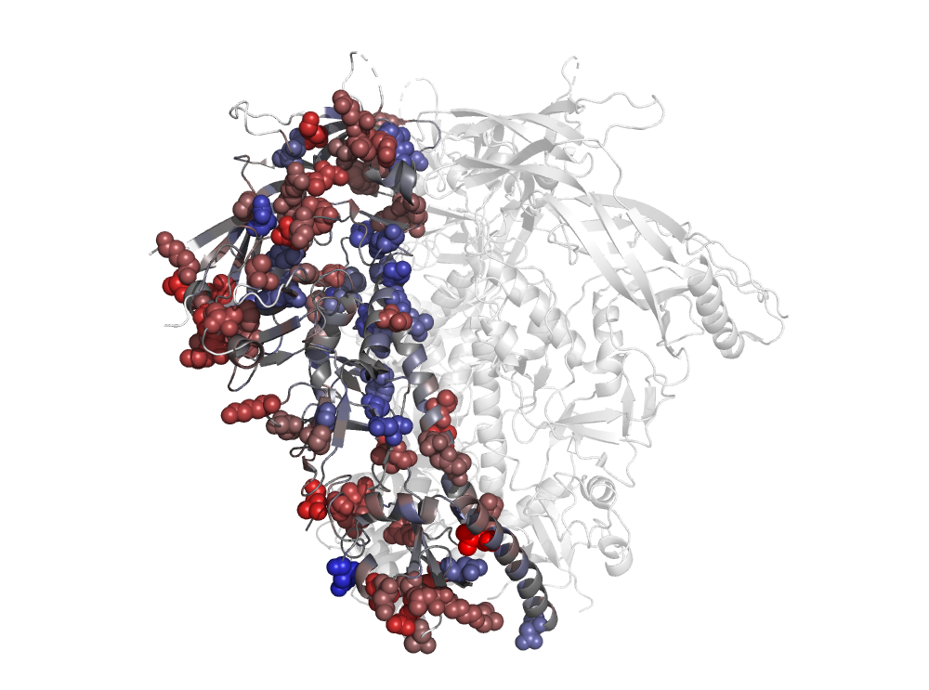
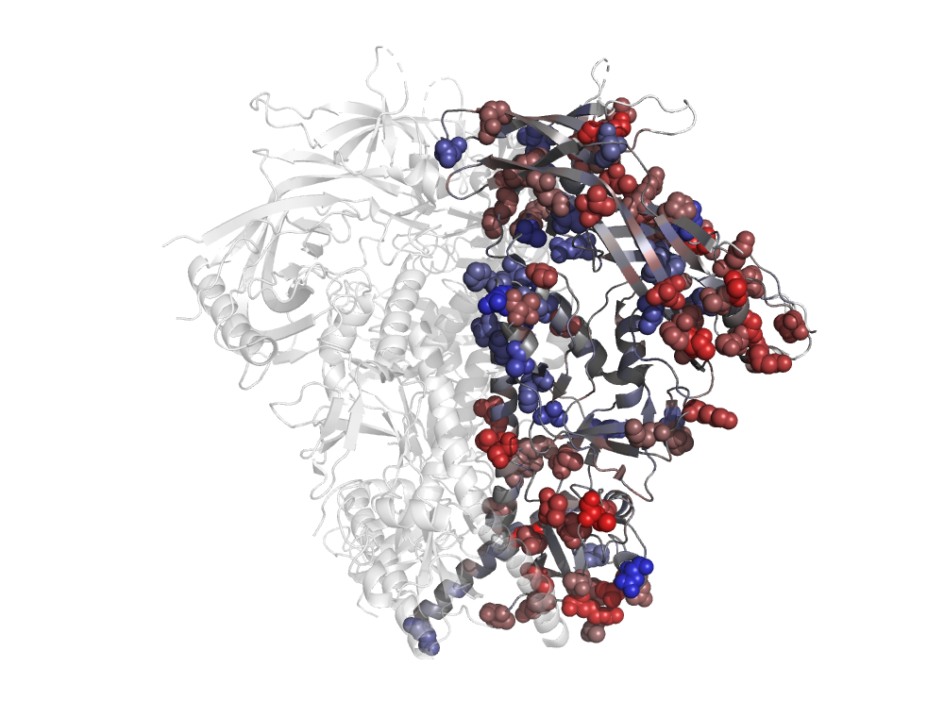
A
BG505
C
120º
B
D
BF520
violin plot showing the distribution of RSA values for:
All sites
Significant sites with omega>1
Significant sites with omega<1
120º

